Slide 1
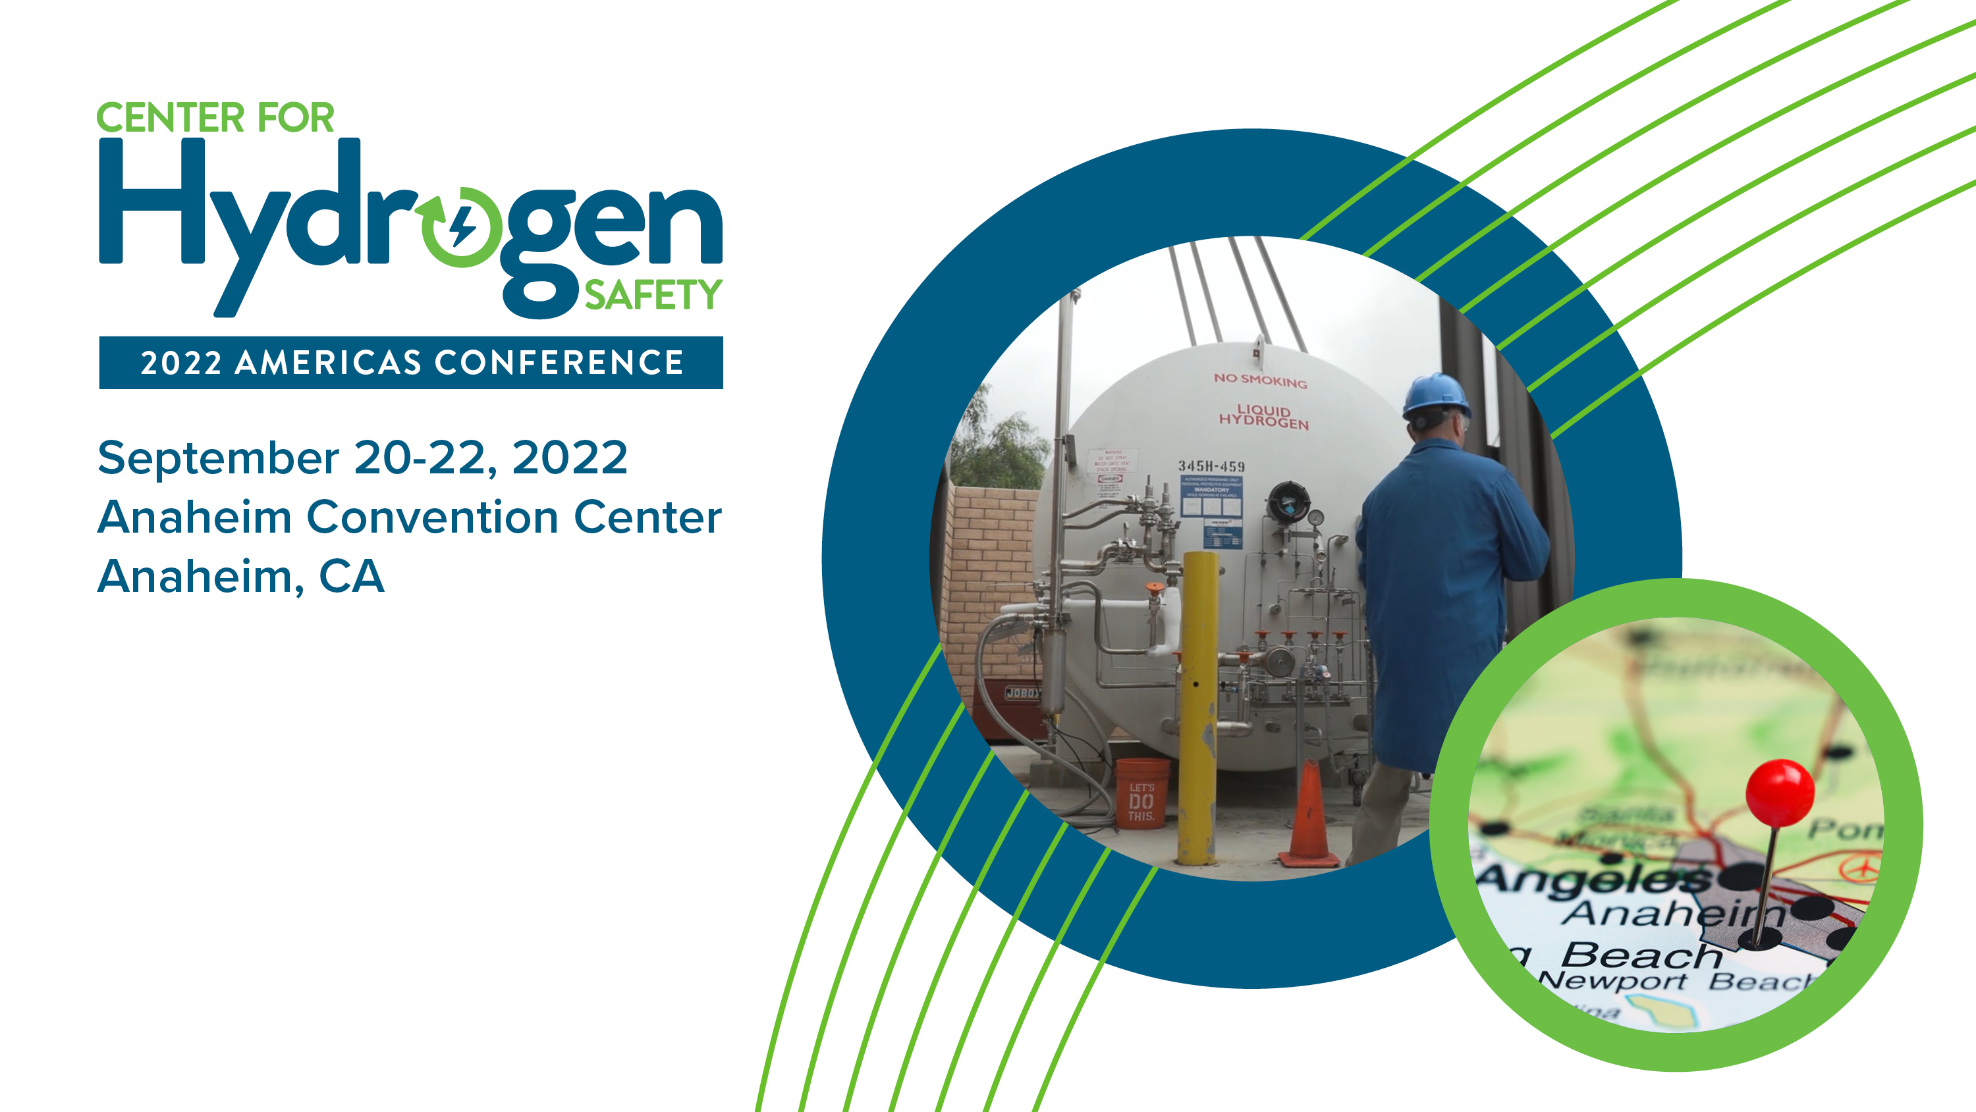

Slide 2
The Center for Hydrogen Safety is holding its 3rd hydrogen safety conference covering the Americas. This year’s conference, September 20-22 in Anaheim, CA, is being held in partnership with RE+.
SESSION TOPICS
CONFERENCE CHAIRS
Lessons Learned In Hydrogen Safety
Hydrogen Safety Public Education And Awareness
Safety In The Transport And Distribution Of Hydrogen
Hydrogen Safety In End Use Applications
Safety Issues Affecting The Production Of Hydrogen
Safe Storage of Hydrogen
Kevin Woo
SoCalGas
Jennifer Hamilton
California Fuel Cell Partnership
Come Curious. Leave Energized.
Submit an abstract, register and learn more. aiche.org/chsus

