Slide 1
Corporate Sponsorship
The University of Michigan AIChE Chapter

Slide 2
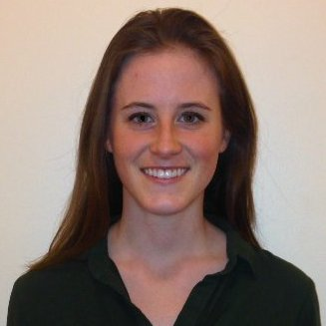
Meg Erkkinen
University of Michigan Student Chapter
BSE Chemical Engineering May ‘17
Chapter Involvement
  2016 - 2017: Vice President
  2015 - 2016: Secretary
  2014 - 2015: Member
Notes:
Hannah

Slide 3
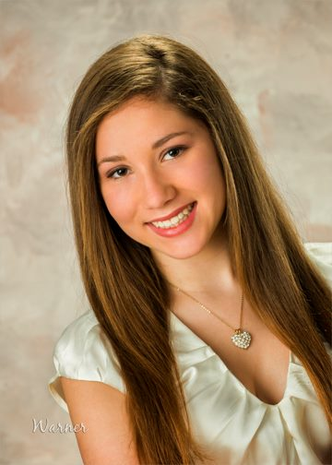
Hannah Fetner
University of Michigan Student Chapter
BSE Chemical Engineering May ‘17
Chapter Involvement
  2016 - 2017: President
  2015 - 2016: Treasurer
  2014 - 2015: Sophomore Representative
Notes:
Hannah

Slide 4
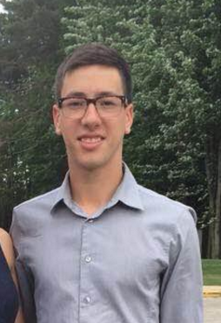
Jeremy Kach
University of Michigan Student Chapter
BSE Chemical Engineering May ‘18
Chapter Involvement
  2016 - 2017: Mentorship Co-Chair
  2015 - 2016: Member
Notes:
Hannah

Slide 5
Agenda
Introduction
Corporate Sponsorship
Best practices for obtaining corporate sponsorship
How UM has built and maintained relationships with sponsors
Weekly luncheon/info sessions
Mentorship program
Event ideas

Slide 6
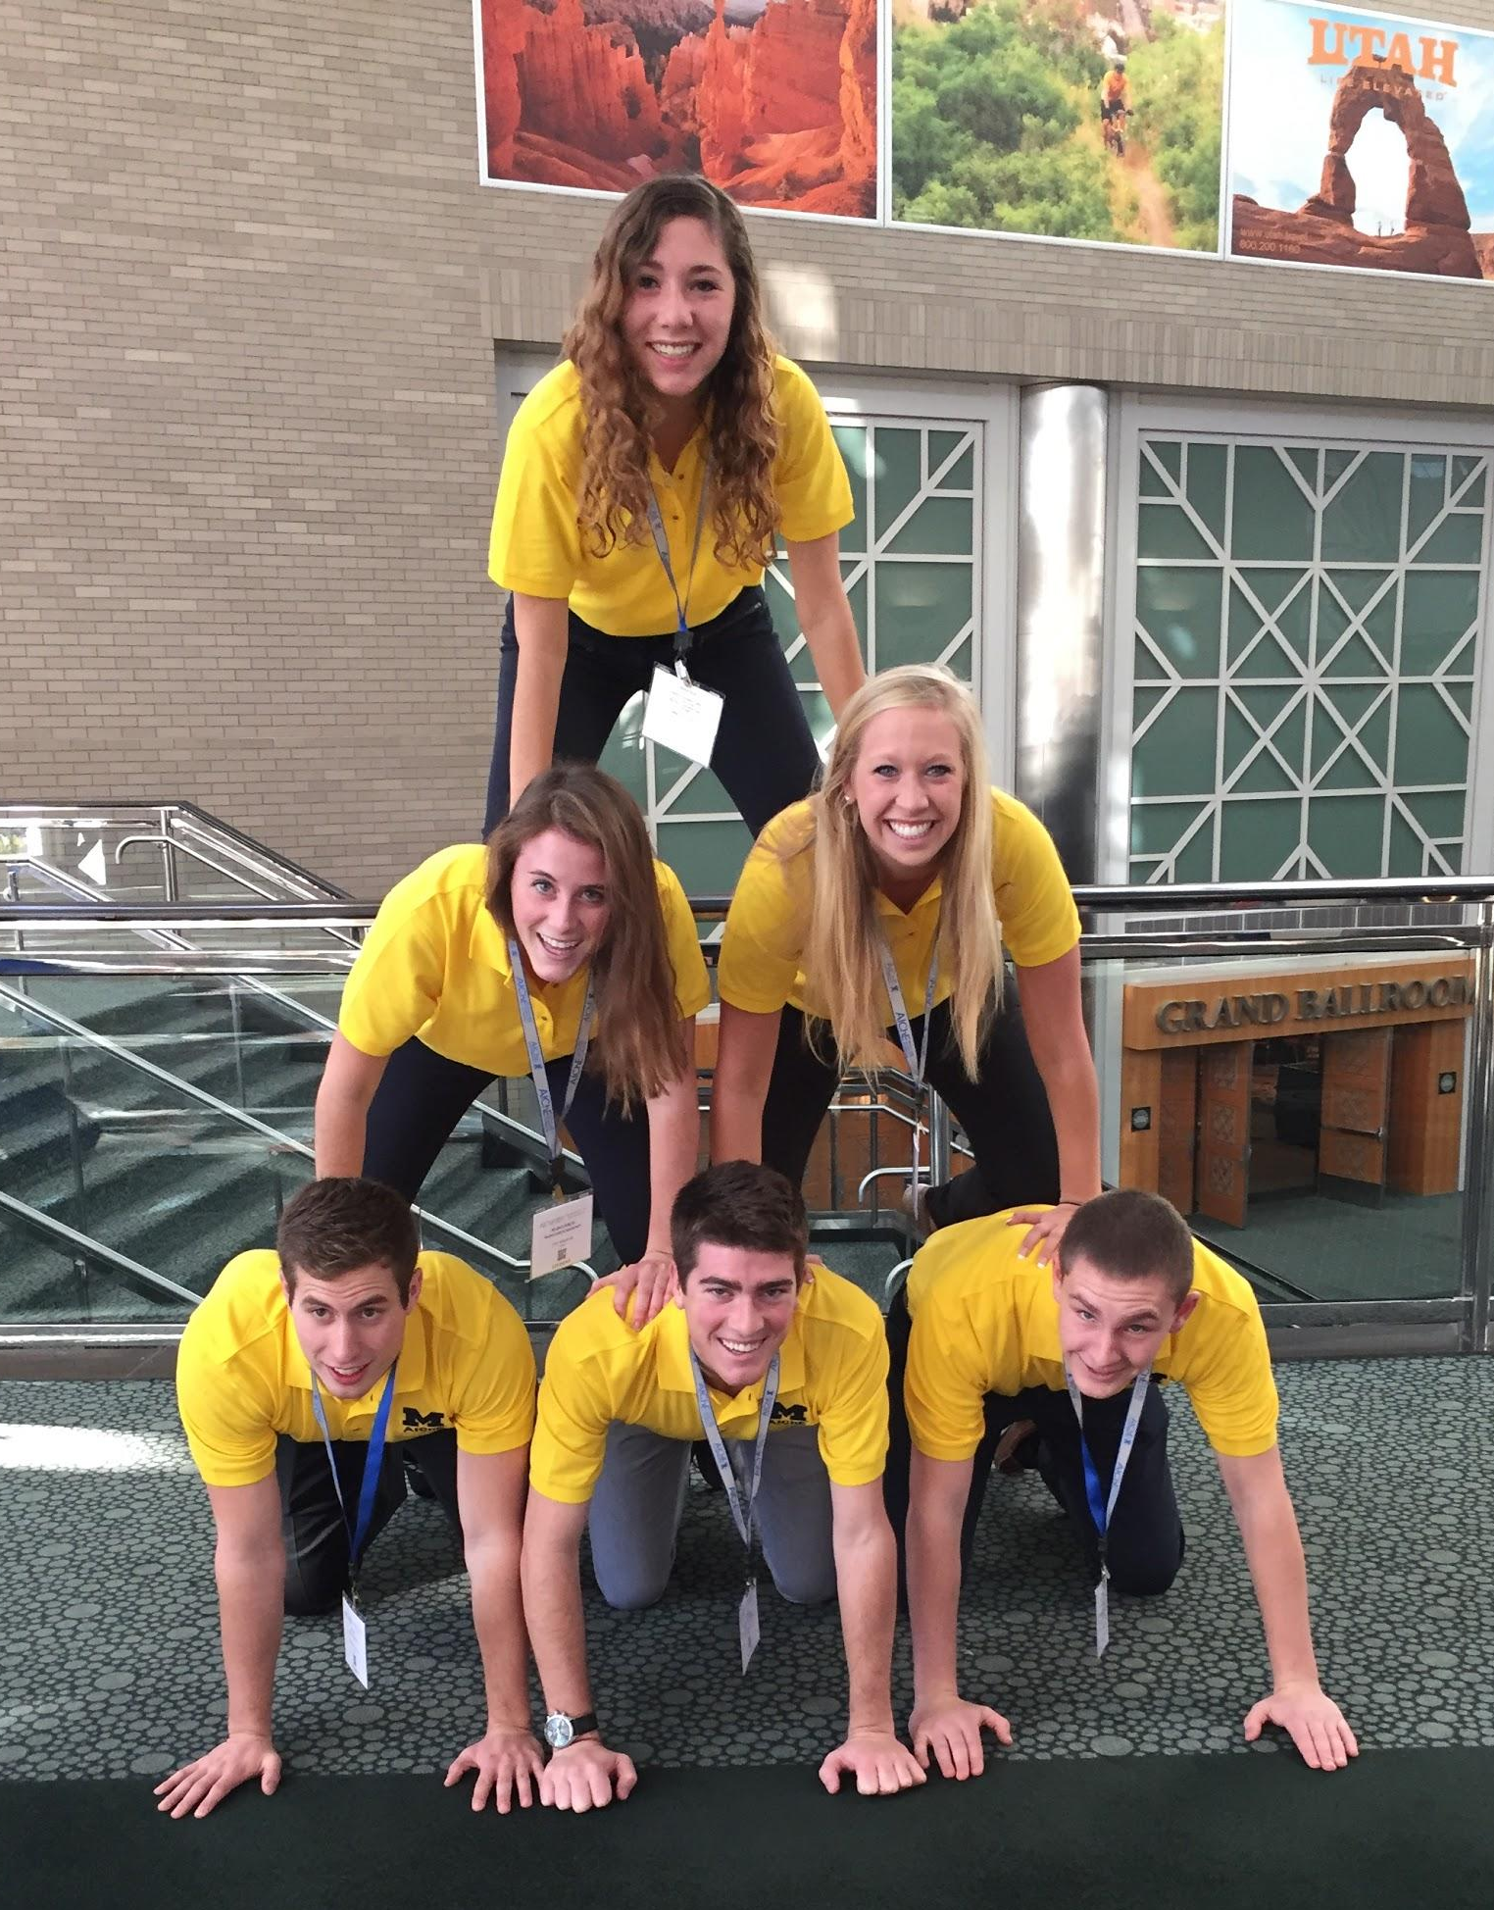
University of Michigan Chapter
Started in 1922
~150 Active Members
Chapter Events:
  Weekly Corporate Luncheons
  Corporate Information Session
  Mentorship Program
  Industry Mentorship Program
  Many Social & Service Events

Slide 7
University of Michigan Chapter
Started in 1922
~150 Active Members
Chapter Events:
  Weekly Corporate Luncheons
  Corporate Information Session
  Mentorship Program
  Industry Mentorship Program
  Many Social & Service Events
It all costs money!!

Slide 8
What is Corporate Sponsorship?
A company sponsors the student chapter by:
  Monetary donations
  Hosting specific event
  Donating food, equipment or other event materials
Build and sustain strong relationships
Notes:
Mutually beneficial relationships!!!

Slide 9


















Our Corporate Sponsors

Slide 10
Benefits of Corporate Sponsorship
AIChE Chapter
Build company relationships
Industry expertise and mentorship
Source of income
Allows our chapter to host wide variety of events
Companies
“Exposure to great candidates more often and earlier”
“Heightens interest in our organization”
“Interact with candidates outside of the hectic career fair”
Notes:
Hannah will outline our procedure for obtaining

Slide 11
Obtaining Corporate Sponsorship
1
Create Well-Defined Program or Event
  Corporate luncheons and information sessions
  Mentorship Program
  Social event (BASF Tailgate) that allows students and recruiters to interact in casual environment
“In order to sponsor an event we need to justify why the money is being used.”
- Keith Minibiole, 3M

Slide 12
Obtaining Corporate Sponsorship
2
Reach out to companies
  Contact chapter alumni
  Describe AIChE and program or event
  Request their presence at event or assistance with program
  Be flexible – offer multiple event options and event dates

Slide 13
Obtaining Corporate Sponsorship
3
Request Sponsorship
  Varies depending on nature of event
    Event - “Would you be willing to sponsor the cost of the luncheon food”
    Program - “Follow these steps to become an official sponsor”
  Make sure it’s clear you want a relationship not just funds
  Follow up with companies closer to event

Slide 14
Obtaining Corporate Sponsorship
SEND FORMAL THANK YOU TO
COMPANIES AFTER EVENT!
4

Slide 15
Industry Recommendations to Start Relations
“Our team is looking for student organizations that give us access to a lot of students in the areas we typically hire.”
“It’s a lot more impressive when a student organization asks for something specific and knows the direct they want the presentation to go in.”
“I look to sponsor student organizations I was a part of.”
“We want a group that’s interested in more than just a cash donation.”
“I would recommend asking companies if they have outside representation that are closer to campus.”
“Know that sometimes coming to campus isn’t in the budget.”

Slide 16
Our Sponsored Programs: Weekly Luncheons
AIChE
      Provides audience of 40 to 60 people
    Coordinates ALL logistics – food, room reservation
    Companies
      Present
    Sponsor cost of food
      $400 to $600
Notes:
ChemE opportunities within company
Internship and Full Time positions
Technology used in specific industry

Slide 17
Corporate Sponsor Example: Kellogg Luncheon
March
April
May
Nov. 2
Nov. 3
Nov. 10
Luncheon
Requested sponsorship
Reminded Kellogg of luncheon
Asked Kellogg to present at luncheon
Initial Email Contact
Attended plant tour

Slide 18
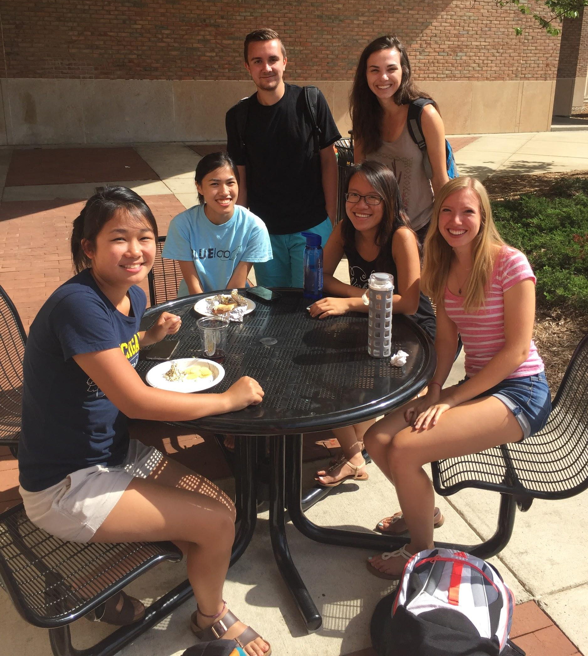
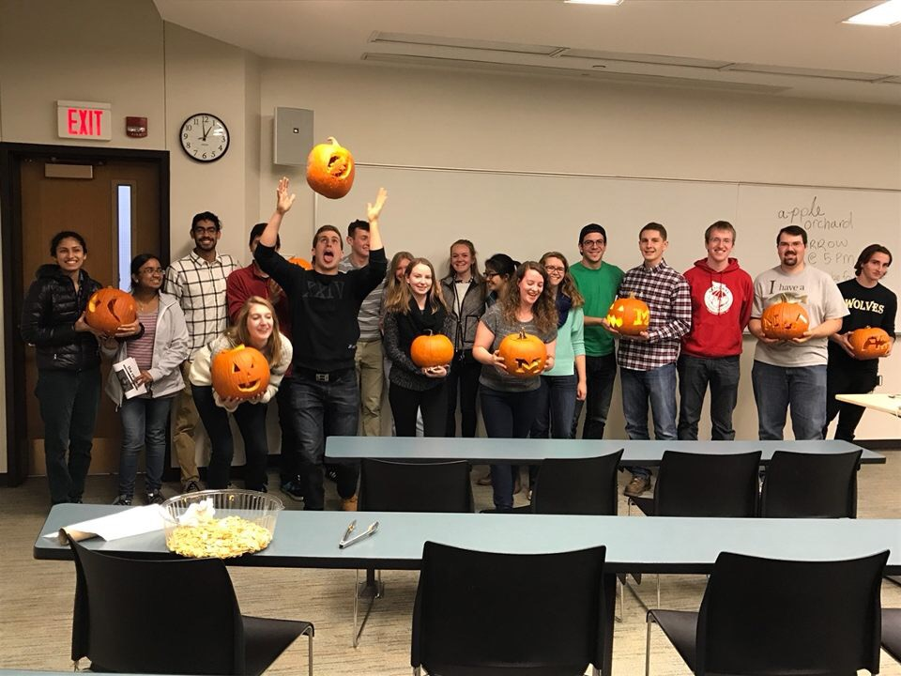
Our Sponsored Programs: Mentorship
Different levels of sponsorship
Utilize corporate sponsorships to fund
  Coffee “dates”
  Mock Interviews
  Scavenger Hunts
  Welcome Back BBQ
  Industry Mentorship
Notes:
Companies get so many ppl from aiche bc they know what were about. They want us to learn more about them to better their stock of future employees

Slide 19
Corporate Sponsor Example: BASF Mentorship
Invited BASF to participate in Night With Industry Event
Invitation included Mentorship Program description which outlines sponsorship opportunities:
1. Gold: $1,000
2. Silver: $500
3. Bronze: $250
Program description includes what sponsorship will be used for
Followed up with Invoice and W-9

Slide 20
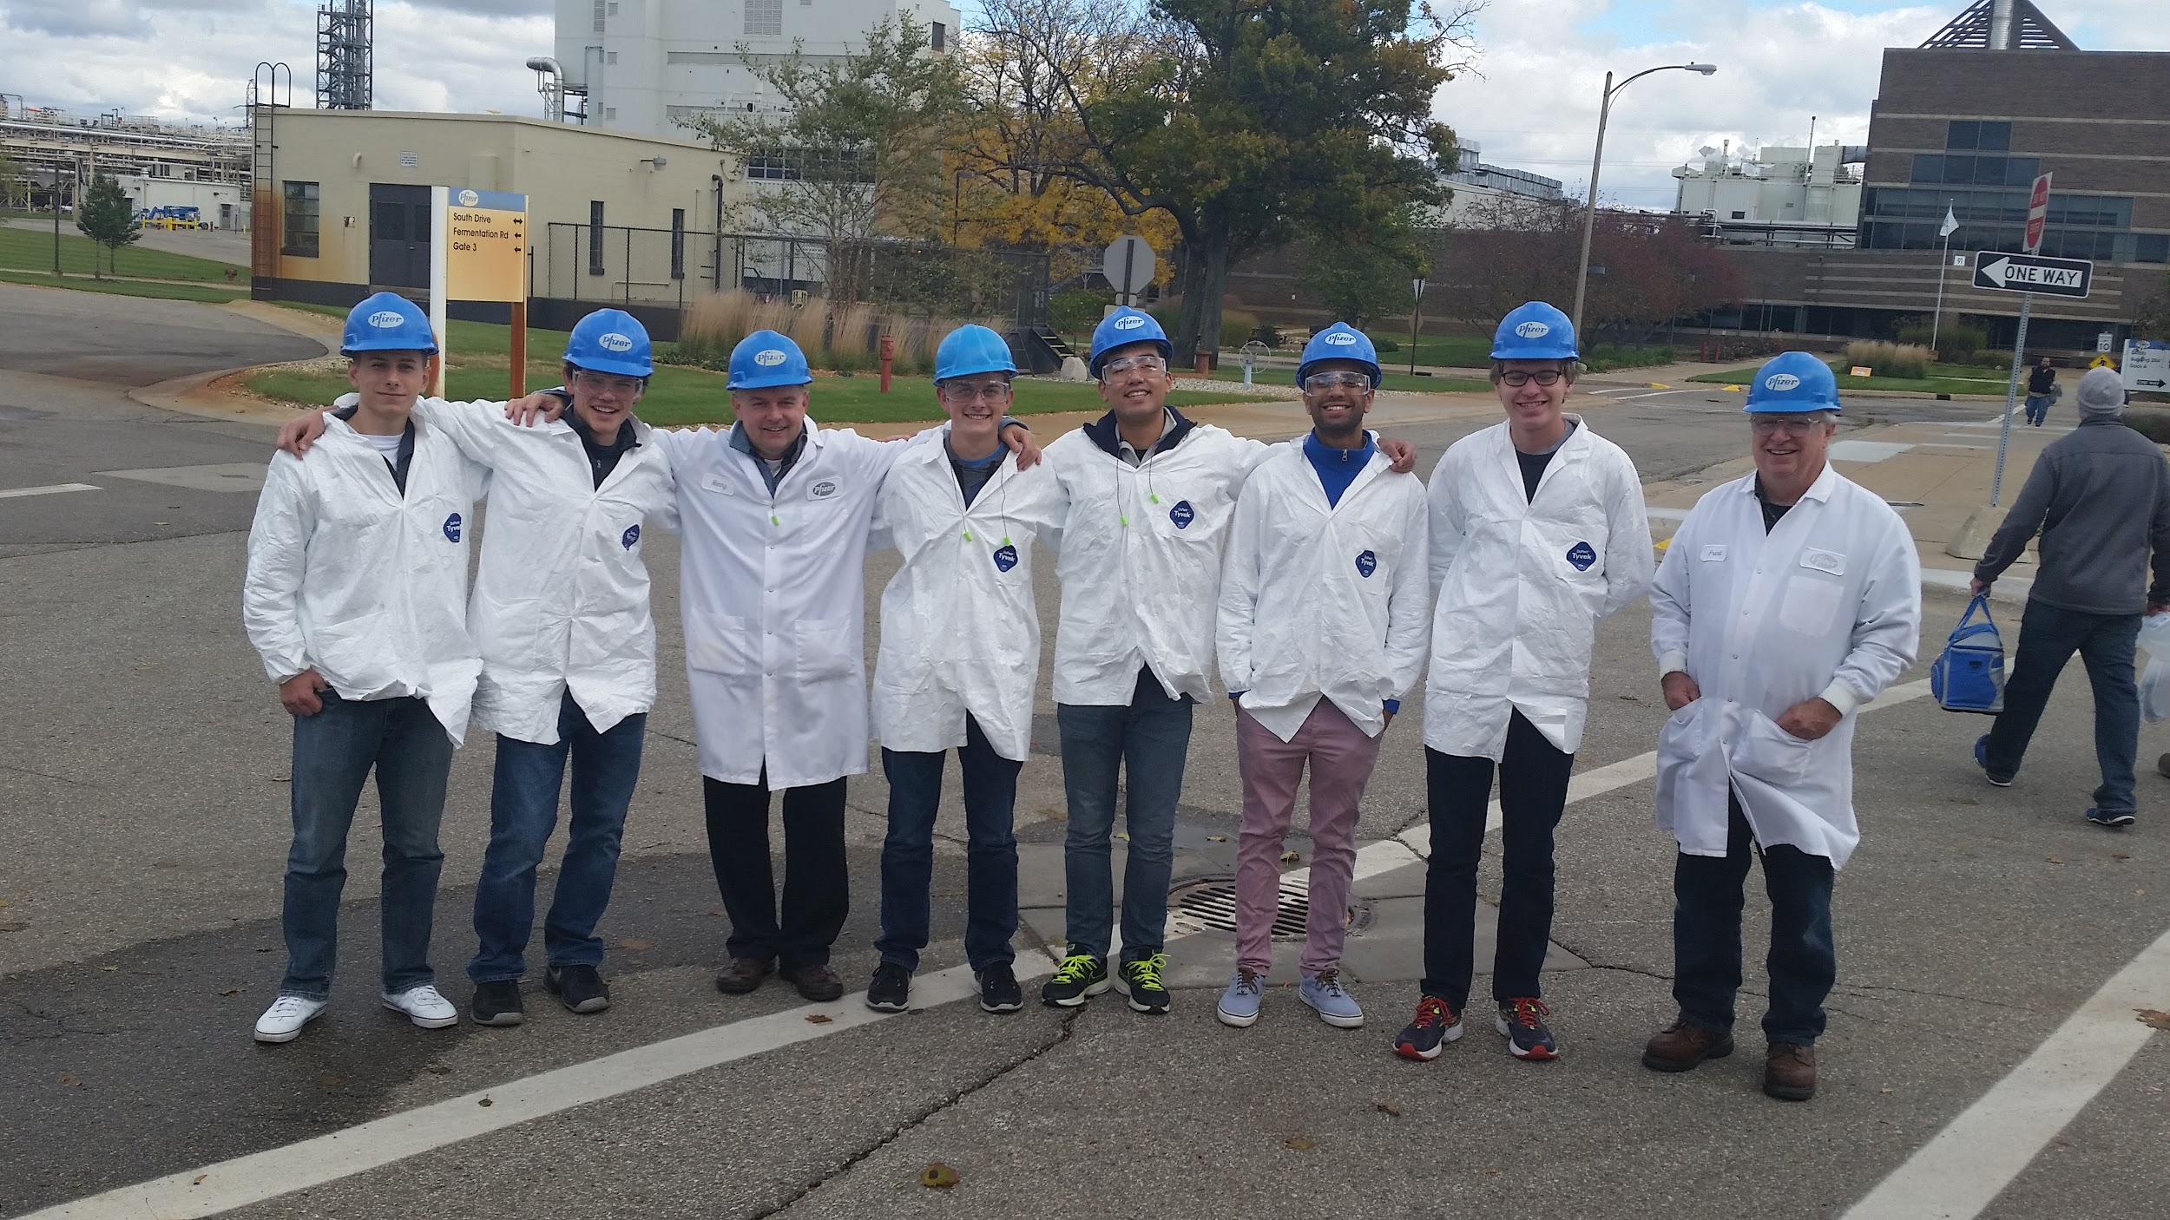
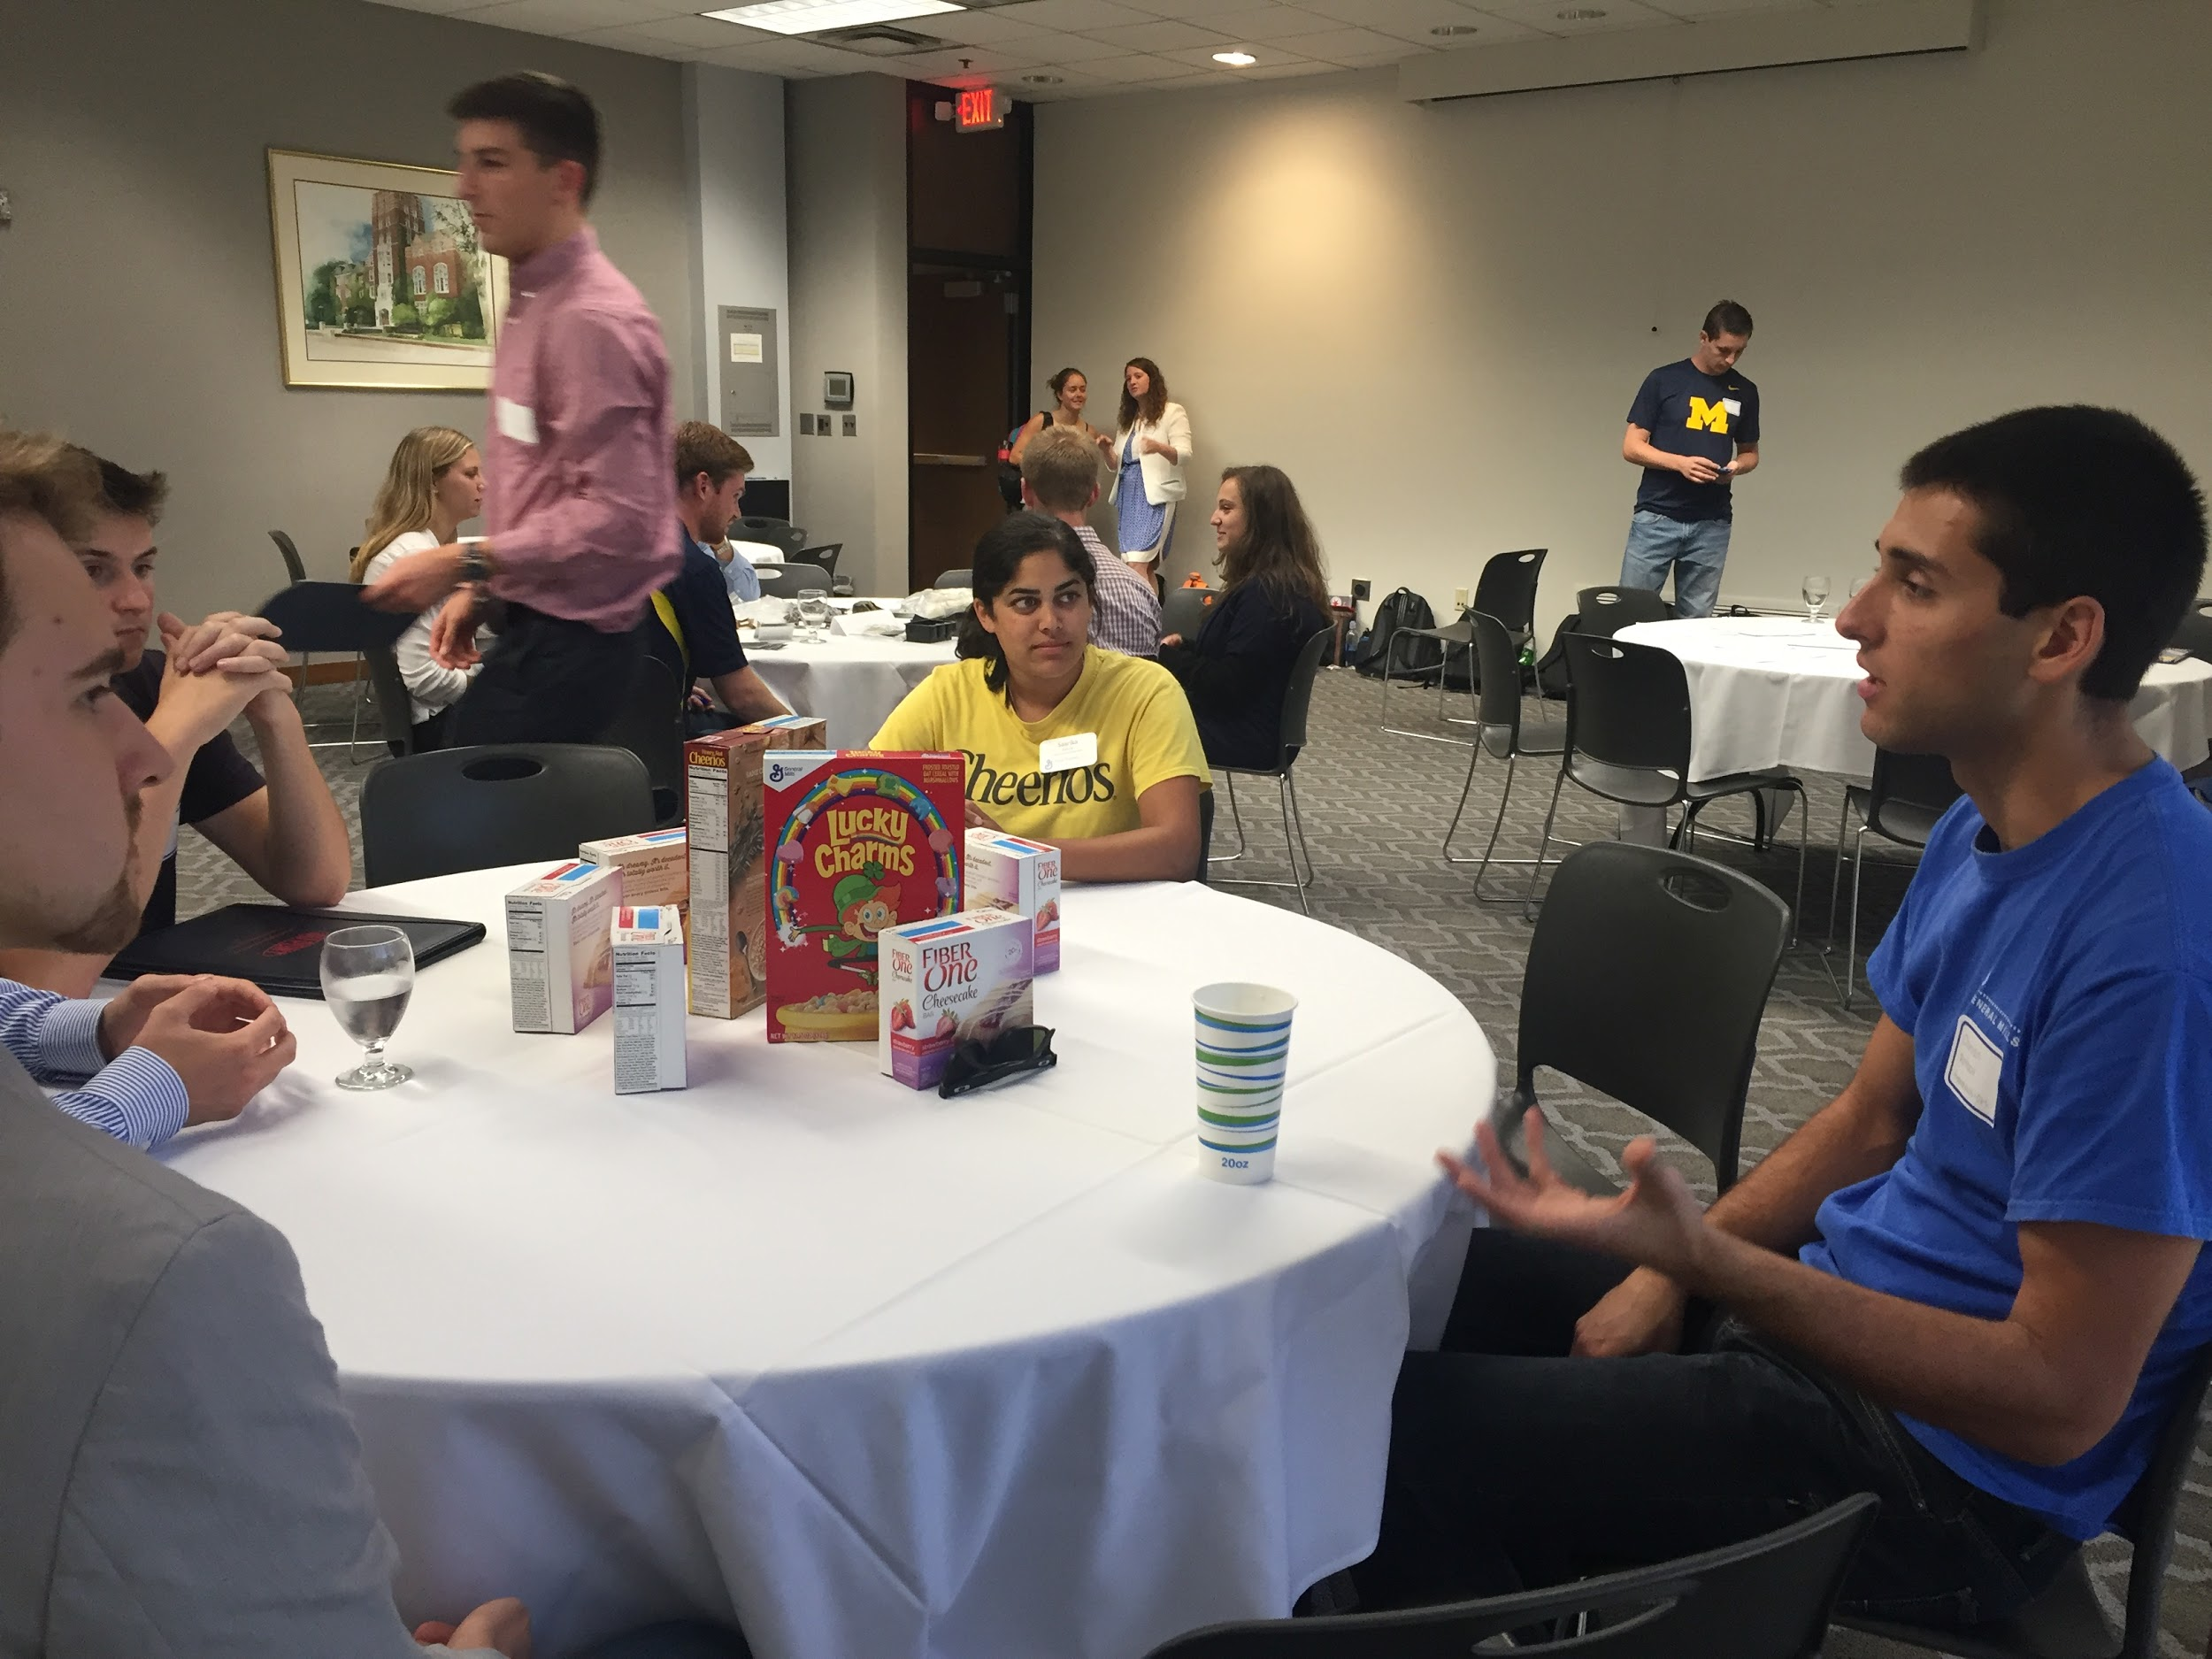
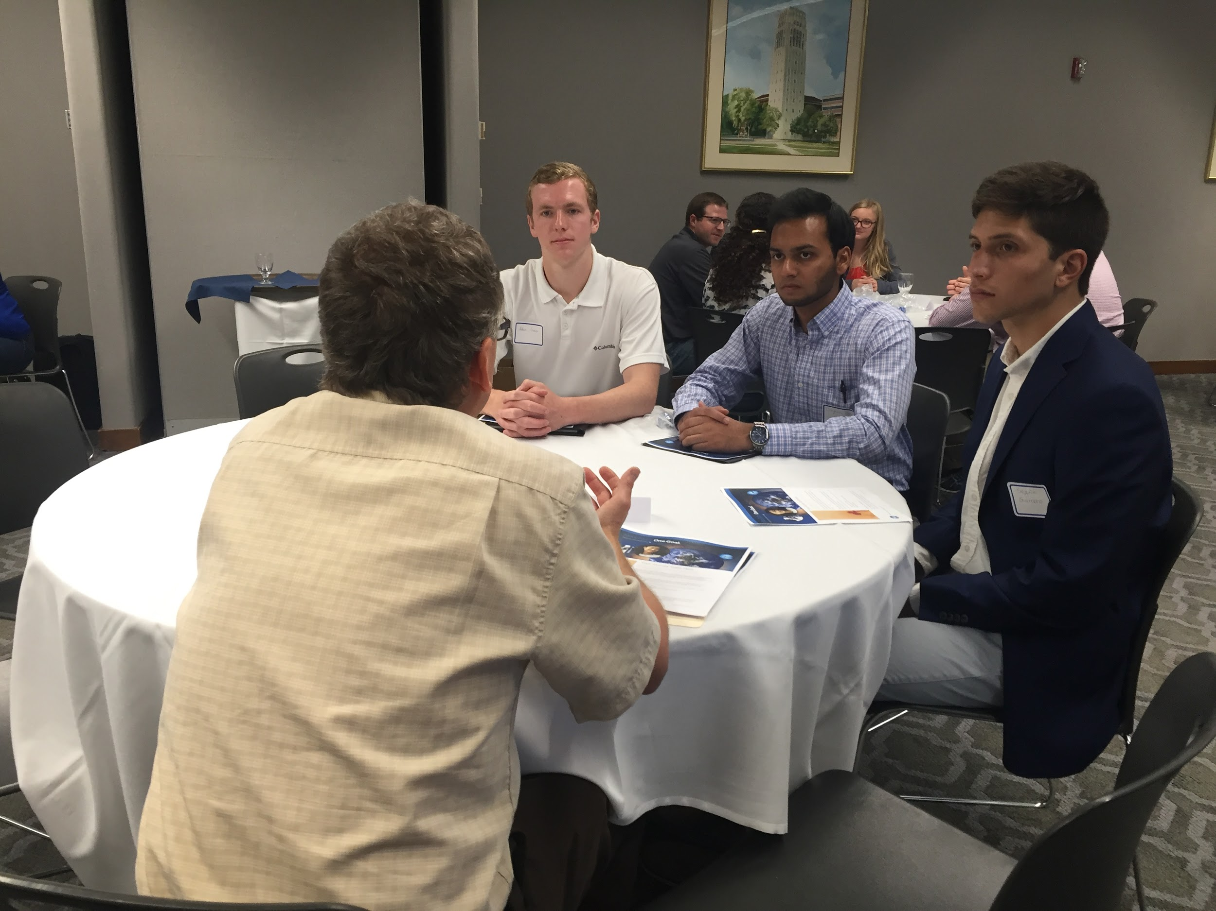
Our Sponsored Events: Recurring
Plant Tours
Night With Industry
AIChE provides interested students, transportation
Companies provide plant tour, lunch
Recruiters from many industries meet with ChE sophomores before career fair to advise
Creates mutually beneficial relationship
Notes:
Plant tours - Companies see that we are interested in learning about them
NWI - Creates personal bond with recruiters

Slide 21
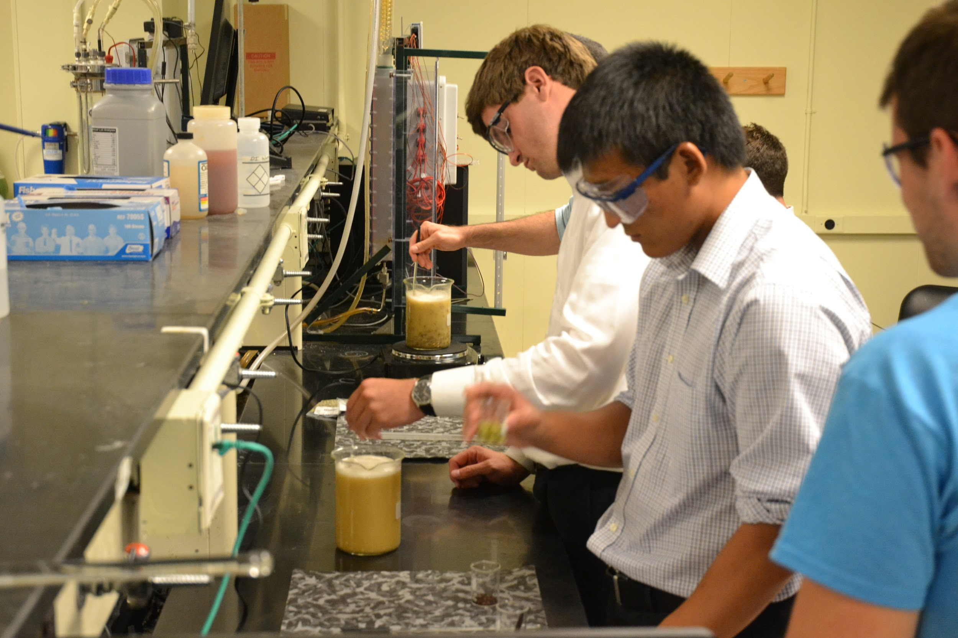
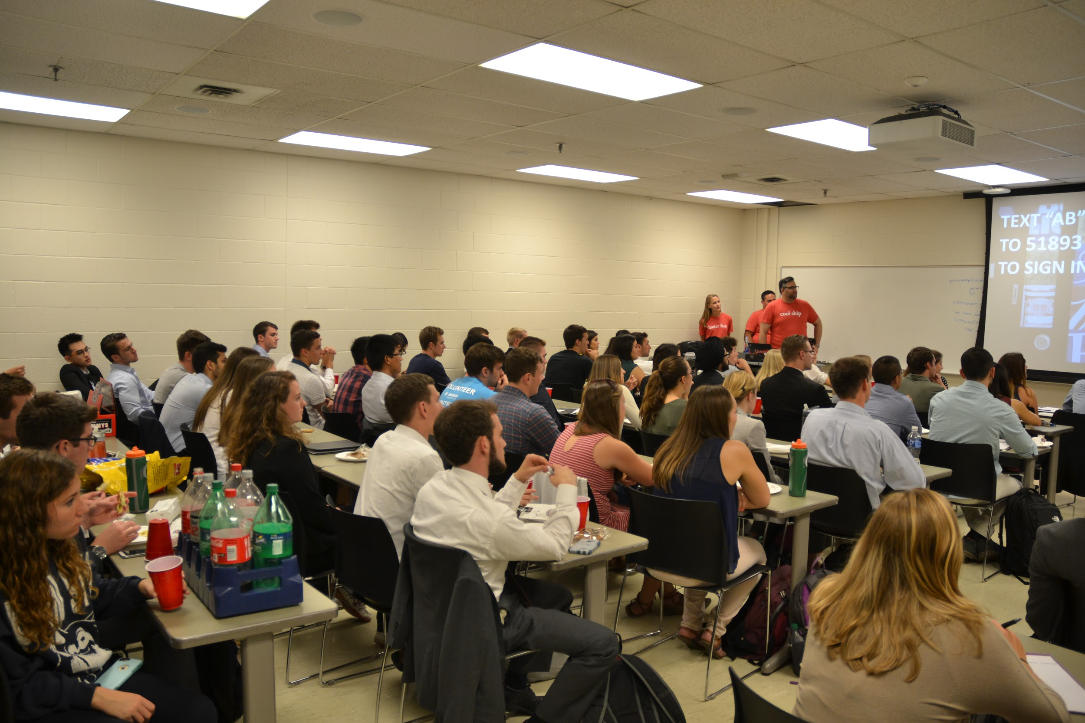
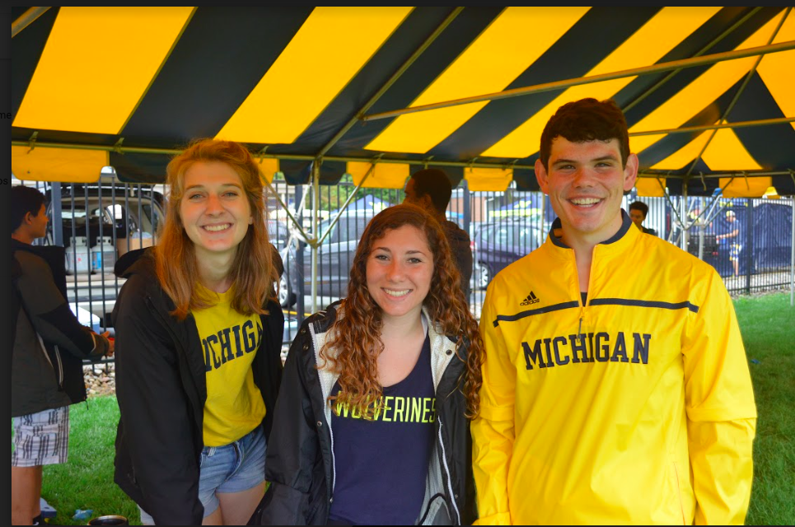
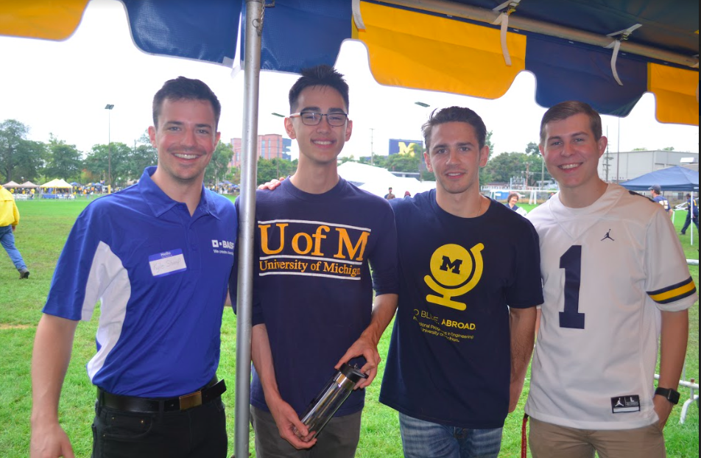
Our Sponsored Events: One-time
Anheuser Busch - Brewing with Beakers
BASF - Tailgate
AB gives 30 min information session
Students and practice brewing beer in lab
BASF sponsors tailgate for all ChE students
We coordinate
  Rental
  Food
  Attendees

Slide 22
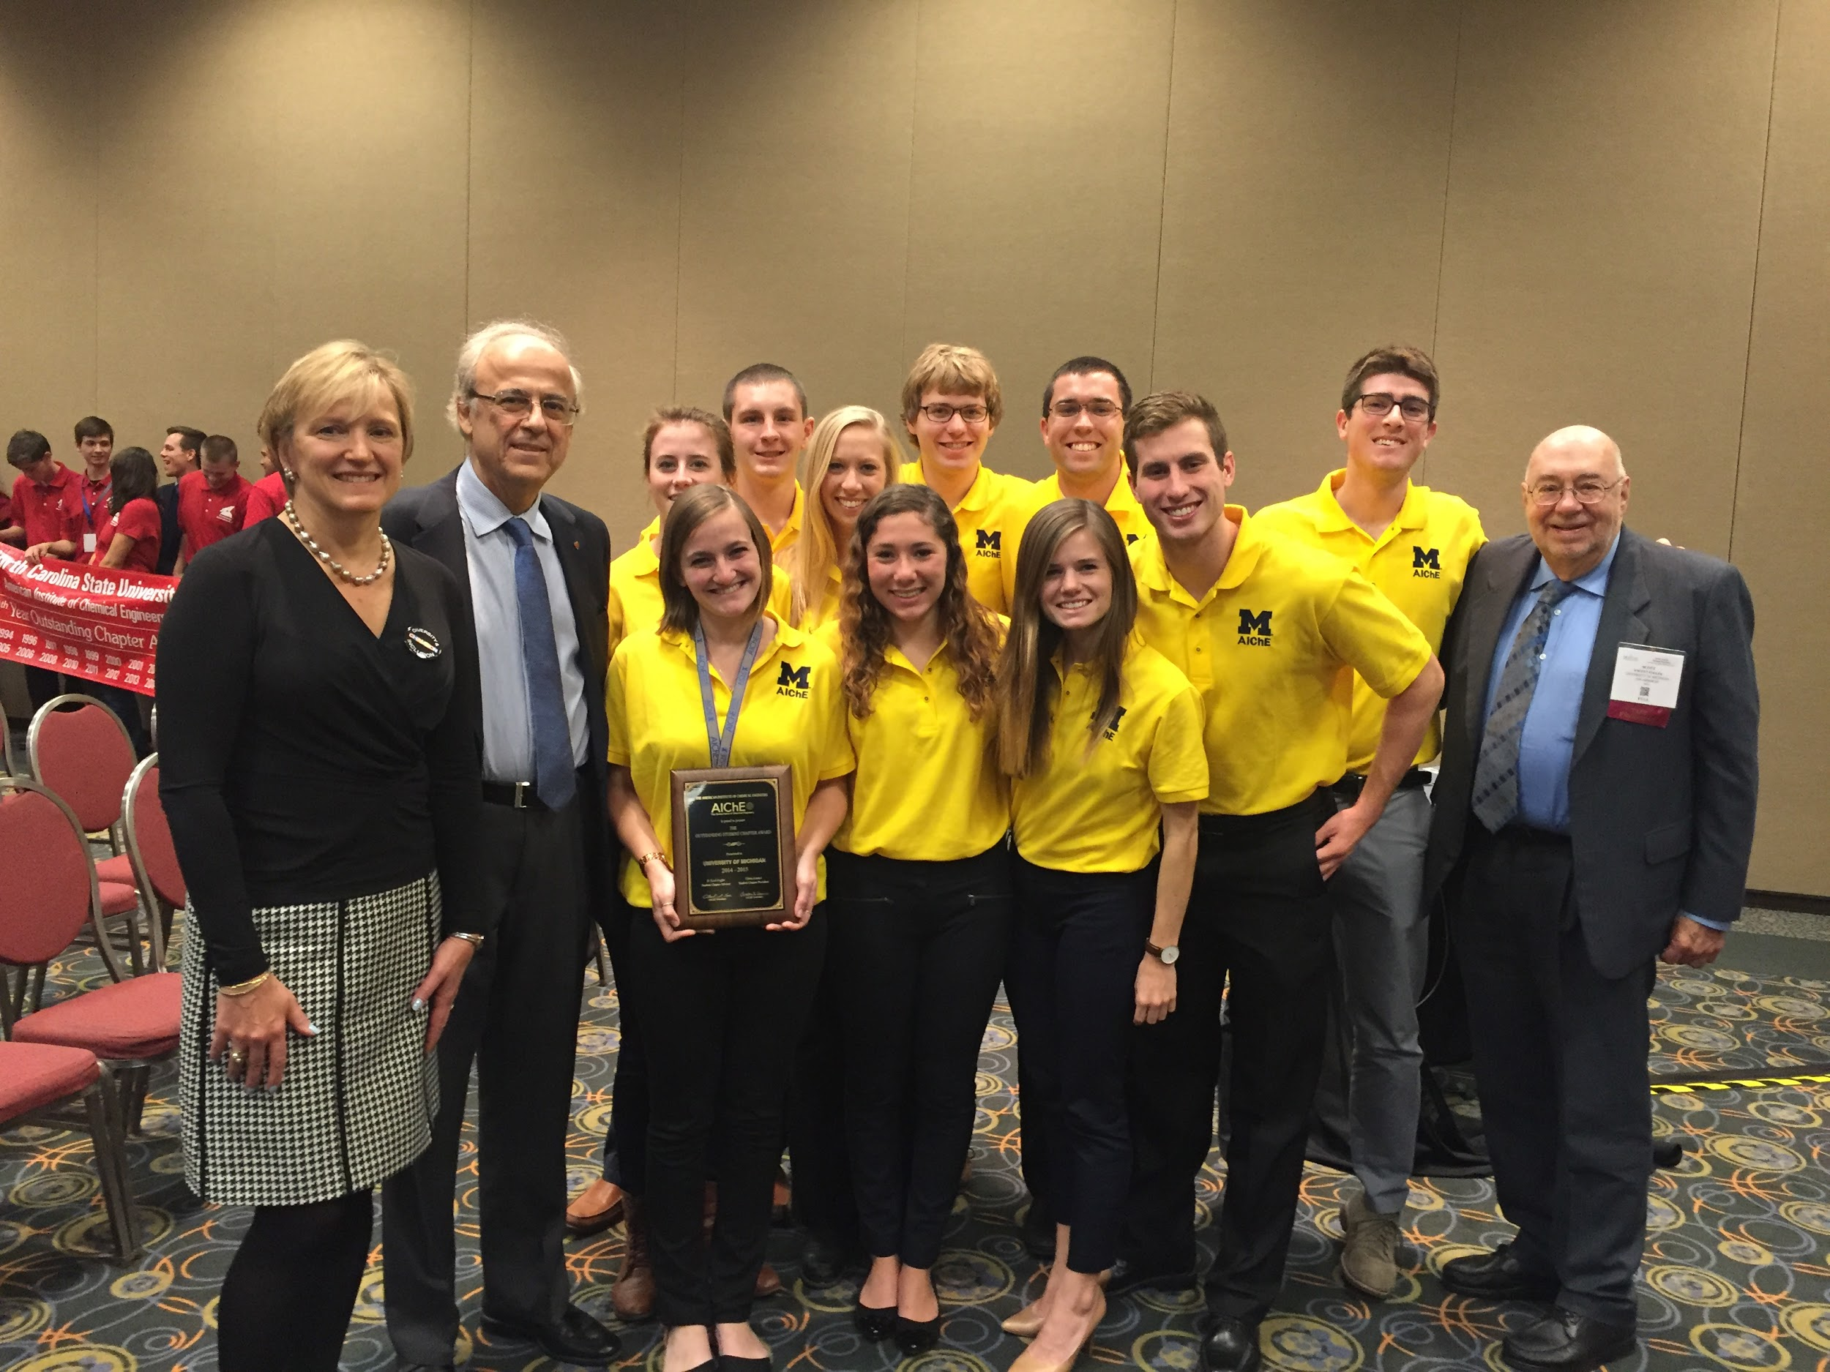
National Conference
Certain companies want to foster chapter development
See National Conference as growth opportunity
Opportunity to encourage other chapters to seek corporate relationships
Notes:
Lastly,
Develop chapter as a whole.
Learn about other chapters and implement new ideas.
Opportunity to spread the word about their company to other chapters

Slide 23
Q&A

Slide 24
Contact Information
Meg Erkkinen; merkk@umich.edu
Hannah Fetner; fetnerhn@umich.edu
Jeremy Kach; kachj@umich.edu

