Slide 1

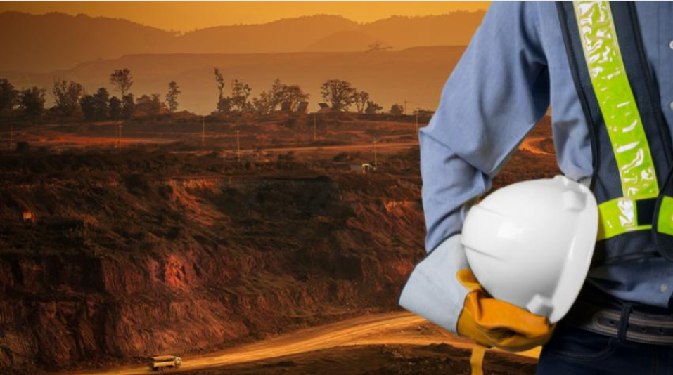
CCPS Mining Minerals and Metals (M-Cubed) Subcommittee

Slide 2
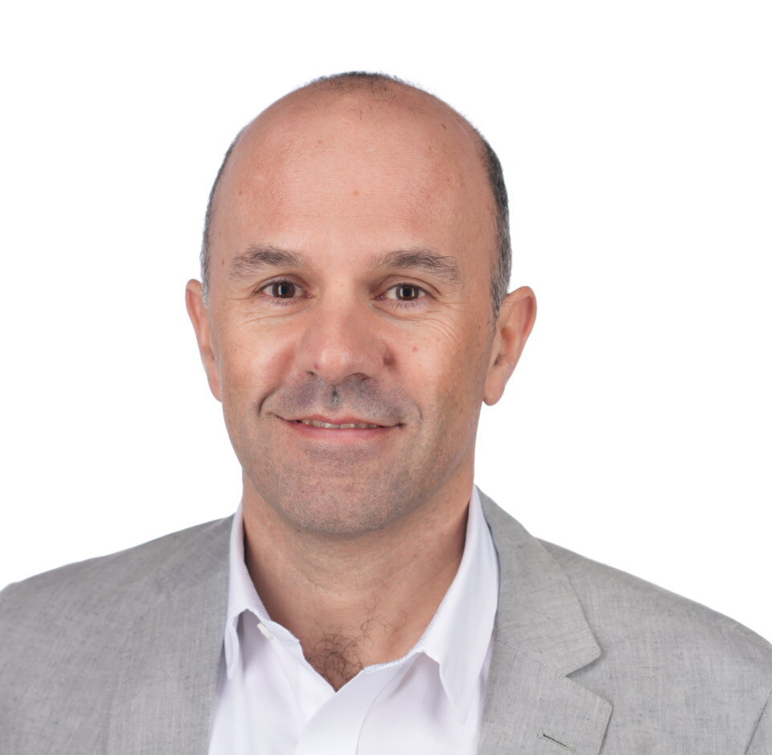
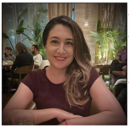
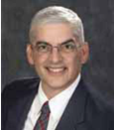
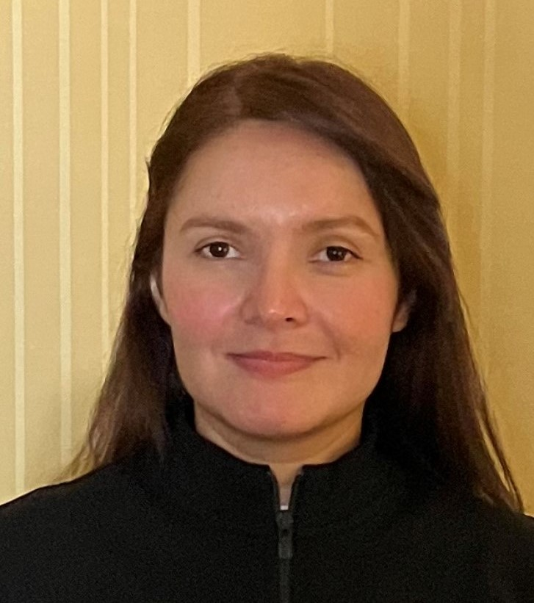
M-Cubed Leadership Team
Chair: Christophe Catala (Rio Tinto)
Co-Chair: Neisy Ellis (Mosaic group)
Global Process Safety Chief Advisor at at Rio Tinto (5 years)
Overall 20 years of experience in Process Safety
Previous experience in engineering & construction (Technip in France), and
Operational experience at site and group level, overseeing PSM in Africa, Middle Est and Europe.(Sinopec)
MSc Chemical engineering and H&S management from Grenoble / Bordeaux (France)
Senior Manager, Process Safety at Mosaic (5 years)
18 years experience with Mosaic in various roles and locations throughout central Florida
B.S. Chemical Engineering from University of Florida, M.B.A. from University of Tampa
Bruce Vaughen, Ph.D., P.E
Carmen Osorio, Ph.D. (CCPS)
Lead Process Safety SME at CCPS (AIChE)
25+ years of experience in engineering, research, teaching, and consulting and has led global PSM initiatives
Developed corporate standards, and designed training programs and workshops.
Author and coauthor of several CCPS guideline books and safety publications, including Process Safety: Key Concepts and Practical Approaches.
CCPS Regional Manager
More than 15 years of experience in Process Safety
Incident investigation experience at Exponent (Thermal Team)
Process Safety and Risk Engineer at BP (Gulf of Mexico)
Fire and Combustion Researcher at MKOPS and Combustion Lab

Slide 3
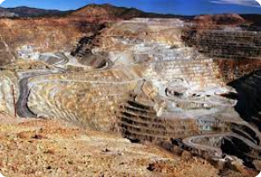
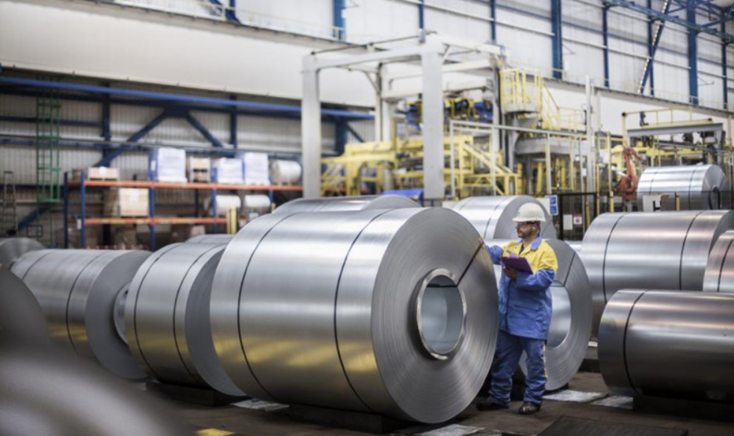
Mining Minerals and Metals (M-Cubed) Subcommittee
Scope:
Companies involved in the metals, minerals, and mining industry
Metallurgic related organizations (i.e. steel producing companies)
Source: https://education.nationalgeographic.org
Source: https://europe.autonews.com/

Slide 4















Mining Minerals and Metals Subcommittee
Scope:
Companies involved in the metals, minerals, and mining industry
Metallurgic related organizations (i.e. steel producing companies)
Source: https://education.nationalgeographic.org
Common effort by CCPS member companies involved in locating, excavating, and processing metals, minerals, and other geological resources
Source: https://europe.autonews.com/

Slide 5
Mining Minerals and Metals Subcommittee
Objectives:
Support mining, minerals, and metallurgic industry around the world, using the CCPS Risk Based Process Safety (RBPS) as foundation.
Identify challenges and provide guidelines and tools to the MMM industry to fill the gaps on those areas not covered by current RBPS framework.
Sharing best practices – learning from each other (Looking for volunteers to present)

Slide 6

Activities of the committee
Development of monograph
Our current work product: put together a monograph intended for mid-level, technical professionals, on how to start incorporating existing process safety techniques in accordance with our objectives
Based on the Plan, Do, Check, Act cycle of Continuous Improvement
Focuses specifically on contextual application of process safety to M-Cubed of toolsets and publications
Covers value proposition, scope of process safety within MMM, designing for process safety, and other items that the reader can understand while drawing upon existing knowledge and experience
Scope, Plan, Do sections drafted, reviewed, and ready to incorporate in an overall draft
Value Proposition, Check, Act sections are in progress
Target completion from the working group is end of this year

Slide 7
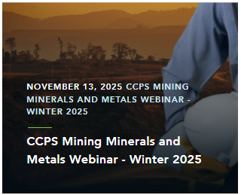
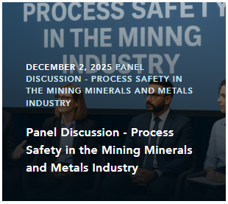
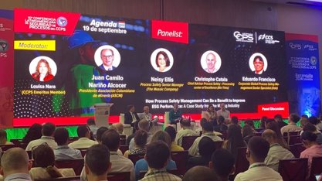
Activities of the committee
Communication and development
2 webinars per year
June 26, 2025
November 13, 2026
Process Safety Day
December 2, 205 (Panel Discussion)
Sharing practices at CCPS conferences
10th LCPS in Barranquilla, 2024 (sessions and panel discussion)
21st GCPS Dallas, 2025 (sessions)
Meeting with Mining Companies (Chile, October 14, 2025)
11th LACPS in Lima, Peru (3Q 2026)

Slide 8


