Slide 1
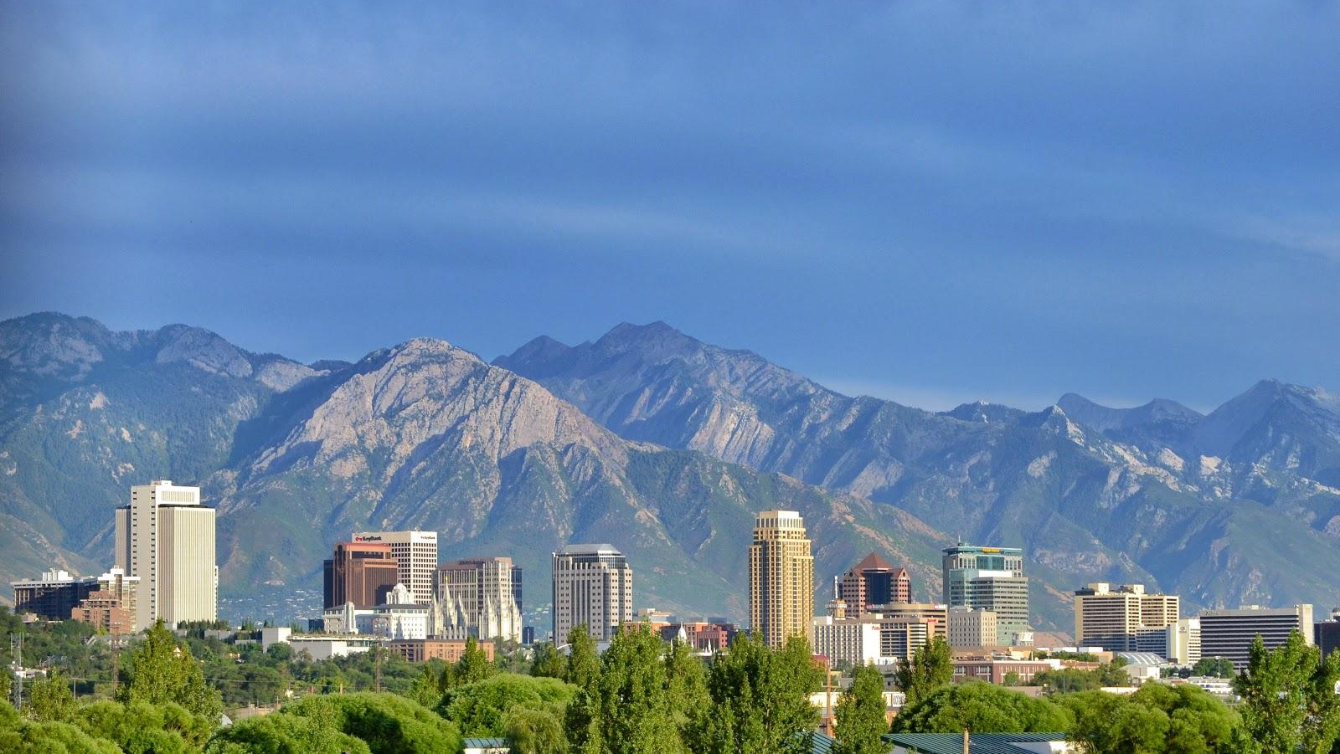

Hosting Large Events
en.wikipedia.org

Slide 2
Presenters
Alex Yang
Zachary Rinaldi
Stefan Busker
Trevor Blanchard
Anna Wagner
University of Virginia
Purdue University
Brigham Young University
Brigham Young University Purdue University

Slide 3

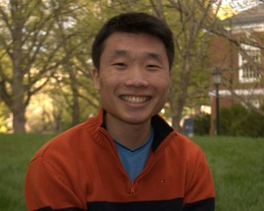
Alex Yang
University of Virginia, May 2016
AIChE Student Chapter Position:
President Fall 2015
Webmaster Fall 2014
Hometown: Great Falls, VA
Interests: Rowing, Ultimate Frisbee

Slide 4

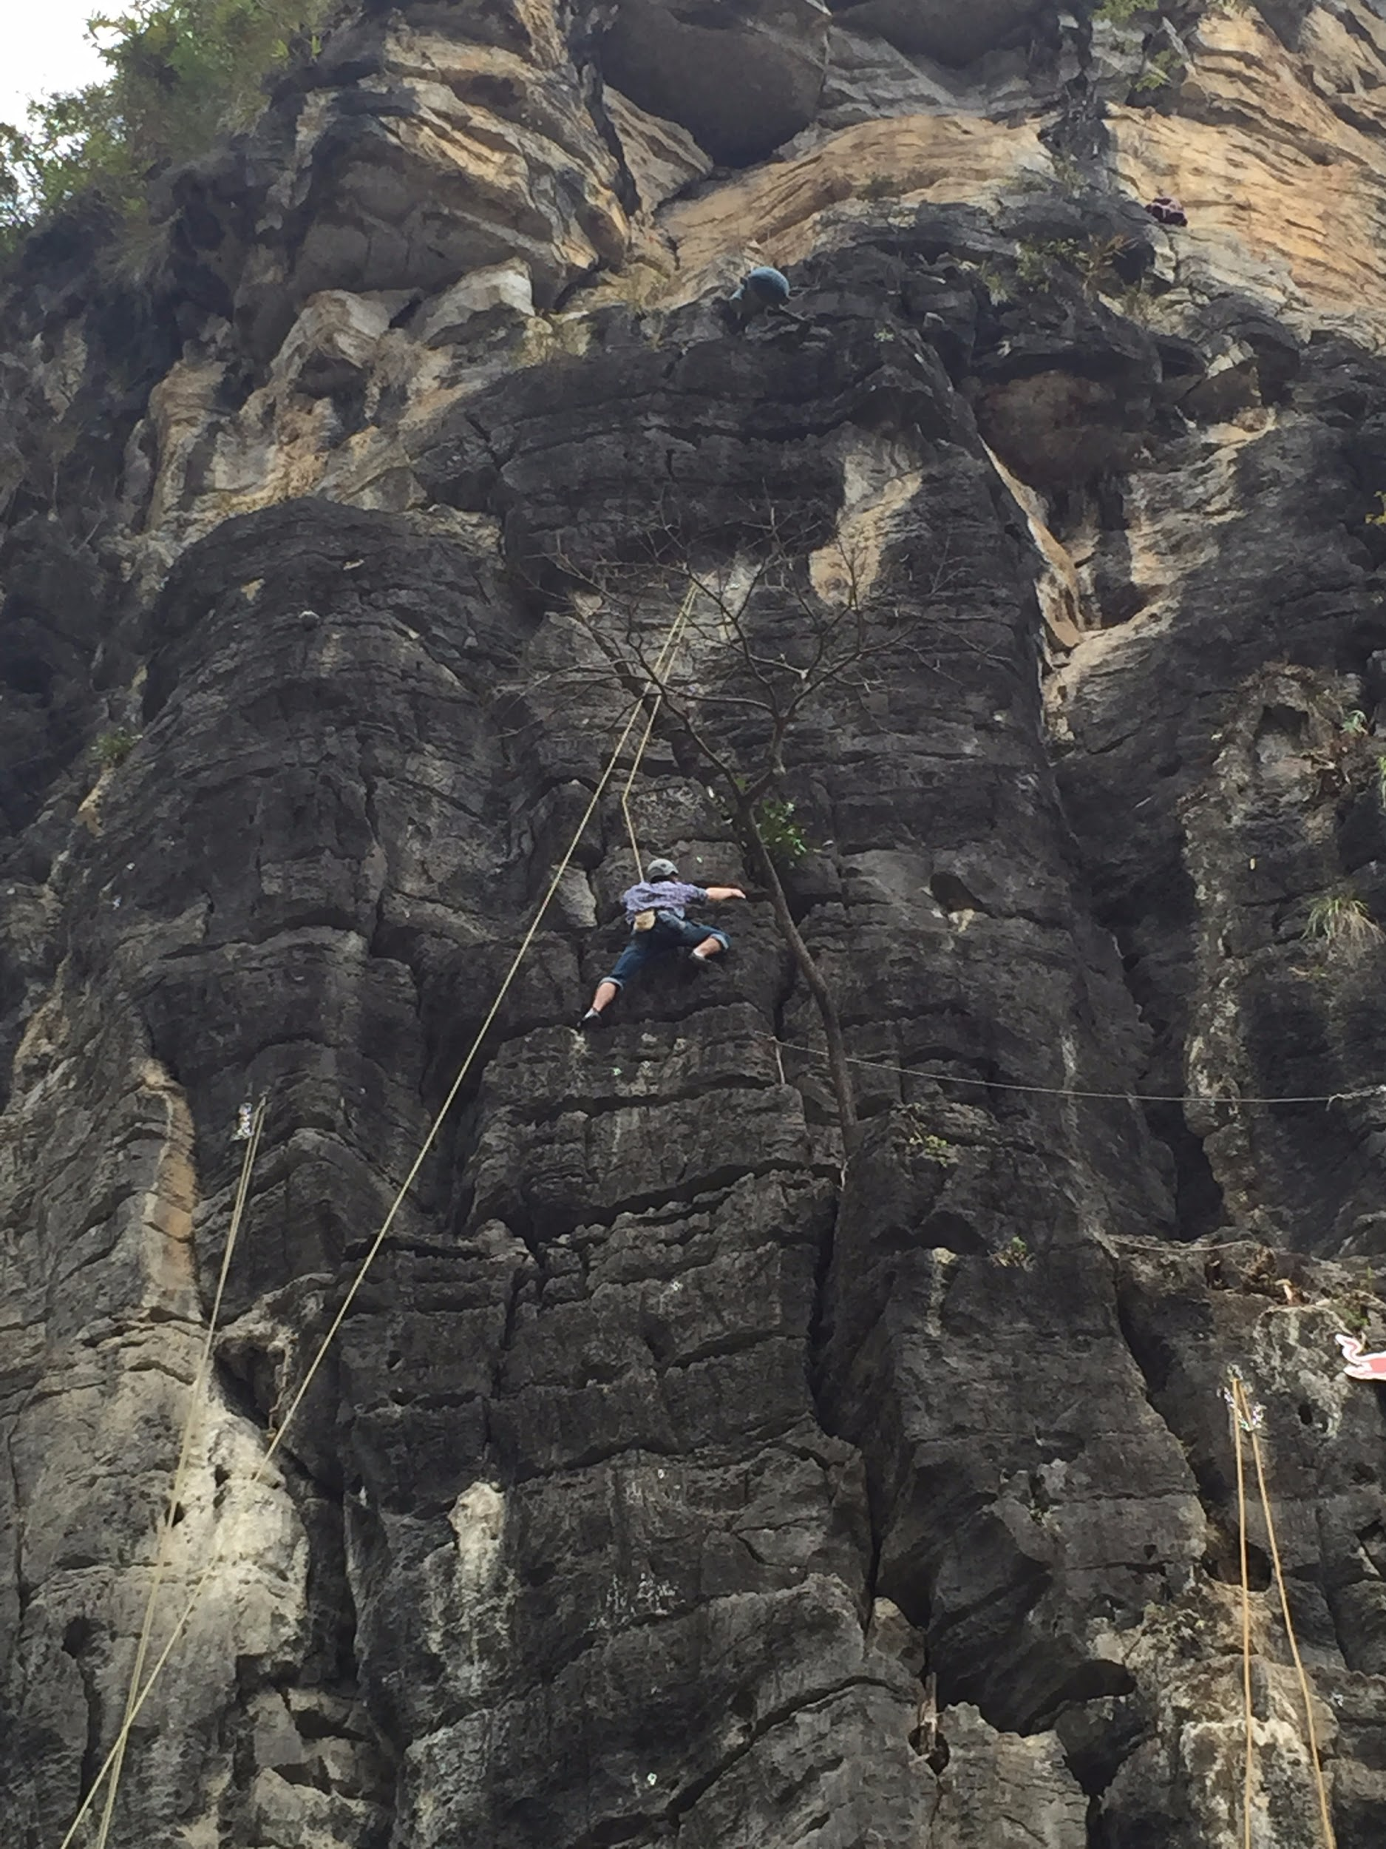
Zachary Rinaldi
Purdue University, Dec 2016
AIChE Student Chapter Position:
President Fall 2015
Internal Vice President Fall 2014
Sophomore Representative Fall 2013
Communications Committee
Hometown: Staunton, VA
Interests: Travelling, Rock Climbing

Slide 5

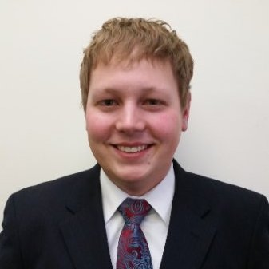
Stefan Busker
Brigham Young University, April 2016
AIChE Student Chapter Position:
Co-Vice President Fall 2015
Member Fall 2013
Hometown: Winnemucca, NV
Interesting Fact: I speak Russian

Slide 6

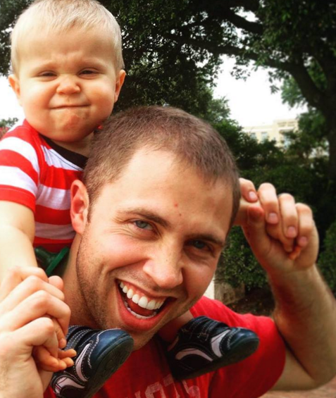
Trevor Blanchard
Brigham Young University, April 2016
AIChE Student Chapter Position:
Co-Vice President Fall 2015
Field Trip Coordinator Fall 2014
Hometown: Rexburg, ID
Interesting Fact: I have driven a “spud” truck

Slide 7
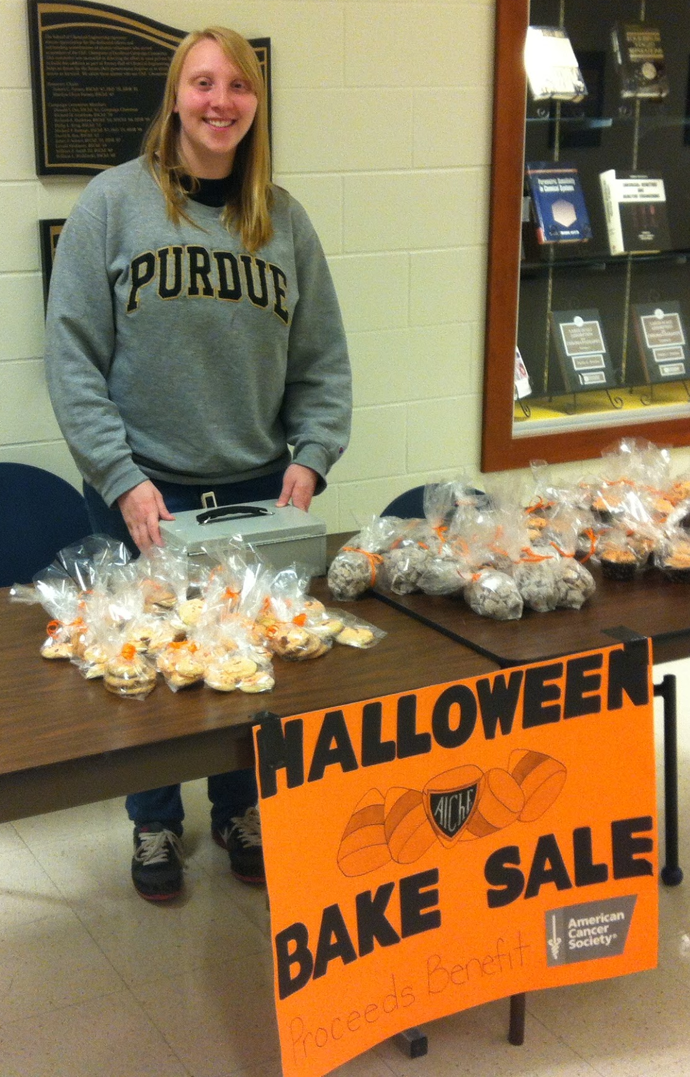
Anna Wagner
Purdue University, May 2017
AIChE Student Chapter Position:
Internal Vice President Fall 2015
Philanthropy Committee Fall 2014
Hometown: Fairview, TX
Interests: Travel, Texas

Slide 8
Getting Started with Planning

Slide 9
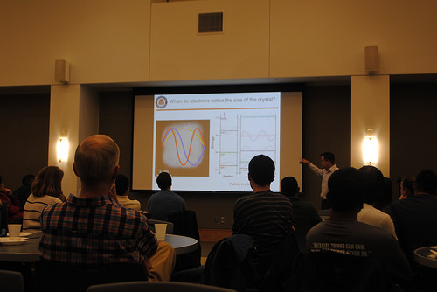
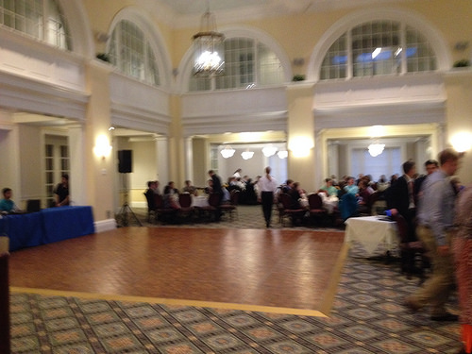
Identify Your Goals
Is this professional, academic, or social?
Outline and brainstorm relevant components
  Registration, corporate liaisons, layout, accommodations
  Music, tickets, advertising, entertainment
Careful planning and logistics help the event run smoothly

Slide 10
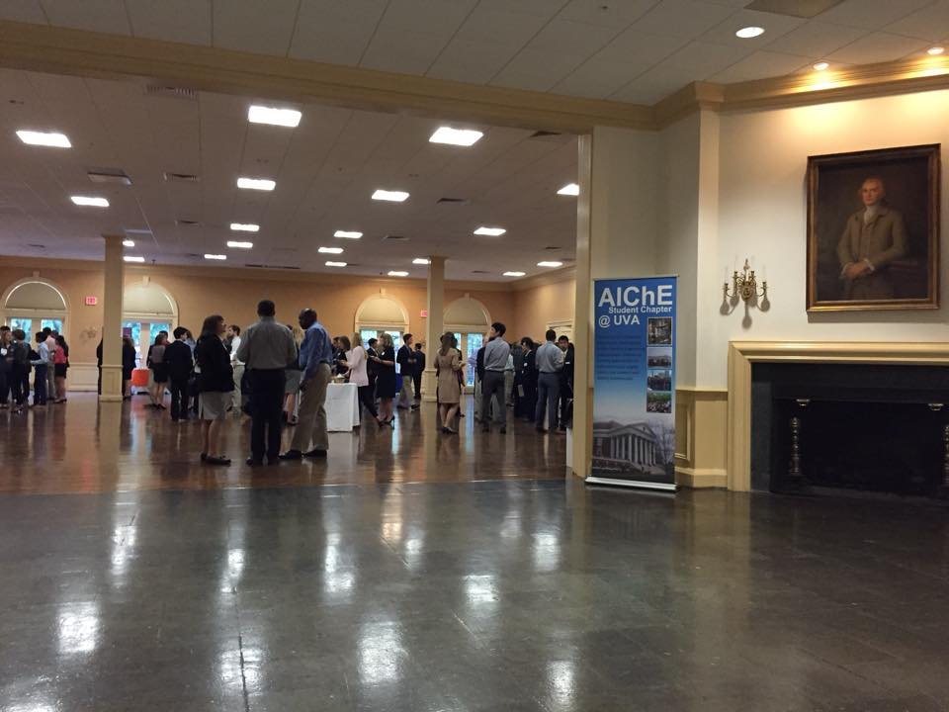
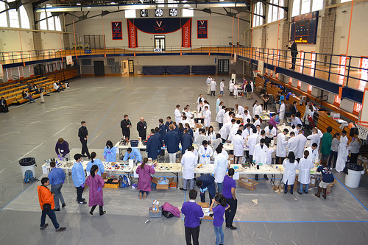
Picking a Venue
Venues will depend on your goals
Consider the audience, safety, messes, floor plan, and accessibility
Ballrooms, lecture halls, gymnasiums, and off-campus options

Slide 11

Advertising and Promotion
Spread the word
  Social media, emails, flyers, handbills, postings, class announcements
Incentives
  Food and catering are always helpful to have
  Extra credit, networking, jobs, internships, prizes, fun, pictures

Slide 12
Utilize Corporate Relations

Slide 13
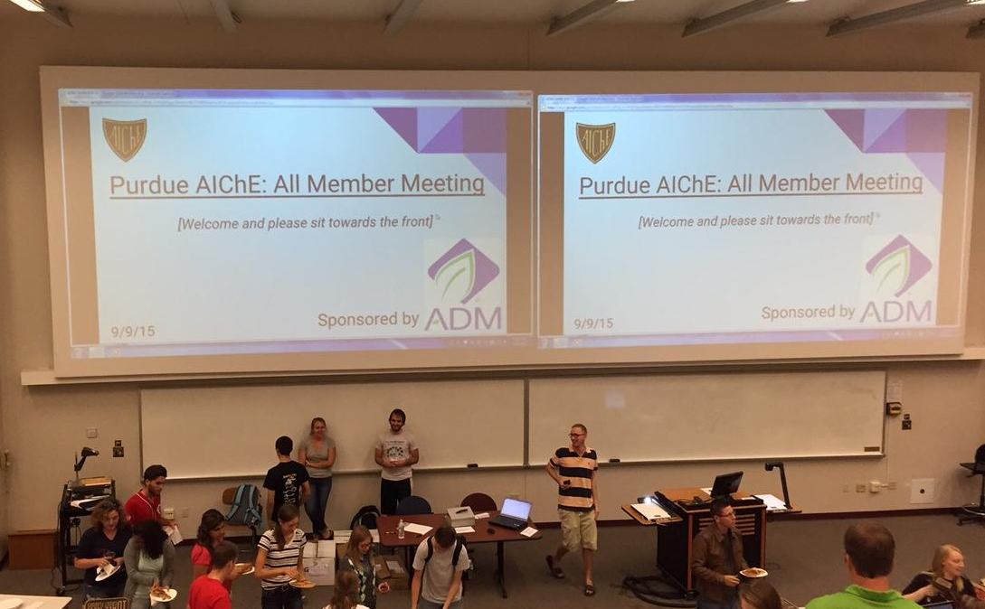
Corporate Relations and Sponsorship
Benefits
Develop corporate relations & acquire sponsorship
Overall recommendations

Slide 14
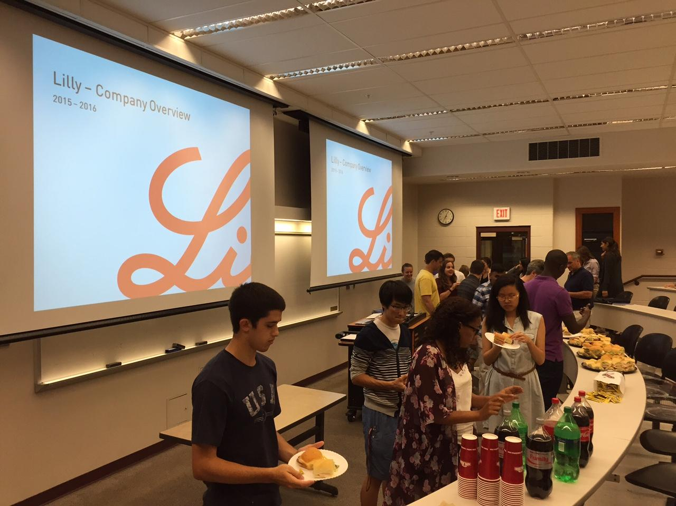
What are the possible benefits?
Foster/Develop corporate relations
  Large event = many students
  Variety in students attending
Lead to more events in the future
  Learn about the chapter
  Chapter hosts meaningful events
Aid in offsetting costs

Slide 15
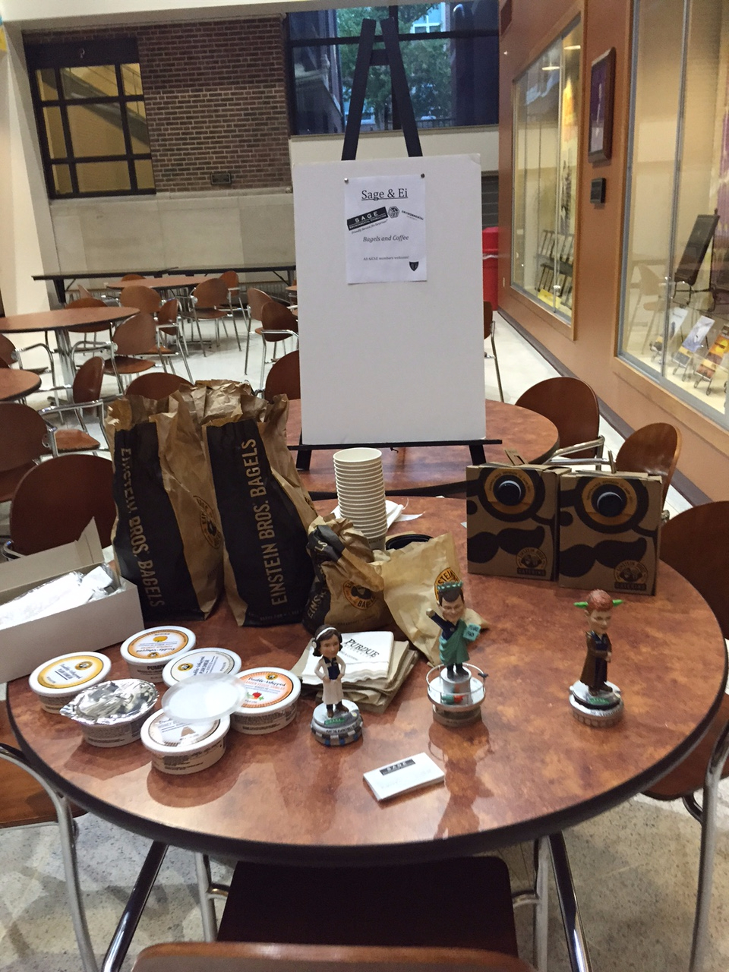
Develop corporate relations
Promote the benefit
  # of accessible students
  Active # of students
  Ways to be involved
Organic process
  What company wants/needs
  How chapter can help
Notes:
KC and Sage

Slide 16
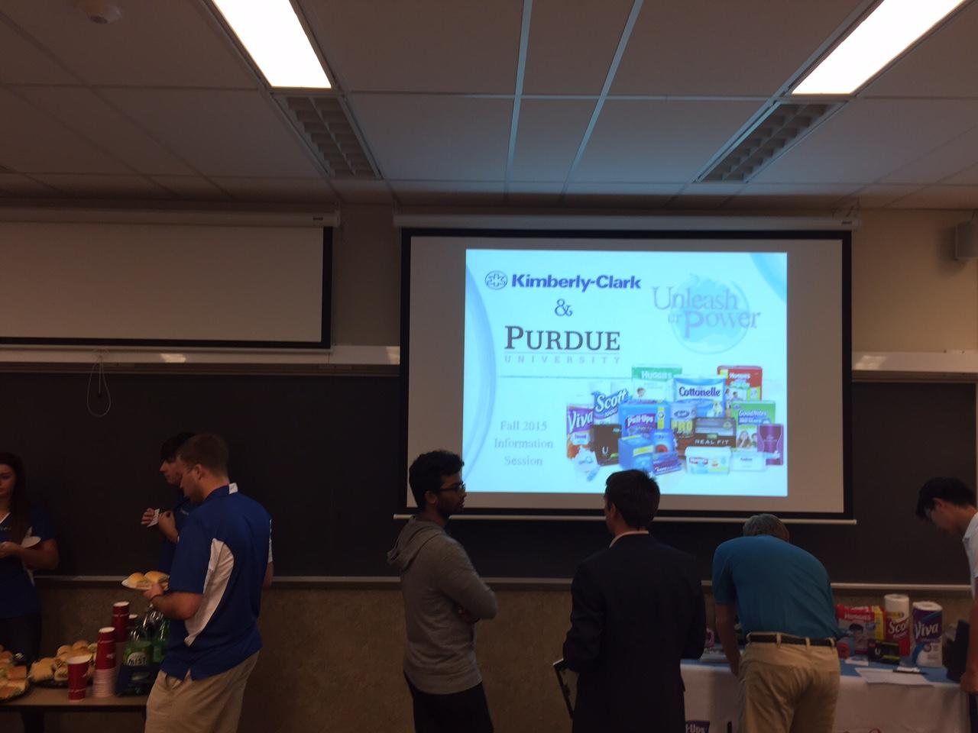
Acquire Sponsorship
Who are you?
Synopsis of chapter
Why you do what you do
Goals & objectives
How do you meet your goals
Activities & events
Promote the “mutual benefit”
Notes:
1: How you can help the corporate partner meet their goals
Achieve this with a “sponsorship package”

Slide 17
Recommendations
Corporate relations and sponsorship is challenging
Be formal
Be concise
Be consistent
Be persistent

Slide 18
Food, Entertainment, and Logistics

Slide 19
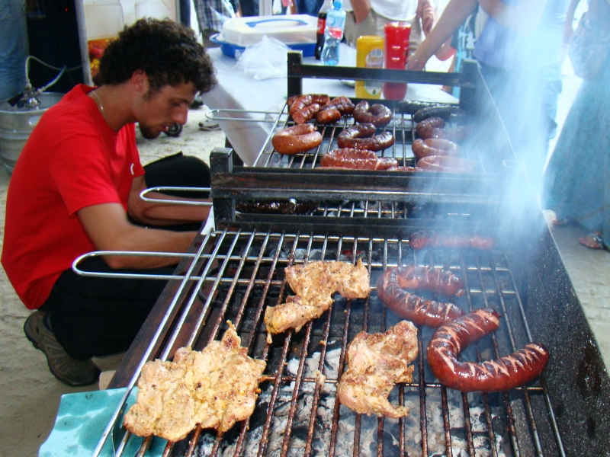
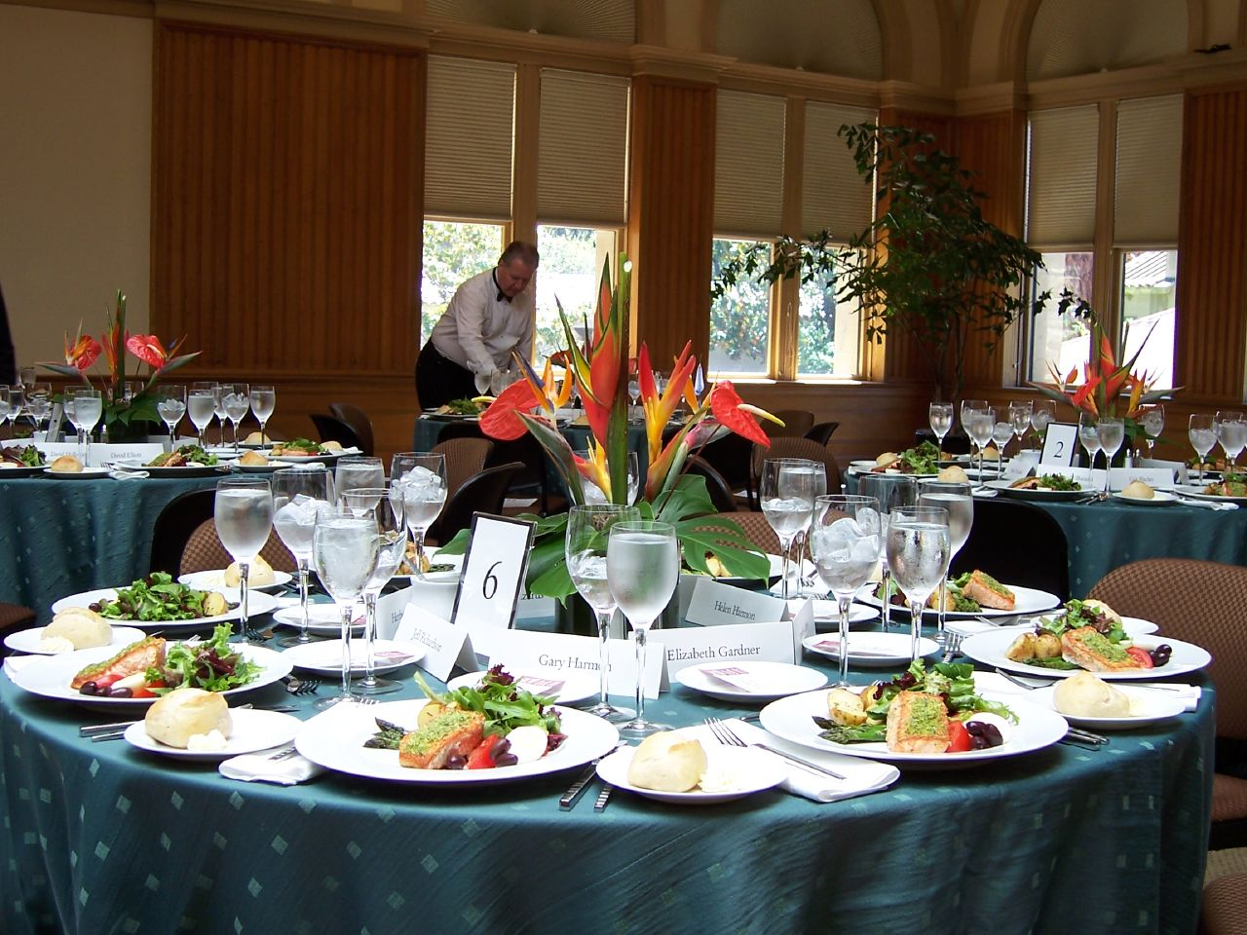
Food
School/Location Restrictions
Working with a catering company
Helping people with special dietary needs
What kind of food do you want to order (ie. buffet style or plated, burgers or snacks)?
By nmlind (100_3062) [CC BY 2.0 (http://creativecommons.org/licenses/by/2.0)], via Wikimedia Commons
By Silar (Own work) [CC BY-SA 3.0 (http://creativecommons.org/licenses/by-sa/3.0)], via Wikimedia Commons

Slide 20

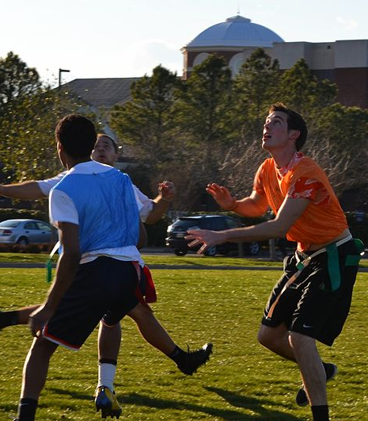
Entertainment
Where is the event taking place?
What do people like to do at your school?
What kind of event is it (social/formal)?
By Jecowa [GFDL (http://www.gnu.org/copyleft/fdl.html) or CC-BY-SA-3.0 (http://creativecommons.org/licenses/by-sa/3.0/)], via Wikimedia Commons
By Tony Alter from Newport News, USA (Fancy Footwork Uploaded by theveravee) [CC BY 2.0 (http://creativecommons.org /licenses/by/2.0)], via Wikimedia Commons

Slide 21
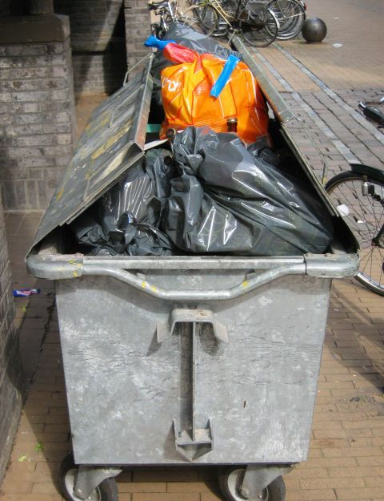



Logistics
Reserve your location as soon as possible!
Make a list of everything that you need (small stuff slips through the cracks)
Communication among key players is key
Do a dry run (look at setup)
By F. Kesselring, FKuR Willich (F. Kesselring, FKuR Willich) [CC BY-SA 3.0 de (http://creativecommons.org/ licenses/by-sa/3.0/de/deed.en)], via Wikimedia Commons
https://commons.wikimedia.org/wiki/File:Vuilnis.JPG#file
By Alanthebox (Own work) [CC0], via Wikimedia Commons
By Elmschrat (Own work) [CC BY-SA 3.0 (http://creativecommons.org/licenses/by-sa/3.0) or GFDL (http://www.gnu.org/copyleft/fdl.html)], via Wikimedia Commons

Slide 22
Coordinating with Others

Slide 23

Planning
Communication
How meet? Video, phone, email, in person?
How often do we meet?
Delegation
Hierarchy and clearly defined roles
Assignments vs volunteers
Trust and flexibility
Schedule
Calendar and timeline with deadlines
Accountability
How will you follow up?

Slide 24

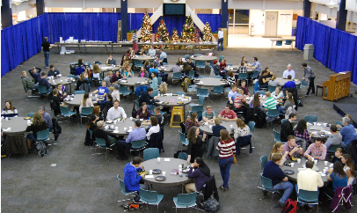
The Day of
Communication
Cell phones, walkie talkies?
Hierarchy of command
Schedule
Timing
Locations
Objectives
Accountability
Resources
Emergency Response
Where go for help or questions

Slide 25
During and After the Event

Slide 26
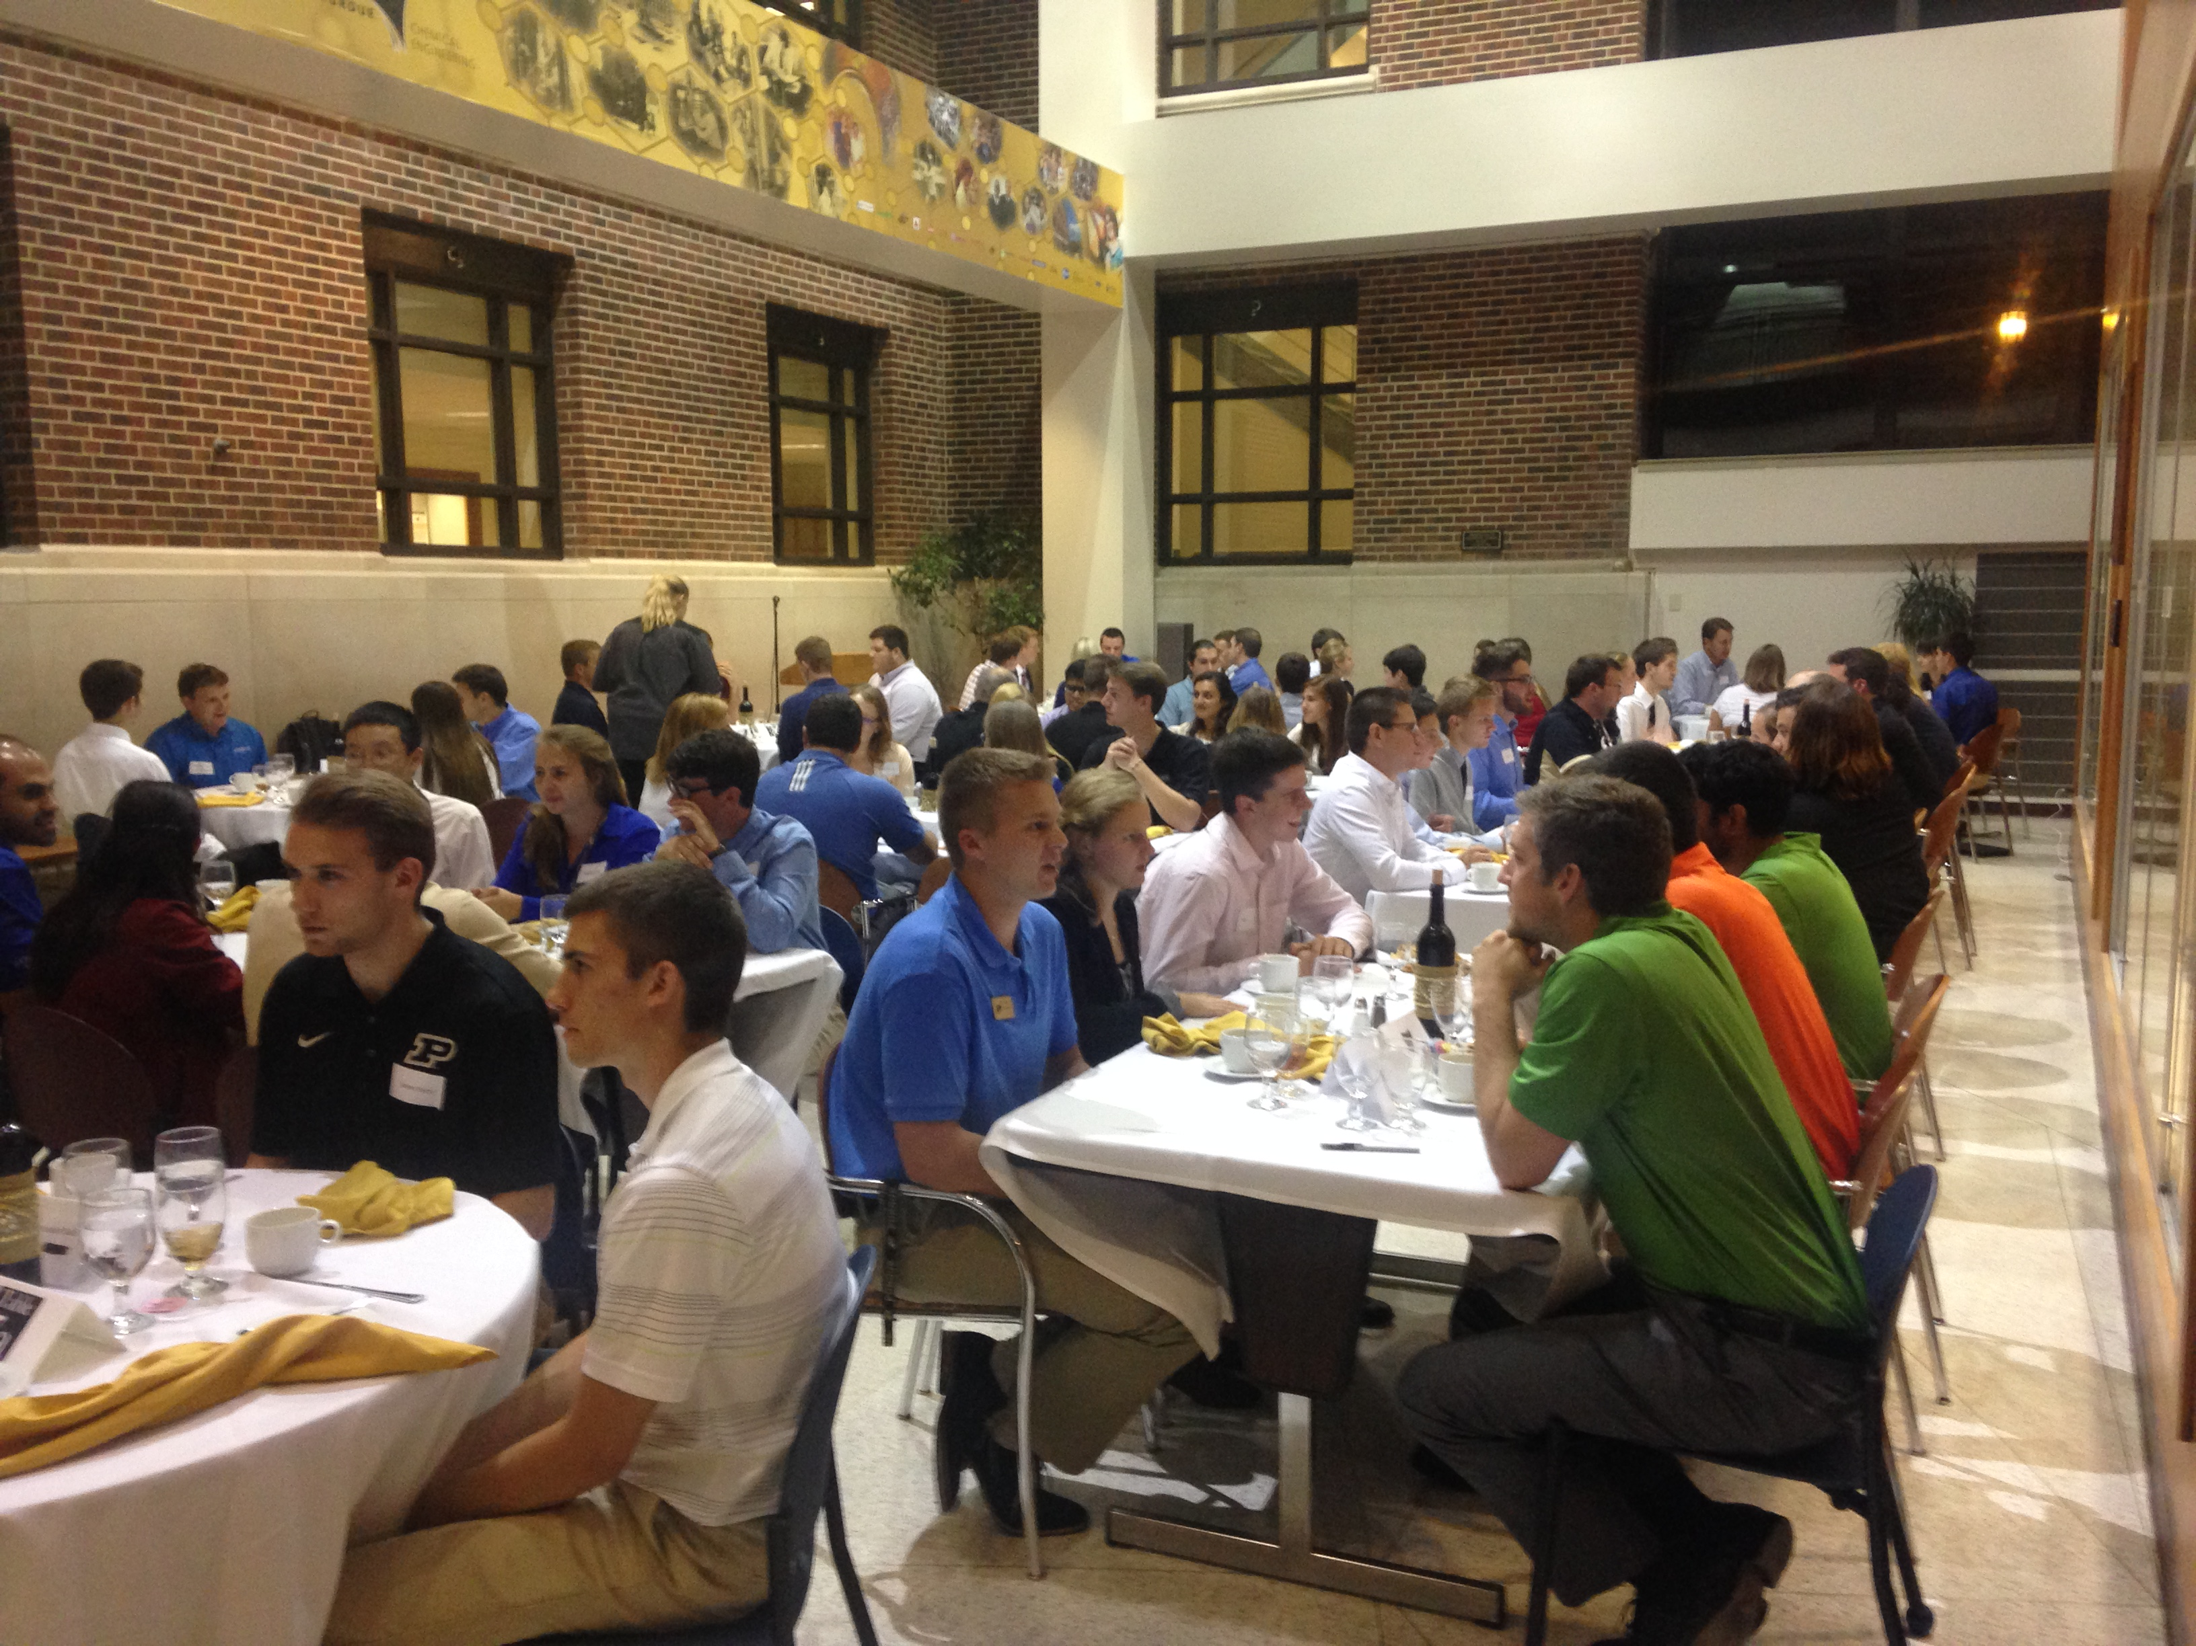
Last Minute Changes
Know your priorities
Consider all resources available
Communication is key

Slide 27
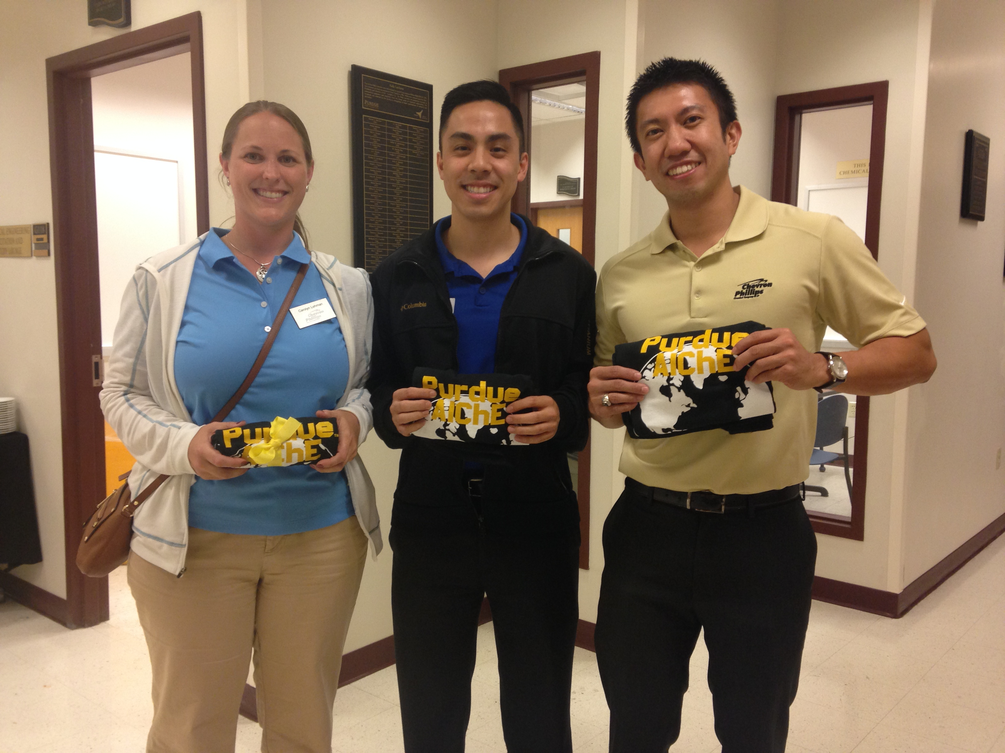
Evaluating your Event
Gather
Surveys and feedback
Notes of the event
Review
Goals and metrics
Compare to other events
Apply
Set new goals
Create strategies

Slide 28
Summary
Getting started with planning
Utilize corporate relations
Food, entertainment, and logistics
Coordinating with others
Evaluating your event

Slide 29
Questions?
Contact Information:
Alex Yang ahy3nz@virginia.edu
Zachary Rinaldi zrinaldi@purdue.edu
Stefan Busker stefan.busker@gmail.com
Trevor Blanchard trevor.blanchard91@gmail.com
Anna Wagner wagne132@purdue.edu

Slide 30
Thank You!
These workshops are organized by AIChE’s Executive Student Committee (ESC)
For more information on ESC:
Check out the ESC booth at the Recruitment Fair in Exhibit Hall 1
      Sunday, November 8th, 9:00am-4:00pm
  Come to the ESC Meeting in Room 155A
      Sunday, November 8th, 4:00pm-6:00pm
      Check out the Website
      http://www.aiche.org/community/sites/committees/executive-student

