Slide 1
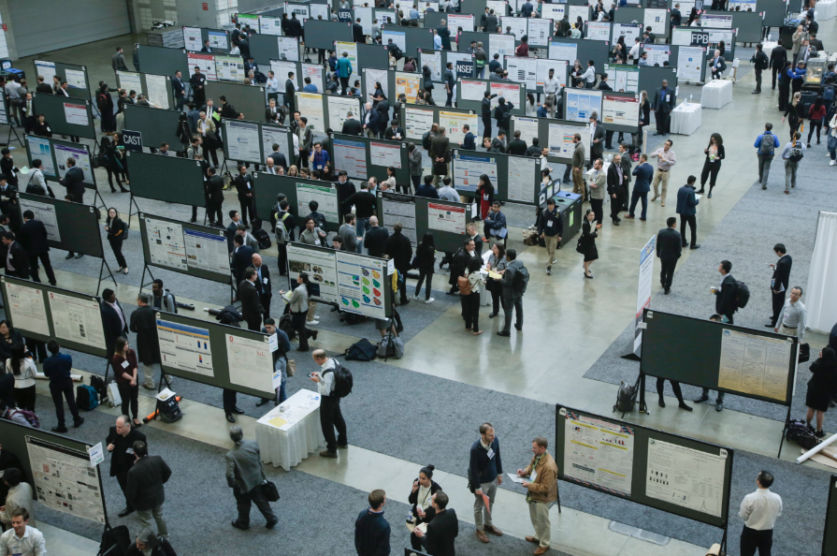
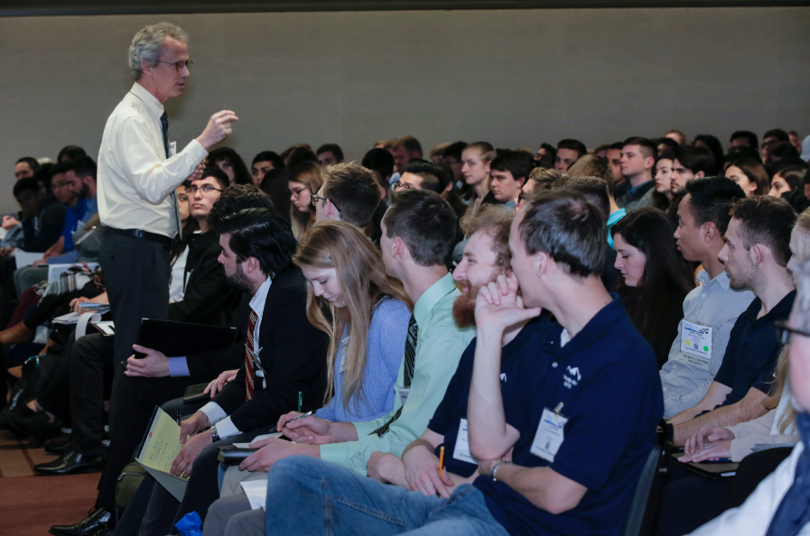
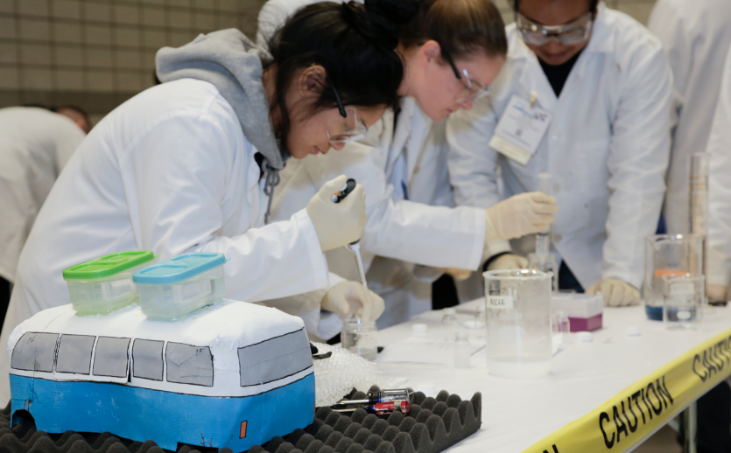
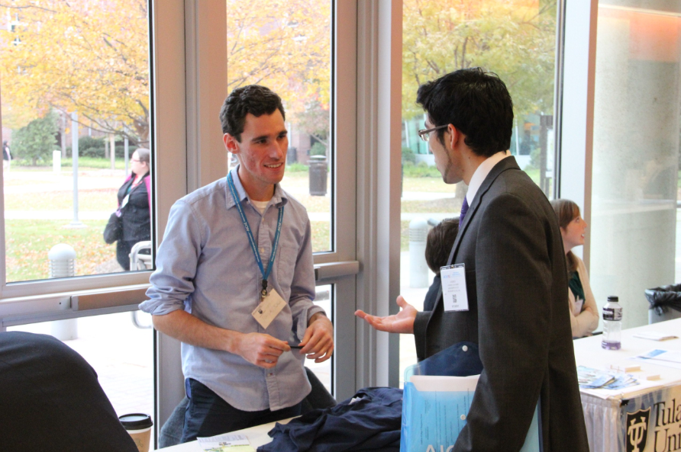
AIChE® Scholarships & Awards

Slide 2
AIChE Scholarships & Awards
www.aiche.org/studentawards
Valued at more than $50,000
Recognize academic accomplishments, student chapter achievements, innovation, and diversity
Available exclusively to AIChE student members and chapters, so keep your membership up to date
Notes:
Earning professional recognition and rewards for your accomplishments is a big deal. As an AIChE student member, you can enrich your résumé with AIChE scholarships and awards valued at more than $50,000 (USD), if you qualify. AIChE scholarships and awards recognize academic accomplishments, student chapter achievements, innovation, and diversity. And they’re available exclusively to AIChE student members and chapters. In addition to the recognition, the extra financial support you’ll receive will help cover essential expenses like books and tuition.

Slide 3
AIChE Scholarships & Awards
John J. McKetta Undergraduate Scholarship Award
Award: Certificate + $5,000 (USD) scholarship
Eligibility: Incoming juniors or seniors planning a career in the chemical engineering process industries
Deadline: June 15th
Notes:
The John J. McKetta Undergraduate Scholarship is awarded to a chemical engineering undergraduate student (incoming junior or senior only), planning a career in the chemical engineering process industries (CPI).
Each AIChE Student Chapter may submit one nomination for this award.
One winner receives a $5,000 scholarship, a certificate, plus recognition during the Annual Student Conference.
Visit the linked page for complete information.

Slide 4
AIChE Scholarships & Awards
Donald F. & Mildred Topp Othmer Scholarship Award
Award: Certificate + $1,000 (USD) scholarship
Eligibility: Must have completed approximately 50% of their degree requirement at the start of the 2019-2020 academic years
Deadline: June 15th
Notes:
Each year, Donald F. & Mildred Topp Othmer Scholarship Awards 15 AIChE student members a scholarship of $1,000. Awards are presented on the basis of academic achievement and involvement in student chapter activities.
Each AIChE Student Chapter may submit one nomination for this award and the nomination must be made by the student chapter advisor
15 winners will receive a $1,000 scholarship, a certificate, plus recognition during the Annual Student Conference.
Visit the linked page for complete information.

Slide 5
AIChE Scholarships & Awards
Freshman & Othmer Sophomore Awards
Award: Certificate, $50 travel allowance and complimentary registration to ASC
Eligibility:
Most active freshman in chapter
Sophomore with the highest GPA
Deadline: July 1st
Notes:
The Freshman Recognition Award is presented to one active AIChE undergraduate student member in each student chapter who has been the most active in their student chapter during their freshman year.
The Donald F. Othmer Sophomore Academic Excellence Award is presented to one active AIChE undergraduate student member in each student chapter who has attained the highest scholastic grade-point average during their freshman and sophomore years.
For both the Freshman and Sophomore Awards, nominations are submitted by the Student Chapter Advisor.
Winners receive a certificate, $50 travel allowance and complimentary registration to the ASC, plus recognition during the Annual Student Conference.
Visit the linked pages for complete information.

Slide 6
AIChE Scholarships & Awards
International Student Chapter Leadership Development Travel Grant Award
Award: Certificate, roundtrip airfare, complimentary registration, and hotel accommodations for ASC
Eligibility: past/current student chapter leader from outside U.S. and Canada + past/current/incoming ESC member + undergrad for 2021-2022 academic year
Deadline: July 8th
Notes:
The purpose of this award is to facilitate the participation and leadership development of international student chapter members at the Annual Student Conference and to strengthen AIChE's relationship with these future global leaders. Up to eight travel grants will be awarded to International Student Chapter leaders for the Annual Student Conference.
The travel grant will be awarded on the basis of leadership involvement in the nominee's Student Chapter and Executive Student Committee (ESC) activities, academic achievement, and strength of nomination from the Student Chapter Advisor. Each AIChE Student Chapter may submit one nomination.
8 winners will receive a certificate, roundtrip airfare, complimentary registration, and hotel accommodations for ASC, plus recognition during the Annual Student Conference.
Visit the linked page for complete information.

Slide 7
Tips & Best Practices
Plan ahead
Get involved in your chapter now
Join AIChE & renew your membership annually
Connect with your student chapter advisor & president early
Closely review award rules, criteria, & submission requirements
Questions? Contact awards@aiche.org.
Browse more scholarships & awards at www.aiche.org/studentawards.
Notes:
When seeking nomination for these awards, it is important that you connect with your student chapter advisor as early as possible. Advisors can only nominate one student from their chapter for most awards, and most awards require that the chapter has submitted its AIChE Student Chapter Annual Report. Verify that your chapter leaders plan to submit the Annual Report on time. For awards requiring additional letters of recommendation or an official transcript, be sure to coordinate with those nominators and your university as early as possible.
Before submitting a nomination/application, make sure your AIChE membership is active. You must take action to join then renew (annually) in order to be considered an active member of AIChE. We also recommend that you review all of the rules, criteria, and submission requirements in detail to make sure you are eligible for the scholarships and awards that interest you.
Be sure to check out our website for an even more comprehensive list of available scholarships and awards, plus student competitions on the link provided on this slide.

