Slide 1
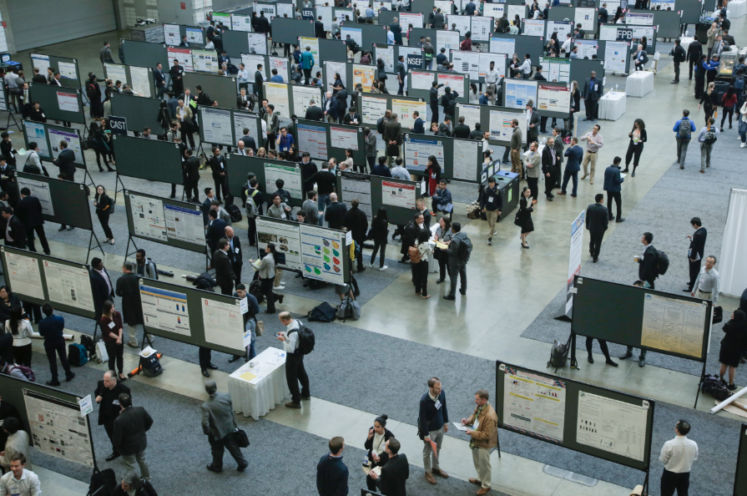
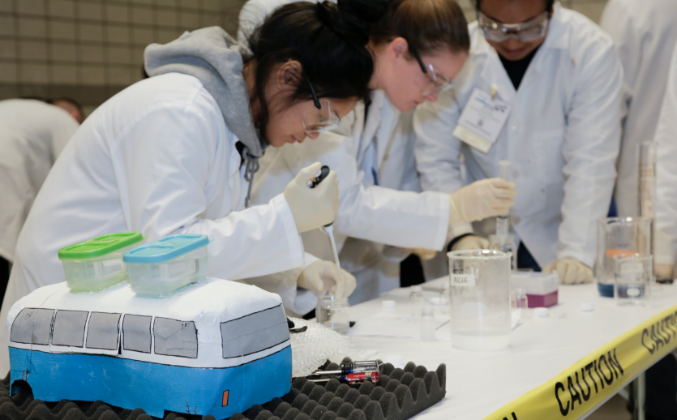
AIChE® Publications

Slide 2
CEP
Chemical Engineering Progress®
Monthly magazine informing on the latest chemical engineering developments and breakthroughs
Archived issues available online date back to 2001
Students can now access on our CEP mobile app
Notes:
Want the latest information on chemical engineering developments and breakthroughs? Chemical Engineering Progress (in print for professional members and online for students like you) is packed with practical information you can apply to current or future projects. Gain insight on technical issues like safety, environmental management, fluids and solids handling, reactions and separations, information technology, and more. Read up on career advice and guidance that you can apply to current or future projects.
Archived issues are available online dating back to 2001. Read the current issue of CEP online or download feature articles as PDF files for your personal reference. And you can now have CEP right at your fingertips — from the latest R&D news and new equipment to feature articles and special sections. Download the Chemical Engineering Progress (CEP) mobile app on your Apple or Android devices to get started.
Each issue of CEP is packed with practical information for chemical engineers:
Learn best practices related to safety, fluids and solids handling, reactions and separations, instrumentation and automation, environmental management, and much more.
Find out about emerging technologies, and gain insights into critical issues important to society.
Browse editorials and columns such as Career Corner, Young Professionals Point of View, Spotlight on Safety, and Patent Update.
Read in-depth “how-to” articles and special sections on biological engineering and energy.
Access the results of AIChE’s latest biennial salary survey.

Slide 3
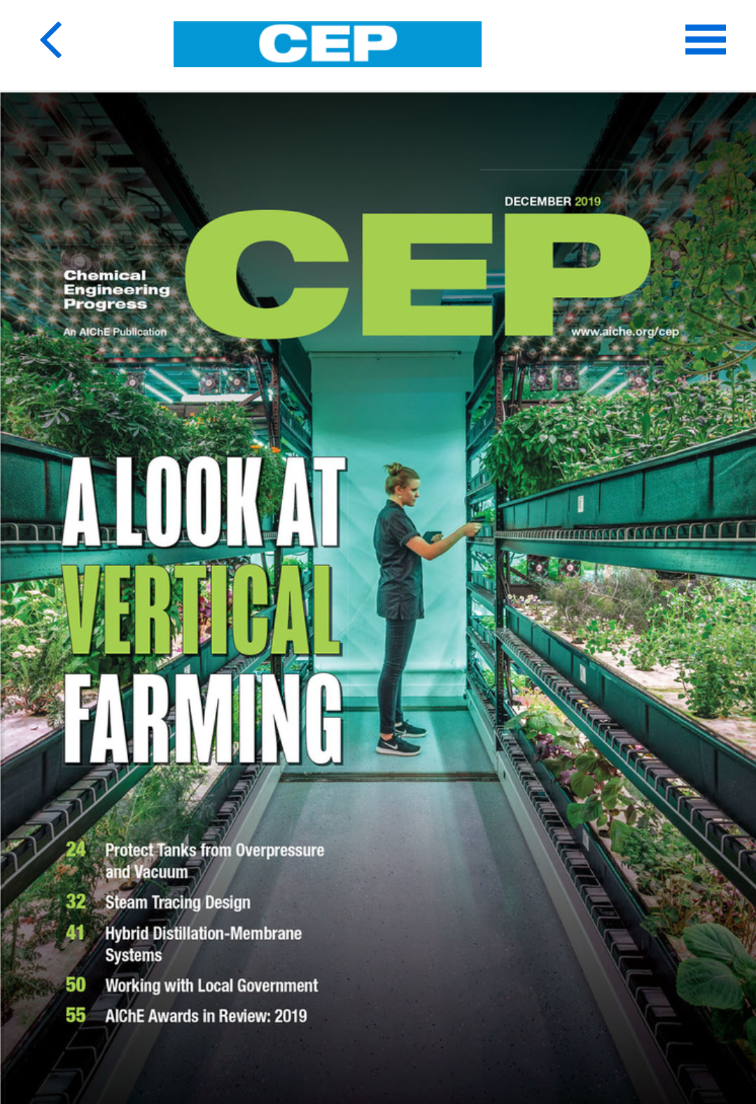
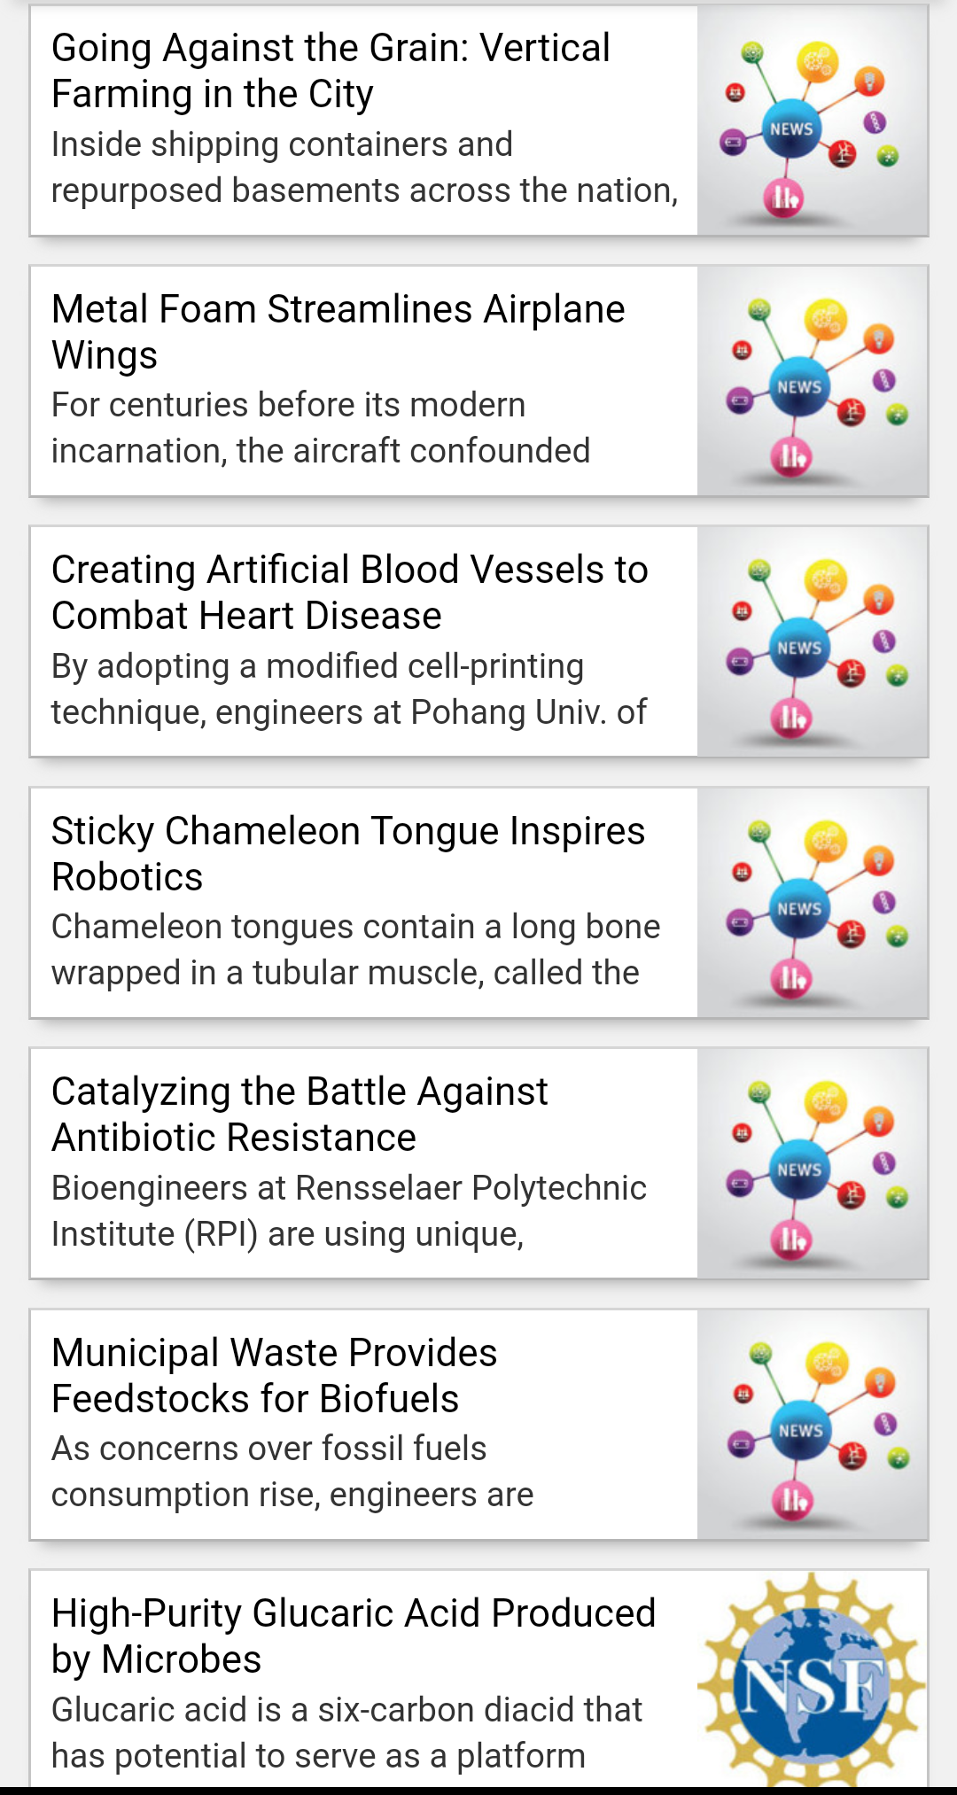
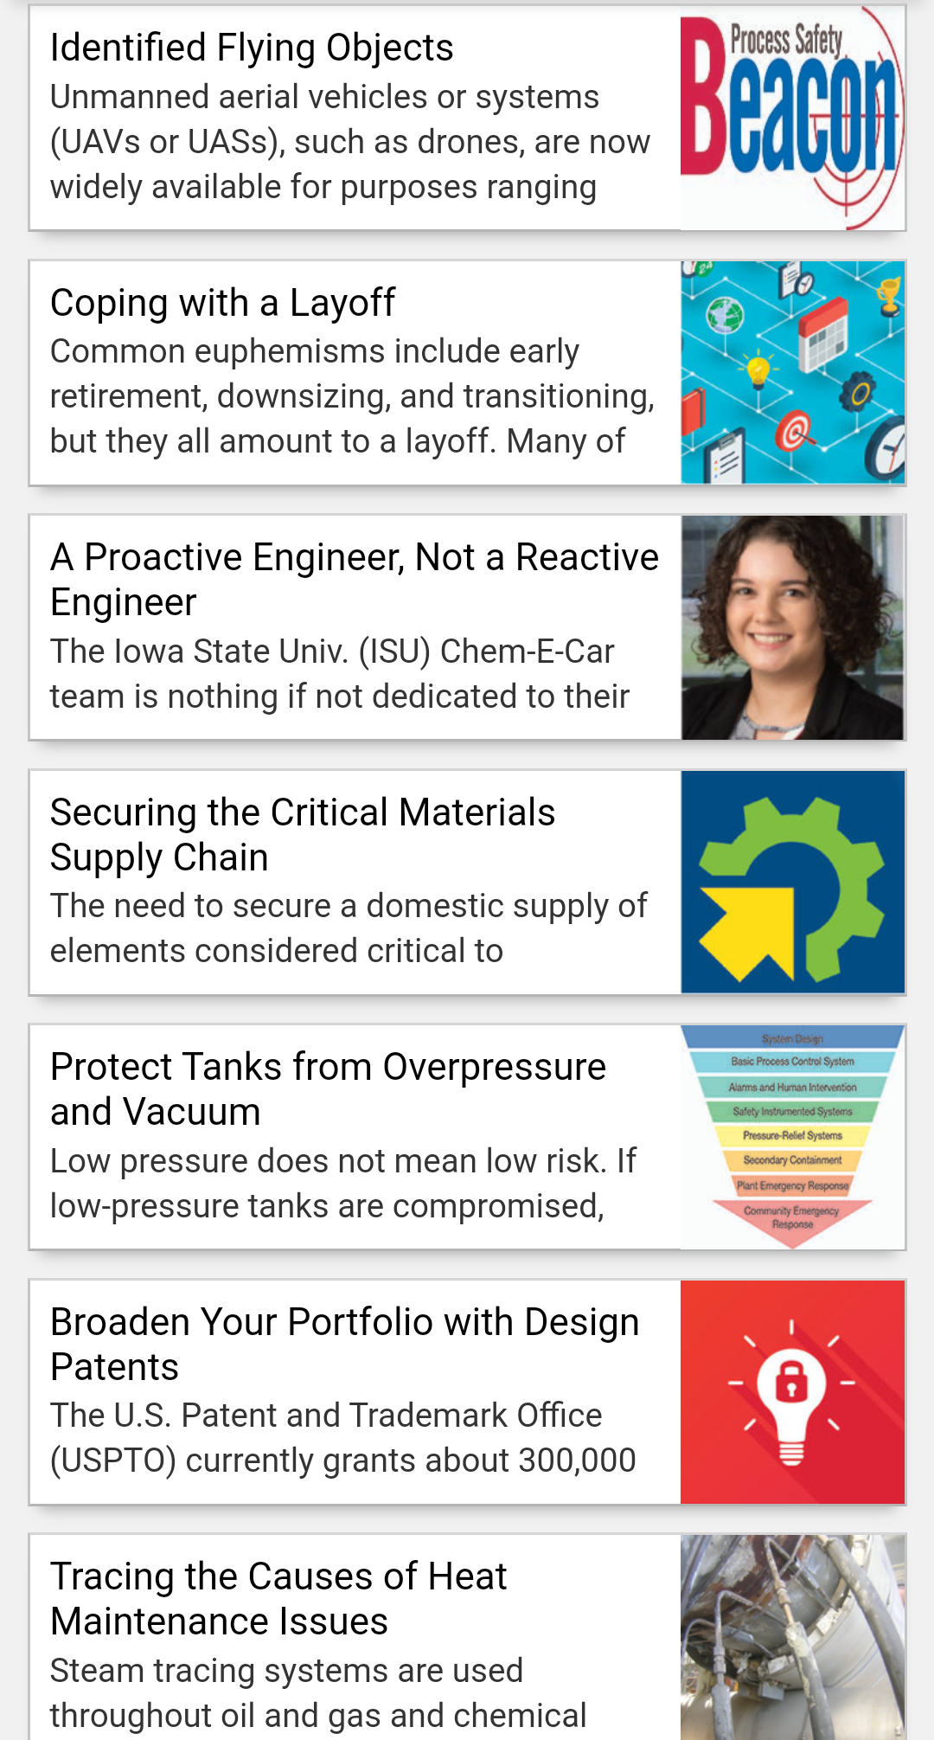
CEP
Notes:
Chemical Engineering Progress (CEP) now has a mobile app available for download on the Apple and Android platforms. You can now have CEP at your fingertips — from the latest R&D news and new equipment to feature articles and special sections.
Each issue of CEP is packed with practical information for chemical engineers:
Learn best practices related to safety, fluids and solids handling, reactions and separations, instrumentation and automation, environmental management, and much more.
Find out about emerging technologies, and gain insights into critical issues important to society.
Browse editorials and columns such as Career Corner, Young Professionals Point of View, Spotlight on Safety, and Patent Update.
Read in-depth “how-to” articles and special sections on biological engineering and energy.
Access the results of AIChE’s latest biennial salary survey.
Read all issues on mobile phones and tablets, beginning with the January 2017 issue — whenever you want and wherever you go.

Slide 4
ChEnected Blog
www.aiche.org/chenected
An online community where you can read, contribute, and engage with everything ChemE
Explore what's trending and gain exposure to hiring companies
Notes:
ChEnected—Where Chemical Engineers Mix it Up—is a unique online community created for and by chemical engineers. Presented by AIChE, ChEnected is where chemical engineers can read, view, contribute, and engage with everything Chem-E. Learn new skills, solve challenges, engage with other chemical engineers, and gain more exposure to hiring companies.
ChEnected is Interactive, featuring polls, reviews, jokes, challenges, and contests.
ChEnected is Connected. Join us on Twitter, Facebook, LinkedIn, Flickr, Slideshare and more.
ChEnected is Multimedia. Look for our ChEtube video content, which can also be accessed on our YouTube channel and ChemE On Demand.
ChEnected is You. Occasionally, we’ll feature new Young Professionals and Students.

Slide 5
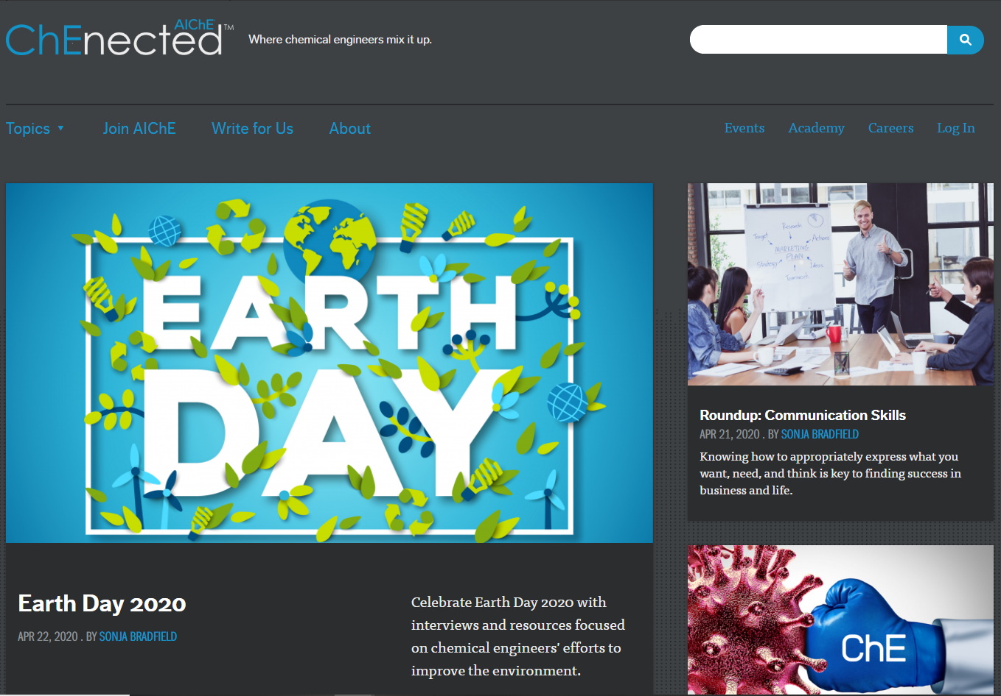
ChEnected Blog

Slide 6
AIChExchange
Monthly newsletter informing on membership activities and institute news
Make the most of your membership benefits with this essential guide to AIChE's upcoming events
Notes:
AIChExchange is a monthly newsletter written exclusively for AIChE Members about membership activities and institute news—local section news, upcoming webinars, events, and more. If you're a member and not already getting Exchange, contact customer service to update your e-mail address.

Slide 7
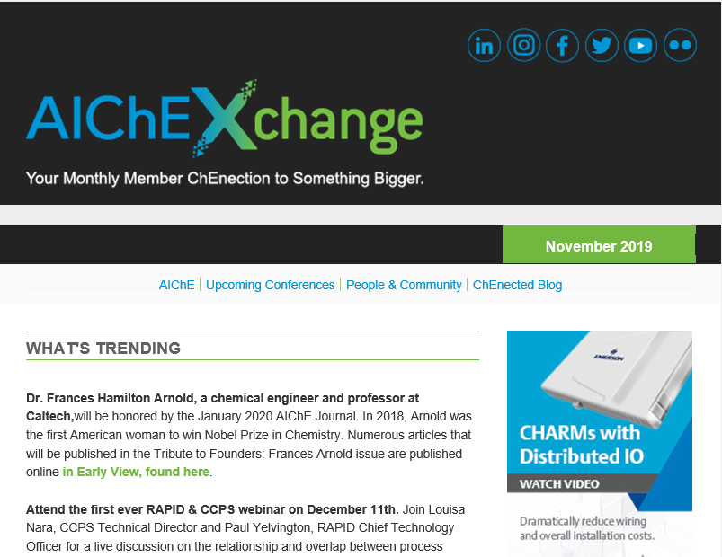
AIChExchange

Slide 8
SmartBrief
AIChE SmartBrief delivers handpicked articles curated to your areas of interest to eliminate information overload
Articles chosen from thousands of news sites are summarized by industry expert editors
Subscribe
Notes:
Why slog through piles of journals to see what’s happening in your field? You can get news at a glance — handpicked from hundreds of publications — in this weekly snapshot of the business and technology news affecting chemical engineers.
Created by business news publisher SmartBrief in partnership with AIChE, and with stories coming from Bloomberg, Reuters and other leading sources, look no further than AIChE SmartBrief for summaries of what matters to you, written by expert editors to save you time and keep you informed and prepared.

Slide 9
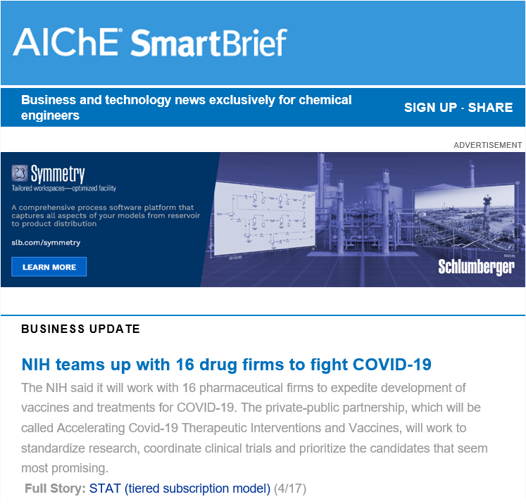
SmartBrief

