Slide 1
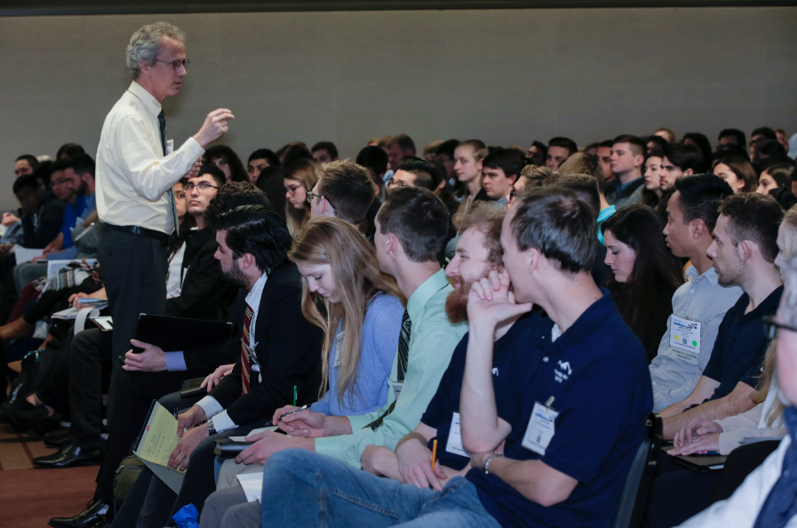
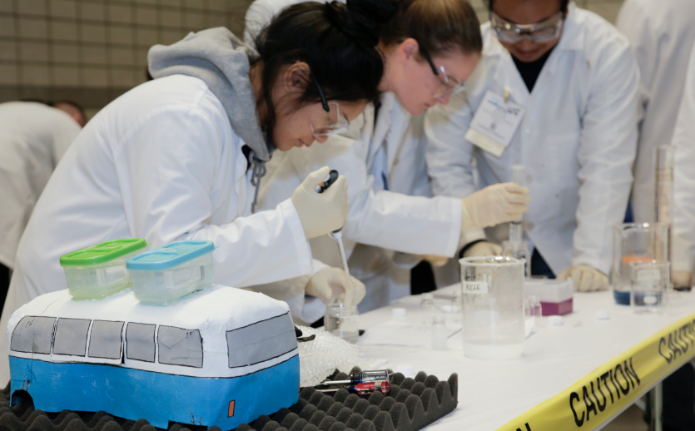
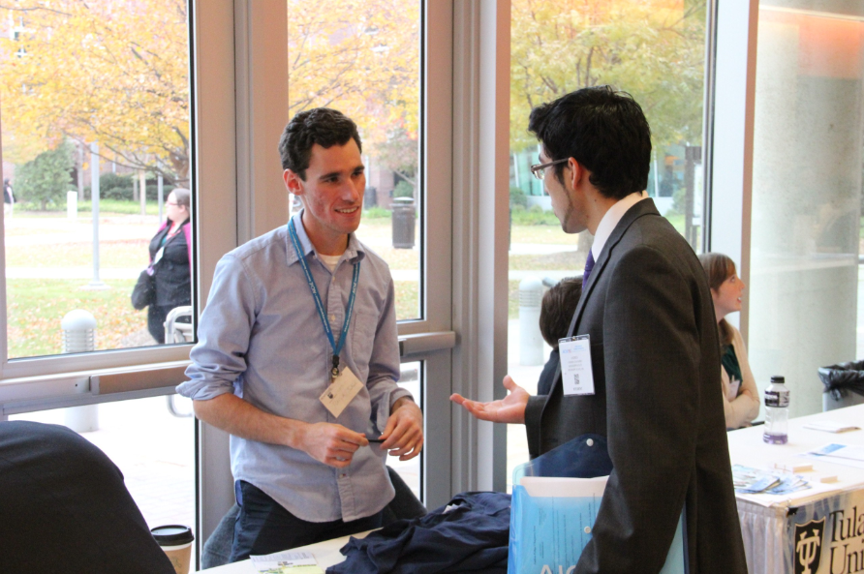
AIChE® Student Membership

Slide 2
What Chemical Engineers Do
Notes:
Chemical engineers’ innovations, products, and solutions play essential roles in people’s lives all over the world. AIChE is helping to shape the future of the chemical engineering profession and ensure it remains a positive, responsible force for change that benefits all of humankind. Belonging to AIChE means being a part of that mission.
Note to presenter: Click on the screengrab in presentation mode to open Youtube and play the video. This video has background music, so be sure to turn on any available speakers when presenting.

Slide 3
Why AIChE® Membership Matters
We are better together.
Learn to lead
Access technical resources
Build your chemical engineering network
Learn more at www.aiche.org/studentmembership
Notes:
AIChE provides professional support to guide you on your journey and help you reach your destination. AIChE serves as the global home of chemical engineers, and gives you your first professional credential, exciting networking opportunities, and essential education, technical resources and career services.
Learning to Lead – Start to establish your name with a global network of students and professionals.
Technical Resources – Stay current with the latest technologies and trends in mature and cutting-edge industries
Build Your Chemical Engineering Network – Connect with Industry experts, young professionals, AIChE leaders and other student engineers

Slide 4
Begin Your Journey With AIChE
Get an AIChE Undergraduate Student Membership.
Being part of your AIChE Student Chapter does not automatically activate your AIChE membership. You must join, then renew annually to maintain access to member benefits.
Membership is $0 to you thanks to ScaleUp sponsors like Chevron, Chemstations, Dow and Honeywell UOP
New members can join here
Notes:
Thanks to ScaleUp Platinum Sponsor Chevron and Gold Sponsors Chemstations, Dow and Honeywell UOP, AIChE undergraduate student membership is fully sponsored and costs $0 for undergrads attending accredited programs anywhere in the world.
You must join and renew each academic year to maintain access to membership benefits. Plus you’ll become eligible for more than $50,000 in scholarships and awards, just for belonging.
New members can click the link provided on this slide to join.

Slide 5
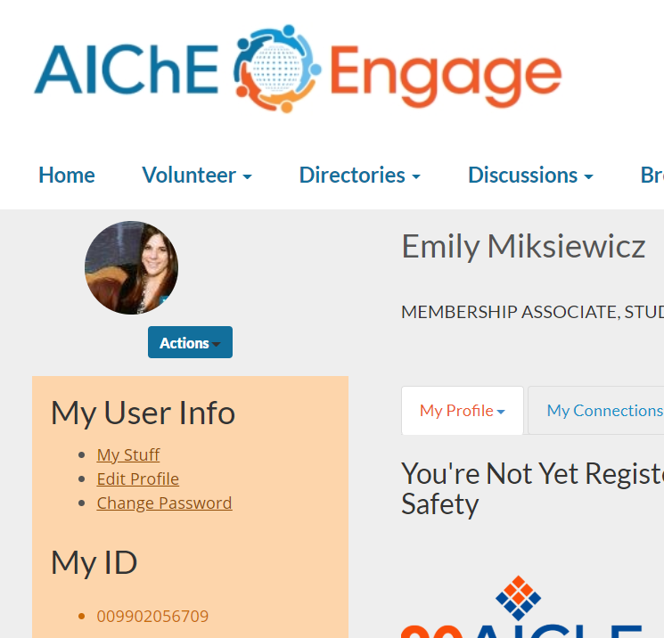
Continue Your Journey With AIChE
Renew your membership.
Existing members can renew here
Find your Member ID on your AIChE Engage Profile
Having trouble? We’re here to help!
customerservice@aiche.org
800-242-4363 (US)
+203-702-7660 (outside the US)
Notes:
To renew:
Make sure you have your Member ID; You can find your Member ID on your AIChE Engage profile. Your Member ID will be on the left side of the screen below your profile picture
Follow the link provided on this slide to renew your membership each year.
Follow the prompts and checkout! It costs $0 to renew your undergraduate student membership.
If you know you have an AIChE account, but are having trouble accessing it, contact AIChE’s Customer Service team. They can help you get access to your existing account so you can avoid creating a duplicate profile.

Slide 6
Update your AIChE Engage profile
Put your best foot forward to the ChemE community.
Update your Engage profile here
Make sure your contact info is up-to date
Verify or update your graduation date
Connect your LinkedIn and Engage profiles
Notes:
AIChE Engage Student Central is an exclusive, undergraduate student discussion forum that allows you to connect with other AIChE student members from around the world. You can post questions about your chemical engineering studies, career goals, or best practices for your student chapter. You can also help other students by answering their questions.
Please note that all AIChE members have profiles listed in the Engage Directory. This is a great platform for potential employers, professors, and peers to access your contact info and reach out to you, so we encourage you to keep your profile up to date.
Doing an annual audit of your contact information and graduation date will ensure that you maintain access to all AIChE student member benefits while you are an undergraduate.

Slide 7
AIChE Newsletter
Make the most of your membership.
Take the following steps to receive this newsletter:
Add customerserivce@aiche.org to your address book
Ensure that your AIChE membership is up to date
If you still aren’t receiving the newsletter, contact customerservice@aiche.org to update your email settings
Access past Newsletters at aiche.org/studentnewsletter
Notes:
The AIChE Student Newsletter is here to help you make the most of your AIChE membership. Each issue includes announcements from the AIChE team, a calendar of upcoming events & deadlines, information about AIChE member benefits and opportunities to do more with AIChE, and student chapter statistics, features, and resources.
To receive the student newsletter directly to you your inbox, be sure to add customerservice@aiche.org to your address book and ensure that your AIChE membership is up to date by logging into your Engage profile
You can also access AIChE Student Newsletters dating back to April 2018 on AIChE’s website.

Slide 8
Follow AIChE on Social Media @ChEnected
Notes:
Make sure to follow AIChE on social media!

