Slide 1
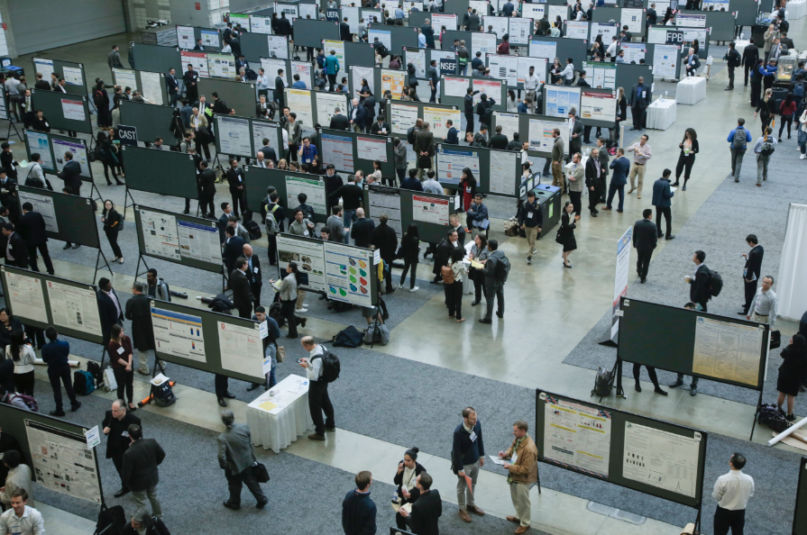
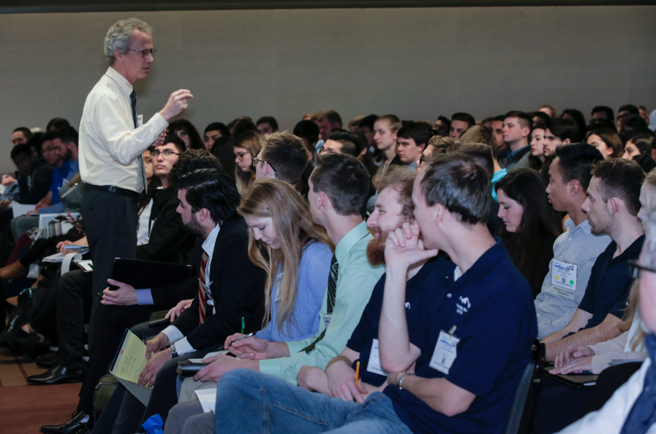
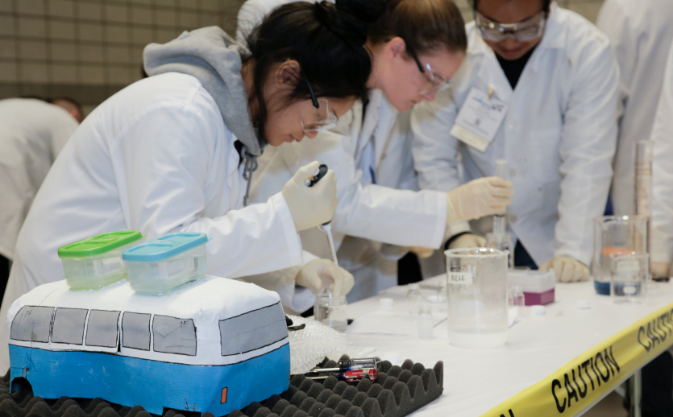
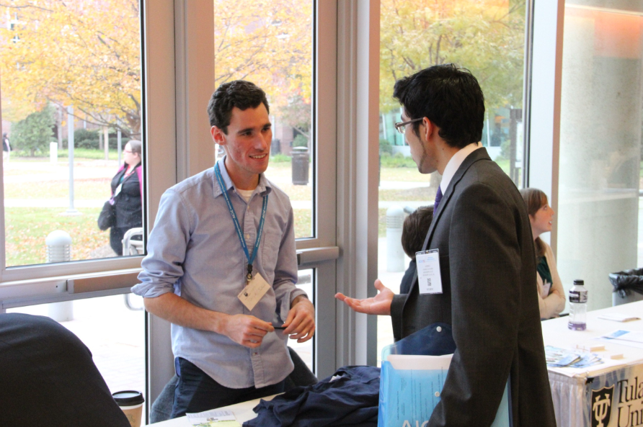
AIChE® Career Services

Slide 2
CareerEngineer
www.aiche.org/careers
Browse jobs and internships
Use the Job Alerts feature
Upload a resume so employers can find you
Notes:
Planning ahead for your career? Smart move. At CareerEngineer, you’ll find internships and jobs at the only job board for chemical engineering undergraduates. Access internships and job openings with ScaleUp sponsors and other industry leaders, use the Job Alerts feature to automatically receive emails when jobs come up that match your criteria, and be sure to upload a resume so employers can find you.

Slide 3
Resume Services
Let us help you improve your resume.
Here’s how:
Upload your resume to CareerEngineer https://careerengineer.aiche.org/resumes/
Opt in to the resume critique service
Look out for an email with suggestions
Notes:
Take advantage of the résumé critique service anytime you upload a résumé. After opting in, an email will be sent to you outlining your strengths and weaknesses, with suggestions on how to ensure that you have the best chance of getting the interview.

Slide 4
Resume Services
Let us send your resume to our sponsors.
Check for emails from AIChE reminding you to submit your resume
Submit your resume here http://www.aiche.org/studentresume
Deadline is 4/12/20 to submit; Sponsors will receive in spring
Only your most recent resume will be shared with sponsors each time, so be sure to submit your updated resume whenever you make changes
Notes:
Did you know AIChE will submit your resume to our sponsor companies (like Chevron and Honeywell UOP) and graduate programs on your behalf? You can submit your resume at any time throughout the year, and resumes will be shared with sponsors once in the spring and up to two times in the fall.
The next time resumes will be shared with our sponsors is in April 2020. To have your resume shared with sponsors at this time, be sure to submit your resume by April 12, 2020. Only your most recent submission received between November 5, 2019 and April 12, 2020 will be shared with AIChE sponsor companies at this time. Be on the lookout for emails from AIChE with future submission timelines.

Slide 5
Recruitment Events
Recruitment Fair at the Annual Student Conference
Meet recruiters representing AIChE ScaleUp sponsors, top grad school programs, and more
Check out the list of 2019 recruiters here
Submit your resume ahead of time (see previous slide) and be considered for on-site interviews
Download the AIChE Events app to start planning
Notes:
Whether you’re an active job seeker or just at the point where you are willing to explore new opportunities, AIChE is the best source for jobs that are targeted to your career goals and experience.
The AIChE Recruitment Fair event will be your chance to decide which path is best for you after graduation. Representatives of graduate schools and companies from across the country will be on hand to describe their degree programs along with job and internship opportunities. You will learn about current research, new and emerging study options and interesting venues for continuing your studies and starting your career.
The Recruitment Fair typically takes place from 9-4 on Sunday of the Annual Student Conference. There, you can hand deliver your resume to recruiters representing AIChE ScaleUp sponsors, top grad school programs, and more. In 2019, nearly 100 organizations were represented at the Recruitment Fair. Click the link on the slide to browse the list of 2019 participating organizations.
Be sure to follow the steps on the previous slide to submit your resume to AIChE. It will be shared with sponsors prior to the fair. Premier recruiters may reach out to you to set up time for an on-site interview during the ASC.
About a month before the conference, our AIChE Events app is updated to include the list of recruiters and a floor plan for the event. You can start planning ahead by bookmarking your favorite companies and graduate schools.
Please note that an Annual Student Conference badge is required to attend this event.

Slide 6
Recruitment Events
Virtual Career Fairs
Visit online booths & chat live with recruiters during our twice yearly Virtual Career Fairs
Pre-register to customize job alerts & upload resume
Check for emails from AIChE containing dates & details of future Virtual Career Fairs
Notes:
Don’t miss out on even more opportunities to connect with potential employers. Attend a Virtual Career Fair and virtually connect with leading employers from a wide range of industries, who are looking for chemical engineering candidates (B.S. through Ph.D.) to fill both entry-level and experienced positions.
Visit online booths to review company profiles and find out about job openings and chat live with recruiters. Be sure to register before the event, create custom job alerts, and build or upload your resume. Remember, AIChE members have an advantage. Member resumes are given “front of the line” placement in the resume database. Plus, employers value AIChE membership as a demonstration of commitment to professional excellence.

