Slide 1
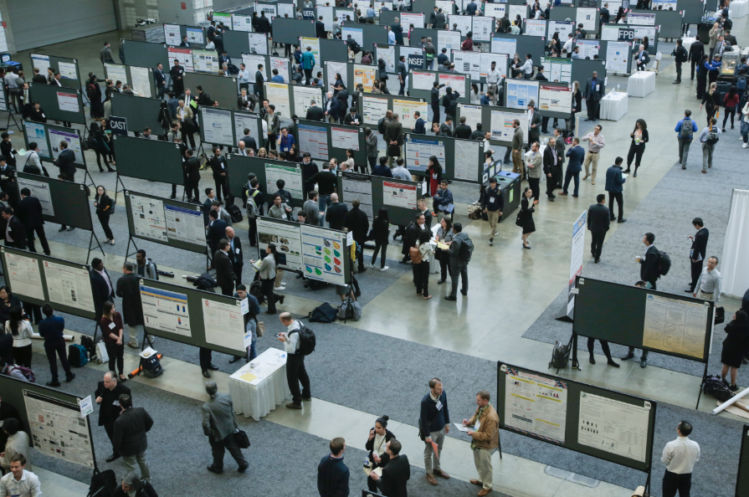
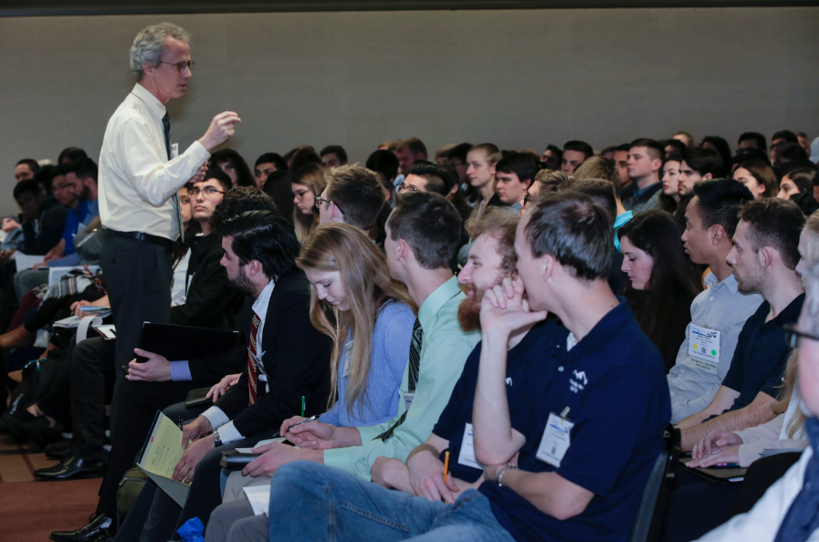
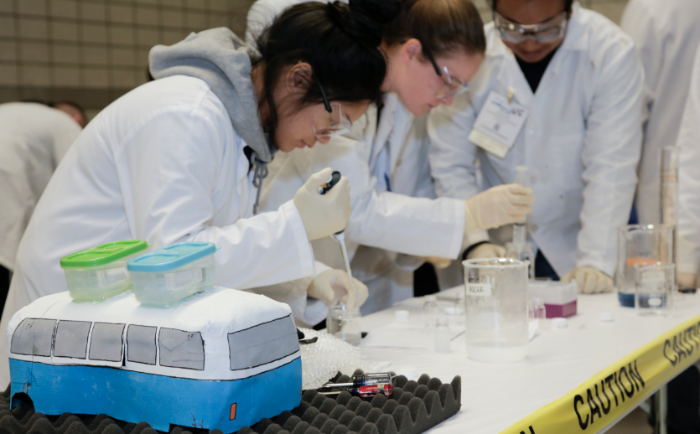
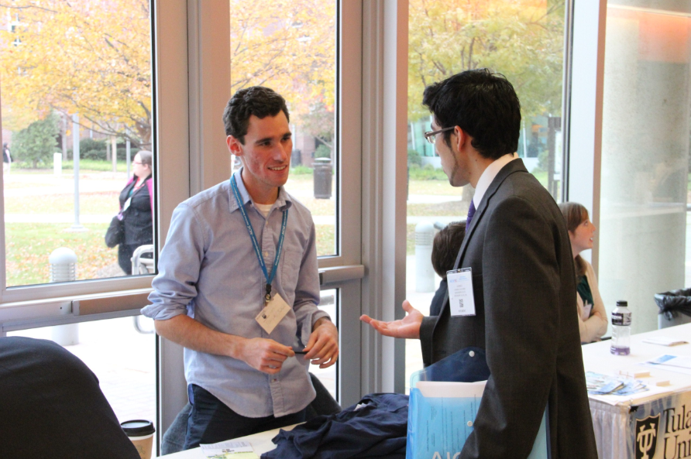
AIChE® Competitions

Slide 2
AIChE Competitions
www.aiche.org/studentcompetitions
Participate to...
Enhance your resume
Show off your hard work in the lab & classroom
Win prize money (and bragging rights)
Grow your ChemE network
Have fun!
Notes:
If you’re serious about some friendly competition, you'll thrive in AIChE's competitions!
Participating in an AIChE competition is a great way for you to:
1. Enhance your resume while showing your ChemE pride
2. Apply what you've learned in the classroom and get an intro to concepts that haven't been covered in your courses yet
3. Show off your hard work in the lab
4. Win prize money (and bragging rights)
5. Connect with your peers and with judges from AIChE's vast network of professionals in industry and academia
And, AIChE offers a mix of virtual and in person competitions as well as individual and team competitions throughout the year.
This presentation highlights some of the competitions that you can still get involved in this year.

Slide 3
Global Undergraduate Student Video Competition
www.aiche.org/studentvideocompetition
Create a 2-5 min. video that explains a Chemical Engineering concept to the general public and inspires future engineers
Total of $2,400 awarded to winners
2020 Competition Topic – The Circle of Life: Plastics Edition
Submissions due June 15th
Check out the 2019 winning video
Notes:
Use creativity and imagination to participate in the AIChE Global Undergraduate Student Video Competition. Student teams will have a chance to create a 2-5 minute video that explains and inspires high school students and communities to learn more about chemical engineers and what they do. Each video will compete to win a judges choice award or a team choice award.
The global reach of the competition will allow the exchange of relevant knowledge between diverse communities and will also enable the exchange of ideas on adaptation of process technology in different countries, highlighting the impact of concerned technologies on societies around the globe.
AIChE is now accepting submissions to the 2020 competition and this year's competition topic is "The Circle of Life: Plastics Edition."
Submissions are due June 15, 2020 and winners will be announced at the Annual Student Conference.

Slide 4
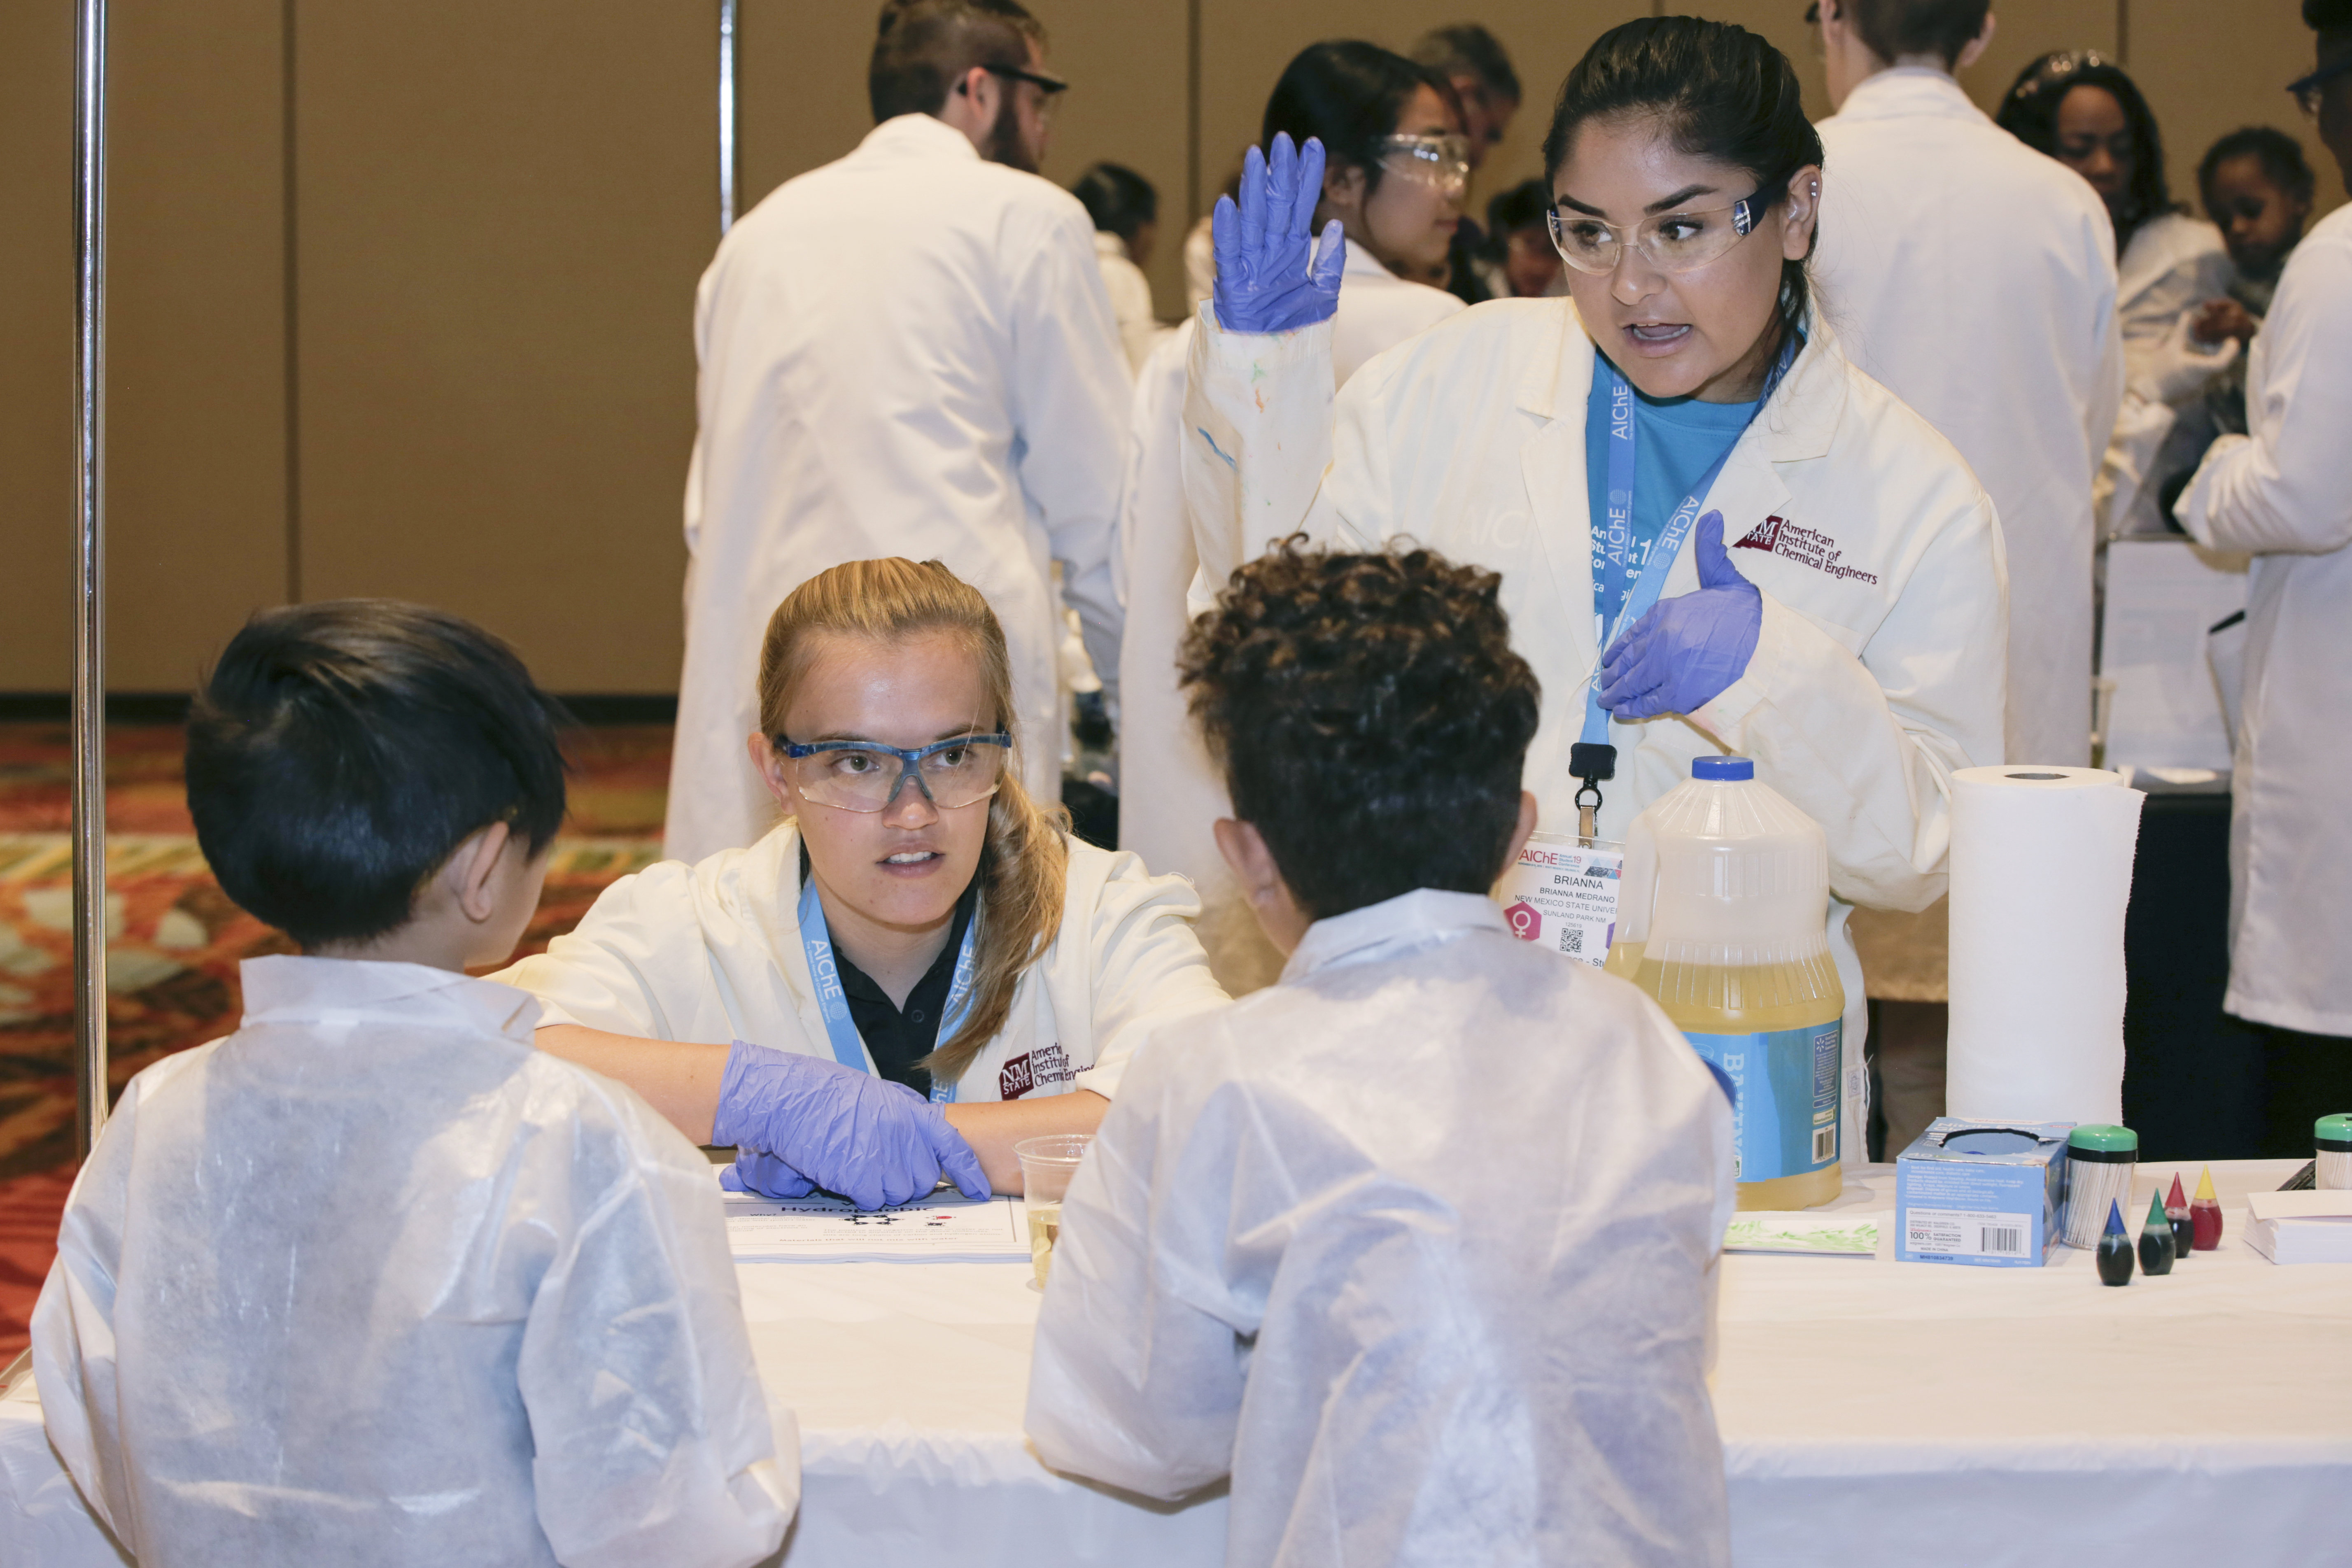
K-12 STEM Outreach Competition
Create & present table-top STEM demo to K-12 students, educators, and parents during the ASC
$500 award for top undergrad student entry
2020 competition information coming in May
Notes:
The AIChEK-12 STEM Outreach Competition serves to connect members of the AIChE & K-12 communities, increase the AIChE community’s engagement in K-12 STEM Outreach, and build & grow a central repository of educational resources for use in K-12 STEM Outreach initiatives.
This competition requires participants to create & present a table-top STEM demonstration to K-12 students, educators, and parents during the AIChE K-12 STEM Showcase at the Annual Student Conference, and students can enter to compete as an individual or as part of a team.
AIChE will release all information for the 2020 competition and start collecting entries in May of 2020 and entries for the 2020 competition will be due on September 1, 2020. All submissions will be reviewed by a team of volunteer judges to determine which entrants will be invited to participate on site at the ASC. Teams will be notified of the decision surrounding their submission in mid-September, and the competition is scheduled to take place on Sunday, November 15, 2020.
The first place student submission will take home $500 and the 1st and second place winners in both the undergrad and professional member categories will receive certificates from AIChE. This is a great opportunity to share your outreach projects with new K-12 communities and to connect with other AIChE members who are passionate about K-12 outreach.

Slide 5
ScaleUp Sponsors Essay Contest
Submit an essay (max 500 words) answering questions on relevant topics in the ChemE industry
$500 awarded by each participating sponsor
2020 competition information coming in June
Notes:
Each year, AIChE's corporate ScaleUp Sponsors award $500 scholarships which may be used as travel stipends for this year's AIChE Annual Student Conference to the winners of this competition. To qualify, students must have a declared major in chemical engineering and complete a written essay in response to one of the prompts from our ScaleUp Sponsors.
This is a great opportunity to have your ideas reviewed by ScaleUp sponsor represenatives from companies like Chevron and UOP. Better yet, winners of this competition will have a chance to meet the sponsor company's representative at the Annual Student Conference and gain exposure with these potential employers.
AIChE will release the 2020 competition information including sponsor essay prompts in June, so stay tuned for more information.

Slide 6
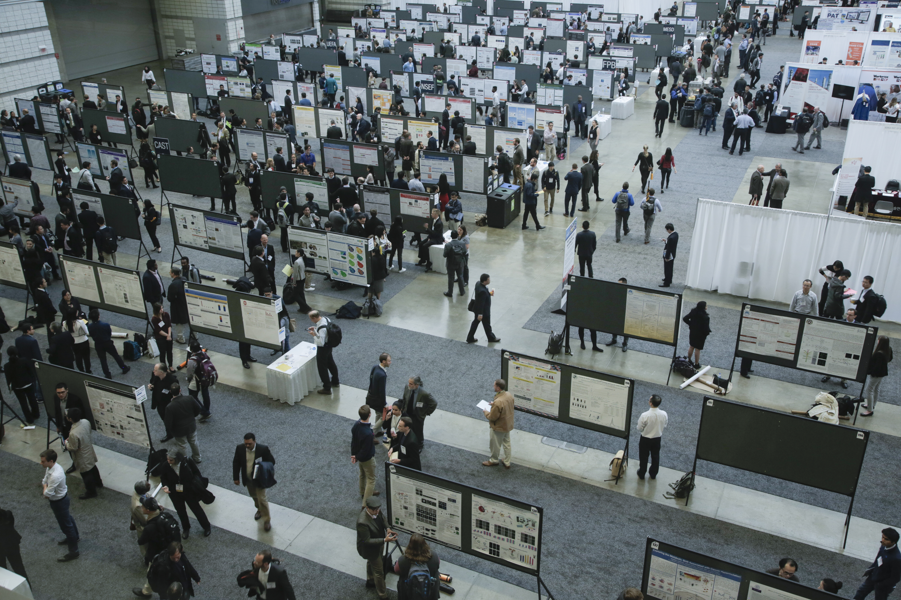
Student Poster Competition
Present your research during the Annual Student Conference and receive professional and peer feedback
Trophies are presented to top 3 winners in each category
2020 competition information coming this summer
Notes:
The Student Poster Competition takes place at the AIChE Annual Student Conference and all undergraduate students are encouraged to submit an abstract to present their research from projects carried out as undergraduate researchers at a University, during an internship, Co-ops or REUs.
Over 400 AIChE student members participate each year, presenting posters on their findings in sustainability, catalysis and reaction engineering, computing and process control, environmental aspects of chemical engineering, as well as food, pharmaceutical, bioengineering, fuels, petrochemicals, energy, materials, separations, among other topics.
Over 100 volunteer judges from industry and academia participate in the event, making this a great opportunity for you receive feedback and grow your network.
AIChE will send an announcement to all AIChE student members once we begin accepting abstracts, and more details about the 2020 competition will be added to our website this summer. Stay tuned for more information.

Slide 7
Other Competitions
AIChE Chem-E-Car Competition®
ChemE Jeopardy Competition
Student Technical Paper Competition (formerly the Student Paper Competition)
Student Design Competition
ChemE Sports Competition
Browse all these student competitions and more at www.aiche.org/studentcompetitions
Notes:
Be sure to attend the Annual Student Conference to watch the top teams from our regional competitions face off in our flagship AIChE Chem-E-Car, ChemE Jeopardy , and Student Technical Presentation Competitions.
If you are already participating in this year's Student Design Competition, don't forget to submit your solutions by the June 12th deadline.
Be on the lookout for more information on the 2nd Annual ChemE Sports Competition, which will take place at the ASC this fall. In this live event focused on optimization and safety, competitors will be given real-life scenarios that could be observed in a plant and an objective to complete the assigned challenge within a given timeframe.
Browse all these student competitions and more at www.aiche.org/studentcompetitions
And, AIChE is always looking for new ways to engage the best and brightest ChemE students in friendly and challenging competitions. Check your inbox to stay up to date on the latest AIChE competition announcements.

Slide 8
Tips & Best Practices
Plan ahead
Review all competition information in detail
Join AIChE & renew your membership annually
Connect with student chapter leaders and research advisors early
Want to start a new team? Get advice on AIChE Engage.
Questions?
Chem-E-Car related? Use the Chem-E-Car Questions Form
Not Chem-E-Car related? Email us at studentchapters@aiche.org
Notes:
Join AIChE & renew your membership annually to ensure that you are eligible for competitions and that you receive competition updates from AIChE in a timely manner. Chapter leaders should also make sure their leadership information is up to date on your chapter's AIChE landing page. Often times, competition related announcements are communicated to student chapter presidents and advisors, so it is important that we have the correct contact information on record.
Find out from your chapter president or advisor if your chapter has any existing teams that you can join. If you are working on research, connect with your research advisor or PI early on to discuss if you are in a position to present your research in the STPC or poster competitions.
If you want to start a new team on your campus, get advice from your peers with successful programs by asking veteran competitors for tips and best practices on AIChE Engage. Even your fiercest competitors want to see you succeed!
Whether you're a veteran or rookie competitor, be sure to review AIChE's competition webpages in detail before entering. If you've reviewed everything in detail and still have questions, for Chem-E-Car, we ask you to use the Chem-E-Car Questions Form and for all other competitions, you can contact us at studentchapters@aiche.org.

