Slide 1
AIChE® Academic Resources

Slide 2
AIChE Academy
www.aiche.org/academy
As a student, get free and unlimited access to the AIChE Academy's archived webinars
Explore:
SAChE Certification
Core Course Bundles
Engineeing Leadership Development curriculum
Notes:
AIChE Academy brings a full array of education and training resources to chemical engineers and the companies they work for. You’ll find courses, webinars, conference presentations and more from AIChE, Center for Chemical Process Safety (CCPS), Society of BIological Engineers (SBE), Institute for sustainaibility (IFS) , and International Society of Water Solutions (ISWS). You can search by topic, availability of CEUs and PDHs, delivery method, skill level - even location.
Advance your technical skills and knowledge as you transition from student to professional. At the AIChE Academy, you’ll find the training and continuing education resources you need to support your professional development — all in one place.
Start learning today!

Slide 3
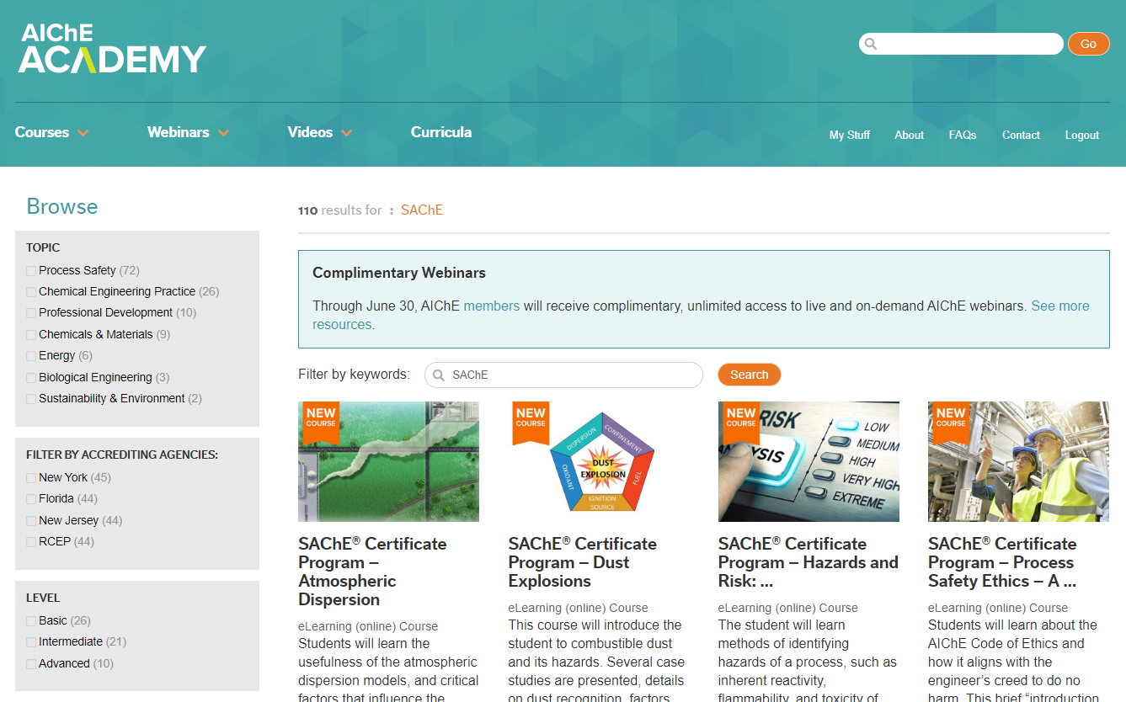
AIChE Academy
Notes:
AIChE Academy brings a full array of education and training resources to chemical engineers and the companies they work for. You’ll find courses, webinars, conference presentations and more from AIChE, Center for Chemical Process Safety (CCPS), Society of BIological Engineers (SBE), Institute for sustainaibility (IFS) , and International Society of Water Solutions (ISWS). You can search by topic, availability of CEUs and PDHs, delivery method, skill level - even location.
Advance your technical skills and knowledge as you transition from student to professional. At the AIChE Academy, you’ll find the training and continuing education resources you need to support your professional development — all in one place.
Start learning today!

Slide 4
AIChE Knovel eLibrary
www.aiche.org/elibrary
Access 300 textbooks, handbooks, standards and databases online or on the Knovel ToGo App
Increase and personalize your productive research using unique analytical tools
Notes:
Looking for an authoritative source of technical information for chemical engineers? The AIChE Knovel eLibrary is continually growing to meet your research and coursework needs.
Enjoy fast, interactive online access to 300 textbooks, handbooks, standards and databases — including expansive materials and compound databases, on-demand training videos, graphing tools and more as you manipulate, share and integrate verified data into your research. And, the Knovel eLibrary’s mobile app is fully integrated with your research and saved materials so you can access your projects on demand.
Knovel increases your productive research of leading technical handbooks, materials, and critical databases using Knovel’s unique analytical tools including interactive graphs, tables, unit converter and periodic chart. Knovel is even better today with some of its most significant updates yet!
Personalization: MyKnovel is expanded to provide instant access to recent searches & views, saved content (including content saved on mobile devices), printed & downloaded content
Upgraded Search: Refine By filter lets users narrow down broad search queries that otherwise result in large, unfiltered Search Results. A suggested focused set of concepts is offered, too.
Enhancements to Search: Auto-Suggest, New Content Type, and Definitions features refine search results and simplify access for those wanting a definition / encyclopedic entry for background
NOTE: AIChE Membership is required to access the Knovel eLibrary, so make sure your membership is renewed! To access the Knovel elibrary through the app, you'll need the Mobile Authentication Code. This code can be acquired through your account on the Knovel website

Slide 5
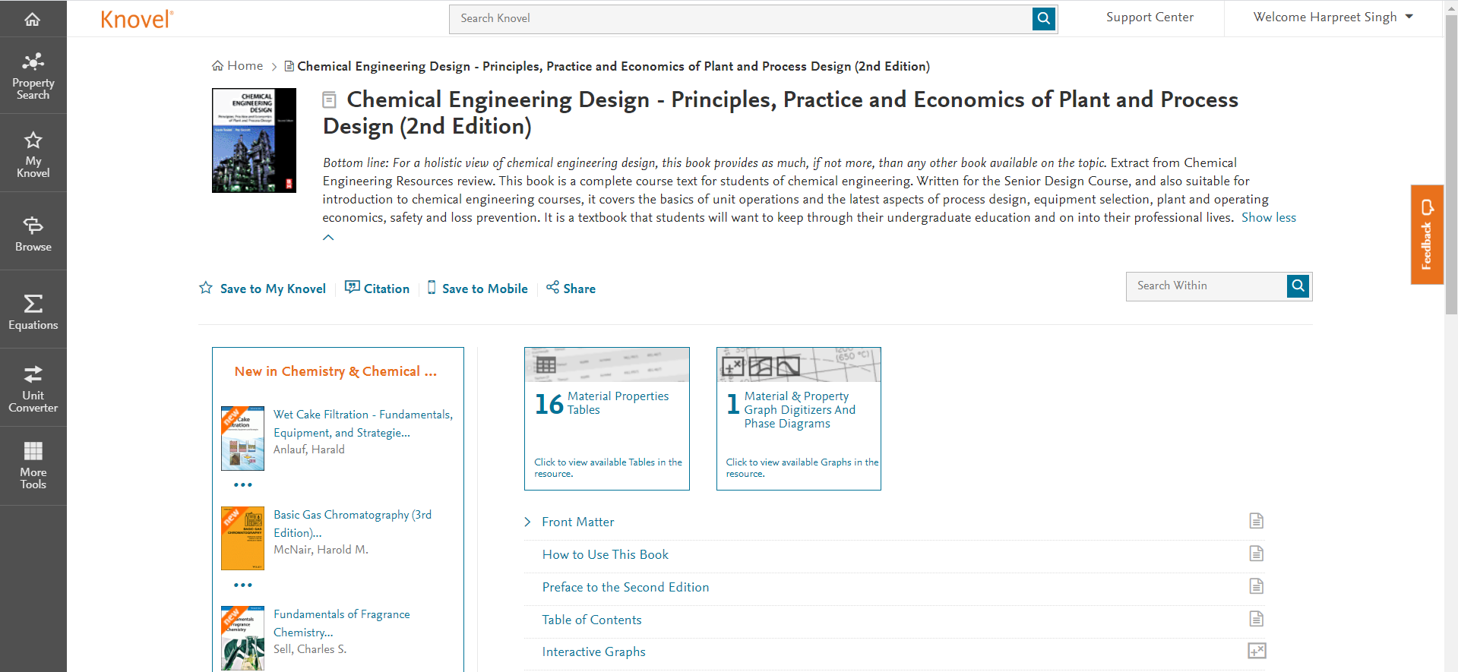
AIChE Knovel eLibrary
Notes:
Looking for an authoritative source of technical information for chemical engineers? The AIChE Knovel eLibrary is continually growing to meet your research and coursework needs.
Enjoy fast, interactive online access to 300 textbooks, handbooks, standards and databases — including expansive materials and compound databases, on-demand training videos, graphing tools and more as you manipulate, share and integrate verified data into your research. And, the Knovel eLibrary’s mobile app is fully integrated with your research and saved materials so you can access your projects on demand.
Knovel increases your productive research of leading technical handbooks, materials, and critical databases using Knovel’s unique analytical tools including interactive graphs, tables, unit converter and periodic chart. Knovel is even better today with some of its most significant updates yet!
Personalization: MyKnovel is expanded to provide instant access to recent searches & views, saved content (including content saved on mobile devices), printed & downloaded content
Upgraded Search: Refine By filter lets users narrow down broad search queries that otherwise result in large, unfiltered Search Results. A suggested focused set of concepts is offered, too.
Enhancements to Search: Auto-Suggest, New Content Type, and Definitions features refine search results and simplify access for those wanting a definition / encyclopedic entry for background
NOTE: AIChE Membership is required to access the Knovel eLibrary, so make sure your membership is renewed! To access the Knovel elibrary through the app, you'll need the Mobile Authentication Code. This code can be acquired through your account on the Knovel website

Slide 6
AIChE Student Handbook App
www.aiche.org/studenthandbook
Put a Chemical Engineering expert in your pocket with handy references to technical facts, fundamental data and formulas
Download today to start searching and bookmarking
Notes:
Put a Chemical Engineering expert in your pocket with AIChE's handy reference to technical facts, fundamental data and formulas.
The AIChE Pocket Handbook makes available some of the more important chemical, biological, physical, safety, and mathematical data and concepts that are fundamental to the practice of the chemical engineering profession. With these principles you should be able to solve many chemical engineering problems.
NOTE: Your AIChE Username and password are required to access the app once downloaded

Slide 7
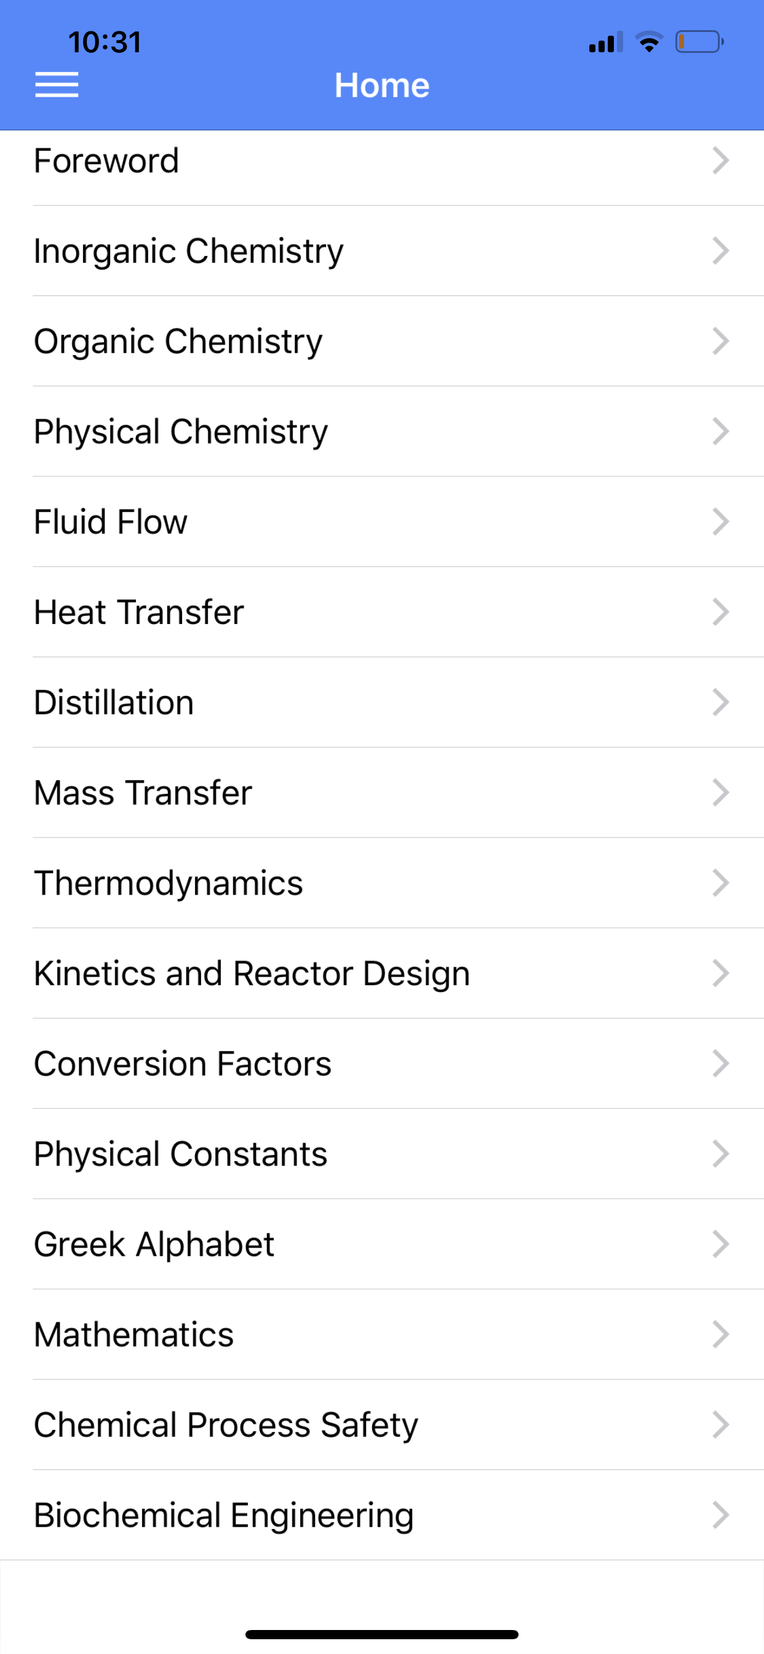
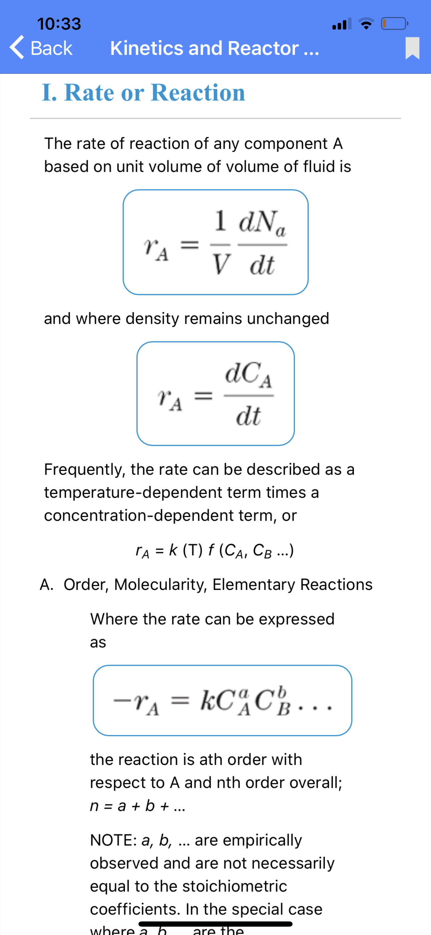
AIChE Student Handbook App

