Slide 1
Shell Upstream
HSE Case, Managing Risk
Glen Worobets
Process Safety Assurance Manager, Upstream Unconventionals

Slide 2
Shell - Hazards and Effects Management Process

Slide 3
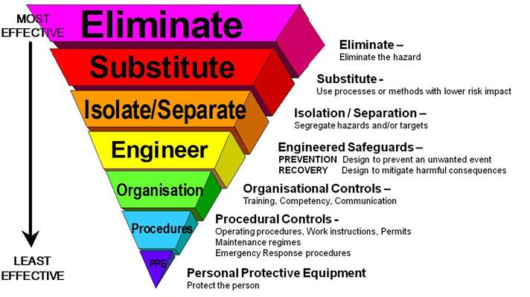
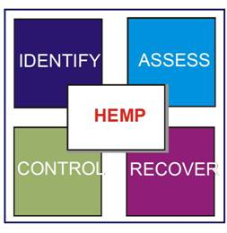
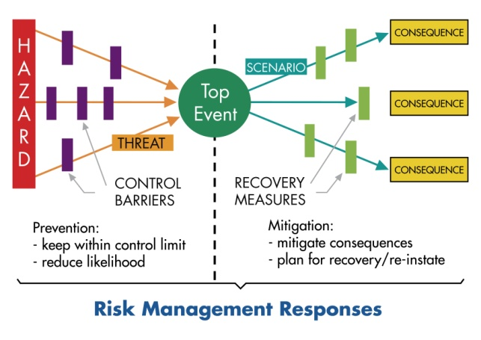
Shell Upstream - Managing HSSE&SP Risk
Hazards and Effects Register
Hazards and Effects Management (HEMP)
Manage Hazards according to the Risk level
Eliminate or Substitute where Practicable
Identify Control & Recovery
Measures
Hazard Identification and Assessment
Identify all HSSE&SP Hazards relating to activities (HAZID)
People, Assets Environment, Reputation
Assess Risk of Worst Case Credible Scenario
Documented
Maintained
HSE Operating Case
Bow-Tie Analysis
Identify Barriers (prevent, reduce conseq.)
Critical Activities to maintain Barriers,
Critical Equipment & Performance Criteria
Remedial Action Plan
Assess the barriers.
  e.g. LOPA, QRA etc.
Operations HSSE Case
Document Bow-Tie Analysis
Document determination that risks are mitigated
Starts in Select and continues through to Operate

Slide 4
Shell Upstream - Managing HSSE&SP Risk
HER (Hazard and Effects Registry)
Summary of MH (Major Hazards)
Facility Overview / Description (Scopes the Case)
Organizational Structure
    HSE Critical Tasks
    Emergency Response
    Change Management (MoC)
HEMP assessment and outcome
    HER
    PHA summary findings and actions
    Bow-tie assessments
    SCE list (Safety Critical Equipment)
    Risk management demonstration
HSE Operating Case

Slide 5
Questions and Answers

