Slide 1
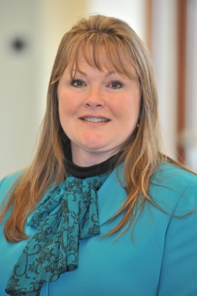
8th Latin American Conference on Process Safety
6th CCPS China Conference on Process Safety
Louisa A. Nara
Global Technical Director
The Global Community Committed to Process Safety

Slide 2
8th Latin American Conference
Held at Universidad Catolica Argentina in Buenos Aires
140 people attended the Metrics and CCPS Tools pre-conference workshop
325+ individuals attended the conference
16 countries
11 Exhibitors

Slide 3
8th Latin American Conference
International keynote speakers (IOGP - Australia, US - CSB, Wilis Risk Insurers –UK, NFPA – Argentina; US – Chevron; AICHE – Executive Director)
High Quality Technical presentations
Competency panel discussion
LinkedIn stats for the 8th LACPS post
10,250 views
83 Likes
2,509 followers
TSC meeting held during conference

Slide 4
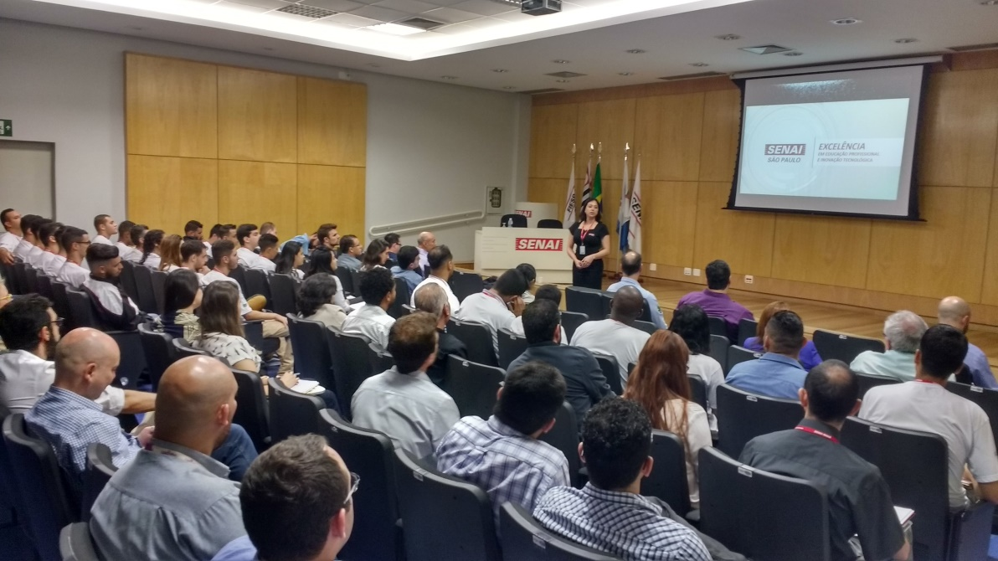
LOW COST PROCESS SAFETY KNOWLEDGE SHARING EVENTS
WHAT IS NEEDED TO HAVE A PROCESS SAFETY EVENT?
People interested in the subject
Knowledgeable Speakers on PS topics
Meeting place + Water + Coffee + Restroom
Lunch arrangements
Interaction between participants
Someone to put all this together
São Paulo – march 2018
4
The Global Community Committed to Process Safety

Slide 5
PARTICIPANTS
The Global Community Committed to Process Safety

Slide 6
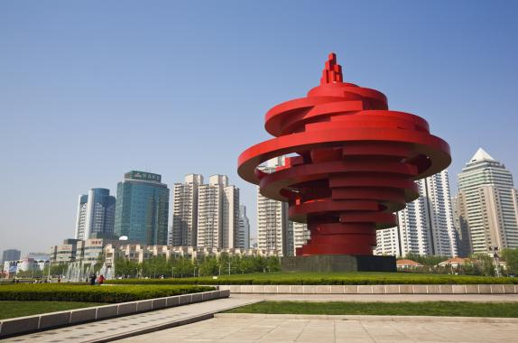
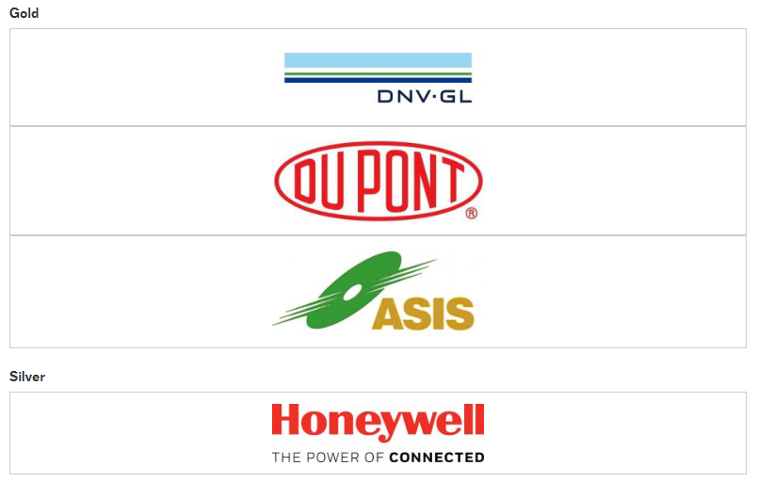
6th CCPS China Conference on Process Safety
September 25-27, 2018
Howard Johnson Kangda Plaza Qingdao
14 Keynote Speakers
56 Presenters
Topics
Implementing PSM in China and other Countries (2)
LOPA and SIS (2)
Mechanical Integrity (2)
Good Practices (2)
Process Safety Technology
Accident Analysis & Investigation
Risk Analysis & Management
Environmental Protection &
Energy Conservation

