Slide 1
CCPS Membership
Presentation for Canadian Regional Meeting
September 20, 2018
Michele Horwitz
CCPS Membership Manager
michh@aiche.org
646-495-1371

Slide 2
Why Process Safety?
CCPS Member Companies collectively working together to address this Business Imperative

Slide 3
CCPS Canadian Members

Slide 4
Welcome Canadian Companies in Attendance
ACM Facility Safety
Alberta Energy Regulator
Aon Affinity Insurance Services
Canadian Natural Resources, Ltd.
Cleartech Industries
DNV GL
Husky Energy
Icarus - ORM
Inter Pipeline
National Energy Board
Nexen, Inc.
Nova Chemicals Corporation
NWA Partnership
Parkland Refining (BC) Ltd.
Petrochina Canada
Plains Midstream Canada ULC
Resolute Risk Management Services
Risk Alive Analytics
Shell Canada Ltd.
Sovereign General Insurance Company
Strathcona County
Suncor Energy
Syncrude
TransCanada
XL Catlin Canada

Slide 6
200 Global Corporate Members!
“The Global Community Committed to Process Safety”

Slide 7
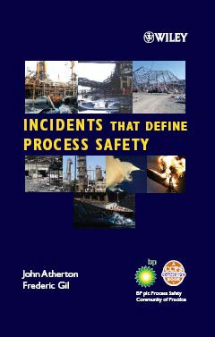
CCPS Project Areas
Concept Books: Good introduction to subject, textbook

Slide 8
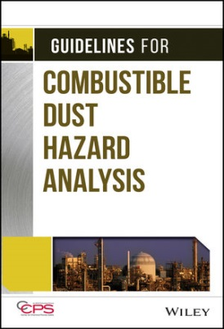
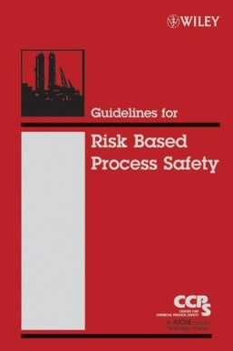
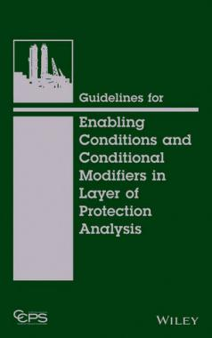
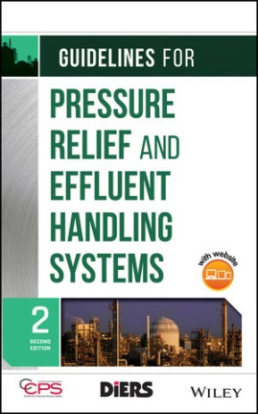
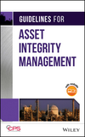
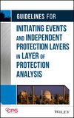
CCPS Project Areas
Guideline Books: In depth guidance

Slide 9
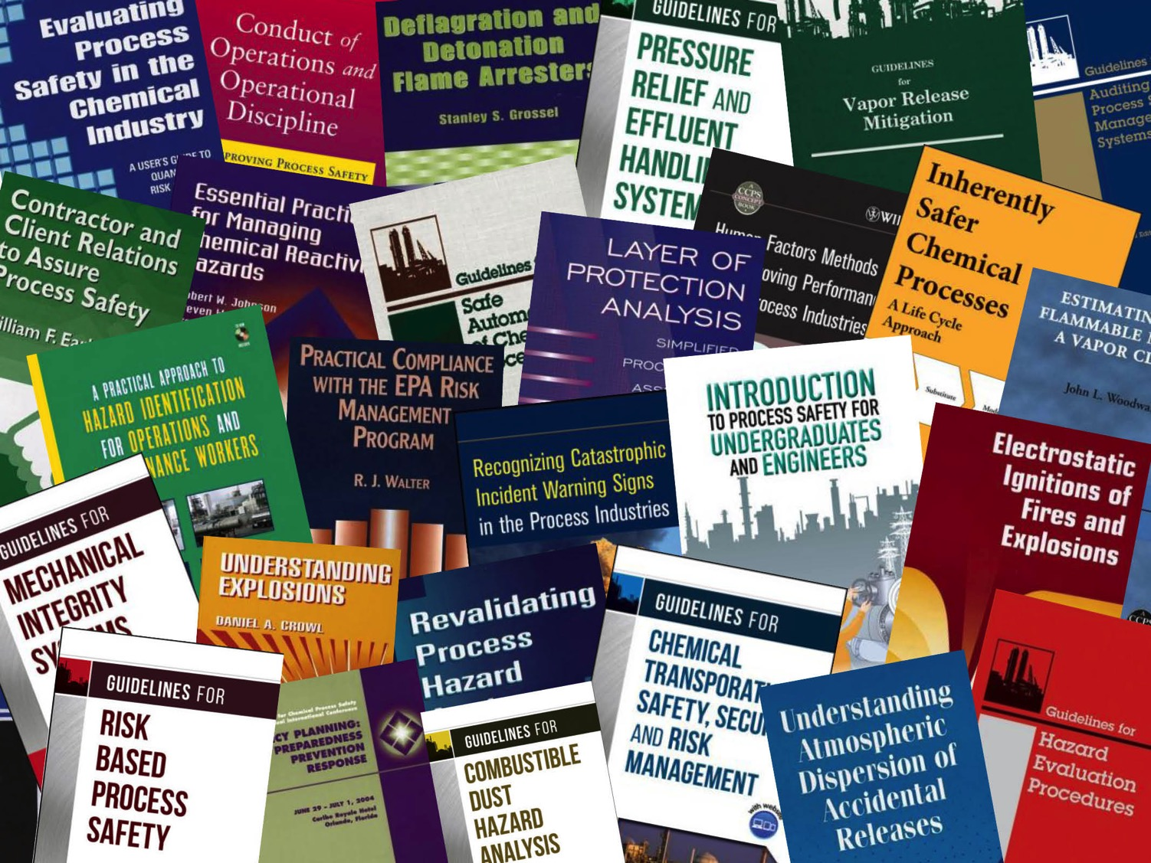

Slide 10
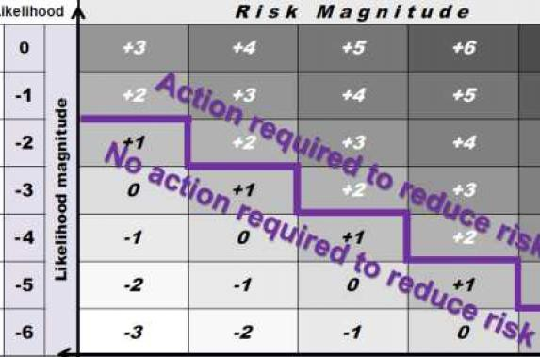
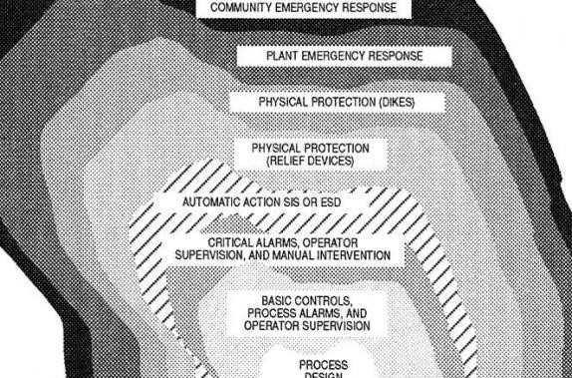
Class Room and E-Learning Course Content
HAZOP Studies and other PHA Techniques for Process Safety and Risk Management
Layer of Protection
Analysis (LOPA)

Slide 11
CCPS Holds Meetings to Get Key Stakeholders Inputs and Sharing
Technical Steering Committee Meetings (4-5 annually)
One in-person meeting following Global Congress on Process Safety
2-3 via web conference
One in-person meeting in the fall
Regional meetings (1-3 annually per region)
Advisory Board Meeting (1 annually F2F and 2 virtual]
Project committee meetings (as needed)
Typical project meets monthly by web conference for 1-3 hours
One in-person meeting/year for duration of project

Slide 12
CCPS E-library
Partnership with Knovel
https://www.aiche.org/ccps/resources/overview/plus-knovel
CCPSonKnovel@elsevier.com
CCPS e-library (available to all, from Knovel)
All CCPS books available at all designated corporate workstations
CCPS+ e-library (members only, from CCPS)
All CCPS books, additional process safety books, process safety proceedings, Process Safety Beacon

Slide 13
Process Safety Incident Database (PSID)
Also known as “Lessons-Learned Database”
Collection of learning's from incidents and near-misses
Useful for hazard analysis, incident investigation, process design, and training
Only active PSID participants may view PSID database
All CCPS Members [manufacturing companies] receive PSID as a membership benefit at no cost.

Slide 14
Training / Continuing Education
Process Safety Boot Camp
4 day course intended for those new to process safety (or in need of refresher)
Taught by 30+ year veterans
Presented at company site, related to company goals and objectives

Slide 15
Training / Continuing Education
Course title | Days
Risk Based Process Safety | 2 or 3
Mechanical Integrity for Process Safety | 2
Incident Investigation | 3
Layer of Protection Analysis / Safety Instrumented Systems | 3
Human Factors for Safety and Improved Performance | 2
Process Safety Auditing – Classroom | 2
Process Safety Auditing – Classroom with Facilitated Audit | 4
Management of Change and Pre-startup Safety Review | 2
Process Hazard Analysis | 2 or 3
Customized topics per company preference | As required

Slide 16
More than a million readers
31 languages
Delivered monthly
Just celebrated 16th anniversary of publishing
“The Global Community Committed to Process Safety”
Notes:
CCPS also publishes the Process Safety Beacon, a monthly lesson for operations staff. The Beacon is published in 31 languages and read by more than 1 million people. Whenever you visit your facilities, look for the Beacon posted in common areas and control rooms, and if you don’t see it, you should ask why not.
A new series of awareness publication, Process Safety Moments is also being launched. These will be presentations which can be used in safety meetings or as the initial safety discussion that many companies use to launch general business meetings

Slide 17
Special Benefits to CCPS Members
Design Institute for Physical Properties (DIPPR) Membership
All CCPS Members receive a 10% discount. (www.aiche.org/dippr)
Training: Discount on all training.
20% discount on Process Safety Boot Camps
Conference registration
$200 discount for the Global Congress on Process Safety.
Job Postings
10% off AIChE Job Board list price postings
Participation
“The Global Community Committed to Process Safety”

Slide 18
Special Benefits to CCPS Members
Involvement and participation on Technical Projects
Voting on new projects to enhance process safety initiatives worldwide
Free postings in the Professional Services Directory (if applicable)
Participation
“The Global Community Committed to Process Safety”

Slide 19
Special Benefits to CCPS Members
CCPS Books: All CCPS Members receive a copy(s) of all newly published CCPS books after the start of their membership.
35% discount on all CCPS/AIChE books through Wiley.
To make use of this benefit, please visit the Wiley website and www.wiley.com/go/ccps and enter CCPS1 at checkout (includes international).
Receive 3 FREE Sessions for any person in your company on newly launched CCPS eLearning Courses. To access this benefit, each TSC Representative must email Customer Service or email their requests to CCPS and send the 3 participants information.
CCPS+ online book library: 35% from list price offered through Knovel
“The Global Community Committed to Process Safety”

Slide 20
CCPS Staff
Shakeel Kadri – Executive Director
Louisa Nara – Global Technical Director
Anil Gokhale – Projects Director
Michele Horwitz – Membership Manager
Orlando Acosta – Latin American Regional Manager
Umesh Dhake – Asia-Pacific Regional Manager
Willi Meier – European Regional Manager
Jing Chen – Senior Engineering Specialist, GCPS Conference Manager, China Liaison
Rukyah Hennessey – Senior Engineering Specialist, Staff Liaison: Pharmaceutical, Food and Fine Chemical Subgroup
Bruce Vaughen – Lead Process Safety Subject Matter Expert
Shami Nayak – Asia Pacific Regional Associate
Christa Pennino – Engineering Associate
Plus…
“CCPS China Section”
Staff Consultants

Slide 21
On Behalf of the
Center for Chemical Process Safety We Thank You for Your
Time and Attention!
Questions?

