Slide 1

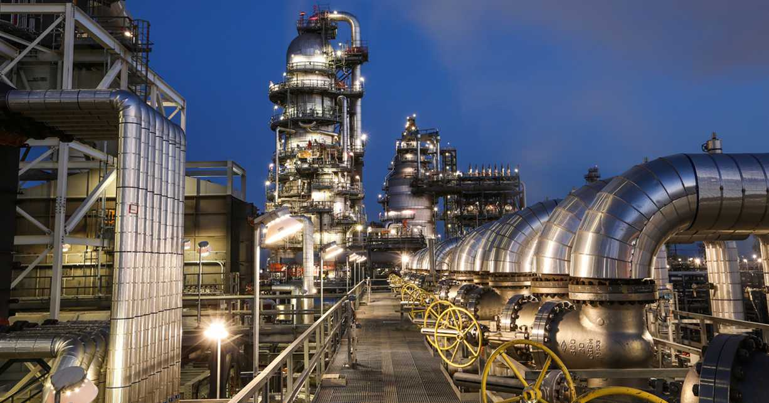
3rd CCPS Canada Regional Meeting
Calgary, Alberta, 20 September 2018
Hosted by:

Slide 2
20 September 2018
AGENDA - AM
Time | Subject | Leader / Speaker
08:30 | Arrival/Networking | (Breakfast available at 8:00)
08:40 | Safety Briefing | Della Wong, CNRL
08:50 | Welcome | Pamela McIntyre, CNRL Senior VP of Safety, Risk Management & Innovation
09:00 | Self-Introductions / Roll Call
09:15 | Welcome Note | Shakeel Kadri, Executive Director, CCPS
09:30 | Foam Chambers for Tank Fire Protection; Technical Performance Standard | Connor Murray, CNRL
10:00 | CSChE Process Safety Management Division Update | Jyoti Patel, PSMD Chair
10:15 | Break
10:30 | CCPS Membership Overview | Michele Horwitz, Membership Manager, CCPS
10:45 | CCPS Review 2018 and plan for 2019 | Shakeel Kadri, Executive Director, CCPS
11:15 | Safety Case Discussion | Tom Guest, Nexen / Glen Worobets, Shell / Fred Henselwood, NOVA Chemicals
12:15 | Lunch

Slide 3
20 September 2018
AGENDA - PM
Time | Subject | Leader / Speaker
13:00 | Member Sharing/Incidents | All
13:30 | CCPS Projects update – via WebEx | Anil Gokhale, Director, CCPS Projects
14:00 | Regional CCPS Projects: engagement and needs | Fred Henselwood, NOVA Chemicals Shakeel Kadri, Executive Director, CCPS
14:30 | 2019 CCPS Project Ballot Review – via WebEx | Rukyah Hennessey, CCPS Senior Engineering Specialist
14:45 | CCPS Technical update – via WebEx | Louisa Nara, CCPS Global Technical Director
15:00 | Break
15:15 | CCPS Key Initiatives update | Shakeel Kadri, Executive Director, CCPS
16:00 | Risk Intelligence for PSM An evolution in thinking about risk assessment | Beth Chisholm, VP Operational Risk, ACM Risk Sciences & Development
16:30 | 2019 Canada Regional Meeting – Calgary Date and Host
16:45 | Round table discussion – open sharing | All
16:55 | Closing Comments | Shakeel Kadri, Executive Director, CCPS
17:00 | Meeting Adjourned

Slide 4
Presentation outline..
About CCPS®
Our Regional Engagement
Our New CCPS members
Global / Regional Conferences and Workshops
Global Responsible Collaboration
CCPS Organization
Q&As

Slide 5

About CCPS
Formed on 23 March 1985
Not for profit organization; part of AICHE
Corporate supported – over 200 members
Global scope and mission; 40% of members outside of USA
Focus: preventing process incidents: fires, explosions, and toxic releases
Petroleum production, refining, chemicals, pharma, chemical users
Headquarter s in New York City, with offices in Frankfurt, Mumbai, Singapore, Ningbo [China] and Houston.
Notes:
How well you manage day to day activities in preventing worker injuries can be an indicator of how well you manage your safety systems. Attention to detail is important and a challenged and trained workforce can contribute a lot to prevention or mitigation of process safety incidents.

Slide 6

CCPS Vision
“To protect people, property and the environment
by bringing the best process safety knowledge and practices to industry, academia, the governments and the public around the world through collective wisdom, tools, training and expertise.”

Slide 7
CCPS Mission
Eliminate catastrophic process incidents globally by:
Advancing global PS technologies, culture, and management practices
Establishing Process Safety as foundation for responsible operation
Serving as premier worldwide resource of Process Safety
Fostering knowledge and understanding of Process Safety
Promoting Process Safety as key societal value and expectation

Slide 8
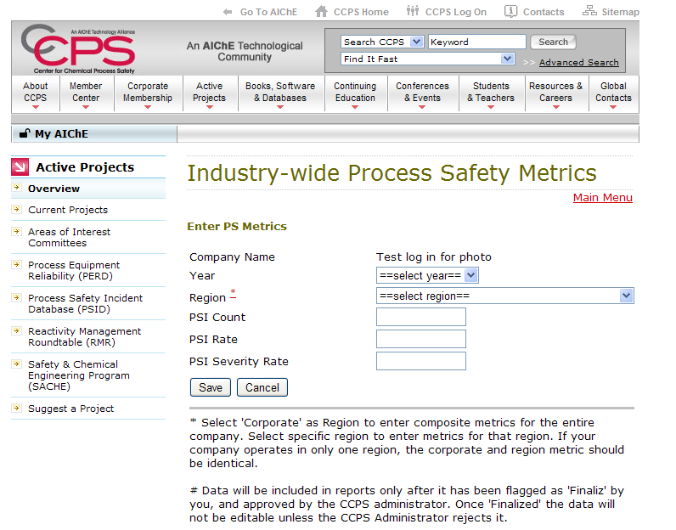
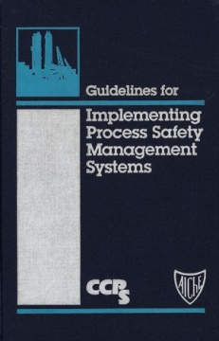
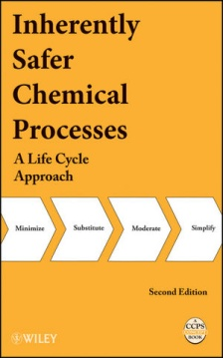
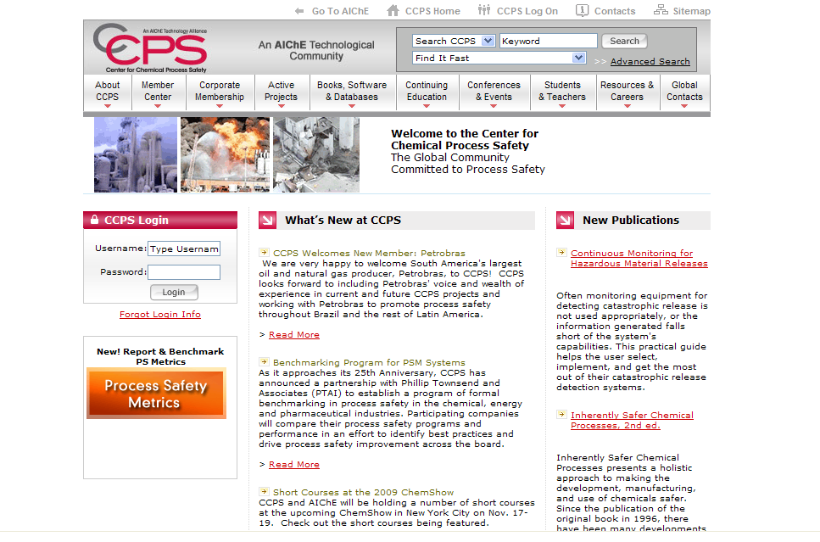
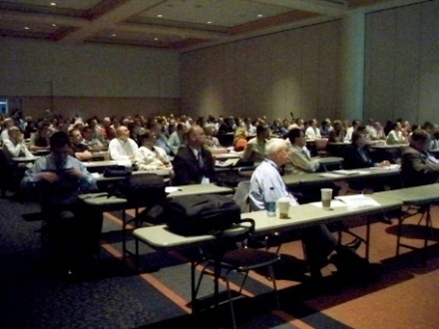
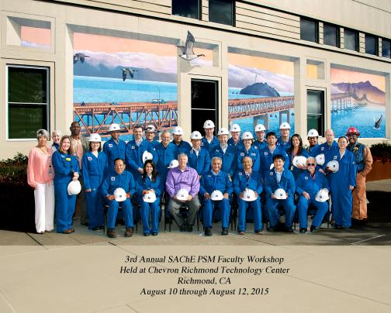
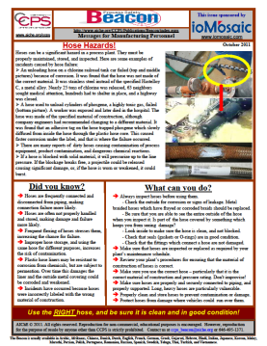
Leading Process Safety
since 1985
Creating Industry-wide
Tools, Programs and Guidelines
CCPS Certified
CCPSC
Creating Books and Publications
Sharing Best Practices
Educating Educators
Process
Safety
Beacon
16 YEARS!!
Conducting Global Conferences
and Training

Slide 9
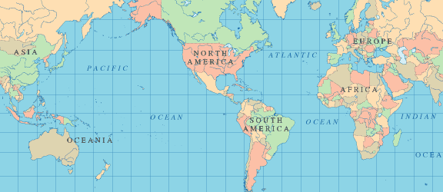
2018 Regional Engagement…
Technical Steering Committee Meetings
Canada Regional –East & West
Europe TSC
China TSC
Global TSC
Pakistan Regional
Asia-Pacific TSC
T&T Regional
India TSC
Latin America
TSCs
9
The Global Community Committed to Process Safety

Slide 10












2018 -- New CCPS Members
North America
Inter Pipeline
Intel Corporation
Parkland Refining (BC) Ltd.
Trinseo
Syncrude
United Natural Foods, Inc.
International
Ambatovy
Arlanxeo
China Chemical Safety Assn.
Deccan Fine Chemicals (I) Pvt. Ltd.
Hengyuan Refining Co. Berhad
Kuwait Oil Company
Lloyd’s Register Group, Ltd.
Michelman Inc.
Nghi Son Refinery and Petrochemical, LLC
Promigas
Sahara Petrochemicals Company
Saudi International Petrochemical Co.
Shenyang Research Institute of Chemical Industry Co., Ltd.
Wanhua Chemical Group Co., Ltd.

Slide 11
2018 -- CCPS Conferences / Workshops
14th Global Congress in Process Safety held in Orlando, FL
8th CCPS Conference in Latin America, Buenos Aires, Argentina
6th China Conference, Qingdao, China
3rd Europe Process Safety + Big Data Conference, Frankfurt, Germany
Process Safety Metrics - API-754 Metrics Implementation workshop, Jubail, Saudi Arabia [Hosted by SABIC]
Process Safety Metrics - API-754 Metrics Implementation workshop, Al-Khobar, Saudi Arabia [Hosted by Saudi Aramco]
Pre-workshop at the 6th China Conference, Qingdao, China
Process Safety Metrics workshop, Buenos Aires, Argentina
The Global Community Committed to Process Safety

Slide 12
2019 CCPS Conference Plan
15th Global Congress in Process Safety held in New Orleans, LU
7th China Conference, China
4th Europe Process Safety + Big Data Conference, Frankfurt, Germany
5th CCPS Global Summit, Singapore
3rd Middle East Process Safety Conference [MEPSC], ME
We will be deploying Process Safety Metrics - API-754 Metrics Implementation workshop at 2-3 locations during 2019
The Global Community Committed to Process Safety

Slide 13
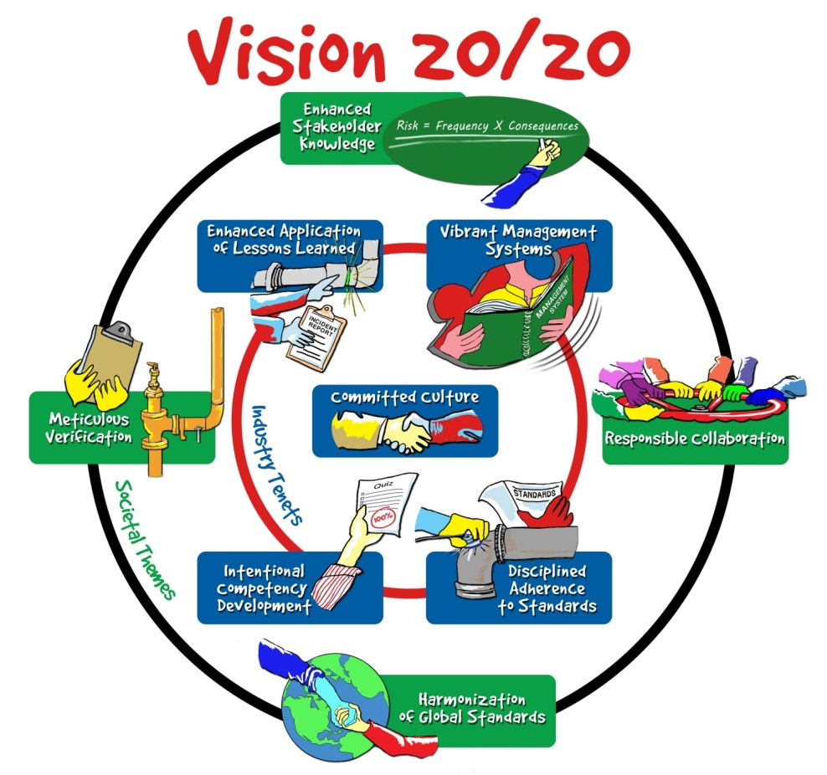

Slide 14
Responsible
Collaboration
Organization | Collaborating activity
Energy Institute [EI] | Bow Tie Guideline Book
Society of Petroleum Engineers [SPE] | Process Safety for Upstream Guideline Book
American Chemical Council [ACC] | Enhancing Process Safety effort
Japan Society for Safety Engineering [JSSE] | 4th Global Summit, Okayama, Japan
European Process Safety Center [EPSC] | Europe PS + Big Data Conference, Frankfurt
EPSC + Dow Chemicals | RAST [Risk Analysis Screening Tool]
IChemE, MKO, EPSC and WPLP | 2017 WCCE-10 Barcelona PSM Track
Singapore Chemical Industry Council | MOU signed; 6th Global Summit [2019]
PERTAMINA University [Indonesia] | MOU signed
Universiti Teknologi Petronas [UTP] University [Malaysia] | 2nd Global Summit
OSHA | CCPS Risk Based Process Safety elements as best practices reference on the OSHA Web Tool
Chemical Safety Board [CSB] | Potential CCPS-CSB collaboration on developing video modules using CCPS content

Slide 15
6/28/2018
Shakeel Kadri
Executive Director,
CCPS
Louisa Nara
CCPS
Global Technical
Director
Michele Horowitz
CCPS
Membership Mgr.
Orlando Acosta
CCPS
Latin America
Manager
Umesh Dhake
CCPS
Asia-Pacific & ME
Manager
Willi Meir
CCPS
Europe
Manager
Anil Gokhale
Director,
CCPS Projects
Horst Massong
Europe
Project Manager
Jing Chen
Sr. Engineering
Specialist
Rukyah
Hennessey
Sr. Engineering
Specialist
Bruce Vaughen
Lead PS SME
Christa Pennino
Engineering
Associate
Shami Nayak
A-P Business
Development
CCPS
A-P Staff
Consultant
Staff
Consultant
Staff
Consultant
Staff
Consultant
Staff
Consultant
CCPS
A-P Staff
Consultant
DIERS
Staff
Consultant
Staff
Consultant
Staff
Consultant
Staff
Consultant
Lead Process Safety/Project
Engineer [Open]
CCPS Staff
Staff
Consultant
Staff
Consultant
Staff
Consultant
Staff
Consultant
The Global Community Committed to Process Safety

Slide 16

Process Safety Journey to Excellence
v
Standards and Procedures
Process Safety Management Systems
Behaviour
Visible leadership
Personal accountability
Shared purpose & belief
Aligned performance & commitment
Standards
Technical requirements
Safety emphasis
Compliance
Process Safety Risk Based Approach
PSM Incident / Severity Rate
Integrated MS
Reporting
Assurance
Competence
Risk Management
Visible Leadership
Learning Process
Risk Quantification
“Risk” Process
External View
Strong PSM Culture
Standards Based
What must I do?
Systems Based
How must I do?
Risk Based
How can I improve?
Culture Based
How can I Lead?

Slide 17
Questions?

Slide 18
CCPS Key Initiatives
Shakeel Kadri

Slide 19
Presentation outline
Undergraduate Process Safety Learning Initiative [UPSLI]
CCPS Credentialing [CCPSC]

Slide 20
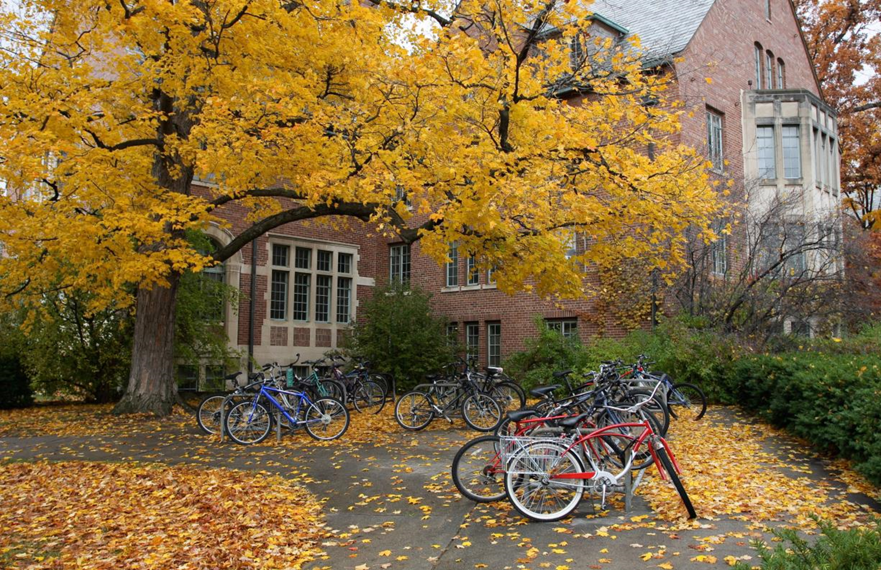
Undergraduate Process Safety Learning Initiative [UPSLI]
VISION
“To accelerate process safety education and
better prepare graduates for the workforce”

Slide 21
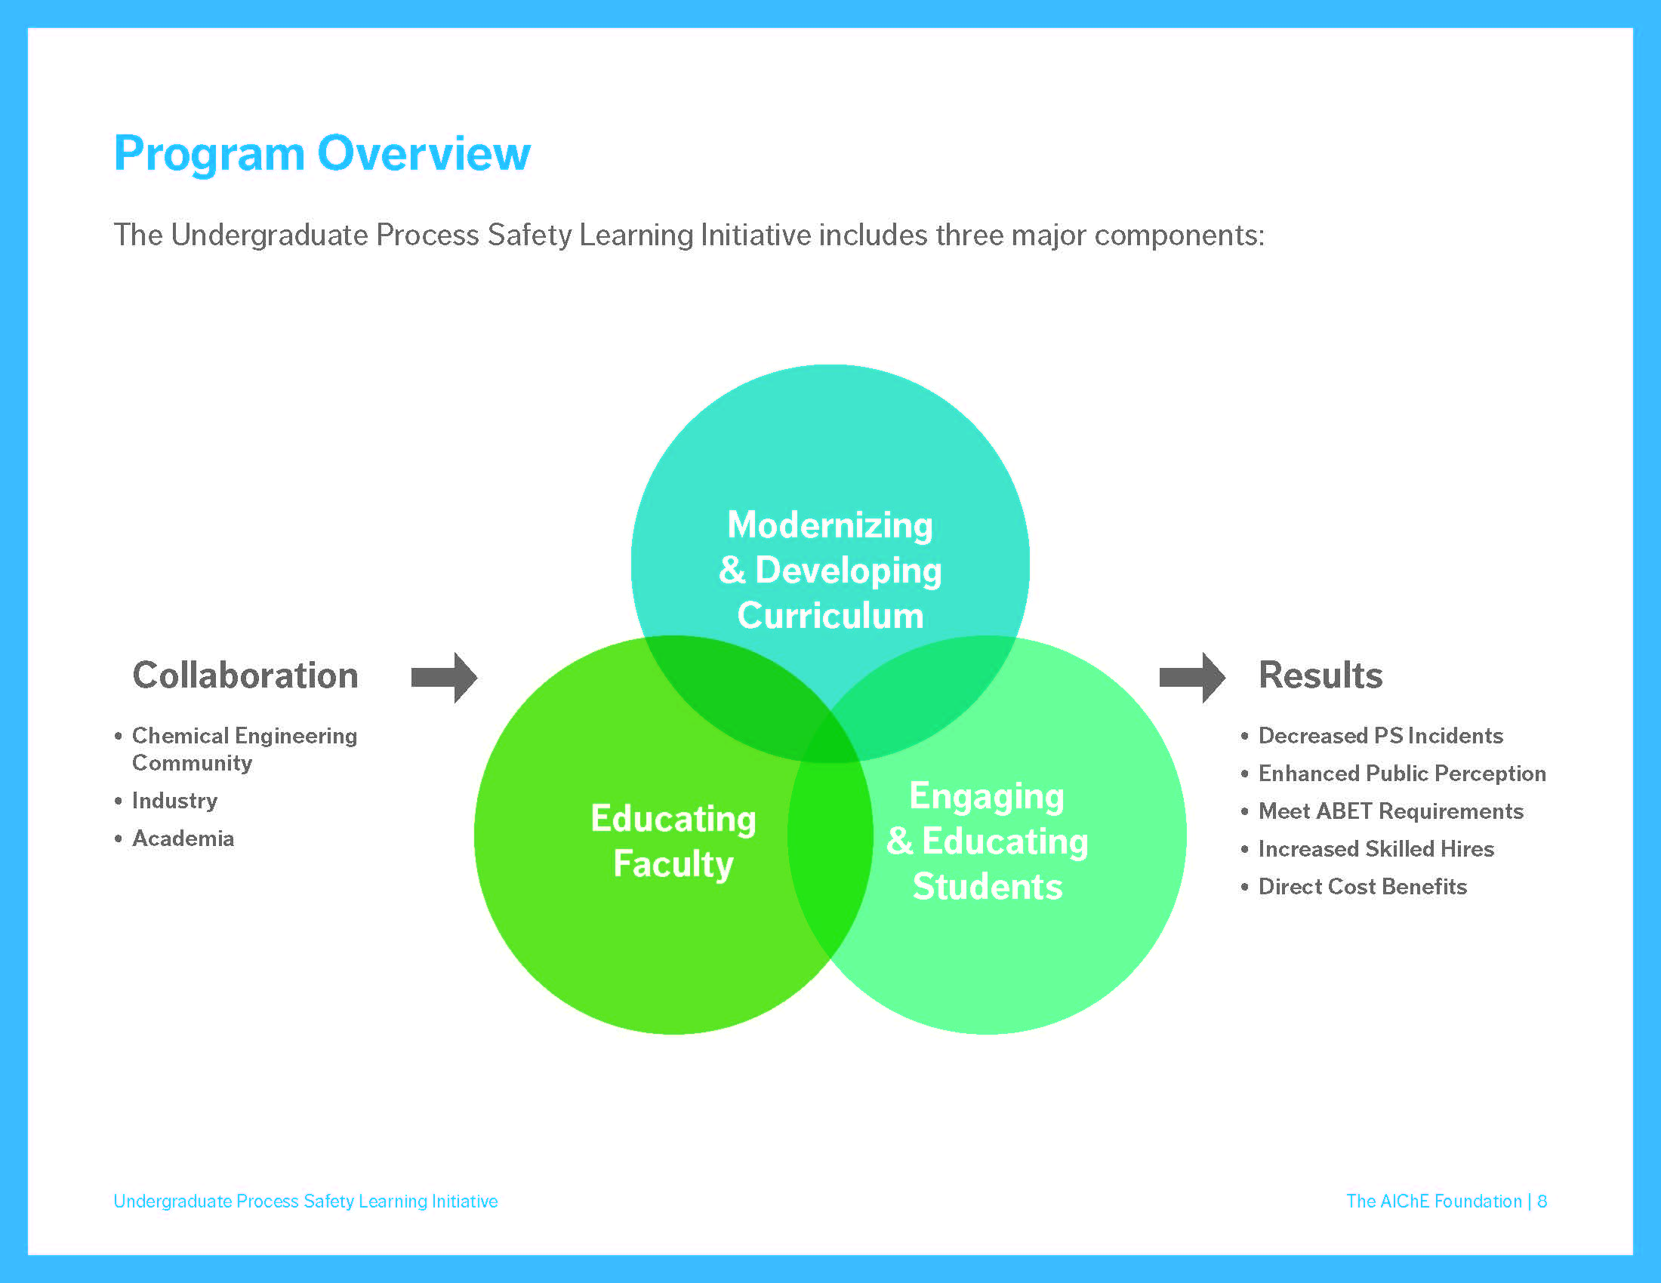
SAChE
Faculty Workshops
Student Outreach & Bootcamps
The ultimate goal is to have 100% of graduating bachelor-degree chemical engineers to be trained and knowledgeable about process safety

Slide 22

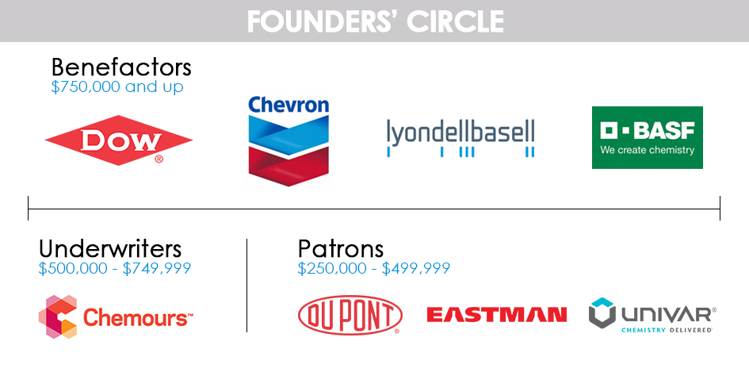
Fundraising
MAJOR CONTRIBUTORS:
Partners - $100,000-$249,000
Albemarle FMC
Archer Daniels Midland Co. Mitsui & Co. (U.S.A.), Inc.
Cabot Corporation Olin
Covestro LLC PolyOne
Evonik Wacker Chemical Corporation ExxonMobil Corporation
Supporters - $50,000 - $99,999
Air Liquide Intercontinental Terminal
Arkema Inc LANXESS
Bouchard Transportation Novus International, Inc.
Cargill Praxair
Honeywell Trinseo
For a complete list of donors, visit www.DoingaWorldofGood.org
* Does not include $1MM in unrecorded pledges
Notes:
Lisa confirmed that we have fundraised $7.3M out of the expected $9M for UPSLI. Of the $7.3M, only $220K is an in-kind contribution. The remainder is cash and in multi-year agreements.

Slide 23
SAChE TSC Sub-committee
23 members committee formed in 2015 with the help of the CCPS Advisory Board
  17 members from the industry
  6 members from academia
SAChE curriculum developed
    Level 1 – prep for an internship / coop
    Level 2 – full undergraduate requirement
    Level 3 – elective modules involving specific hazards.

Slide 24
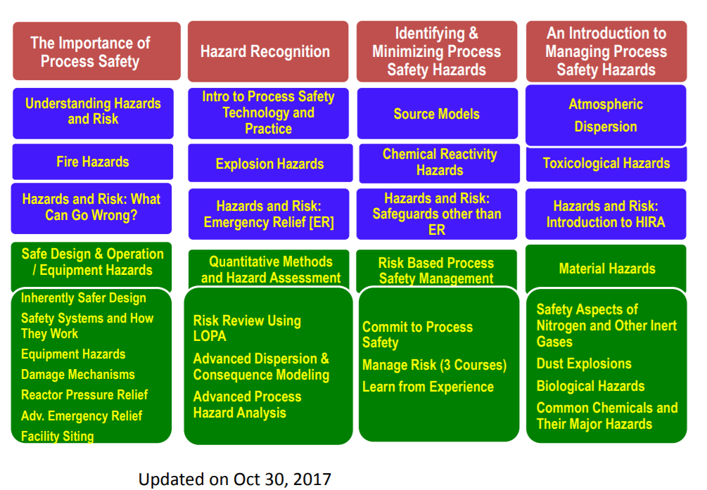
Safety and Chemical Engineering Education (SAChE) – Overall Curriculum
www.aiche.org/sache
Notes:
Need to add asterisks for those that have been translated into Spanish, Portuguese and Mandarin

Slide 25
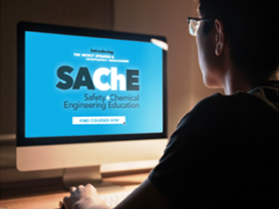
SAChE – 11 Modules Available Today
The Importance of Process Safety*
Level 2 (Intermediate)
Toxicological Hazards
Chemical Reactivity Hazards *
Level 3 (Advanced)
Inherently Safer Design
Fire Hazards*
Understanding Hazards and Risk*
Hazards and Risk: What Can Go Wrong?
Hazard Recognition*
Identifying & Minimizing Hazards*
Intro to Managing Process Safety Hazards*
Hazards and Risk: Introduction to Pressure Protection
Level 1 (Basic)
*Translated into either Spanish and/or Mandarin

Slide 26
12 SAChE Modules in
Development in 2018
Level 2
Explosion Hazards
Source Models
Atmospheric Dispersion
Hazards and Risk: Safeguards Other Than Relief Systems
Hazards and Risk: Introduction to Hazard Identification and Risk Analysis
Level 3
Review Using Layer of Protection Analysis (LOPA)
Reactor Pressure Relief / DIERS
Siting of Facilities
Safety Aspects of Nitrogen and Other Inert Gases
Dust Explosions
Common Chemicals and Their Major Hazards
Risk Based Process Safety - Manage Risk: Operations

Slide 27
SAChE Modules to be Developed by 2020
Level 3
Introduction to Process Safety Technology & Practice
Process Hazards Analysis Methodologies (Advanced)
Dispersion and Consequence Modeling (Advanced)
Practical Process Safety 1
Practical Process Safety 2
Damage Mechanisms: Asset Integrity and Reliability
Biological Hazards
Risk Based Process Safety - Commit to Process Safety
Risk Based Process Safety - Manage Risk: Training and Procedures
Risk Based Process Safety - Manage Risk: Asset Integrity
Risk Based Process Safety - Learn from Experience
34 modules in total

Slide 28
Impact of SAChE
Highlights
Nearly 85,000 certificates awarded since the 2012
Over 25,000 students using SAChE since 2012
Average of 3 certificates per student
Notes:
From Lisa’s spreadsheet

Slide 29
17 Faculty Workshops [since 2015]
2016
Archer Daniels Midland, Decatur, IL
Cargill, Blair, NE
Chevron, Richmond, CA
2017
Dow, Freeport , TX
WACKER, Charleston, TN
Archer Daniels Midland, Decatur, IL
Chevron, Richmond, CA
Reliance Industries, India
2018
LyondellBasell, Houston, TX
Dow, Freeport, TX
Chevron, Richmond, CA (August 26-29)
Chemours, Fayetteville, NC (August 6-9)
BASF, Wyandotte, MI (July 23-26)
Plus at the AIChE Annual Meetings
Chevron – 4 & planned yearly
Dow Chemicals – 3 & planned yearly until 2023
Archer Daniels Midland – 2016 & 2017
Cargill – 2016 & considering one in Europe
Wacker – 2017 & planning in the future
Reliance Industry Ltd. – 2017 & planning in the future
LyondellBasell – 2018 & planning in the future
BASF – 2018 & planning in the future
Chemours – 2018 & planning in the future
NEW – ExxonMobil and Monsanto
Notes:
LyondellBasell and BASF – 5 years
Chemours – 5 years
Chevron – 4 and planned yearly
Dow Chemicals – 3 and planned yearly till 2023
ADM – 2016 and 2017
Cargill – 2016, considering one in Europe
Wacker – 2017 and planning in the future
Reliance Industry Ltd. – 2017, planning in the future
LyondellBasell – 2018, planned in the future
BASF – 2018, planned in the future
Chemours – 2018, planned in the future
AIChE Annual Meetings – 3 and planned yearly, as needed

Slide 30
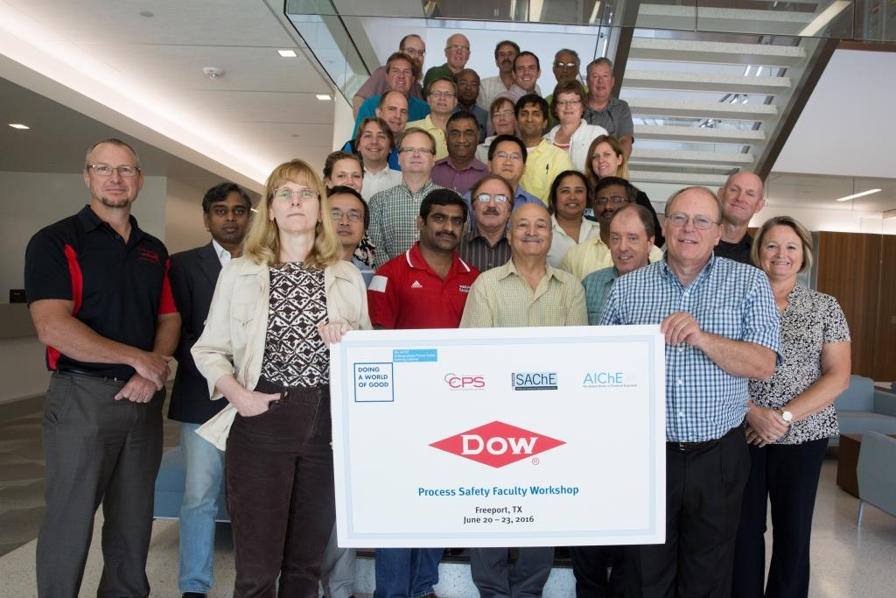
Impact of Faculty Workshops
Faculty Workshops
Educating the Educators
300+ faculty
educated on
process safety
“Incorporated CHEF analysis (from Dow workshop) into CHE 572-Plant, Process and Project Design. Most students applied principles to their final design project.” - James Charles Watters, University of Louisville
Link to list of all past and upcoming faculty workshops
https://www.aiche.org/ccps/resources/conferences/events/faculty-workshops

Slide 31
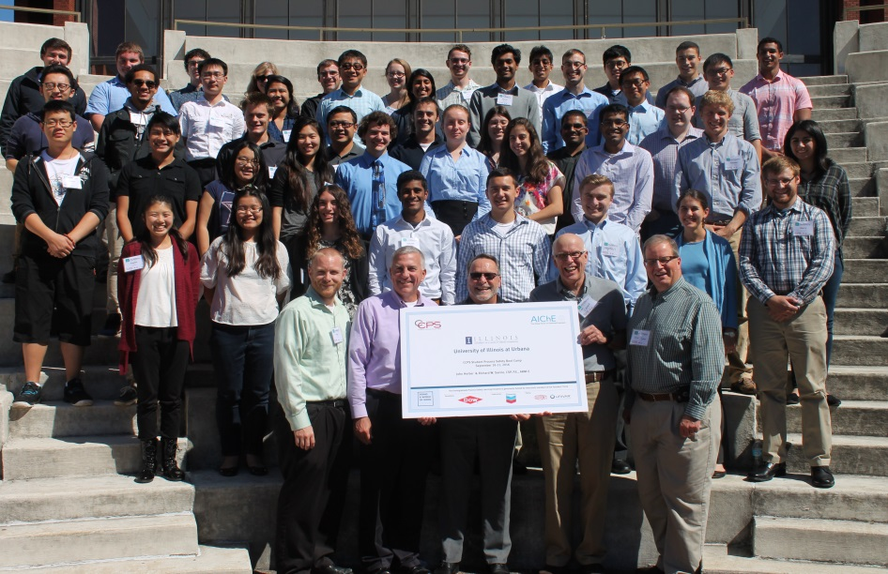
Impact of Student Bootcamps
Student Bootcamps
2016
UC Berkeley
Georgia Institute of Technology
University of Illinois-Urbana
2017
Virginia Tech
University of Delaware
Louisiana State University
University of Texas, Austin
2018
University of Michigan
Colorado School of Mines
North Carolina State University (September 22-23)
Mississippi State University
(September 8-9)
University of Tennessee-Knoxville (August 25-56)
Ohio State University
(August 25-26)
Average of 30 students/bootcamp
“The course helped emphasize the importance of process safety as lives are on the line. Keep up the work!”
– Undergraduate Student,
Colorado School of Mines

Slide 32

CCPS Credentialing - CCPSC

Slide 33

Outline
CCPSC – what is it
Why is it needed/important
How it works
Who is it for
Summary & Q/A

Slide 34
What is CCPSC
  The CCPS Credentialing Program
  Purpose: To evaluate and certify Process Safety Professionals
  Started in 2015
  Global Reach
  Modeled after the Professional Engineering Certification in the US
CCPS Certified
Notes:
It is rigorous by design and the credentials are not awarded lightly

Slide 35
What is CCPSC
  The Definitive stamp of approval in Process Safety
  A mark of True Expertise in Process Safety Practice
  Uniform and Consistent basis for assessing the Body of Knowledge in Process Safety
    Criteria: Range, Rigor, References
      Range: Breadth of experience
      Rigor: Depth of hands on experience
      References: Recognition by peers and colleagues
  Risk Based Process Safety (RBPS) at the core
  More at: www.aiche.org/ccps-certified
Notes:
Both the depth of knowledge as a practicing Process Safety professional and Breadth of a wide variety of Process Safety aspects is required
Your references about your work as a process safety practitioner are also essential

Slide 36
Why CCPSC
  Directly tied to the mission of CCPS
  Provide a global uniform standard for knowledge assessment
  Benefits:
    Individuals: Distinguish your expertise
    Companies: Know who can do what for you
    Industry as a whole: Accurately recognize the expertise
  Overcome the clutter of various denominations that do not really focus on Process safety
Recognition with the CCPS brand

Slide 37
How CCPSC Works
Decision to apply
Awarding credential
Conduct as certificant
Application
Scoring
Maintaining credential
Application
Review
Testing
Notes:
Your application will be reviewed by peer review team
More on testing on the next page
Scoring is done via a standardized method
Continuing education and ongoing contribution to Process Safety are needed for maintaining and renewing the credential

Slide 38
How it Works - Requirements
Education: A STEM degree
  Science / Technology / Engineering / Math
Experience: Minimum 5 years relevant
  Additional 5 years may be substituted for education
Hands on Knowledge of many elements of RBPS
  With Familiarity with all 20 elements
An ongoing commitment to Process Safety & personal development
  Continuing Education requirements
Notes:
RBPS is at the core of how the assessment is done. It is important to know about all the elements and have hands on experience in several. The experience is not required to be on all the 20 elements

Slide 39
How it Works
Examination - Typically 2 or 3 times a year
  4 hours, continuous, open book, individualized
Conducted Online
Multiple Choice questions
  120 questions covering the 20 elements of RBPS
Essay questions
  Descriptive answers required for situation analysis
Examination is in English
  Careful consideration is given to avoid confusion for applicants whose first language is not English

Slide 40
Who Should Apply
All individuals globally with some responsibility for Process Safety
Chemicals, Oil & Gas, Petrochemicals
Food, Mining, Pharma, Other Manufacturing
Consulting, Academia, Government

Slide 41
Summary
CCPSC – a definitive recognition of Process Safety Expertise
Globally available
Wide interest and growing rapidly
For more information or to get started, visit
www.aiche.org/ccps-certified

Slide 42
Questions?

