Slide 1
HSE Case:
Risk Based Approach

Slide 2
Why the HSE Case Approach?
Formal demonstration our Oil Sand Facility was Safe to Operate
Awareness of Major Incident Hazards; barriers (Safety Critical Elements) & how to keep them effective over asset lifecycle.
Utilize UK Assets Safety Case Experience
Safety Case Regime is a well-recognized best practice
HSE Case:
Structured argument, supported by evidence that is intended to justify that the facility is acceptably safe to operate
Identifies the hazards and risks
Describes how the risks are controlled
Describes the safety management system in place to ensure the controls are effectively and consistently applied
Notes:
The Safety Case Regime is a well-recognized best practice. Today, most of the major Oil & Gas producers require Safety Cases for their facilities regardless of regulatory requirements. In addition to Oil & gas, numerous other industries such as Nuclear, Defense, Transportation and Aerospace use this practice as well.
Purpose: A Safety Case for an operating asset provides a demonstration that the facilities design and the management system followed are consistent with the requirements for safe and responsible operation. The main focus of the Safety Case is aimed at major accident hazards, which can be generalized as hazards with the potential for multiple fatalities, but it also documents the application of the assets HSE management system.
In general, a Safety Case:
Identifies the hazards and risks,
Describes how the risks are controlled, and
Describes the safety management system in place to ensure the controls are effectively and consistently applied.

Slide 3
How we are doing it?
Risk Based Approach
Demonstrate risks are being managed to ALARP through applying a risk based decision framework.
Hazard Identification & Risk Assessment (HIRA) Process
Hazard & Risk Register
(HAZOP Revalidations) & LOPA
Bowtie Analysis (Identification of Safety Critical Elements)
Quantitative Risk Analysis
Hazard Identification
Risk Analysis
Risk Evaluation
Risk Treatment
Risk Communication
Notes:
Risk Based Approach
Within Nexen, we use the ALARP principle to apply a risk based decision framework that makes a risk related decision and justifies it to stakeholders. The framework helps to define the context of the decision and assists in the identification of methodologies to allow a decision to be made, and whether it is reasonably practicable to implement a risk reduction option. i.e. As the risk increases the level of rigour increases. For example, MIHs required more additional methodologies e.g. Bowties; QRAs to demonstrate we have sufficient barriers in place to manage the risk
Step 1: Hazard Identification
Identification of process safety hazards and potential effect to people, environment, assets and reputation. This also includes identification of all our Major Incident Hazards (more details on the next slide)
Step 2: Risk Analysis
Analysis of risk using appropriate PHA technique.
Step 3: Risk Evaluation
Comparing the analyzed risk to Nexen’s Risk Acceptance Criteria. The goal is to assist in making decisions, based on the outcomes of risk analysis, about which risks need treatment and the priority for treatment implementation.
Step 4: Risk Treatment
Risk Treatment follow the hierarchy of controls. Risk-reduction measures include those that prevent incidents (i.e. reduce the probability of occurrence), control incidents (i.e. limit the extent and duration of a hazardous event) and to mitigate the effects (i.e. reduce the consequences). For MIHs, Safety Critical Elements are identified through the Bowtie Analysis. Each SCE is then managed by a Performance Standard which defines the functional performance required by that system i.e. what do we need it to do.
Step 5: Risk Communication
All operating assets shall have a formal demonstration of ALARP that documents the medium and high process safety risks at the site and indicates how they have been controlled to ALARP. This is the HSE Case.

Slide 4
Operationalizing the HSE Case
Major Incident Hazard Awareness Training
What it is, what are the specific MIHs at the facility, what are the barriers we have in place, how do we maintain their effectiveness and what happens if barriers fail?
Safety Critical Elements (SCE)
Introduction of Performance Standards & Technical Authorities
ITPMs to manage SCEs
Updating HSE KPI Dashboard to include a snapshot of the strength of our barriers
Safety Critical Task (SCT) Rollout
Competency Assurance (update of profiles to reflect SCT)
SCE Verification Audits
Procedures
Update to include HSE Case inputs e.g. Using Bowties for Safety Critical Bypasses; Facility Siting
Projects
Safety In Design Standard
Requirement for Design HSE Case in Project Stage Gate Process
Notes:
While the HSE Case demonstrates that the risks have been identified, analyzed and treated, if they do not maintain there effectiveness it will all be for naught. There are a initiatives to operationalize the HSE Case including:
Development of an MIH KPI Dashboard to provide a snap shop of the strength of our barriers over time. This will allow for weakness in barriers to be identified quickly and easily
SCE Verification Audits to ensure that Safety Critical Equipment is meeting the requirement of the Performance Standards and identify any gaps in the maintenance process
Personnel on site will be responsible for understanding the safety critical components of their roles.
Incorporate use of the HSE case in Long Lake Procedures. For example, bypasses should consult the bowties to ensure that sufficient measures are in place. Utilize the QRA for trailer/temporary equipment siting.
Through the completed work and the integration of the HSE case into day to day activities the facility would be considered safe to operate.
For the NSGP for Major capital projects, we are proposing an update to the HSE deliverables, one of which will be a Design HSE Case.
The Design HSE Case would be a summary of all the HSE activities conducted in that phase of the project, and a demonstration that the HSE risks are being managed to ALARP. It follows the structure of the Facility HSE Case but made fit for purpose for the hazards and risks identified for the project. For small capital projects, the ALARP demonstration will be included within the PEP., but its important to note that it is risk based not cost based, so a small project where MIHs are identified.
The purpose of the Safety Engineering in Design Standard is to define the minimum requirements projects have to meet in order to demonstrate that risks are managed to ALARP.
The primary objectives of this standard are to:
Define the process for project teams to deliver safety through design,
Describe the rational for selecting specific safety related deliverables and activities to be completed during the project phases,
Provide reference to guidelines (standards and procedural aids) for the execution of safety engineering deliverables, and
Identify the project systems & processes that support the delivery of safety in design.

Slide 5
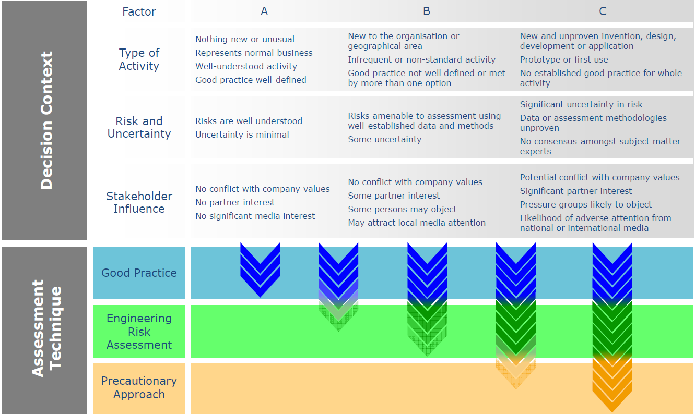
Risk Based Decision Framework
Ref: Oil & Gas UK, Guidance on Risk Related Decision Making, Issue 2, July 2014

