Slide 1
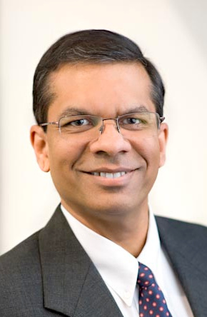
CCPS Projects & Publishing
Dr. Anil Gokhale, P.E.
Director, CCPS Projects
The Global Community Committed to Process Safety

Slide 2
2018 Books
PUBLISHED
“The Global Community Committed to Process Safety”

Slide 3
2018 Books
PUBLISHED
Sept 2018
“The Global Community Committed to Process Safety”

Slide 4
2018 Books: Work in Progress
Early Nov. 2018
1Q 2019
“The Global Community Committed to Process Safety”

Slide 5
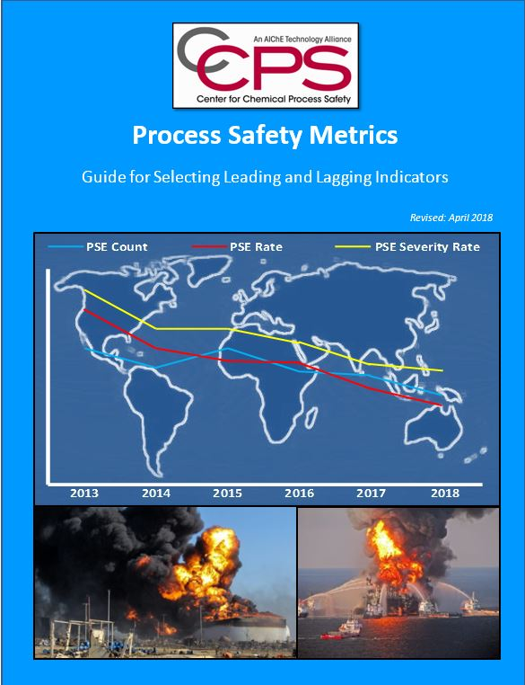
2018 Non-Book Publications
Guide Document
Monograph
“The Global Community Committed to Process Safety”

Slide 6
2019 Publications Projection
Process Safety Leadership from Board Room to Front Lines
Guide to making Acute Risk Decisions
Guidelines Process Safety in Pilot plant and Labs
Guidelines for Inherently Safer Design 3rd Ed
More Incidents that define Process Safety
Incident Investigation 3rd Ed
Guidelines for Process Safety in Upstream Industry
Might slip to 2020
“The Global Community Committed to Process Safety”

Slide 7
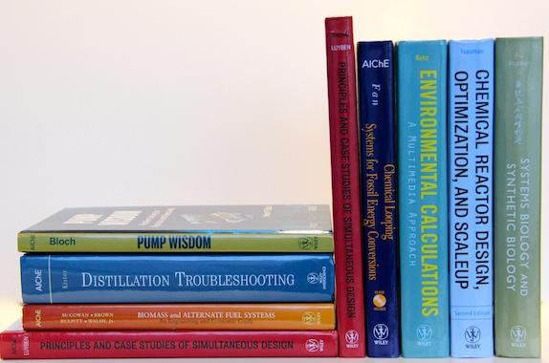
Targeted for 2020
P281 Human Performance in Process Safety
Scope document finalization next
P283 PHA Revalidation 2nd Ed
Strong Survey feedback, completing book scope/layout
P289 Golden Rules for Process Safety
Team leaning towards an ‘app’, not a book
P292 Lessons Learned Years Later
Sub-Committee: 7 Volunteers. NEED MORE
P290 Process Safety Toolbox
Need Volunteers
P291 GL for Abnormal Situation Management
Team formation in progress
“The Global Community Committed to Process Safety”

Slide 8
Focus on Canada
How to move forward New Topics
Example: Pipelines
Proposal: You have the expertise. Take the lead
Provide strong justification of the need
Document it to the Planning committee
Approval and get on the TSC ballot
Focal Point of contact: Louisa Nara
Volunteer for the sub-committee
Your sweat equity is critical to making it successful

Slide 9
Process Safety Incident Database (PSID)
Reopened in December 2017
Opened access to all CCPS members
Except government / regulatory entities
Over 800 incidents and expanding
Member benefit – no fees required
Company admin and user registrations required
User Approval: CCPS Operational admin or Company admin
We encourage every PSID company to submit at least one incident every year
For more information, please contact ccps_psid@aiche.org
Over 130 new registrations, representing more than 60 companies

Slide 10
Other Updates
UPSLI
Faculty Workshops
Student Boot Camps
SAChE development – new eLearning modules
Credentialing
Two very successful Exams completed with new software platform (July, Sept 2018)
Key focus forward
Processes & Procedures streamlining
Marketing – Spread the word

