Slide 1
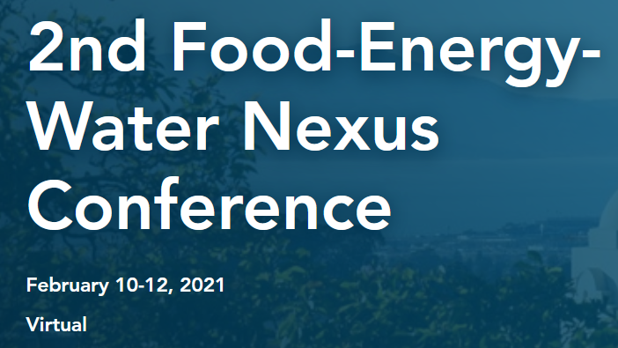
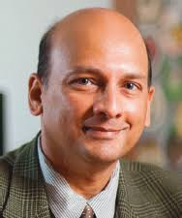
Sanjiv Gokhale, Ph.D., P.E. , F. ASCE
Professor of Civil Engineering - Vanderbilt University
Director - Construction Management Graduate Program
Global Professor of Civil Engineering - NYU
s.gokhale@vanderbilt.edu

Slide 2
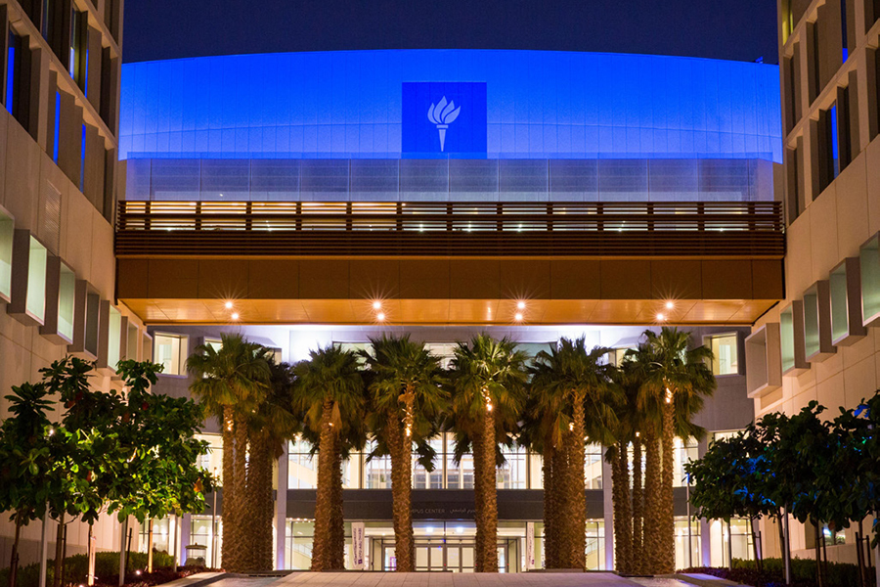
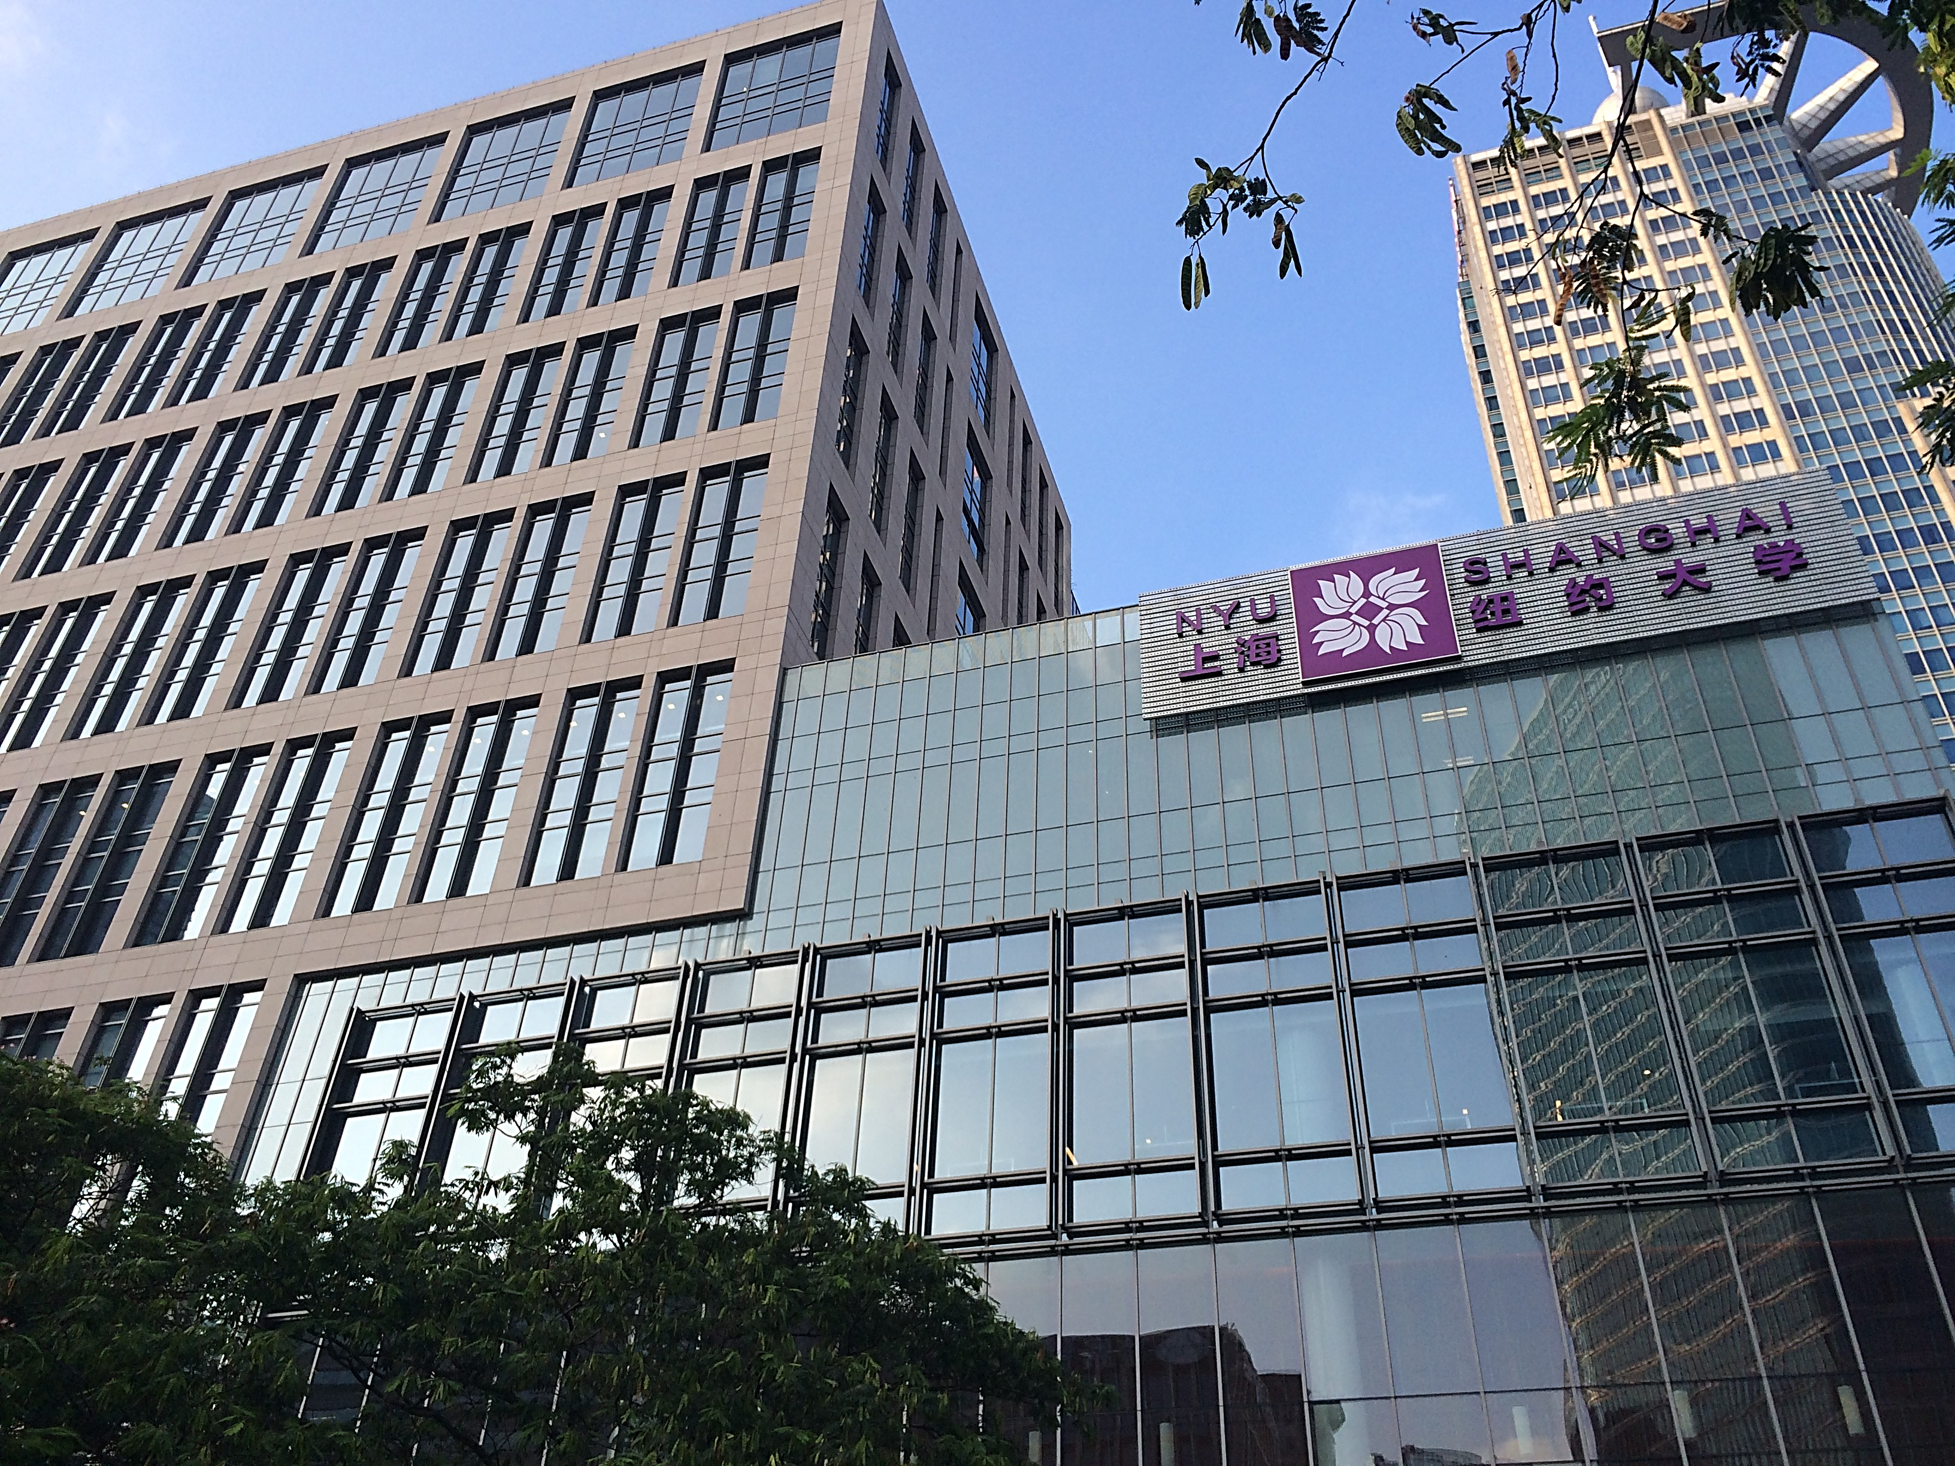
2019 & 2020
J-Term (3 weeks)
S2020 Abbreviated (13 weeks)

Slide 3

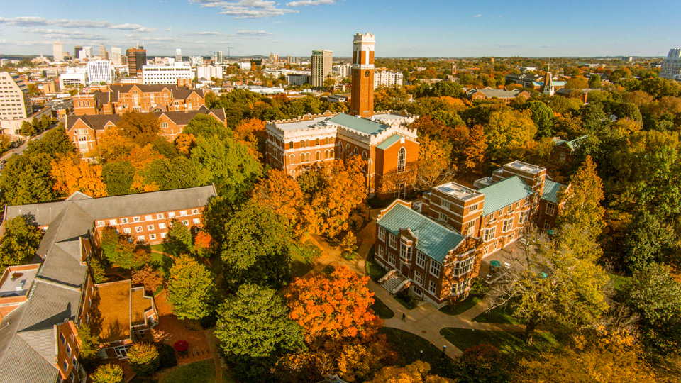
CE 4150/5150 Energy Systems Engineering
S2021 (16 weeks)

Slide 4

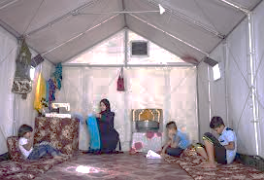



3m
3d
Basic
Necessities
3w
Notes:
United Nations High Commissioner for Refugees (UNHCR)

Slide 5
Energy is at the heart of development. Energy makes possible the investments, innovations and new industries that are the engines of jobs, inclusive growth and shared prosperity for entire economies. Universal access to affordable, reliable and sustainable and modern energy – Sustainable Development Goal (SDG) 7
Today, 789 million people live without electricity and hundreds of millions more live with insufficient or unreliable access to it. Nearly 3 billion people cook or heat their homes with polluting fuels like wood or other biomass, resulting in indoor and outdoor air pollution that cause widespread health impacts.
- The World Bank
https://www.worldbank.org/en/topic/energy/

Slide 7
Water Energy Food Nexus: 5 Big Questions
What are the interdependencies that exist between water, food and energy? How do actions in one area impact one or both of the others?
How are water, energy and food security linked?
How can industry leaders and policymakers approach these issues?
How will population growth/urbanization and climate change affect the WEF security in the future?
What roles can renewable energy and new technologies play?

Slide 8
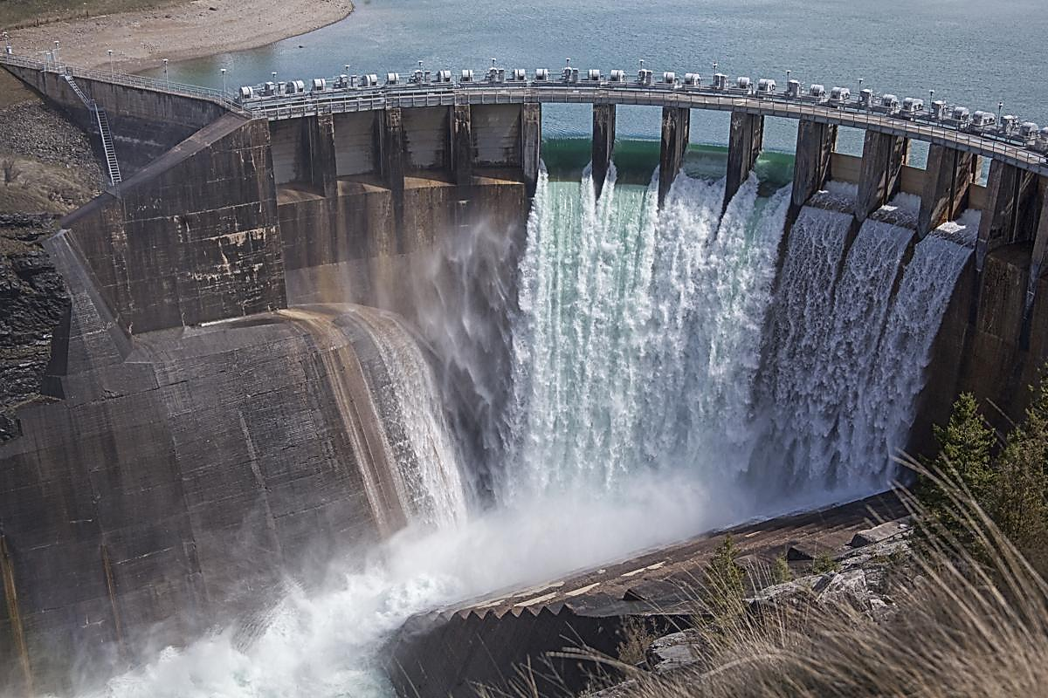
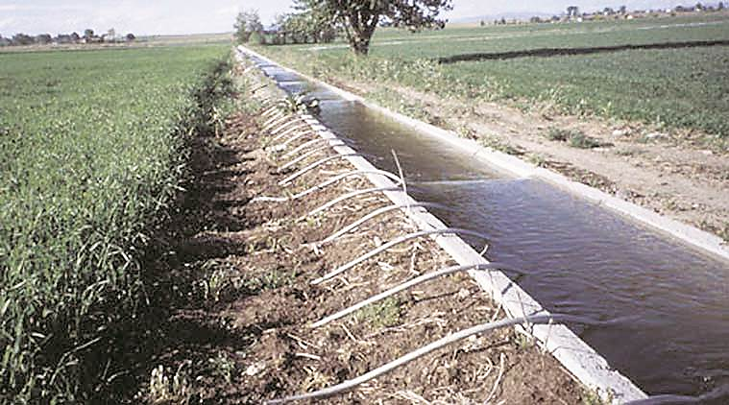

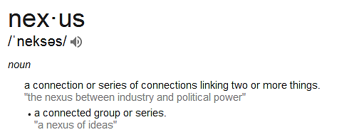
What is Nexus?
Security is freedom from, or resilience against, potential harm from external threats.
Wikipedia

Slide 9
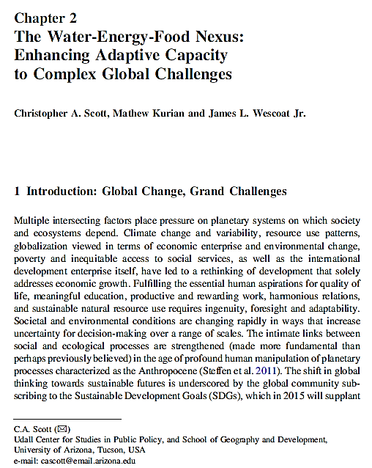
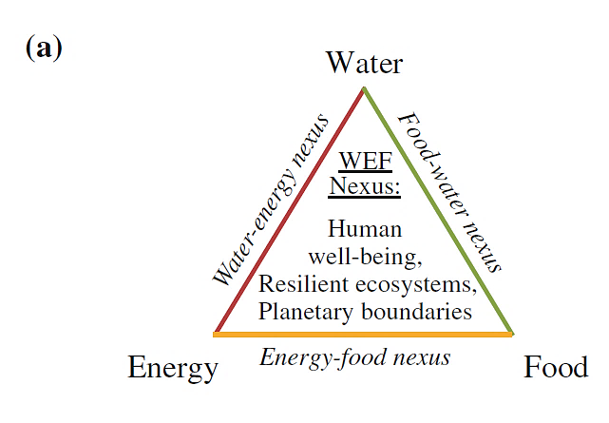
The Water-Energy-Food Nexus: Enhancing Adaptive Capacity to Complex Global Challenges, Christopher A. Scott, Mathew Kurian and James L. Wescoat Jr.

Slide 10
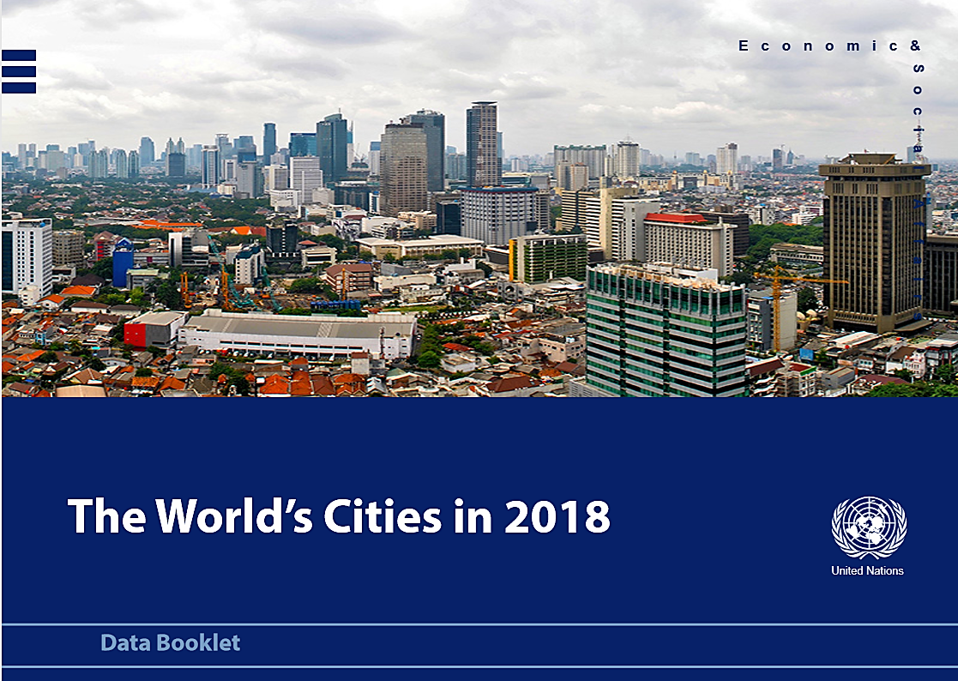

Slide 11
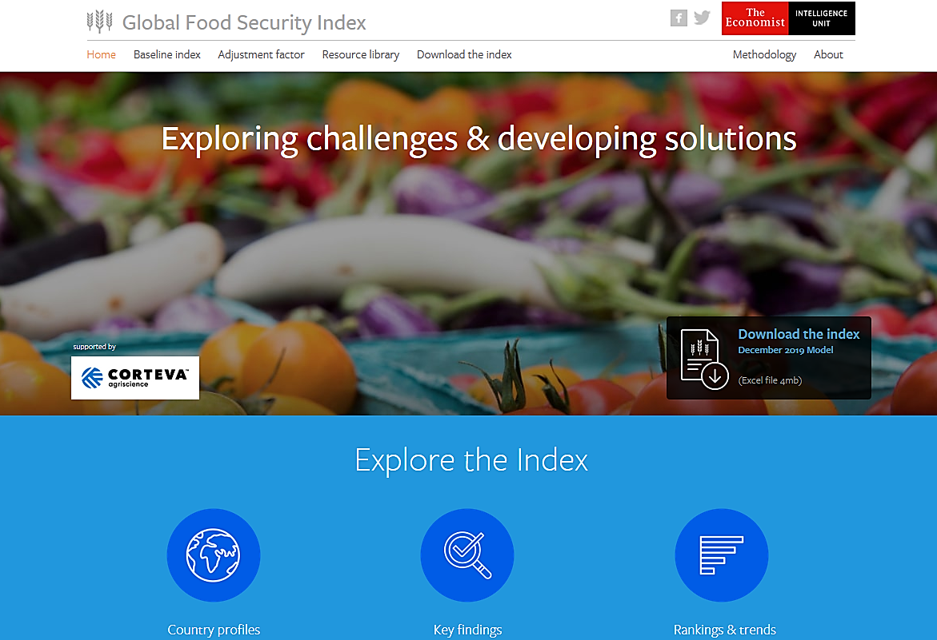
https://foodsecurityindex.eiu.com/Index

Slide 12
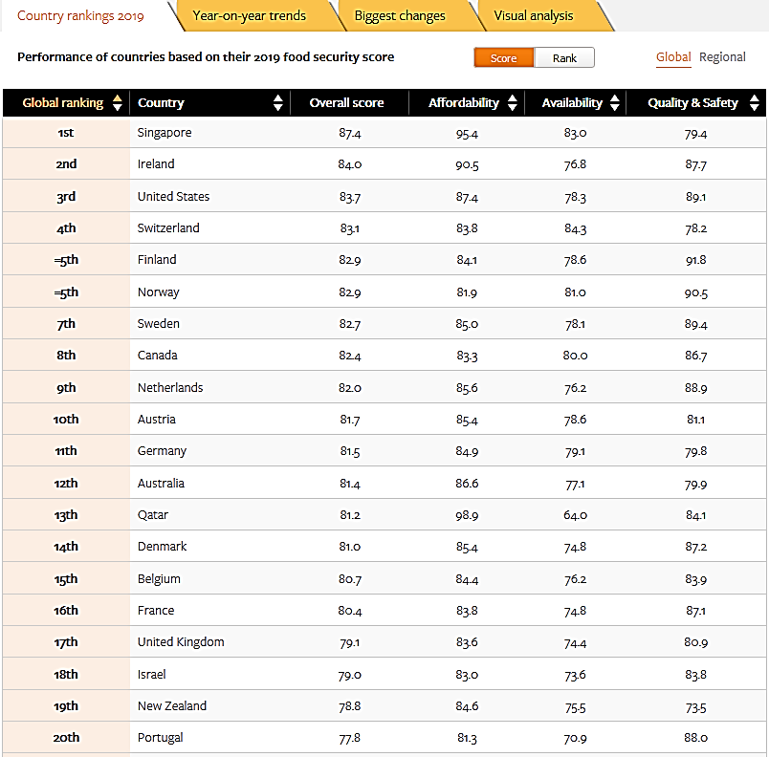

Slide 13
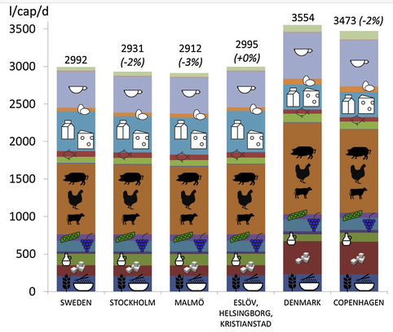

Eating habits influencing the water needs of a Country
More meat in one’s diet = more water (liters per capita per day)
Calories consumed per day

Slide 14
Access to energy is a key pillar for human wellbeing, economic development and poverty alleviation. Ensuring everyone has sufficient access is an ongoing and pressing challenge for global development.
https://ourworldindata.org/energy-production-and-changing-energy-sources

Slide 15
Energy system showing the flow of energy from primary energy supply to final
energy consumption.
Modeling and Simulation of Energy Systems: A Review
Avinash Shankar Rammohan Subramanian, Department of Energy and Process Engineering, Norwegian University of Science and Technology (NTNU),
Physical Financial Environmental

Slide 16
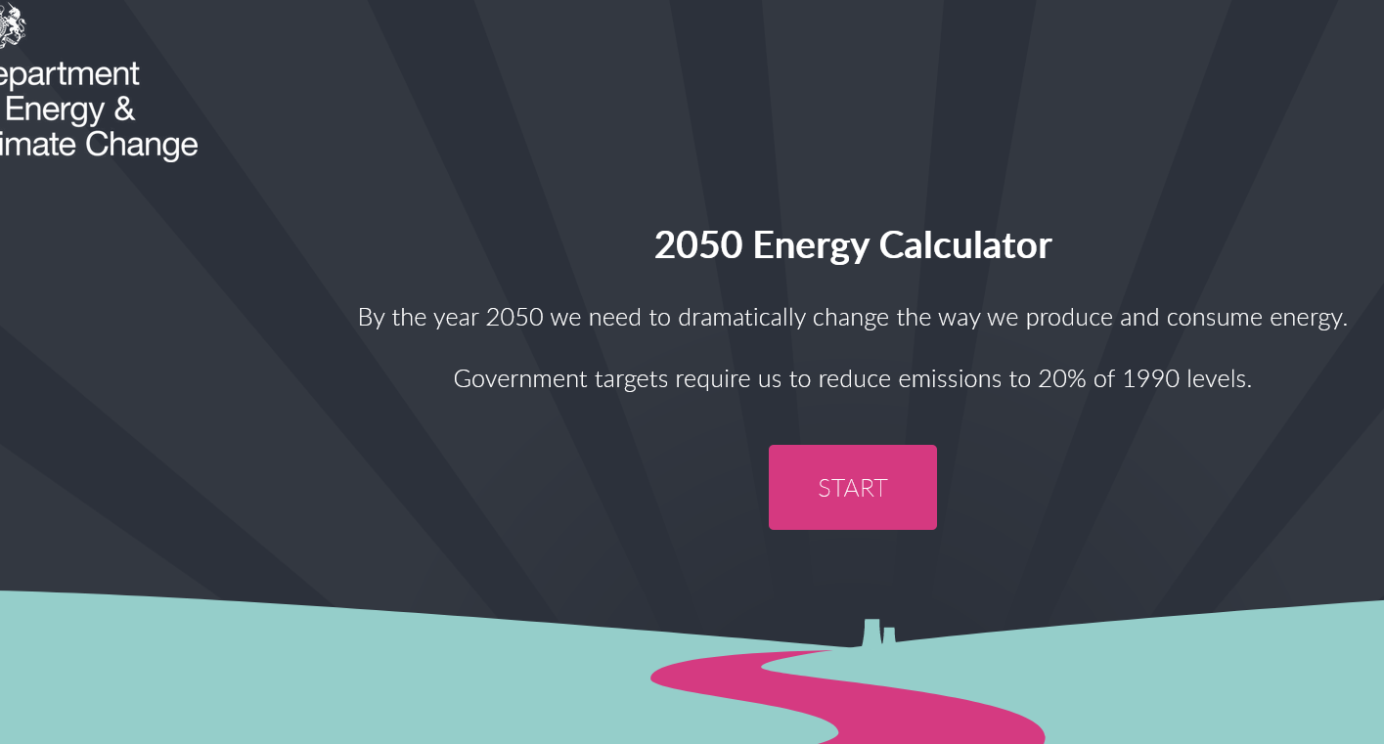
http://2050-calculator-tool.decc.gov.uk/#/home

Slide 17
Brazil’s São Paulo, a megacity of 20 million, faced its own Day Zero in 2015. The city turned off its water supply for 12 hours a day, forcing many businesses and industries to shut down. In 2008, Barcelona, Spain, had to import tankers full of freshwater from France. Droughts have also become more frequent, more severe, and affecting more people around the world.
Fourteen of the world’s 20 megacities are now experiencing water scarcity or drought conditions. As many as four billion people already live in regions that experience severe water stress for at least one month of the year, according to a 2016 study in the journal Science Advances. Nearly half of those people live in India and China..
Perhaps ironically, too much water too fast was California’s most recent water problem. Following its worst wildfire season in history, heavy rainfall this winter produced mud slides that killed more than 20 people and destroyed or damaged hundreds of homes. Hurricane Harvey, which hit Texas and Louisiana last August, causing $125 billion in damage, dumped more water out of the sky than any storm in U.S. history.

Slide 18
With limited land to collect and store rainwater, Singapore faced drought, floods and water pollution in the early years of nation building.
These challenges inspired Singapore to strategize and seek innovative ideas, develop capabilities and secure a sustainable supply of water.

Slide 19
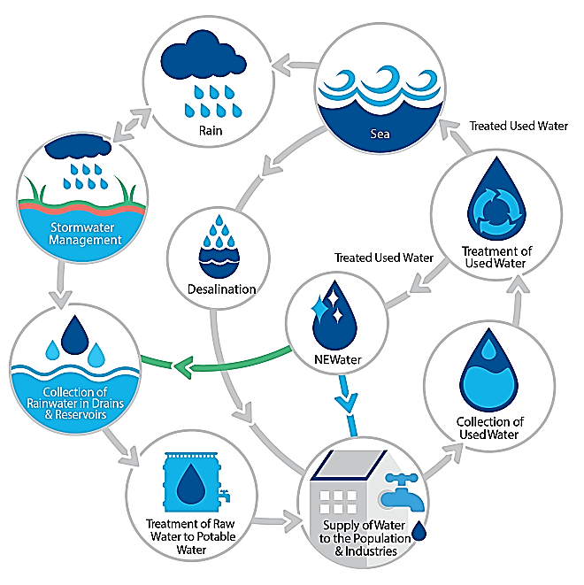
Water demand in Singapore is currently about 430 million gallons a day (mgd), with homes consuming 45% and the non-domestic sector taking up the rest.
Holistic approach to water management:
Collect every drop of water
Reuse water endlessly
Desalinate seawater

Slide 20
This document contains the premises, results and analysis of the impact evaluation of the Ikondo-Matembwe project, including the positive externalities on the socioeconomic system of Tanzania.
The project is a comprehensive and holistic set of activities aiming to bring access to
un-polluting electricity from renewable resources, fresh and potable water and improve nutrition and food security of a target population.

Slide 22
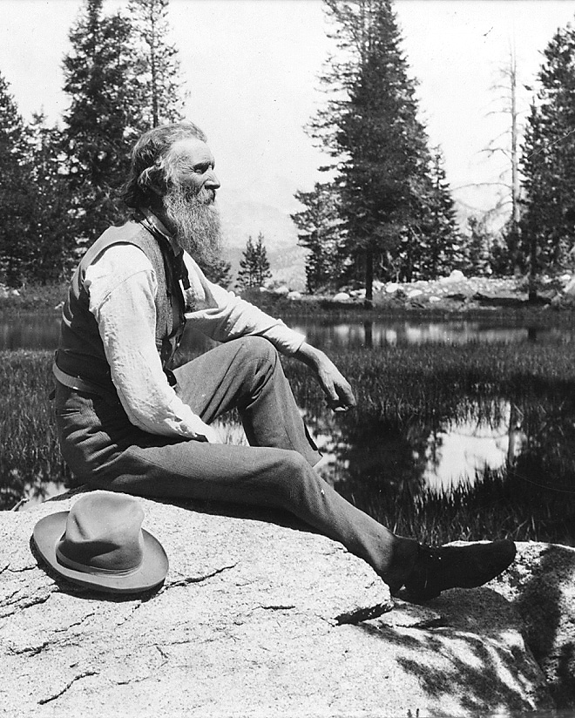
“When we try to pick out anything by itself, we find it hitched to everything else in the Universe.”
My First Summer in the Sierra, (1911), John Muir.

Slide 23
Questions?

