Slide 1
Process Safety Spotlights

Slide 2
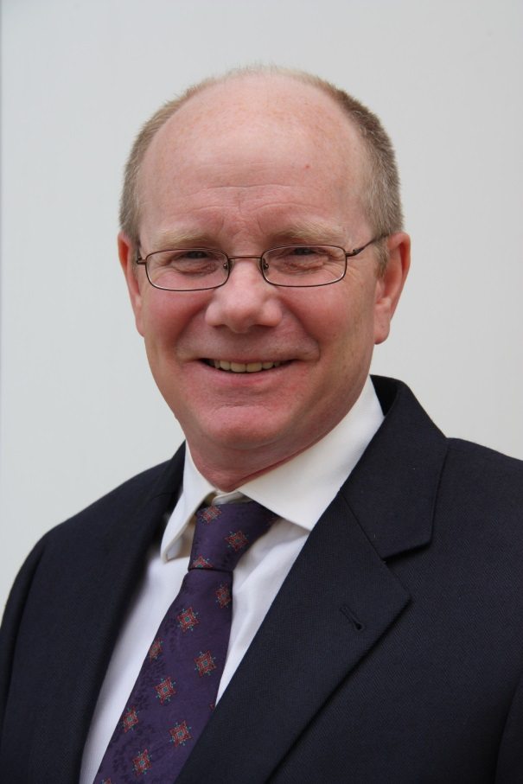
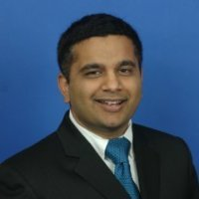
Spotlight Track Chair and Vice-Chair
Chair: Eric Peterson, PhD
Vice-Chair: Sanjeev Saraf, PhD

Slide 3
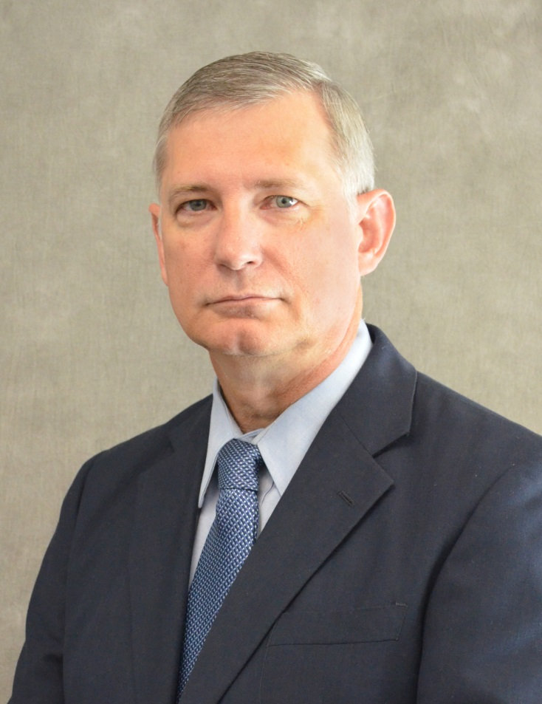
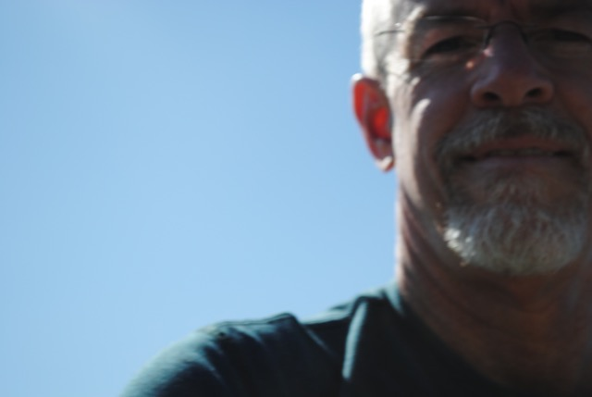
T1F100 Human Factors in Chemical Process Safety
Chair: David Weimer
Co-Chair: Dave Halloway

Slide 4
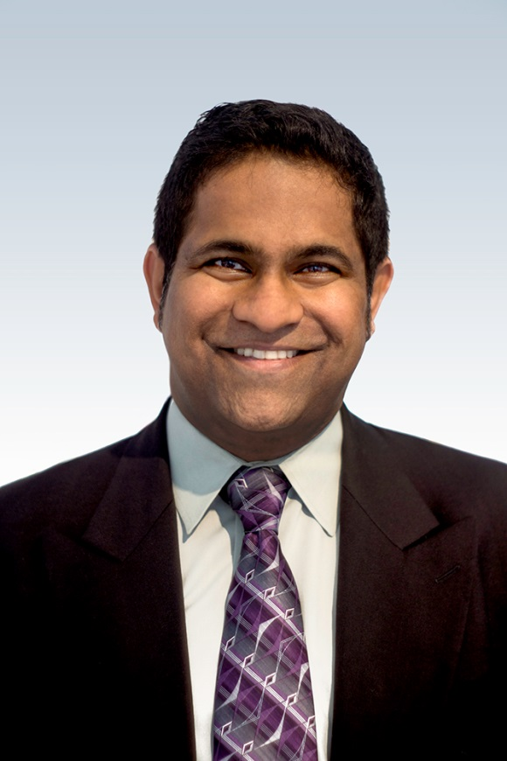
T1F100 Human Factors in Chemical Process Safety
Chair: Irfan Shaikh
Co-Chair: John Jacob

Slide 5
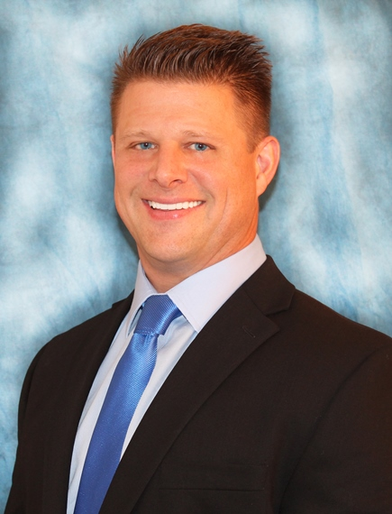
T1F100 LNG, LPG, and NGL Safety
Chair: Chad V. Mashuga
Co-Chair: Harri Kytomaa

Slide 6
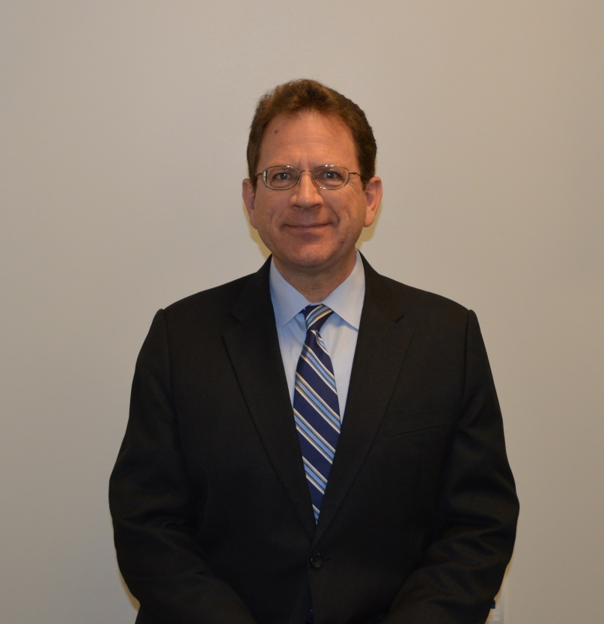
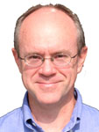
T1F100 Refinery Safety
Chair: Mike Moosemiller
Co-Chair: Chris Buehler

Slide 7
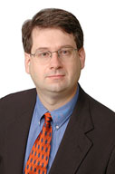
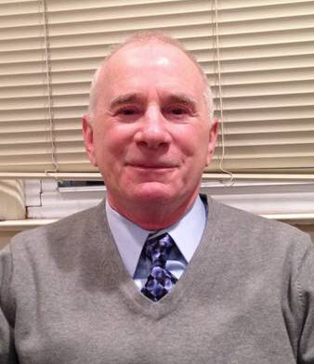
T1F100 Diers Pressure Relief
Chair: Warren Greenfield
Co-Chair: Wayne Chastain

Slide 8
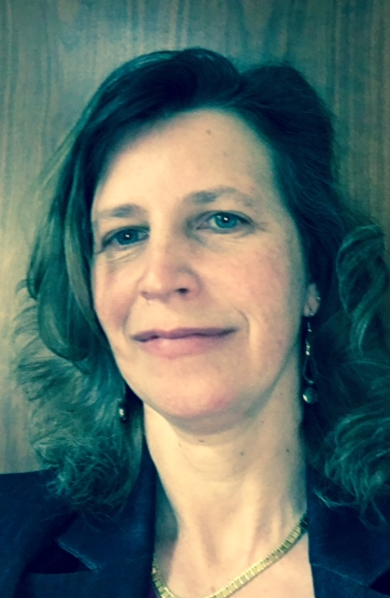
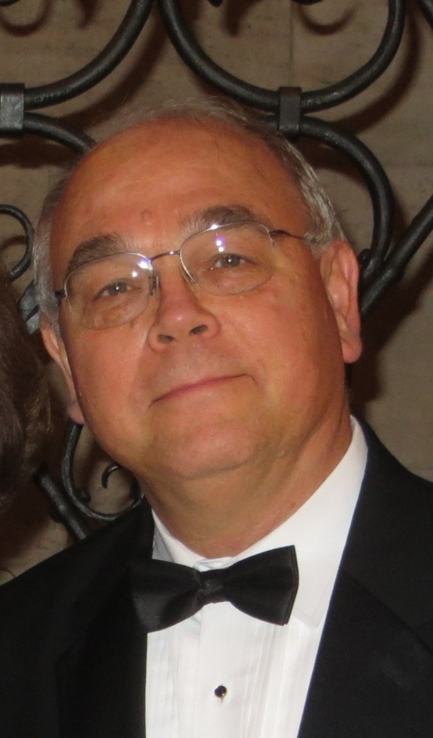
OSHA Executive Order 13650
Chair: Lisa Long
Co-Chair: Peter N. Lodal

Slide 9
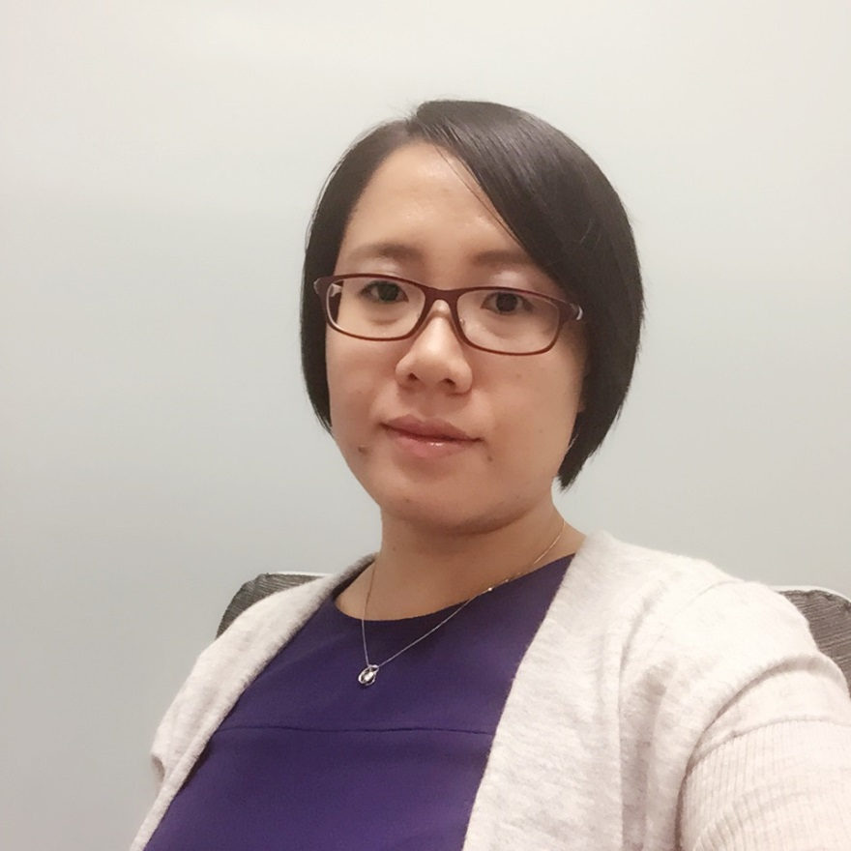
OSHA Regulation
Chair: Brian Kolodji
Co-Chair: Jessie Lu

