Slide 1
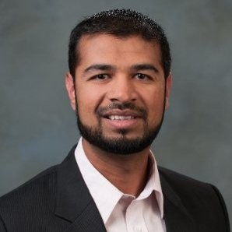
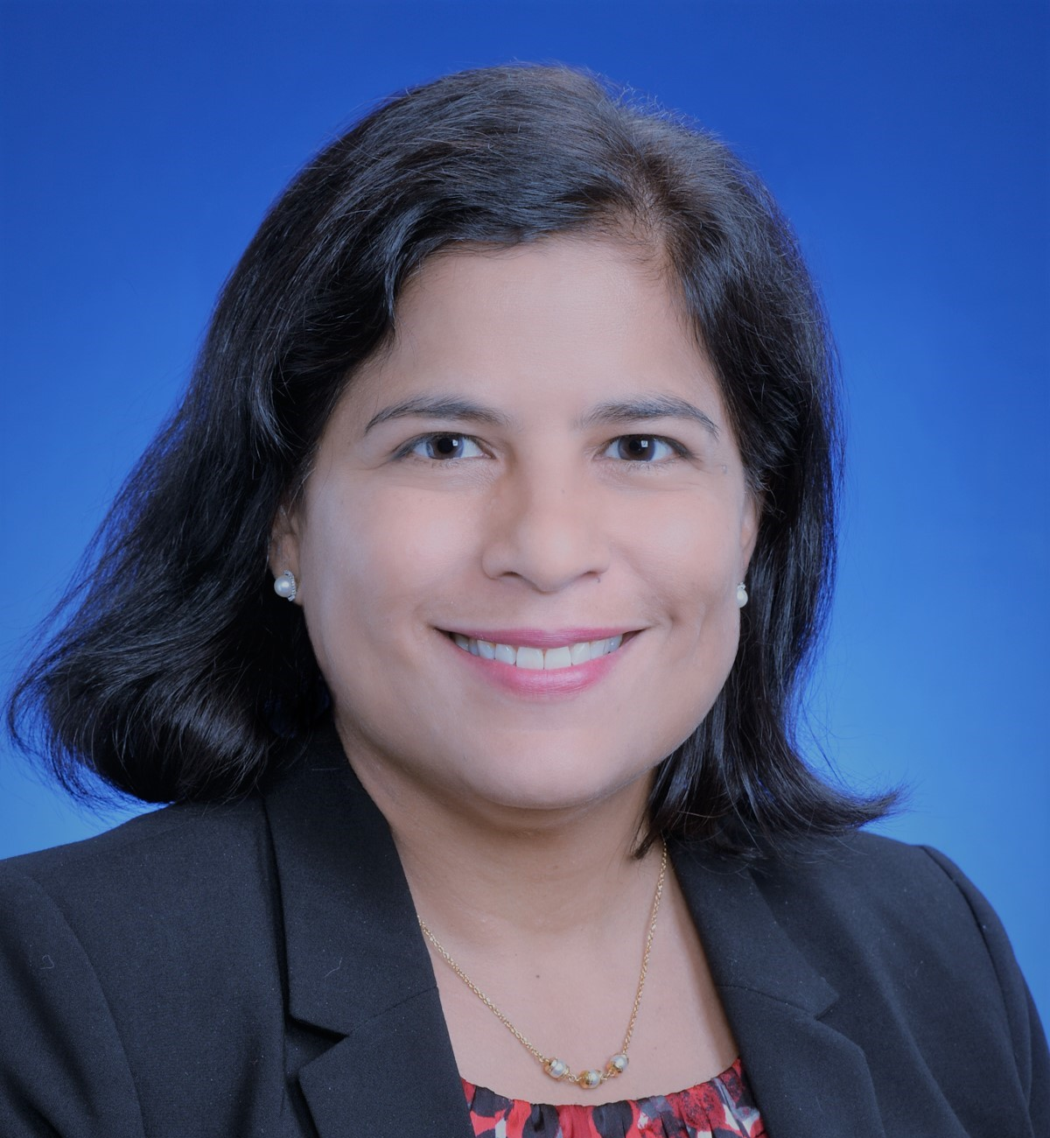
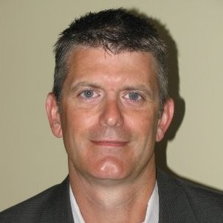
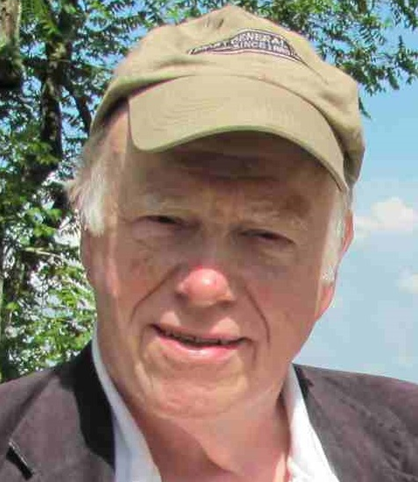
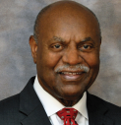
In Honor of Young Leader Award Recipient - Leadership and Innovation in Pharmaceutical Development and Manufacturing
Tuesday, April 20, 2021, 11 AM - 12 PM CST
This invited session at the 2021 AIChE Spring Meeting features talks from the pharmaceutical industry leaders on their experiences on leadership and leveraging innovative technologies to accelerate process development and manufacturing and discuss the challenges and opportunities to position for a sustainable future.
Speakers
Presentation Title
Moiz Diwan
AbbVie
Leading by Example – Innovations in Pharmaceutical Development to Position for a Sustainable Future
Celia Cruz
Eli Lilly
Enabling Innovation in New Modalities Synthesis
Tom Nikolai
AbbVie
Getting Ahead of the Curve – Emerging Trends and Success Factors in Biopharmaceutical Development
Session Chairs
Dr. Joseph Cramer
Director Emeritus, AIChE
Dr. Harold Conner
UCOR Senior Advisor

