Slide 1
31st Center for Chemical Process Safety Conference

Slide 2
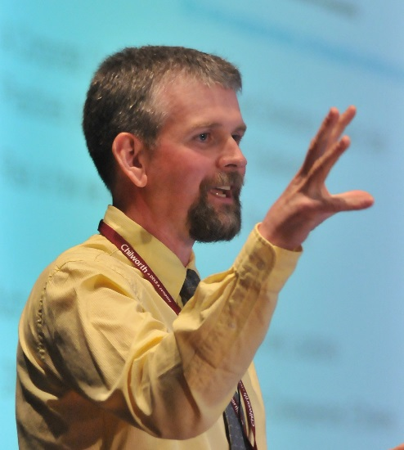
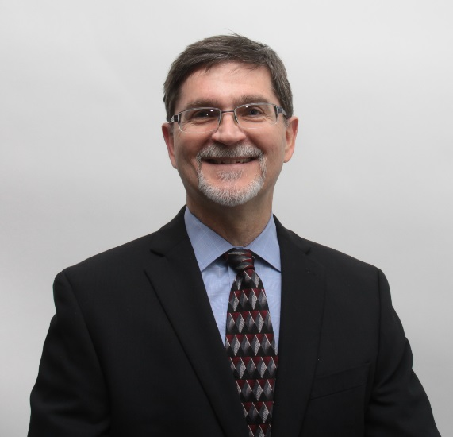
Symposia Chair and Vice-Chair
Chair:
Fred Henselwood
Vice-Chair:
Russ Ogle

Slide 3
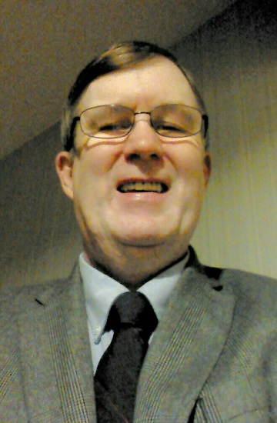
Committed Culture - Creating Felt Leadership
Chair:
Jim Klein
Co-Chair:
Sunil D. Lakhiani

Slide 4
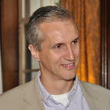
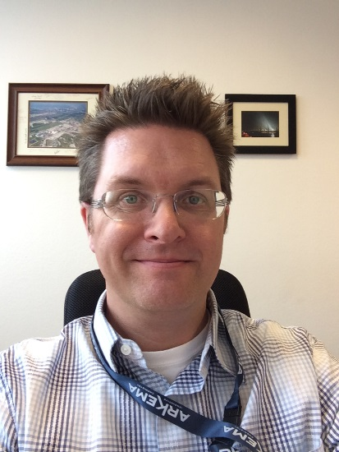
Committed Culture - Obtaining Operational Discipline
Chair:
Andrew Goddard
Co-Chair:
Tim Murphy

Slide 5
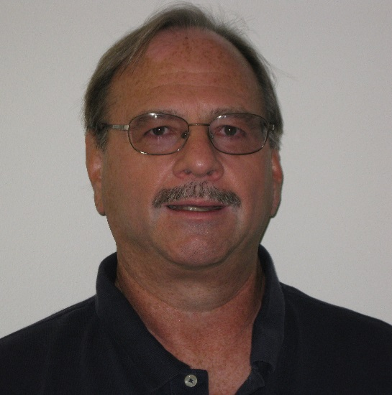
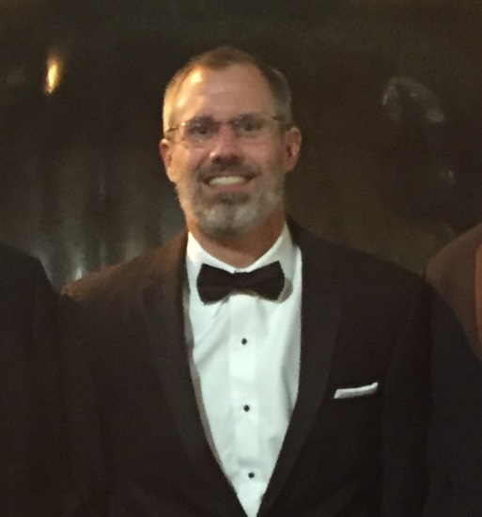
Committed Culture - Maintaining a Sense of Vulnerability
Chair:
Don Connolley
Co-Chair:
Eric Freiburger

Slide 6
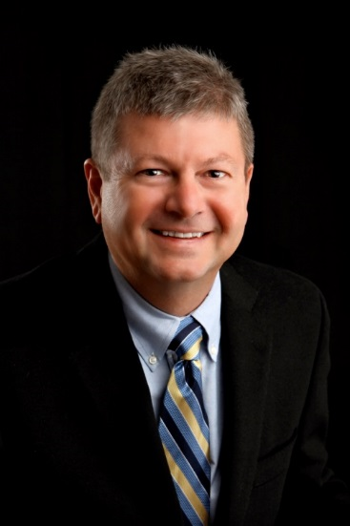
Vibrant Management Systems and Intentional Competency Development
Chair:
Jerry J. Forest
Co-Chair:
Ryan J. Hart

Slide 7
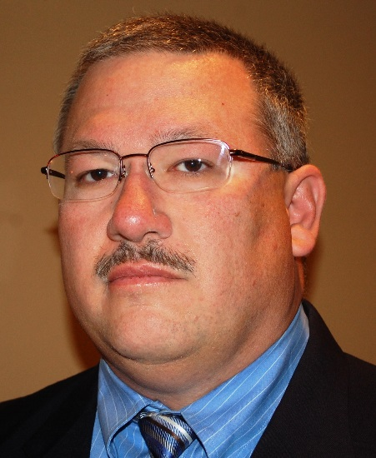
Disciplined Adherence to Standards
Chair:
John Wincek
Co-Chair:
Lizbeth Cisneros

Slide 8
Enhanced Application of Lessons Learned
Chair:
Ryan J. Hart
Co-Chair:
Jerry J. Forest

Slide 9
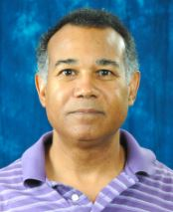
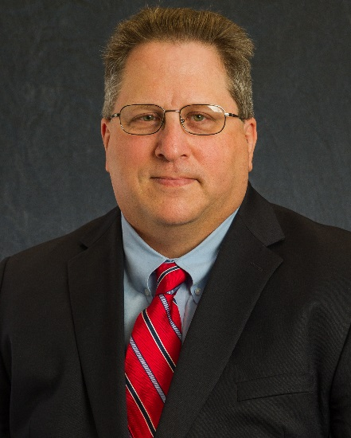
Societal Themes
Chair:
Bernard Groce
Co-Chair:
Martin Timm

Slide 10
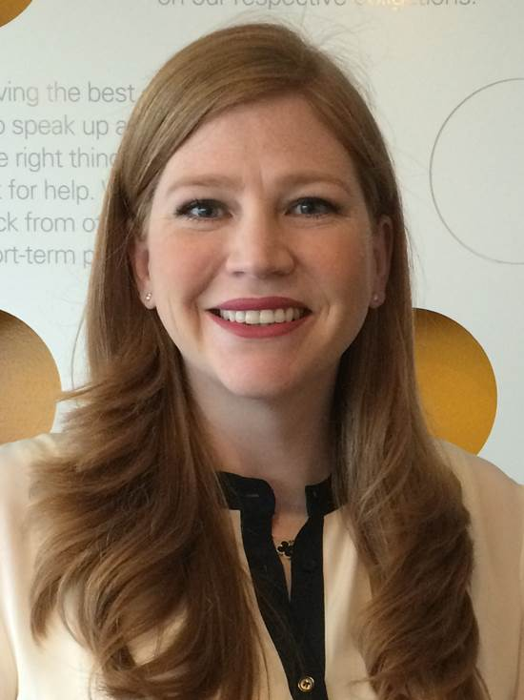
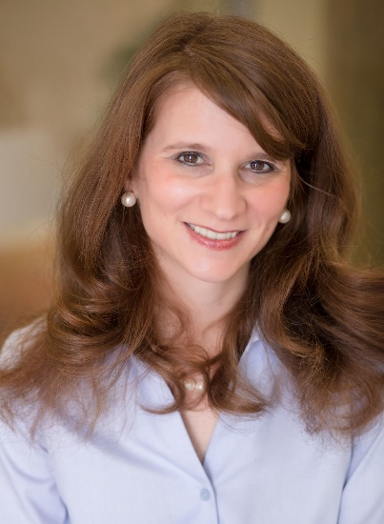
Journey Towards Vision 2020
Chair:
Samantha Scruggs
Co-Chair:
Marisa Pierce

Slide 11
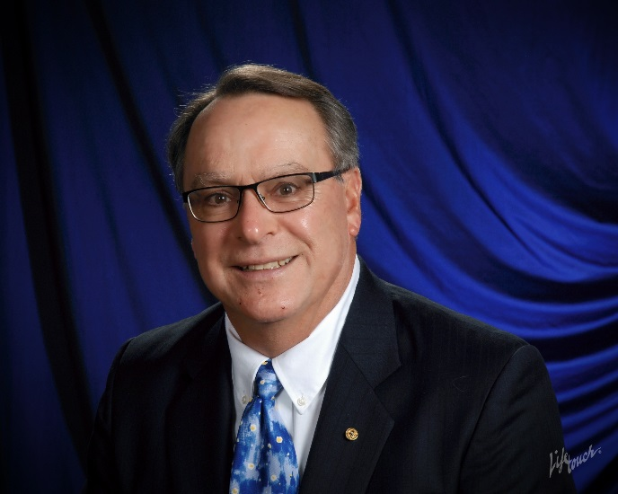
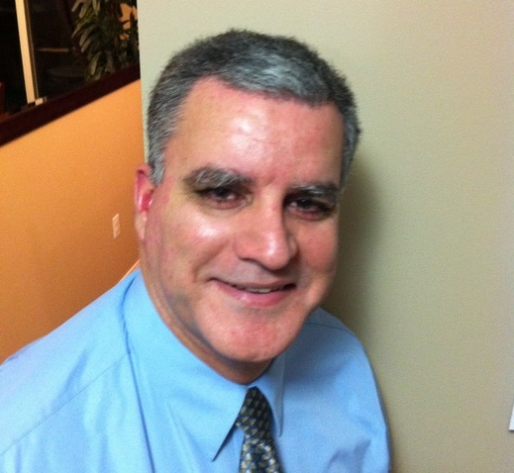
Featured CCPS Projects
Chair:
John Herber
Co-Chair:
Jonas Duarte

