Slide 1
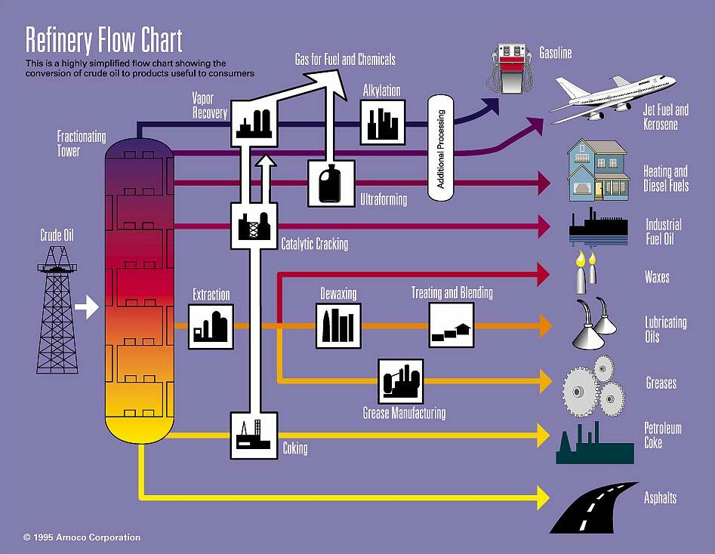
“Interviewing in the Energy Sector” hosted by AIChE Fuels and Petrochemicals Division
AIChE Annual Student Conference Career Workshops

Slide 2
Agenda
Background to Energy Opportunities
Before the Interview
During the Interview
After the Interview
After your are hired
Closing remarks

Slide 3
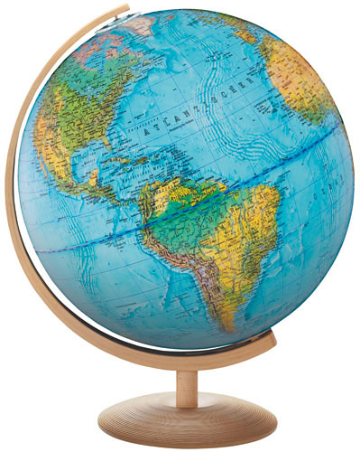
Why Work in Energy?
Technical Challenges
Societal Impact
High Salaries & Benefits
International Travel
Diversified Opportunities
ChE’s are Valued as Leaders

Slide 4
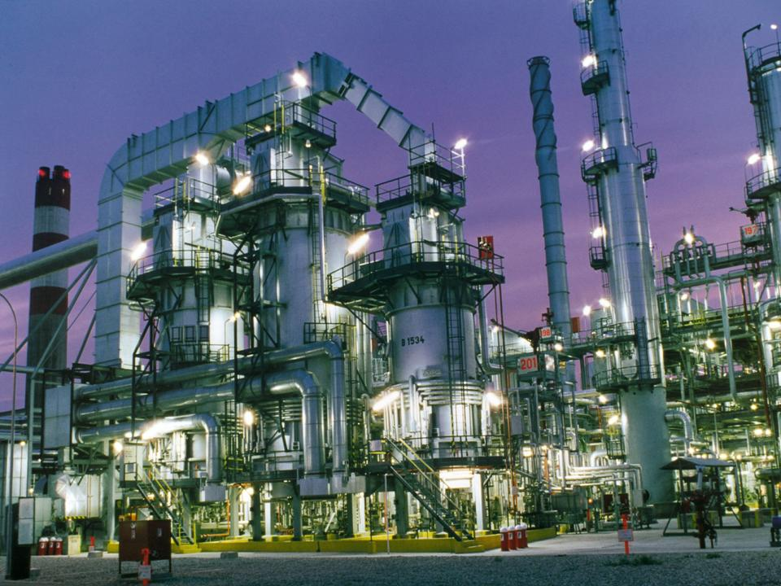
Typical Industry Opportunities
Operating Companies
Upstream
Midstream
Downstream
EPC Companies
Technology Vendors
Service Companies
Companies can range from very large to less than 10 employees

Slide 5
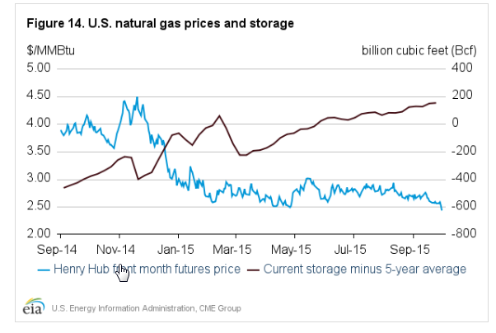
Current Market – Natural Gas

Slide 6
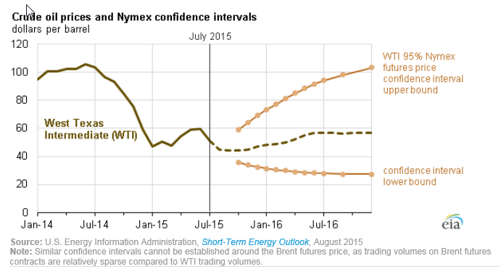
Current Market – Crude Oil

Slide 7
Interviewer Interaction
The interviewer is looking for the “right” balance of:
Technical Aptitude/Capability
Demonstrated Leadership
A person they can work with
People Aptitude
Enthusiasm, Interest
Flexibility
Communication Skills
“Grit”
What does the interviewer have to go on?
Academic record
Resume
Face to face interview
Internship (maybe?)
Campus interview (maybe?)
Phone interview (maybe?)
Does this person make my team better? Is this an engineer that I want on my next project?”

Slide 8
Get Organized!
Research the company before the interview
Know the company before interviewing
Understand what they are looking for
Your resume is a guide to the conversation
Emphasize previous experience and skills
Customize resume specific for each company
Where applicable, highlight benefits and value added work experience compared to skills
Prepare good questions
Look for a mutual good fit – you are interviewing the company as well
Look for opportunities to make you stand apart

Slide 9
Lunch/Dinner
This is probably part of the interview process. Be yourself! This person is trying to get to know you.
Are you the kind of person they would want to work with?
Ask lots of questions Show genuine interest. Let this meeting be part of your prep
This person got a job – learn from them
Be energetic, interested, professional
Most hiring managers will always talk to the person who took you to dinner before their interview.

Slide 10
At the Interview
Dress for Success. If you don’t know, ask or overdress.
Silence your phone in advance
Use positive body language
Be enthusiastic, engaging, and authentic. Make eye contact. Show interest. And mean it.
Create a two way conversation You are interested in this interviewer and company
Ask questions. Take the lead when it’s offered.
Be able to tell an interesting story that relates to the position/company.
Leadership
Working with / connecting with people
Technical depth
Ability to stick with tough challenges

Slide 11
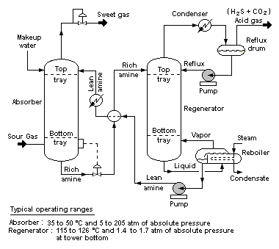
Differentiate Yourself
I know MS Office, same as everyone else…
I utilized MS Excel to uncover mass balance error – fix resulted in 3% increase in production.

Slide 12
Example of Good Questions!
Where do you make most of your revenue?
What are your most profitable products or services?
How many of your executive leaders are ChE’s?
What is a typical career path for a ChE?
What opportunities are there for training, travel, continuing education?
How do you help employees with work-life balance?
What is your strategy for globalization?
What is your strategy for growth?
Do you see my experience and skills as a good fit for this position?
Is there any reason why you don’t think I am right for this opportunity?

Slide 13
After the Interview
Before you leave, ask,
“What’s the next step?”
When can you expect to hear from them?
Thank everyone that you talk to
Send a follow-up note or email
Analyze your performance
What should I do differently next time?
Follow up

Slide 14
After the Job - Build A Network
Your first job most likely will not be your last
Remain on good terms with employers and past-employers
Interview widely to get to know many companies, see different business cultures
Keep contact with classmates
Be Professional – LinkedIn
Be careful about content – Facebook, Twitter – use social media wisely!
Stay involved with AIChE
Local Sections
Technical Divisions, such as Fuels & Petrochemicals
Be willing to offer assistance-best way to network

Slide 15
Join Fuels & Petrochemicals Division Free for students!!
BENENFITS
OPPORTUNITIES
Learn Today, Apply Tomorrow
Networking
Access to Past Presentations and Papers
Active Involvement
Mentorship with Young Professionals
Share News and Information
Outreach programs

Slide 16
What does the Fuels and Petrochemicals Division do?
The F&P Division provides a forum for the exchange of information and ideas among chemical engineers engaged in all phases of fuels and petrochemicals activities.
The Division provides opportunities to network with peers in the F&P Industry
The division coordinates activities through its own subcommittees, as well as with other societies in the field.
Petroleum Refining
Petrochemicals
Ethylene Producers
Each year, the F&P division sponsors some 350 papers in nearly 70 technical sessions at AIChE national meetings
Biofuels and Alternative Energy
Natural Gas
Environmental

Slide 17
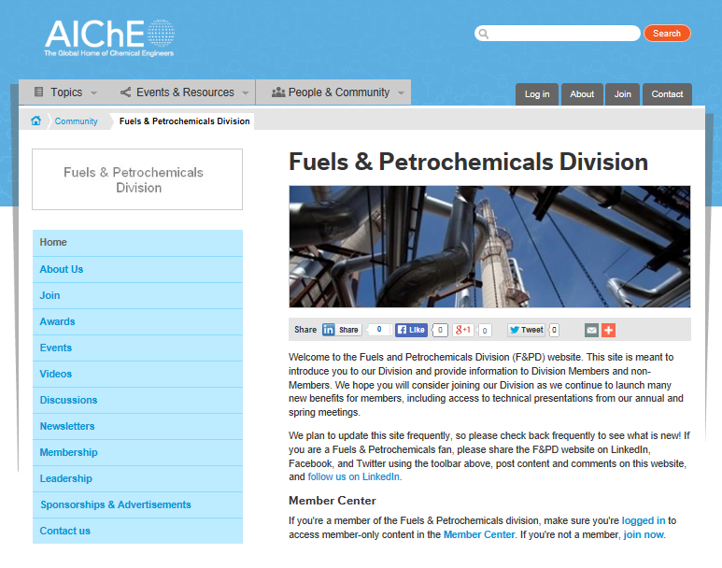
Fuels & Petrochemicals Division Website
www.aiche.org/fpd

Slide 18
Acknowledgements
F&PD Executive Committee
Dennis O’Brien – Chair
Richard Isherwood – Past Chair
Rick Kolodiziej – 1st Vice Chair
Ian M. Glasgow – 2nd Vice Chair
James Turner, Fluor
Greg Yeo, ExxonMobil

Slide 19
Questions?
There will also be a 30 minute Q&A Session at 1:00 and 3:30

