Slide 1
Brand Refresh: Division & Forum Recommendations
June 2019

Slide 2
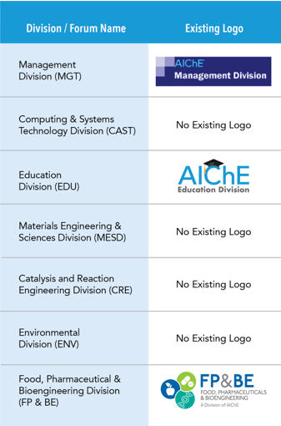
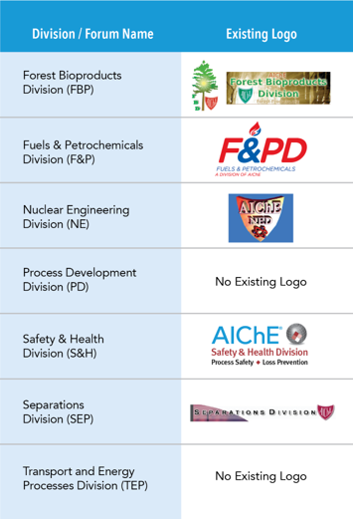
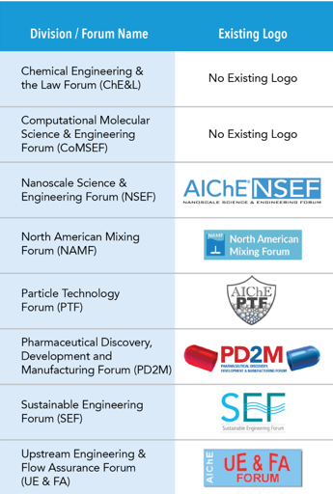
Current state
Not all D&Fs have logos
Inconsistent look & feel

Slide 3
Where we would like to be…
Consistent, modern, and clean look & feel
All divisions & forums have a logo they can use to help increase membership and engagement
Emphasize our AIChE community and reasons to be a part of it, one of them being our Divisions & Forums
Create a standard design format to use moving forward as we continue to grow

Slide 4
Logo Recommendation
Each division and forum will receive:
1 primary logo that features an icon and text to use on collateral they develop, e-newsletters, etc. Choose 1 out of 3 options.
1 secondary logo that is text based to use on smaller, horizontal spaces such as a promo item, like a pen. 1 option.
1 tertiary logo that is text based to use on social media. 1 option.

Slide 6
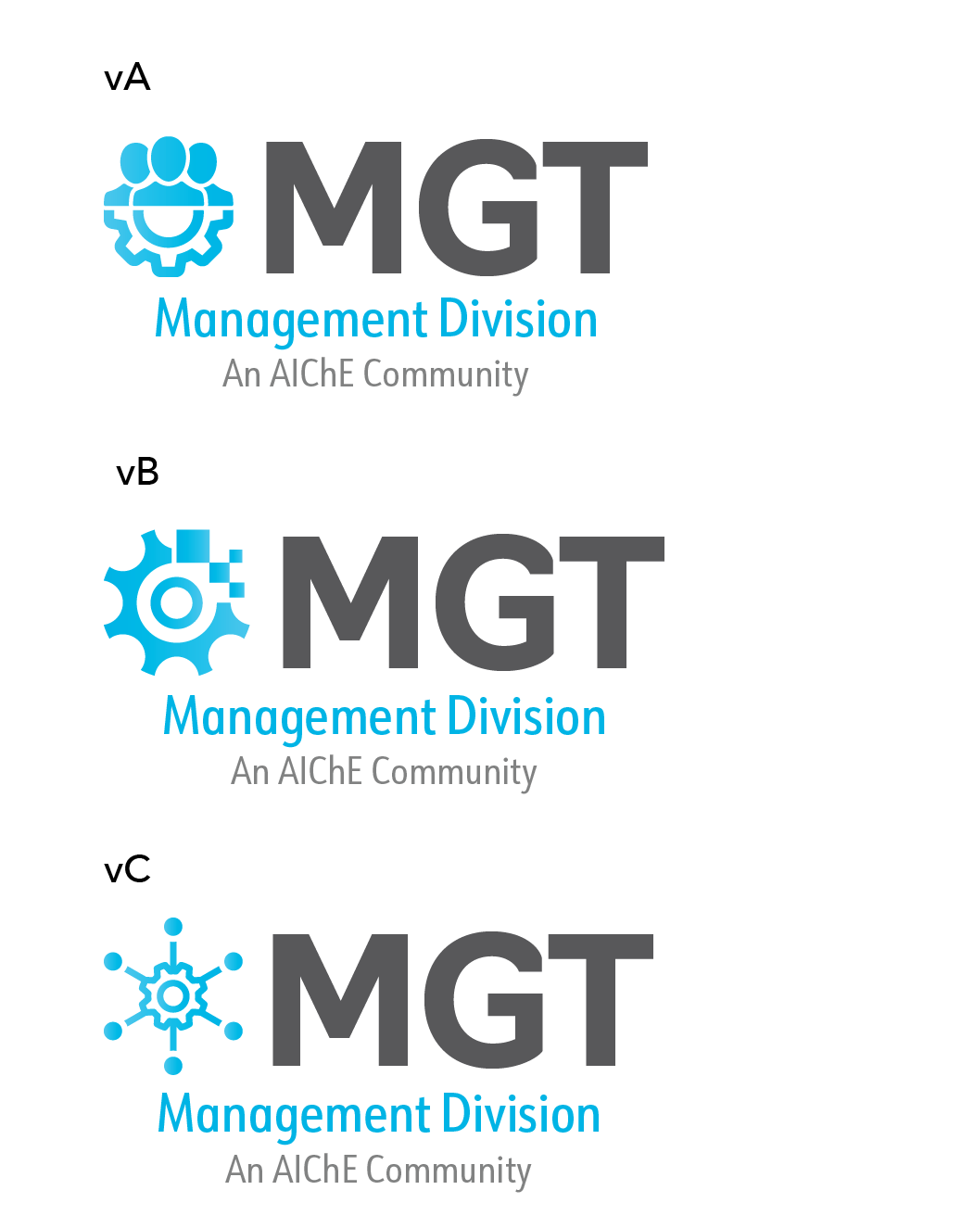
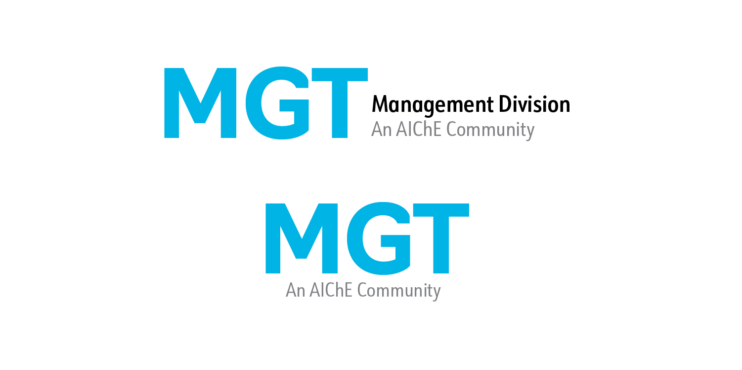
Management Division, growing our AIChE communities and creating a consistent brand is important. In saying this, we are excited to share with you three primary logos for you to choose from that align with AIChE branding. This logo will be your main logo to use for print and online. We know space can be tight, so that’s why we’ve also included 2 additional logos for you. Logo #2 is to be used on small promo items (like a pen) or horizontal spaces. Logo #3 is for your social media (such as your LinkedIn group profile image). Please select which version of the primary logo best speaks to your Division’s voice and brand by Friday, 7/19. If you have an additional icon idea, please provide that to us as well by the due date.
Example Communication to Mgt Division
Choose 1 primary logo
1
The following logos are to be used for smaller spaces and social media
2
3

Slide 7
Visualize your Division logo within the family of new and refreshed AIChE community logos. A consistent brand builds member loyalty and entices new members to join.
Example of what the AIChE family could look like
Please note that these are examples, and none of these logos are approved.

Slide 8
Summary roll-out plan
Date | Initiative
June 21st | Community Counts Divisions (CAST, EDU, MGT, MESD) receive primary logo options, text based logo (secondary logo) and social logo (tertiary logo).
By July 19th | Community Counts Leadership to choose primary logo and/or suggest a new icon.
By July 21st | All Division & Forum leadership will receive a text based logo (secondary logo) and social logo (tertiary logo).
By July 21st | CTOC leadership and AIChE staff begin to develop a suggested change management plan for those divisions and forums that already have a primary logo.
By August 1st | AIChE to share final primary logos with Community Counts Divisions for use.
By August 12th | Finalize change management plan.
By August 19th | Primary logo options sent via email to Division & Forums.
By Nov. 20th | Division & Forums provide final decision or icon suggestion for primary logo choice.
By Dec. 20th | Provide all final primary logos to Divisions & Forums
January 2020 | Launch a marketing campaign to promote the many communities that AIChE has to offer for member renewal and acquisition purposes, showcasing the refreshed logos for all the Division & Forums.

