Slide 1
September 2019 STS Meeting
Chair: Thomas E. (Tom) Rehm
Michael Foggia
Process Combustion Corporation (PCC)
Flameless Thermal Oxidation
Achieve 99.999% DRE at < 2 ppmv NOx

Slide 9
North Atlantic Category 5 Hurricanes:
2000-2015: 8
2016-2018: 4 (Matthew, Irma, Maria, Michael)

Slide 10
North Atlantic Category 5 Hurricanes:
2000-2015: 8
2016-2019: 5 (Matthew, Irma, Maria, Michael, Dorian)
Dorian
2019

Slide 11
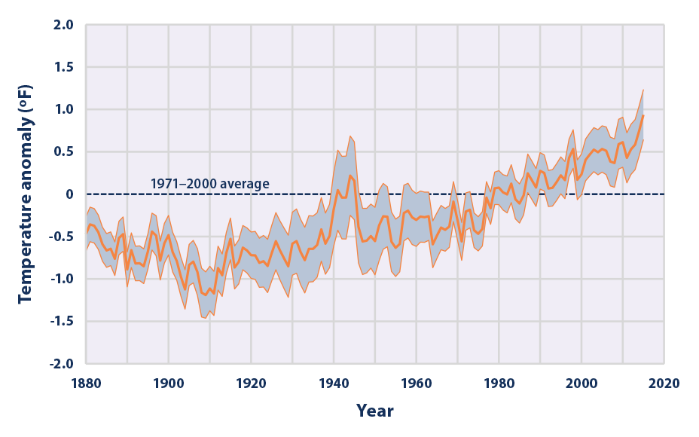
NOAA (National Oceanic and Atmospheric Administration). 2016. Extended reconstructed sea surface temperature (ERSST.v4). National Centers for
Environmental Information. Accessed March 2016. www.ncdc.noaa.gov/data-access/marineocean-data/extended-reconstructed-sea-surface-temperature-ersst.

Slide 12
Climate Solutions
Local Initiatives
  Climate Solutions for Texas, September 26 meeting
  Climate Solutions for Nigeria
  Climate Solutions for Illinois (now forming)
October 2nd Climate Solutions Session at SPTC
November 12th Climate Solutions Session at Annual Meeting
Local Happenings

Slide 13
Climate Solutions
Local Initiatives – Texas, Nigeria, Illinois
October 2nd Climate Solutions Session at SPTC
  Evidence of Climate Change: An Overview of the Science
  Stephanie Thomas, Geologist
  Strategic Approaches in Developing and Implementing Mitigating Solutions Hebab Quazi, Chemical Engineer
  Risky Business? The Very Tangible Supply Chain Threats of Climate Change Matthew Berg, Hydrologist
  Facility Preparedness to Solutions for Today and Tomorrow
  Rebecca Luman, Civil Engineer
November 12th Climate Solutions Session at Annual Meeting
Local Happenings

Slide 14
Climate Solutions
Local Initiatives – Texas, Nigeria, Illinois
October 2nd Climate Solutions Session at SPTC
November 12th Climate Solutions Session at Annual Meeting
  AIChE Climate Change Policy Review Process – New Policy
  Mary Ellen Ternes, Chemical Engineer and Environmental Lawyer
  Plastics and Greenhouse Gas Emissions
  Jeffrey Seay, University of Kentucky Chemical Engineering Professor
  Getting to Zero: Options for Decarbonizing Electricity in the United States Jesse Jenkins, Energy Systems Engineering & Policy, Princeton University
  Climate Solutions’ Path Forward
  Tom Rehm, Chemical Engineer
Local Happenings

Slide 15
Climate Solutions
Local Initiatives – Texas, Nigeria, Illinois
October 2nd Climate Solutions Session at SPTC
November 12th Climate Solutions Session at Annual Meeting
Local Happenings
  September 26, Climate Solutions for Texas Meeting
  October 19, Houston Energy Day
  20Q1, Climate Solutions Seminar
  AIChE Spring Meeting, March 29 – April 2, 2020, Houston
  Climate Solutions Session: Climate Solutions for Large Industrial Areas

Slide 16
Climate Solutions
Local Initiatives – Texas, Nigeria, Illinois
October 2nd Climate Solutions Session at SPTC
November 12th Climate Solutions Session at Annual Meeting
Local Happenings
The Climate Solutions Community – getting involved
  Studies
  Local Initiatives
  Liaisons

Slide 17
Climate Solutions
Local Initiatives – Texas, Nigeria, Illinois
October 2nd Climate Solutions Session at SPTC
November 12th Climate Solutions Session at Annual Meeting
Local Happenings
The Climate Solutions Community – Studies
  Electrical Grid Stability
  Electricity Baseload Generation
  Nuclear Generation IV Technology – Fuel Recycling

Slide 18
Climate Solutions
Local Initiatives – Texas, Nigeria, Illinois
October 2nd Climate Solutions Session at SPTC
November 12th Climate Solutions Session at Annual Meeting
Local Happenings
The Climate Solutions Community – Studies
AIChE 2020 Spring Meeting, Houston TX

Slide 19
Climate Solutions
Local Initiatives – Texas, Nigeria, Illinois
October 2nd Climate Solutions Session at SPTC
November 12th Climate Solutions Session at Annual Meeting
Local Happenings
The Climate Solutions Community – Studies
AIChE 2020 Spring Meeting, Houston TX
  Climate Solutions for Large Industrial Areas

Slide 20
… because nuclear plants do not emit carbon dioxide, this energy source will have a part in any long-term plan to reduce our national carbon footprint.

Slide 21
July 20, 2019
… how AIChE sections conduct government relations. We would love to learn about South Texas’ best practices to share with other local sections.

Slide 22
Excerpt from 3/31/2019 AIChE Press Release on Launch of The Climate Solutions Community
July 20, 2019
… how AIChE sections conduct government relations. We would love to learn about South Texas’ best practices to share with other local sections.

Slide 23
11th Southwest Process Technology Conference
October 1-2, 2019
Sugar Land Marriott Town Square
Notes:
The South Texas Section of the American Institute of Chemical Engineers, in partnership with the AIChE headquarters, is hosting its 11th annual AIChE Southwest Process Technology Conference at the Sugar Land Marriott Town Square, October 1-2. The conference provides technical sessions, industry solutions in process technology, and networking opportunities for the nearly 500 chemical engineers and students that attend, as well as exhibits, a career fair, a happy hour reception and a student program.

Slide 24
11th Southwest Process Technology Conference
October 1-2, 2019
Sugar Land Marriott Town Square
Sessions (9)
  Energy Efficiency
  Catalysis & Reaction Engineering
  IIoT/Big Data
  Process Intensification
  Process Safety
  Distillation & Separation
  Climate Solutions
  Petroleum Refining Technology
  Chemical Process Technology
Notes:
The South Texas Section of the American Institute of Chemical Engineers, in partnership with the AIChE headquarters, is hosting its 11th annual AIChE Southwest Process Technology Conference at the Sugar Land Marriott Town Square, October 1-2. The conference provides technical sessions, industry solutions in process technology, and networking opportunities for the nearly 500 chemical engineers and students that attend, as well as exhibits, a career fair, a happy hour reception and a student program.

Slide 25
11th Southwest Process Technology Conference
October 1-2, 2019
Sugar Land Marriott Town Square
Sessions (9)
October 1 Keynote Session. John Hofmeister, 2005-2008 Shell Oil Company President, Energy Transition
October 1 South Texas Section Dinner. Joseph Powell, Shell Chief Scientist, Chemical Engineering, Addressing Climate Change: An Energy Industry Perspective
October 2 Keynote Session. Eric Cosman, 2020 President of the International Society of Automation (ISA), Imperatives for the Automation Profession in a Changing World
Exhibition Hall
Career Fair
Notes:
The South Texas Section of the American Institute of Chemical Engineers, in partnership with the AIChE headquarters, is hosting its 11th annual AIChE Southwest Process Technology Conference at the Sugar Land Marriott Town Square, October 1-2. The conference provides technical sessions, industry solutions in process technology, and networking opportunities for the nearly 500 chemical engineers and students that attend, as well as exhibits, a career fair, a happy hour reception and a student program.

Slide 26
11th Southwest Process Technology Conference
October 1-2, 2019
Sugar Land Marriott Town Square
Sessions (9)
October 1 Keynote Session. John Hofmeister, 2005-2008 Shell Oil Company President, Energy Transition
October 1 South Texas Section Dinner. Joseph Powell, Shell Chief Scientist, Chemical Engineering, Addressing Climate Change: An Energy Industry Perspective
October 2 Keynote Session. Eric Cosman, 2020 President of the International Society of Automation (ISA), Imperatives for the Automation Profession in a Changing World
Exhibition Hall
Career Fair
Notes:
The South Texas Section of the American Institute of Chemical Engineers, in partnership with the AIChE headquarters, is hosting its 11th annual AIChE Southwest Process Technology Conference at the Sugar Land Marriott Town Square, October 1-2. The conference provides technical sessions, industry solutions in process technology, and networking opportunities for the nearly 500 chemical engineers and students that attend, as well as exhibits, a career fair, a happy hour reception and a student program.

Slide 27
11th Southwest Process Technology Conference
October 1-2, 2019
Sugar Land Marriott Town Square
Sessions (9)
October 1 Keynote Session. John Hofmeister, 2005-2008 Shell Oil Company President, Energy Transition
October 1 South Texas Section Dinner. Joseph Powell, Shell Chief Scientist, Chemical Engineering, Addressing Climate Change: An Energy Industry Perspective
October 2 Keynote Session. Eric Cosman, 2020 President of the International Society of Automation (ISA), Imperatives for the Automation Profession in a Changing World
Exhibition Hall
Career Fair
Notes:
The South Texas Section of the American Institute of Chemical Engineers, in partnership with the AIChE headquarters, is hosting its 11th annual AIChE Southwest Process Technology Conference at the Sugar Land Marriott Town Square, October 1-2. The conference provides technical sessions, industry solutions in process technology, and networking opportunities for the nearly 500 chemical engineers and students that attend, as well as exhibits, a career fair, a happy hour reception and a student program.

Slide 28
11th Southwest Process Technology Conference
October 1-2, 2019
Sugar Land Marriott Town Square
Sessions (9)
October 1 Keynote Session. John Hofmeister, 2005-2008 Shell Oil Company President, Energy Transition
October 1 South Texas Section Dinner. Joseph Powell, Shell Chief Scientist, Chemical Engineering, Addressing Climate Change: An Energy Industry Perspective
October 2 Keynote Session. Eric Cosman, 2020 President of the International Society of Automation (ISA), Imperatives for the Automation Profession in a Changing World
Exhibition Hall
Career Fair
Notes:
The South Texas Section of the American Institute of Chemical Engineers, in partnership with the AIChE headquarters, is hosting its 11th annual AIChE Southwest Process Technology Conference at the Sugar Land Marriott Town Square, October 1-2. The conference provides technical sessions, industry solutions in process technology, and networking opportunities for the nearly 500 chemical engineers and students that attend, as well as exhibits, a career fair, a happy hour reception and a student program.

Slide 29
11th Southwest Process Technology Conference
October 1-2, 2019
Sugar Land Marriott Town Square
Conference Registration at the Early Bird Rate ended August 26 for almost everyone … except for those here tonight
Notes:
The South Texas Section of the American Institute of Chemical Engineers, in partnership with the AIChE headquarters, is hosting its 11th annual AIChE Southwest Process Technology Conference at the Sugar Land Marriott Town Square, October 1-2. The conference provides technical sessions, industry solutions in process technology, and networking opportunities for the nearly 500 chemical engineers and students that attend, as well as exhibits, a career fair, a happy hour reception and a student program.

Slide 30
11th Southwest Process Technology Conference
October 1-2, 2019
Sugar Land Marriott Town Square
Conference Registration at the Early Bird Rate ended August 26 for almost everyone … except for those here tonight who write down this special code.
2019STSEB
This code will get you the Early Bird Rate if used by 11:59PM EST on Monday, September 9.
Notes:
The South Texas Section of the American Institute of Chemical Engineers, in partnership with the AIChE headquarters, is hosting its 11th annual AIChE Southwest Process Technology Conference at the Sugar Land Marriott Town Square, October 1-2. The conference provides technical sessions, industry solutions in process technology, and networking opportunities for the nearly 500 chemical engineers and students that attend, as well as exhibits, a career fair, a happy hour reception and a student program.

Slide 31
CALL FOR 2019 SPTC VOLUNTEERS:
Volunteer duties typically include working at registration, as session aides for the technical presentations, assisting exhibitors, working meals and collecting event tickets.
Volunteers will receive free registration for the day or days they volunteer. If you are interested contact David Silarski at sts-membership@aiche.org and let him know if you can work one or both days.
Further information including confirmation and a schedule will be sent out later. It will be a greater conference because of your assistance.

Slide 32
CALL FOR 2019 SPTC VOLUNTEERS:
Volunteer duties typically include working at registration, as session aides for the technical presentations, assisting exhibitors, working meals and collecting event tickets.
Volunteers will receive free registration for the day or days they volunteer. If you are interested contact David Silarski at sts-membership@aiche.org and let him know if you can work one or both days.
Further information including confirmation and a schedule will be sent out later. It will be a greater conference because of your assistance.

Slide 33
CALL FOR 2019 SPTC VOLUNTEERS:
Volunteer duties typically include working at registration, as session aides for the technical presentations, assisting exhibitors, working meals and collecting event tickets.
Volunteers will receive free registration for the day or days they volunteer. If you are interested contact David Silarski at sts-membership@aiche.org and let him know if you can work one or both days.
Further information including confirmation and a schedule will be sent out later. It will be a greater conference because of your assistance.

Slide 34
CALL FOR 2019 SPTC VOLUNTEERS:
Volunteer duties typically include working at registration, as session aides for the technical presentations, assisting exhibitors, working meals and collecting event tickets.
Volunteers will receive free registration for the day or days they volunteer. If you are interested contact David Silarski at sts-membership@aiche.org and let him know if you can work one or both days.
Further information including confirmation and a schedule will be sent out later. It will be a greater conference because of your assistance.

Slide 35
CALL FOR 2019 SPTC VOLUNTEERS:
Volunteer duties typically include working at registration, as session aides for the technical presentations, assisting exhibitors, working meals and collecting event tickets.
Volunteers will receive free registration for the day or days they volunteer. If you are interested contact David Silarski at sts-membership@aiche.org and let him know if you can work one or both days.
Further information including confirmation and a schedule will be sent out later. It will be a greater conference because of your assistance.

Slide 36
CALL FOR 2019 SPTC VOLUNTEERS:
Volunteer duties typically include working at registration, as session aides for the technical presentations, assisting exhibitors, working meals and collecting event tickets.
Volunteers will receive free registration for the day or days they volunteer. If you are interested contact David Silarski at sts-membership@aiche.org and let him know if you can work one or both days.
Further information including confirmation and a schedule will be sent out later. It will be a greater conference because of your assistance.

Slide 37
CALL FOR 2019 SPTC VOLUNTEERS:
Volunteer duties typically include working at registration, as session aides for the technical presentations, assisting exhibitors, working meals and collecting event tickets.
Volunteers will receive free registration for the day or days they volunteer. If you are interested contact David Silarski at sts-membership@aiche.org and let him know if you can work one or both days.
Further information including confirmation and a schedule will be sent out later. It will be a greater conference because of your assistance.

Slide 38
CALL FOR 2019 SPTC VOLUNTEERS:
Volunteer duties typically include working at registration, as session aides for the technical presentations, assisting exhibitors, working meals and collecting event tickets.
Volunteers will receive free registration for the day or days they volunteer. If you are interested contact David Silarski at sts-membership@aiche.org and let him know if you can work one or both days.
Further information including confirmation and a schedule will be sent out later. It will be a greater conference because of your assistance.

Slide 39

Silver Sponsor Bronze Sponsor

Slide 40
2019 Offshore Technology Conference
South Texas Section – AIChE 2019 OTC Volunteers
The STS – AIChE received a $1,000 honorarium from the OTC, thanks to STS volunteers who provided more than 64 hours of volunteer time. Thanks to all of them and to Tom Menn for herding all these cool cats:
Dewayne Anderson, Susan Bayley, Steven Briley, Arthur Camero, Ryan Chun, Yurika Diaz Bialowas, Joseph Greenbaum, James Grubb, Sivashankarappay Gurusiddappa, Debra Haney, Dannis Jen, Jim Keller, Marie Laplante, Ken Lloyd, Ric Massie, James Menn, John Middleton, Bob Naeger, Mary Needham, Israel Perez, Syamal Poddar, Tushar Poddar, Gary Reeves, Stephany Romanow, Carlos Salamanca, Tushar Shah, Tencha Shoemaker, David Silarski, Mark Smith, Roger Trandell, Deanna Wightman, James Woods, John Woods

Slide 41
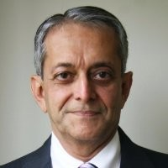
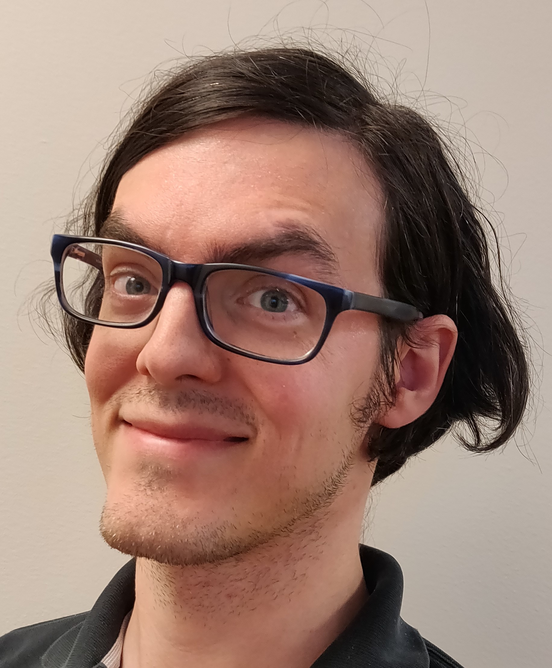
Thanks to Tonight’s Workshop Speakers
Jimmy Kumana, Kumana & Associates
Using CHP Simulation Models to Accurately Predict True Net Utilities OPEX Impact of Proposed or Planned Plant Projects
Trevor Rice, Chemstations Inc.
Multi-Variable LNG Optimization Using Parallelized Simulator with Integrated Optimizer
Notes:
I would like to recognize our Workshop Speakers. Could you stand when I call your name and remain standing. Charles Herzog presented a workshop on Achieving Test Run Objectives with Advance Preparation and Real Time Information. Lisa Smith presented a workshop on Blockchain in the Chemical Industry.
We thank you very much for your time and efforts in improving our knowledge in these areas, and for joining us these evening.

Slide 42
Spring 2020 PE Review Course for Chemical Engineering
Friday, January 31 - April 24, 2020, 4:00pm CST
University of Houston Main Campus - Cullen College of Engineering 1
4726 Calhoun Rd.
Houston, TX
Course Cost
Members of both National AIChE & STS $650
Non-members $900
cut-off for class registration: January 19th
For more details, take Events link on STS main menu and go down to Upcoming Events.

Slide 43
Thanks to my Executive Committee Colleagues
Mark Harkness, Chair Elect
Carlos Salamanca, Past Chair
Debra McCall Haney, Secretary
Yurika Diaz Bialowas, Treasurer
Babak Rafienia, Education Officer
Sheena Reeves, Outreach Officer
Meghan Spivak, Communications Officer
William Pittman, Human Resources Officer

Slide 44
Rising Scholarships
Ozem Franklin
Katie Givans
Nicholas Sims
Congratulations!

Slide 45
South Texas Section Holiday Social
Thursday, December 5
A Mystery Murder Dinner
Venue: TBD

Slide 46

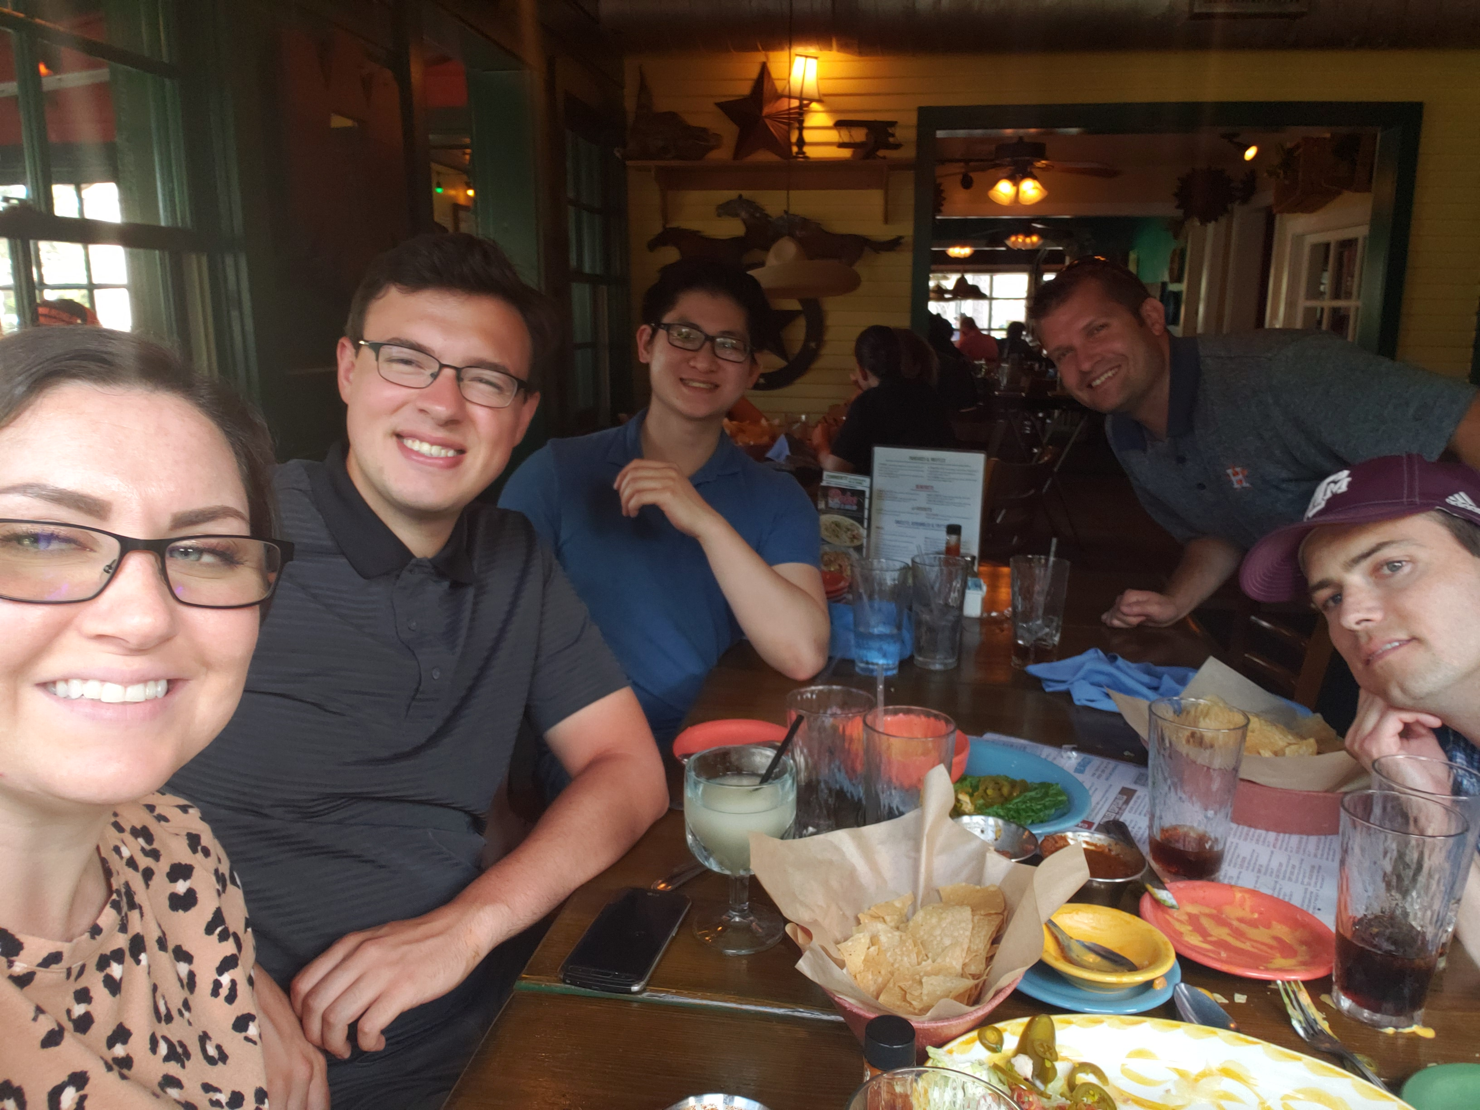
May 2019 Happy Hour at Lupe Tortilla
Notes:
46

Slide 47
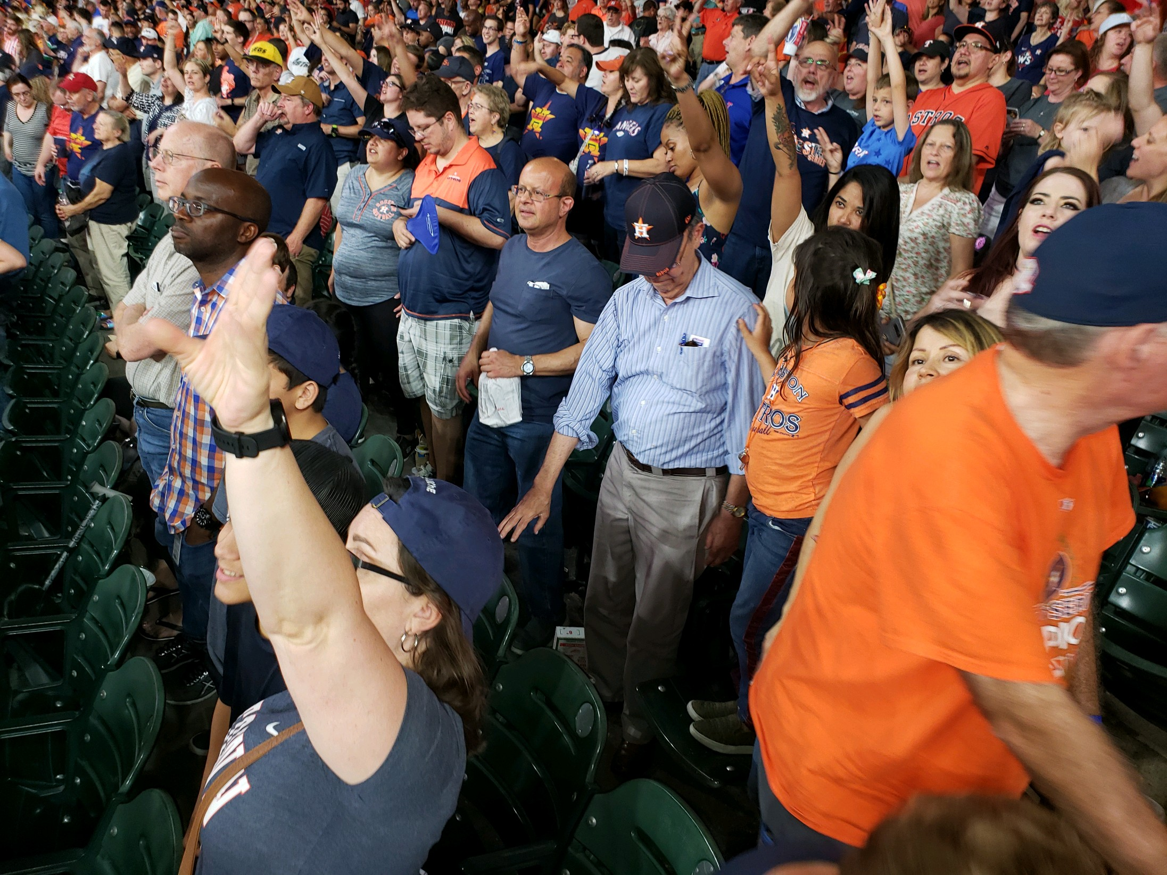
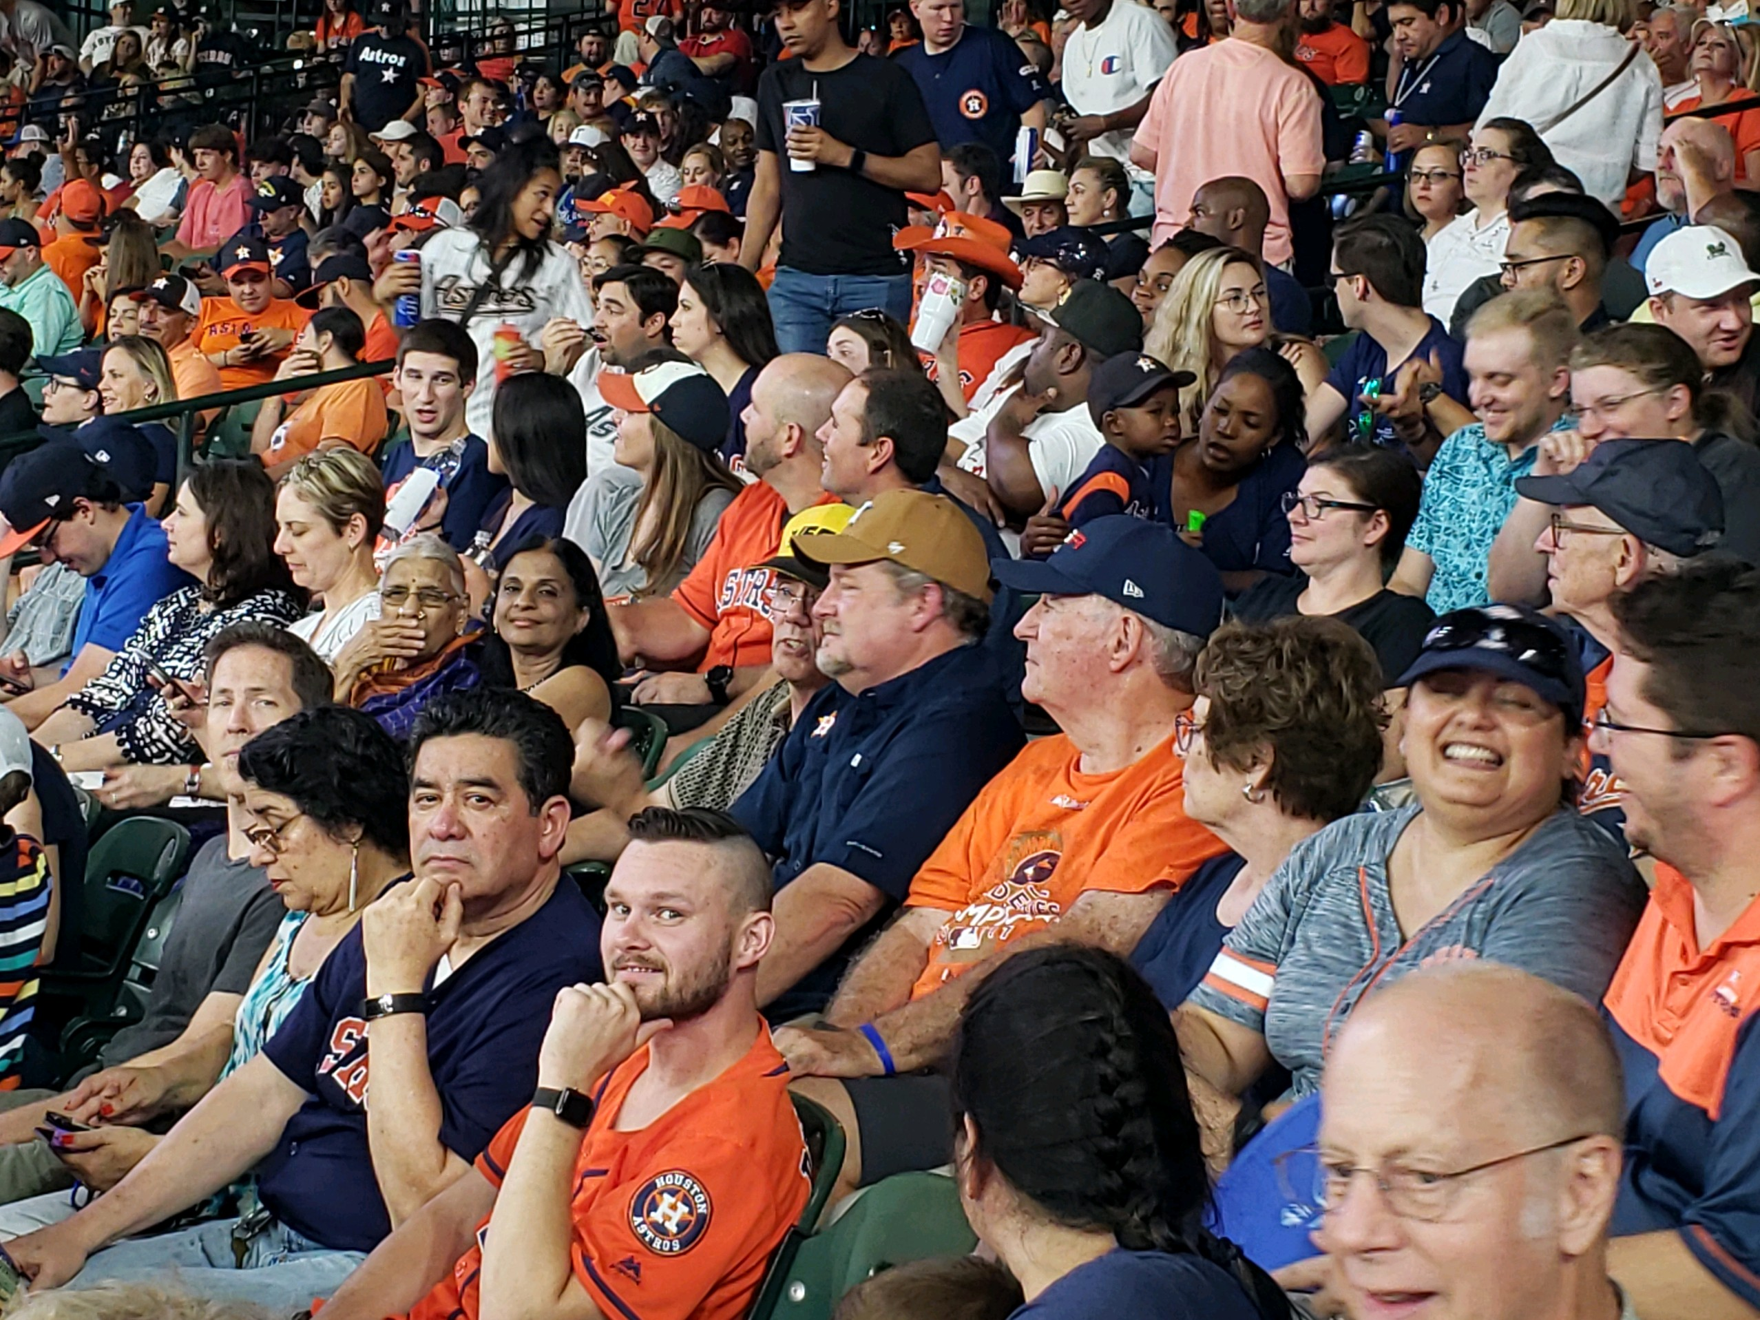
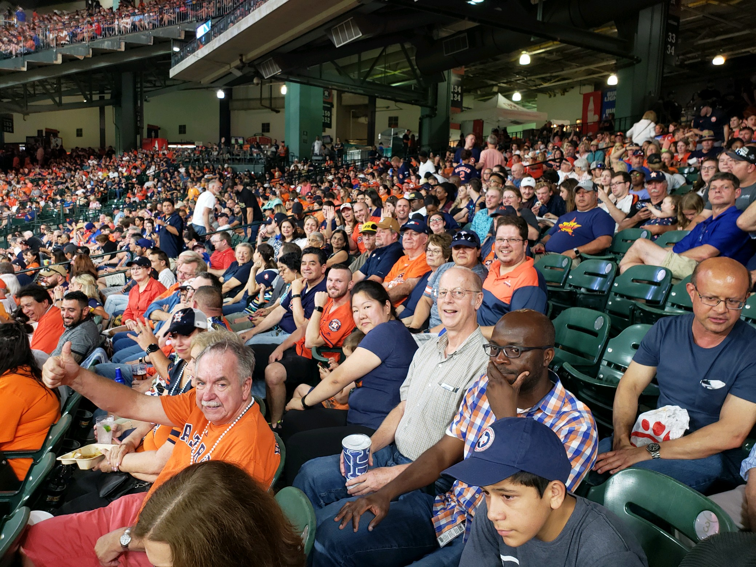
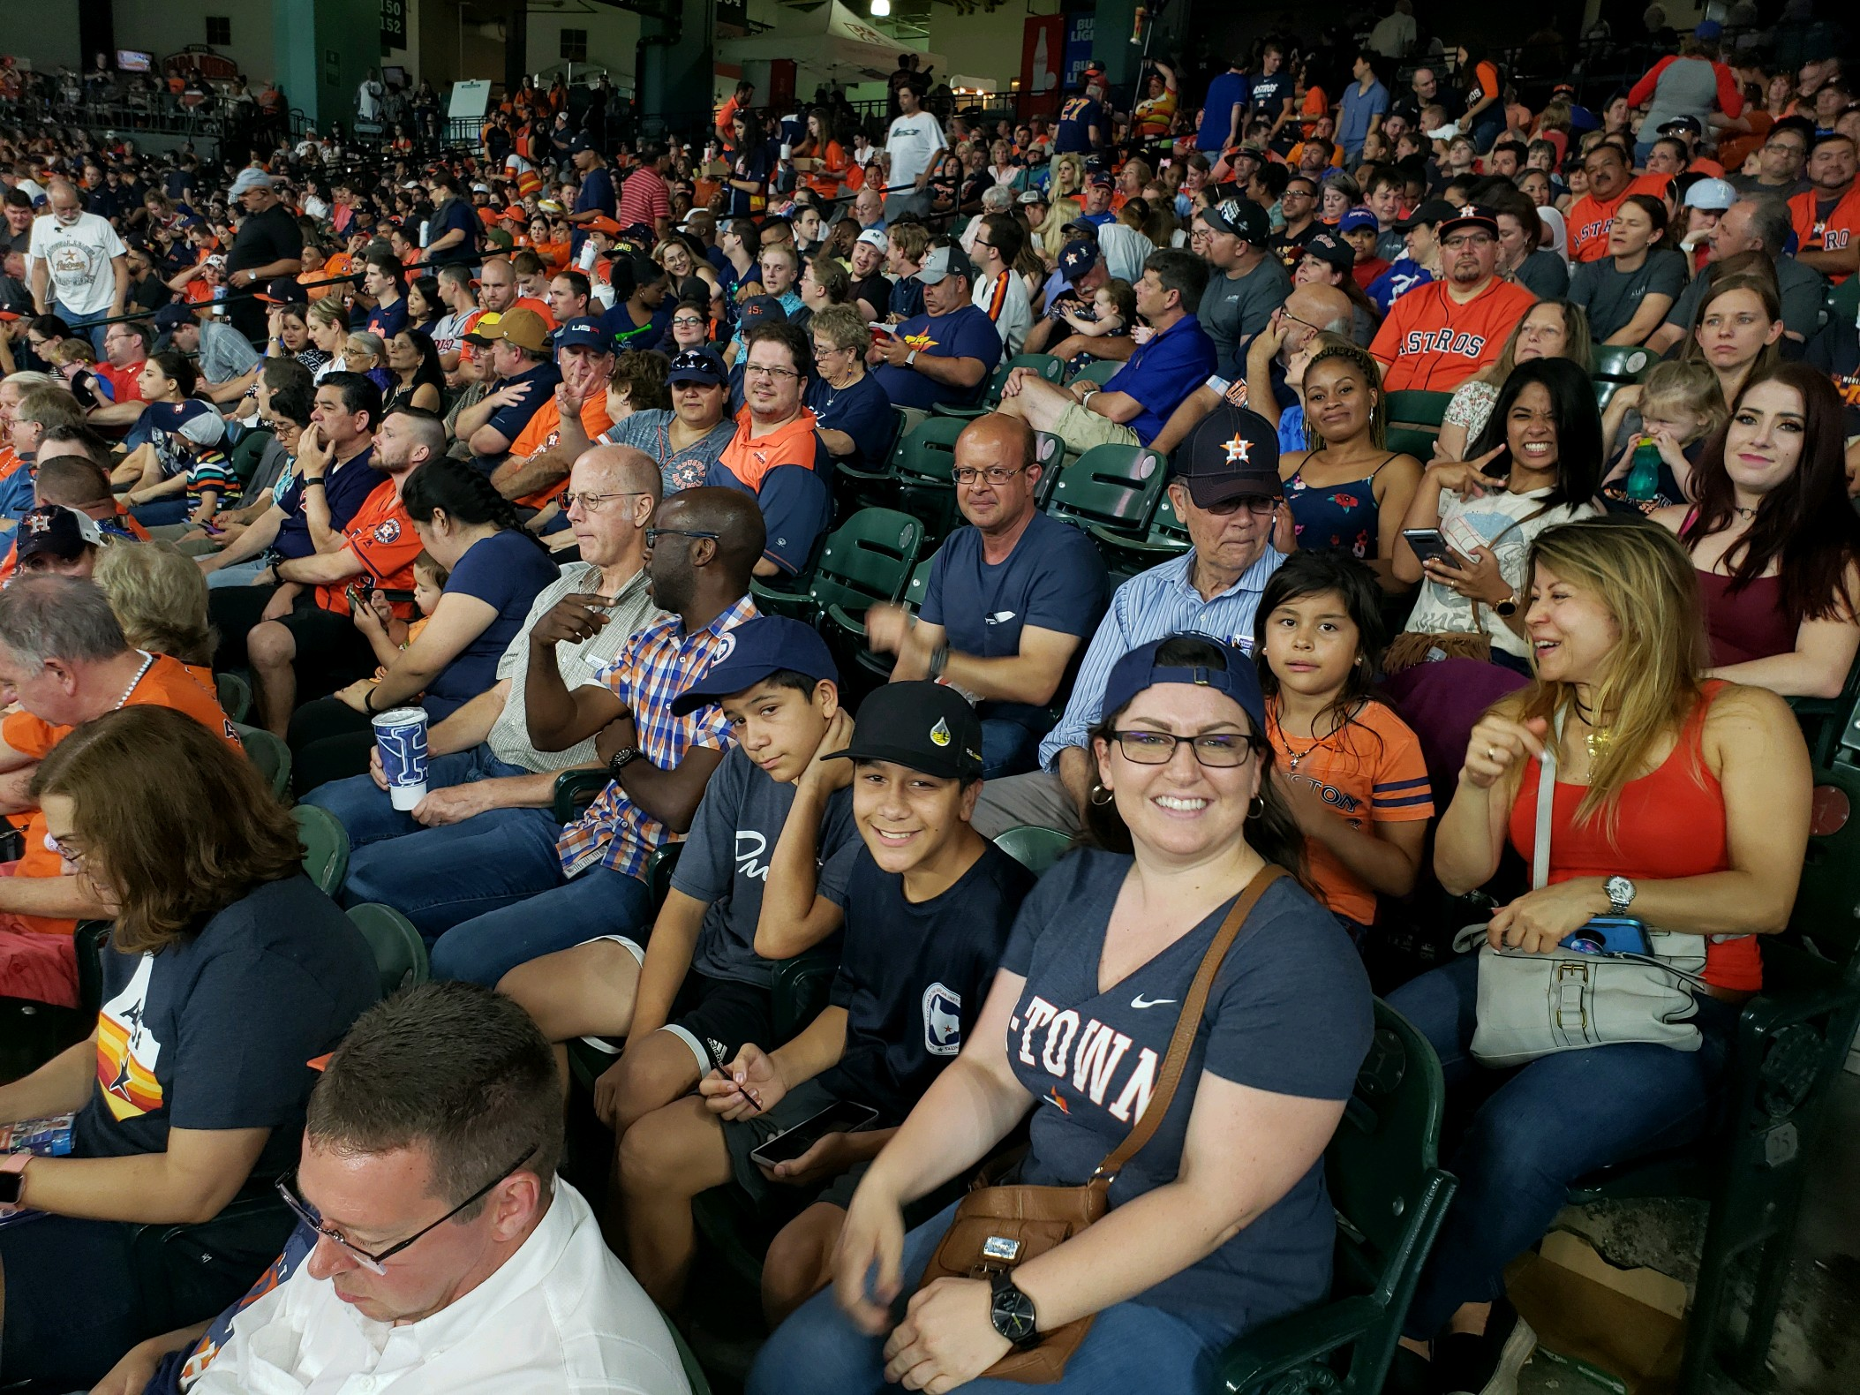
Annual Astros Game
Notes:
47

Slide 48
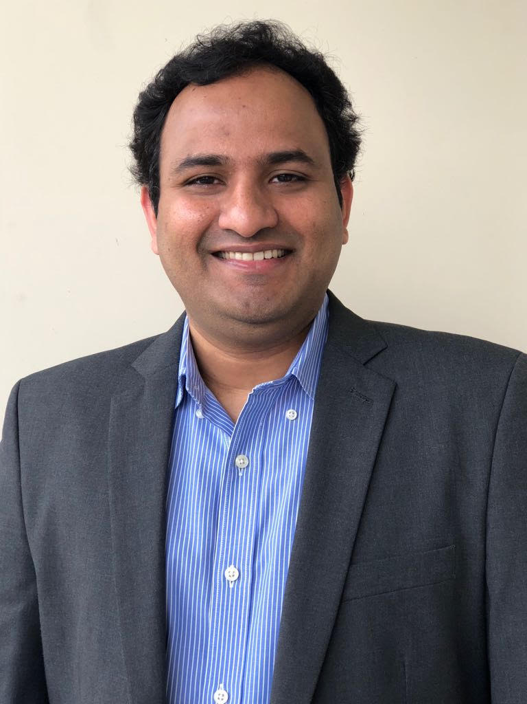
YP of the Month
Srihari Maganti
Senior Process Safety Consultant at Brown and Root Industrial Services
He is an active member of AIChE national and South Texas Section (STS)
  AIChE Young Professional (YP) Directory Coordinator from 2012 to 2014
  AIChE YP Gulf Region Representative from 2014 to 2015
  2018 STS YP Treasurer
  2019 STS YP Co-chair
  Chaired/co-chaired various AIChE and Global Congress on Process Safety technical sessions.
Ph.D. in Chemical Engineering from South Dakota School of Mines & Technology.
Notes:
48

Slide 49

September 2019 Happy Hour
Get More Involved with STS and the YPs!!
Date: September 27th, 2019
Location: Bovine and Barley
416 Main St, Houston, TX 77002
Time: 4:00pm – 7:00pm
RSVP: Contact Emily Jackson
(e.jackson.ut@gmail.com or
512-661-8223) or e-mail
sts-yp@aiche.org
Notes:
49

Slide 50
University Outreach
This fall the Young Professionals will be reaching out to local AIChE university chapters to discuss career opportunities, industry experience, and more!
To volunteer please contact Emily Jackson at e.jackson.ut@gmail.com
We’d love to have you join!
Notes:
50

Slide 51
December Social
Save the Date: December 5th
Join AIChE STS for a Murder Mystery Dinner!
Location, Tickets, and Time to be announced soon!
Please keep an eye out for an e-blast with a link to register!
Notes:
51

Slide 52
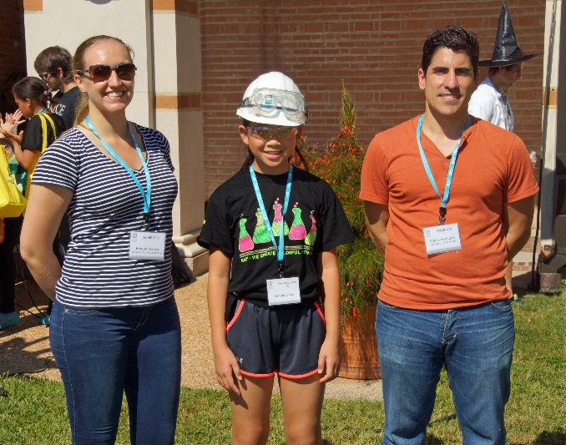
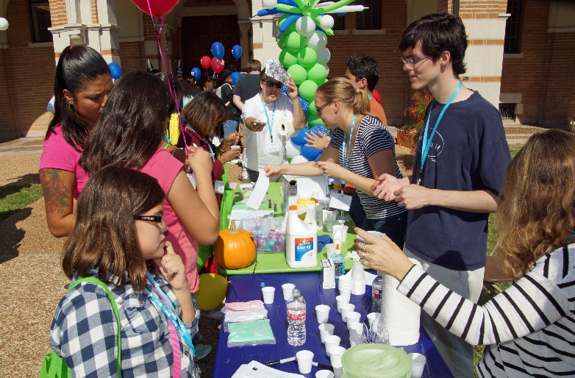
Sally Ride STEM Festival
• Saturday, October 12, 2019 at Rice University
• 10:30 a.m. – 4:30 p.m.
• Volunteers Needed—Free lunch & parking
• Contact Matt Kolodney 713-471-8956

Slide 53
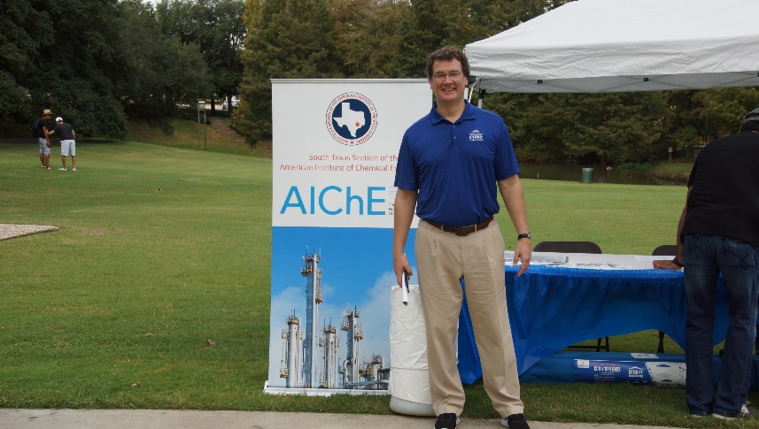
Upcoming K-12 Outreach Event
Energy Day: Saturday October 20
10:00 – 4:00 at Sam Houston Park (downtown)
Lunch & Parking Costs Reimbursed
The chair of the event is inviting our volunteers
Contact Matt Kolodney
713-471-8956

Slide 54
Congratulation for 50 Years of AIChE Membership to: Don Petree
BSChE, University of California, 1961
MS, Cal. Davis
  1964: Food Science
  1966: Chemical Engineering
Studied at Stanford and M.I.T.
Worked for:
  Phillips Petroleum for 27 years.
  Continental Can Company for 2 years.
In the Air Force Reserves from 1958 to 1964.
  Called into active duty in 1962 for the Cuban Missile Crisis

Slide 55
Congratulation for 50 Years of AIChE Membership to: Don Petree
Holds 2 Patents
Author on 6 papers
Hobbies:
  Tennis
  Bowling (perfect game in 1979)
  Senior Olympics
Family:
  Wife: Vickie Petree
  2 Sons
  5 grandchildren (1 grandson, 4 granddaughters)
  1 great granddaughter

Slide 56
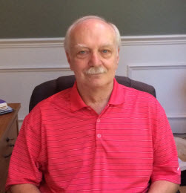
Tonight’s After-Dinner Speaker
Michael Foggia
Business Development and Marketing Manager for Process Combustion Corporation, Pittsburgh PA
Flameless Thermal Oxidation:
Achieve 99.999% DRE at < 2 ppmv NOx

Slide 57
Tonight’s Pop Quiz
Global energy-related CO2 emissions in 2018 reached an all-time high. How much greater were these 2018 emissions than corresponding 2017 emissions? 0.5%, 1.7%, 2.9%
As of 2019 there are 17 operating CCS projects in the world. What percentage of 2018 global energy-related CO2 emissions was stored geologically by carbon capture and storage? 0.01%, 0.02%, 0.03%
Notes:
Per https://www.iea.org/geco/emissions/, global energy-related CO2 emissions grew 1.7% in 2018 to reach a historic high of 33.1 Gt CO2. The incremental increase in global energy-related CO2 emissions was 550 Mt of CO2.
As of 2019 there are 17 operating CCS projects in the world, capturing 31.5 Mt of CO2 per year, of which 3.7 is stored geologically.

Slide 58
Tonight’s Pop Quiz
Global energy-related CO2 emissions in 2018 reached an all-time high. How much greater were these 2018 emissions than corresponding 2017 emissions? 0.5%, 1.7%, 2.9% (https://www.iea.org/geco/emissions/)
As of 2019 there are 17 operating CCS projects in the world. What percentage of 2018 global energy-related CO2 emissions was stored geologically by carbon capture and storage? 0.01%, 0.02%, 0.03% (BECCS deployment: a reality check, MATHILDE FAJARDY et al, Imperial College, London)
Notes:
Per https://www.iea.org/geco/emissions/, global energy-related CO2 emissions grew 1.7% in 2018 to reach a historic high of 33.1 Gt CO2. The incremental increase in global energy-related CO2 emissions was 550 Mt of CO2.
As of 2019 there are 17 operating CCS projects in the world, capturing 31.5 Mt of CO2 per year, of which 3.7 is stored geologically.

