Slide 1
Process Digital Twins for Optimal Plant Operations
Presented by Bill Poe
South Texas Section AIChE
November 2, 2023

Slide 2
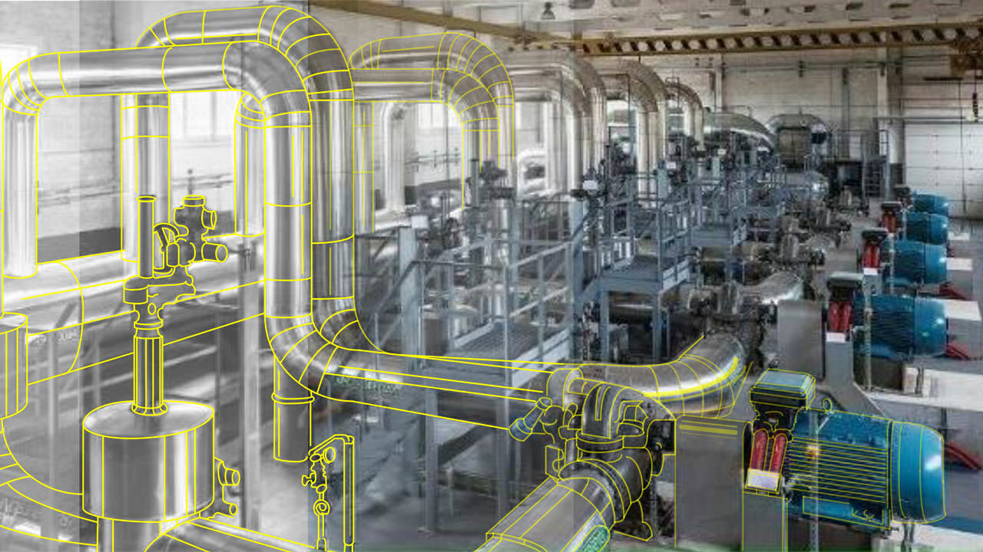
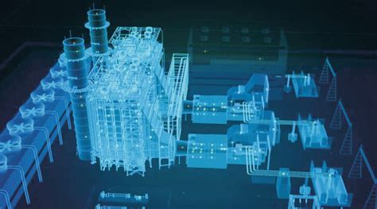
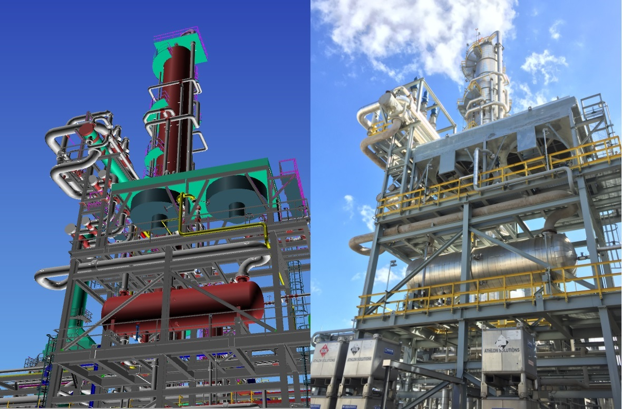
Digital Twins
Engineering Digital Twins
Process Digital Twins
Online Process Digital Twins
Closed Loop Optimization
Processes and Typical Benefits
What’s Next
South Texas Section AIChE – November 2, 2023

Slide 3
What is a Digital Twin?
Digital Twins integrate internet of things, artificial intelligence, machine learning and software analytics with spatial network graphs to create living digital simulation models that update and change as their physical counterparts change.
© Microsoft – Azure Digital Twin
“A Digital Twin is a virtual representation of a real object. Digital Twins are designed to optimize the operation of assets or business decisions about them, including improved maintenance, upgrades, repairs and operation of the actual object. Digital Twins include the model, data, a one-to-one association to the object and the ability to monitor it.”
© Gartner – Adopt a Data Governance Strategy for Long-Term Digital Twin Success (Published 20th Dec. 2018, ID: G00377062)
A digital twin is a digital representation of a physical object, person, or process, contextualized in a digital version of its environment. Digital twins can help an organization simulate real situations and their outcomes, ultimately allowing it to make better decisions.
McKinsey -What is digital-twin technology? July 12, 2023 | Article
South Texas Section AIChE – November 2, 2023

Slide 4

Types of Engineering Digital Twins
Physical
  External Structures
  Piping
  Instruments Equipment
  etc.
Electrical
  Transmission
  Distribution
Equipment
  Asset Performance
Production
  Supply Chain
Process
  Steady State
    Design, Debottleneck
  Dynamic (Behavior)
    Mechanical Studies
    Operations, Control
  Real-time Model
Engineering
Design
Procurement &
Contracting
Build
Handover
Plan
Operate &
Optimize
Maintain
VISUALIZATION
Enriches the Digital Twin with the intelligence to:
Run agile, continuously optimized supply chains and production
Operate reliably and safely with reduced supervision
Multi-faceted views of the Digital Twin enables organizational collaboration and remote plant monitoring.
PERFORMANCE
Brings life to the Digital Twin with real time data for more efficient work process.
OPERATIONS
ENGINEERING
Creates the Digital Twin combining data in 3D, 2D, 1D with process simulation tools for engineering efficiency.
South Texas Section AIChE – November 2, 2023

Slide 5
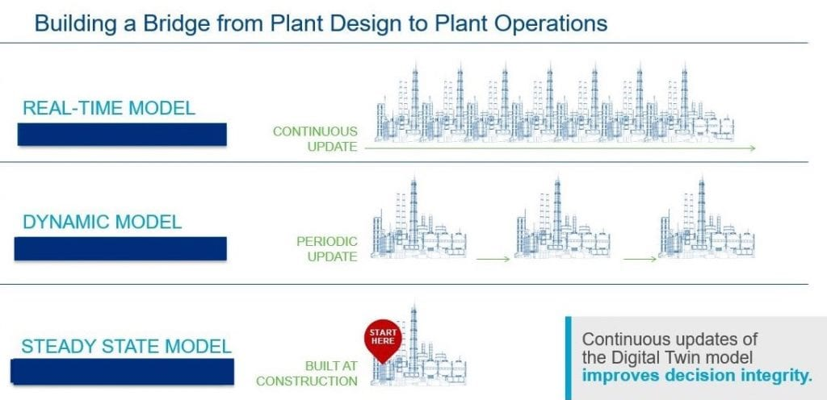
Process Digital Twins
South Texas Section AIChE – November 2, 2023

Slide 6
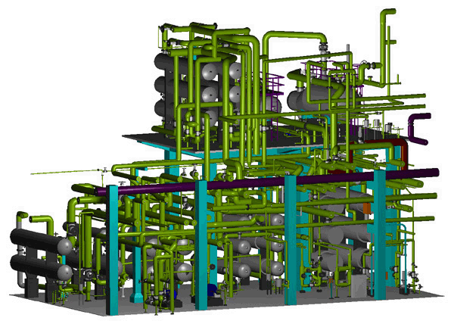
Keys to Closed Loop Online Optimization
Reactor Models
Equation Oriented Models – converge faster
Real Time Sequencer
  Steady State Detection
  Data Reconciliation
  Model Parameter Update
  Constraint Projection
  Solve Objective Function
  Send Optimization Targets
Nonlinear Solver
Closed Loop
Economic Updating
Steady State
Dynamic
Constraint Projection
Optimization
APC/DCS
Data Reconciliation
and Model
Parameter Update
Output To Plant
Data Gross Error
Detection and
Validation
Data From
Plant
Steady-State
Detection

Slide 7
Control Perspective
Process Measurements
Controller
Setpoints
Manipulated Variable
Setpoints
F
Process Ouput
On-line Optimization:
Maximize Economics
Steady-state operation
Operating constraints
Adv. Process Control:
Dynamic operation
Constraint handling
Disturbance rejection
Multivariable
Basic Control:
Regulatory
SISO or MISO systems
Updates: 4-8 hours
Updates: ~ 1 sec.
Updates: ~ 1 min.
South Texas Section AIChE – November 2, 2023

Slide 8
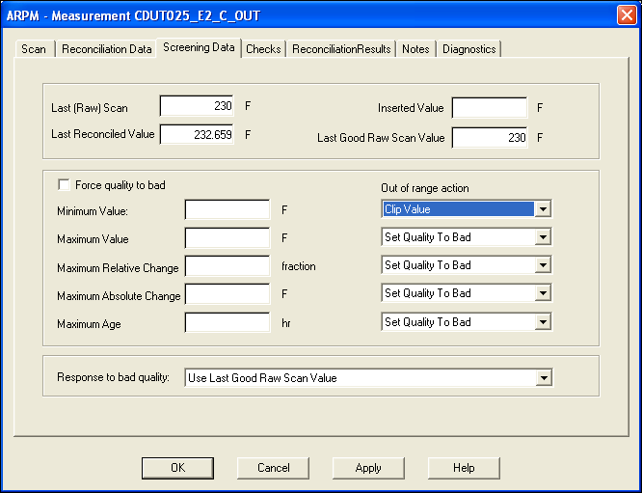
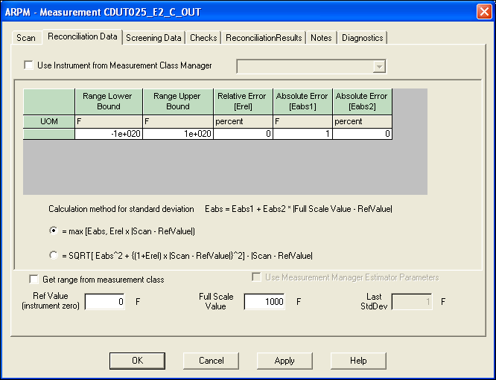
Defense against Bad Data
Data Screening, Flexible Consequences
  Use Last Good Scan
  Use Last Reconciled Value
  Substitute Curve Fit Value
  Stop solution
Simplified Material Balance & Reconciliation
South Texas Section AIChE – November 2, 2023

Slide 9
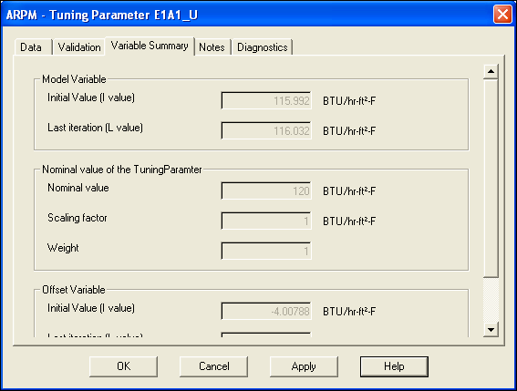
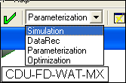
Data Reconciliation and Performance Calculation
Integrated Data Reconciliation
  Reconcile inconsistent process data
  Rigorous Soft Sensor for process parameters
  Provide a continuously self tuning model of the process
Performance Calculations
  Calculate equipment performance parameters
  Identify performance deterioration
South Texas Section AIChE – November 2, 2023

Slide 10
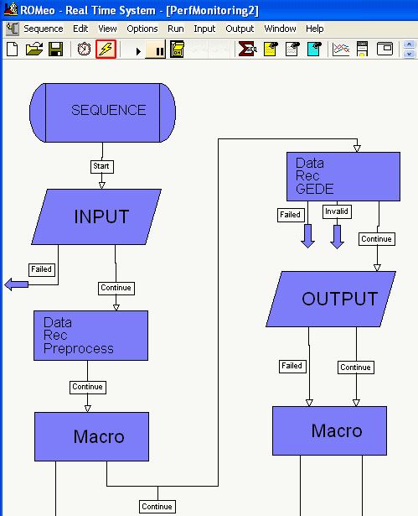
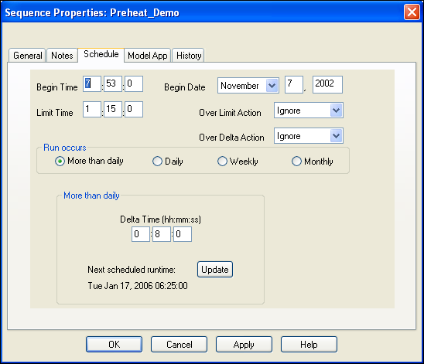
Automate Performance Monitoring
Real Time System (RTS)
Graphical environment for scheduling and sequencing real-time activities
  Monitor online sequence
Run daily at 6:00
Detect gross errors + reconcile the model
Download measurements
Export Reconciled Values to Excel
Stop if task fails
Screen measurements
If gross errors, send
E-mail to instrumentation engineer
Run macro to
change lineup
South Texas Section AIChE – November 2, 2023

Slide 11
Other Online Optimizer Features
Communication with Plant Historian and other Databases
Interactive Modeling Environment
Open for Third Party Components
  Reactor Technologies
  User Added Models
Model Reparameterization
  Heat Exchanger Fouling Factors
  Equipment Efficiencies
    Rotating Equipment
    Fired Equipment
  Catalyst Activity
Expose Sensitivities – partial derivatives
Reporting

Slide 12
Other Online Process Digital Twin Uses
Material Balance – Material and Volume Balances Only – Find meter errors
Process and Equipment Performance Monitoring
LP Vector Updating for Planning Systems
Utilities Optimization – Requires Mixed Integer Linear Programming (MINLP)
Plant Wide Optimization
Green Optimization
COLLECT
plant data
DATA
validation & steady state detection
DETECTION
of gross error
&
reconciliation
OPTIMIZATION
Ordinally Process Digital Twin
GREEN MODE
optimization
Green Mode Process Digital Twin
ANALYSE
reports
Real-time
analysis

Slide 13
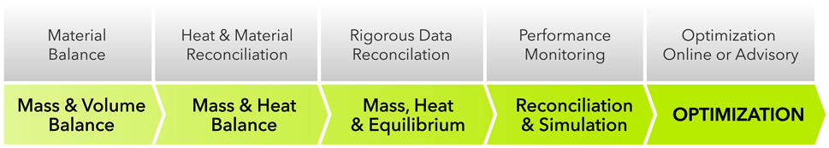
Stepwise Approach to Optimization
Incremental Value
Daily Material Balance
No Thermo required
Monitor Meter accuracy
Gross Error Detection
Material & Heat Reconciliation
No separation prediction
KPI Evaluation
Inferential sensors
Separation efficiencies
KPI Evaluation
Unit/Equipment Monitoring
What-if Case Studies
Closed loop 24x7 optimization
Automated Setpoints
Integrated with APC
Increasing Model Fidelity
Increasing Benefits

Slide 14
Typical Processes and Benefits
Refining
Olefins
Natural Gas Processing
Utilities
  Cogeneration Plants
  Electrical Import/Export
  Hydrogen Management
Unit | Typical Benefits | Typical Capacity | Typical Annual Benefits
Crude / Vacuum | 10 cpb | 135 kbpd | $4,455,000
FCC | 18 cpb | 60 kbpd | $3,564,000
Hydrocracker | 18 cpd | 30 kbpd | $1,782,000
Ethylene | $5 per mt | 500 ktpa | $2,500,000
LNG | $1.50 per mt | 1000 ktpa | $1,500,000
NGL Recovery / Fractionation | $15/MMSCFD | 200 MMSCFD | $1,100,000
Utilities |  |  | $500,000 - $2,000,000

Slide 15
Material Balance Case Study
Problem
Meter inaccuracy hindering decision making in planning, maintenance, process engineering and optimization
Current refinery-wide planning tool could not match refinery operations
Objectives
Daily material balance around each major unit & plant
Identify bad meters
Pinpoint material loss location
Simplified mass balance of the entire refinery including intermediate tanks
Benefits
Reduced Meter errors from 20% to less than 5%
Found meter error in Hydrocracker Feed and Reformer overhead liquid flow
Prevent emissions & improved yields

Slide 16
Process Equipment Performance Monitoring
Problem
  Compressor and heat exchanger performance degrades over time
  Operations don’t know impact of performance degradation
  How is the compressor operating currently vs. how it is supposed to operate
  How is exchanger fouling impacting process performance
Solution
  Model based performance monitoring
  Track Design vs. Actual efficiency for compressors
  Track impact of clean versus actual heat exchanger performance on energy usage and throughput
Benefits
  Know when it is economical to service compressors and clean heat exchangers
  Prevent damage to valuable and costly machinery
Compressor monitoring
Design
Day 0
Efficiency
Day 100
Day 200
Flow
Heat Exchanger Monitoring
0
ΔE
Design Eff
(best)
0
100
200
300
Time

Slide 17
Stand-alone Real-time Optimization (RTO) Implementations
Independent Unit RTOs
Crude Distillation Unit RTO
Reformer RTO
CDU/VDU products characterize the feed of the units downstream
Many refineries and chemical sites have installed RTOs for one or more processing units
  Crude distillation units, reformers, FCCU, energy systems, H₂ systems, etc.
A number of these sites have RTO systems on all major process units
Lt Virgin Naphta
LPG
Product Blending
IMP
Product Blending
Reformer Feed
N
C
VN to Reformer
S
Reformer
RF8
Ref LE
L
P
Reactor
AROM
MOGAS
E
Hvy Virgin Naphta
BZ
XYL
Product Blending
Sales Price
KERO
CRUDE
A
FCCU RTO
P
LPG
S
ICN to Reformer
Diesel
Product Blending
FCCU Feed
FCC
Cat LE
VGO to FCCU
Reactor-
M
LCN / HCN
V
Regen.
F
to Mogas Blend
P
S
Slurry to HFO Blend
HFO
Product Blending
Cycle Oils to Diesel Blend

Slide 18
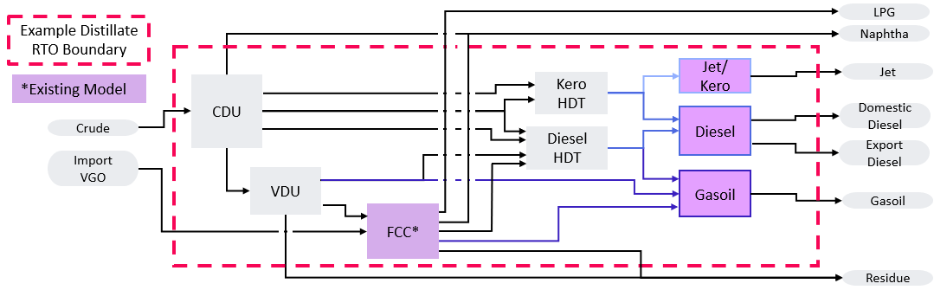
Multi-Unit / Refinery-wide Product Complex
Optimizes a whole process complex
      e.g. Naphtha Complex, Distillate Complex
    Scope includes finished product blending
      Product specifications, demand/supply drive the optimization of upstream processes
      Economics driven by feed and finished product prices – few / no intermediate product prices
    Scheduler specifies daily feed and product supply / demand needs directly in the RTO/APC
    Flexible to respond to different product demand / supply and operating situations
      Maximizes profit, or when logistics constraints, minimizes loss

Slide 19
Refinery-wide Optimization
RVP
LPG
RVP
RON
Benzene
D95
Butane
Naphtha Stab.
O
Premium
Crude
Assays (Offsites)
ISOM
CDU
P
Gasoline
F
P
H2
Crude Blend
O
Regular
Naphtha Split.
P
Reformer
MTBE
KERO
Reformate
H2
Jet/ Kero
Jet HDS
Flash
D95
Freeze
Jet
Model Boundary
P
LGO
H2
S
Density
Sulfur
Cloud
Domestic Diesel
Example Decision Variables
HGO
Diesel HDT
Diesel
P
T
Tower/React Temp
S
Export Diesel
P
Temp Cut Point
F
Feed Flowrate
P
D95
AGO
O
Octane Number
VDU
S
Sulfur Content
VGO
Rigorous Inferentials
P
Viscosity
Residue Fuel Oil
To Deasphalt Unit

Slide 20
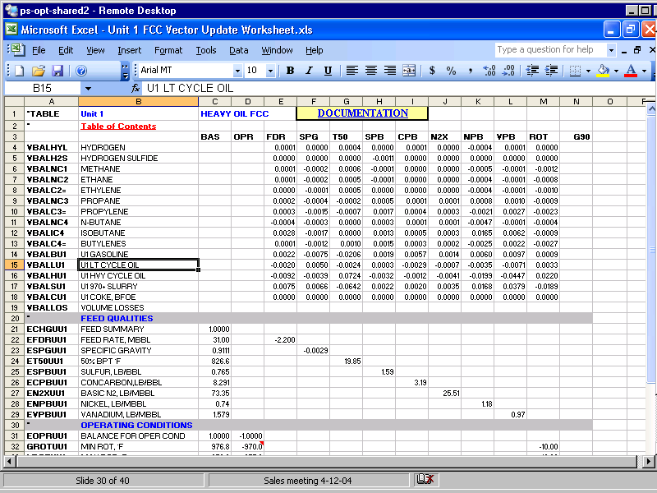
Long Term Planning
Planning and Decision Support
  Nonlinear
  Turnaround scheduling
  Evaluate feedstock
  Evaluate cost of constraints
  Update LP vectors On a More Frequent Basis

Slide 21
Artificial Intelligence and Machine Learning versus First Principles Modeling
Some digital twins are not based on exact physical models
  only use experimental datasets and machine learning algorithms
AI does have some advantages
For example, build a model using a deep neural net to capture the true dynamics of the data
However, generalizing this model to other objects requires a large number of samples in order to obtain a reliable general model.
Also, are Mass, Energy and Equilibrium balances assured?
When working with physical models we require less data to obtain an accurate general model.

Slide 22
Thank You!
Bill.Poe@se.com
LinkedIn - Bill Poe

