Slide 1
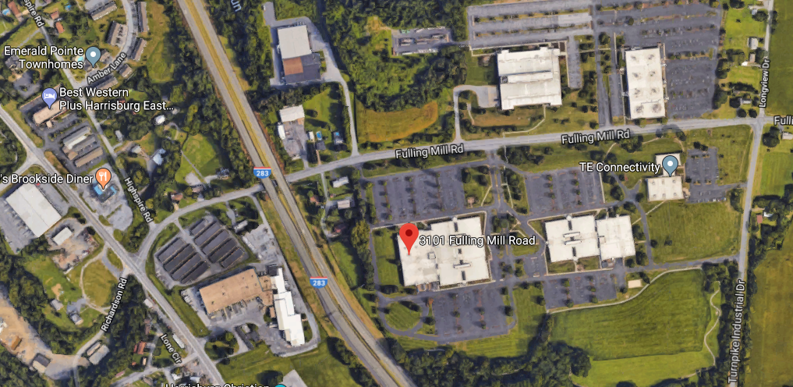
TE Connectivity, 3101 Fulling Mill Road, Middletown, PA – Volta Conference Room
From Eisenhower Blvd., turn east on Fulling Mill Road. Go under I-283. The TE campus is on both sides of the road; 3101 is the first TE building on the south. Use the entrance on the north side of 3101 and sign the visitor log. Glen Foster will meet you there. Glen’s cell phone is 717-979-6441.
TE
TE
Angies
Parking
Entrance
TE
TE
TE

