Slide 1
A Winning Recipe: Chemical Engineers and Homebrew
MMAIChE Seminar
4 December 2018

Slide 2
Introductory Quiz

Slide 3
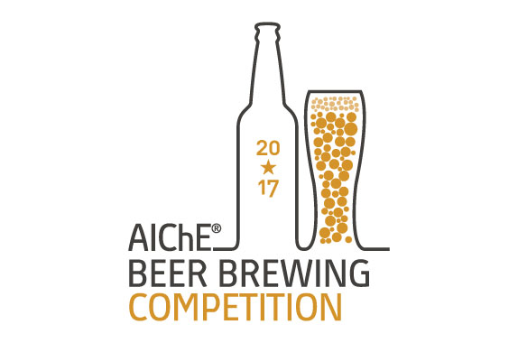
What four states have the most craft breweries?
Michigan, California, Colorado, Washington
New York, Oregon, Colorado, California
California, Pennsylvania, Oregon, Colorado
Washington, Oregon, California, Colorado

Slide 4
How many cases of beer are produced in the U.S. annually?
A. 2.9 Billion
B. 5.1 Billion
C. 990 Million
D. 610 Million

Slide 5
What is the name of a common instrument used in homebrewing?
Goniometer
Sphygmomanometer
Hydrometer
Lupulinometer

Slide 6
How many official beer categories exist?
A. 16
B. 34
C. 28
D. 52

Slide 7
The water-to-grain ratio of a standard mash is typically within ________ quarts of water per pound of grain
0.5 – 1.0
1.5 – 2.0
3.0 – 3.5
4.5 – 5.0

Slide 9
Answers
1. What four states have the most craft breweries?
D. Washington, Oregon, California, Colorado
2. How many cases of beer are produced in the U.S. annually?
  A. 2.9 Billion
3. What is the name of a common instrument used in homebrewing?
C. Hydrometer
4. How many official beer categories exist?
B. 34
5. The water-to-grain ratio of a standard mash is typically within ________ quarts of water per pound of grain
B 1.5 – 2.0

Slide 10
2017 Competition Summary
17 AIChE Local Section teams competed
  32 brews judged (15 dark/malty, 10 bright/hoppy, 7 seasonal)
66 guest taste judges
10 Beer Judge Certification Program (BJCP) judges
15+ onsite and 10 pre-competition volunteers

Slide 11
MMAIChE Brewing Process

Slide 12

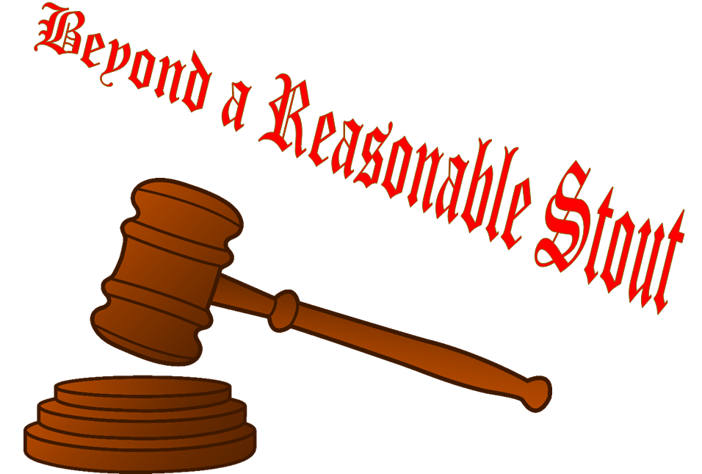
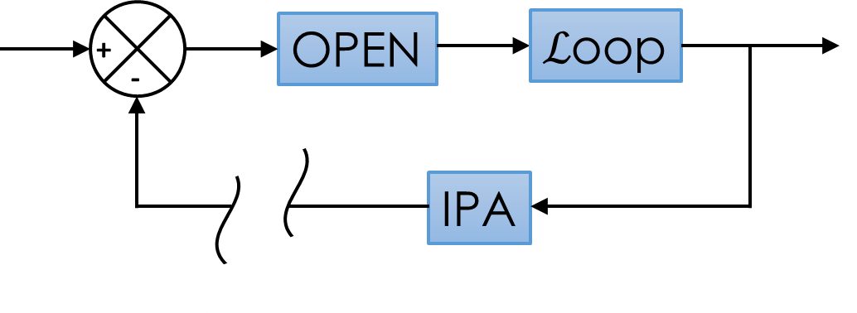
Team MMAIChE
Mid-Michigan Local Section (Midland, Michigan)
William Liechty, David Couling, Scott Tipler, Bala Sreedhar, Pat Heider
2017 Summary
  Brews: Black Lagoon Porter (American Porter, Dark/Malty) and Billy’s Breakfast Bitter (Strong Bitter, Bright/Hoppy)
  Awards: Grand Prize, 1st in Bright/Hoppy Tasting Category, 3rd in Dark/Malty Tasting Category, 3rd Best Poster Presentation
2018 Summary
  Brews: Saison’s Greetings (Saison), Beyond a Reasonable Stout (American Stout), Open Loop IPA (NE IPA)
  Awards: Grand Prize (Saison’s Greetings), Biggest Beer (Beyond a Reasonable Stout)

Slide 13
An incomplete history of beer
7000 BC: Chinese villagers brew fermented fruits and honey
882 AD: First recorded use of hops in brewing
1516: Bavarian Beer Purity law established (Reinheitsgebot)
1722: Porter is born and gives rise to industrial brewing
1822: India Pale Ale is born
1967: First US Light Beer (Gablinger)
2016 AD: Number of breweries in US exceeds 5000.
2400 BC: Sumerians invent the straw for beer drinking
1040: Weihenstephan Abbey Brewery opens
1705: Pale ale/bitter production begins for well-heeled English
1920 - 1933: Prohibition era, shutting down many maltsters and small breweries
1978: Record low number of breweries in US (89)
“Without question, the greatest invention in the history of mankind is beer. Oh, I grant you that the wheel was also a fine invention, but the wheel does not go nearly as well with pizza.”
– Dave Barry

Slide 14
Brewing ingredients
Water
Malted Barley
Hops
Yeast
Convert fermentable sugars into carbon dioxide and ethanol
Available as malt extract or whole grain (advanced)
Beer is ~90% water
Mineral content can impact mash performance and fermentation process
Preservative agent and adds bitterness to balance sweet malt sugars
Types, amounts, and step additions have strong impact on beer flavor
Each strain has an optimum temperature range
Provides flavor, body, and a source of sugars for fermentation

Slide 15
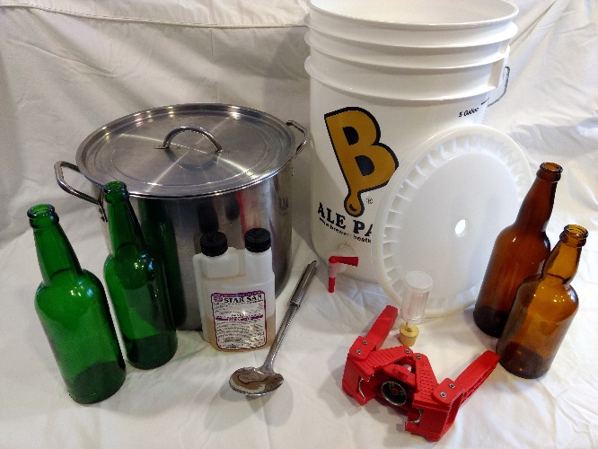
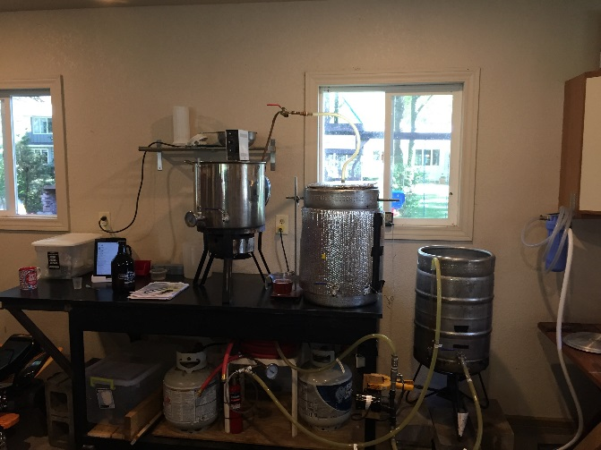
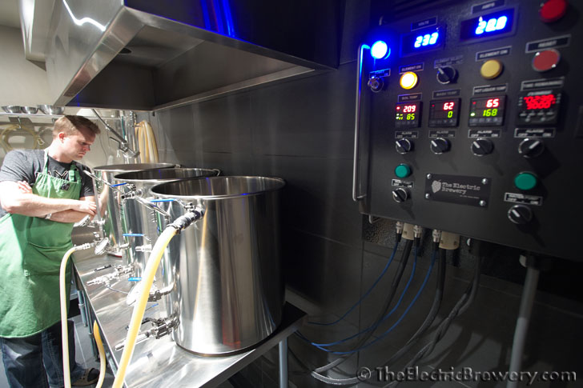
Homebrewing equipment
Home breweries span a wide range of process sophistication and control
Opportunities to customize and DIY are endless
Team MMAIChE
www.electricbrewery.com
~$200 investment
Kit/mini-mash
~$1000 investment
All-grain
>$3000 investment
All-grain
Increasing cost, complexity, and process control

Slide 16
Baseline Process Filled with ChemE Challenges
Hops Addition
Malt Extraction
Reaction Engineering
  Starch hydrolysis
Separations
  Malt extraction
  Removal of spent grain
Separations
  Hops extraction
Reaction Engineering
  Fermentation
Process Control
  Temperature, Stoichiometry
Fermentation

Slide 17
Baseline Process Filled with ChemE Challenges
Malt Extraction
Hops Addition
Heat Exchanger Design
Reaction Engineering
  Starch hydrolysis
Separations
  Malt extraction
  Removal of spent grain
Separations
  Hops extraction
Heat Exchanger Design
Reaction Engineering
  Fermentation
Process Control
  Temperature, Stoichiometry
Fermentation

Slide 18


MMAIChE Brewing Process
Water treatment with various brewing salts to achieve desired water profile
Starch conversion (saccharification) using heat-exchanged recirculating mash (HERMS) Mash/lauter tun (MLT = V-1)
Hot liquor tank (HLT = HX-1)
Hop addition and isomerization in boil kettle (V-2)
Wort cooling via counterflow wort chiller (HX-2)
Direct O₂ injection through 0.5 µm diffusion stone
Fermentation in temperature-controlled chamber
Force carbonation with CO₂
Packaging with Blichmann BeerGun®
1
HX-1
V-1
V-2
3
2
HX-2
4
V-4
5
7
V-3
8
6

Slide 19
Iterative recipe design process
Design recipe
Generate product
Evaluate product
Bottle final product
Recipe | Taste Panel Feedback | Changes Made
Strong Bitter | High drinkability Low hop flavor and aroma Dry finish Needs more amber/ruby color Hazy appearance | Modified hop addition schedule to add flameout hops Added 1 oz dry hop Increased Crystal 40L Malt Increased cold crash period
Porter | Overpowering smoke flavor Light color No discernable hop aroma Light body and mouthfeel | Eliminated smoked malt Added black patent malt Added light dry hop Increase mash temperature by 2°F

Slide 20
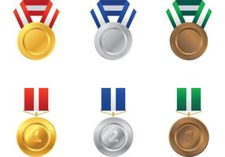
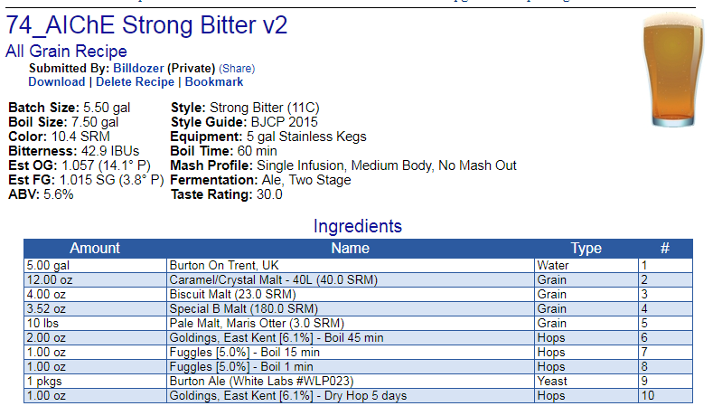
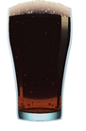
The beers
Bright and hoppy
Dark and malty
Billy’s Breakfast Bitter
Black Lagoon Porter
Batch Size: 5.50 gal Style: Strong Bitter (11C)
Boil Size: 7.50 gal Style Guide: BJCP 2015
Color: 10.4 SRM Equipment: 5 gal Stainless Kegs
Bitterness: 42.9 IBU Boil Time: 60 min
Est OG: 1.057 (14.1° P) Act OG: 1.060
Mash Profile: Single Infusion at 153°F
Est FG: 1.015 SG (3.8° P) Act FG: 1.014
Fermentation: 67°F ABV: 6.1%
Batch Size: 5.50 gal Style: American Porter (20A)
Boil Size: 7.50 gal Style Guide: BJCP 2015
Color: 34.3 SRM Equipment: 5 gal Stainless Kegs
Bitterness: 47.3 IBU Boil Time: 60 min
Est OG: 1.063 (15.5° P) Act OG: 1.066
Mash Profile: Single Infusion at 155°F
Est FG: 1.014 SG (3.7° P) Act FG: 1.019
Fermentation: 67°F ABV: 6.3%

Slide 21
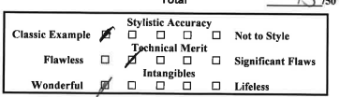
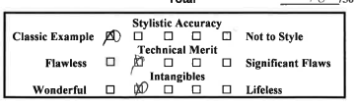
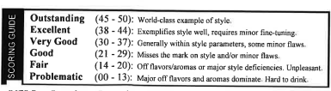
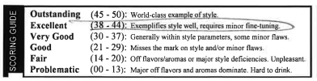
The beers
Bright and hoppy
Dark and malty
Billy’s Breakfast Bitter (44/50)
Black Lagoon Porter (39/50)
Batch Size: 5.50 gal Style: Strong Bitter (11C)
Boil Size: 7.50 gal Style Guide: BJCP 2015
Color: 10.4 SRM Equipment: 5 gal Stainless Kegs
Bitterness: 42.9 IBU Boil Time: 60 min
Est OG: 1.057 (14.1° P) Act OG: 1.060
Mash Profile: Single Infusion at 153°F
Est FG: 1.015 SG (3.8° P) Act FG: 1.014
Fermentation: 67°F ABV: 6.1%
Batch Size: 5.50 gal Style: American Porter (20A)
Boil Size: 7.50 gal Style Guide: BJCP 2015
Color: 34.3 SRM Equipment: 5 gal Stainless Kegs
Bitterness: 47.3 IBU Boil Time: 60 min
Est OG: 1.063 (15.5° P) Act OG: 1.066
Mash Profile: Single Infusion at 155°F
Est FG: 1.014 SG (3.7° P) Act FG: 1.019
Fermentation: 67°F ABV: 6.3%

Slide 22
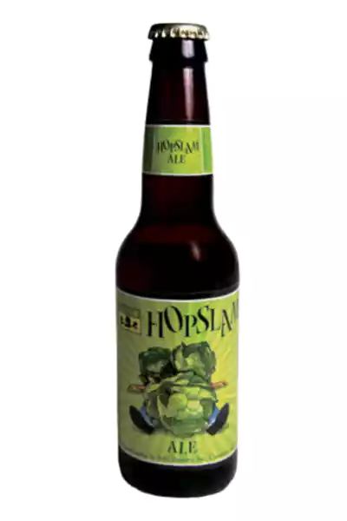
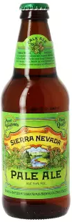
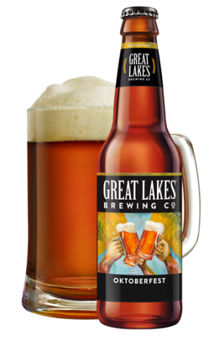
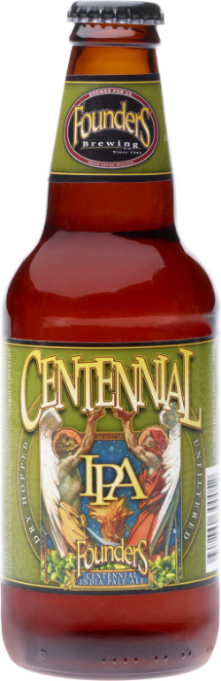
Commercial examples
0
10
20
30
40
50

Slide 23
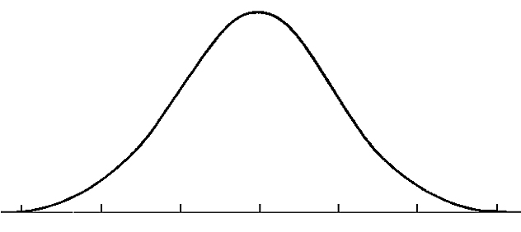
Lessons learned and tips for success
Sanitation and cleanliness are paramount
Use high-quality ingredients (water, grain, hops, yeast)
Learn from others
Keep good notes (including tasting!)
Get feedback – friends and family love free beer
Have fun!
Good Beer
Bad Beer
Great Beer

Slide 24

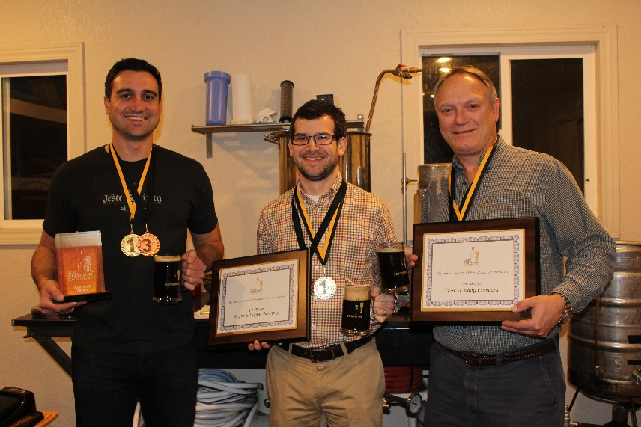

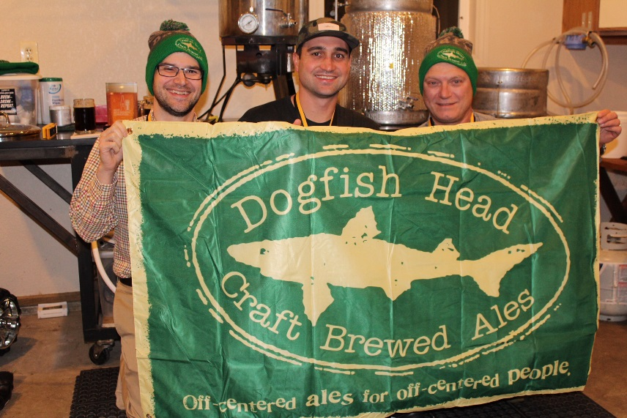

Acknowledgments
Bala Sreedhar
Pat Heider
Ted Calverley
Pranav Karanjkar

Slide 25
References
Palmer, J. J. (2017). How to brew: everything you need to know to brew great beer every time. Boulder, CO: Brewers Publications, a division of the Brewers Association.
Daniels, R. (2000). Designing great beers: the ultimate guide to brewing classic beer styles. Boulder, CO: Brewers Publications.
"The New Complete Joy of Home Brewing", Charlie Papazian, Avon Books, 1984 and 1991
"The Home Brewers Companion", Charlie Papazian, Avon Books, 1994
"How to Brew: Everything You Need To Know To Brew Beer Right The First Time", John L. Palmer, Brewers Publications, 2006
www.homebrewersassociation.org
Local homebrew clubs (www.homebrewersassociation.org/community/clubs/find-a-homebrew-club/)

