Slide 1
Process Safety Leadership:
The challenge for this generation!
Process Safety Management Systems and Driving Continuous Improvement
Notes:
Good afternoon, its great to be here in Denver! The focus of this presentation is on PS Leadership – The Challenge for this generation.
I want to make the case for integration of PS into Management systems.
I believe its all about organizations being professional and most importantly about you being professional – you are the chemical engineer – you will typically be the person on point and most knowledgeable about PS, if you don’t do it, who will?

Slide 2
Kenan Stevick - Bio
1981: Michigan Tech - BS Chemical Engineering
1981 – 2015: Dow Chemical in Manufacturing and Process Safety
  Manufacturing Assignments 1981 – 2001 (10 + years as Plant / Site Leader)
  Process Safety Discipline Leader and Reactive Chemicals Manager 2002 – 2009
  Chief Process Safety Engineer and Global Director of Process Safety 2009 – 2015
  Various Manufacturing Positions: Plant Engineer, Project Manager, Plant Manager, Global Business EH&S Manager, Site Leader
2016 – Present: President: KPS Inc., Process Safety Consulting
  kenan@kpscps.com, kpstevick@gmail.com, 970-409-2528

Slide 3
How is the Chemical Industry doing?
Have you picked up a newspaper or I-pad lately?
April 2, 2019, KMCO, LLC (“KMCO”) facility in Crosby, Texas
  Vapor cloud explosion of isobutylene killing one worker and seriously burning two others.
  200 employees, contract workers, and visitors were onsite. At least
  30 workers were injured.
  A shelter-in-place was issued to community members within one mile of the KMCO facility.
  The incident interrupted normal business operations at KMCO and resulted in two rounds of employee layoffs, reducing the number of employees at the Crosby facility from more than 180 to less than 50.
Does this appear to be a daily occurrence globally?
Notes:
On Sunday, March 17, 2019 at approximately 10AM, a storage tank caught fire at the Intercontinental Terminals Company (ITC) Deer Park facility, the entire city of DP sheltered in place for days
On Wednesday, August 4, 2019 a massive explosion and fire rocked ExxonMobil's Baytown plant near Houston, one of the largest oil refineries in the country.
Thirty-seven were injured and panic spread throughout the community. Quickly, iPhones began buzzing with a notification warning nearby residents to “shelter in place” or risk exposure to the toxic brew of chemicals in the air.
Around the globe, significant hazardous releases continue to occur daily, many with catastrophic potential.
Nearly all look like previous incidents, what Tony Barrell described as “an awful sameness,” and all are preventable.
As leaders, how can we accept this, when one of our primary roles is to manage risk, including the risk of process safety incidents?

Slide 4
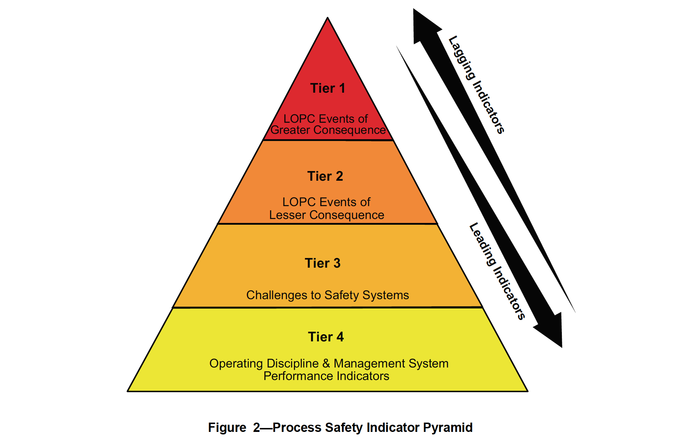
API RP 754 – Process Safety Performance Indicators for the Refining and Petrochemical Industries
Tier 1 and Tier 2: Public Reporting
Tier 3 and Tier 4: Internal Company reporting for continuous Improvement
Notes:
Industry Approach to standardized Incident Reporting

Slide 5
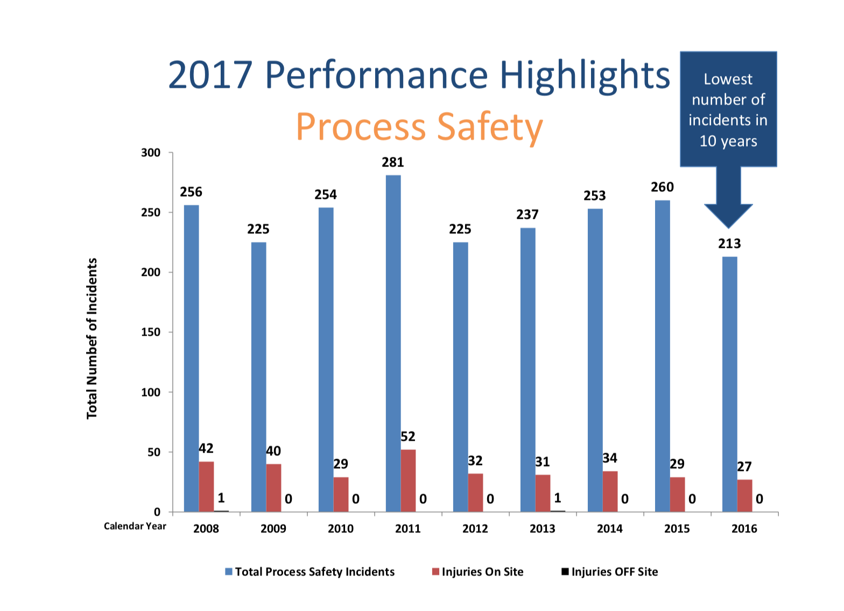
Case for Integrating PS into Management Systems and Driving Continuous Improvement
ACC Member Companies, Process Safety Incidents
60% Reduction since 1995
Lowest # of Incidents in
10 years
Plateaued
Notes:
Talking Points:
ACC Companies - Much has been accomplished
Lies, Damn Lies and Statistics
Despite heavy Human and Capital Expense performance has Plateaued for the last 10 years

Slide 6
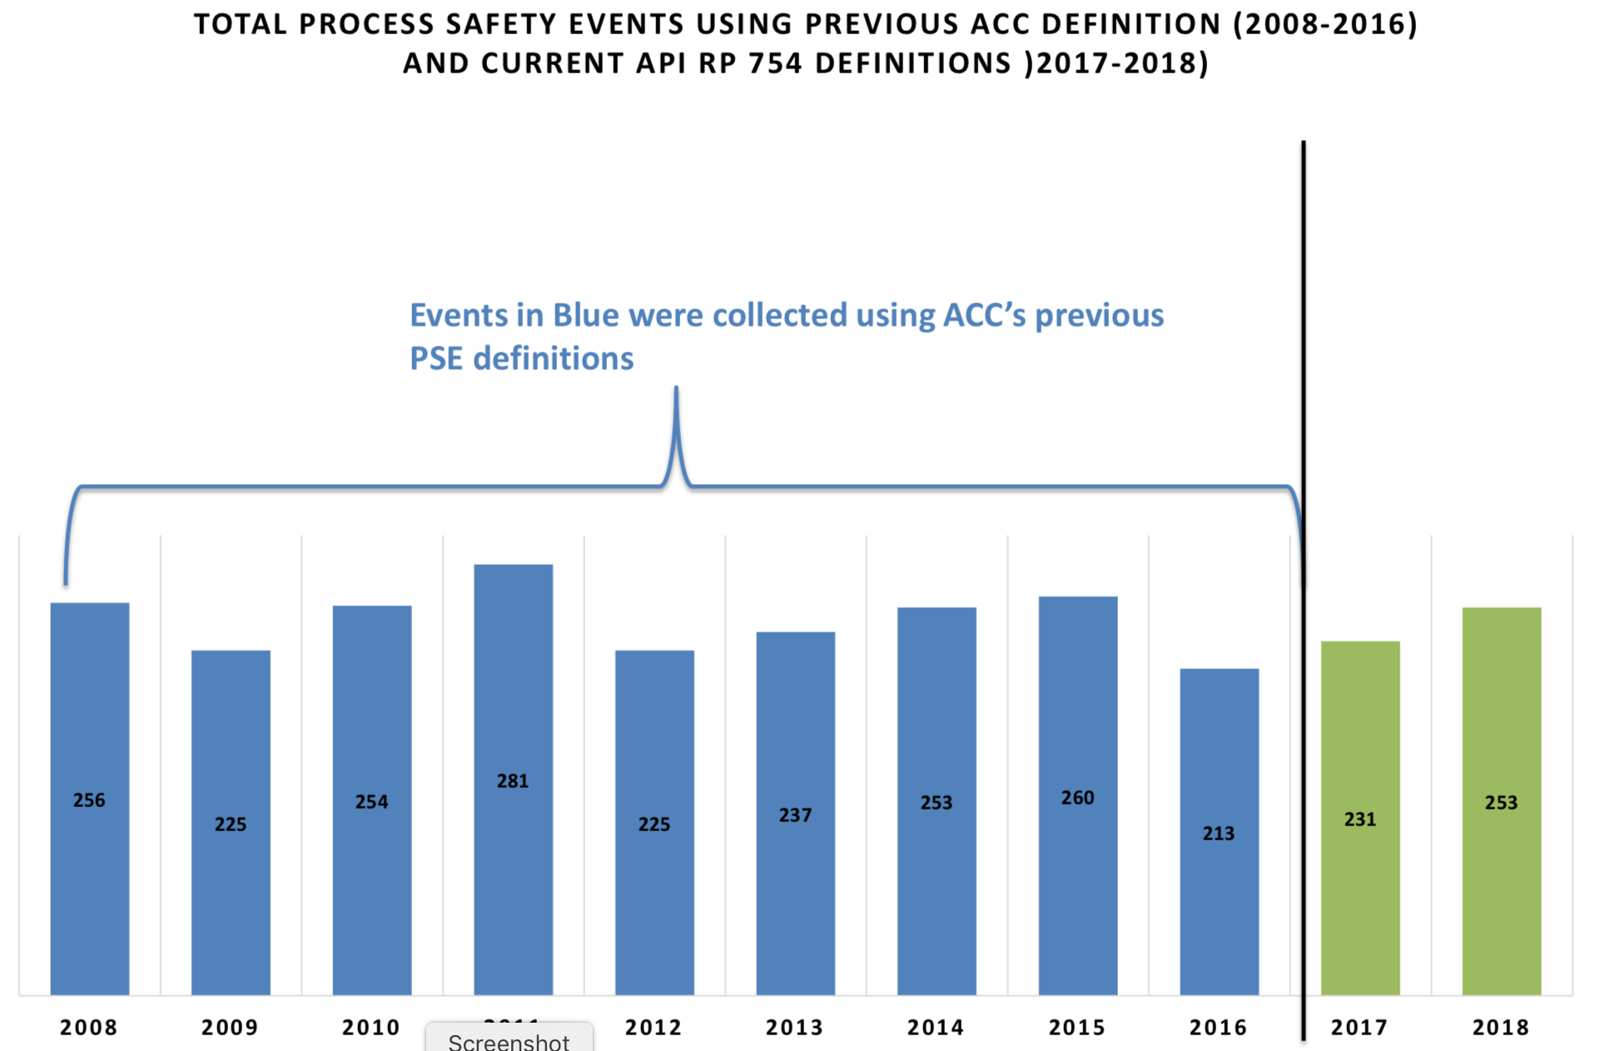
Case for Integrating PS into Management Systems and Driving Continuous Improvement
ACC Member Companies, Process Safety Incidents
48% Reduction since 2000
In 2018, 92 percent of the Tier 1 PSI categorized as "low severity."
The plateau continues
Notes:
Talking Points:
Starting in 2017, ACC members began using a new methodology for reporting annual process safety incident information.
As a result of the change in reporting criteria, data results prior to 2017 are similar, but not identical to data now being collected.
Under the API Recommended Practice 754 methodology, Tier 1 process safety incidents are given a severity score ranging from 0-135, 0 being a low severity incident and 135 being the maximum severity score. In 2018, 92 percent of the Tier 1 process safety incidents reported by ACC members were categorized as "low severity."

Slide 7
Case for Integrating PS into Management Systems and Driving Continuous Improvement
Boardroom Realization
Potential for Major Incidents
  Catastrophic Impact on Employees / Community
  Impact on Company Sustainability
  Societal Expectations and Company Reputation
  Executive Legal Accountability
  Major Incidents – Gov. Oversight & Regulatory Initiatives
    Refinery and Chemical Plant National Emphasis Program
    EPA RMP Update
    Combustible Dust Regulations
    Etc.
Notes:
Potential for Major Incident
Catastrophic Impact on Employees / Community – Can impact large # of people, incidents are happening every few years to very reputable companies
Impact on Company Sustainability – Can be a matter of survival – Examples: Macondo Well/DWH , Freedom Chemical Bankruptcy
Societal Expectations and Company Reputation -
Executive Legal Accountability – Executives are being pursued by the law after major incidents – Examples: 1. 2007 ThyssenKrupp Steel Plant Fire in Turin Italy resulting in 7 fatalities, Chairman of ThyssenKrupp’s Italian division and Five other ThyssenKrupp managers were tried and convicted of manslaughter. 2) 2014 Freedom Chemicals Spill into Elk River – Executives indicted and plead guilty to violations of the Clean Water Act
Regulatory Initiatives
Refinery and Chemical Plant National Emphasis Program
EPA RMP
Combustible Dust
Etc.

Slide 8
Case for Integrating PS into Management Systems and Driving Continuous Improvement
Boardroom Realization
  Tier 1 Process Safety Incidents
    Significant Cost: People, Recovery, Loss of Sales, Insurance, etc.
    Same Management System Failures that can lead to major Incidents
  Tier 2 and 3 Process Safety Incidents
    Same Management System Failures that can lead to major Incidents
    All of these incidents at some level are repetitive
  Heavy Human and Capital Resources Investment
    Process Safety Management Systems
    RAGAGEP and IPLs
    Where are the results?

Slide 9

Case for Integrating PS into Management Systems and Driving Continuous Improvement
Industry success in improving operational performance through management systems.
The basis underlying all management systems is founded on the concept of Plan-Do-Check-Act (PDCA).
The PDCA model provides an iterative process to achieve continual improvement.
Notes:
Quality Management Systems, Environmental Management Systems

Slide 10
Case for Integrating PS into Management Systems and Driving Continuous Improvement
The PDCA model can be applied to any management system:
  Plan: establish objectives, processes and procedures necessary to deliver results in accordance with the organization’s policy.
  Do: implement the processes & procedures as planned.
  Check: monitor and measure processes against the policy, including its commitments, and operating criteria, and report the results.
  Act: take actions to continually improve.

Slide 11
Process Safety Management System (PSMS)
Process Safety Management System (PSMS): “A management system that is focused on prevention of, preparedness for, mitigation of, response to, or restoration from catastrophic releases of chemicals or energy from a process associated with a facility.”
Management systems for chemical process safety are:
  comprehensive sets of policies,
  processes,
  procedures, and safe work practices
  designed to ensure that barriers to major incidents are in place, in use, and effective.

Slide 12
Process Safety Management System (PSMS)
Management systems serve to integrate process safety concepts into ongoing activities of everyone – from the process operator to the chief executive officer.
Guess who is the most knowledgeable or should be the most knowledgeable about PSMS?

Slide 13
Traditional Regulation approach that define, implement and govern barriers
Process Hazard Analysis/ Risk Analysis Work Process
Design Standards
Reactive Chemicals
Project Methodology: Engineering, Procurement, Construction and Startup
Pre-startup safety Reviews
Emergency Preparation and Response
Safe/Hot Work/Confined Space Permits
Mechanical Integrity
Interlocks, Controls, Safety Instrumented Systems
Procedures
Contractors
MOC
Incident Investigation
Auditing
Notes:
What does this look like? OSHA PSM, What Concept are missing

Slide 14
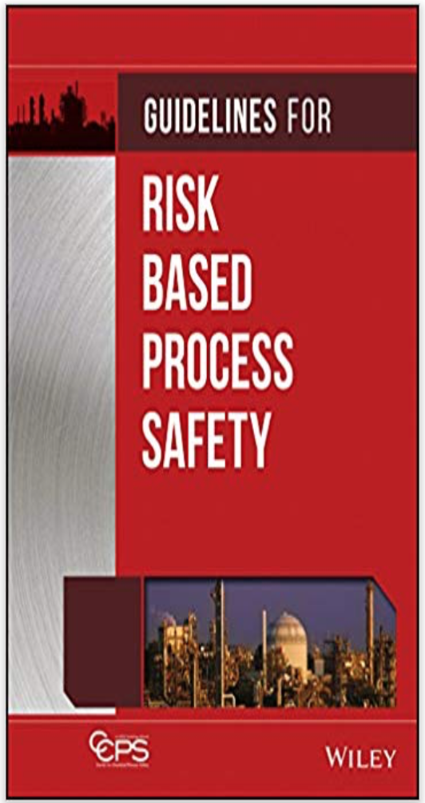
Center for Chemical Process Safety Publications
2007, Risk Based Process Safety: Introduces additional elements → Management System → Continual Improvement
  Leadership and Culture
  Competency for all employees
  Conduct of Operations
  Measurements and Metrics
  Management Review and Continuous Improvement
Notes:
What does this look like? OSHA PSM

Slide 15
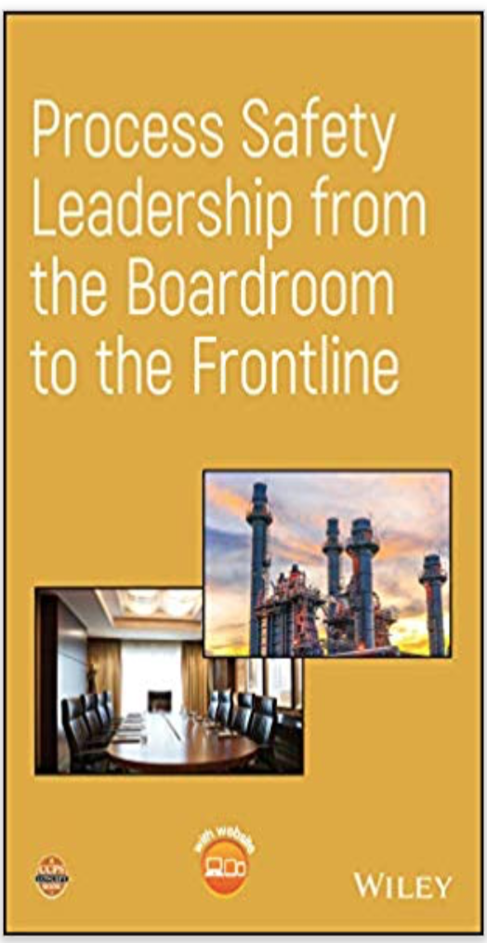
Center for Chemical Process Safety Publications
2019, Process Safety Leadership from the Boardroom to the Frontline
Outlines responsibility of leadership at all levels:
  C-suite executives and the board of directors
  frontline managers and supervisors
  Operators and Technicians
  Support Roles: Engineering, HR, Procurement
Intent to create a viable culture of safety within an organization,
implement and maintain disciplined management systems,
and address the risks of process safety deficiencies.
Notes:
What does this look like? OSHA PSM

Slide 16

Case Study for Integrating PS into Management
Systems and Driving Continuous Improvement
Generational goals to reduce PS and LOPC Incidents
1996 → 2005: 90% Reduction
2005 → 2015: 75% Reduction
2015 → 2025: Eliminate
2005 → 2008 Plateaued performance
Repetition
Same Failure Modes / Management Systems
Action Plan
Notes:
Dow has had a long and successful history of reducing process safety incidents. This started with the establishment of formal generational goals in 1995 to reduce incidents by 90% over 10 years. These goals and progress metrics were and are externally published on Dow.com
In 2005 another 10 year goal was established to further reduce process safety incidents and their severity by 75% and 90% respectively.
By 2008 it was clear that our performance had plateaued and we were not continuing to make progress towards meeting our 2015 goal for reducing incidents. As process safety incidents were analyzed, the data showed a lot of repetition. While an incident may not be on the same equipment or in the same plant, it was clear that the same failure mode(s) and management system(s) were involved.
Analysis of the data also showed an opportunity to ensure every required protection layer failure and its associated management system failure were identified and fixed and to improve how the investigation results were leveraged across the company.
In other words we had to fully integrate Process Safety Management Systems into our Operations
By 2009 we were back on track and actually surpassed our 2015 goal in 2011.

Slide 17
Case for Integrating Process
Safety into Management Systems
What Happened: MS Upgrade - Corporate Wide Actions
Ethylene piping failure due to Corrosion Under Insulation (CUI) – Picture 1
Note: CUI is particularly aggressive where operating temperatures cause frequent or continuous condensation and re-evaporation of atmospheric moisture.
Management System Failure
Corporate Mechanical Integrity (MI) Standard and Work Process was not specific on performing CUI inspections
Corporate Corrective Actions
Update MI Standard and Work Process
to clearly articulate CUI Requirements
Train Maintenance and Production Leadership
Technology Centers define and prioritize
susceptible areas for CUI
Facilities to carry out CUI Inspections within
a defined time frame and report back findings
Results
Additional finding of severe CUI, prevention of
repeat incidents – Picture 2
Notes:
Example of actual incident with MS strategy employed to leverage the learnings of the incidents through formally tracked action items.

Slide 18
Case Study for Integrating PS into Management
Systems and Driving Continuous Improvement
More information can be found: K. Stevick, “Next Generation Root Cause Investigation and Analysis” 11th Global Congress of Process Safety”, Austin Texas, 2015
Notes:
Dow has had a long and successful history of reducing process safety incidents. This started with the establishment of formal generational goals in 1995 to reduce incidents by 90% over 10 years. These goals and progress metrics were and are externally published on Dow.com
In 2005 another 10 year goal was established to further reduce process safety incidents and their severity by 75% and 90% respectively.
By 2008 it was clear that our performance had plateaued and we were not continuing to make progress towards meeting our 2015 goal for reducing incidents. As process safety incidents were analyzed, the data showed a lot of repetition. While an incident may not be on the same equipment or in the same plant, it was clear that the same failure mode(s) and management system(s) were involved.
Analysis of the data also showed an opportunity to ensure every required protection layer failure and its associated management system failure were identified and fixed and to improve how the investigation results were leveraged across the company.
In other words we had to fully integrate Process Safety Management Systems into our Operations
By 2009 we were back on track and actually surpassed our 2015 goal in 2011.

Slide 19
Leadership = Professionalism
The catastrophic potential of operations handling and/or processing hazardous materials requires taking personal accountability to conform to the technical and ethical standards of Process Safety Management.
Leaders must be a professional in the implementation, operation, maintenance and verification of PSMS.

Slide 20
What will our professions legacy be?
1974: Flixborough – 28 Fatalities
1984: Bhopal – Thousands of fatalities
1988: Piper Alpha – 167 Fatalities
1989: Pasadena – 23 Fatalities
2005: Texas City – 15 Fatalities
2010: Macondo well – 11 Fatalities
2015: Tianjin – 173 Fatalities

Slide 21
  Process Safety Professionalism
  Your companies responsibility, Your responsibility
  It's time to eliminate catastrophic PS incidents
  Our Shareholders demand it
  Our Employees deserve it
  Our Communities expect it

