Slide 1
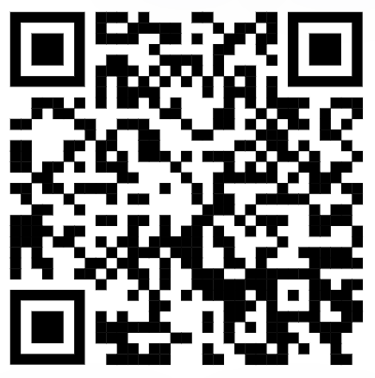
Minority Affairs Community
Officer and Volunteer Positions
Join MAC

Slide 2
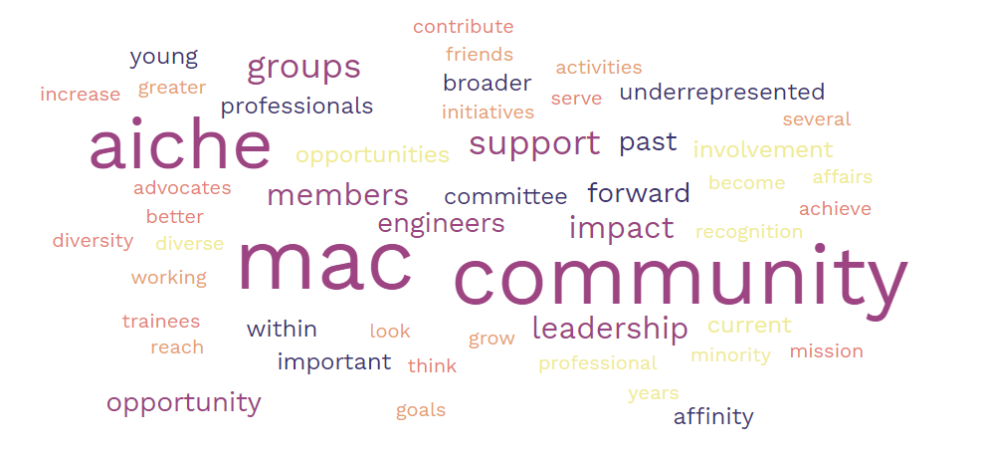
AIChE Minority Affairs Community (MAC)
The Minority Affairs Community (MAC) provides a supportive environment for Chemical Engineers of underrepresented races, ethnicities, cultures, and their allies, to develop within their profession.
MAC is committed to fostering a more equitable and accommodating field of Chemical Engineering where people of various backgrounds and experiences can feel safe and celebrated.
Join MAC

Slide 3






Board of Directors
Career and Education Operating Council (CEOC)
Societal Impact Operating Council (SIOC)
Chemical Engineering Technology Operating Council (CTOC)
Global Society Initiative Committee (GSIC)

Slide 4
MAC Bylaws – Purpose
The purpose of MAC is to promote the entry, development, and full participation of underrepresented communities and people with diverse identities and backgrounds in the Institute and the profession. The objectives of MAC are to:
Develop & distribute resources on subjects pertaining to diversification in the profession.
Mobilize AIChE to meet the needs of existing and potential members of AIChE and the profession from an underrepresented identity group.
Provide networking opportunities for people from diverse cultures in AIChE to use each other as resources.
Increase the visibility of people of color within AIChE and the profession.

Slide 5
MAC Bylaws – Rights of Members
Rights and responsibilities of Members will include, but not be limited to:
Participate in programs of research seminars, networking opportunities, meetings, and publications that develop and disseminate information from expert resources.
Right to use MAC data and training in proportion to the class of membership.
Opportunities to propose and set forth programs for MAC.
Participation on various committees and projects in proportion to the class of membership and participation.
Recognition in MAC promotional media, materials and events.

Slide 6
MAC Bylaws – Executive Committee
The ExCom is composed of the Past Chair, Chair, Vice-Chair, Secretary, and Treasurer, whom shall be Fellows, Senior Members, or Members of AIChE. AIChE graduate and undergraduate student members are ineligible to hold officer positions.
The Executive Committee will be responsible for, but not limited to the following:
Establish membership fees, levels, and privileges.
Provide oversight of MAC activities, facilities, operations, and its budget, which are accomplished with the MAC Staff Director, subject to the ultimate direction and control of SIOC.
Prepare and deliver to SIOC’s Executive Committee annual reports of MAC activities and prospective programs.
Inform MAC’s Staff Director of activities and issues important to MAC.
Recommend annual budgets for approval by SIOC.
Approve MAC projects and project committees.
Operate on a majority vote basis.

Slide 7
Current Minority Affairs Community Leadership
MAC Chair (2023)
Carlos M. Rinaldi-Ramos, Ph.D.
Professor and Department Chair,
Chemical Engineering, University of Florida
Secretary (2022-2023)
Karen Romero, Ph.D.
Safety Process Engineer, Exida
MAC Chair-Elect (2023)
Tayo Femi-Fowode, M.Sc., M.B.A.
Operations Leader, GE Vernova
Treasurer (2023-2025)
Damilola Daramola, Ph.D.
Assistant Professor,
Chemical Engineering,
Northeastern University
MAC Past-Chair (2023)
Manuela A.A. Ayee-Leong, Ph.D.
Associate Professor,
Chemical Engineering, Dordt University

Slide 8
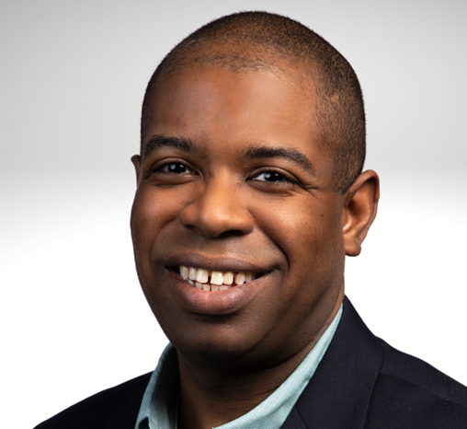
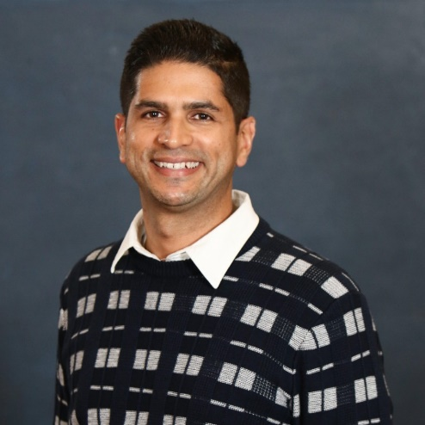
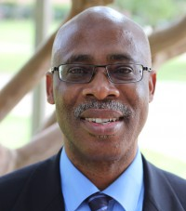
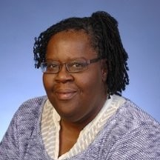
MAC Committees, Affinity Groups, and Volunteers
Many, many other volunteers who have helped with nominations, award review, session organization, etc.
Communications Committee
Azeem Farinmade, Ph.D.
Outgoing Chair
Minority Faculty Forum
Reginald Rogers, Ph.D.
Outgoing Chair
LatinXinChE
Gabriel Rodriguez-Rivera, Ph.D.
Chair & MAC Liaison
Scholarships Review
Emmanuel Dada, Ph.D.
Young Professionals Liaison
Mary Kathryn Lee, Ph.D.

Slide 9
Planning for 2024
Join MAC

Slide 10
2024 Minority Affairs Community Awards
Endowed
Minority Scholarship Awards for College Students
  $1,000 per AY (~15)
Scholarship Awards for Incoming College Students
  One-time $1,000 (~15)
Non-Endowed
William W. Grimes Award for Excellence in Chemical Engineering
  $1,000 award, $500 travel, plaque
Eminent Chemical Engineers Award
  $500 travel, plaque
  2-3/year → 1 in 2024
Non-Endowed
Distinguished Service Award
  $500 travel, plaque
  1-3/year → up to 1 to individual and up to 1 to an organization in 2024
Janice Lumpkin Travel Award
  $500 travel, plaque
  2-3 each year → 1 in 2024
Early Career Travel Award for Industry Professionals
  $500 travel
  1 in 2024
Trainee Travel Awards
  $250 travel allowance
  PhD student and postdoc
  Goal: 10 in 2024
Non-Endowed Awards cost: $6,500 (same as 2023)
Limit non-endowed awards to MAC members
All due May 15 with decisions by August 15
Notes:
WIC travel awards – 16 in 2019, 6 in 2018, 9 in 2017, 15 in 2016, 15 in 2015, 6 in 2014, 11 in 2013
For 2023:
WIC supports travel for female graduate students, post-doctoral associates, early career individuals, and young professionals. The travel award would cover some costs for the 2023 AIChE Annual Meeting, to be held in Orlando, FL from November 5-10 and 1 year membership. WIC will provide individuals $800 each (which includes conference registration) for in-person attendees. The remaining funds to go towards travel - hotel, airfare, meals and incidentals).
Travel award winners will be notified ahead of the early conference registration deadline. In-person conference attendees will be required to present a poster highlighting their work at the WIC breakfast and keynote.

Slide 11

MAC 2024 Spring and Fall Meeting Programming
2024 AIChE Spring Meeting & 20th Global Congress on Process Safety
March 24th – March 28th
New Orleans, LA
No planned MAC sessions!
Need champions to develop programming for the 2025 Spring Meeting
Core MAC Programming:
MAC Eminent Engineers Awards Ceremony & Breakfast, Monday, October 28, 7:30-9:00 AM – Ticketed and Sponsored Event
MAC Eminent Engineers Poster Session, Monday, October 28, 3:30-5:00PM (during regular poster session time)
Assume there will be an IDEAL reception on Monday, October 28, 5:30-7:00 PM.
MAC Business Meeting – move to Tuesday, October 29
Affinity Groups and Joint sessions:
Minority Faculty Forum
LatinXinChE
Joint sessions – depend on volunteers to champion joint sessions with Women in Chemical Engineering (WIC), Young Professionals (YP), and other groups.
Thursday,
November 30:
Confirm 2024 Contact(s)
Friday,
December 15:
Confirm Sessions in Confex
Monday, April 8:
Call for Abstracts Deadline
Friday, May 17:
Abstract decisions due

Slide 12
Volunteer and Elected Positions
Join MAC

Slide 13
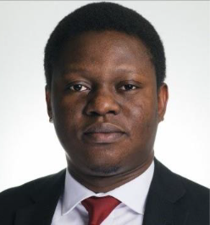


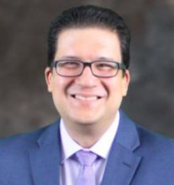
2024 MAC Executive Committee
MAC Chair (2024)
Tayo Femi-Fowode, M.Sc., M.B.A.
Coordinates ExCom and core MAC activities
Manages review of Grimes and Eminent Engineer awards
Secretary (2024-2025)
2-year term
Maintains meeting minutes
MAC Chair-Elect (2024)
3-year term
Chair in 2025, Past-Chair in 2026
Manages review of Janice Lumpkin Travel Award and student travel awards
Treasurer (2023-2025)
Damilola Daramola, Ph.D.
Manages MAC budget
MAC Past-Chair (2024)
Carlos M. Rinaldi-Ramos, Ph.D.
Assists the Chair
Manages review of Distinguished Service Award
Open to Fellows, Senior Members, or Members of AIChE.
AIChE graduate and undergraduate student members are ineligible to hold officer positions.

Slide 14

Other MAC Leadership Positions
Fall 2024 Programming Chair
1-year term
Must be committed to attend 2024 Annual Meeting in San Diego, CA
Communications Chair (2024-2025)
2-year term
Manages all MAC communications
Chairs the communications committee
Spring 2025 Programming Chair
1-year term
Must be committed to attend 2025 Spring Meeting – venue TBD
Member-at-Large
2-3 positions
1-year term
Ideally at least one representative from industry, one who is an early career professional or trainee.
Scholarship Review Chair
2-year term
Coordinates review of undergraduate scholarship & award applications.

Slide 15
MAC Nominations and Elections Process
MAC has many positions to fill to address expanded role of a community.
Solicit additional nominations from professional MAC members during business meeting
Contact nominees with position details and requesting information to be reviewed by ExCom
ExCom selects slate of candidates for each position
Professional members asked to vote on candidate slate
Process adapted from SIOC / AIChE Executive Committee
Send contact information of nominees to
Bryan Deschamps (bryad@aiche.org)

