Slide 1
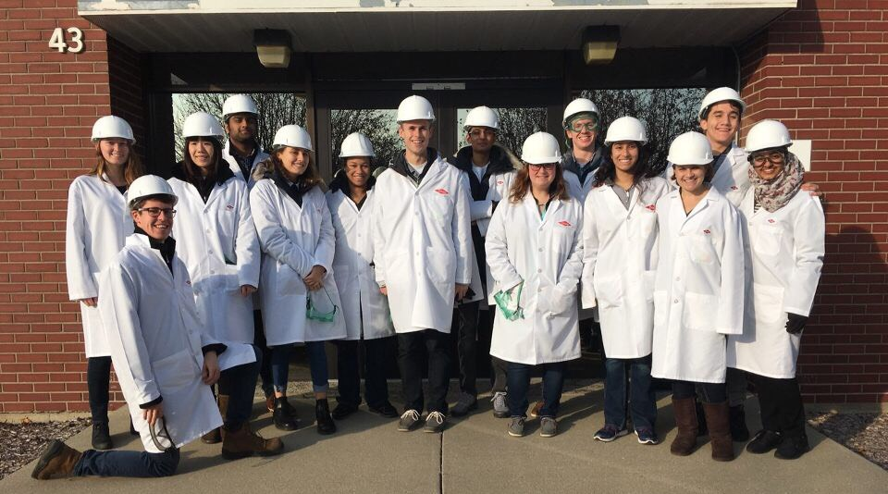
University of Michigan
AIChE Chapter: Mentorship
President:
Fritz Hyde
Mentorship Co-Chairs:
Elaine Parkanzky and Elias Tavarez

Slide 2
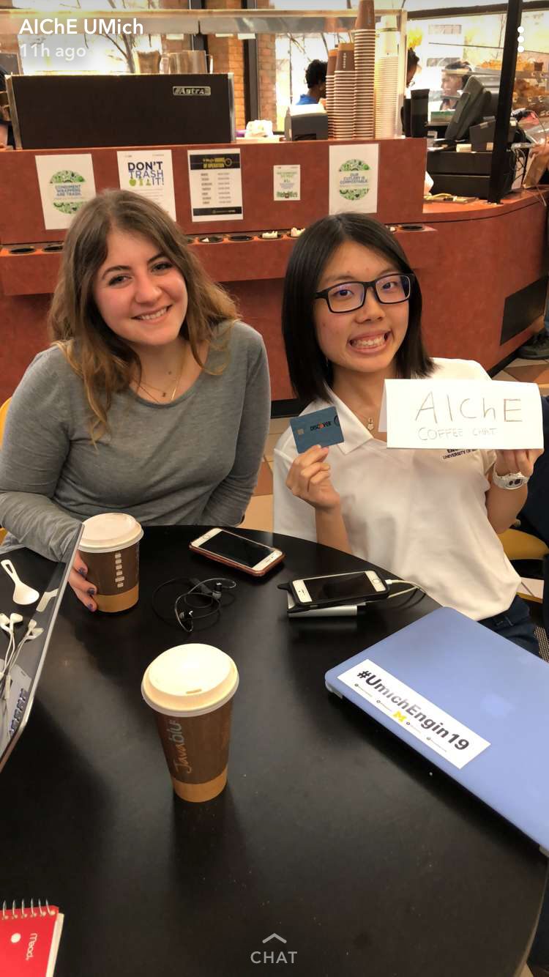
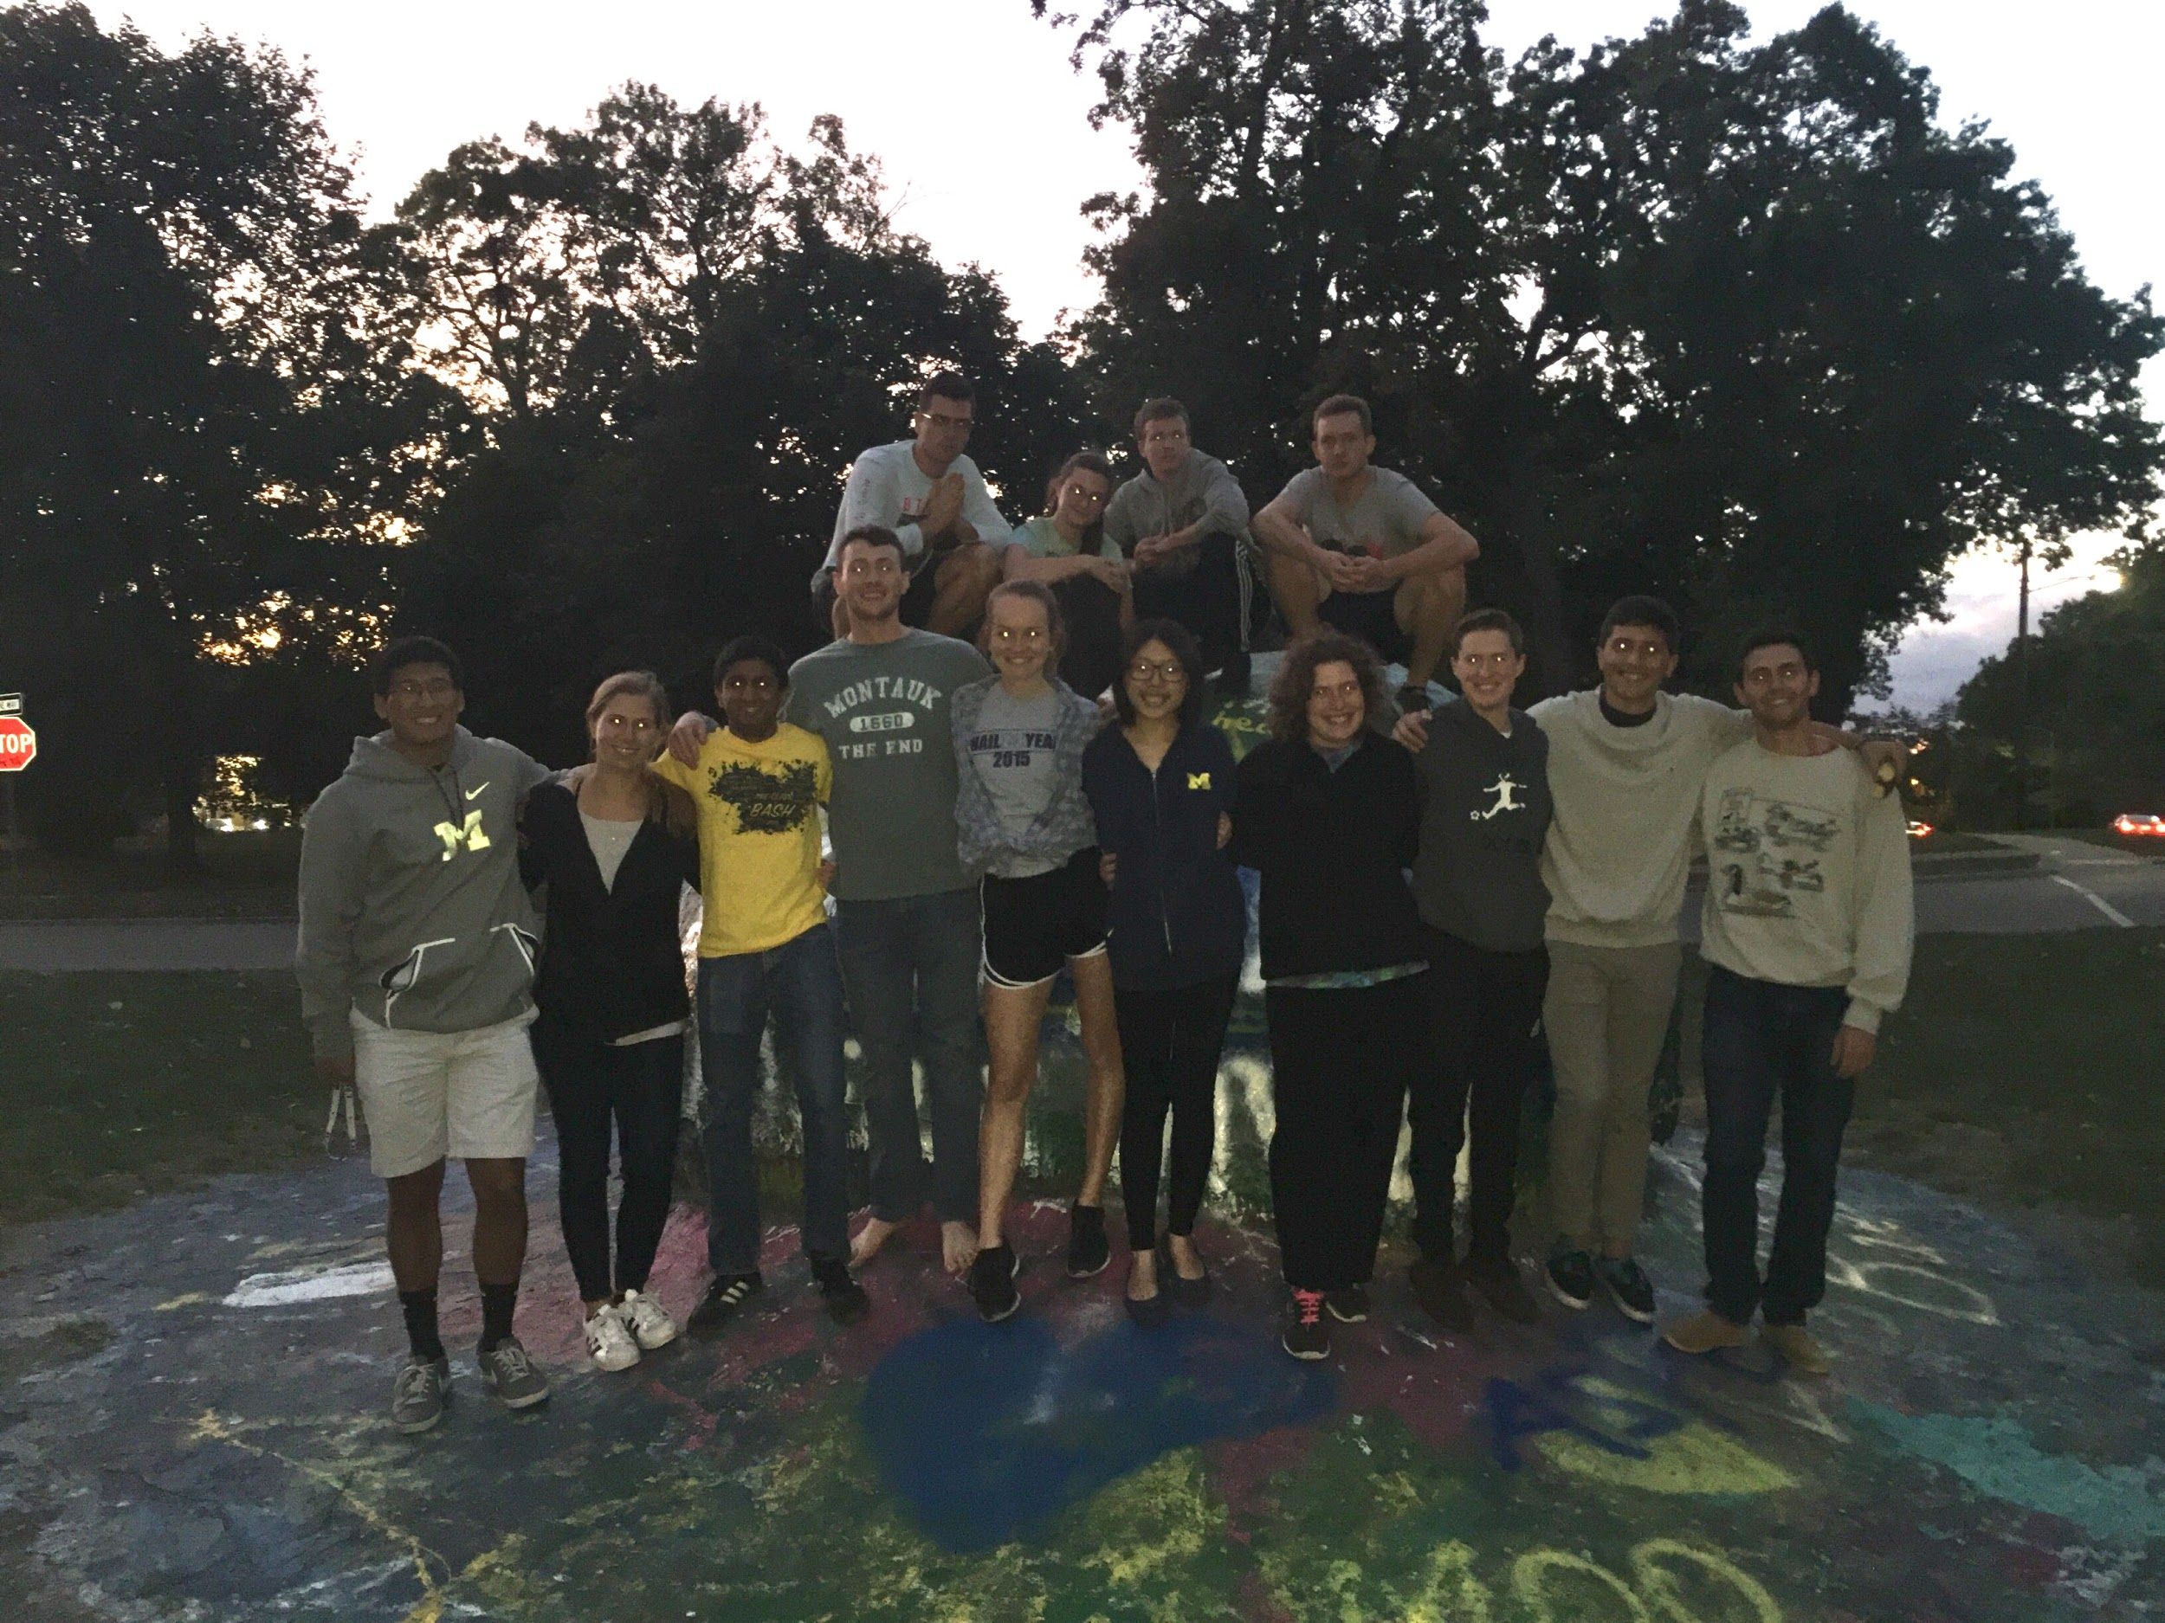
What’s the Purpose of a Mentorship Program?
Foster a community between under and upperclassmen
Provide resources and knowledge to underclassmen who may dsadasdasdasdasdasd not know much about Chemical Engineering
Create opportunities for students to network and learn about dsadasdasdasdddsad companies or graduate schools
Host fun events throughout the year to build relationships

Slide 3
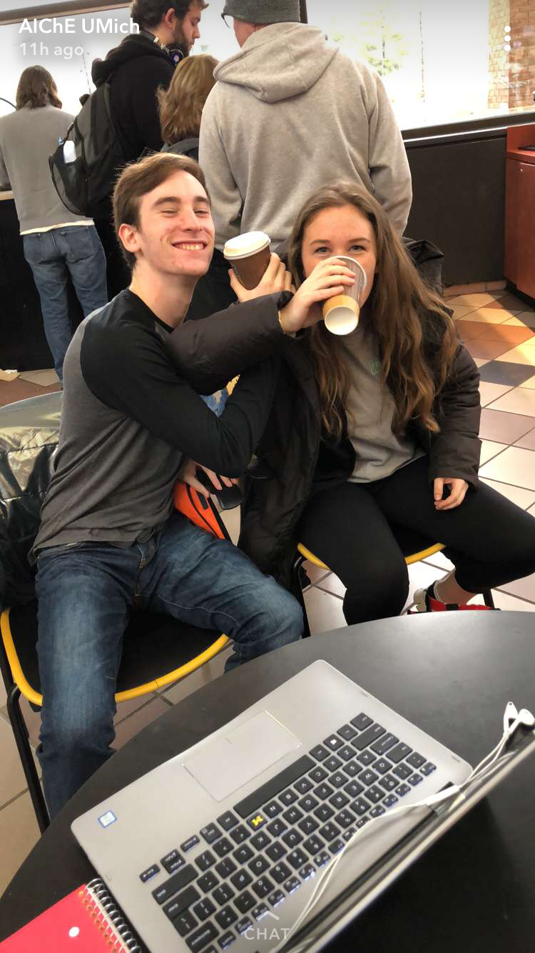
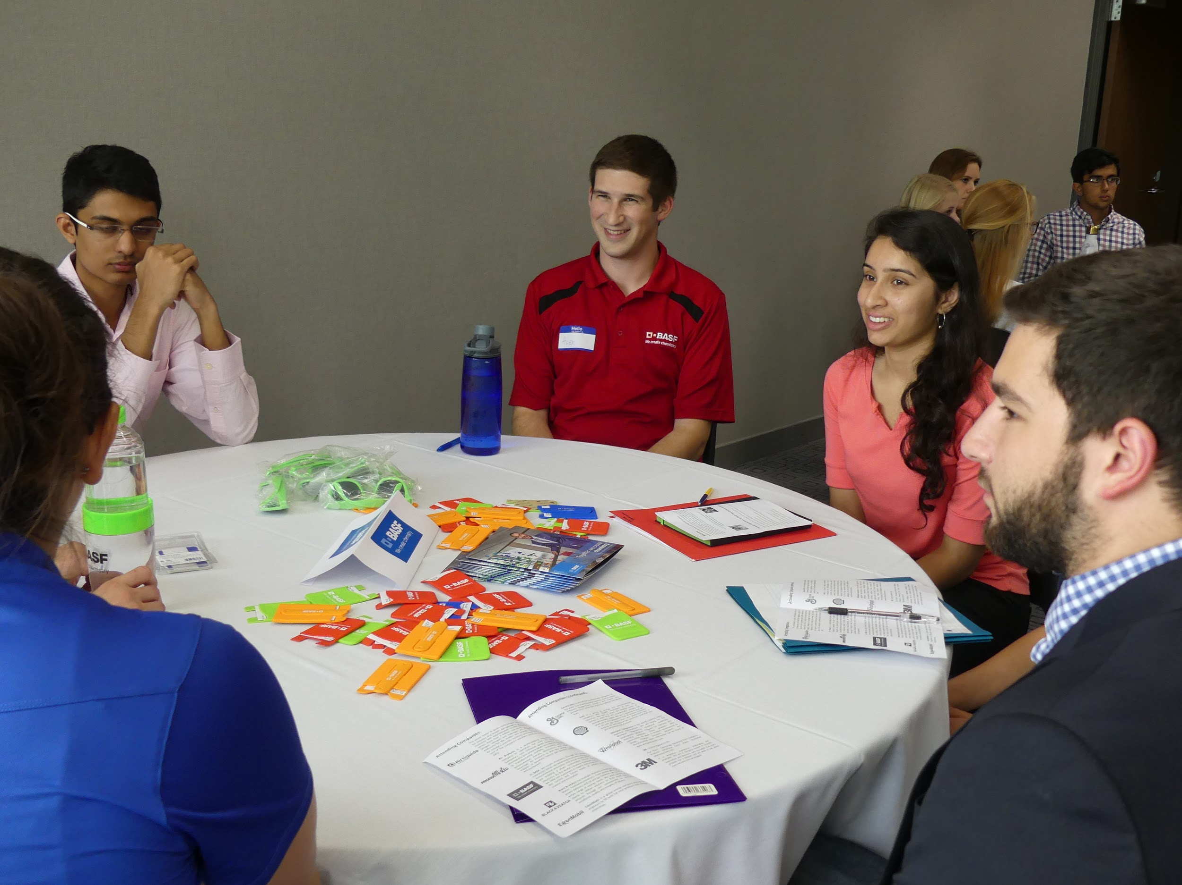
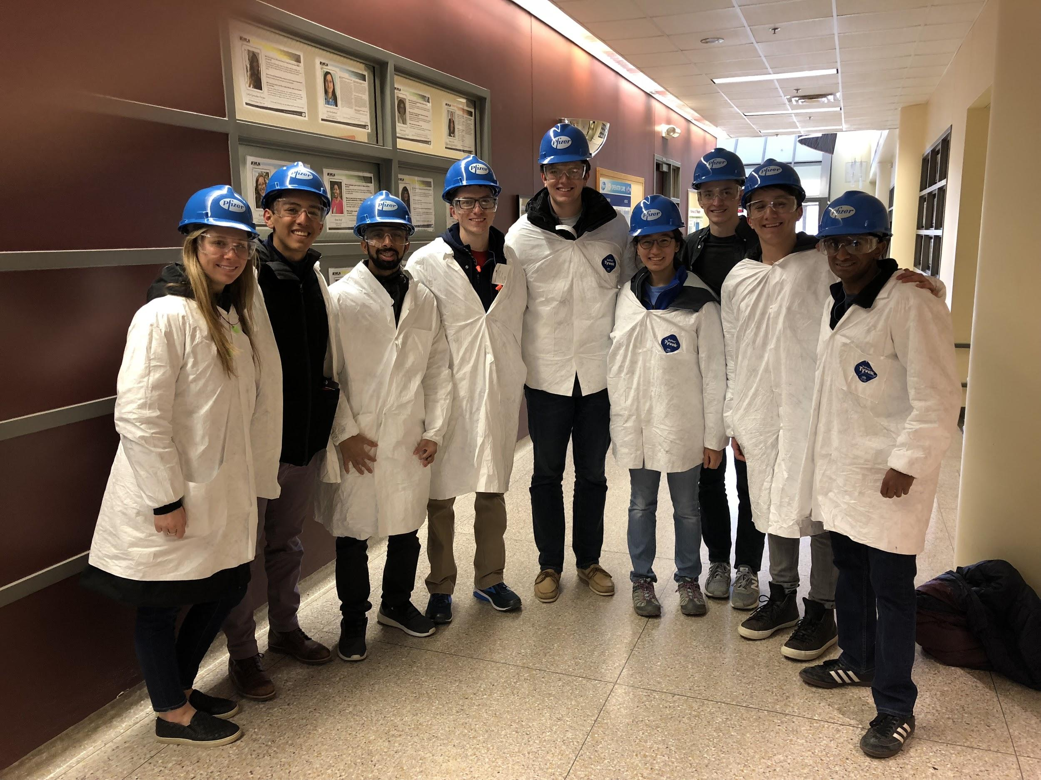
Mentorship Events
Social Mentorship
Welcome Back Ice Cream Social
Mentor-Mentee Socials
Outreach Committee events
Industry Mentorship
Night with Industry
Professional Mentorship
Plant Tours

Slide 4
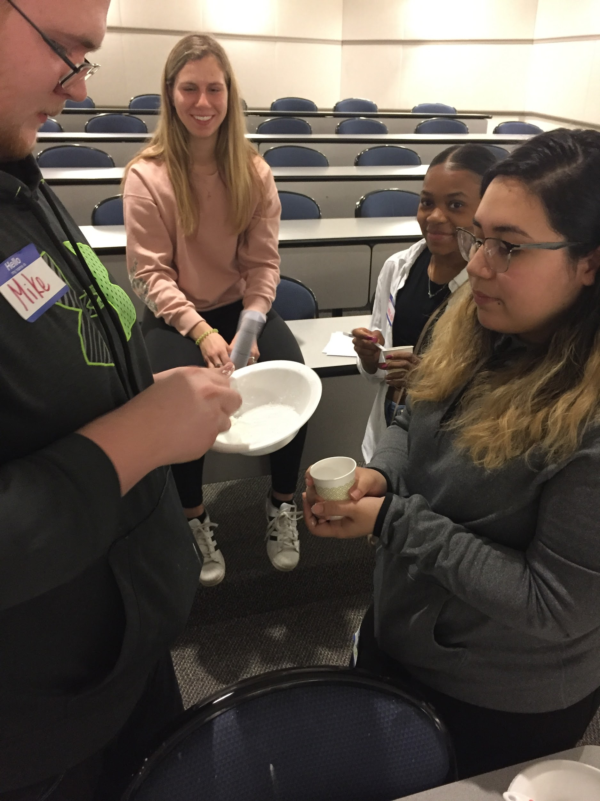
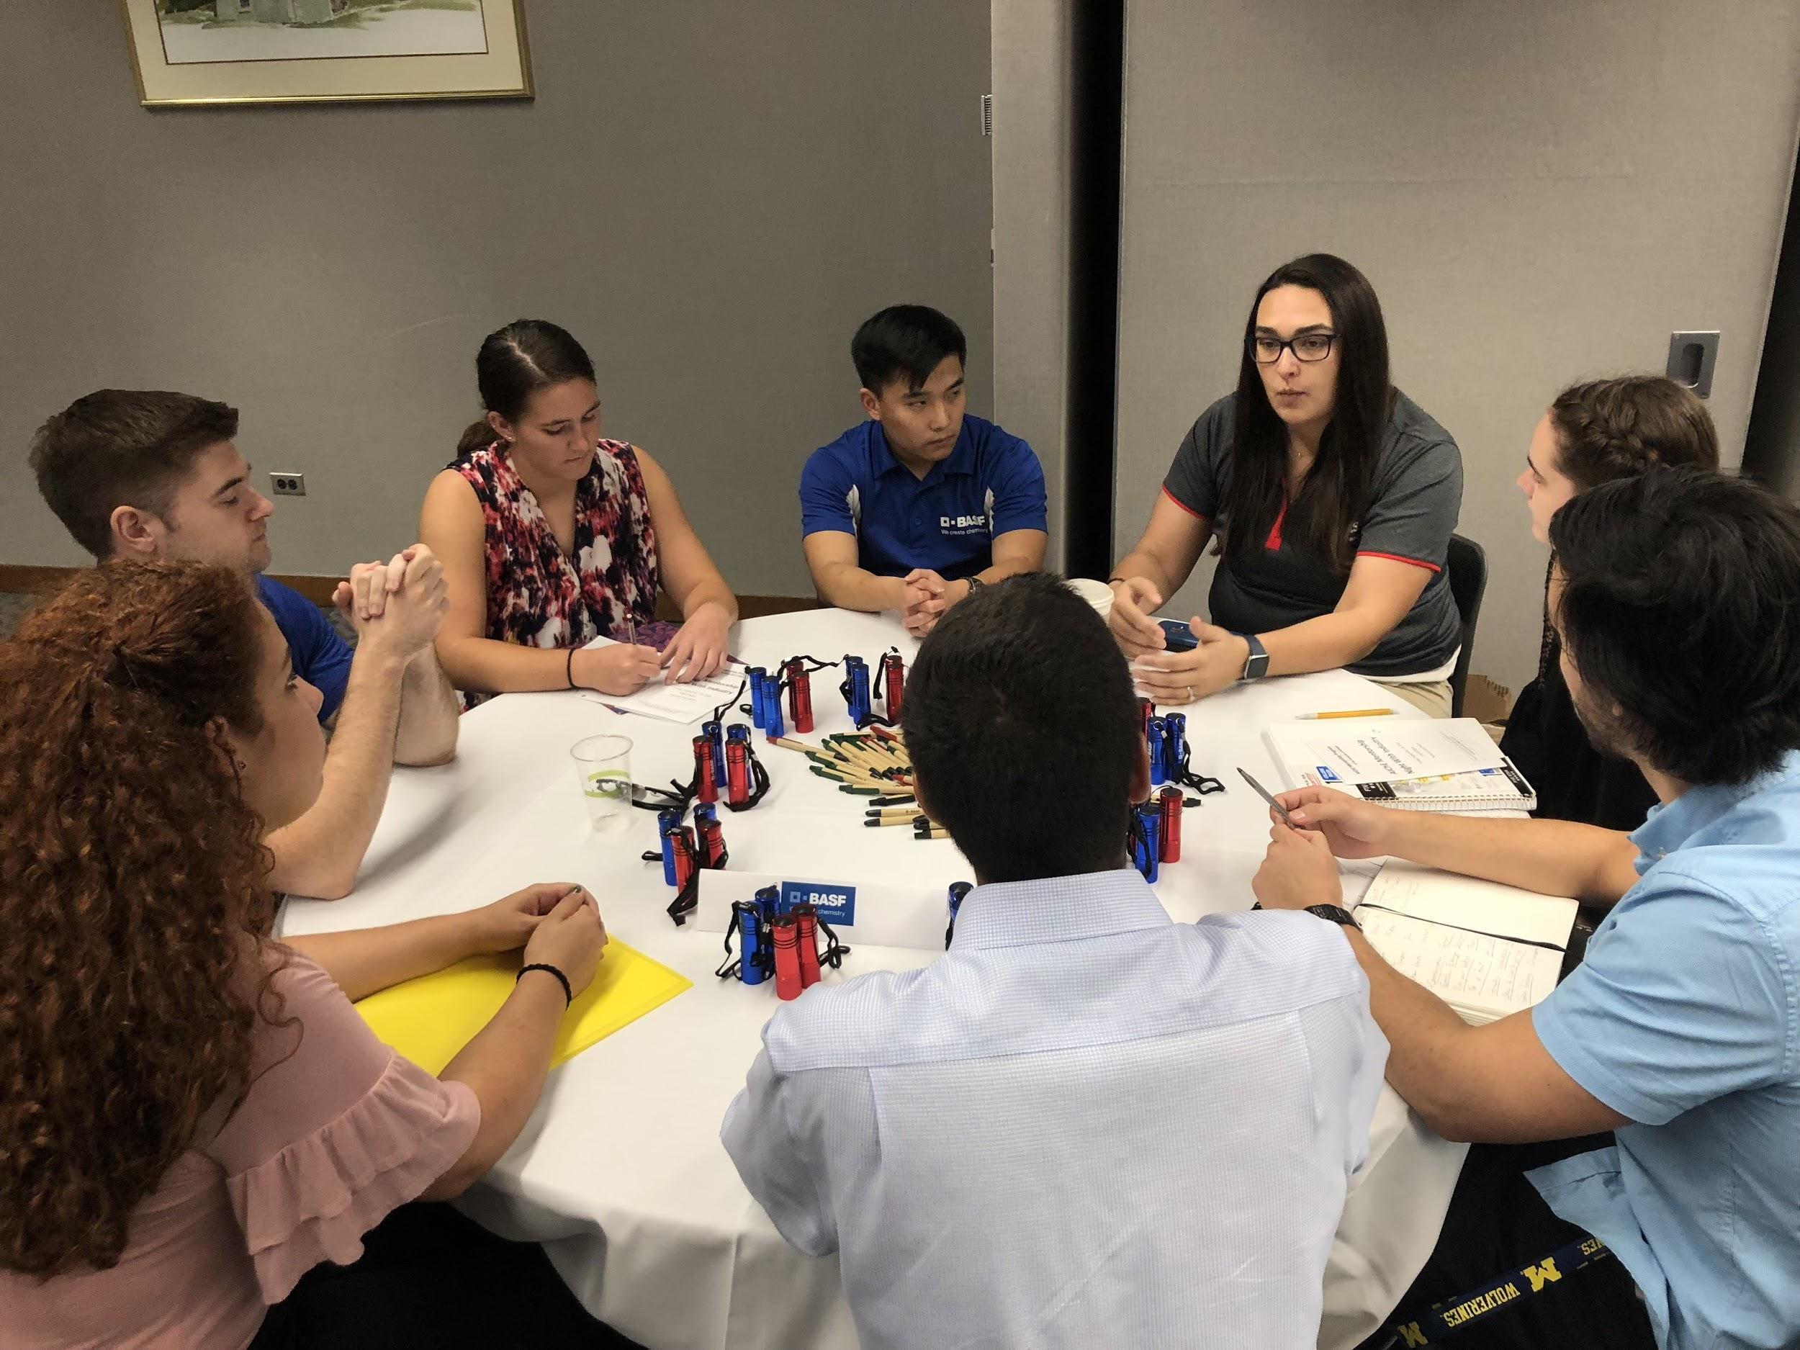
Starting Mentorship in your Chapter!
Talk to your advisor
Set reasonable goals
Build on your successes and failures
Reach out to corporate contacts and discuss objectives

Slide 5
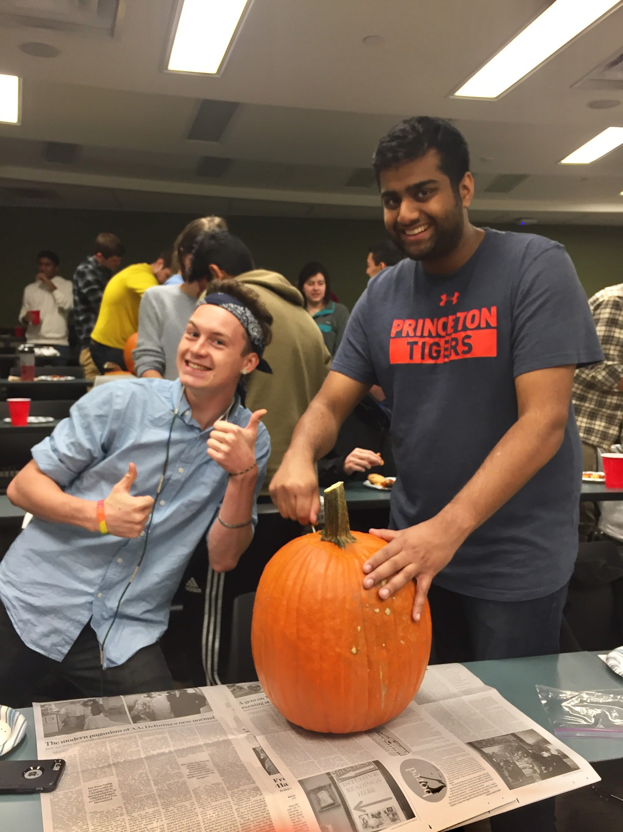
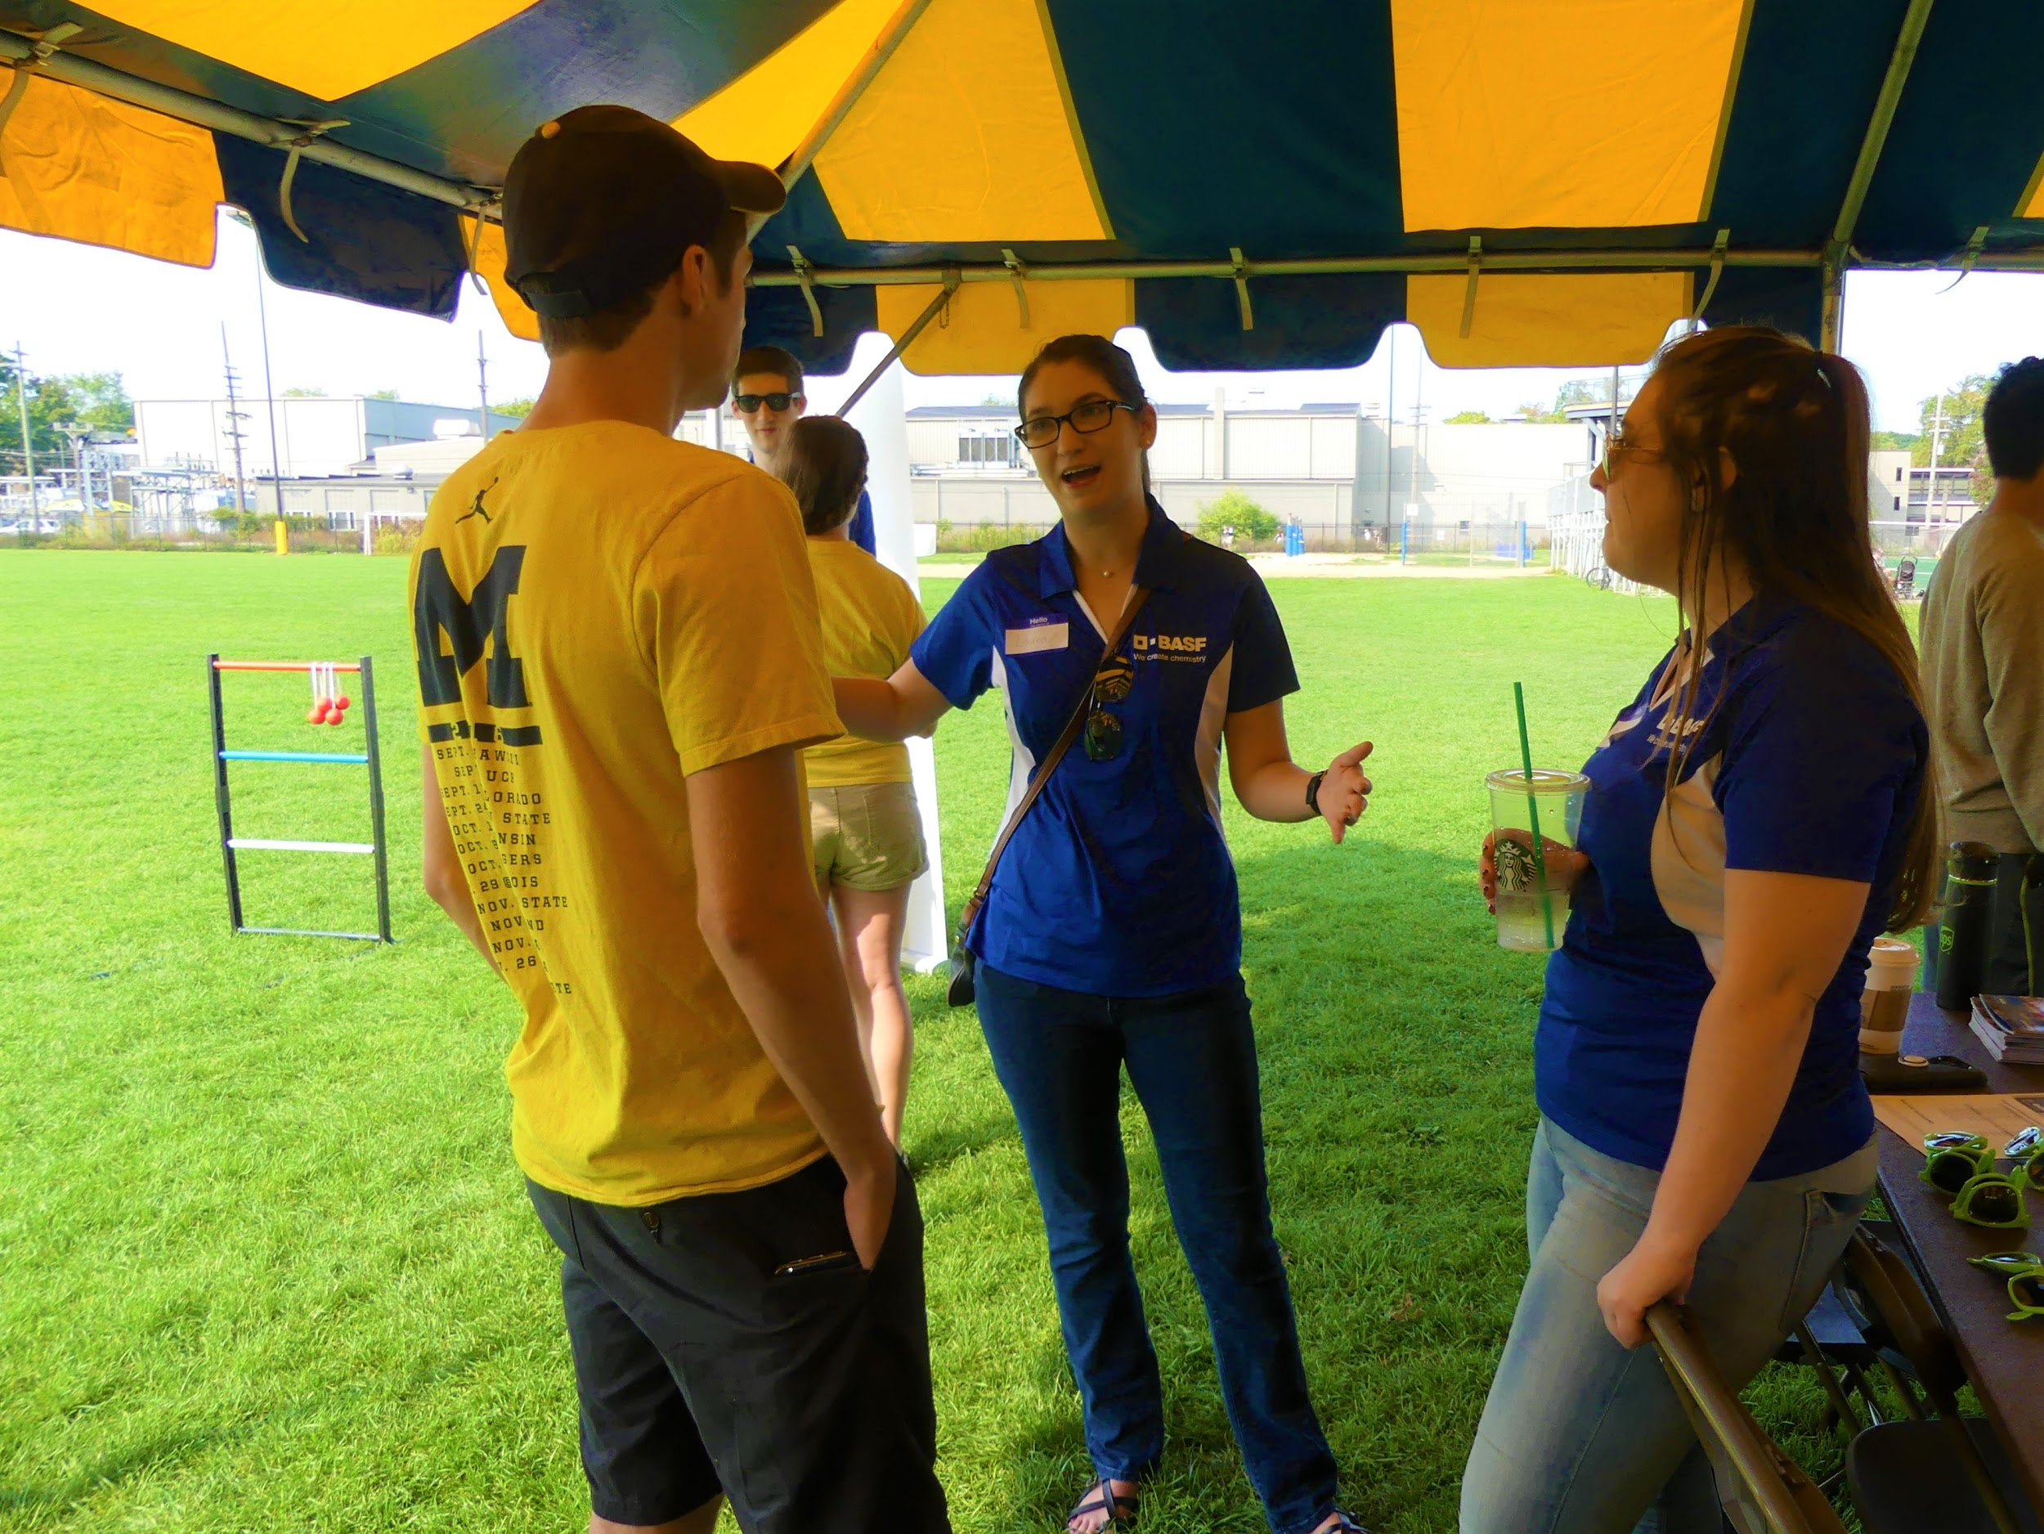
Maintaining a Successful Program
ADVERTISE, ADVERTISE, ADVERTISE!
Social media, word of mouth, etc.
Incentives
Point system with rewards, such as free dinners
Inclusive and positive mindset
Keep your head up, establishing mentorship kdksandkasndkjndkjnkjnkjnkjnkjn is a marathon, not a sprint

Slide 6
Questions? aichementorship18-19@umich.edu

