Slide 1
Challenge your colleagues and climb the leaderboard with the all new AIChE Scavenger Hunt!
Login to www.aiche.org/ScavengerHuntASC.
Find and enter the code for each activity to earn points.
This session’s code is: SCWorkshop

Slide 2
CORPORATE SPONORSHIP AND YOUR AICHE CHAPTER
Fritz hyde, v - president
Christina meyer - Internal vice president
Joseph mcmullen- Treasurer
University of Michigan aiche chapter
October 27th, 2018
Notes:
Joseph

Slide 3
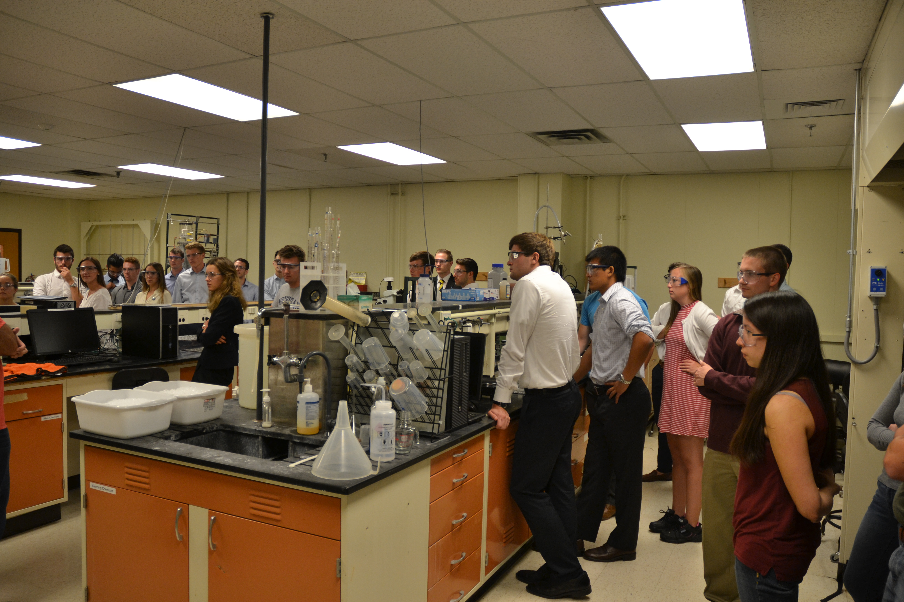
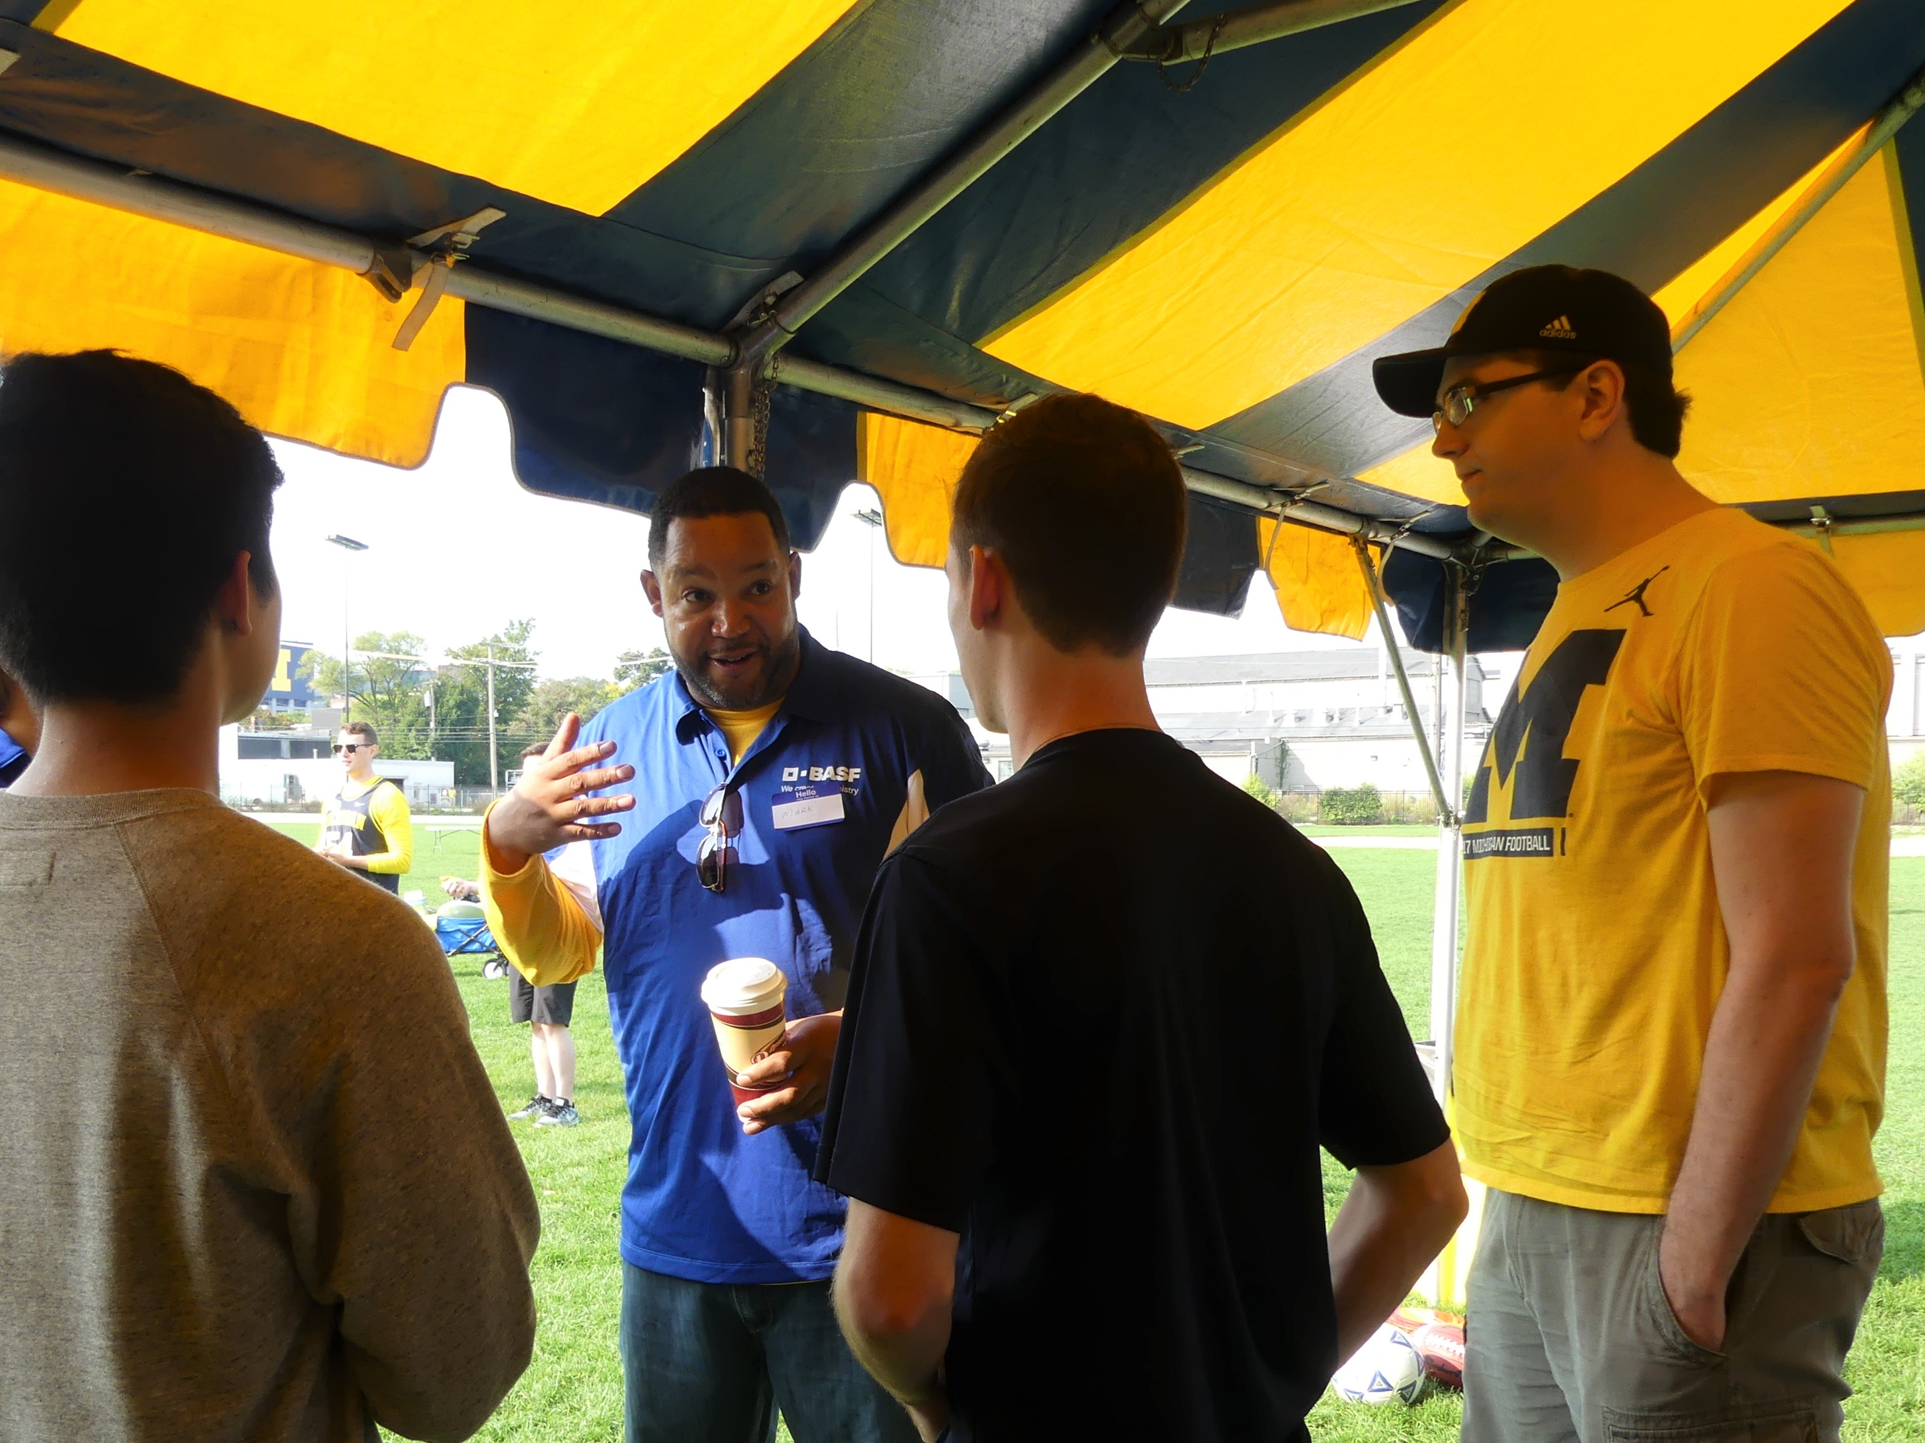
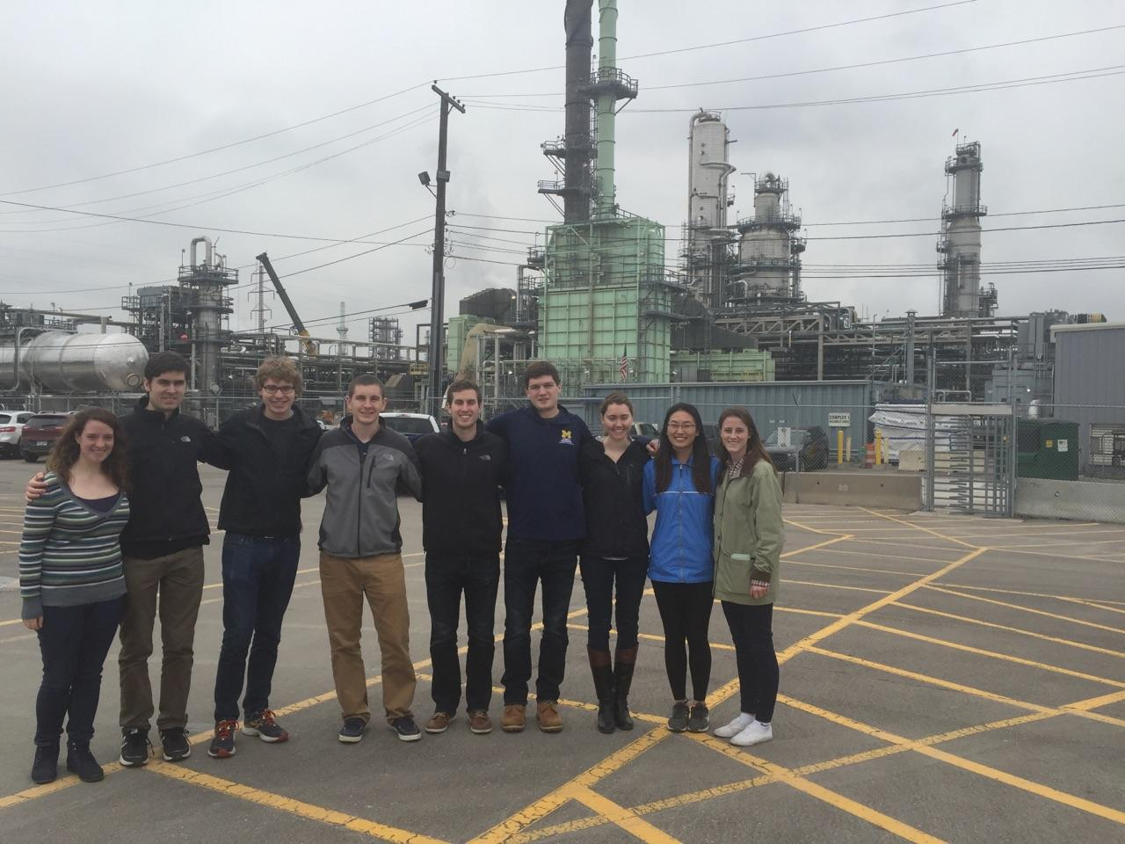
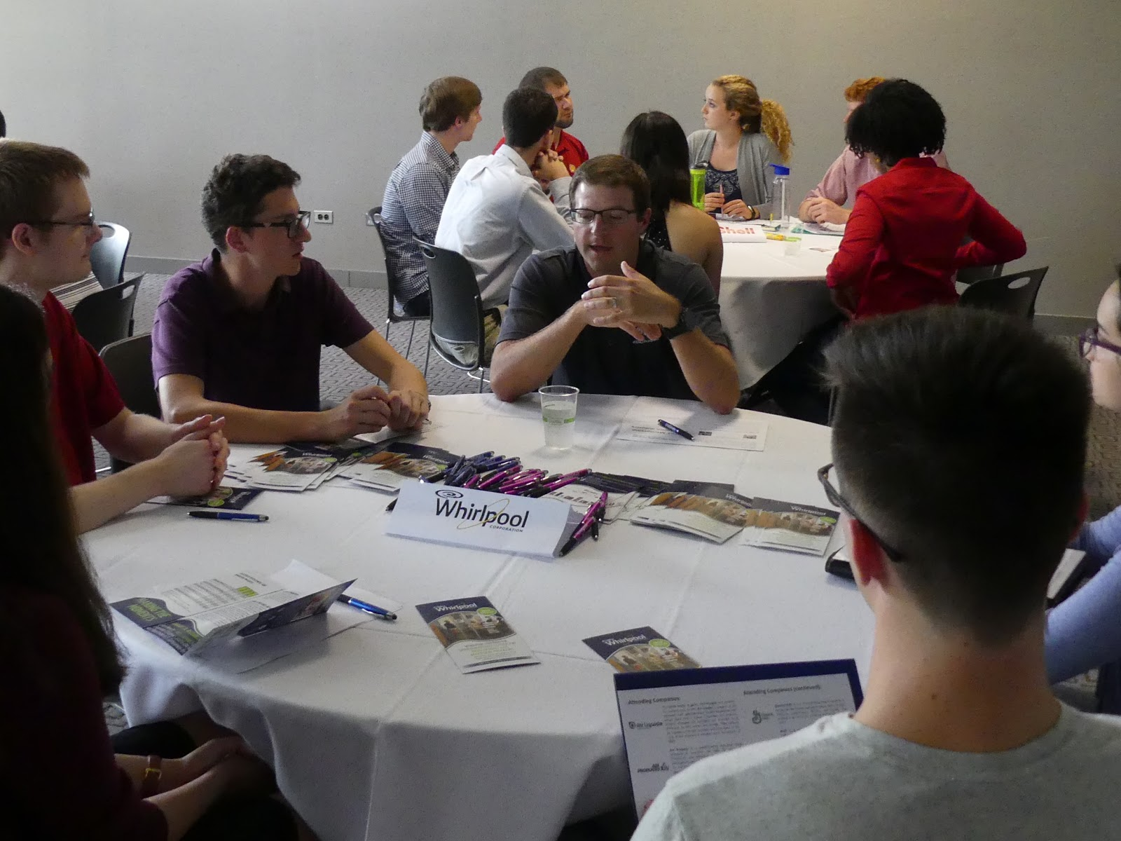
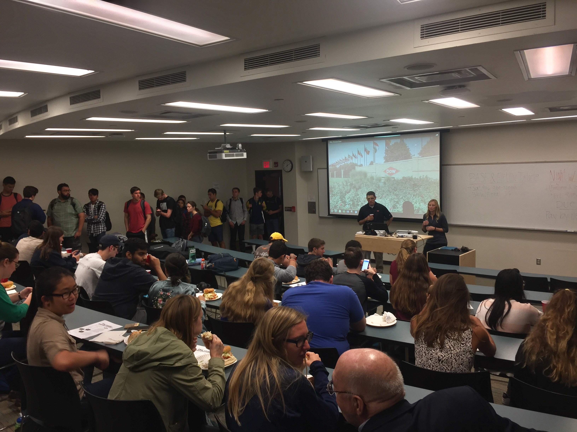
What is corporate sponsorship?
Companies committing resources to aid student chapters
Notes:
Joseph

Slide 4
Outline of today’s presentation
Making initial contact with companies
How to reach out
Who reaches out
Where to reach out
Why you deserve funding
How to sustain these corporate relationships
Detailed examples of our two main corporate sponsored events
Weekly luncheons
Company tailgate
Notes:
Joseph

Slide 5
How to reach out
What content to put in an email
Formatting of emails
Goal is to build a sustainable relationship
Notes:
Fritz

Slide 6
Who reaches out
Depends on the type of outreach
For ongoing primary events - President
For funding applications - Treasurer
Try to encourage people to join executive board by showing different positions can be in charge of different corporate outreach
Notes:
Fritz

Slide 7
Where to reach out
Some questions to ask of your chapter to find the right companies to reach out to:
What companies hire a lot of chemical engineers from our school?
What companies have money set aside for campus involvement?
Are they any local companies with ties to your chapter/school?
Where are recent alumni working at with strong ties to the chapter?
Notes:
Fritz

Slide 8
Justification for why you deserve resources
First and foremost, companies set this money aside and it is there for the taking
These companies have complex processes in their plants and will always need Chemical Engineers. Coming to campus helps them recruit the best
This helps students in your chapter figure out if they want to work for these places and ultimately save these companies money
Notes:
Fritz

Slide 9
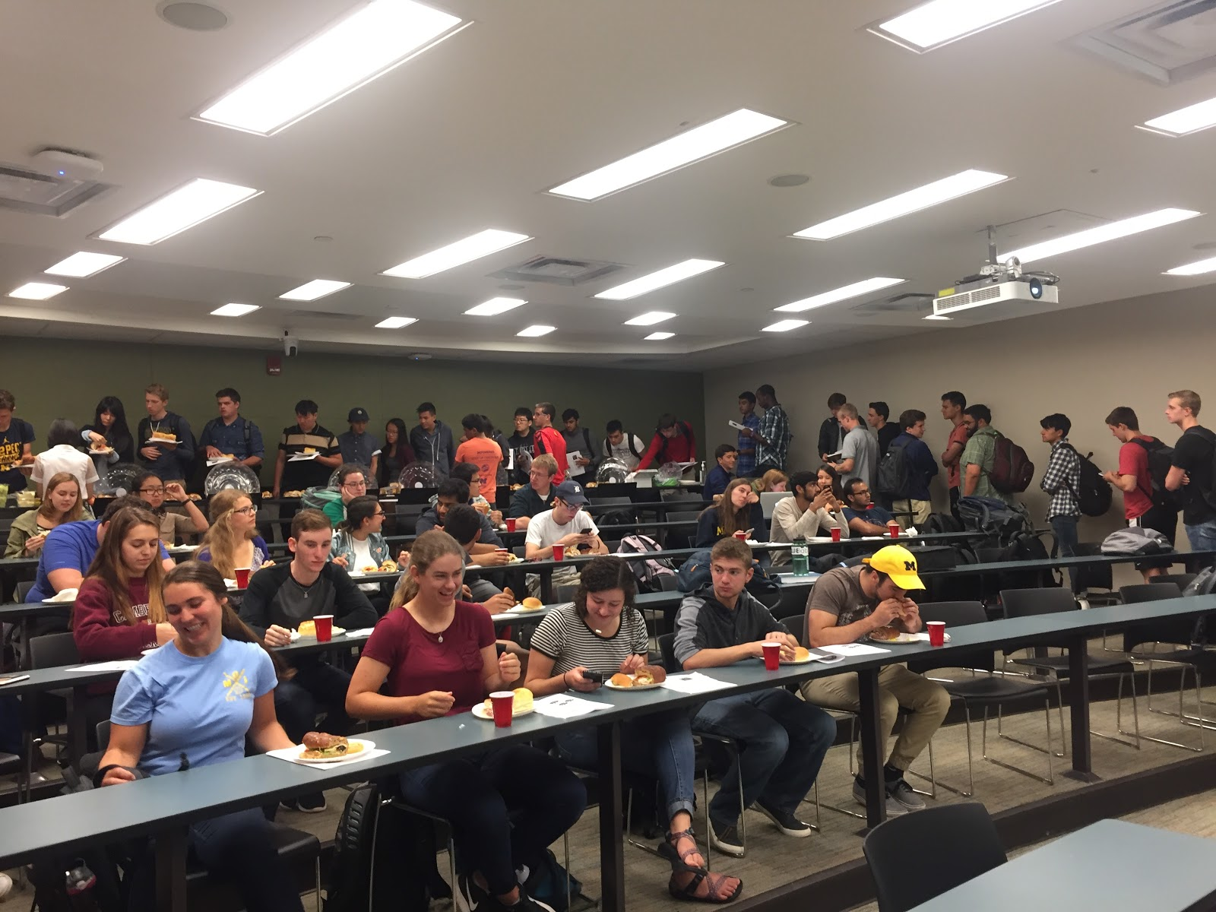
Luncheons
What are they?
Who attends?
How are they organized?
Notes:
Christina

Slide 10
What are Luncheons?
Catered presentation from any company with ChE ties
Procter & Gamble, Kraft Heinz, Ford
Not unlike info sessions
Open to only AIChE dues paying members
Regularly scheduled
Every Thursday, 12-1 PM. 1200 EECS
Notes:
Christina

Slide 11
Who attends luncheons?
Company Representative
Arrive on campus ~10 minutes before the luncheon starts
AIChE Members
Students line up outside of the meeting room
AIChE Executive Board
Set up the food
Facilitate smooth process
Faculty
AIChE Advisor, department advisor, & other professors attend
Notes:
Christina

Slide 12
How are luncheons organized
President reserves classroom for luncheon three to four months in advance
President reaches out three to four months in advance
Generally with set of dates available
Every Thursday in the semester
Notes:
Christina

Slide 13
How Are Luncheons Organized? (cont)
Coordination of date generally include email chains with companies
Educate on how to interact professionally over email
Reminder email one - two weeks in advance
Details logistics, expectations, other information
Begin planning catering
Open avenue for questions from company
Notes:
Christina

Slide 14
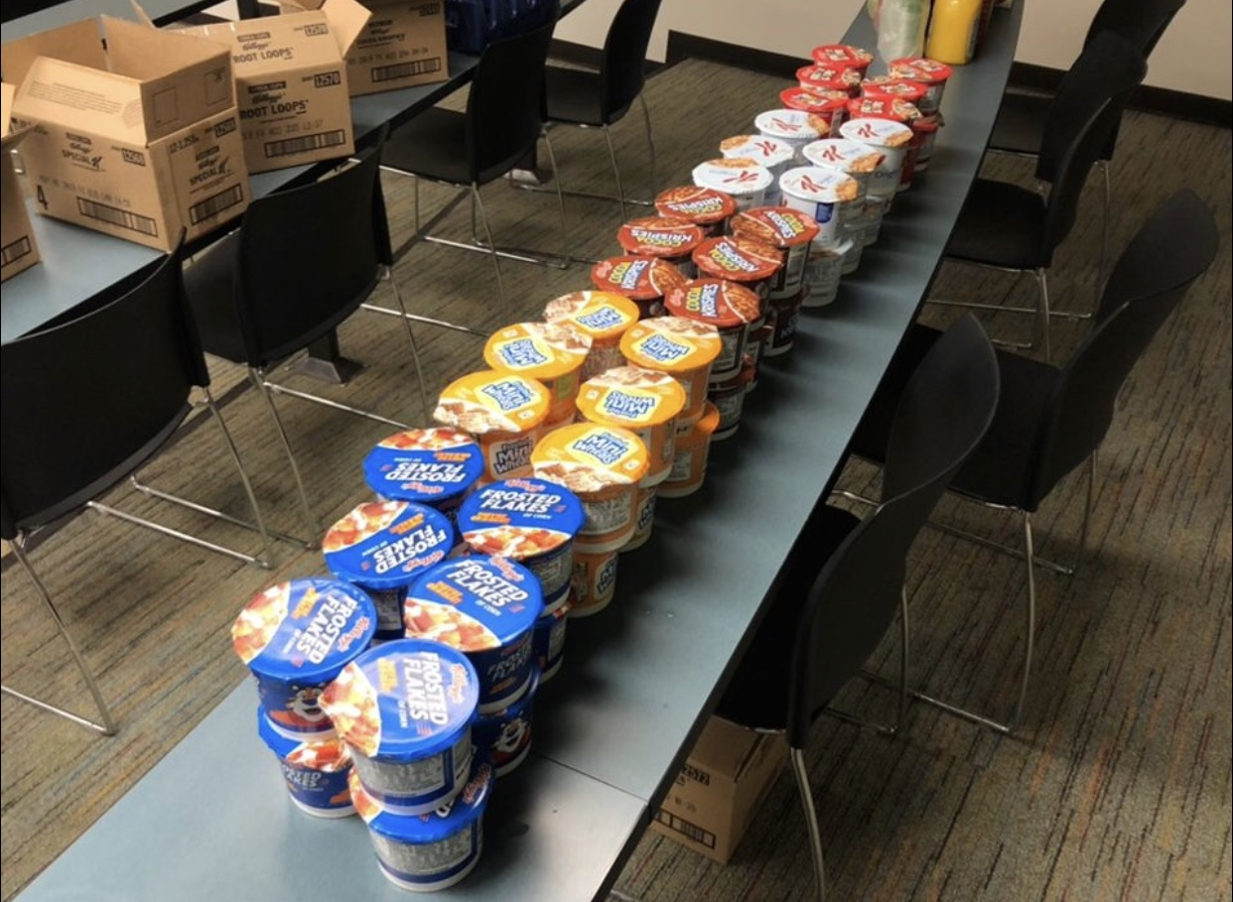
How Are Luncheons Organized? (cont)
Catering Planning
Companies usually sponsor catering for their luncheon
AIChE IVP orders food and company calls restaurant to pay
Currently give budget ranging $200-$600
Learn to ask for more money as politely as possible
Use evidence
VARY YOUR CATERING
Attendance will suffer without food variety
Order food at least 48 hours in advance of the luncheon
Notes:
Christina

Slide 15
How Are Luncheons Organized? (cont)
Day of Luncheon - Executive Board
President meets with company representative(s)
Other members (IVP) take care of food and drinks
Secretary signs people in
Card Scanner and Excel
Treasurer takes dues
Newsletter Chair prints newsletter
Rest of E-Board monitors food and pours drinks
Notes:
Christina

Slide 16
How Are Luncheons Organized? (cont)
Day of Luncheon - General Members
Wait outside the room until secretary and IVP are ready
File into room & sign in with secretary
Get food, drink, & newsletter
Sit and eat/wait for presentation to begin
Day of Luncheon - Company
Arrive 10-15 minutes before
Present and answer questions
Generally open to staying later to speak individually
Notes:
Christina

Slide 17
How Are Luncheons Organized? (cont)
Day of Luncheon - Afterwards
Sustainability Committee
Committed to reducing luncheons to zero-waste
Composting sustainable materials
President requests mailing address from presenter(s)
Thank you notes
Ensure presenters get a receipt for catering
Notes:
Christina

Slide 18
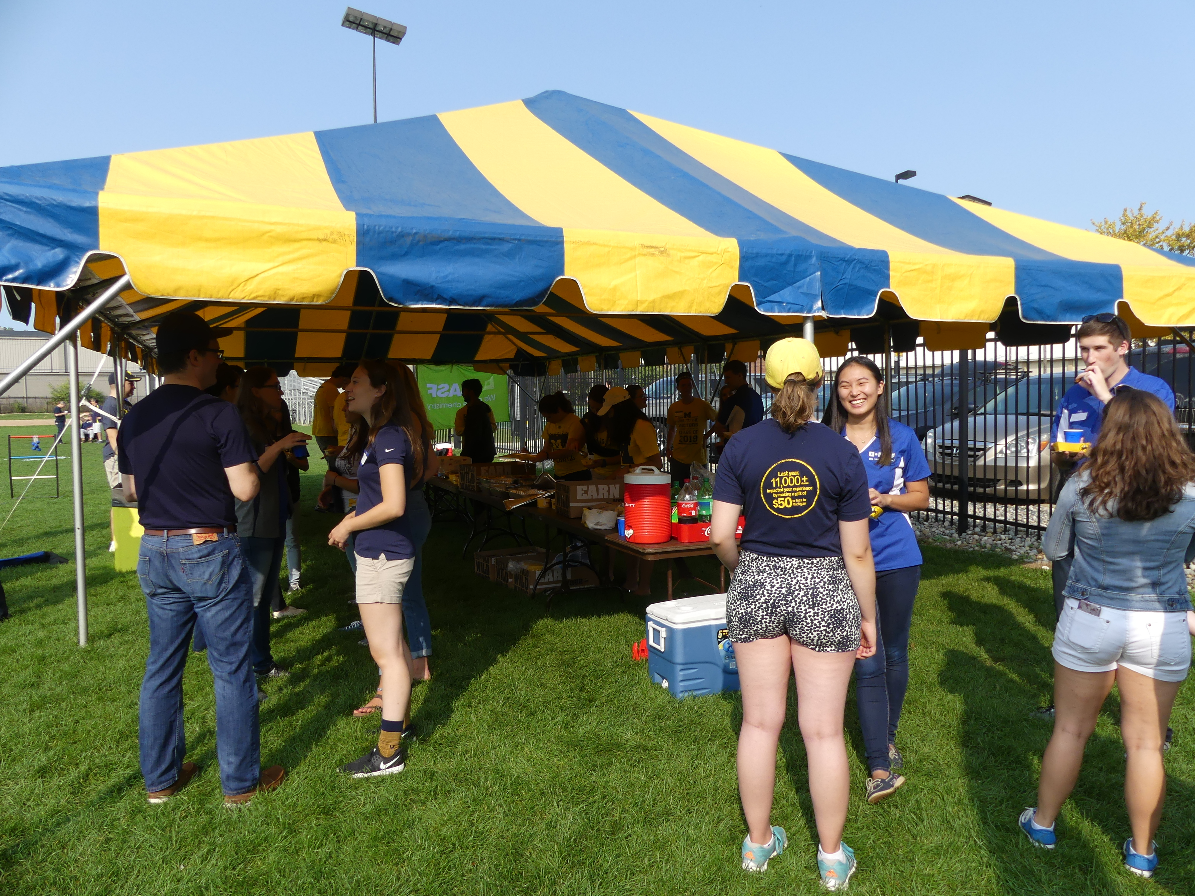
Company Tailgate
What is it?
What are the benefits?
Notes:
Christina

Slide 19
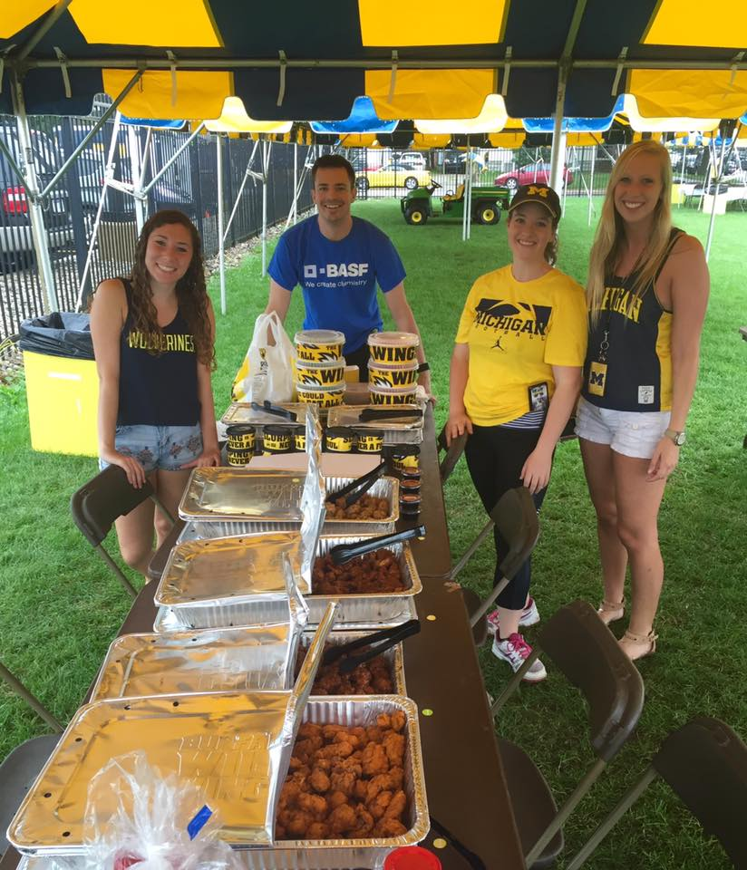
Company tailgate: logistics
Which game day to pick
Before career fair
Day game
Ordering food
Depends on game time
How to get students to show up
Advertise event in class
Casual networking
Notes:
Christina

Slide 20
Conclusion
Notes:
Joseph

Slide 21
questions
?

Slide 22
Challenge your colleagues and climb the leaderboard with the all new AIChE Scavenger Hunt!
Login to www.aiche.org/ScavengerHuntASC.
Find and enter the code for each activity to earn points.
This session’s code is: SCWorkshop

