Slide 1
K-12 OUTREACH: INFORM, INFLUENCE, & INSPIRE
PRESENTED BY THE EXECUTIVE STUDENT COMMITTEE

Slide 2
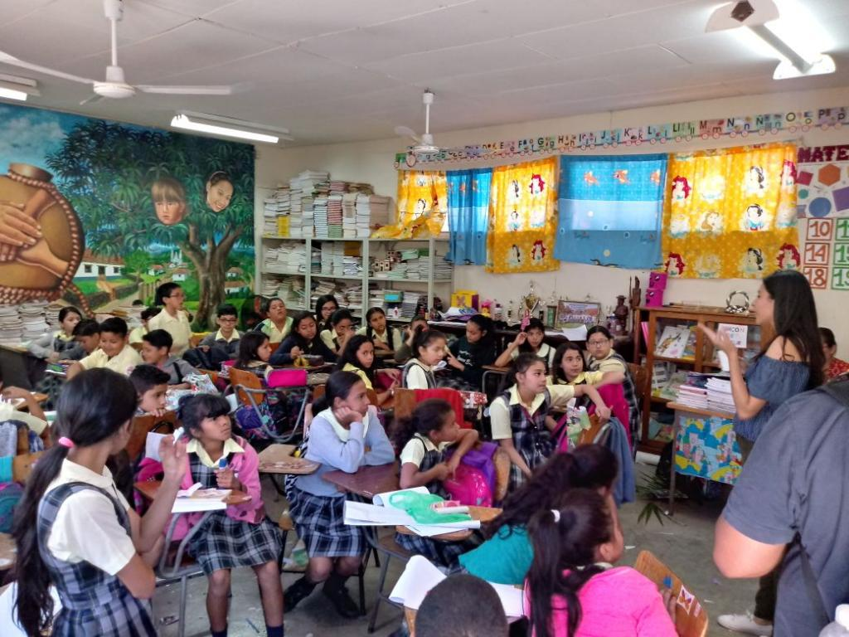
WHY REACH OUT?
Inform:
Raise awareness of what Chemical Engineers do
Communicate which qualities and interests would make Chemical Engineering a possible career choice
Influence:
Make an impact on students’ lives
Increase diversity by encouraging women and minorities to join this field
Inspire:
Recruit future Chemical Engineers
Plant a seed
4th, 5th, & 6th Grade Outreach
Universidad Nacional Autónoma de Honduras
Morazán , Tegucigalpa, Honduras
Purpose – Key Strategies – Elementary – Junior High – High School – Best Practices – Our Program – Conclusion

Slide 3
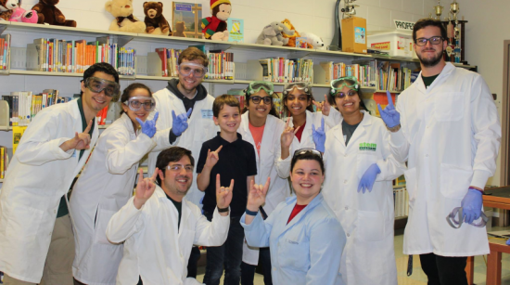
WHY REACH OUT?
Other Benefits:
Volunteer hours for your chapter
Presentation practice
University Recruiting
Put AIChE’s name out there
Recruit future chapter members
ChemE Magic Show
The University of South Florida – Tampa, Florida
Purpose – Key Strategies – Elementary – Junior High – High School – Best Practices – Our Program – Conclusion

Slide 4
KEY STRATEGIES
Incorporate hands on learning safely
Use experiments as a tool to explain Chemical Engineering concepts
Pair up with other engineering organizations to reach larger audiences
Reach out to companies for event sponsorship
Reach out to schools where AIChE members have connections
Keep students engaged
Communicate on your audience’s level
Purpose – Key Strategies – Elementary – Junior High – High School – Best Practices– Our Program – Conclusion

Slide 5
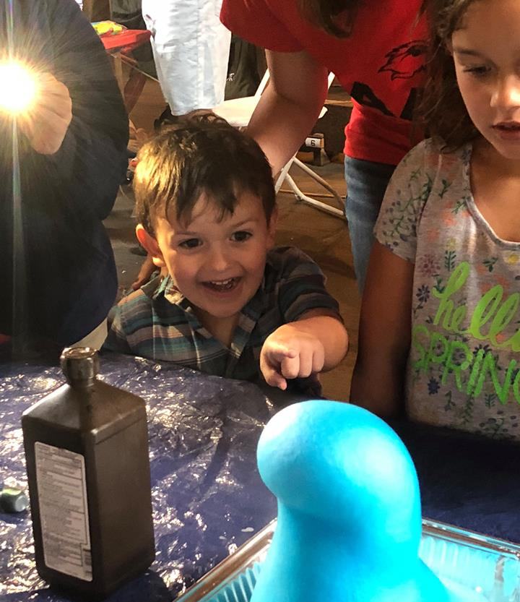
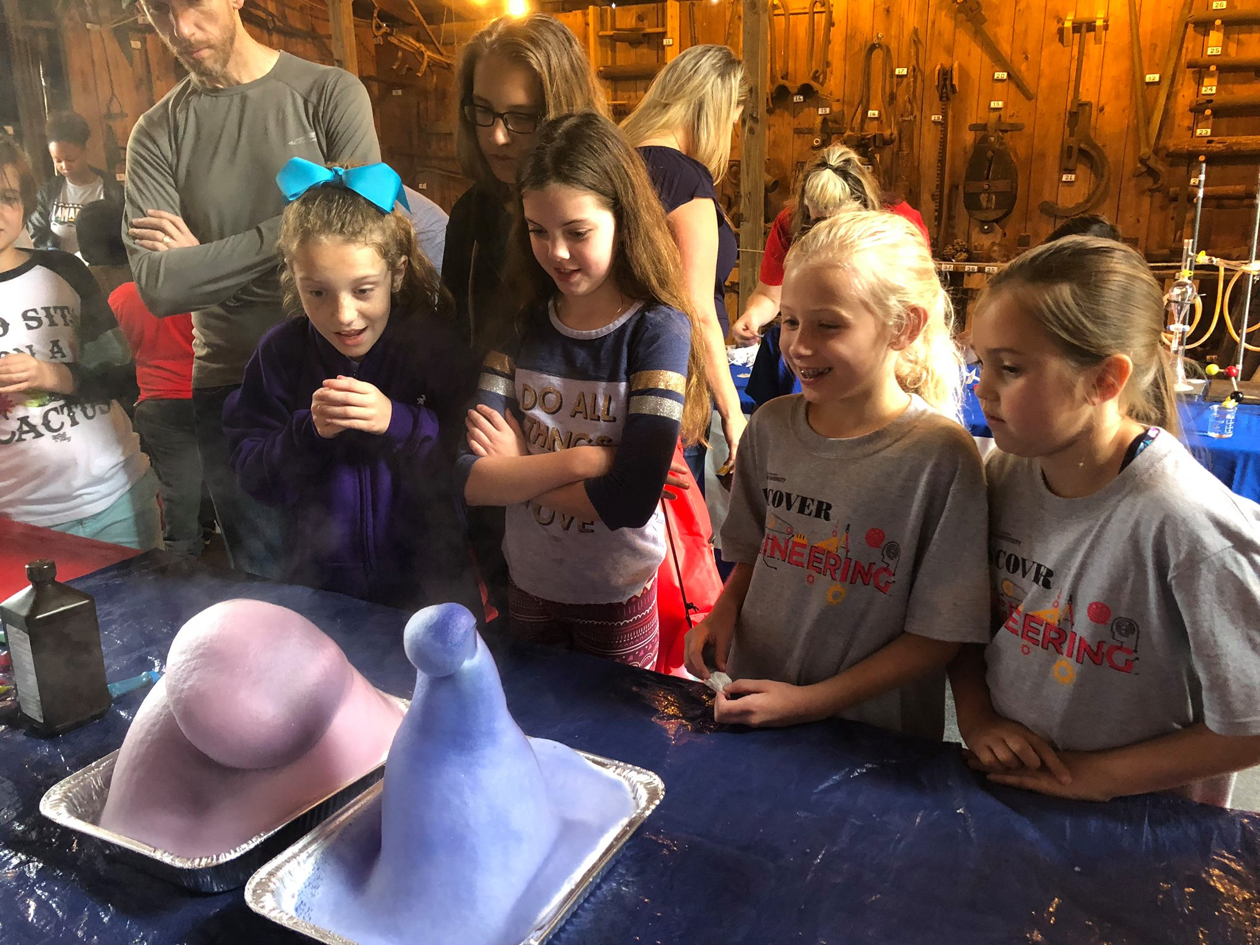
ELEMENTARY SCHOOL (K-5)
Spark their interest in STEM fields
Hands on learning is essential
Experiments
Games
Unit Ops (4th grade +)
Facilitate conversation
Connect concepts to things they have experienced
Encourage questions
Emphasize the importance of education
Discover Engineering
Lamar University – Beaumont, TX
Purpose – Key Strategies – Elementary – Junior High – High School – Best Practices – Our Program – Conclusion

Slide 6
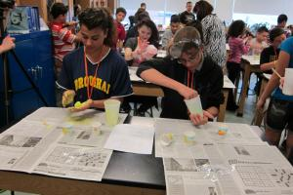
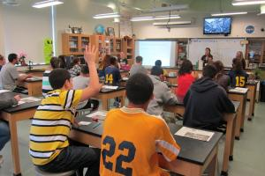
JUNIOR HIGH (6-8)
Target gifted and/or passionate students
Incorporate a mixture of presentations and hands on activity
Introduce research and incorporate more unit ops.
Don’t underestimate
The students’ curiosity
The students’ ability to understand difficult concepts
What the students already know
Give them a goal to work towards
Middle School Outreach
Lehigh University – Bethlehem, Pennsylvania
Purpose – Key Strategies – Elementary – Junior High – High School – Best Practices – Our Program – Conclusion

Slide 7
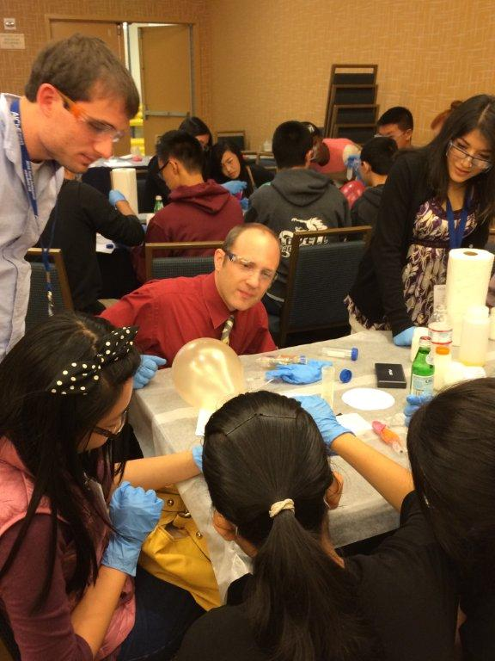
HIGH SCHOOL (9-12)
Presentations, questions, and unit ops.
Basic questions to prepare for include:
What interests/qualities would make me a good ChemE?
What does a ChemE do? Coursework and career?
Is Chemical Engineering hard?
University Recruiting
Target Sophomores and Juniors in advanced science classes
Don’t force them to listen—just offer up the information
AIChE’s Outreach in Action
Annual Meeting
San Francisco, California (2013)
Purpose – Key Strategies – Elementary – Junior High – High School – Best Practices – Our Program – Conclusion

Slide 8
BEST PRACTICES
Dos
Do be honest.
Do be kind, smiling, and welcoming.
Do answer all questions, regardless of complexity or lack thereof. No question is a “stupid” question.
Do give your complete attention to any student who is interested.
Don’ts
Don’t sell Chemical Engineering.
Don’t be closed-off or unapproachable.
Don’t assume students should know anything or that it is their fault for lacking information.
Don’t judge any student as being “unfit” for chemical engineering.
Purpose – Key Strategies – Elementary – Junior High – High School – Best Practices – Our Program – Conclusion

Slide 9
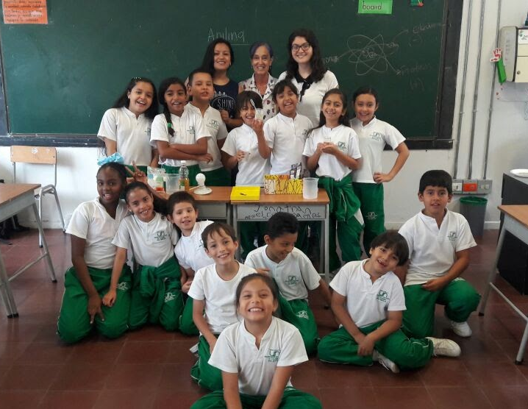
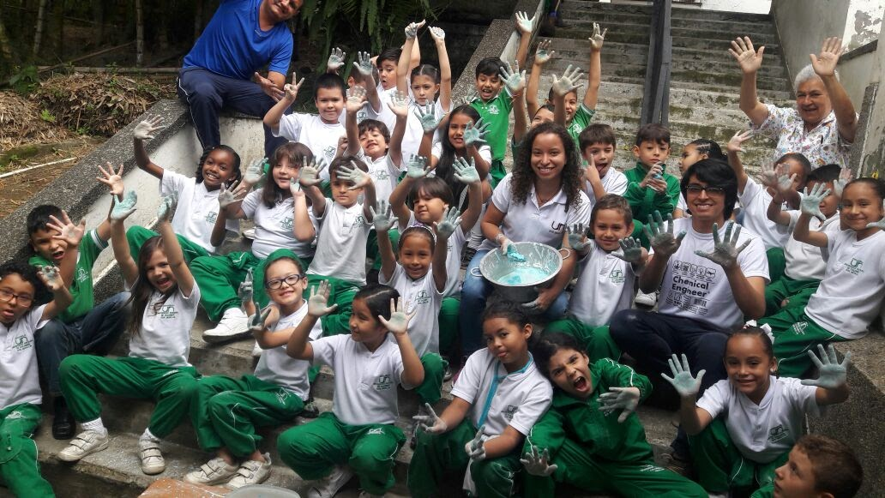
International Outreach
Universidad Nacional de Colombia Sede Medellín – Medellín, Antioquia, Colombia
Niños cientificos
2 phase program
Preparation: Chemistry teachers help prepare for experiments
1st Phase: Experiments with easily accessible elements
Teach chemistry concepts like density, viscosity, temperature, and chemical reactions.
2nd Phase: Assist in Science Fair where kids explain their experiments
You don’t understand a concept until you can explain it to someone else!
Purpose – Key Strategies – Elementary – Junior High – High School – Best Practices – Our Program – Conclusion

Slide 10
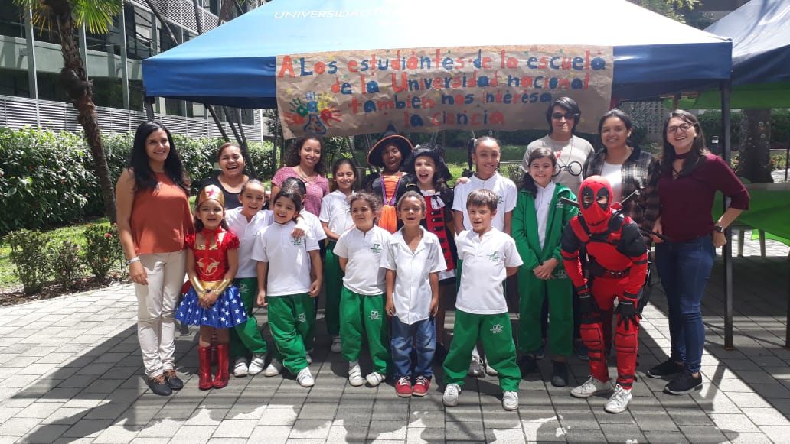
International Outreach
Purpose – Key Strategies – Elementary – Junior High – High School – Best Practices – Our Program – Conclusion

Slide 11
Impactful K-12 Outreach – Program Launch
Objective: Connect AIChE Chapters with each other and K-12 students
Founding Chapter: Universidad Nacional Autónoma de Honduras
How to Participate
Follow a module
Submit a module – Be a founding chapter!
Web Address: https://www.aiche.org/community/sites/committees/executive-student/k-12-outreach-program
Email me @ national.director.esc@gmail.com for the link
Directly contact the program @ outreach.esc@gmail.com
Purpose – Key Strategies – Elementary – Junior High – High School – Best Practices – Our Program – Conclusion

Slide 12
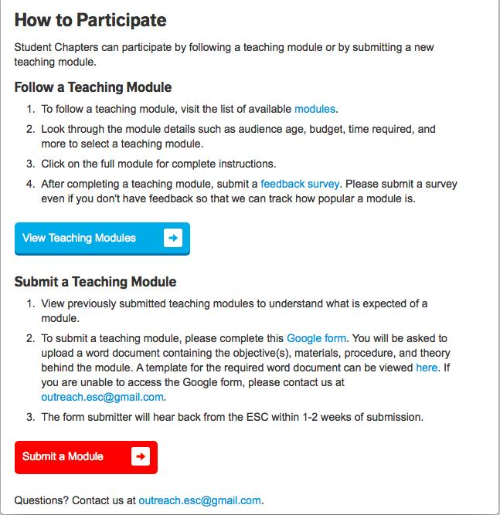

Slide 13
CONCLUSION
K-12 Outreach allows AIChE to make a positive impact in students’ lives.
Remember a few key strategies:
Hands on interaction (SAFELY)
Communicate based on your audience’s age
Collaborate with other organizations to reach even bigger audiences
Prepare yourself for questions, ensure that you look approachable and welcoming, and be honest.
Purpose – Key Strategies – Elementary – Junior High – High School – Best Practices – Resources – Conclusion

Slide 14
CONCLUSION
Questions?
Purpose – Key Strategies – Elementary – Junior High – High School – Best Practices – Resources – Conclusion

Slide 15
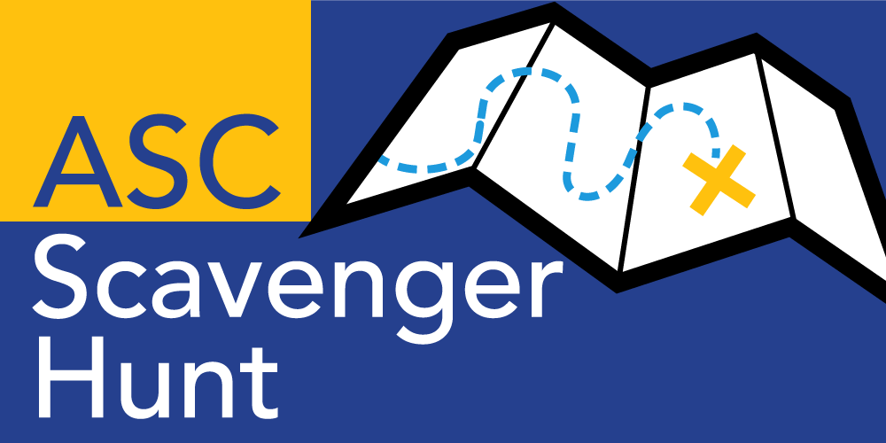
Challenge your colleagues and climb the leaderboard with the all new AIChE Scavenger Hunt!
Login to www.aiche.org/ScavengerHuntASC.
Find and enter the code for each activity to earn points.
This session’s code is: SCWorkshop

