Slide 1
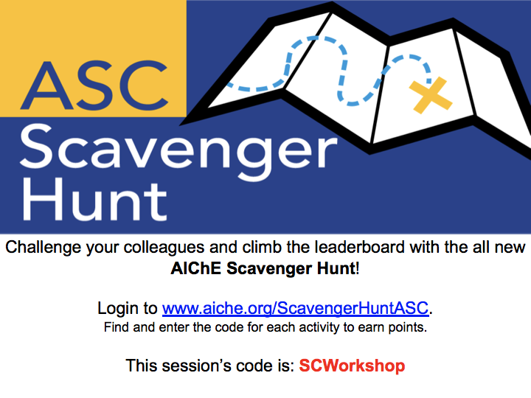
Notes:
Richa

Slide 2

Diversifying Technical Projects:
The Chemical Engineering
Introductory Project (ChIP)
Notes:
Richa and Steven

Slide 3
AIChE at UCLA
Professional
Development
Outreach
Mentorship
Technical
Projects
Notes:
Richa
4 Pillars of AIChE at UCLA

Slide 4
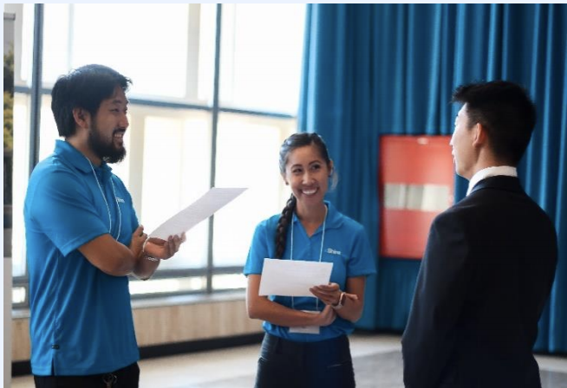
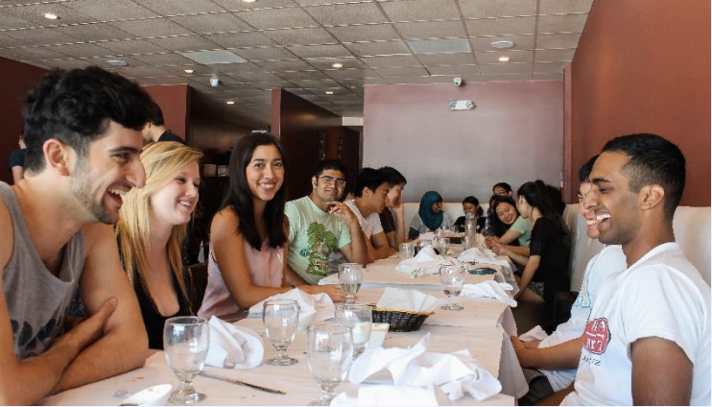
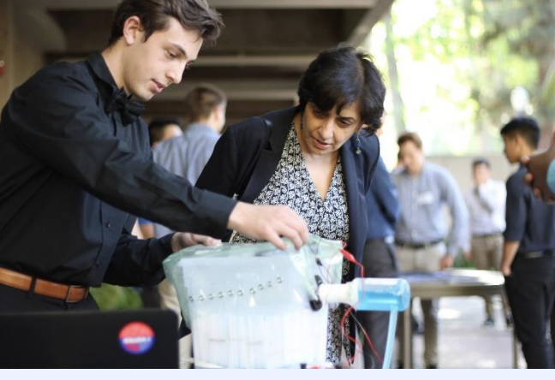
AIChE at UCLA
Technical Projects
  Chem-E-Car
  Chemical Engineering Introductory Project (ChIP)
  Lifetime Engineering Applications Project (LEAP)
Professional Development
Mentorship Program
Outreach
Notes:
Richa
Technical projects include Chem-E-Car, ChIP (which we will be talking about today) and LEAP which is based off of the AIChE Design Project
We host an annual career fair (12 attending companies) and offer mock interview and resume workshops
Mentorship program with 100 participants
STEM outreach to local high school and middle schools
Mention dean and picture and Mentorship Banquet

Slide 5
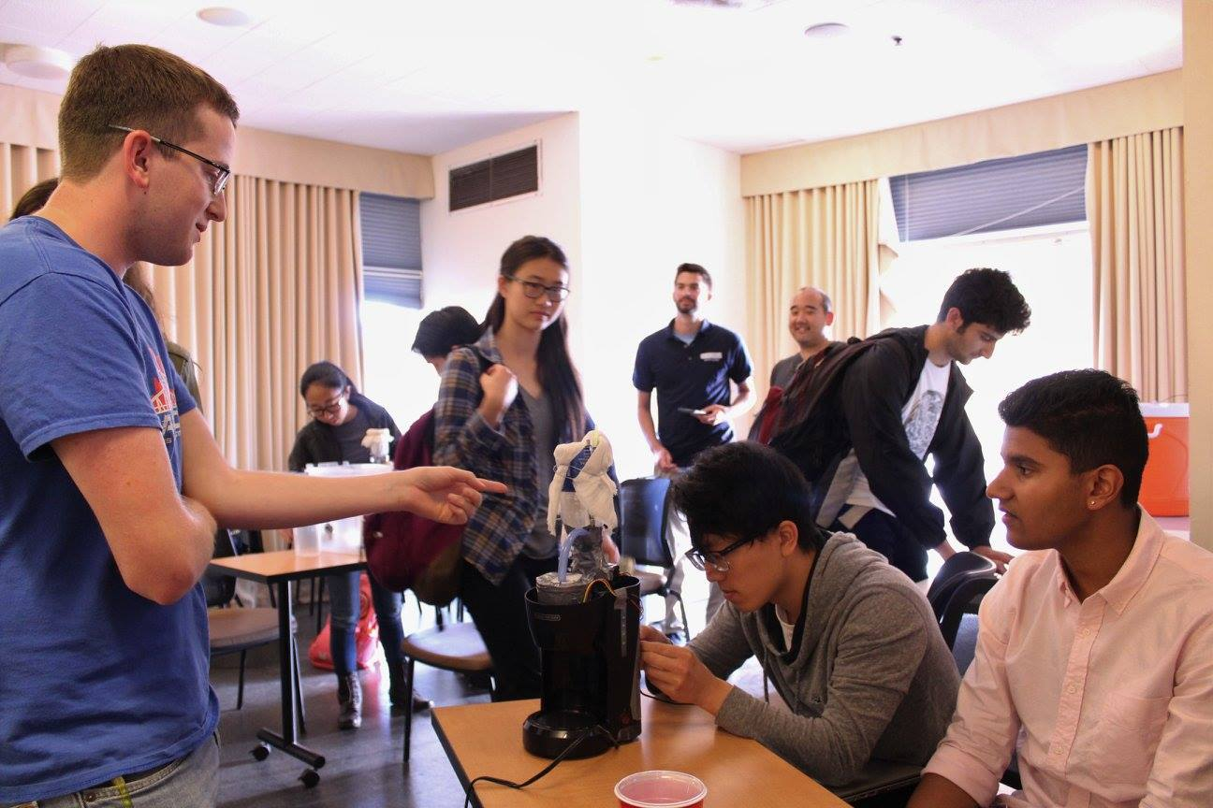
What is ChIP?
Lessons and short term projects
Final Project
Introductory technical project
Notes:
Richa
The goal of this talk is to provide information about this introductory project and provide the tools and resources you may need to implement the project at your chapter
Introductory technical project
Geared towards freshmen and transfer students
Lessons and short term projects
Teach participants basic principles of chemical, mechanical and electrical engineering
Final Project
Participants design and build a small scale system that mirrors an industrial chemical engineering process

Slide 6
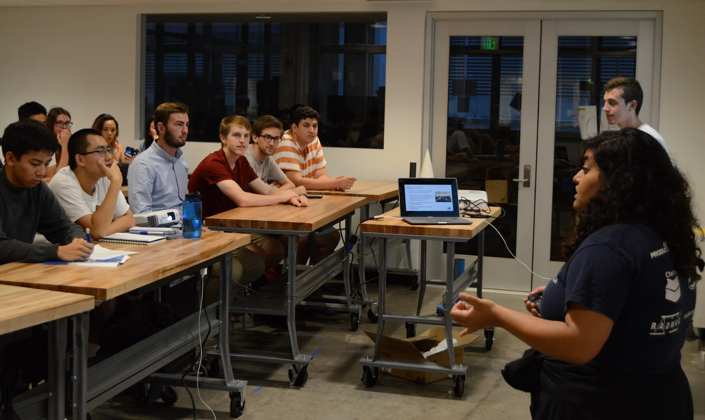
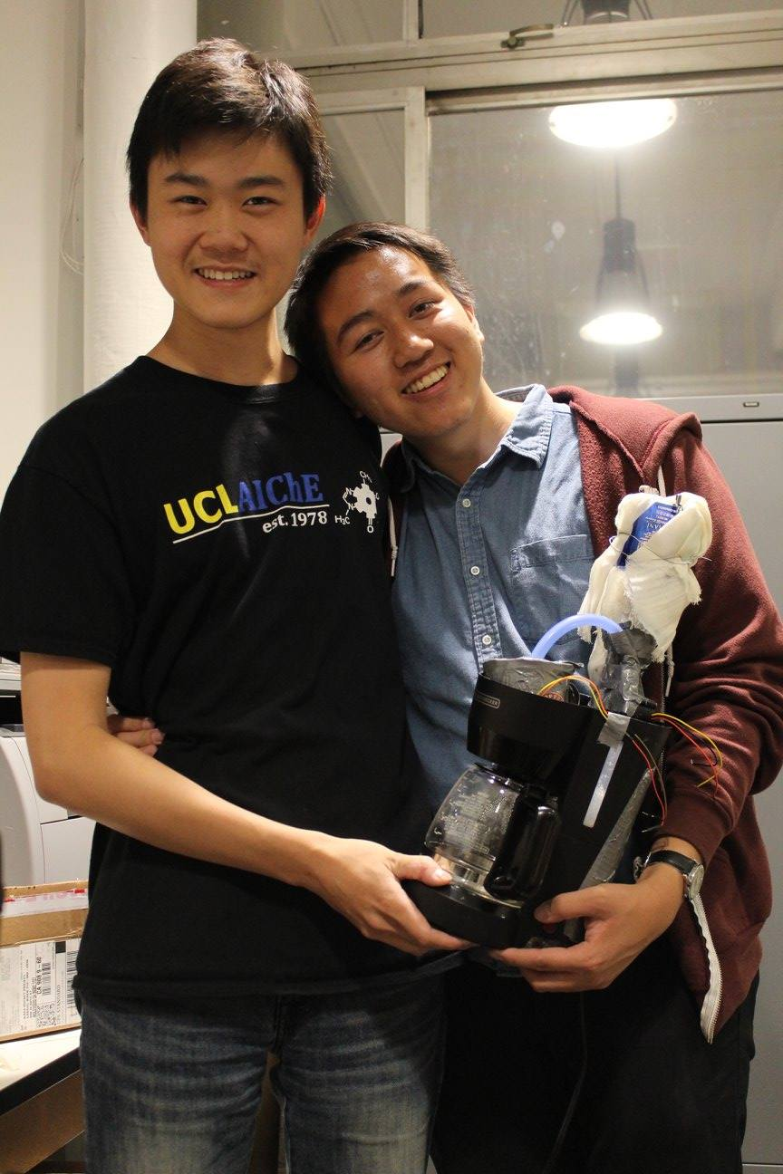
Goal of ChIP
Explain and explore the field of Chemical Engineering
Hands-on technical experience
Diversify AIChE at UCLA’s technical projects
Increase freshmen and new student participation in AIChE at UCLA
Notes:
Richa
Provide the opportunity for students with no previous chemical engineering knowledge to learn basic chemical engineering principles and gain hands-on technical experience
Explain and explore the field of Chemical Engineering
Diversify AIChE at UCLA’s technical Projects
Opportunity for freshmen and new students to become involved in AIChE at UCLA

Slide 7
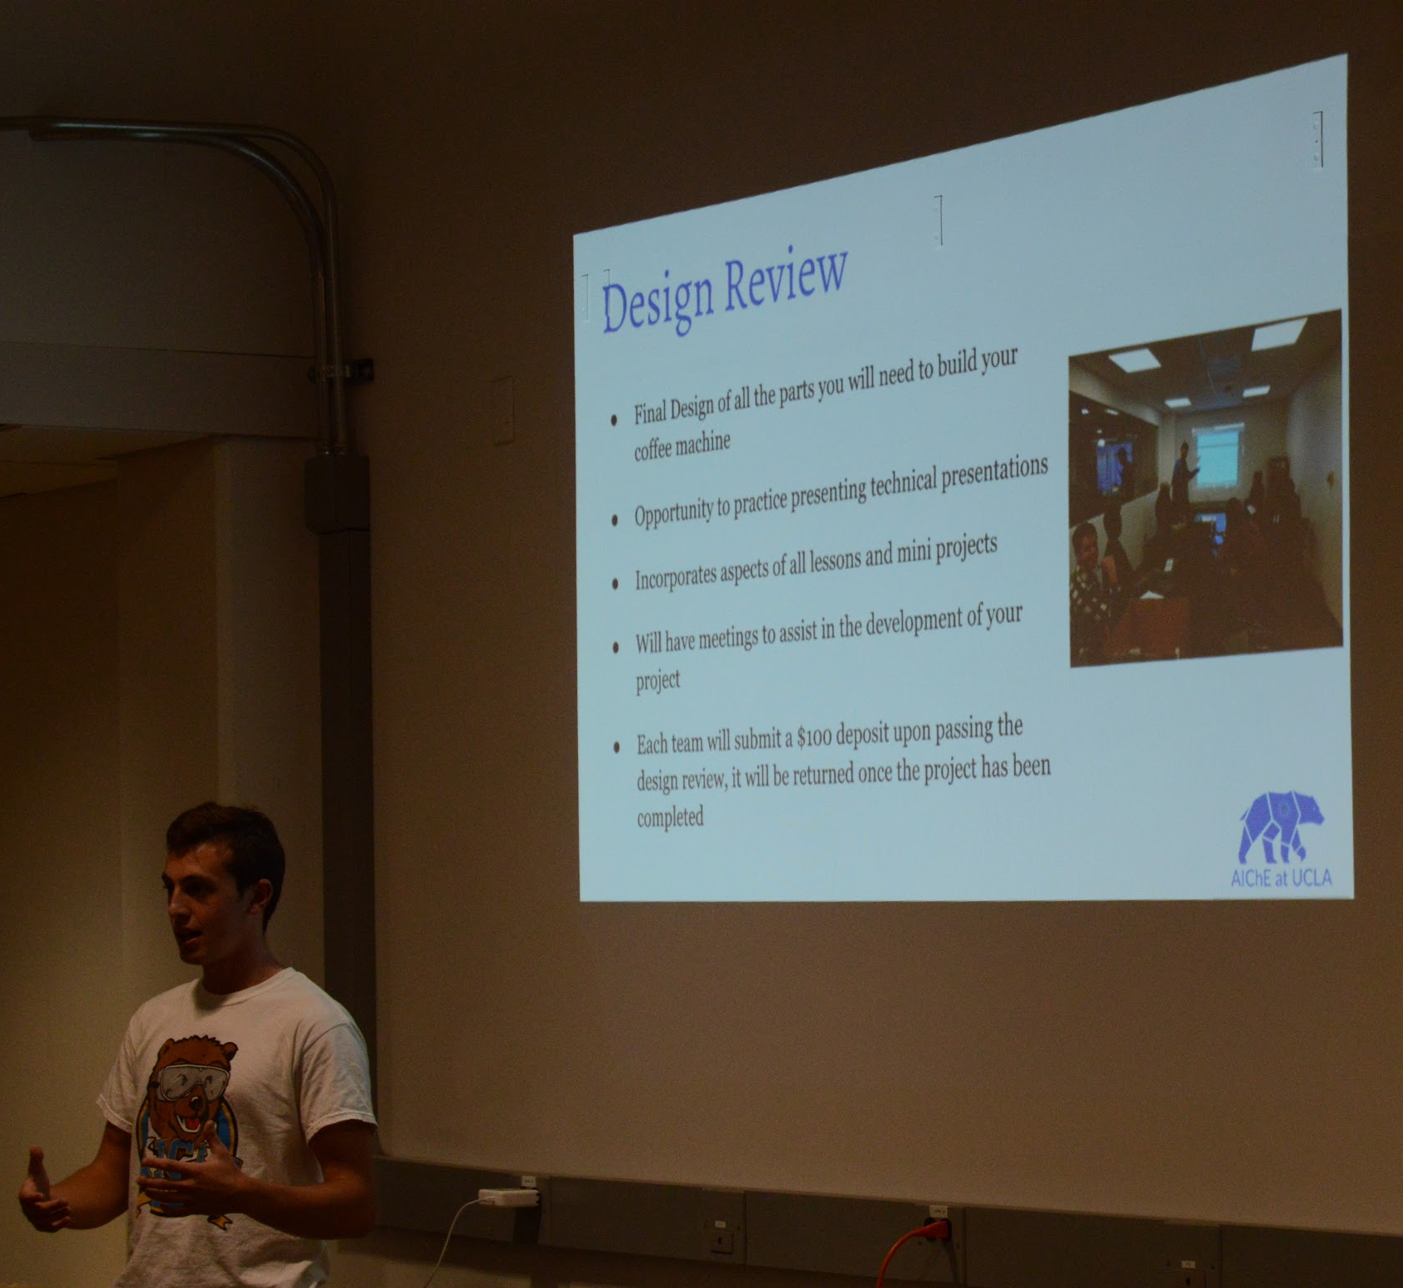
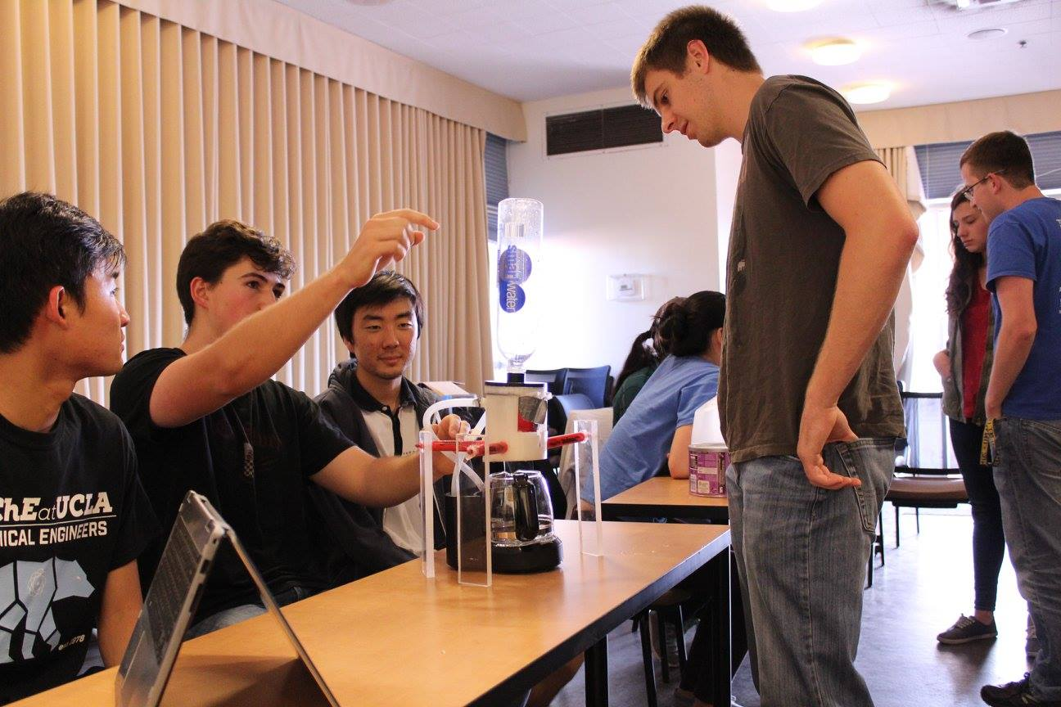
Structure
  Lessons and Mini Projects
  Begin working on project
Project lasts approximately 7-8 months
  Finish project and Present
Notes:
Steven
Project lasts approximately 7-8 months
Fall Quarter (3 months): Lessons and Mini Projects
Lessons and mini projects
ChemE in Industry, Circuitry, Process Control, Engineering Design
Winter Quarter: Begin working on project (3 months)
Design Review
Computer Aided Design and 3D Printing
Resume workshop
Spring Quarter: Finish project and Present (2 months)
Final Presentations
Competition with prizes
Mock Interviews

Slide 8
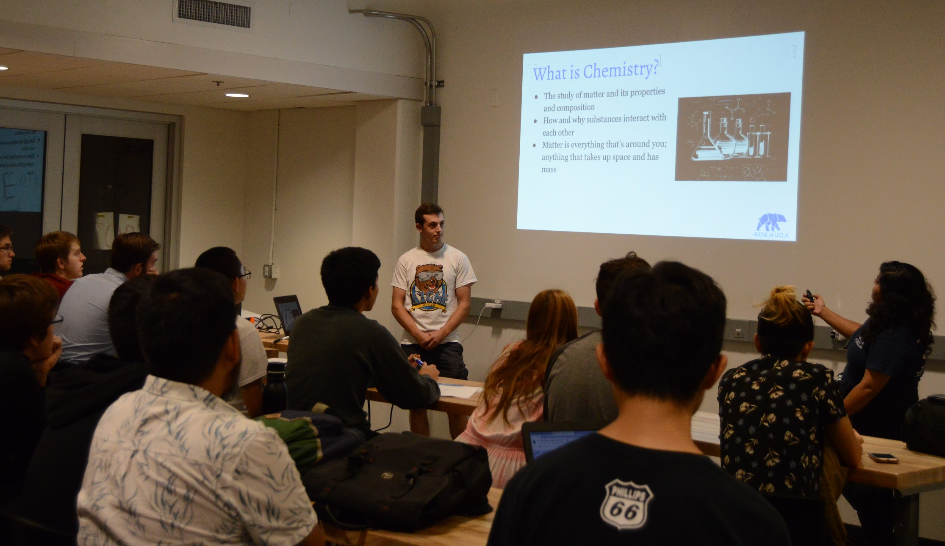
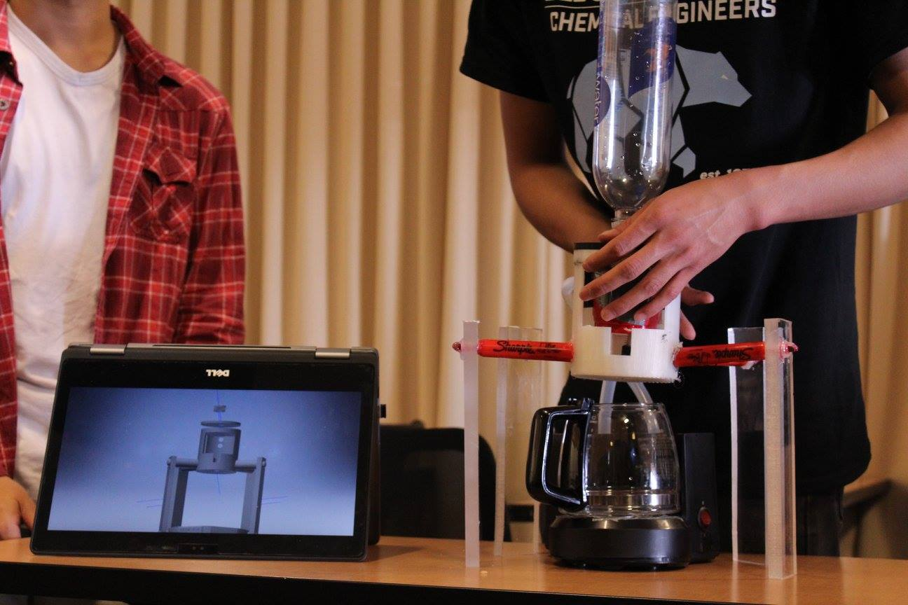
Lectures
3 Months
ChemE Fundamentals
Basic Coding and Circuitry
3D Printing: CAD
Design
Cost Optimization
Notes:
Steven
ChemE Fundamentals: mass and energy balances, thermodynamics, transport phenomena, process control, separations, reactions
Talk specifically about what lessons and workshops we have (look at syllabus)

Slide 9
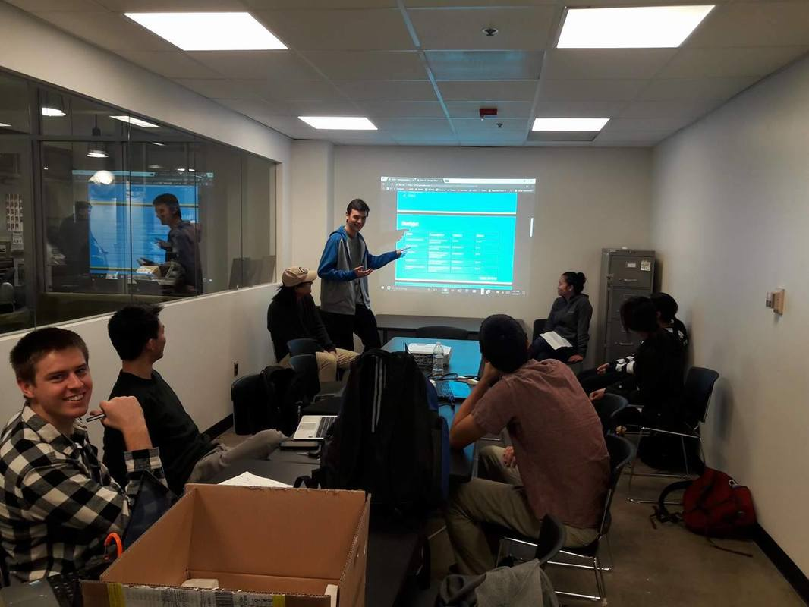
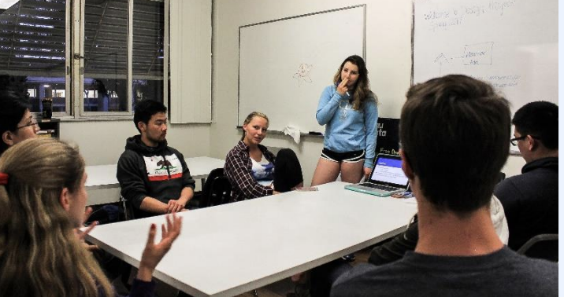
Design Review
  Budget Proposal
Teams present:
Similar to design reviews in industry
  Proposed Design
Notes:
Initial Design of Project
Incorporates aspects of all lessons and mini projects
Opportunity to practice presenting technical presentations
Project leads check in with teams to ensure they are on track
Design Review analogous to project proposal or design review in industry
Describe what we look for in design review, who we present to, technical presentation
Steven

Slide 10
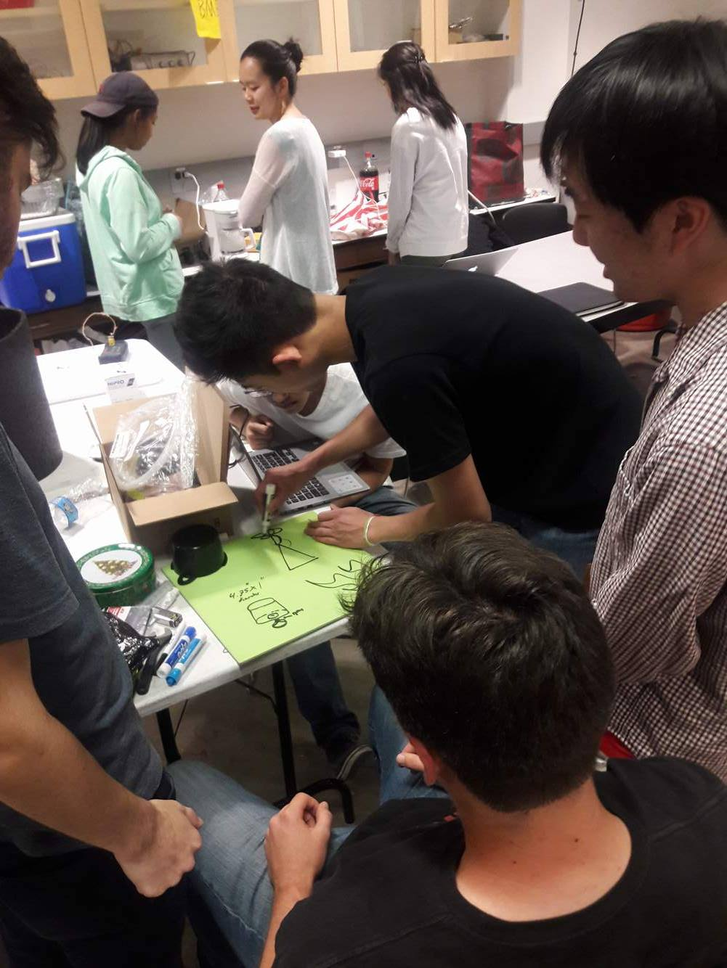
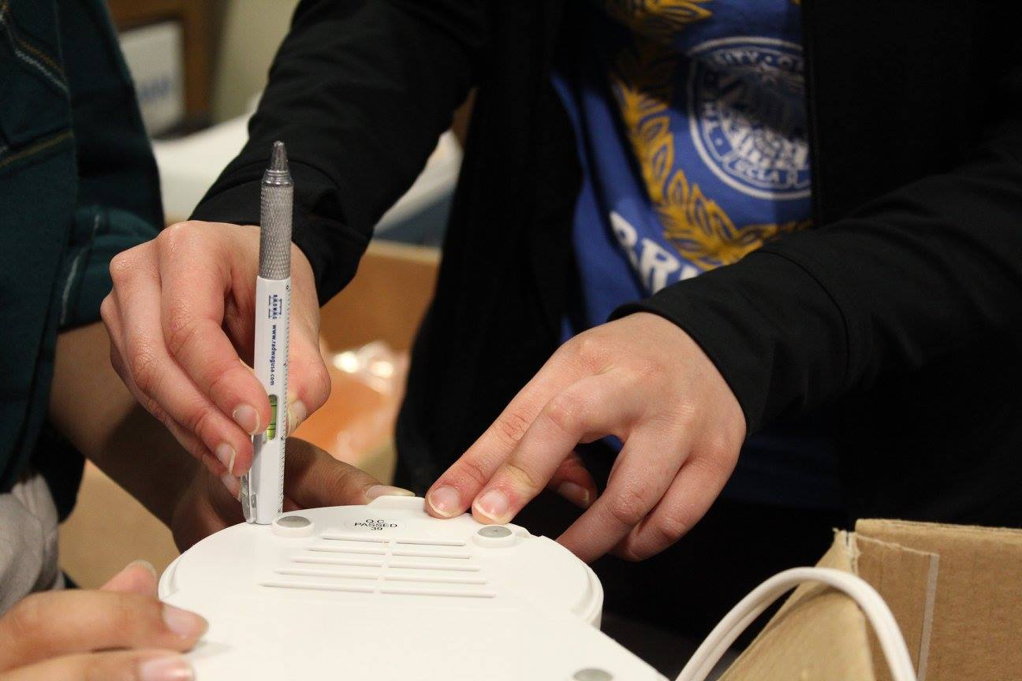
Building the Project
Teams work independently as groups to build projects
Approximately 2-3 months given to build project
Project leads hold weekly office hours
Notes:
Project leads act as project managers to mediate group conflicts and offer support with technical issues
Describe time given, how teams work together to create final product
Steven

Slide 11
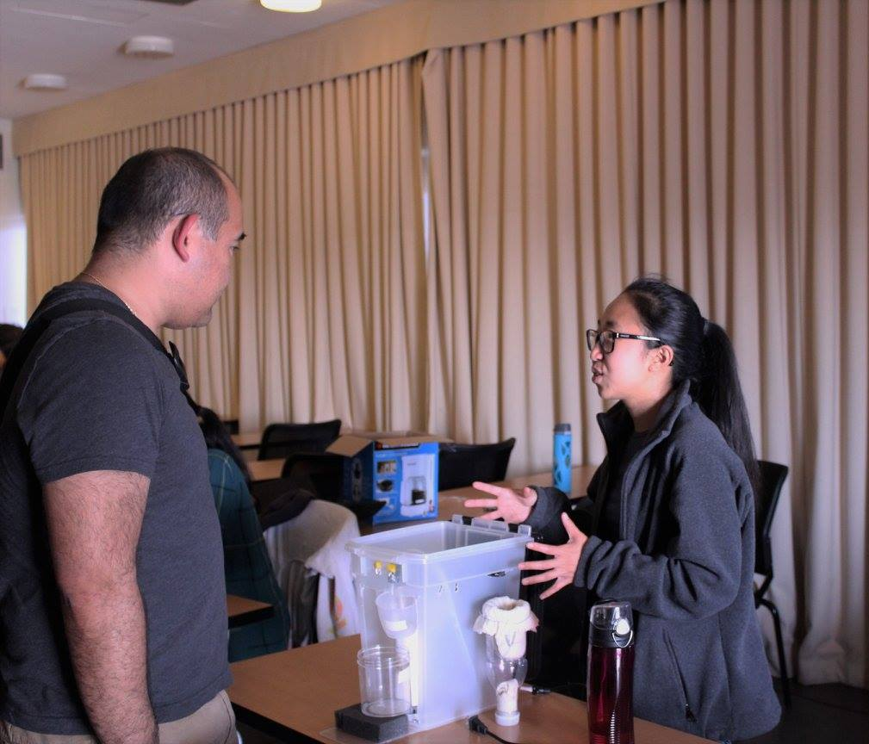
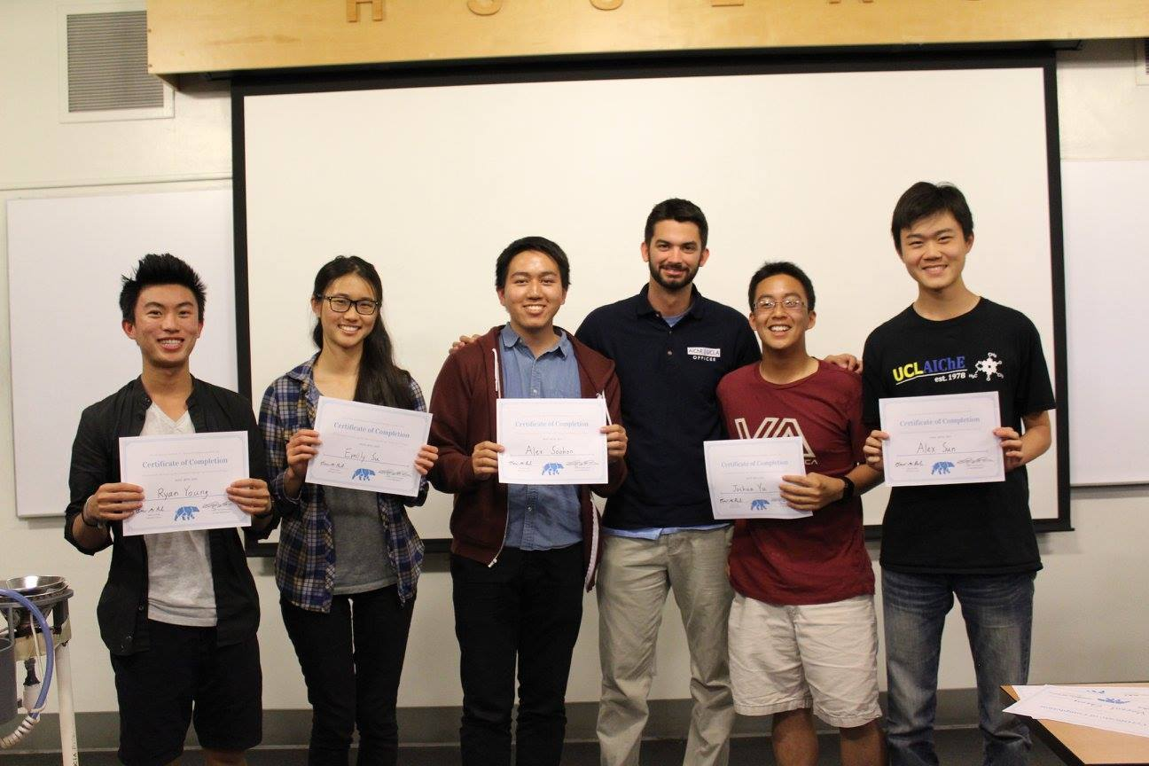
Final Presentation
Teams present and test final project in showcase
Formal final presentations
Competition with awards
  Alumni, Faculty and Upperclassmen Judges
Notes:
Teams present and test final project to fellow undergraduates, graduate students, alumni and faculty
Competition where upperclassmen, alumni and faculty will judge project and present awards
Awards for Best Overall Project, Best Design and Most Economical Design with prizes
Certificate of Completion
Final presentation analogous to final intern presentation or project review
Modify to tailor to student chapters
Steven

Slide 12
Past Projects
Notes:
Richa

Slide 13
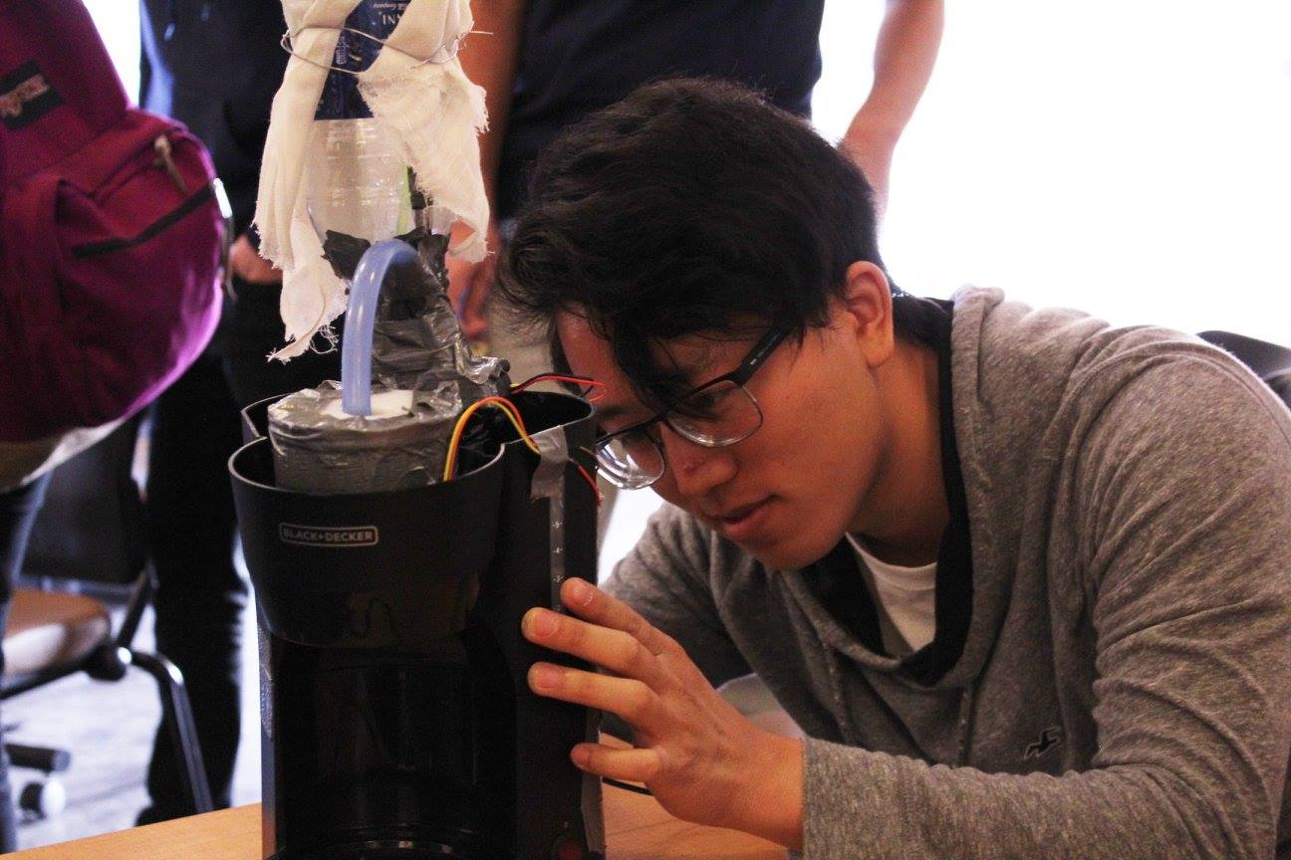
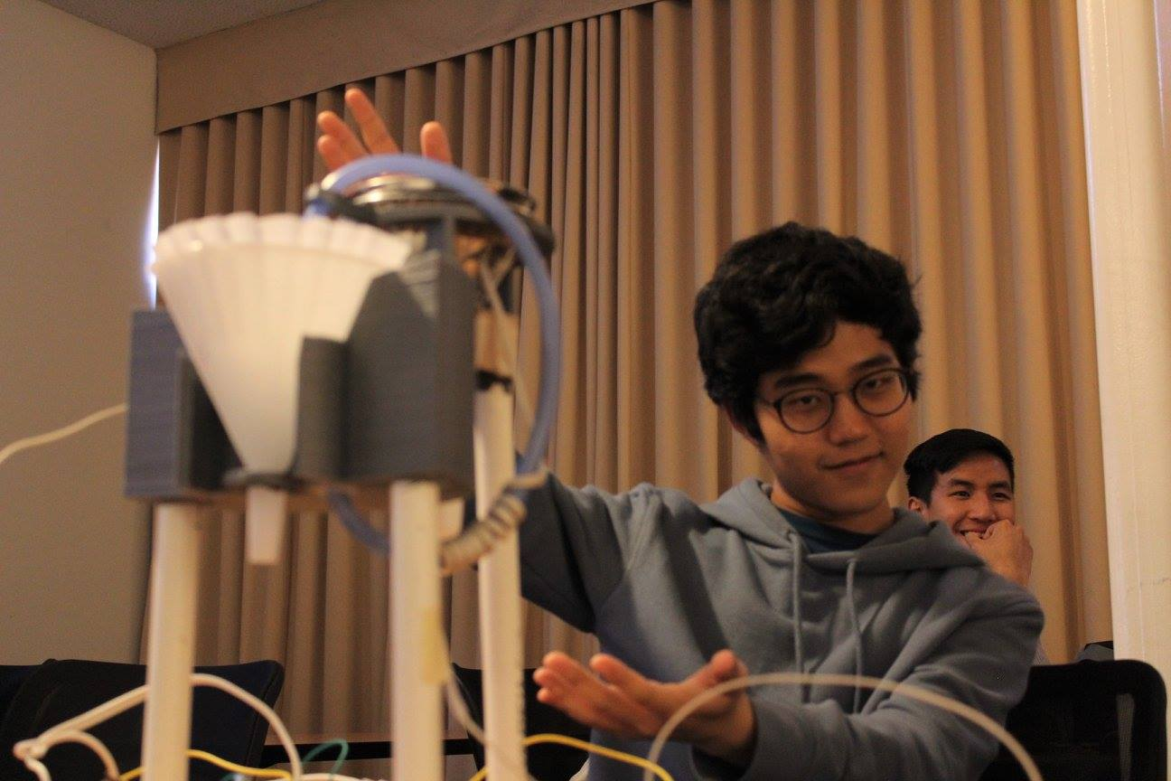
The Coffee Machine
Notes:
Richa
Bring up personal experience

Slide 14
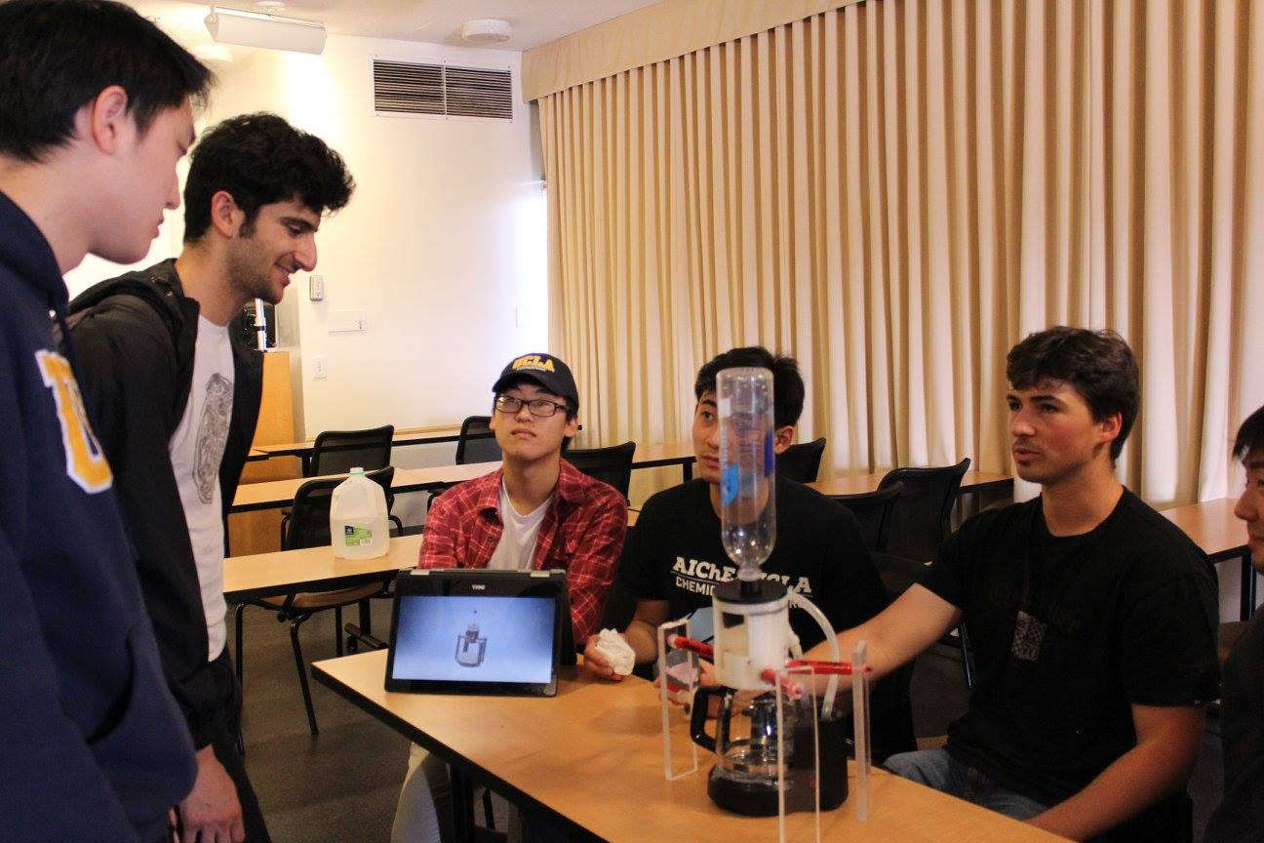
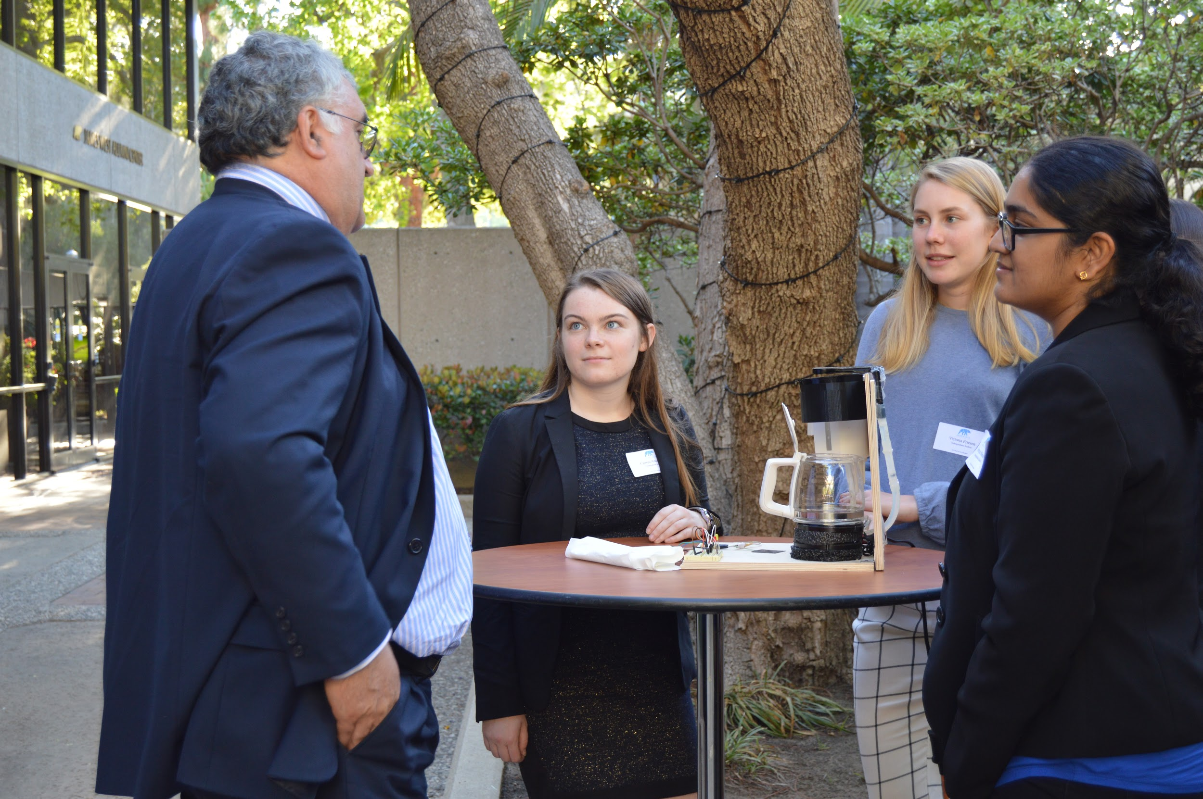
Why Coffee?
Safe and easy to work with
Analogous setup to many large scale chemical engineering processes
Covers aspects of chemical engineering
  Filtration and Separation
  Process Control
Notes:
Safe and easy to work with
Coffee brewing is a familiar process to most students
Many large scale chemical engineering processes have analogous setups
Covers aspects of chemical engineering
Filtration and Separation Processes
Process Control
How temperature, pressure, concentration, etc. relates to quality of coffee
CAD and 3D printing
Pumps, Body of coffee machine, etc.
Engineering Design
Project Management and Presentation
Richa

Slide 15
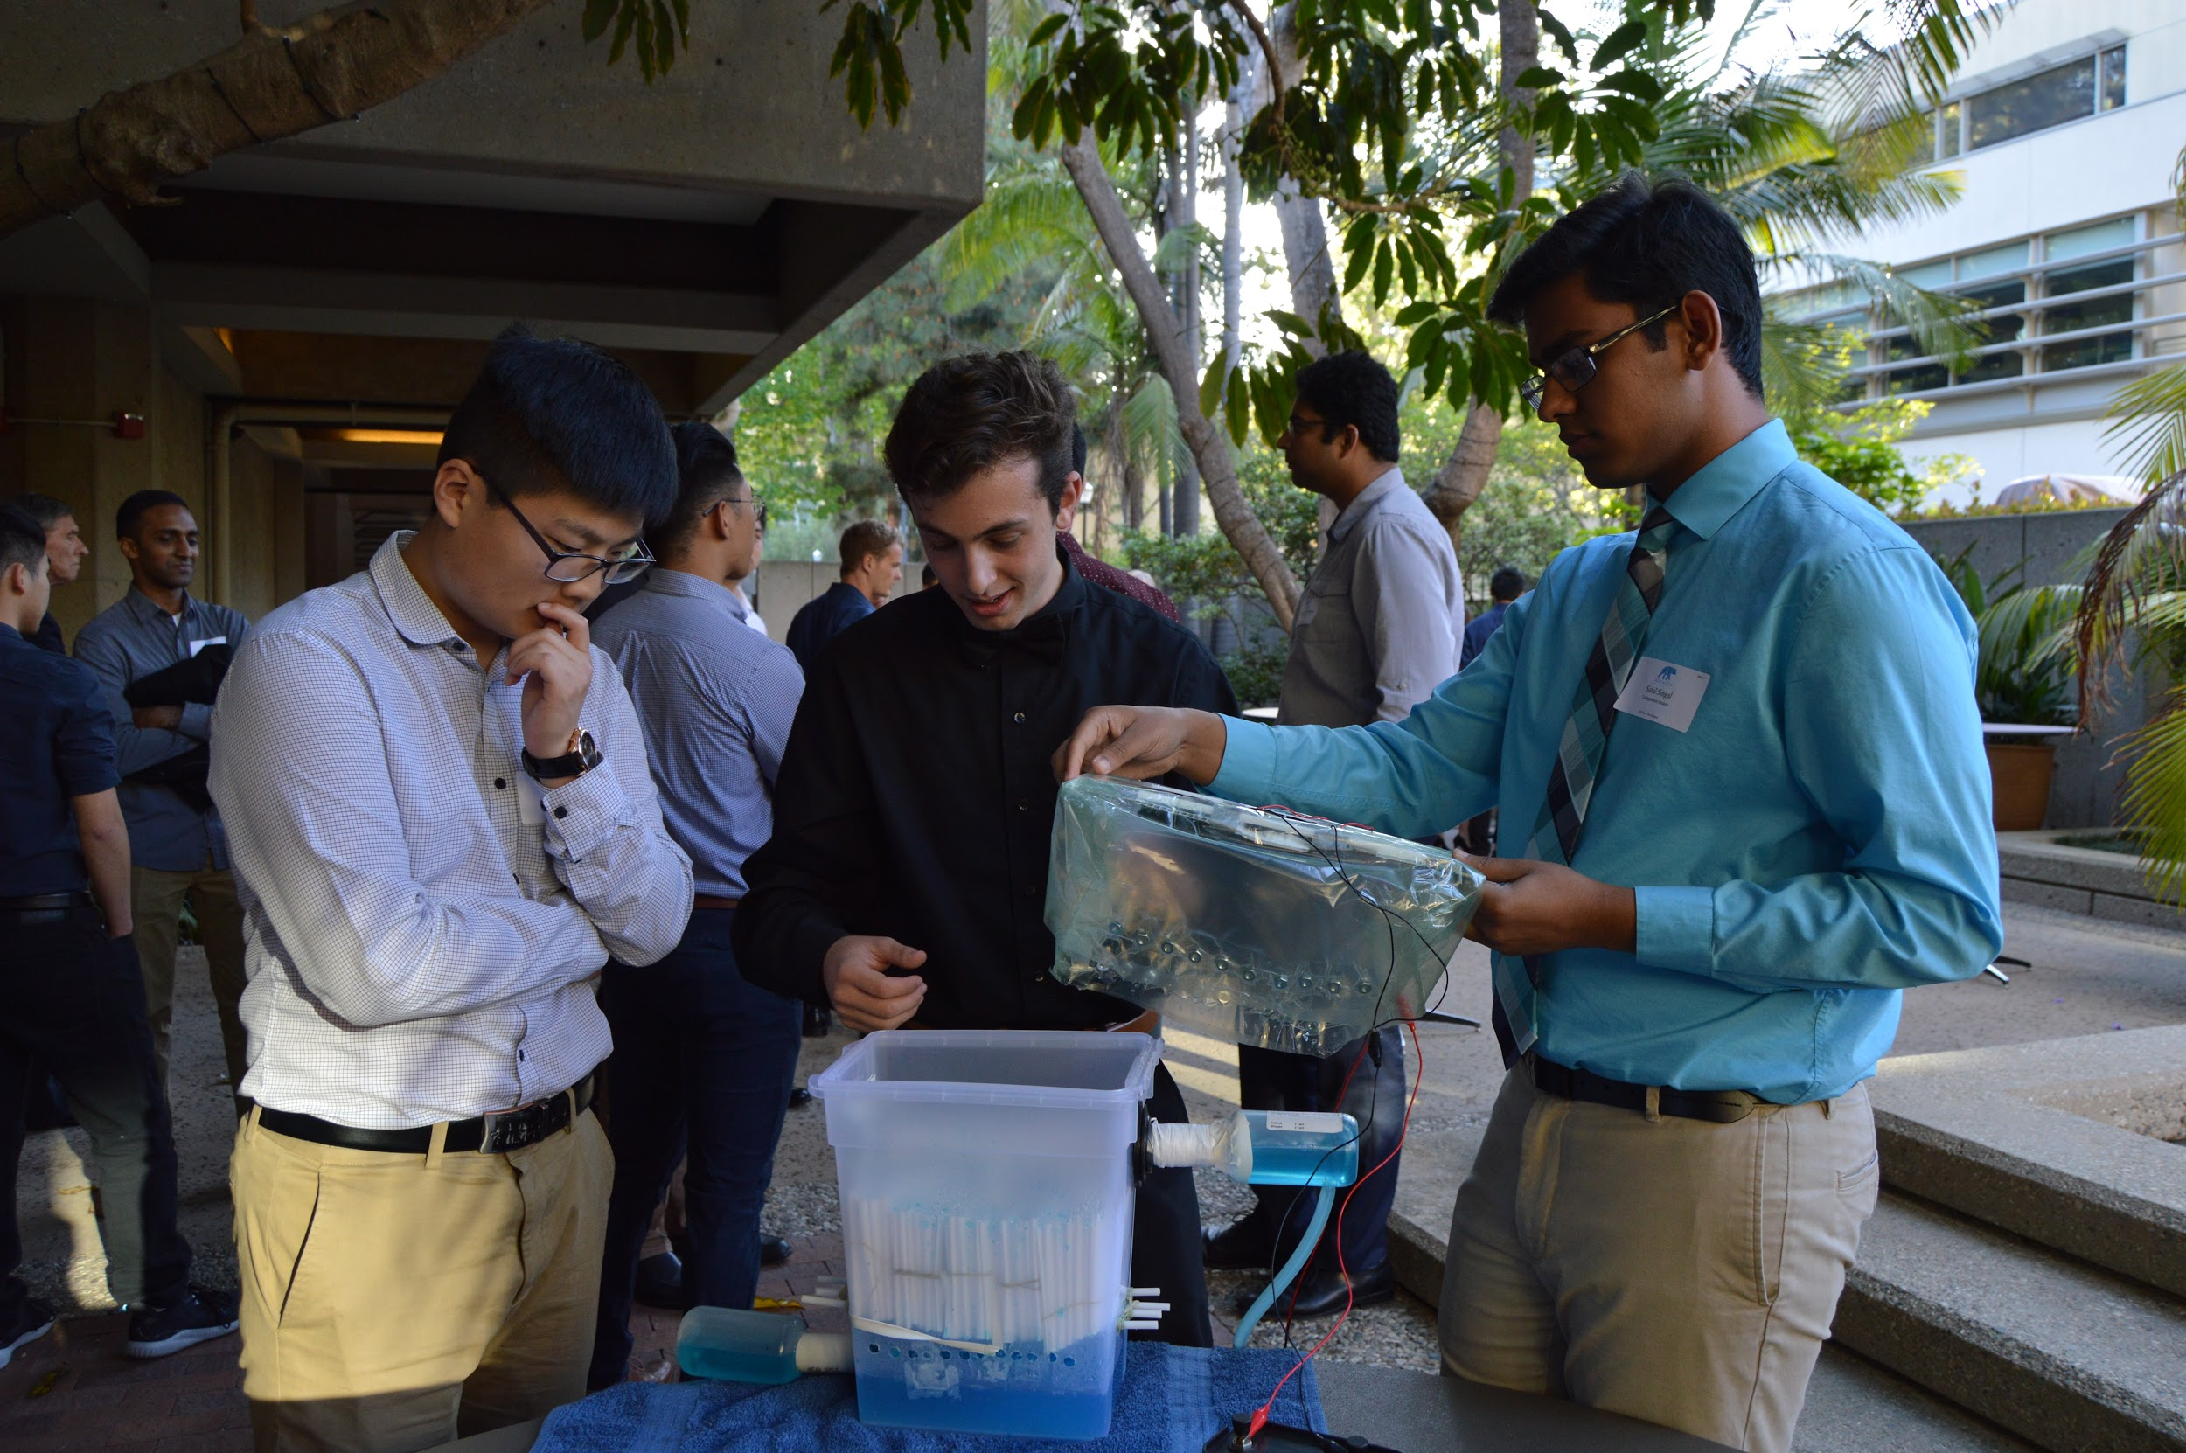
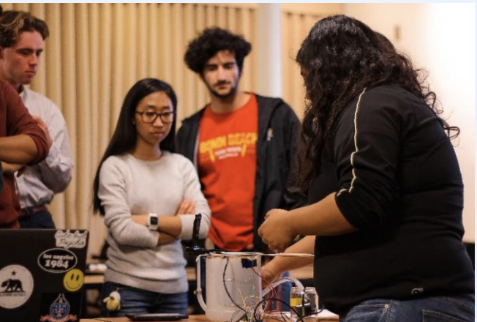
The Soap Maker
Notes:
Steven
Bring up personal experience

Slide 16
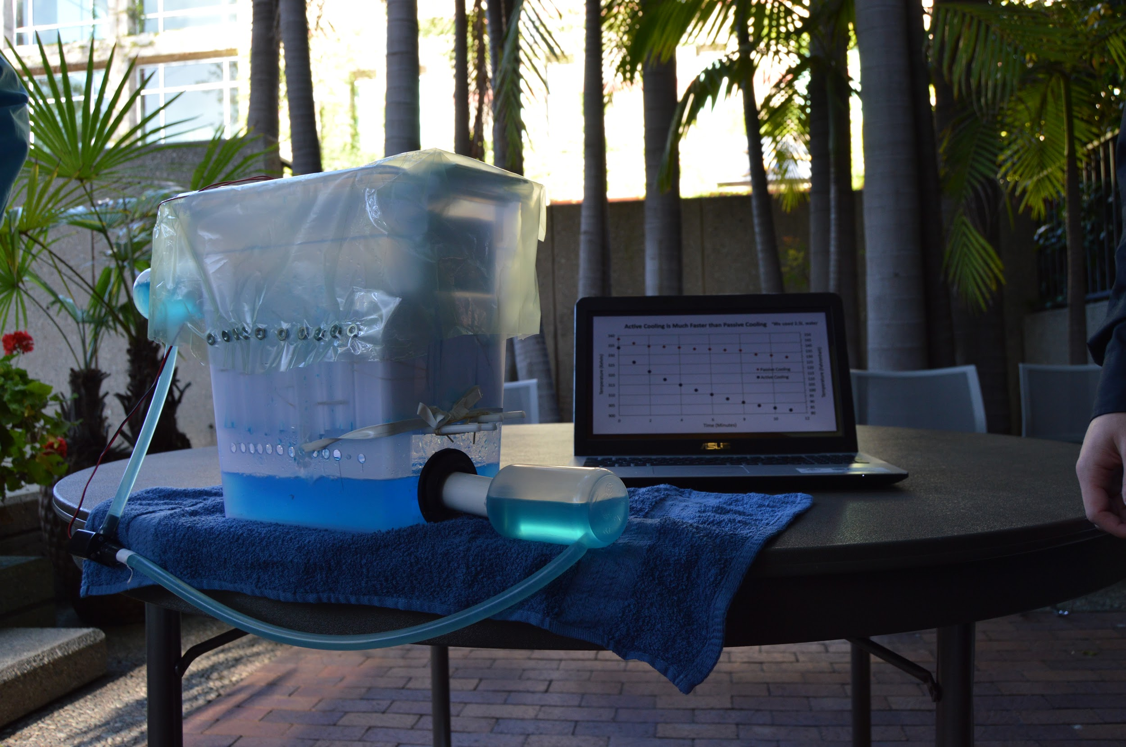
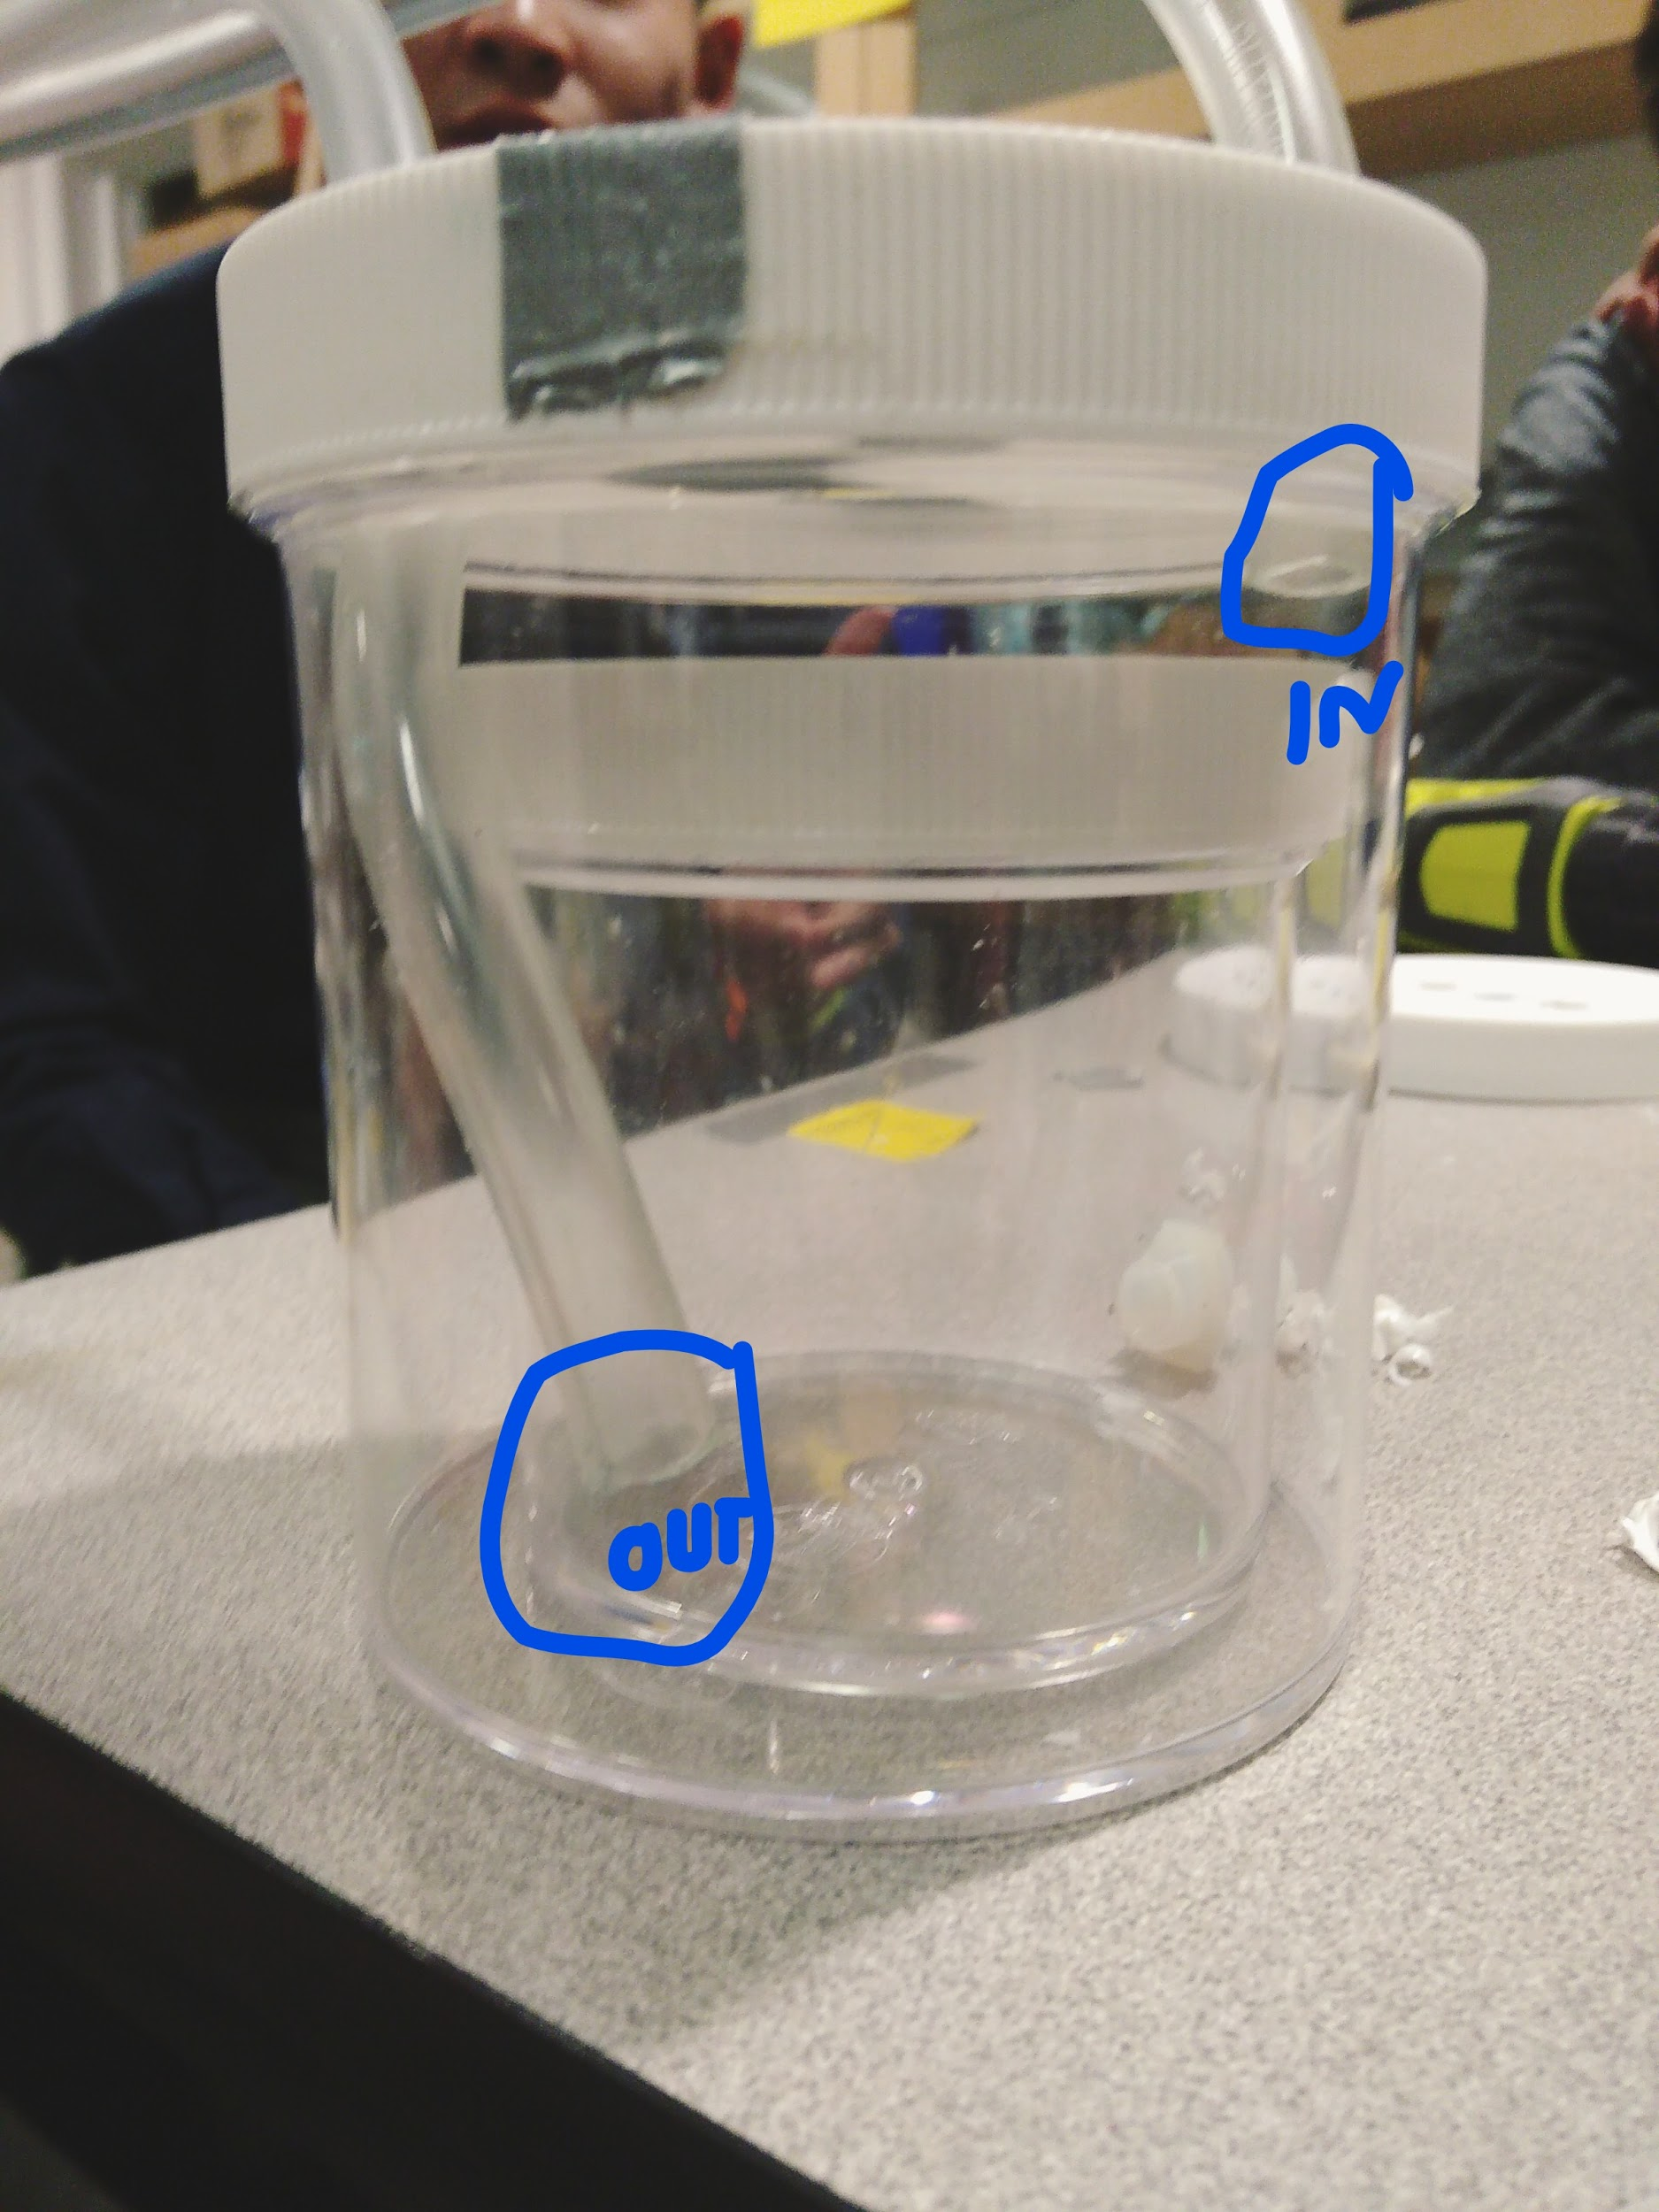
Why Soap?
Two Components
  Batch Reactor
  Cooling Tower
Adds reaction component
Process Control
  Temperature and Flow Rate
Notes:
Two Components
Batch Reactor
Where soap will be made
Effect of temperature and time
Cooling Tower
Cool and form soap as it is formed
Thermal Efficiency
CAD and 3D Printing
Pumps, Body of soap maker
Circuitry and Arduino
Process Control: Temperature and Flow Rate and its effect on soap
Engineering Design
Project Management and Presentation
Talk about personal experience
Steven

Slide 17
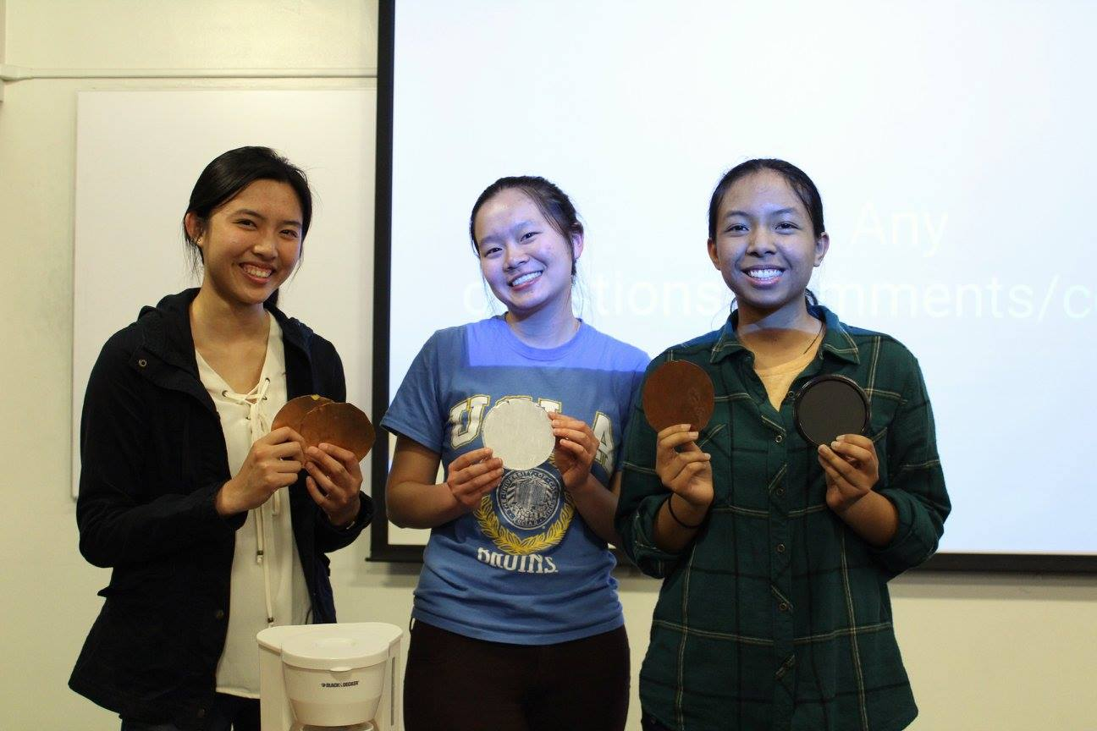
Benefits of ChIP
Hands-on technical experience
Freshmen and New Students
Easy to implement
Diversifies Technical Projects
Cost-Friendly
No lab space needed
Notes:
Richa
Easy way to introduce technical projects to club if there have never been any technical projects
Additional technical project besides Chem-E-Car
Provides hands-on technical experience and introduces chemical engineering topics to students earlier than upper division classes
Has potential of making participants more competitive in internship market
No lab space needed
Can modify soap maker project in order to eliminate need of NaOH
Geared towards freshmen and other members who are not familiar with Chemical Engineering or any other aspects of project
Cost-Friendly: project can be modified to accommodate constrained budget
Bring up how it is easy to modify - talk about allysons team

Slide 18
Implementing ChIP
Find Funding Sources
Write Project Proposal and Build Prototype
Develop Curriculum and Iron Out Logistics
Advertise Project
Notes:
Richa
Transition: bring up challenges we have overcome: funding and space

Slide 19
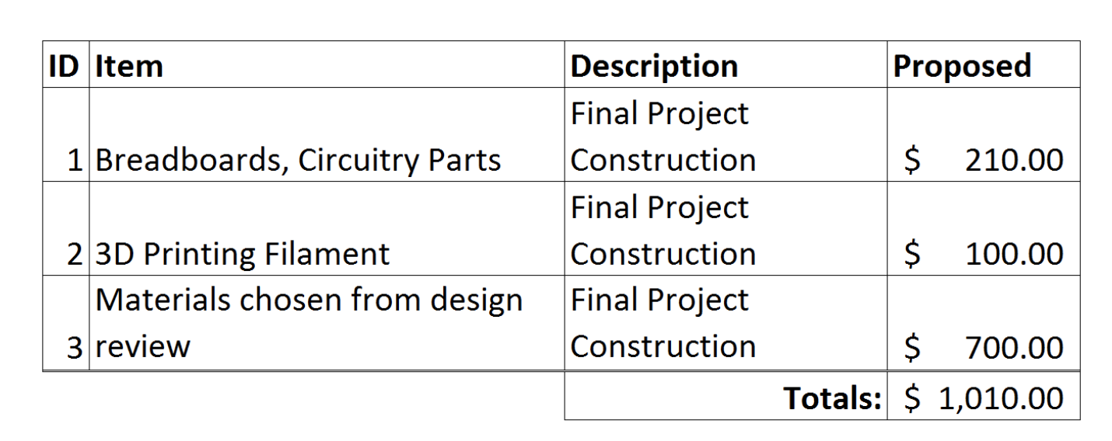
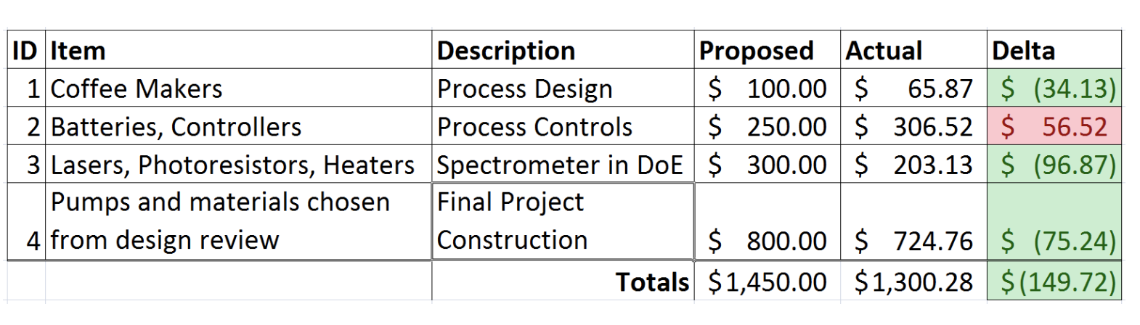
Cost of ChIP
One-Time Expenses
  Tools
  Circuitry Components
Yearly Expenses
  Budget
  3D Printing
Notes:
Richa

Slide 20
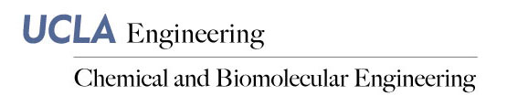
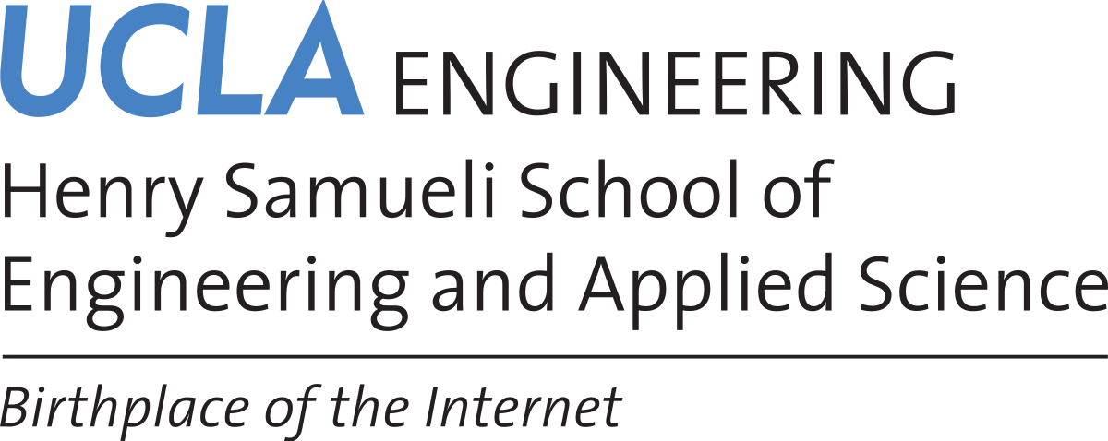

Funding ChIP
Funding sources:
  Chemical Engineering Department
  Corporate Sponsors
  Alumni Donations
  School of Engineering
Notes:
Richa

Slide 21
Implementing ChIP
Find Funding Sources
Write Project Proposal and Build Prototype
Develop Curriculum and Iron Out Logistics
Advertise Project
Notes:
Steven
Mention that coffee is an easy project to start with
-No reaction
-People understand it already
-All you need is tubing, a body, and a heater

Slide 22
Implementing ChIP
Find Funding Sources
Write Project Proposal and Build Prototype
Develop Curriculum and Iron Out Logistics
Advertise Project
Notes:
Steven
-Now you’ve built the prototype, you know what the project entails
-Logistics: where to host meetings, maybe you need a wet lab

Slide 23
Implementing ChIP
Find Funding Sources
Write Project Proposal and Build Prototype
Develop Curriculum and Iron Out Logistics
Advertise Project
Notes:
Richa

Slide 24
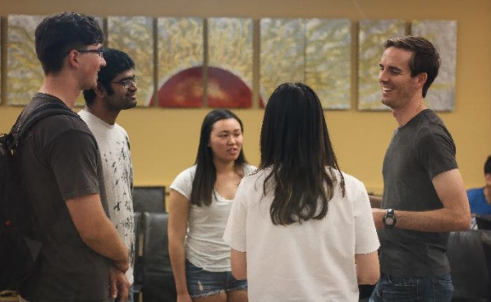
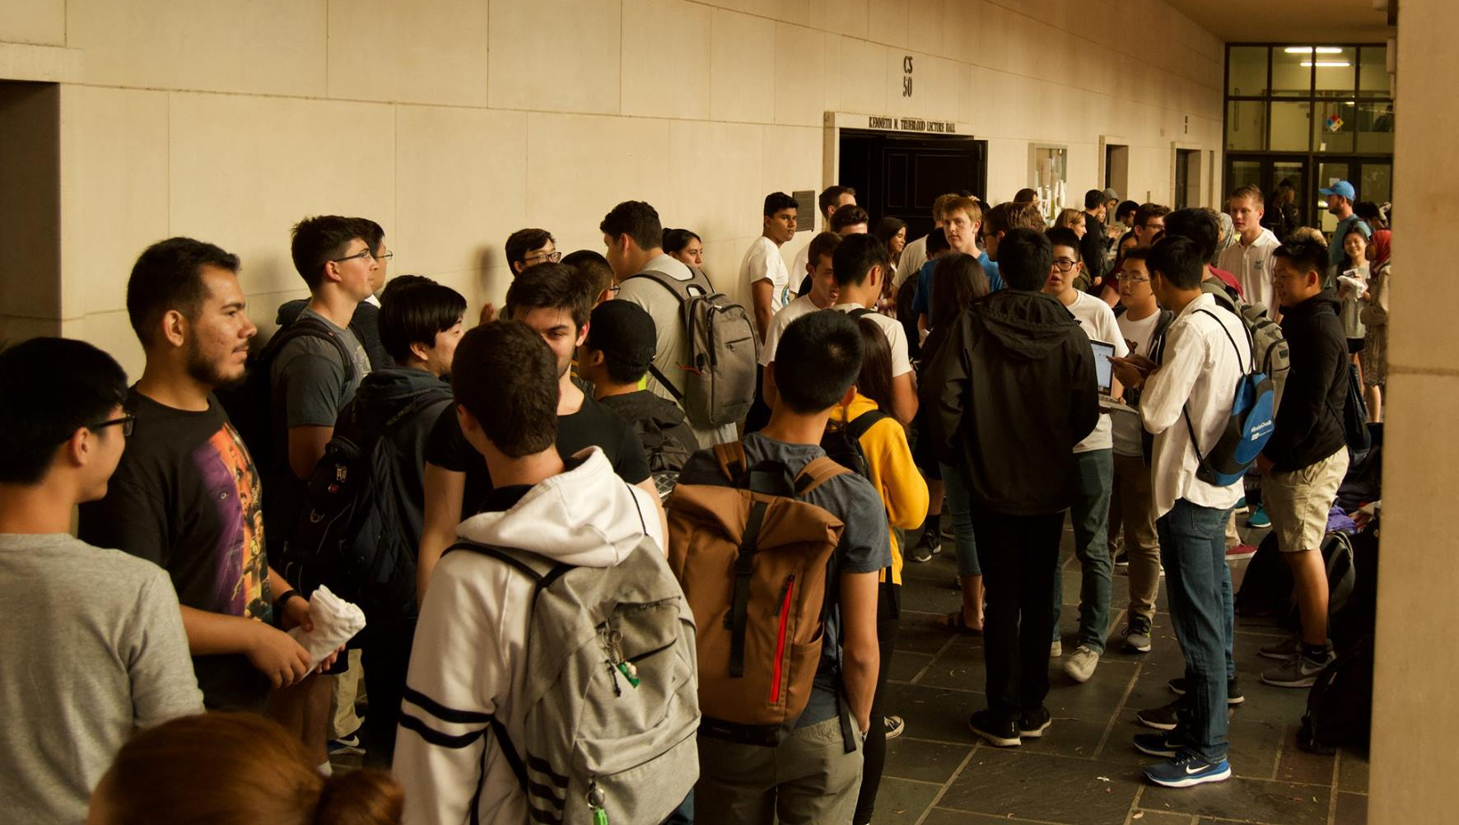
Advertising ChIP
Events for Freshmen and Transfer Students
Advertise in introductory Chemical Engineering courses
Workshops on research and industry
Notes:
Richa
Determine target audience
Most likely freshmen, transfer students, new students
Advertise in introductory ChemE classes
Emphasize hands-on technical skills and presentation skills that will be learned
Incorporate industry or research related workshops in order to drive interest
Resume Workshop, Mock Interviews, How to Become Involved in Research, etc.

Slide 25

Questions?
Contact chip.aiche.ucla@gmail.com for questions and concerns
Notes:
Richa and Steven

