Slide 1
Challenge your colleagues and climb the leaderboard with the all new AIChE Scavenger Hunt!
Login to www.aiche.org/ScavengerHuntASC.
Find and enter the code for each activity to earn points.
This session’s code is: SCWorkshop

Slide 2
Hosting a Career Fair
Northeastern University
presents:
2018 AIChE ASC Workshop

Slide 3
Why We Host a Fair
Provide students professional opportunity
Northeastern’s co-op program makes a career fair a logical fit
Engage with industry partners
Local employers look forward to this opportunity to connect with students
Develop E-Board leadership
Large event for our chair and committee to plan and host
Notes:
Lexi
Explain co-op program and how we work within that structure
Talk about history of the career fair

Slide 4
Our Process
E-Board structure
Professional and Alumni Chair
Formal processes
Operating procedures and post-event forms
Organization for smooth execution
Google Drive, schedules, and trackers
Notes:
Lexi point 1, then Beth

Slide 5
Format and Publicity
Logistics
Tabling style - one employer per table
Casual networking style - not like an interview
Time alternates between evening and daytime
Publicity
Facebook Event
Email Blasts
College or University newsletter
Flyers
In-class announcements

Slide 6
Metrics of Success
Attendance
20-25 employers per fair
150-200 students per fair
Space restriction plays a role in planning
Define target audience
Feedback
Space is an issue for us
Collaboration and target majors
Preparedness - student and employers
Continuous improvement
Notes:
Beth
How this fits within co-op application process and develops networking skills
Time alternating - talk about how we made that choice in response to employer feedback and student schedules
Space Restriction - new table rule from feedback, pay attention to capacity limits
Target Audience - undergrads only

Slide 7
Our Pro Tips
Use feedback to your advantage
Incorporate comments while maintaining goals
The more feedback the better: employers, staff, students, faculty
And remember: no feedback is bad feedback!
Know your school policies
Space booking can be problematic
Communicate with event planning staff - know your do’s and don’ts
Utilize all resources available
Start Early!
Identify your purpose
Understand your audience
How does a fair fit your mission?
Know your role within the university
Notes:
Purpose - Lexi
Policy - Michael
Feedback - Beth

Slide 8
Professional Communication
Know your space limits
Don’t over-commit
Always pay close attention to your interactions with employers, campus staff, and other students
Don’t cram 300 people in a space for 100!
Lessons Learned
Set reasonable goals for your event
Notes:
Michael

Slide 9
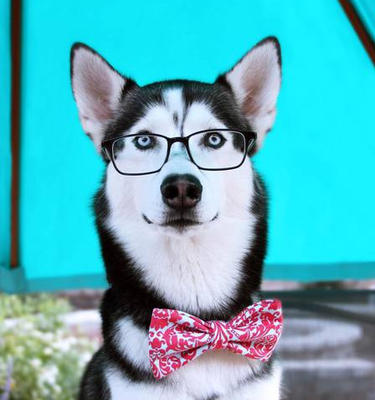
Summary
Anyone can host a career fair! You don’t need to have a co-op program to do it
Have a process and stick to it — organization is the key to success
Don’t be shy — be confident and persistent with employers but always be professional
Feedback is your friend — remember it’s not criticism, it’s a chance to improve
Notes:
1 - Michael
2-3 - Beth
4 - Lexi

Slide 10
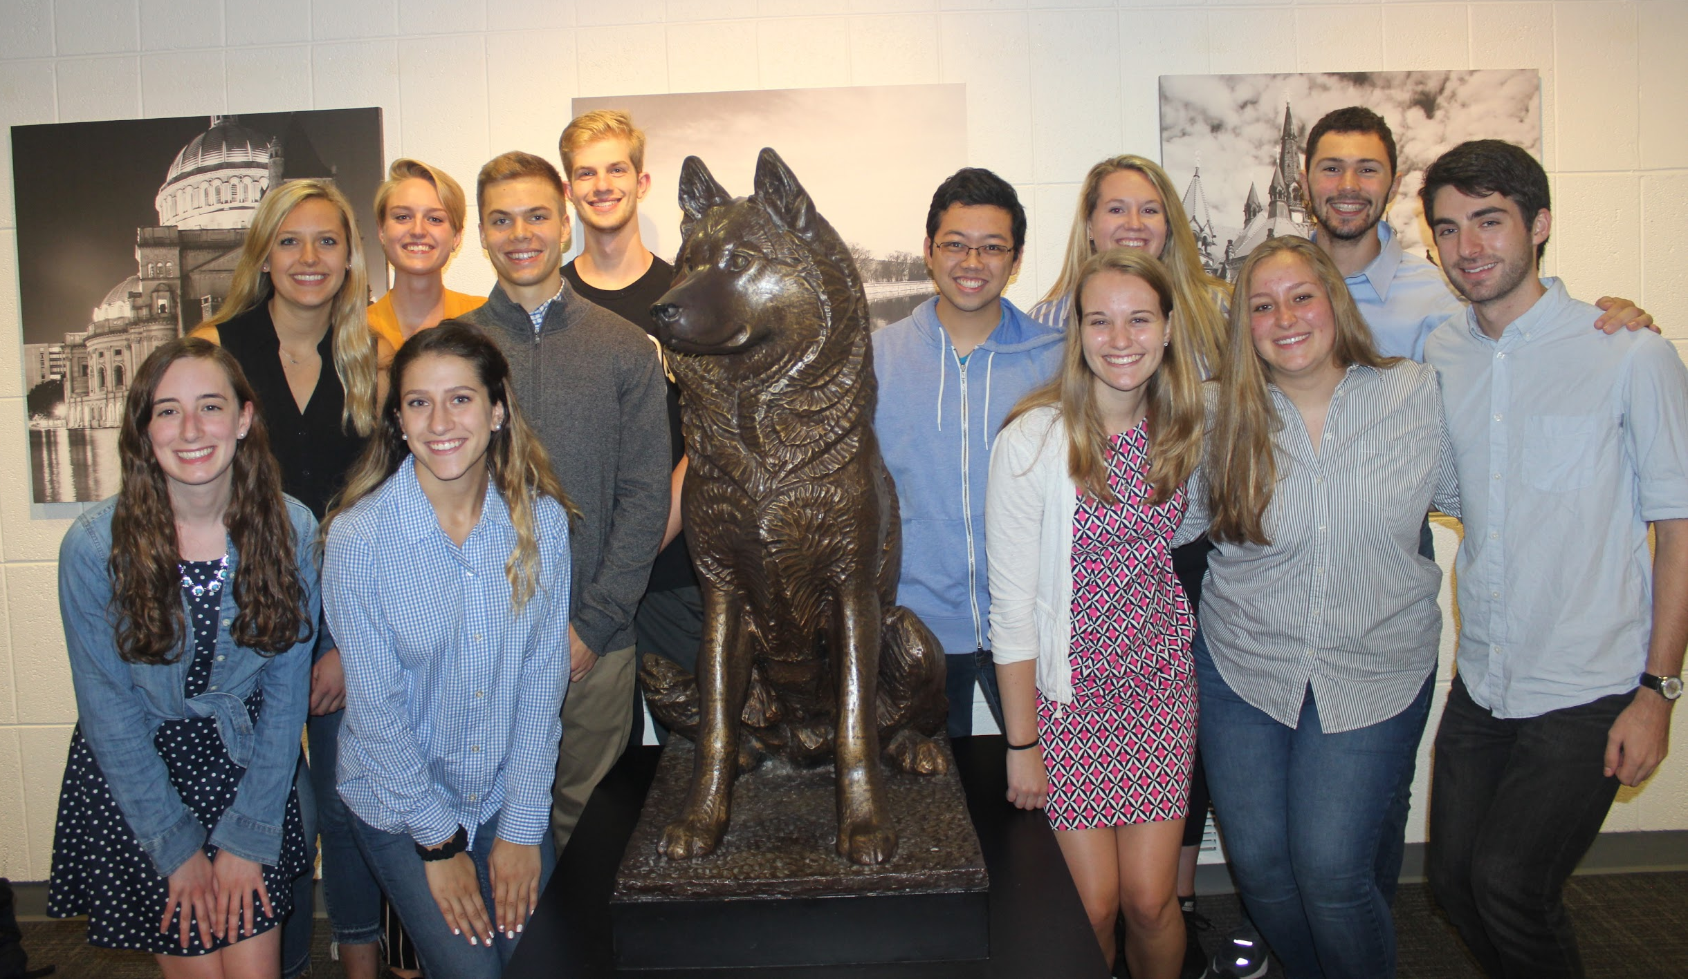
Thanks!
Questions??
Comments??
Notes:
Lexi

Slide 11
Challenge your colleagues and climb the leaderboard with the all new AIChE Scavenger Hunt!
Login to www.aiche.org/ScavengerHuntASC.
Find and enter the code for each activity to earn points.
This session’s code is: SCWorkshop

