Slide 1
American Institute of Chemical Engineers (AIChE)
Student Membership Benefits
2018
Student Membership Benefits
Notes:
Questions about these presentation slides? Contact chairman.esc@gmail.com

Slide 2
Overview
About AIChE
Conferences and Competitions
Network & Career Development
People & Community
Education Resources
Online Publications
Leadership Development
2018
Student Membership Benefits

Slide 3
About AIChE
World’s leading organization for ChemE’s
Provides networking opportunities, educational and technical resources, and career services
Over 22,000 students from over 280 Student Chapters
2018
Student Membership Benefits

Slide 4
Conferences aiche.org/conferences
Annual Student Conference
9 Regional Student Conferences in the US
Competitions aiche.org/studentawards
Chem-E-Car®
Student Design Competition
Student Poster and Paper Competitions
Global Undergraduate Student Video Competition
ChemE Jeopardy
2018
Student Membership Benefits

Slide 5
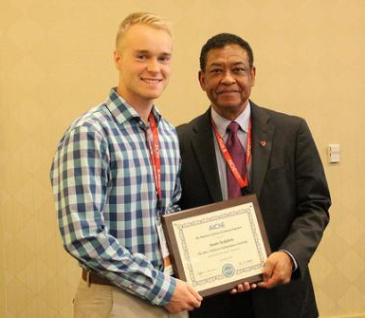
Network & Career Development
CareerEngineer aiche.org/careerengineer
Access internships and job openings
Post your resume online
Enable “Job Alerts”
Scholarships aiche.org/studentawards
>50 scholarships totaling over $50,000
2014 McKetta Scholarship Winner Austin Tackaberry and Past AIChE President Otis Shelton
2018
Student Membership Benefits

Slide 6
People & Community
ChEnected aiche.org/chenected
Online blog posts
Read, view, contribute, and engage with posts
AIChE Engage aiche.org/engage
Student Central: Online community for ChemE students
Mobile App available
2018
Student Membership Benefits

Slide 7
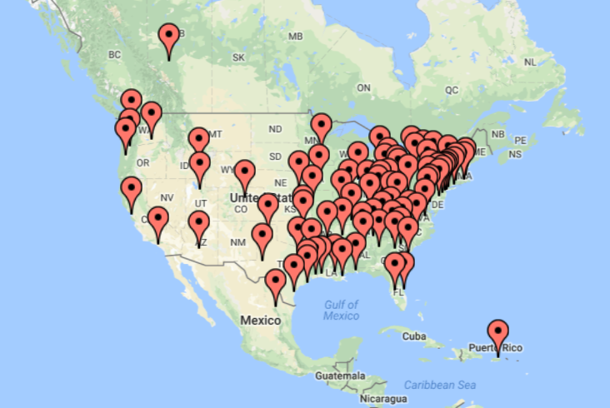
People & Community
Local Sections aiche.org/localsections
Network with peers at regular meetings
~ 90 Local Sections
Virtual Local Section
Local Section Locations in North America
Local Section Locations in North America
2018
Student Membership Benefits
Notes:
Local Sections
Network with peers at regular meetings
~90 Local Sections
Virtual Local Section

Slide 8
People & Community
Divisions and Forums aiche.org/divisions
Free membership for up to two divisions or forums
Stay up-to-date on trends
2018
Student Membership Benefits
Notes:
Divisions and Forums
Free membership for up to two AIChE technical divisions or forums
22 technical groups
Stay up-to-date on trends

Slide 9
Education Resources
SAChE Certification aiche.org/sache
Process Safety courses
Online: accessible anywhere at anytime
AIChE eLibrary aiche.org/elibrary
Free, interactive online access to more than 500 textbooks
Latest research findings and conference reports
Perry’s Handbook and Knovel Database
AIChE Academy aiche.org/academy
Archived digital library
More than 2,000 presentations on technical subjects and career skills
2018
Student Membership Benefits
Notes:
SAChE Certification
Earn certificates in any or all of these areas:
Basics of Laboratory Safety
Chemical Process Safety in the Chemical Process Industries
Chemical Reactivity Hazards
Dust Explosion Control
Inherently Safer Design
Process Safety 101
Process Safety Lessons Taught from Experience
Risk Assessment
Runaway Reactions

Slide 10
Online Publications
Chemical Engineering Progress (CEP) Magazine aiche.org/cep
Latest developments in cutting-edge technologies
Business news
Career advice
AIChExchange
Monthly newsletter of Institute news
AIChE SmartBrief
Weekly news summary of stories and trends
Must-read news summarized
December 2017 Edition of CEP
2018
Student Membership Benefits

Slide 11
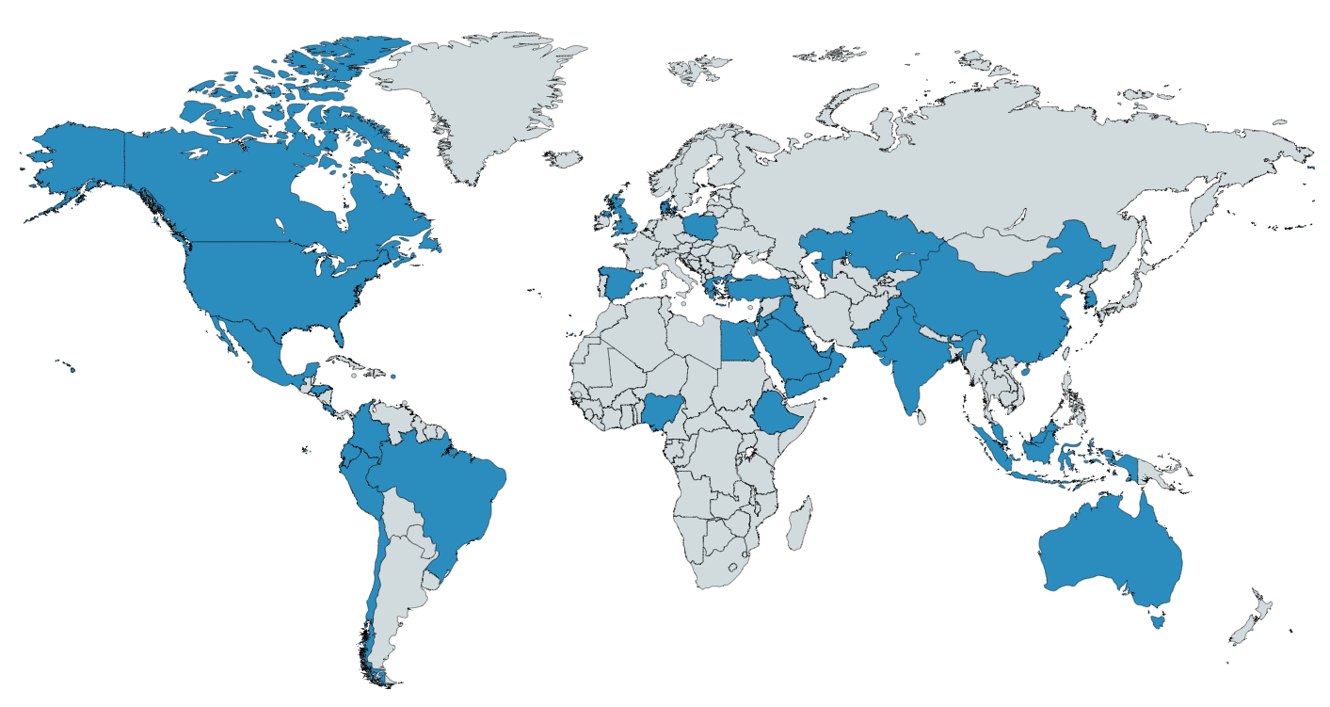
Leadership Development
Executive Student Committee (ESC) aiche.org/esc
Student-run committee that serves AIChE Student Chapters
Regional and International positions available to undergraduates
The ESC works with Student Chapters from 40 Countries
2018
Student Membership Benefits

Slide 12
Thank You
Presentation slides prepared by the Executive Student Committee
You can access this powerpoint on the ESC’s website: aiche.org/esc
2018
Student Membership Benefits

