Slide 1
2019 Annual Student Conference
AIChE Executive Student Committee
Notes:
This presentation was compiled by the AIChE Executive Student Committee.
The information presented may be subject to change. For errors or questions, please contact us at esc@aiche.org.

Slide 2
Agenda
About the Annual Student Conference
Location and Venue
Featured Events
Registration Information and Steps
Notes:
These presentation slides will (1) provide an introduction to the Annual Student Conference, (2) share the 2019 conference location and venue, (3) feature the most popular conference events, and (4) provide information and instructions for registering.

Slide 3
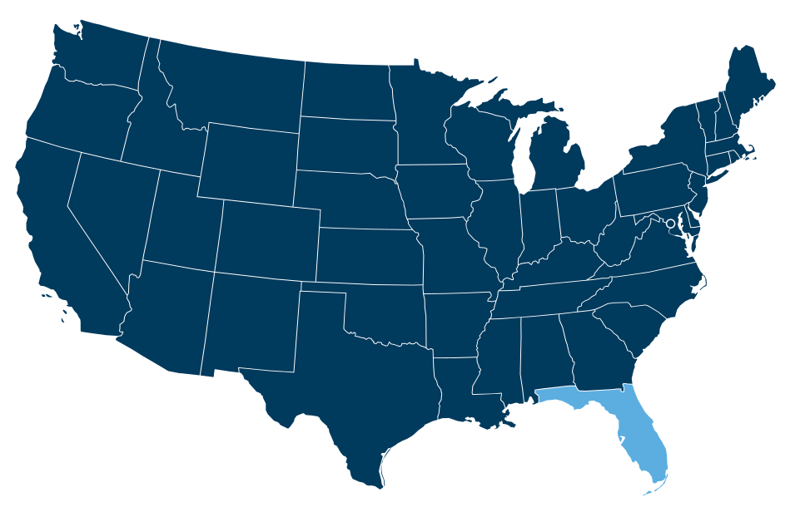
About the Annual Student Conference
Largest AIChE conference for students
Four days of career information, social events, and competitions
All AIChE student members are invited to attend
November 8-11, 2019 in Orlando, Florida
Notes:
The Annual Student Conference is AIChE’s largest conference for students. All AIChE student members are invited to attend. The ASC features four days of career information, social events, and competitions. The 2019 ASC will be held November 8-11, 2019 in Orlando, Florida.

Slide 4
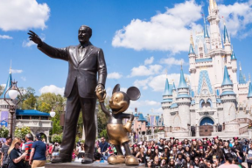
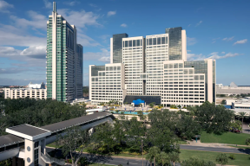
Location and Venue
Orlando, Florida, USA
Known as the “Theme Park Capital of the World“
Home of Walt Disney World and Universal Studios
One of the world's most visited tourist destinations
Hyatt Regency Orlando
Special rate for the conference
Single room rates start at $159 per night
Book online before Friday, Oct. 18, 2019
commons.wikipedia.org
hyatt.com
Notes:
Location
The 2019 ASC will be held in Orlando, Florida. The city of Orlando is known as the “Theme Park Capital of the World” because of its numerous theme parks, including Walt Disney World and Universal Studios. Thanks in part to these theme parks, Orlando is one of the most visited tourist destinations in the world.
Venue
Conference events will be held at the Hyatt Regency in Orlando. AIChE has negotiated a special rate for the ASC. Single rooms are available starting at $159/night. Book online before Friday, October 18, 2019. The hotel block is expected to sell out, so book early.
https://www.aiche.org/conferences/annual-aiche-student-conference/2019/hotel-information

Slide 5
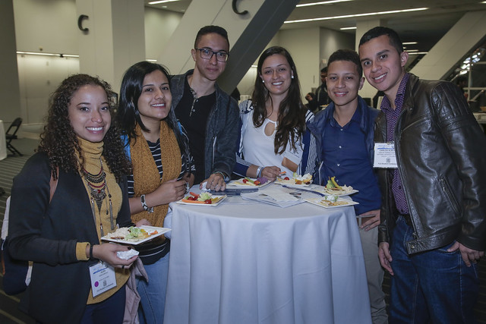
Featured Events
Speakers and Panels
Networking Opportunities
Student Chapter Competitions
Research Competitions
Ticketed Events
A full itinerary of conference events is available online: aiche.org/asc/activities19
By Margot Hartford
Notes:
Dozens of events are held over the course of the four-day conference. Some of the most popular events include (1) speakers and panels, (2) networking opportunities, (3) student chapter competitions, (4) research competitions, and (5) ticketed events.
A full itinerary of conference events is available online:
www.aiche.org/asc/activities19

Slide 6
Speakers and Panels
Keynote Speech
Kicks off the conference
Karen McKee, President of ExxonMobil Chemical Company
Town Hall with AIChE Leadership
Make your voice heard
Share with the AIChE Board of Directors
Leadership Panel
Features ChemE’s from a variety of career paths
Learn about their experiences and obstacles
Notes:
Keynote Speech
Karen McKee, president of ExxonMobil Chemical Company, will be kicking off the conference with her keynote speech.
https://www.aiche.org/conferences/annual-aiche-student-conference/2019/events/2019-annual-student-conference-keynote-address
Town Hall with AIChE Leadership
Meet with the AIChE Board of Directors and make your voice heard. Ask questions or share your thoughts and experiences.
https://www.aiche.org/conferences/annual-aiche-student-conference/2019/events/town-hall-aiche-leadership
Leadership Panel
The Leadership Panel will feature successful chemical engineers in a variety of career paths. During this event, students will have the opportunity to ask questions and learn about the panel members’ experiences and obstacles during their careers.
https://www.aiche.org/conferences/annual-aiche-student-conference/2019/events/leadership-panel

Slide 7
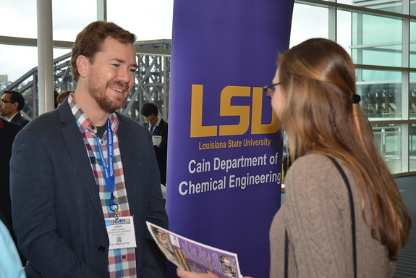
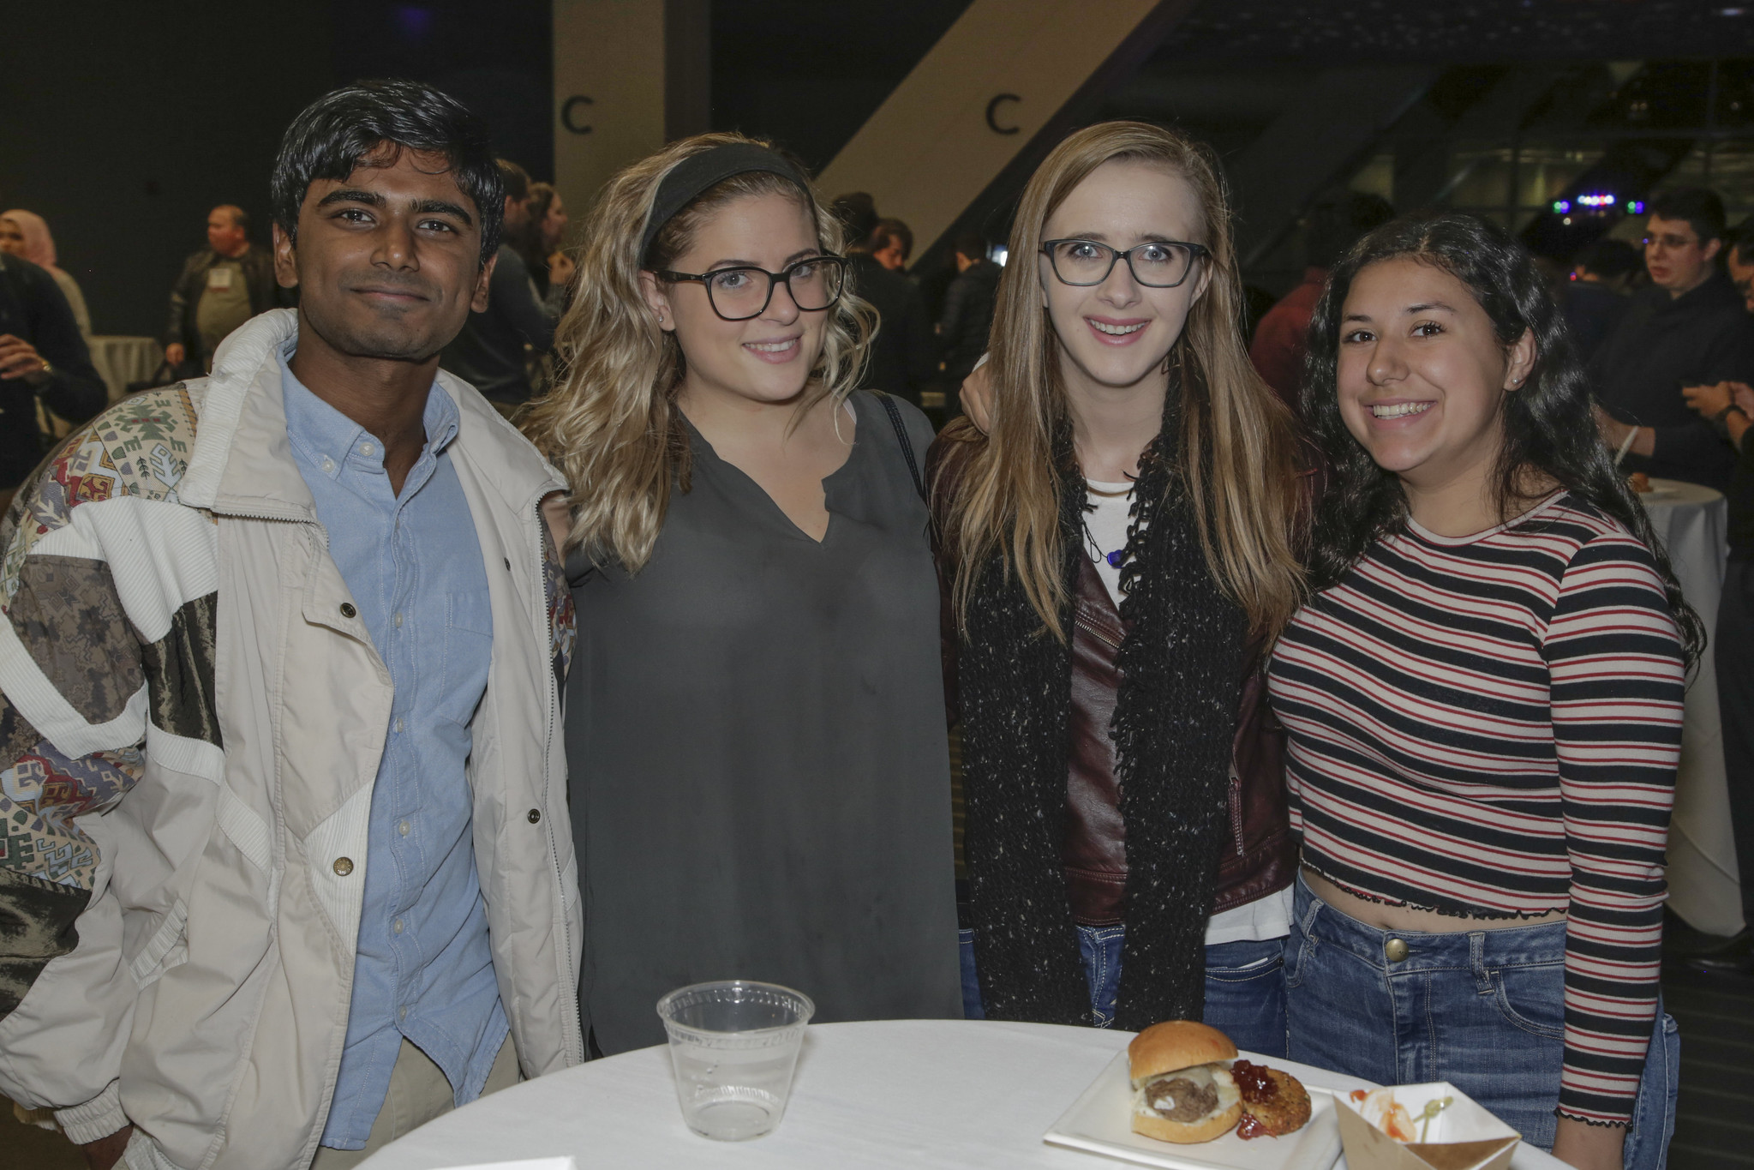
Networking Opportunities
Recruitment Fair
Meet graduate schools and company recruiters
Determine which path is best for you after graduation
Learn about degree programs and internships
By Gordon Ellis
Night of Networking
First time conference event
Expand your network and meet fellow ChemE’s
Food, networking games, and prizes
By Margot Hartford
Notes:
Recruitment Fair
During the recruitment fair, students will have the opportunity to meet with graduate schools and company recruiters. Learn from the graduate schools what their degree programs are and find out what open entry-level positions companies are looking to fill.
https://www.aiche.org/conferences/annual-aiche-student-conference/2019/events/2019-recruitment-fair
Night of Networking
During this first ever event, meet other ChemE’s and expand your network over food and games. There will also be a chance to win prizes.
https://www.aiche.org/conferences/annual-aiche-student-conference/2019/events/student-conference-night-networking

Slide 8
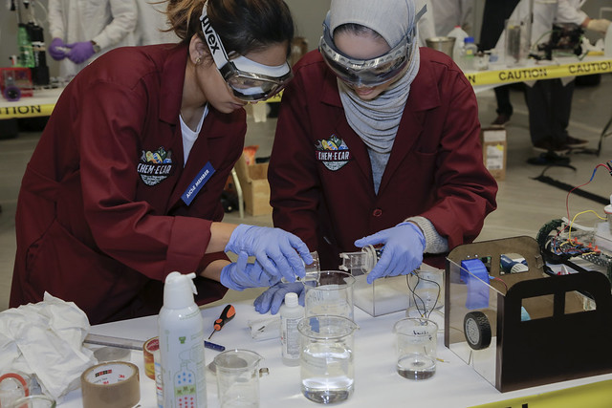
Student Chapter Competitions
Chem-E-Car Competition®
Teams construct a chemically powered car
Car carries a given load over a specified distance
ChemE Jeopardy
Based on popular American game show “Jeopardy!”
Quizzes teams’ knowledge of ChemE principles
K-12 STEM Outreach Competition
Teams showcase interactive STEM modules
Over a hundred K-12 students invited
From ChEnected Flickr
Notes:
Chem-E-Car Competition
Student Chapters from around the world will compete in the poster and performance competitions. During this competition, teams will use their chemically powered car to carry a given load over a specified distance.
https://www.aiche.org/conferences/annual-aiche-student-conference/2019/events/2019-annual-student-conference-chem-e-car-competitionr
ChemE Jeopardy
Winners of the regional ChemE Jeopardy competition will compete to become the 2019 ChemE Jeopardy World Champion. Based on the popular American game show “Jeopardy!”, teams will be quizzed on their knowledge of ChemE principles.
https://www.aiche.org/conferences/annual-aiche-student-conference/2019/events/cheme-jeopardy-competition
K-12 STEM Outreach Competition
During this first ever conference event, teams will showcase their interactive STEM modules to hundreds of K-12 students, parents, educators, and AIChE members. Prizes will be awarded to the top teams.
https://www.aiche.org/resources/conferences/events/k-12/2019-11-10

Slide 9
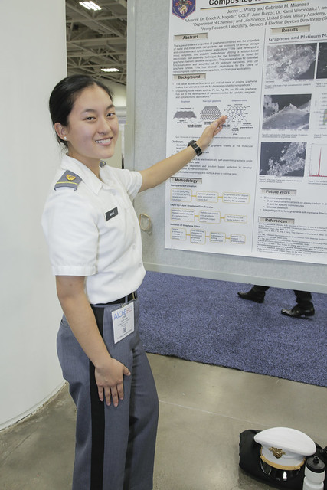
Research Competitions
Student Poster Competition
Largest research forum for chemE undergraduates
Open for any undergraduate student
Student Paper Competition
Winners from each regional competition will present
Top three papers will be awarded cash prizes
Student Design Competition
Winners from the 2019 Student Design Competition
Presentation and discussion of their solutions
By Margot Hartford
Notes:
Student Poster Competition
The ASC poster competition is the largest research forum specifically for chemE undergrads. This research competition is open to any undergraduate student.
https://www.aiche.org/conferences/annual-aiche-student-conference/2019/events/2019-undergraduate-student-poster-competition
Student Paper Competition
The winner of each regional competition is invited to present their research during the ASC. The top three papers will be awarded cash prizes, which are sponsored by Omega Chi Epsilon.
https://www.aiche.org/conferences/annual-aiche-student-conference/2019/events/student-paper-competition
Student Design Competition
The individual and team winners from the 2019 Student Design Competition are invited to present their solutions during the ASC.
https://www.aiche.org/conferences/annual-aiche-student-conference/2019/events/student-design-competition

Slide 10
Ticketed Events
Some events are ticketed:
Graduating Senior Networking Mixer ($5)
Annual Student Conference Welcome Breakfast & Keynote Address ($0)
Annual Student Conference Lunch ($0)
LGBTQ+ & Allies Ice Cream Social ($0)
Undergraduate Professional Workshop for Women & Minorities ($5)
MAC Real Talk Speed Mentoring ($5)
To attend one or more of these events, indicate such during your registration

Slide 11
Registration Information
Category | Early (until Sept. 30) | Standard (until Nov. 6) | Onsite (until Nov. 8)
Student Member | $130 | $145 | $160
Student Non-Member | $160 | $175 | $190
Registration includes:
Access to all ASC events
Access to the Annual Meeting
Invitation Letter
An invitation letter can be requested via an online form
Refer to instructions on ASC registration page
Notes:
Registration Information
There is a registration fee for conference attendees. AIChE student members can take advantage of discounted registration fees. There are three registration fees based on the date of registration.
ASC registration also includes complimentary access to the Annual Meeting (Nov. 10-15).
https://www.aiche.org/conferences/annual-aiche-student-conference/2019/registration-information
Invitation Letter
AIChE can provide an invitation letter upon request. Complete and submit the AIChE ASC Invitation Letter Request Form:
https://www.aiche.org/conferences/annual-aiche-student-conference/2019/registration-information#Invitation%20Letters

Slide 12
Individual Registration
Visit aiche.org
Login to your AIChE account to receive reduced member rates
Navigate to aiche.org/asc
Locate and click on the blue “Register Now” button
Save registration confirmation email
Notes:
Individual Registration:
To register yourself or one other person, visit aiche.org. Login to your AIChE account to ensure you will receive the reduced member registration rate. Afterwards, visit aiche.org/asc to view the Annual Student Conference website. Locate and click on the blue “Register Now” button. Complete your registration using the instructions provided on the registration forms. After successfully registering, please save your confirmation email.
https://www.aiche.org/conferences/annual-aiche-student-conference/2019/registration-information

Slide 13
Group Registration
To register a group of students:
Find the Group Student Conference Registration Sheet on the ASC registration site
Email the completed sheet to customerservice@aiche.org
An invoice for all registrations will be sent back to you with payment instructions
Note that registration will not be complete until payment is made
Notes:
Group Registration
If you are registering multiple students for the Annual Student Conference, submit a Group Student Conference Registration Sheet. To find and download the registration sheet, visit the registration page and locate the “Group Registration” section. Once completed, email the registration sheet to customerservice@aiche.org. AIChE Customer Service will review the registration sheet and send payment instructions. Please note that registration will not be complete until payment is made.
https://www.aiche.org/conferences/annual-aiche-student-conference/2019/registration-information#Group%20Registration

Slide 14
Thank you
Find more information at aiche.org/asc
Connect with AIChE on social media and use the hashtag #AIChEASC

