Slide 1
Welcome! Please be seated by region
FRONT
Pacific Northwest
Southwest
Rocky Mountain
Int’l
Western
Mid-America
Mid-America
Int’l
Northeast
Southern
Southern
Misc.
Northeast
Mid-Atlantic
Southern
Northeast
North Central
North Central
Mid-Atlantic
Mid-Atlantic
North Central
N
NNort
North Central
Mid-Atlantic
Mid-Atlantic
2018
Annual Student Conference
Presidents Meeting

Slide 2


Presidents Meeting

Slide 3

Agenda
About the ESC
Getting Involved
AIChE
Updates from the ESC
  Sister Chapter Program
  K-12
Leadership Pages
ChenEcted
Annual Reports
How can we help you
2018
Annual Student Conference
Presidents Meeting

Slide 4

Who are we?
Help improve student chapters
1 of the 23 Global AIChE Committees
Encourage inter-chapter communication
The ESC seeks to
Be the liaison between student chapters and AIChE staff
Motivate student chapter members to be active in other aspects of AIChE
Encourage student chapter members to continue their relationship with AIChE beyond graduation
2018
Annual Student Conference
Presidents Meeting

Slide 5
Organizational Structure
Executive Committee
Chair
Vice Chair
National Director
Global Director
2018
Annual Student Conference
Presidents Meeting

Slide 6
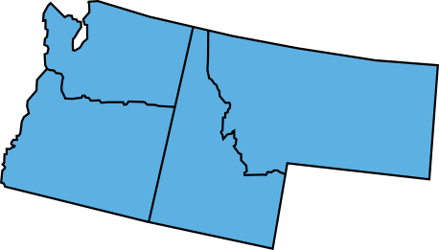
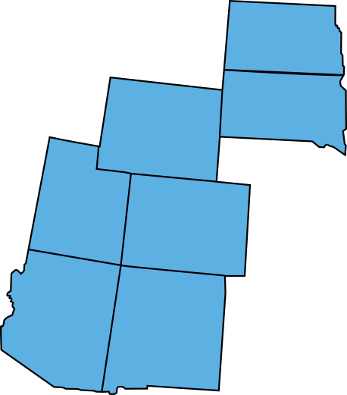
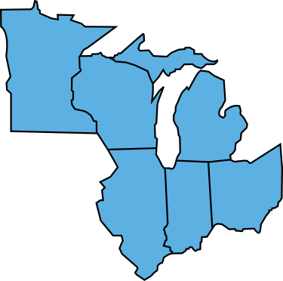
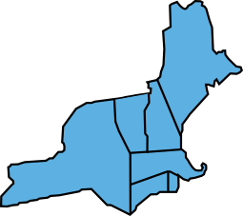

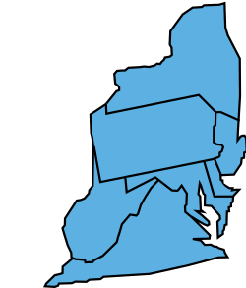
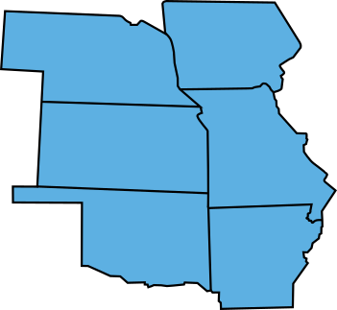
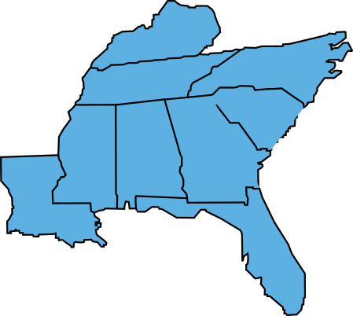
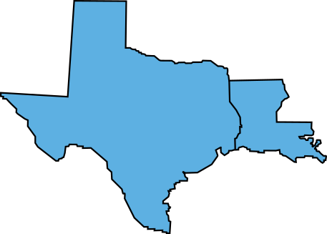
Organizational Structure
Executive Committee: Chair, Vice Chair, National Director, and Global Director
14 Regional Subcommittees:
5
Mid-America
Mid-Atlantic
North Central
Northeast
Pacific Northwest
Rocky Mountain
Southern
Southwest
Western
Asia Pacific
Europe and Africa
Latin America
Middle East
Southern Asia
6
4
9
3
2
1
7
8
2018
Annual Student Conference
Presidents Meeting

Slide 7
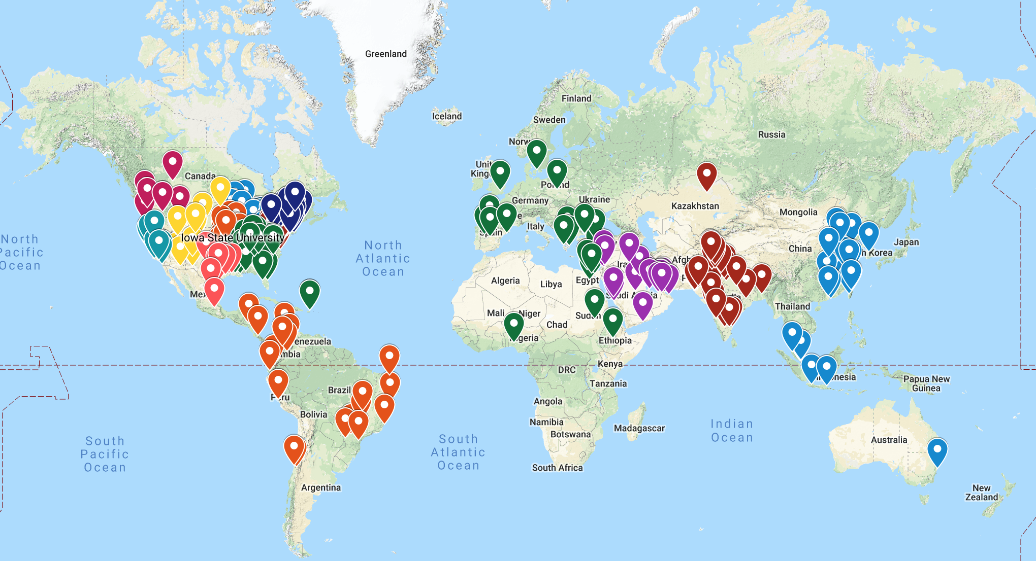
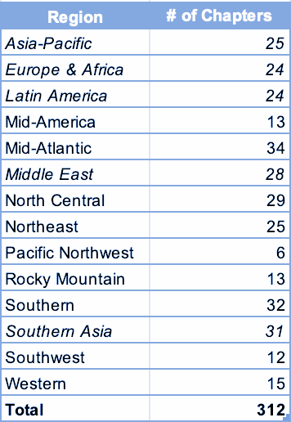
Notes:
over 120 international chapters...132 international chapters..approx 42%

Slide 8
National Director
Mid-America Mid-Atlantic North Central Northeast Pacific Northwest Rocky Mountain Southern Southwest Western
Regional Chair
Regional Chair
Regional Chair
Regional Chair
Regional Chair
Regional Chair
Regional Chair
Regional Chair
Regional Chair
Regional Liaison
Regional Liaison
Regional Liaison
Regional Liaison
Regional Liaison
Regional Liaison
Regional Liaison
Regional Liaison
Regional Liaison
Regional Liaison
Regional Liaison
Regional Liaison
Regional Liaison
Regional Liaison
Regional Liaison
Regional Liaison
Regional Liaison
Regional Liaison
Regional Liaison
Regional Liaison
Regional Liaison
Regional Liaison
Regional Liaison
Regional Liaison
Regional Liaison
Regional Liaison
Regional Liaison
Regional Liaison
Regional Liaison
Regional Liaison
Regional Liaison
Regional Liaison
Regional Liaison
Regional Liaison
2018
Annual Student Conference
Presidents Meeting

Slide 9
Global Director
Latin America Asia-Pacific Southern Asia Middle East Europe & Africa
Regional Chair
Regional Chair
Regional Chair
Regional Chair
Regional Chair
Regional Liaison
Regional Liaison
Regional Liaison
Regional Liaison
Regional Liaison
Regional Liaison
Regional Liaison
Regional Liaison
Regional Liaison
Regional Liaison
Regional Liaison
Regional Liaison
Regional Liaison
Regional Liaison
Regional Liaison
Regional Liaison
Regional Liaison
Regional Liaison
Regional Liaison
Regional Liaison
Regional Liaison
Regional Liaison
Regional Liaison
Regional Liaison
Regional Liaison
Regional Liaison
2018
Annual Student Conference
Presidents Meeting

Slide 10
Growth of AIChE
Currently, 312 Student Chapters in 43 countries
Since 2017, AIChE Student Chapters has increased by 17%.
Most growth has occurred in the International Region
Growth had led to key events in the International Region
2018
Annual Student Conference
Presidents Meeting
Notes:
GROWTH OF AICHE
-- 312 student chapters in 43 countries
-- 1st ever india student regional conference held in 2018
-- 1st ever colombia student regional conference to be held in 2019
** recap of 2018 student regional conferences, preview of 2019 student regional conferences?
2018
Indian Student Regional Conference
China Chem-e-car competition
Colombia chem-e-car competition
2019
Colombia--Jefferson and Mayra

Slide 11
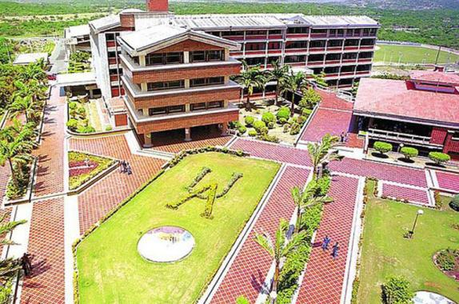

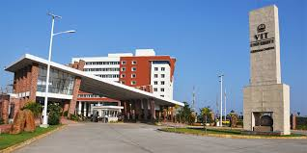
Spreading Our Wings
In April 2018, Colombia held its 3rd Regional Chem-E-Car Competition.
In May 2018, China held its 2nd Regional Chem-E-Car Competition
In August 2018, India held its 1st ever Student Regional Conference.
2018
Annual Student Conference
Presidents Meeting

Slide 12
Preview of 2019 Regional Student Conferences
Region | Host School
India | Maharashtra Institute Of Technology, Pune
Colombia | Universidad Nacional de Colombia, sede Medellin
China | Nanjing University of Technology
Mid-America | Missouri S&T
Mid-Atlantic | Penn State
North Central | University of Toledo
Northeast | UMass, Amherst
Pacific Northwest | University of Idaho
Rocky Mountain | Colorado School of Mines
Southern | Mississippi State
Southwest | Texas Tech
Southern | USC
2018
Annual Student Conference
Presidents Meeting

Slide 13

Student Membership
SAChE
AIChE eLibrary
Engage
Scholarships
CareerCentral
Newsletter
YP
2018
Annual Student Conference
Presidents Meeting
Notes:
Engage

Slide 14
Student Newsletter
  Newsletter serves as platform for updating Student Members with the latest information
  First Student Newsletter was sent out in April 2018
  Each month, a new newsletter is sent out with the following highlights:
    What's New - announcements from the AIChE team
    Don't Forget! - calendar of upcoming events & deadlines
    Get Involved! - opportunities to do more with AIChE
    What's in it for me? - information about AIChE member benefits
    Student Chapter Corner
  Ensure that your AIChE membership is up to date by logging into your Engage profile
  Add customerservice@aiche.org to you
2018
Annual Student Conference
Presidents Meeting

Slide 15

Young Professionals
AIChE's 35 under 35 Award
First Year Membership is now waived for Young Professionals
As a Young Professional, you can still have access to all the Member Benefits of an AIChE member as well as being a part of the Young Professionals Committee (YPC).
Local Sections
PD Courses and Webinars
2018
Annual Student Conference
Presidents Meeting

Slide 16

ChEnected is an online community created by young professional Chemical Engineers for all AIChE users.
ChEnected is where chemical engineers can read, contribute, and engage with everything Chem-E.
2018
Annual Student Conference
Presidents Meeting

Slide 17



  Volunteer Central
  Some ex’s: Social Media Content Contributor
  Online forum
    Student Central
    Discussion Central
Volunteer
Discussion
2018
Annual Student Conference
Presidents Meeting

Slide 18
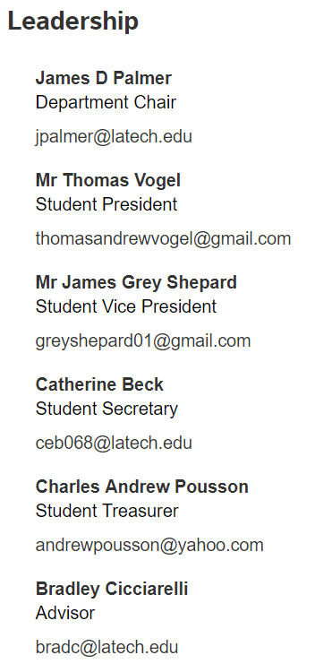
Leadership Pages
What to include:
Department Head/Chair
Faculty Advisor(s)
Student Chapter Presidents
Executive Board/Officers
Link to website
Ask your RL for the form to submit leadership changes
2018
Annual Student Conference
Presidents Meeting

Slide 19
Annual Reports
Submit feedback on the ESC’s website
No Annual Report = Ineligible for Chem-E-Car
Submit an Annual Report here: http://www.aiche.org/StudentChapterAnnualReport
2018
Annual Student Conference
Presidents Meeting

Slide 20
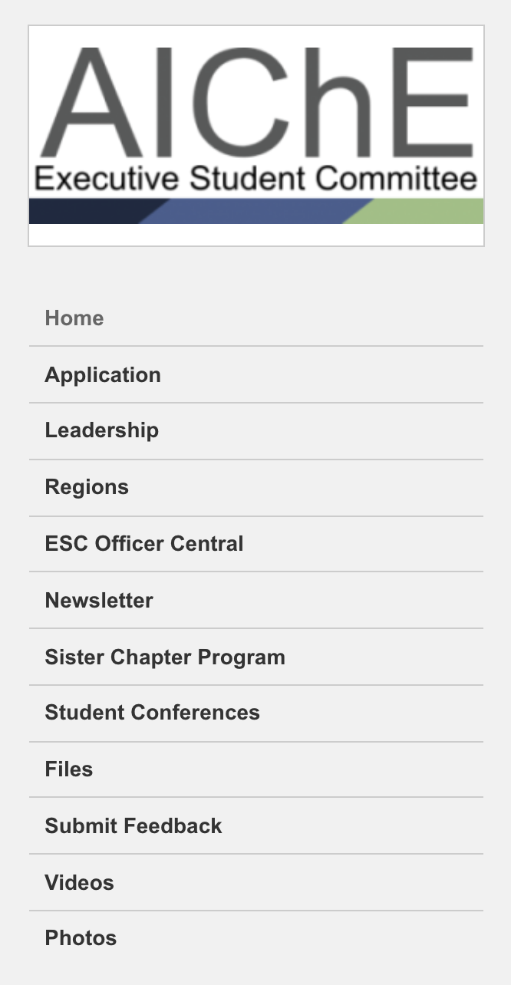
ESC Officer Central
Starting an AIChE Chapter
Engaging Freshman
Student Membership Benefits
Fundraising Methods
Corporate Sponsorship

Slide 21
Sister Chapter Program
Purpose
  The Sister Chapters program helps prepare our students for the increasingly global environment they will enter upon graduation.
  Chapters to discuss their Student Chapter goals and give each other ideas on how to improve their Student Chapters
Goals
  Increase international awareness of, connection to, and involvement with AIChE
  Build an ongoing relationship between International and American AIChE student chapters
  Connect future chemical engineers from around the globe with AIChE
Getting Involved
  Sister Chapter Matchmaking is currently handled by the ESC.
2018
Annual Student Conference
Presidents Meeting
Notes:
TALKING POINTS:
how many new chapters joined
new sister chapter subcommittee
how many chapters are participating
sister chapter spotlights

Slide 22
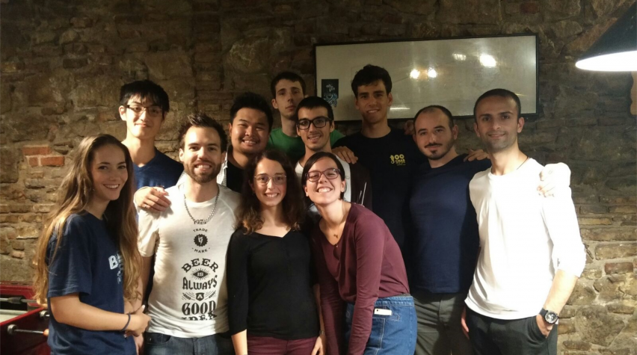

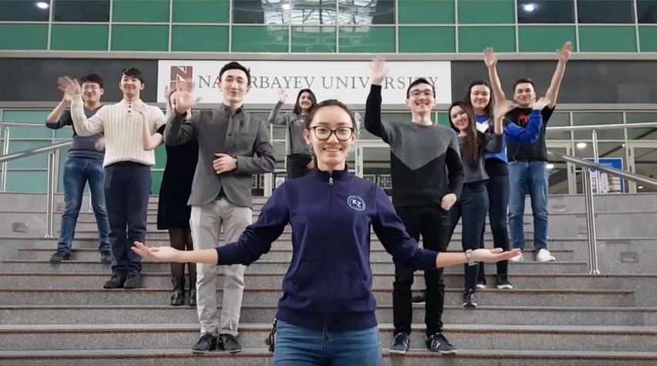
Sister Chapter Spotlights
Sister Chapter duo:
University of British Columbia
Universitat Politècnica de Catalunya
Sister Chapter duo:
Universidad Nacional de Colombia sede Medellín
University of Michigan
Sister Chapter duo:
Nazarbayev University
Texas A&M University

Slide 23
Sister Chapter Matchmaking
Submit a Sister Chapter Interest Survey
Get to know the other fish in the sea
Consult your RL or one of our love doctors
Matchmake!
Live happily ever after
2018
Annual Student Conference
Presidents Meeting
Notes:
Not required to join program

Slide 24


Show and Tell Challenge
2018
Annual Student Conference
Presidents Meeting

Slide 25
ESC’s K-12 Outreach Program
We help provide Chapters the resources they need for participating in a K-12 program
Provide Chapters with a Teaching Module which is provided by other chapters
2018
Annual Student Conference
Presidents Meeting

Slide 26
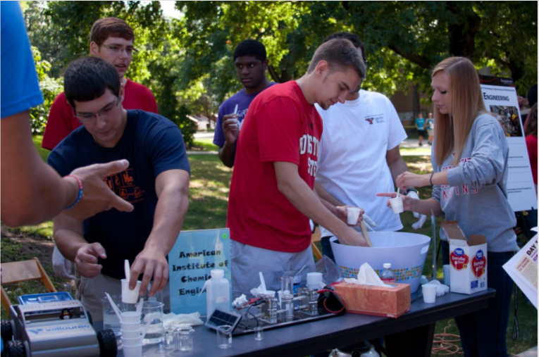
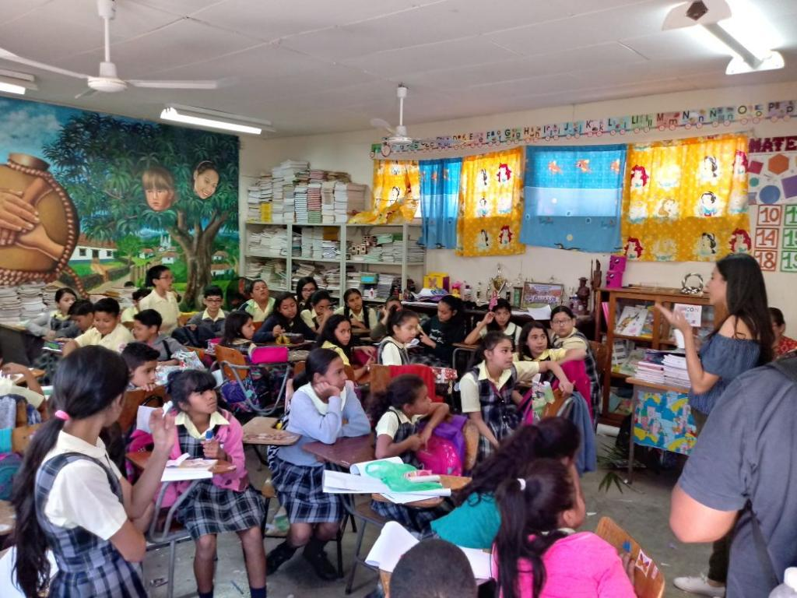
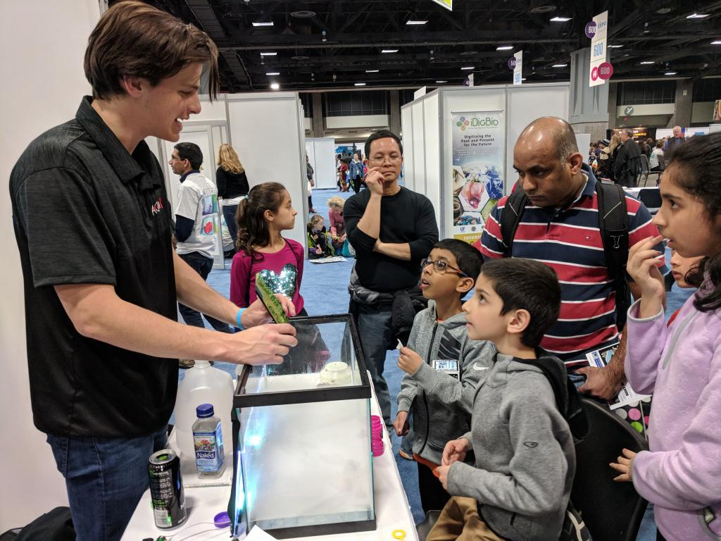
K-12 Teaching Module
Objective
Theory
Materials
Procedure
2018
Annual Student Conference
Presidents Meeting

Slide 27
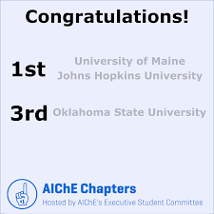
March Madness
32 Student Chapters
ESC
AIChE Staff
2018
Annual Student Conference
Presidents Meeting
Notes:
last year we held our first ever AIChE Student Chapter March Madness competition. We had chapter, plus ESC, plus staff.

Slide 28
Getting Involved
Applications are accepted at the start of the academic year
E-board elections occur close to the ASC
Term Length: May-May
2018
Annual Student Conference
Presidents Meeting
Notes:
Volunteer to speak about serving as RL

Slide 29
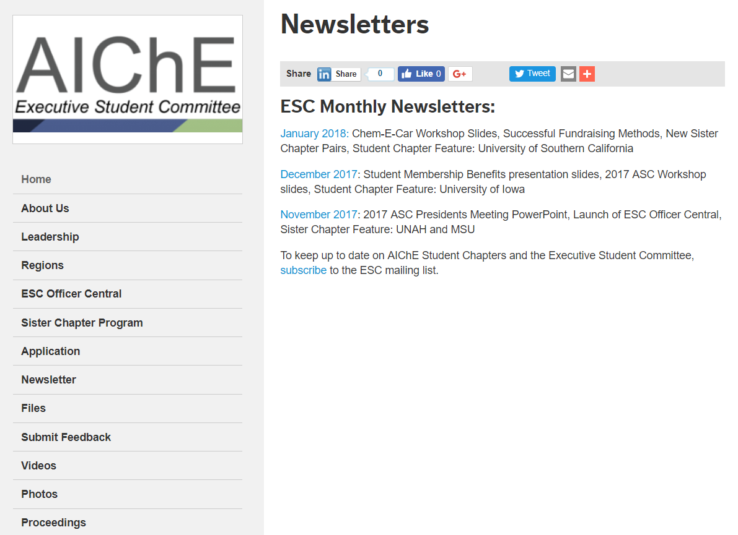
ESC Newsletter
Stay up-to-date with the ESC
2018
Annual Student Conference
Presidents Meeting

Slide 30
Feedback
We appreciate all feedback!
2018
Annual Student Conference
Presidents Meeting

Slide 31



Connect With Us On Social Media
aiche.esc
aiche_esc
aiche_esc
2018
Annual Student Conference
Presidents Meeting

Slide 32

Questions?
Fahima Rafiqi
chairman.esc@gmail.com
2018
Annual Student Conference
Presidents Meeting

