Slide 1
>100 International Chapters

Slide 2
Agenda
About the ESC
Annual Reports
Leadership Pages
ESC Officers/Liaisons
International Region
Sister Chapter Matchmaking
Questions
2017
Annual Student Conference
Presidents Meeting

Slide 3
About Us
1 of the 23 Global AIChE Committees
The ESC seeks to
Help improve student chapters
Encourage inter-chapter communication
Be the liaison between student chapters and AIChE staff
Motivate student chapter members to be active in other aspects of AIChE
Encourage student chapter members to continue their relationship with AIChE beyond graduation
2017
Annual Student Conference
Presidents Meeting

Slide 4
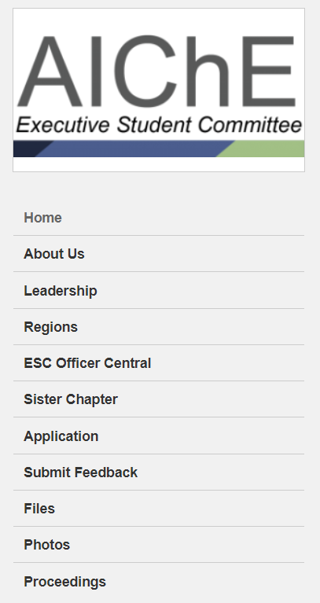
Getting Involved
The ESC is comprised of Regional Liaisons (RLs)
Applications accepted year-round
Next term: January-May
2017
Annual Student Conference
Presidents Meeting
Notes:
Volunteer to speak about serving as RL

Slide 5
Annual Reports
Submit feedback on the ESC’s website
No Annual Report = Ineligible for Chem-E-Car
Submit an Annual Report here: http://www.aiche.org/StudentChapterAnnualReport
2017
Annual Student Conference
Presidents Meeting

Slide 6
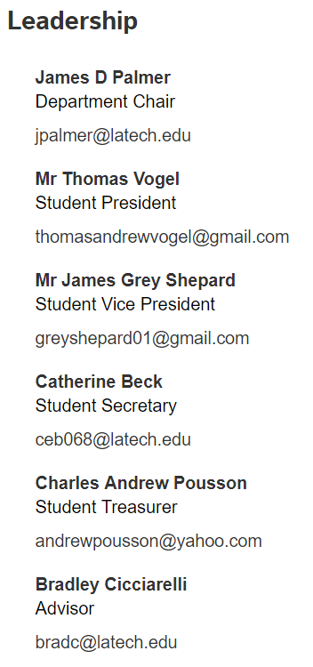
Leadership Pages
What to include:
Department Head/Chair
Faculty Advisor(s)
Student Chapter Presidents
Executive Board/Officers
Link to website
Ask your RL for the form to submit leadership changes
2017
Annual Student Conference
Presidents Meeting

Slide 7
ESC Officers
New, optional position for Student Chapters
Handle ESC correspondence
Attend All-Region Calls
Communicate Global AIChE news and initiatives
ESC Officer Central
Student Chapter related resources
Videos
ESC Files
Mailing List
Submit position changes
2017
Annual Student Conference
Presidents Meeting

Slide 8
Restructuring the International Region
>100 International Chapters
11 countries represented on ESC
5 International Sub-Regions:
Latin America
Asia and Australia
India/Pakistan/Kazakhstan
Middle East and Africa
Europe and Africa
New leadership position: Sub-Region Chair
2017
Annual Student Conference
Presidents Meeting

Slide 9
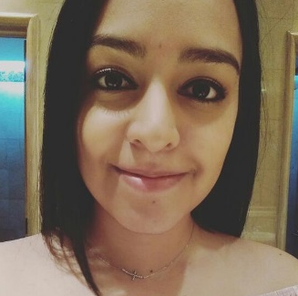

Slide 10
Sister Chapter
Working with MSU has been a wonderful experience, we get to understand their chapter structure and working dynamics. Getting in contact with other sister chapters allows your own chapter to learn from different cultures, to share experiences or ideas, to meet new people and you can even accept suggestions for improvement. I am grateful to collaborate with MSU, it feels good to know that you can count on them and what’s better, having good friends there even if we’re far away.
-Janelle, UNAH Student Chapter International Liaison
The sister chapter program is the best way to network with AIChE member across the globe and grow as a chemical engineer not solely as a professional but as an individual. As the Honduran Sister Chapter Liaison, I've expanded my horizons and learned so much from fellow engineers. Consequently, this once in a lifetime experience made me cherish my position as the international linkage between Mississippi State University and UNAH because of the incredible memories and friendships I have built throughout my experience in AIChE.
-Laihmen, MSU Student Chapter International Liaison

Slide 11
Sister Chapter Matchmaking
Submit a Sister Chapter Interest Survey
Get to know the other fish in the sea
Consult your RL or one of our love doctors
Dr. Contreras
Past International Liaison
Latin America Chair
Dr. Phatarphod
International Liaison
International Region Chair
Dr. Wagner
Not actually qualified
Superb conversationalist
Matchmake!
Live happily ever after
2017
Annual Student Conference
Presidents Meeting
Notes:
Not required to join program

Slide 12
Feedback
2017
Annual Student Conference
Presidents Meeting

Slide 13
Questions?
Anna Wagner, vchair.esc@gmail.com
2017
Annual Student Conference
Presidents Meeting

