Slide 1
Reactive Distillation:
What, why, and how?
Bob Huss
East Tennessee AICHE Seminar Program
November 17, 2015

Slide 2
Reactive Distillation
Simultaneous removal of vapor products from a boiling, reacting mixture
purge
A, B
purge
Reactor
A+B = C
C
C
Traditional
Reactive Distillation

Slide 3
Why Reactive Distillation?
Beat low equilibrium constants
Enhance overall rates
Improve selectivity & reduce byproducts
Avoid/eliminate difficult separations
React away impurities
Reduce/eliminate solvents
Energy reduction potential

Slide 4
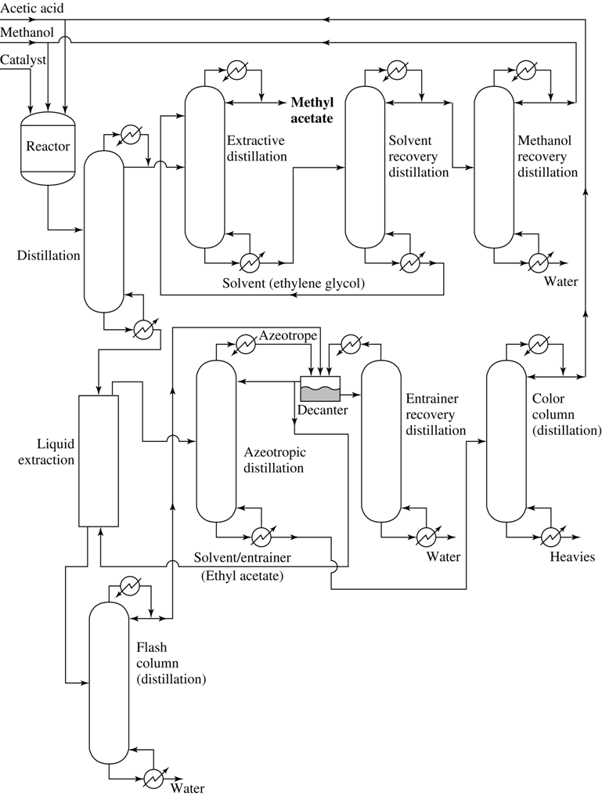
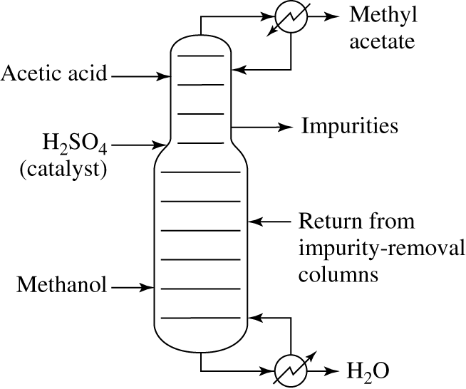
Methyl Acetate

Slide 5
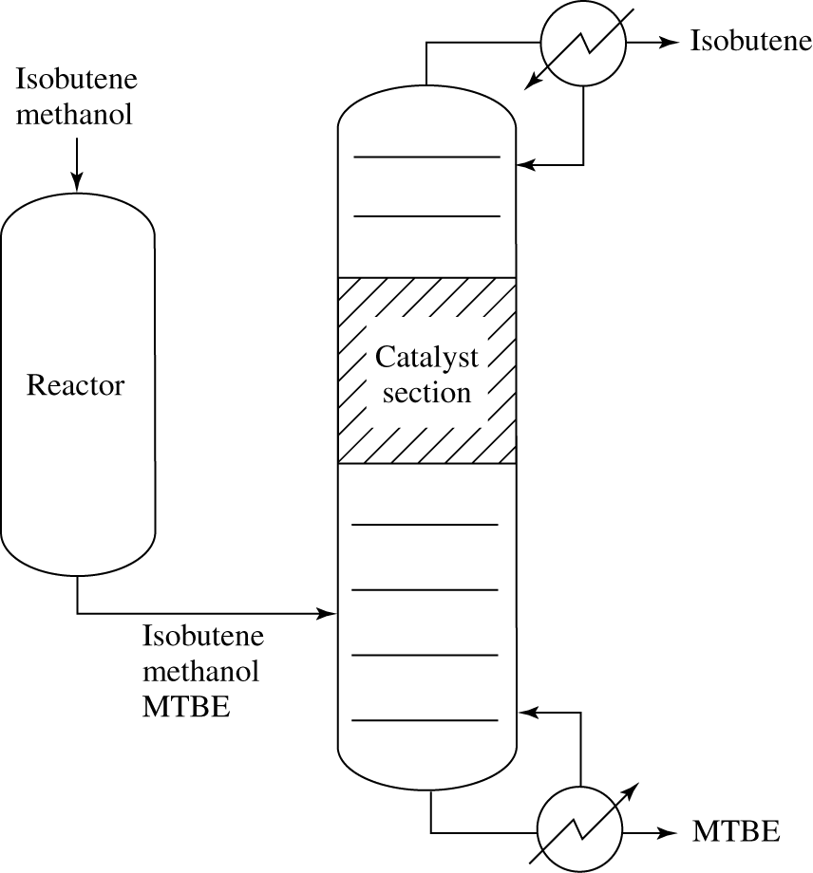
MTBE

Slide 6
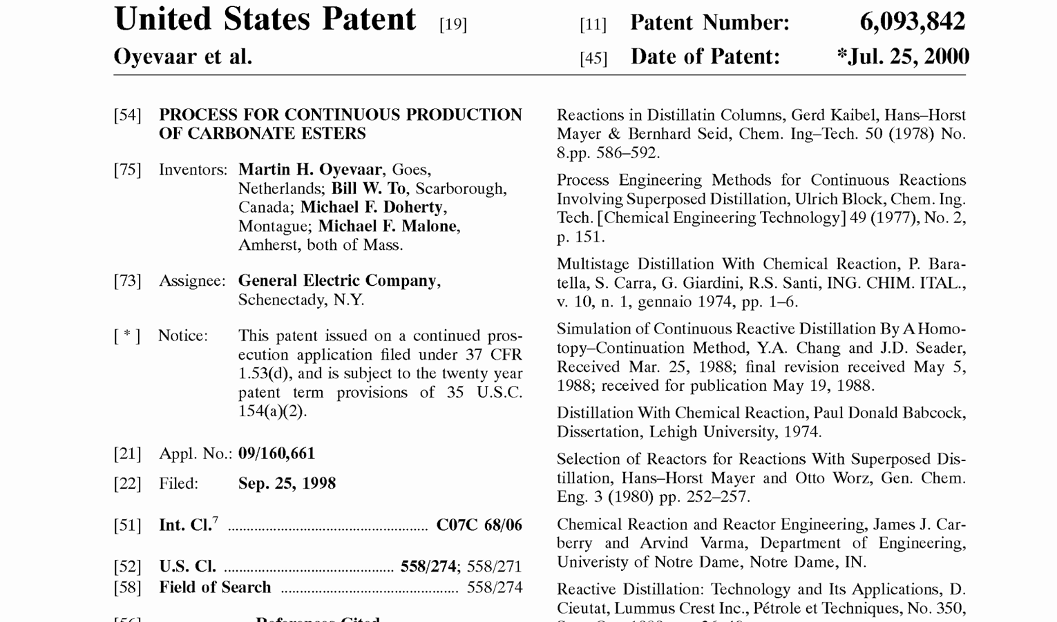
Carbonate Esters

Slide 7
Why Not Reactive Distillation?
Process Understanding
  Hard to Design
  Harder to Control/Operate
Phase Contacting
  Catalyst Contacting, Deactivation, Fouling
  Volatility of Reactants
Heat Transfer
  Energy Reduction Potential Not Always Realized
Safety Limits
Not Always Feasible
  T&P for Distillation vs. Reaction
  Azeotropes & Distillation Boundaries

Slide 8
Why not RD?
Operating window
Chemical Reaction
Temperature
Gas-liquid phases
Mechanical Design constraints
Pressure
From Kenig et. al., Reactive Separations in Fluid Systems, in
Reengineering the Chemical Processing Plant, Stankiewicz and Moulijn, Ed., 2004.

Slide 9
What are the possibilities?
From Schoenmakers and Bessling, Chemical Engineering and Processing 42 (2003)
High
Reactive column
(homogeneous or catalytic internals)
Short column
(homogeneous or catalytic internals)
Small reactor with evaporator
Reactive column with internals design for high residence time
Reaction rate
Column with sidedraw reactor(s)
Short Column with sidedraw reactor(s)
Reactor + evaporator
Low
Low
Relative Volatility
High

Slide 10
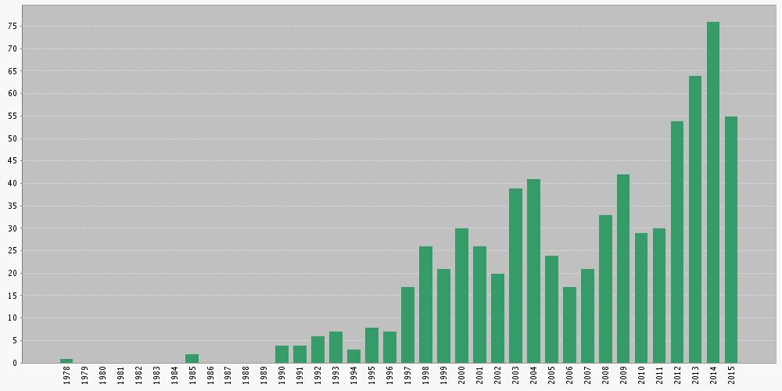
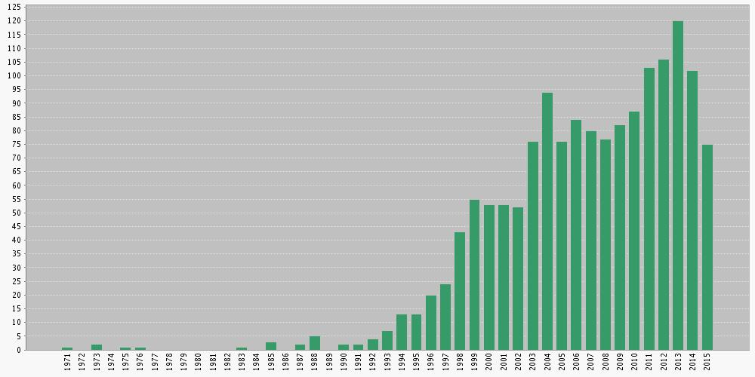
Reactive distillation literature (via Web of Science)
Patents
Papers

Slide 11
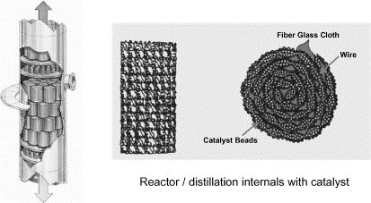
Development of Catalytic Internals
CDTECH – structured “bales” with catalyst in cloth pockets placed on trays
Dautzenburg and Mukherjee, Chem Eng Sci, 56, vol 2, Jan, 2001.

Slide 12
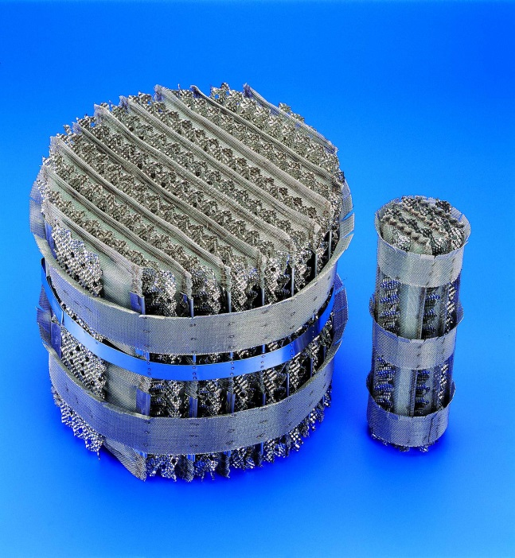
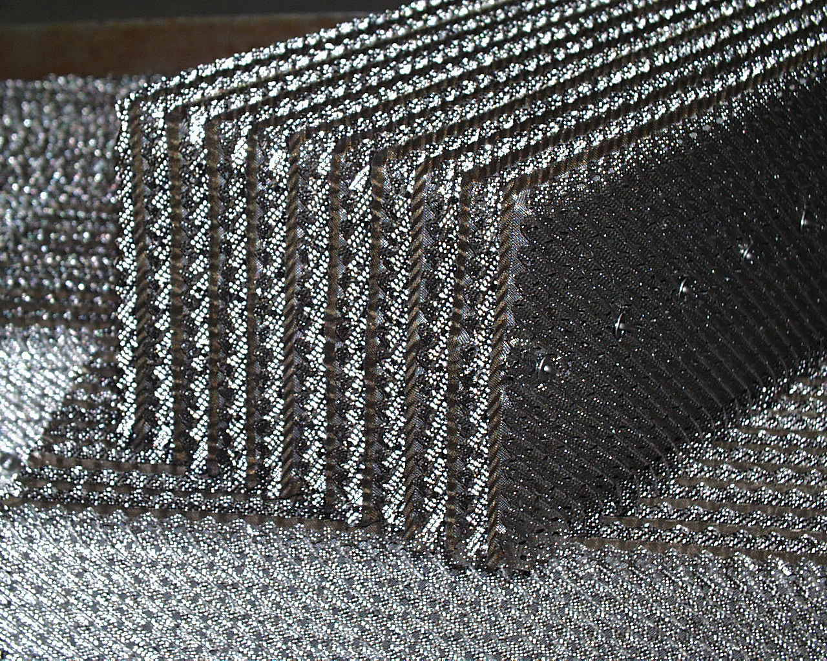
Development of Catalytic Internals
Sulzer Katapak-S – catalyst sandwiched between corrugated sheets of wire gauze structured packing

Slide 13
Reactive Distillation Applications in 2Ks?
CDTECH has licensed over 146 commerical scale processes
  69 in ethers (MTBE, TAME, ETBE)
  50 in hydrodesulfurization
  3 in isobutylene production from C4 stream
  3 in ethyl benzene
Sulzer claims licenses in:
  Ethyl, butyl and methyl acetate
  Hydrolysis of methyl acetate
  Synthesis of methylal
  Removal of methanol from formaldehyde
  Fatty acid esters

Slide 14
Conceptual Design Methods
Hoyme 2004: initial screening
Doherty and Malone: feasibility, design
Hauan, Lee, Westerberg: phenomenon based approach, graphical techniques
Optimization methods (several)
Subawalla and Fair (Heuristics to go from concept to column)

Slide 15
Useful references
Good Review Papers
  Taylor, R., Krishna, R. (2000). “Review: Modeling reactive distillation.” Chem. Eng. Sci., 55, 5183–5229.
  Malone, M. F., Doherty, M. F. (2000). “Reactive distillation”. I & EC Res. , 39, 3953–3957.
  Almeida-Rivera, C.P. et al. (2004) “Designing reactive distillation processes: present and future” Comp. & Chem. Eng. 28 1997-2020
Books
  Reactive Distillation: Status and Future Directions, Sundmacher, K. and Kienle, A. Editors, Wiley, 2003
  Reactive Distillation Design and Control, Luyben W.L. and Yu C., Wiley, 2008

Slide 16
RD Configurations (Hoyme, 2004)

Slide 17
Example (Hoyme, 2004)
A, B
A, B
A, B
A,B
Region 1
A
B
C
A,B
A,B
C
C
C
Configuration II
Configuration I
Configuration III

Slide 18
Suggested column configurations
(Hoyme, 2004)
Column configurations for reactive systems with a light desired product
A↔C |  | A+B↔C |  | A↔C+D |  | A+B↔C+D
Region 2 C A | II, III | Region 3 C A B | II, III | Region 6 C D A | II, III RDS | Region 11 C D A B | I, II, III RDS
 |  |  |  |  |  | Region 9 C A D B | II, III
- |  | - |  | Region 3 C A D | I, II, III | Region 7 C A B D | I, II, III

Slide 19
Heuristics (Hoyme, 2004)
General
  A reactive distillation column of Configuration II is usually the best configuration for all A↔C+D and A+B↔C+D systems.
  The separation of the desired product and by-product is the primary factor limiting reactive distillation for A↔C+D and A+B↔C+D systems with a K_{eq} > 1.0.
  For a reactive distillation column to be economically feasible and have a reflux ratio < 5, the relative volatility of the by-product and product must be less than approximately 0.69 or greater than 1.45. (α_{DC} > 1.45 or α_{DC} < 0.69).
Single Feed vs. Double Feed Reactive Distillation Columns
  A double feed reactive distillation column is usually the best feed design for reactive systems where the reactant boiling points are far apart, α_{AB} > 4.0.
  A single feed reactive distillation column is usually the best feed design for reactive systems where the reactant boiling points are close together, 1.0 < α_{AB} < 1.2.

Slide 20
Doherty and Malone
Feasibility Tools
  Transformed compositions
  Residue Curve Maps (RCM)
  Find reactive azeotropes
Reaction equilibrium
  RCM
  Column Design
Kinetic regime
  Damköhler number
  Kinetic simulations of equilibrium designs

Slide 21
Hauan, Lee, Westerberg
Phenomenon based approach
Combination of reaction, separation, mixing vectors
Graphical techniques
Reaction difference point – define by stoichiometry
Critical composition region approach (Lee)

Slide 22
Optimization methods
Superstructure approach
Mixed Integer Non-Linear Programs (MINLP)
Minimize cost or maximize profit
Need feasible starting point
Difficult to generalize

Slide 23
From concept to column
Subawalla, H., & Fair, J. (1999). “Design guidelines for solid-catalyzed reactive distillation systems”. I & EC Res., 38 (10), 3696–3709
Heuristics
  Pre-reactor
  Diameter, reflux ratio, number of stages
  Placement of feed(s), reaction zone
  Catalyst volume / mass
Recommend rate-based simulation (Both VLE and reaction)

Slide 24
University of Massachusetts conceptual design methods
Developed by combined groups of Doherty and Malone
Chapter 10 of their textbook
  Conceptual Design of Distillation Systems, McGraw Hill, 2001
Fundamentals rely on non-reactive conceptual design methods
Methods were implemented in research software
  Mayflower: non-reactive distillation, extraction, extractive distillation
  Fortune: equilibrium and kinetic reactive distillation
Some of the following material from a short course developed by Doherty and Malone
Methyl acetate design example done by me at UMass. (only based on publicly available information)

Slide 25
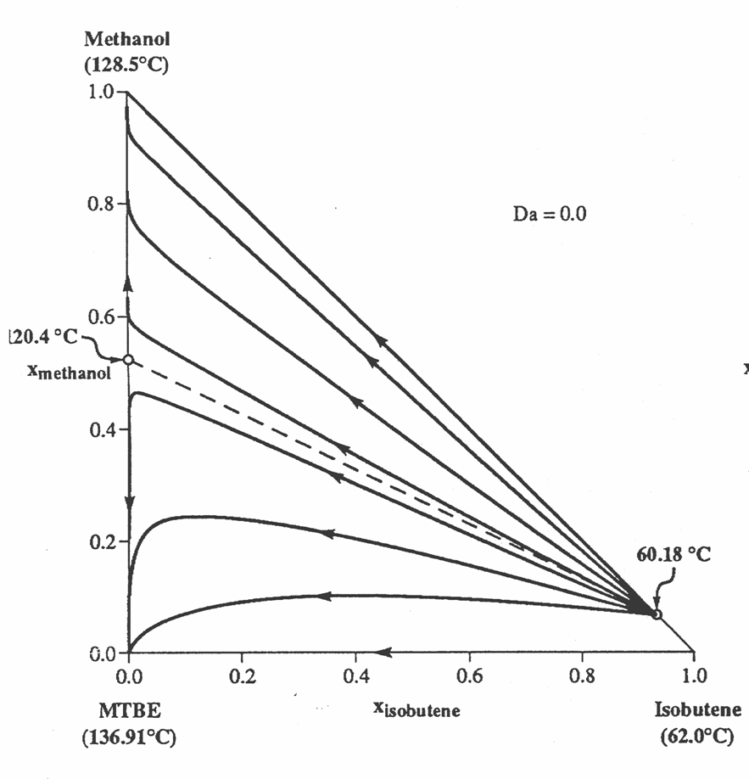
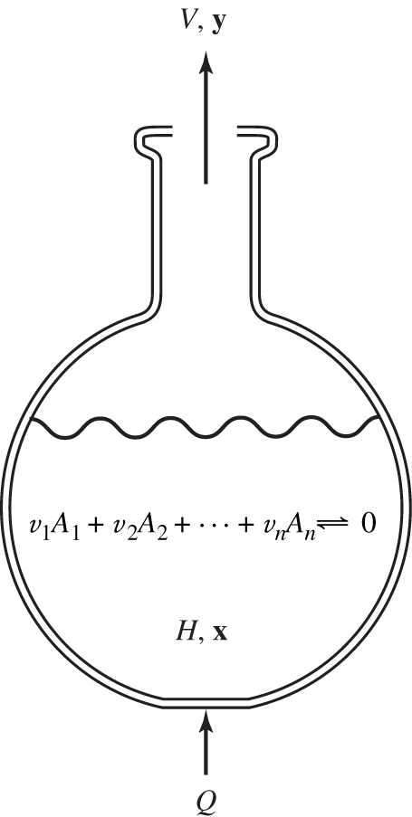
Residue Curve Maps
25
© 2008, M. F. Doherty & M. F. Malone

Slide 26
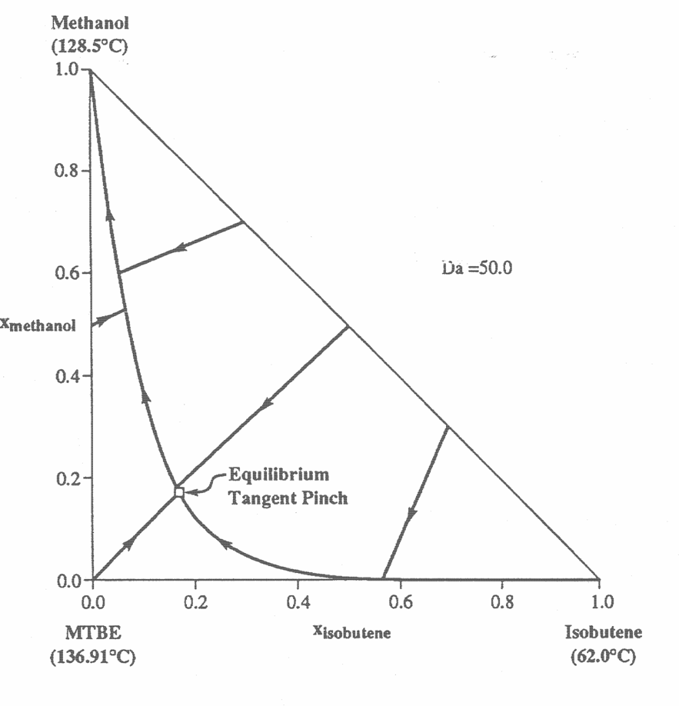
Residue Curve Maps – reaction!
26
© 2008, M. F. Doherty & M. F. Malone

Slide 27
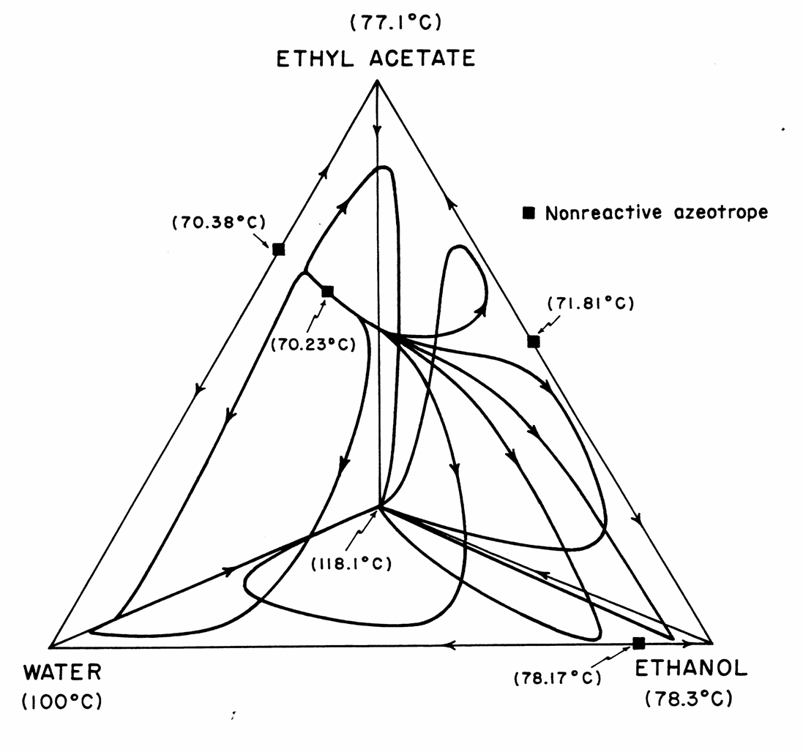
4 Component residue curves, no reaction
© 2008, M. F. Doherty & M. F. Malone

Slide 28
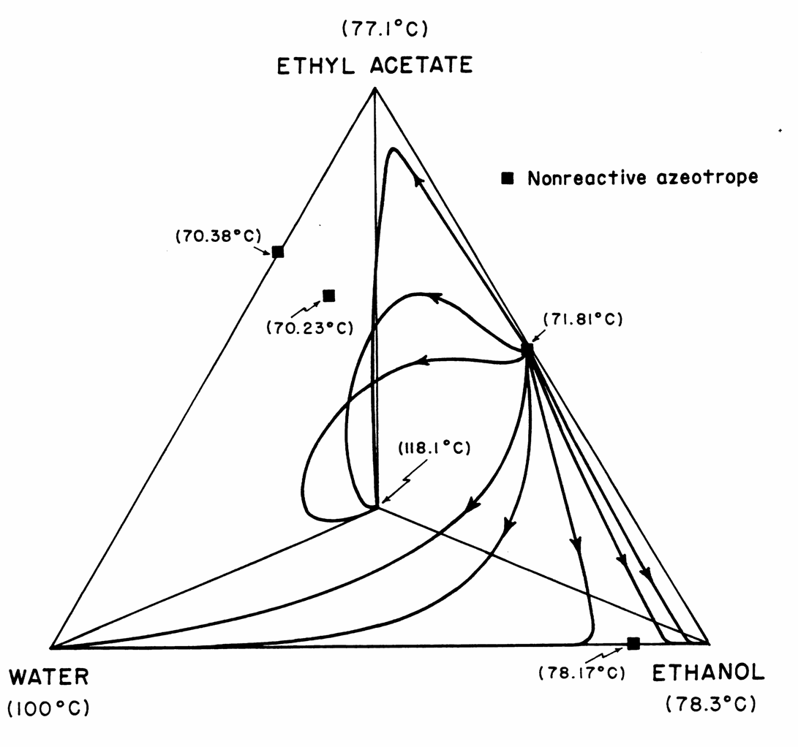
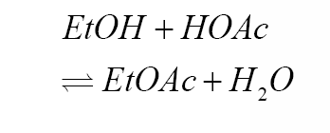
4 Component residue curves, equilibrium
© 2008, M. F. Doherty & M. F. Malone

Slide 29
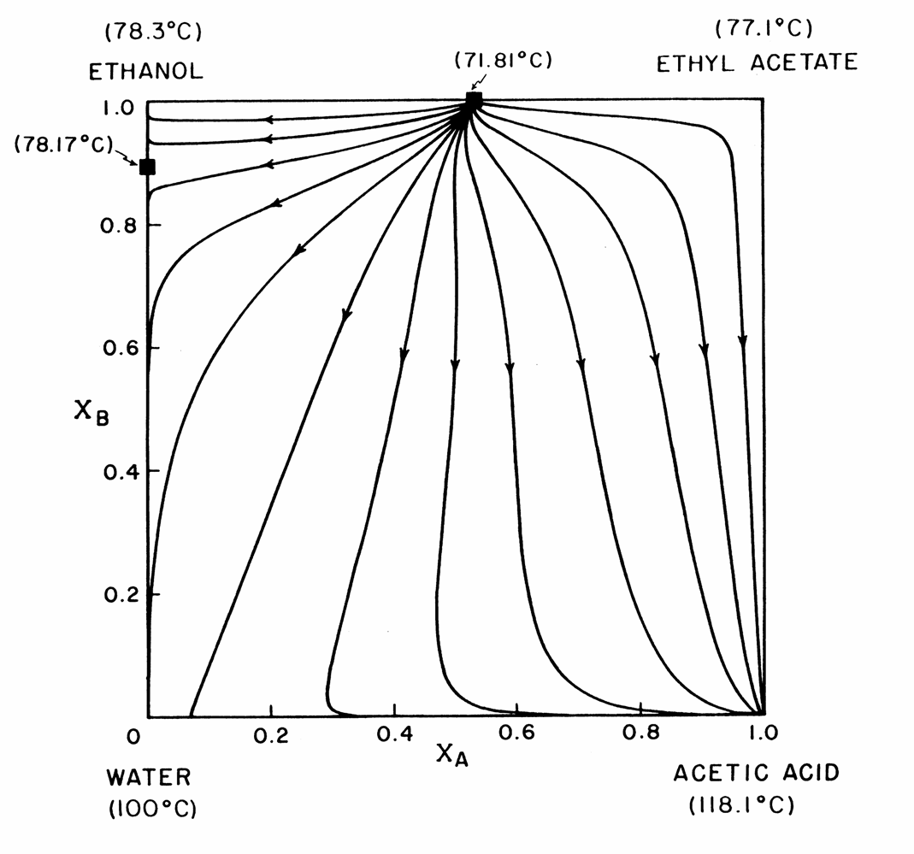
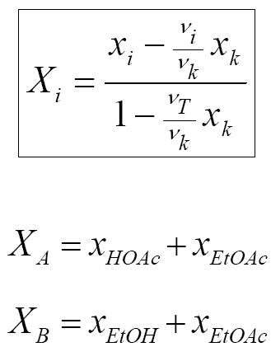
Transformed Variables
29
© 2008, M. F. Doherty & M. F. Malone

Slide 30
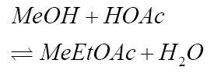
Residue Curves, Equilibrium
Methyl
Acetate
Methanol
Azeotrope
64.7 ºC
53.5 ºC
57.1 ºC
1.0
0.8
0.6
X_{B}
0.4
0.2
0.0
0.0
0.2
0.4
0.6
0.8
1.0
Water
X_{A}
Acetic Acid
100 ºC
118.1 ºC
© 2008, M. F. Doherty & M. F. Malone

Slide 31
Isopropyl Acetate RCM
P = 1 atm
NRTL & Dimer VLE
UNIFAC estimates for alcohol/acetate and acetate/acid
K_{eq}= 8.7 (Lee and Kou
Low-boiling quaternary reactive azeotrope predicted
Isopropanol
Isopropyl Acetate
(82.25 °C)
(79.06 °C)
(88.5 °C)
1
0.8
(78.23 °C)
(80.12 °C)
0.6
X_{B}
0.4
0.2
0
0
0.2
0.4
0.6
0.8
1
Water
X_{A}
Acetic Acid
(100.0 °C)
(117.79 °C)
© 2008, M. F. Doherty & M. F. Malone

Slide 32
Isopropyl Acetate – experimental confirmation
Isopropanol
Isopropyl Acetate
(82.25 °C)
(79.75 °C)
(88.5 °C)
1
0.8
(78.9 °C)
(80.12 °C)
0.6
X_{B}
0.4
0.2
0
0
0.2
0.4
0.6
0.8
1
Water
X_{A}
Acetic Acid
(100.0 °C)
(117.79 °C)
W. Song, R.S. Huss, M.F. Doherty, M.F. Malone, “Discovery of a Reactive Azeotrope” Nature, 388, August 7, 1997.
32

Slide 33
Methyl Acetate Equilibrium Designs
Methyl
Acetate
Methanol
Azeotrope
65 ºC
54 ºC
56 ºC
Two feeds, excess AcAcid, MeOAC product. (Barbosa & Doherty,88)
Single or two feed, get Azeo and Water products
Two feeds, stoichiometric amounts, get MeOAc and Water products (Huss et al, 97)
  39 trays, r = 1.7, s = 2.7
  Feeds tray 3, 36
  MeOAc 0.985 mole, 0.992 mass
  H₂0 0.985 mole, 0.959 mass
Water
Acetic Acid
100 ºC
118ºC
Notes:
Design 1: Example presented by Barbosa and Doherty, 1988. This column produces methyl acetate as a distillate, but uses an excess of acetic acid and therefore has a bottoms stream of water and acetic acid
Design 2. This is the conceptual starting point for the Eastman column. The common interpretation of the Eastman column is to react to the Methanol/Methyl acetate azeotrope and then put an extractive section on the top of the column to force the methanol down.
Design 3. This is an equilibrium version of the Eastman column. However, we find that the extractive section is a separation between methyl acetate and acetic acid. We realized this design was possible when doing a two-feed version of Design 2, and found that the middle trajectories reached the methyl acetate - acetic acid edge

Slide 34
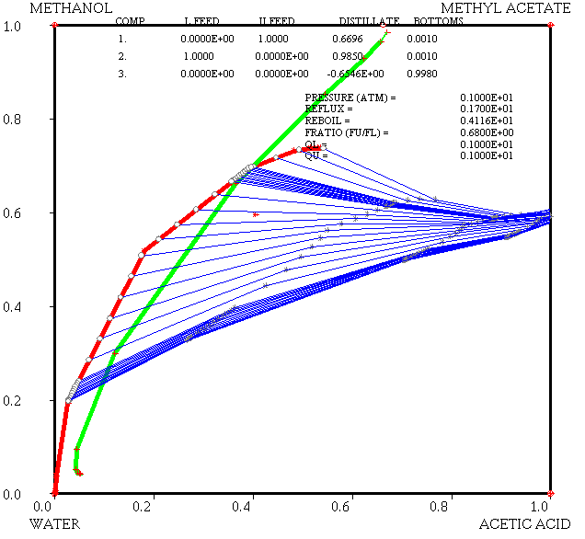
Methyl acetate design example: azeotrope

Slide 35
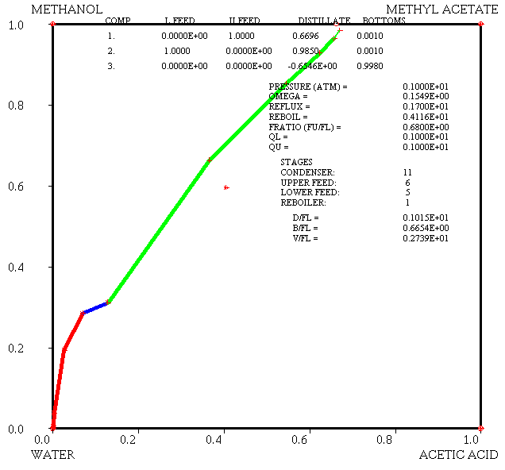
Methyl acetate design example: azeotrope

Slide 36
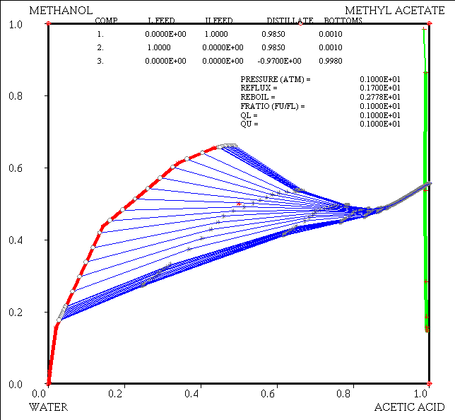
Methyl acetate design example: MeOAc

Slide 37
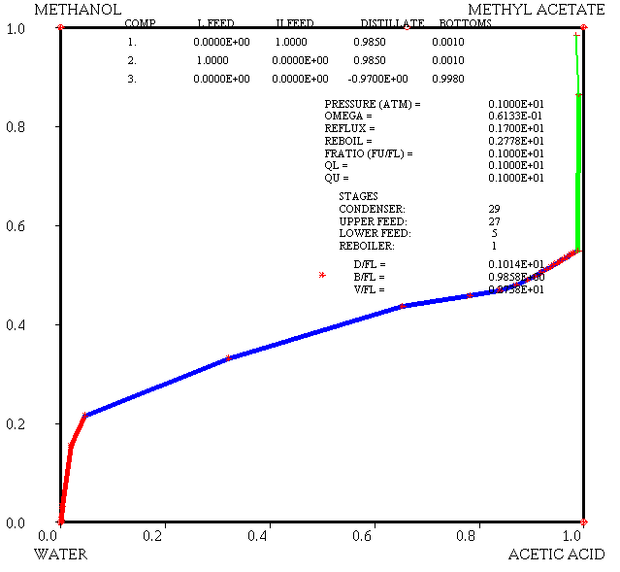
Methyl acetate design example: MeOAc

Slide 38
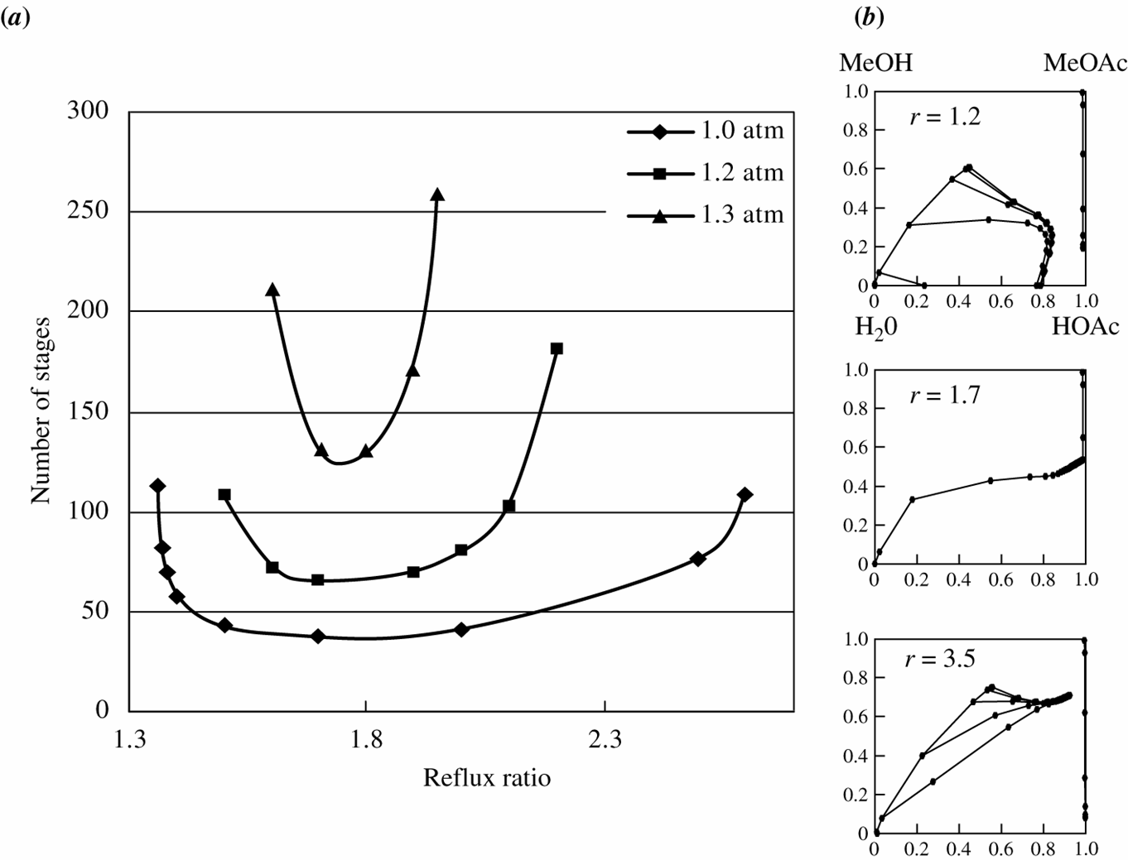
Effect of Reflux Ratio
38

Slide 39
Conclusions
Experimental work is important, even though I didn’t talk about it!
Many chemical processes are candidates for RD
Pros and cons to RD, but worth considering!
Heuristics and conceptual design methods can help you rule out RD
Experiments and detailed modeling can verify feasibility
Economic competitiveness determined on case-by-case basis

