Slide 1
Polymer Recycling – An Insider’s Perspective
Tom Pecorini
December 16, 2014

Slide 2
Tom Pecorini
Fellow in Polymers Technology Division
PhD from Lehigh University
Started at Eastman in 1992
Involved in many plastics development projects for SP
Eastman’s representative to the APR
Chairman of the ASTM Section D20.95 on the RICs

Slide 3
Recycling Overview
Definition of Recycling
Types of Recycling
Post Consumer - From Home to Bale
Plastics - From Bale to Pellet
Plastic Recycling Standards
Resin Identification Codes

Slide 4
Definition of Recycling
All materials are potentially recyclable, but not all materials are recycled
Recycling involves BOTH collecting a material, AND having an economic incentive to convert it into a product
Many factors limit both collection and economic incentive
Recycling is a fight against entropy!!
Apathy
Dispersion
Separation

Slide 5
Post Consumer Recycling
Uses the residential waste stream as a source of material
Must have >300lbs of common articles to make recycling worthwhile
Paper/cardboard are the moneymakers
Al, Fe, glass, PET and HDPE containers are break even
There is no economic incentive to recycle anything else
Deposit laws provide incentive
Don’t assume every composition within a given “resin” can be recycled together

Slide 6
Other Types of Recycling
Post industrial
Articles that have a controlled distribution system are also recycled, even at lower volumes
Examples include computers and bulk water bottles
Energy recovery
Plastics have high energy content
Energy recovery would dramatically reduce the amount of plastics diverted from the landfill
Europe practices energy recovery, US does not

Slide 7
Post Consumer - From Home to Bale
Source separation
Residents place different articles in different bins
Requires more effort by residents
Original form of domestic recycling, but becoming less common
Single stream
Residents place all recyclables in a common bin and MRFs separate articles
Greatly improves recycling rates due to simplicity
Dirty MRF
Both waste and recyclables are collected together
MRFs sort everything

Slide 8
Single Stream MRFs
These videos show how a single stream Material Recovery Facility (MRF) operates
https://www.youtube.com/watch?v=_GP3JuiX5BY
https://www.youtube.com/watch?v=osDD1TCBOJg
https://www.youtube.com/watch?v=BjzyvzLSzNA

Slide 9
Plastics - From Bale to Pellet
96% of all post consumer plastics recycled in NA are bottles made from PET and HDPE
Emerging interest in PET thermoforms and PP moldings
MRFs bale the bottles
Reclaimers convert the bales into pellets
Converters turn the pellets into products
Roughly 350 MRFs and 40 Reclaimers in US

Slide 10
US HDPE Recycling (2013)
End-Use | MM lbs | % of available | % of bottles sold
Total available | 3,300 | n/a | 100%
Total recycled | 1,100 | 100% | 33%
Non-Food Bottles | 390 | 35% | 12%
Pipe | 290 | 26% | 9%
Molded Parts | 290 | 26% | 9%
Film & Sheet | 50 | 5% | 1%
Net Export | 80 | 8% | 2%

Slide 11
US PET Recycling (2013)
End-Use | MM lbs | % of available | % of bottles sold
Total available | 5,700 | n/a | 100%
Total recycled | 1,800 | 100% | 31%
Fiber | 560 | 31% | 10%
Bottles | 480 | 27% | 8%
Sheet & Film | 310 | 17% | 5%
Strapping | 150 | 8% | 3%
Net Export | 300 | 17% | 5%

Slide 12
Contamination in Plastics Recycling
Contamination reduces the value of a recycled product
Sources of contamination
Food products
Look-alike bottles
Labels, handles, etc.
The tolerance for contamination depends on the end-use
Most plastics are down-cycled, instead of re-cycled
It is extremely difficult to get the quality of PET PCR good enough to go back into PET bottles
Food contact, clear, pressurized, high barrier, etc

Slide 13
HDPE Process
Reclaimer
MRF
Grind
Flake Wash
Sink/Float
Color Sort
Pelletize
Converters

Slide 14
PET Process
Reclaimer
MRF
Full Bottle Wash
Grind
Separate
Color
Metal
PVC
Flake Wash
Sink/Float
Pelletize
Converters

Slide 15
Plastics Recycling Standards
Many organizations post documents and standards to help people understand the impact of their designs and innovations on the recycling stream as well as to show the benefits of recycling plastics
Association of Post Consumer Plastics Recycling (APR)
National Assn. for PET Container Resources (NAPCOR)
American Chemical Council (ACC)
Society of the Plastics Industry (SPI)
Sustainable Packaging Coalition (SPC)

Slide 16
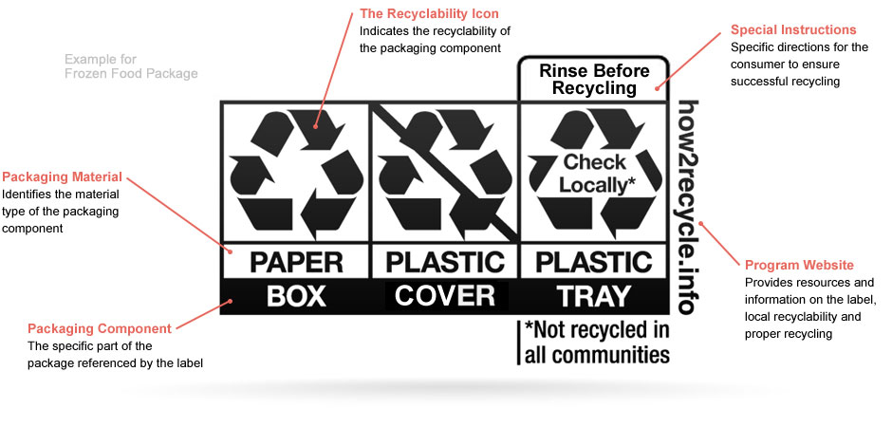
SPC Label for Recovery

Slide 17
Resin Identification Codes
In 1988, the only plastic articles being collected and recycled in the US were PET soda bottles and HDPE milk jugs
It was assumed that other resins would be recycled if only they could be properly identified in the waste stream
Thus, SPI developed the RIC system to identify the six most common packaging resins found in the municipal waste stream
The RICs are being updated by ASTM, at SPI’s request
ASTM D7611 is the Standard

Slide 18
Resin Identification Code Facts
RICs are NOT recycling codes
NOT all articles with an RIC are collected for recycling
NOT all articles with a given RIC are recycled - many compositions within a given RIC are not compatible with each other
The RICs were NOT originally intended for use by the general public - the chasing arrows on an RIC were merely intended to help sorters on a sorting line identify the resin
“7” does NOT mean contains BPA or other dangerous chemicals

Slide 19
Changes to D7611
Convert the Chasing Arrows into Triangles
Add “sub-codes” to improve identification
1-6
7
Become adopted by the states

Slide 20
Questions?

