Slide 1

An Overview of Pressure Relief Devices
Jennifer F. Mize, PE
Eastman Chemical Company
Process Safety Services, TNO Plant Protection
September 16, 2014

Slide 2
Agenda
Why are relief systems important?
Types of vessels / allowable overpressure
Types of relief devices
  Relief valves
  Rupture disks
  Conservation vents
When is a relief evaluation required?

Slide 3
Why are relief systems important?
Relief systems are often the last line of defense against a serious overpressure incident
While they are technically classified as an active safety instrumented function (SIF), they generally do not give active feedback on their status, as they are standby devices.
  Note: Emergency relief systems should NEVER be used for routine pressure control
They are generally a single device that is intended to protect against multiple potential overpressure scenarios
Therefore, proper design, specification, installation, maintenance, and testing are critical if relief systems are to fulfill their proper place in the overall safety layers of protection.

Slide 4
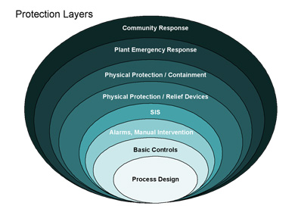

Slide 5
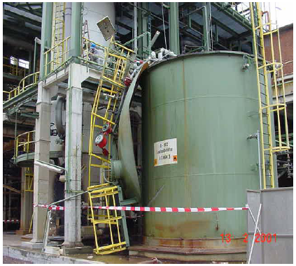
Notes:
The tank roof ruptured due to high pressure when materials were transferred into the vessel. The flame arrester in the pressure / vacuum relief system was plugged. The pressure control system, which would have allowed venting to another vessel, was out of service.

Slide 6
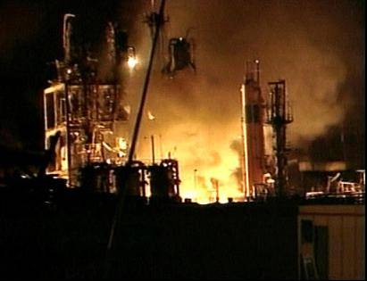
Notes:
A defective, high pressure, steam boiler ruptured. The resulting explosion damaged nearby vessels containing flammables. The release of flammables resulted in further fires and explosions.
23 workers were killed. 4 were injured. $800,000,000 (U.S.) estimated property damage.

Slide 7
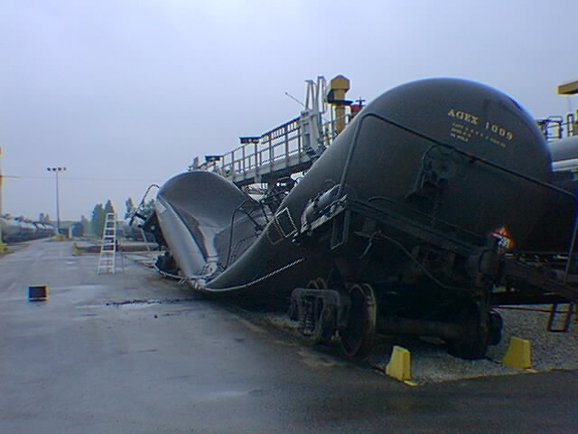
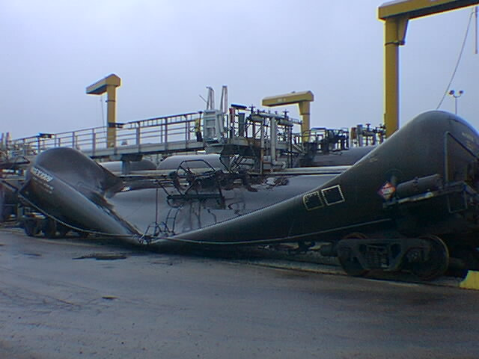
Undervacuum
This damage occurred due to pumping out with a
closed vent.
Notes:
If a vessel is not designed for vacuum, it will likely be damaged if placed under vacuum. Low pressure storage tanks and railcars are particularly susceptible to damage. Not only is the equipment damaged but the contents may also be released.

Slide 8
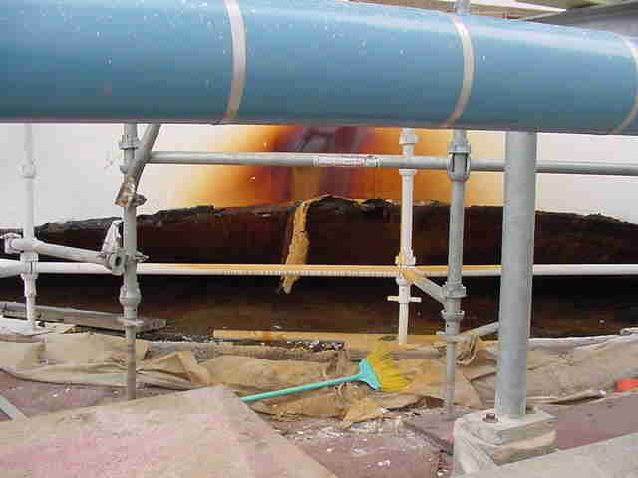
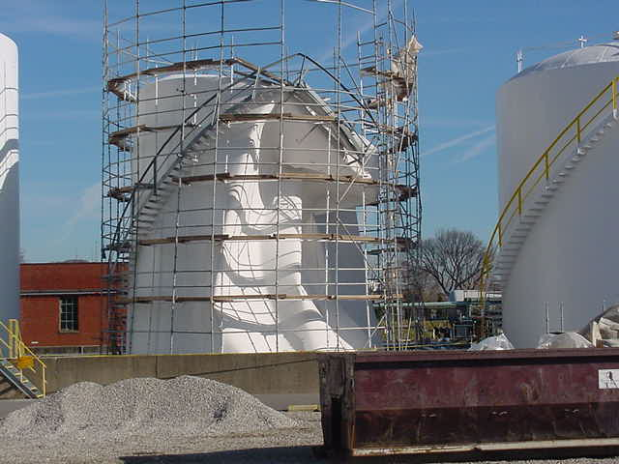
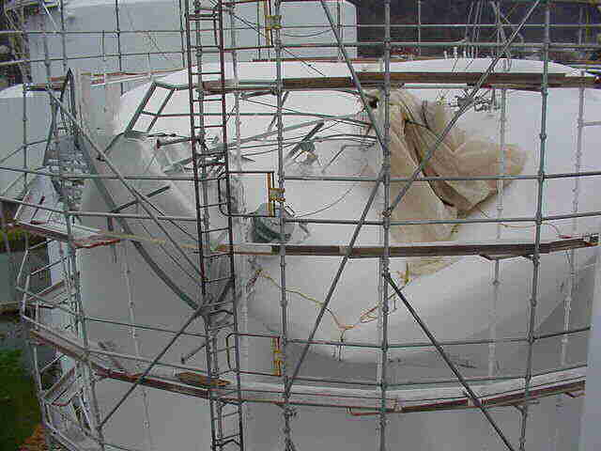
This damage occurred due to pumping out with the conservation vent covered by plastic.

Slide 9
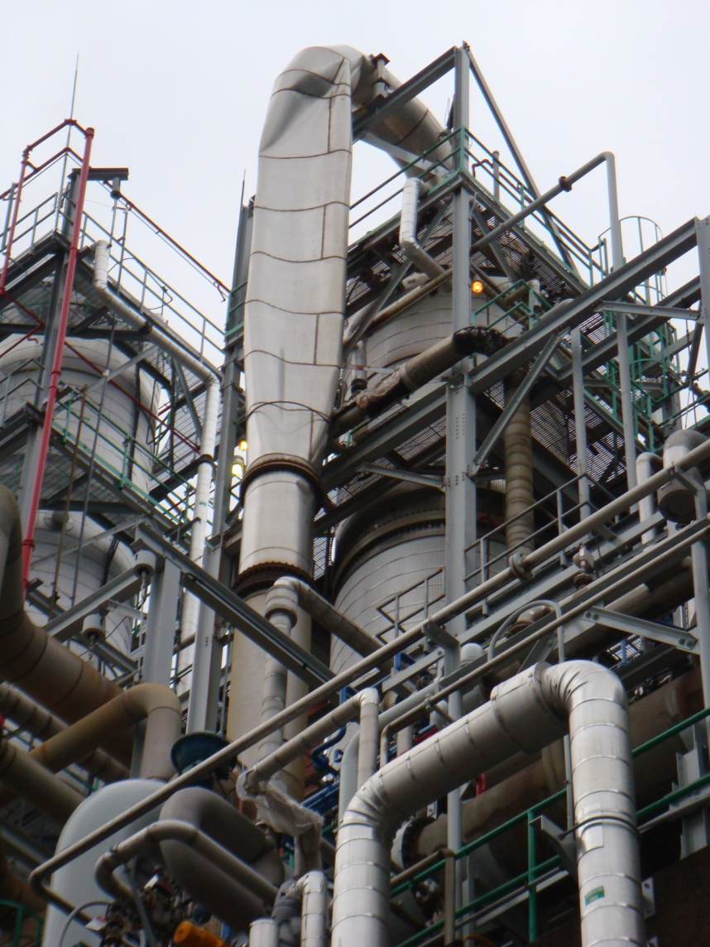
Significant vacuum can result from collapsing vapors when an ESD is initiated on a distillation column.

Slide 10
Types of vessels / allowable overpressure
Types of vessels
  MAWP < 2.5 psig API 650
  2.5 psig < MAWP < 15 psig API 620
  MAWP > 15 psig ASME
Allowable overpressure
  API 650: 1 x MAWP (No allowable overpressure)
  API 620: 1.1 x MAWP, 1.2 x MAWP for fire case
  ASME: 1.1 x MAWP or +3 psig, whichever is greater, 1.21 x MAWP for fire case
There is no allowable undervacuum for any vessel.
Other countries also have other design codes.
All vessels must have documented pressure and vacuum ratings before a relief evaluation can be done.

Slide 11
Determining appropriate set pressure
Set pressure for relief valves and rupture discs is most often equal to the vessel MAWP unless limited by connected equipment.
Set pressure for conservation vents must be below the MAWP for API 650 vessels.
  Conventional conservation vents require 100% overpressure to be fully open.
  The minimum overpressure for proper performance of a conventional conservation vent is 20%.
Set vacuum for conservation vents must be below the MAWV.
P_{F} = Flowing pressure (MAWP) P_{S} = Set pressure
Notes:
A low set pressure may be beneficial for relief systems designed to relieve a runaway reaction.

Slide 12
Relief Devices
Three major categories
  Relief valves
  Rupture disks
  Conservation/pressure/vacuum vents
ASME code certification / UV and/or UD stamp
  Relief devices with set pressures above 15 psig are certified by the National Board (relief valves and rupture disks)
  Certifications are recorded in the Redbook (NB18)
  NB18 is updated once a month
  http://www.nationalboard.org/SiteDocuments/NB18/PDFs/NB18ToC.pdf

Slide 13
Relief valves
Automatically reclose when pressure excursion ends
Available set pressures ranging from 15 psig to 6000 psig
ASME “safety valves” for steam, gas, or vapor service exhibit quick-opening “pop” action and achieve full capacity at 10% overpressure
ASME liquid service “relief valves” are of modulating design (begin opening at set pressure and open further as pressure increases)
“Safety relief valves” can function as either a safety (pop) valve or as a modulating liquid relief valve, depending on the application

Slide 14
Conventional Safety Relief Valve
(From API Standard 520, Part I, Figure 2)

Slide 15
Balanced Bellows Relief Valve
(From API Standard 520, Part I, Figure 4)

Slide 16
Pop-Action Pilot Operated Relief Valve
(From API Standard 520, Part I, Figure 6)

Slide 17
Relief valves
All spring-loaded valves have some hysteresis in their opening and closing characteristics.
Blowdown
  Point at which the valve completely reseats
  Typically 93% of set pressure (7% blowdown)
  Manually adjusted, not tested
Simmer
  Bubbles first pass around the edge of the disc, but the disc has not yet risen off the seat.
  Occurs between 97% and 103% of the valve set pressure

Slide 18
Relief valves
Chatter
  Chattering is the rapid opening and slamming shut of a disc on the seat. Chatter can quickly damage or destroy the valve internals.
  If the inlet pressure drop exceeds the blowdown point, chatter can occur.
  ASME Section VIII guidance (Appendix M, non-mandatory) and API Standard 521 recommend limiting inlet pressure drop to 3% of the set pressure.
  Chatter is only experienced with compressible flow.

Slide 19
Relief valve certification
Relief valve certification testing is conducted using air, steam, and/or water
Relief valves can be certified for one, two, or all three media
Relief valves certified for gas/vapor and/or steam may provide a coefficient of discharge for non-code liquid service, usually at 25% overpressure
Relief valves certified for liquid (water) may use a liquid trim that is not certified for gas/vapor and/or steam
For ASME Code vessels, the relief valve must be certified for all flow types that could pass through the valve during a relief event

Slide 20
Rupture disks
Non-reclosing pressure relief devices
Can be used alone or in combination with a relief valve
Used alone when it is desirable to keep the relief line open after the disc has ruptured
OP/BP ratio very important
  OP – operating pressure
  BP – burst pressure
Types of rupture discs
  Direct acting (forward)
  Reverse acting
  Flat discs (non-metallic)
Newer disk designs can achieve low burst pressures in small size disks (< 15 psig)
Should not be used in locations where water hammer can be experienced

Slide 21
Conventional (Tension Type) Rupture Disks
(From API Standard 520, Part I, Figure 11)
Notes:
OP/BP limited to 70% May require vacuum support Non-scored designs and composite disks can fragment (scoring can help prevent fragmentation and increase OP/BP to 85%)

Slide 22
Reverse Acting Rupture Disks
(From API Standard 520, Part I, Figure 15)
Knife blade designs should be used with extreme caution
(knife blades used to burst the disc instead of scoring)
Notes:
Can be FV rated OP/BP up to 95% More tolerant of process pressure fluctuation (cycling)
Flat disks: Designed to burst at a given set pressure in either direction OP/BP usually around 50% Can burst at much lower pressures than domed disks
Can be made of almost any metal Non-metallic disks usually made of graphite or graphite composites (should NOT be used in combination with a relief valve due to fragmentation)

Slide 23
Rupture disks
Manufacturing range
  The manufacturing range is the range of pressure within which the average burst pressure of test disks must fall to be deemed acceptable.
  The disk will be stamped at the average burst pressure of all test disks.
Burst tolerance
  Burst tolerance is the maximum variation from the stamped burst pressure.
  Per ASME Code, Section VIII, Division 1, UG-127 (a)(1), the burst tolerance shall not exceed ± 2 psig for burst pressures ≤ 40 psig or ± 5% for burst pressures > 40 psig.

Slide 24
Rupture disks
Using manufacturing range and burst tolerance
  Requested burst pressure: 100 psig
  Burst pressure is typically equal to the vessel MAWP.
Direct acting rupture disks
  Manufacturing range: +10% to -5%
  Stamped burst pressure range: 95 psig to 110 psig
  Burst tolerance: ±5%
  Minimum and maximum actual burst pressure: 90.25 psig (min) / 115.5 psig (max)
Reverse acting rupture disks
  Manufacturing range: 0%
  Stamped burst pressure: 100 psig
  Burst tolerance: ±5%
  Maximum and minimum actual burst pressure: 95 psig (min) / 105 psig (max)

Slide 25
Rupture disk burst temperature
For typical installations, specify the burst temperature equal to the normal operating temperature.
If the disk is not located directly on the vessel, the actual temperature at the disk can be much closer to ambient temperatures than to the normal operating temperature.
The burst pressure increases as the temperature decreases.
This is a significant concern for rupture disks specified with elevated burst temperatures (>150 °F), since the increase in burst pressure due to lower temperature at the disk can exceed the typical overpressure allowances for a pressure vessel during a relief event.

Slide 26
Rupture disk / relief valve combinations
Why are rupture discs installed in series with relief valves?
  Protect an expensive spring-loaded device from a corrosive environment
  Give absolute isolation when handling extremely toxic chemicals
  Give absolute isolation when handling flammable gases
  Protect the relatively complex parts of a spring-loaded device from reactive monomers which could cause plugging
  Relieve slurries which may plug spring loaded devices
  Environmental concerns

Slide 27
Rupture disk / relief valve combinations
Space between the devices is susceptible to pressure buildup due to small leak in disk
If pressure is high enough, effective burst pressure of the disk can exceed allowable accumulation
Methods for detection of pressure buildup
  Pressure switch/transmitter with remote indication and local manual bleed
  Excess flow valves may be included to vent very small leaks
  Excess flow valves and manual bleeds must be vented to safe location, such as the relief valve discharge line

Slide 28
Conservation vents
Reclosing devices used for low pressure applications (settings from 0.5 oz/in² to 15 psig)
Can be used for emergency pressure relief (typically manway relief devices), vacuum relief, and/or normal breathing
Typically used on large, low pressure storage tanks and other low pressure vessels (< 15 psig)
  API 650
  API 620

Slide 29
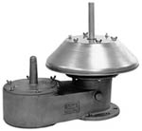
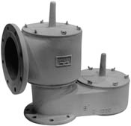
Conservation vents
Weight-loaded pressure / vacuum vents
End-of-line
Pipeaway

Slide 30
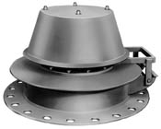
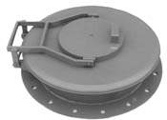
Conservation vents
Manway relief devices
Pressure / vacuum manway relief device - hinged
Pressure manway relief device - hinged

Slide 31
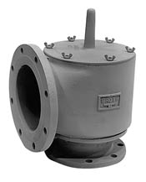
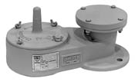
Conservation vents
Pipeaway weighted pressure vent
Weighted vacuum vent - top mount

Slide 32
Conservation vents
Design considerations:
  Do not meet ASME Code requirements
  Conventional designs require 80-100% overpressure to achieve full opening.
  Special designs can achieve full opening at 10% overpressure.
  Designed for gas or vapor flow ONLY
  Selected based on manufacturer’s capacity curves/tables
  Weighted designs are typically less expensive than spring-loaded designs.
  Spring-loaded designs are available for settings greater than 1 psig.

Slide 33
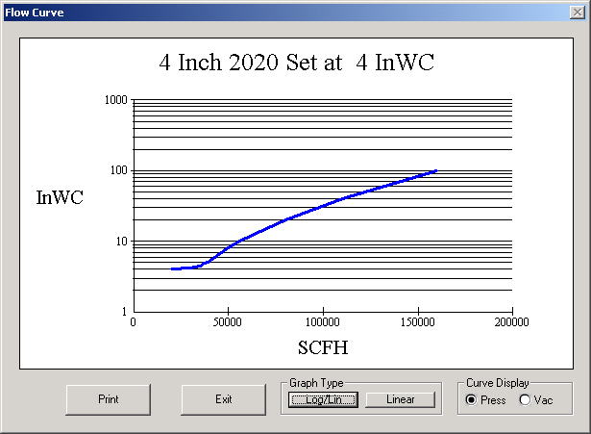
Tank MAWP
Set pressure
Pressure curve for 4" Varec 2020A conservation vent

Slide 34
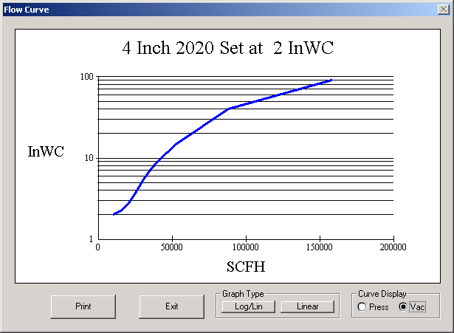
Tank MAWV (4" wc)
Set vacuum
Vacuum curve for 4" Varec 2020A conservation vent

Slide 35
When is a relief evaluation required?
All vessels should have a relief evaluation.
Update your relief documentation for:
  Relief path sizing for a new installation
  Replacement of an existing device or vessel
  PHA requirements (relief documentation is required Process Safety Information)
  Relief path piping modifications
  Change in the relief device setpoint
  Composition changes
  Introducing flammable solvents in an area, even if only a transfer line passing through

Slide 36
Update your relief documentation for:
  Change in pumping dynamics
    Increase in the speed (RPM) of a pump motor
    Increase in pump impeller diameter
    Decrease in supply pipe equivalent length
  Increase in utility temperature and/or supply pressure
  Changes in control valve or supply piping
  Decrease in condenser heat transfer area
  Increase in heater heat transfer area
  All vessels should have a relief evaluation.

