Slide 1

R&D tax credit presented for ETLS AICHE members

Slide 2

about our speaker
Extensive financial background including service in the specialty tax, commercial banking and insurance industries.
Consulting heavily with ETS clients since 2010, to identify, qualify and capture tax benefits.
Frequent speaker at industry events, with individual and firm- wide CEU and CPE sessions on a variety of topics.
Presenter | Geoffrey Kimmel
Business Development Director

Slide 3
about
engineered tax services

Slide 4
National | Basis | Results
Licensed Engineering Firm with 16 offices across the U.S.A. | Specializes in engineering studies for tax strategies | Tremendous Revenue generated for ETS partners
Achievements | Clients | Partners
ETS averages $24,500,00 in monthly refunds and tax benefits for architects, contractors and engineering firms involved in Public Building designs. | Clients include IKEA, JW Marriott, Boeing, Snowbird Ski Resort, Ford, BMW, Outback, top 100 CPA firms and Architectural firms | Tremendous Revenue generated for ETS partners

Slide 5
presentation
overview

Slide 6
overview
AICHE Relationship
Attributes of the Credit
The PATH Act of 2015
Qualifications of the Credit
State Credits
Industries that Qualify
Quantification of the Credit
Q&A

Slide 7
AICHE
relationship

Slide 8
AICHE relationship
We are not trying to replace your CPA or finance team, we collaborate with you and them
Educational Content
Create Awareness
Professional and Firm Development
A resource you can call on for advice/direction
Membership Benefit – IEEE Preferred Pricing

Slide 9
YES, you do R&D
If you are in the Chemical Engineering field, you already qualify for the R&D Tax Credit through your normal business activities

Slide 10
YES, you do R&D
If you are in the Chemical Engineering field, you already qualify for the R&D Tax Credit through your normal business activities

Slide 11
R&D credit in context
Credit is economic stimulus to keep innovation and creativity in the US and encourage job creation
Originally legislated by Congress in 1981 and extended 16 times
Became a permanent federal incentive in Dec 2015 within the PATH Act
40+ states have adopted R&D incentive-based programs no TN Credit
Multiple countries have adopted R&D incentive programs based on the US program
- Canada, China, India and others offer R&D tax incentives

Slide 12
attributes
of the credit

Slide 13
attributes of the credit
Regulations Finalized Dec 2003
- Easier for a broader array of companies to qualify their activities as R&D
- Greater flexibility in satisfying certain record keeping requirements
Unused credits carry back 1 year, and then carry forward 20 years
Opportunity to capture credits from closed tax years for companies coming out of NOL or AMT positions
Shareholder’s utilization limited to income from business generating the credits (e.g., W-2 income, K-1 pass thru)

Slide 14
the PATH act
of 2015

Slide 15
the PATH act of 2015
Finally made permanent!!!
Beginning in 2016, AMT (Alternative Minimum Tax) turnoff for Eligible Small Businesses
- Under $50M in gross receipts (prior 3-year average)
- Privately held
- Very significant especially for flow-thru entities whose owners have been in or close to AMT
- AMT turnoff rule was also in place for 2010

Slide 16
the PATH act of 2015
Beginning in 2016, certain “Startup Companies” will be able to use R&D credits to offset federal payroll taxes (capped at $250K per year)
- Under $5M in gross receipts and can have no gross receipts in any prior to the 5-year period ending with the current taxable year
- Election allowed for up to 5 years
- Allowed in first calendar quarter which begins after the date the return is filed for respective year
    Applies to the employer’s share of FICA tax

Slide 17
qualification
of the credit

Slide 18
qualification of the credit
In 2004, regulations were finalized that significantly increased the types of activities that qualify for the credit.
“Discovery Test” was replaced with the “Four-Part Test”
Requirement changed from “new to the industry” to “new to the company”
Lots of self-censoring still occurs
- Seems too good to be true, its not lab coats and clip boards

Slide 19
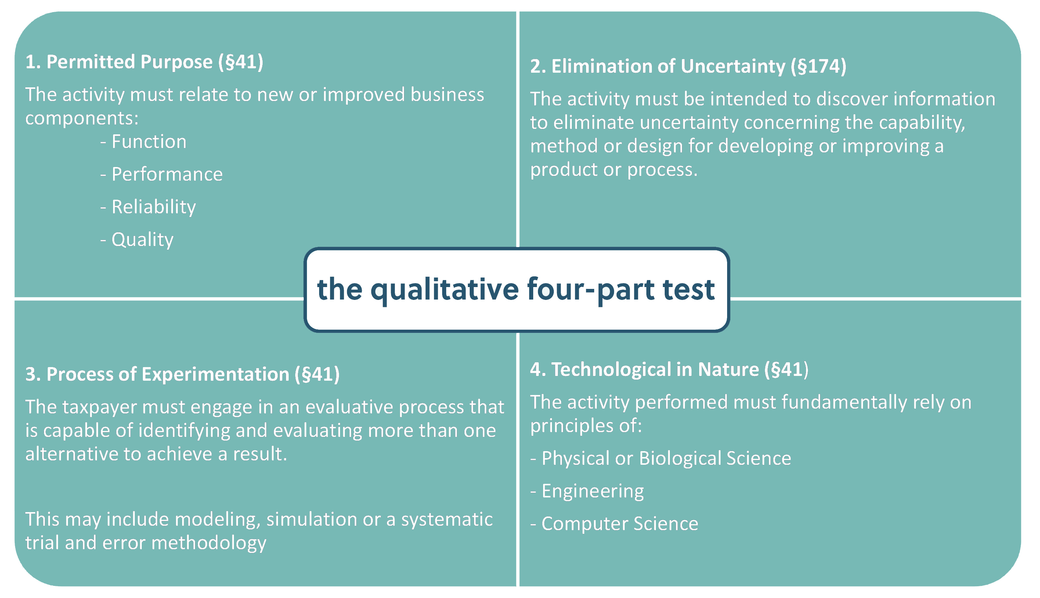
do your research & development activities qualify?

Slide 20
qualification of the credit
New or Improved Business Component (the permitted purpose test)
- Product, process, technique, invention, formula or software
- Attempt to improve
- Performance
- Functionality
- Reliability
- Quality
- Taxpayer does not need to succeed to claim the credit

Slide 21
qualification of the credit
Technological in Nature
- The process of experimentation must rely on principles of the physical or biological sciences, engineering or computer science.
- Taxpayer may rely on existing technologies and principles
- The research cannot be in the soft sciences, such as economics, psychology, management sciences, etc.

Slide 22
qualification of the credit
Elimination of Uncertainty
- Uncertainty exists if the taxpayer is uncertain:
- (1) if it can develop the business component it want to develop, or
- (2) how to develop the business component it wants to develop, or
- (3) of the appropriate design of the business component it wants to develop.

Slide 23
qualification of the credit
Process of Experimentation
- Must involve a process of evaluating alternatives designed to achieve a result in which the means of achieving that result were uncertain at the outset.
- Taxpayer must engage in a process of evaluating and testing different alternatives designed to eliminate the uncertainty about the development of the business component, though, for example, modeling, simulation, or systematic trial and error.

Slide 24

YES, you do qualify
Related to a new or improved business function, performance, reliability or quality
Technological in nature – chemical engineering is technological
Does it eliminate uncertainty of capability, method or design
Is there a process of experimentation evaluating alternatives
There is little doubt that many of your normal activities will pass The Four-Part Test and qualify as R&D expenses.

Slide 25
qualification of the credit
Other Requirements
- Research can not be funded time and materials vs fixed fee
- Taxpayer must retain substantial rights to research
- Activities must be conducted within the United States and its territories
Excluded Activities
- Research after commercial production
- Reverse engineering
- Qualify control
- You do not own the IP

Slide 26
quantification
of the credit

Slide 27
quantification of the credit
Eligible Costs
- Wages
- Form W-2, Partnership Earnings subject to Self Employment Tax, Schedule C
- Excludes 401(k) & benefits
- Supplies
- Cost to fabricate prototypes / items consumed in R&D process
- 65% of Contract Research
- Fees paid to outside consultants / engineers / software developers

Slide 28
quantification of the credit
Wages
- Qualified wages are W-2 wages
- Includes taxable fringe benefits, as well as:
- vacation,
- sick pay,
- bonuses, and
- taxable stock options.
- Substantially All Rule
- If 80% or more of an employee’s time is devoted to qualified research activities, then 100% of the employee’s wages may be included in the research credit calculation.

Slide 29
quantification of the credit
Wages for Qualified Services
- Wages paid to employees engaged in qualified research, direct supervision, and direct support of qualified research activities are eligible for the credit.
- Indirect activities that qualify must directly benefit the research activities. For example,
- direct supervision of research engineers;
- typing lab reports;
- technician performing validation testing;
or
- machinist machining prototype parts.

Slide 30
quantification of the credit
Supplies
- Supplies are tangible personal property other than
- land or improvements to land, and
- property of a character subject to the allowance for depreciation
- Examples can include:
- general supplies (i.e., pens, paper, etc.),
- design and construction of prototypes
and
- extraordinary utilities.
- TG Missouri Corp. Case
- cost of depreciable property (molds)
if retain possession but not title

Slide 31
quantification of the credit
Contract Research Expenditures
- 65% of amounts paid to anyone (other than an employee) for qualified research or services (75% if payments are made to a research consortium)
- Contract research must be performed under an agreement that:
- is entered into prior to the performance of qualified research,
- provides that research be performed on behalf of the taxpayer,
- requires the taxpayer to bear the risk of the expense if the research is not successful.

Slide 32
Some example typical qualifying activities
While qualified activities differ by discipline . . . . . . . .
New and improved products, designs, compounds, equipment or manufacturing processes
Creation and testing of prototypes
General trial and error experimentation
Experimentation and testing new materials, concepts, materials, tools or procedures
New and improved methods to recover and reuse products or substances
Development of more efficient processes or technologies
Development of innovative and improved systems
New or improved designs that optimize material, energy or water usage
Development of unique designs, material selection, techniques and processes

Slide 33
software engineering
– qualified research expense (QRE) examples
Designing and developing structural software
Programming software source code
Establishing electronic interfaces and functional relationships between software modules
Conducting requirements, domain, software elements or scope analysis of a new functional software enhancement
Evaluating and establishing functional specifications
Conducting unit, integration, functional performance and regression testing
Compiling and testing source code
Developing new or improved technologies

Slide 34
quantification of the credit
What’s in it for me

Slide 35
general, not absolute, target sizes
1 or more employees
$250,000 or more in annual wage and 1099 expense
S Corps, LLCs, Partnerships – pass throughs
C Corps – retain earnings

Slide 36
assessment approach
Client / CPA discussion
Overview Credit
Determine Structure Type
Review Typical Activities
Client Projections of Qualified Research Expenses
Engagement Letter
- Contingent based fee structure
- Small retainer
- Balance upon delivery of 6765
- Technical report

Slide 37
quantification of the credit
Conservatively, 33% of your expenses will be QREs; likely more
Rule of thumb - $7,000 to $8,000 net Federal Credit per $100,000 of QREs
State Credits as well – but not TN
Three year look back option

Slide 38
c corps | s corps, llcs
Different approaches and uses
C Corps – tax rates changed for Bonus Out – prepaids can max out, R&D can be a way to retain cash in the firm for contingencies with no tax cost
S Corps/LLCs – Carry back 1 year and carry forward 20 years, personal orientation, passes through to shareholders
Sales and M&A value

Slide 39
Q&A

Slide 40
thank you
Geoff Kimmel | 609.915.1607 | gkimmel@engineeredtaxservices.com
Mary Carter | 989.484.0537 | mcarter@engineeredtaxservices.com
AIChE.org/membership/benefits

