Slide 1
Soteria and Battery Safety

Slide 3
Every Battery Fire Hurts
80 ton battery fire in Chicago
Some fire statistics
Waste Management: 245 fires, $1.2 B/a
Energy Storage: 28 fires in Korea
Hybrid EVs: 3,474 fires per 100k sales
(EV is lower, but they have not been on the road as long.)
Air/airports: 350 fires
Vapes: 2,035 fire injuries
Consumer Products: 138 fire recalls
E-bike: battery fires double in NYC
Battery-related: 78,926 hospitalizations 2016 – 2020 in USA
Confidential

Slide 4
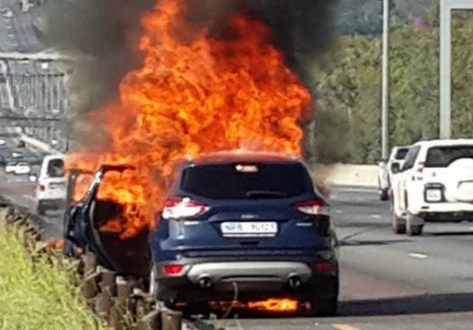
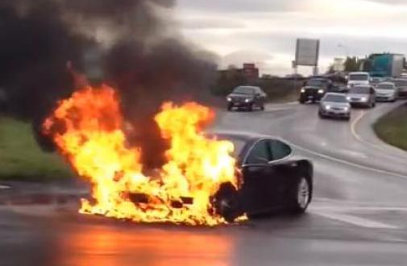
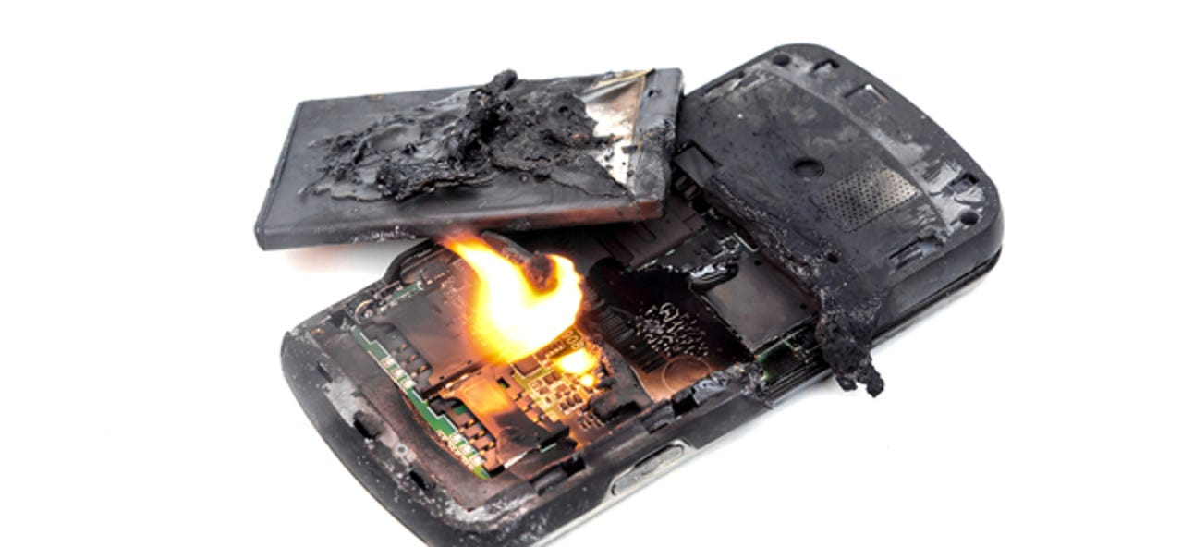
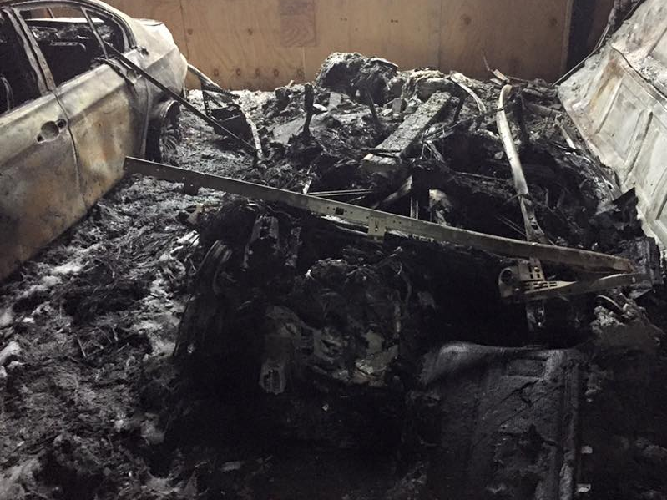
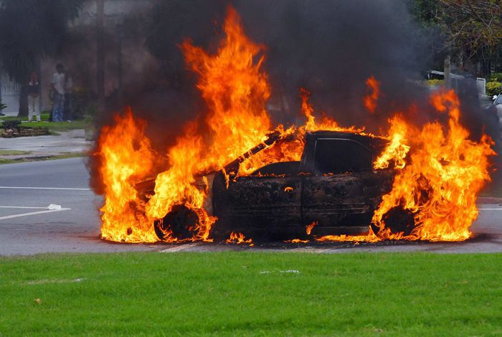
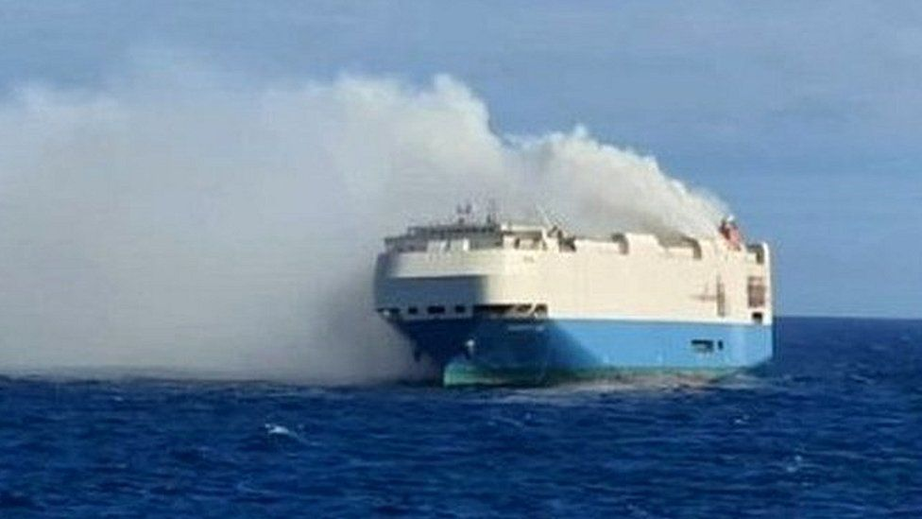
Lithium-ion fires: a drumbeat of public events
2014
2015
2020
2021
2021
Boeing 787 Grounded
~$1 billion loss
Amazon & Target stop selling hoverboards due to fires.
Ford recalls 20,000 vehicles, stops production & US launch
Tesla S Plaid production stopped for battery fires.
Chevrolet Bolt recall
$2 billion
2014
2016
2020
2021
2022
Tesla recall, adds titanium plate to all Model S, X
Samsung Galaxy Note 7 Recall. $17 billion lost revenue
BMW EV recall.
26,700 vehicles
Hyundai Kona EV recall
$900 million
EV container ship sinks
$440 million

Slide 5
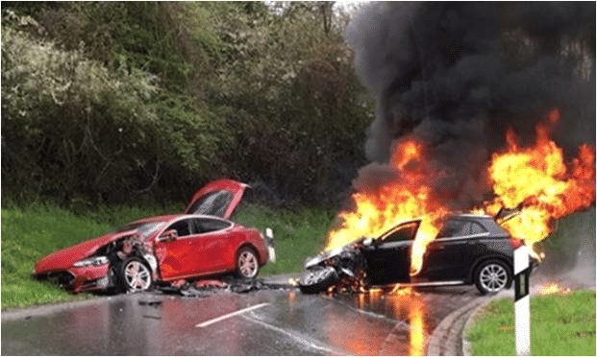
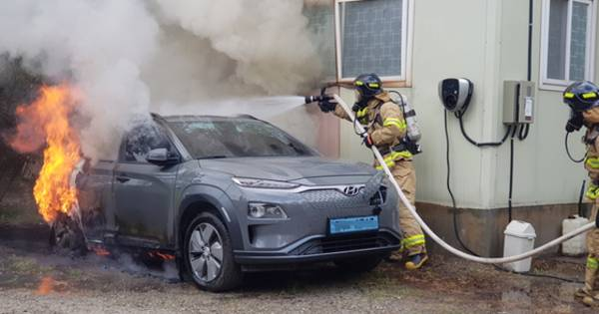
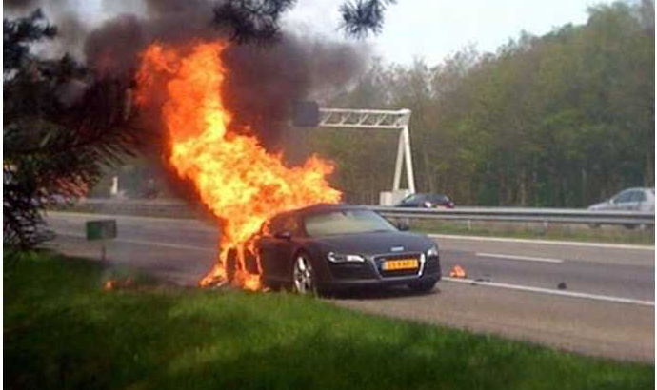
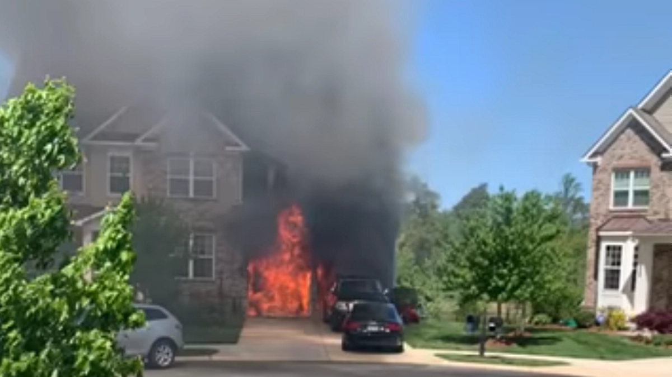
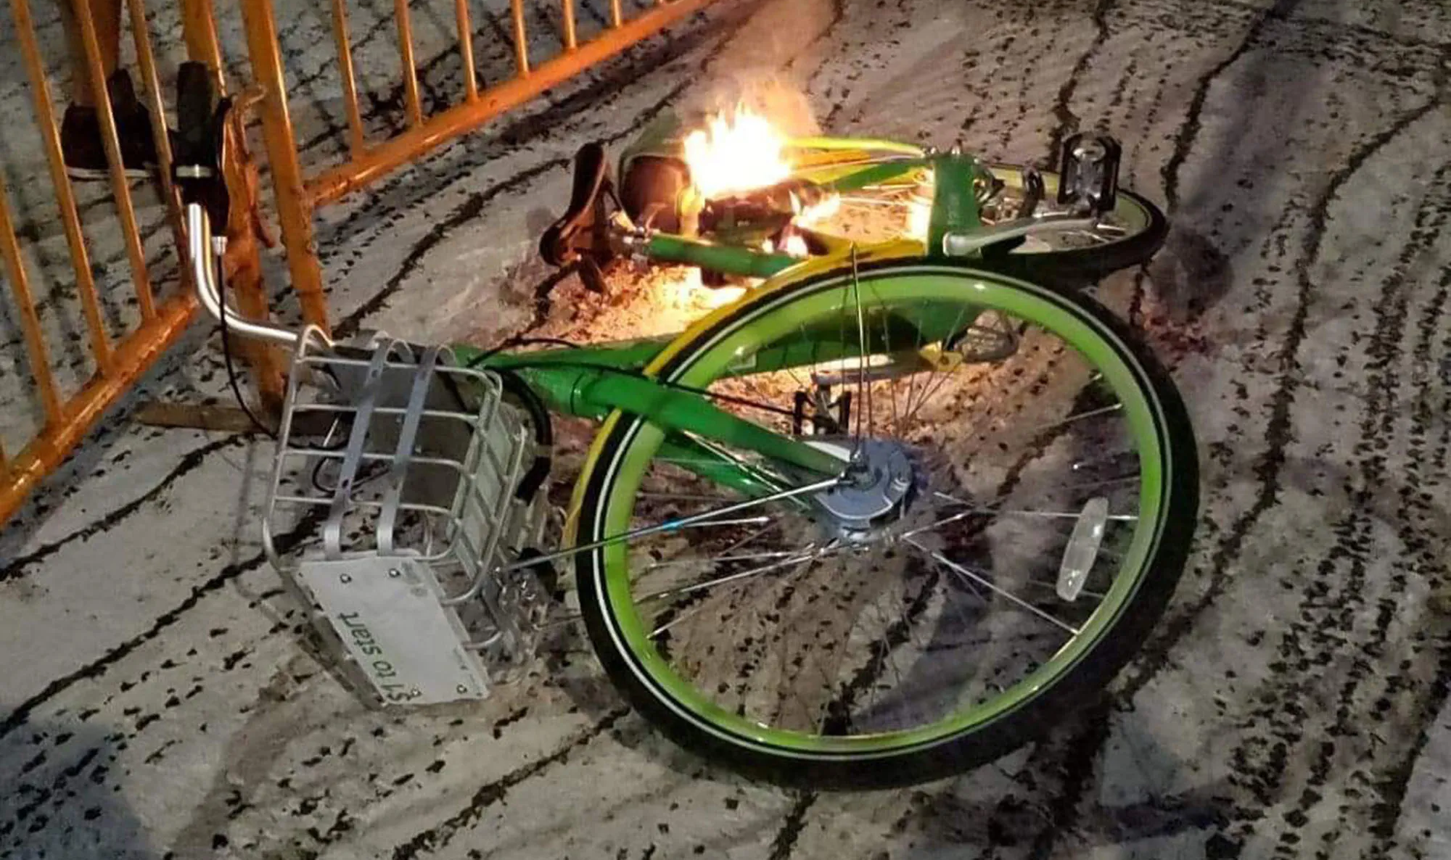
How lithium-ion batteries catch fire
Contain flammable materials
Electrolytes
Lithium metal
Ignition caused by release of electrical energy
Manufacturing defects
Charging
Accidents
Physical damage
Heat
Once put out, electrical energy can reignite batteries
Average 30,000 gallons of water to put out EV fire, vs. 300 gallons for gasoline fire
After an accident
While charging
Driving
While parked
Pedaling
Playing golf

Slide 6
How lithium-ion batteries catch fire
Contain flammable materials
Electrolytes
Lithium metal
Ignition caused by release of electrical energy
Manufacturing defects
Charging
Accidents
Physical damage
Heat
Once put out, electrical energy can reignite batteries
Average 30,000 gallons of water to put out EV fire, vs. 300 gallons for gasoline fire
After an accident
While charging
Driving
While parked
Pedaling
Playing golf

Slide 7
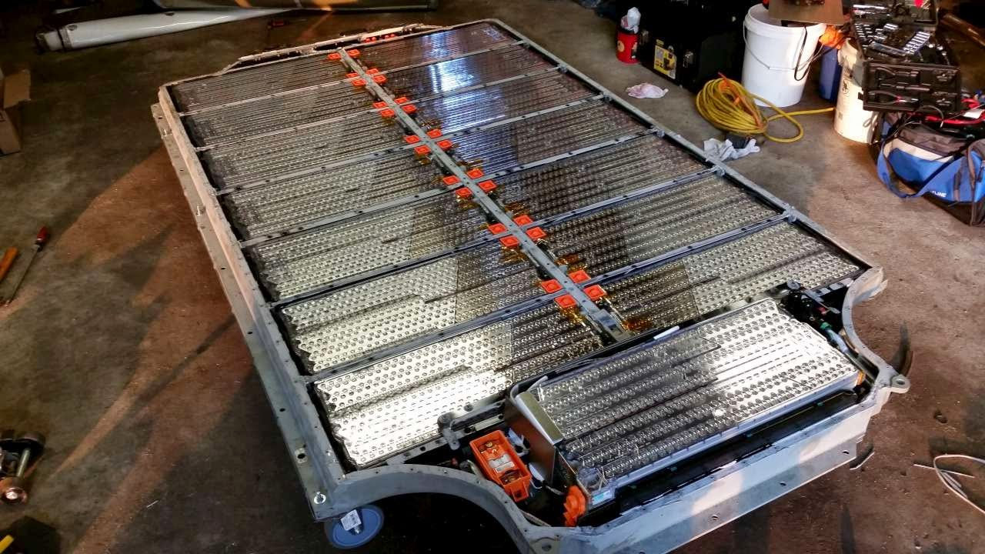
Current solution is heavy, expensive and inadequate
>30% weight and cost burden
Steel / aluminum box
Titanium plates
Spacers / dividers
Sensors
Fuses / switches
Fires still occur
Current solution does not protect against defects
Inadequate protection against physical damage
Vehicle Battery Pack

Slide 8
But today, demand is outstripping supply
Confidential

Slide 9
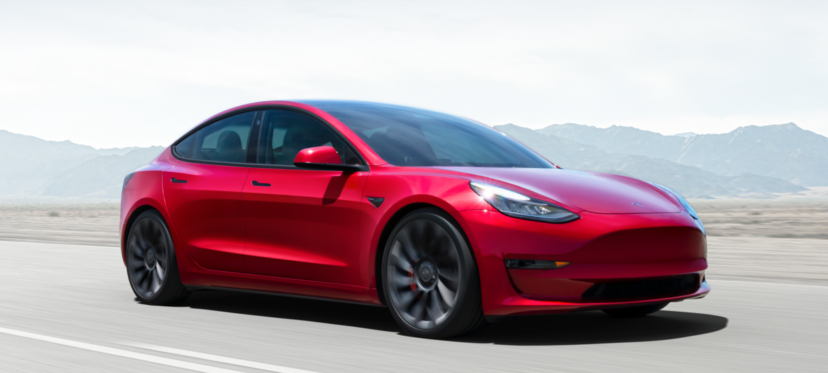
Gigafactories: 250 GWh or 0.25 TWh
~7 Tesla Gigafactories
200-mile range: 3 hrs of driving time
200,000 mile battery
60 kWh battery: 400 kg
Today’s Electric Vehicle
3% of car industry
50% of battery industry
100 – 300-mile range
40 – 100 kWh battery
$40 – 120,000
1 – 8h charge
Safety – Spontaneous fires
– Damage induced fires
$40 – 100,000: Total cost of ownership ~200% of ICE
1h charge: 250 kW
Safety: some spontaneous fires
many/most collisions fire
Confidential

Slide 10
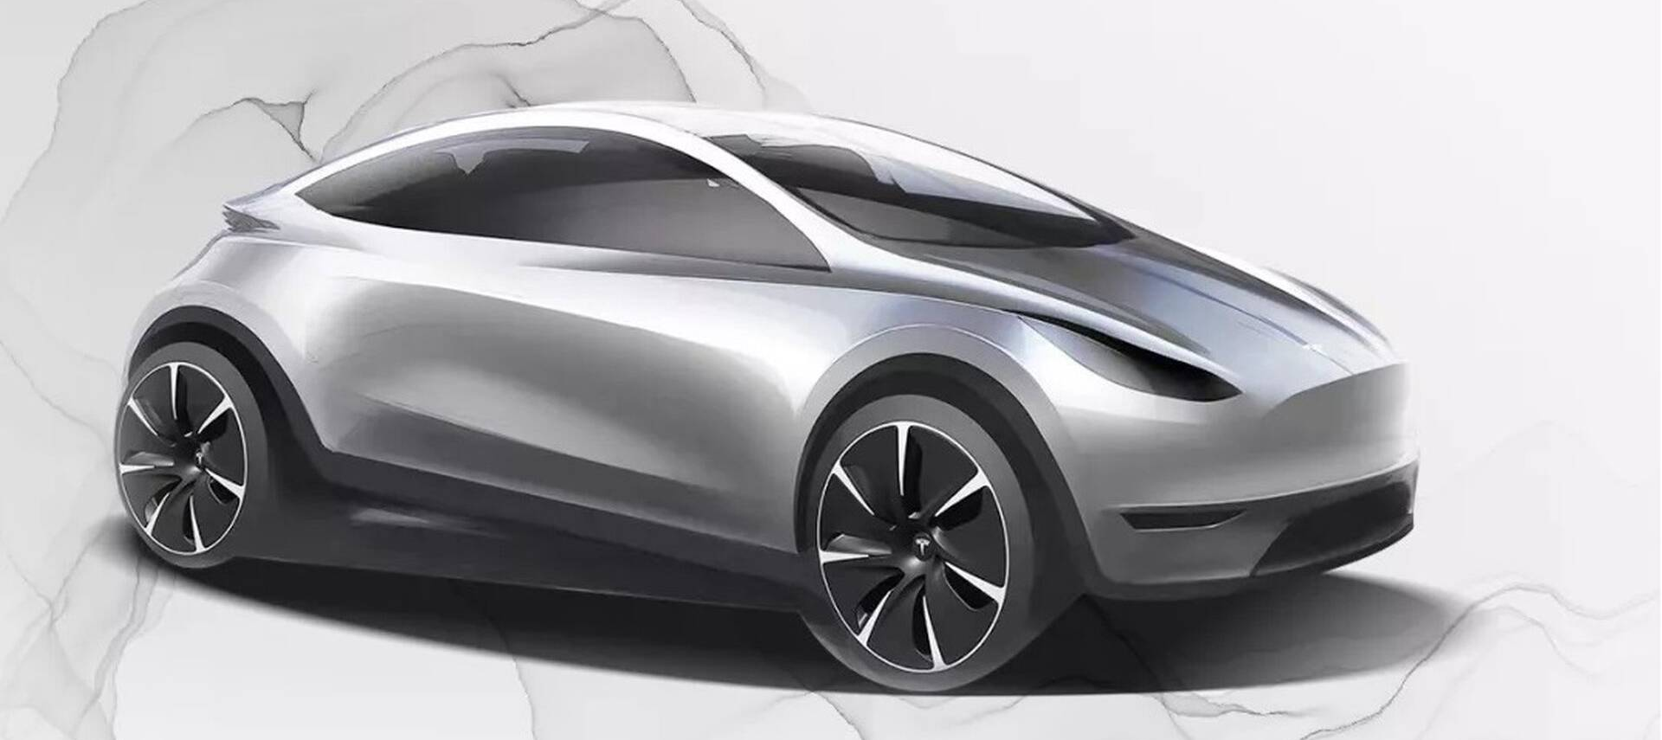
Today’s Electric Vehicle
3% of car industry
50% of battery industry
100 – 300-mile range
40 – 100 kWh battery
$40 – 120,000
1 – 8h charge
Safety – Spontaneous fires
– Damage induced fires
Tomorrow’s Electric Vehicle
80% of car industry
75% of battery industry
600-mile range
200 kWh battery
$20 – 50,000
0.5h charge
Safety – no fire after 75 mph collision
Confidential

Slide 11
Gigafactories: 16,000 GWh or 16 TWh
~400 Tesla Gigafactories
600-mile range: 8 – 10 hrs of driving time
1.2-million-mile battery
200 kWh battery: today – 1,000 kg
tomorrow < 500 kg
Tomorrow’s Electric Vehicle
80% of car industry
75% of battery industry
600-mile range
200 kWh battery
$20 – 50,000
0.5h charge
Safety – no fire after 75 mph collision
$20 – 50,000: Total cost of ownership ~50% of ICE
0.5h charge: 400 kW, about 3x today’s fast charge
Safety: no fire after 75 mph collision
Today—some spontaneous fires
most collisions fire
Confidential

Slide 12
Reflections
Near Future of EVs
Distant Future of EVs
Supply limited market keeps prices high
➔EVs will remain premium product
Old guard will fight a rear retreat
EV sales will not make up for lost market share of ICE
New entrants will succeed
Rivian, Lucid, Nio, Li Auto
Once-a-century opportunity for premium brands
Everything changes
Cars drive you for 600 miles without charging
Charging in every parking lot along travel lanes
Travel is no longer an inconvenience because mobile office, work-from-car
Auto becomes competitive with air
Cost per mile traveled goes down
…but EV prices remain high for a long time
Electric point-to-point air is real
Drone delivery is real
Drivers rarely needed in air, cargo, personal transport
Confidential

