Slide 1
Effective Networking in the Virtual Business World
Devon Clymer

Slide 2
Agenda
Introduction
What is Networking
Virtual Networking Tools
Virtual Networking Events
AIChE Resources
Next Steps/Looking Forward
Q+A
Networking Breakout Sessions

Slide 3
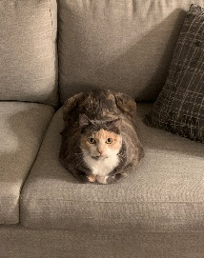
A Short Introduction
Born in Lancaster, PA. Grew up in Augusta, GA. Lived in Greenville, SC since 2013
Graduated from Georgia Tech in 2013 with degree in Chemical Engineering
Started working at Jacobs/CH2M in 2013
Originally started in Specialty Chemical Industry
Worked in the Microelectronics field for the past 2.5 years
Enjoys being a traveling, cycling, photography, video games, and is a proud cat-dad.

Slide 4
What is Networking?

Slide 5
What is Networking?
Definition:
The action or process of interacting with others to exchange information and develop professional or social contacts.
Basically:
Networking is about building new relationships with people and growing established relationships

Slide 6
Types of Networks
Professional Network
College
Coworkers
Customers/Clients
Suppliers/Vendors
Professional Societies
Personal Networks
School
Mutual Friends
Hobbies

Slide 7
Virtual Networking Tools

Slide 8
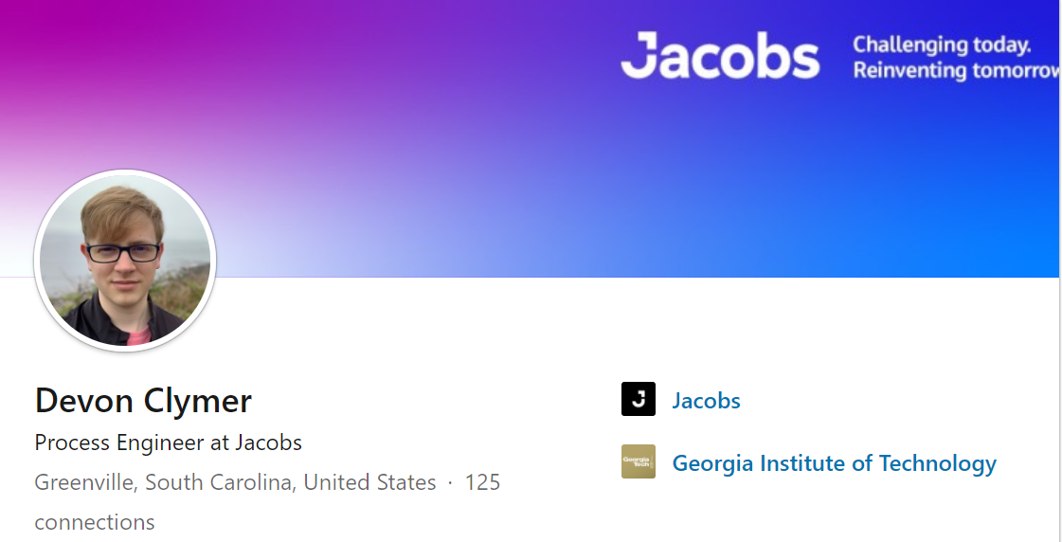
LinkedIn
LinkedIn is a digital business card
Will be the first/last thing people see at networking event
LinkedIn Best Practices
Professional Profile Picture
Background Photo
Strong Headline
Use Summary to tell your story
Highlight your experience

Slide 9
LinkedIn
Managing your Personal Brand
How others view your accomplishments, experience, capabilities, and potential
On LinkedIn
Be yourself
Be professional
Be relevant
Share what you are passionate about
Check your activity history

Slide 10
Virtual Collaboration Platforms
Zoom, RingCentral
Messaging/Video Conference Focused
Breakout Rooms enabled
Microsoft Teams, Webex, Google Meet/Workspace
Integrated solutions
Messaging/Video Conferencing
Breakout Rooms
Google Meet: Included
Teams: Coming End-October
Webex: Included

Slide 11
Virtual Networking Events

Slide 12
Virtual Networking Events - Hosting
-Think about the intention behind the event
Teambuilding
Sell or Educate your audience
Social Mixer for Professionals
Invite the right number of people
Breakout sessions
Make the Invite easy
Include calendar invite, App platform link, alert if download is needed

Slide 13
Virtual Networking Events - Hosting
Reach out to Attendees before the event
Share invite list – LinkedIn Link
Allow time for socialization ahead of time
Have a flexible agenda
Introductions
Have specific questions ready
Stick to your schedule
Recommended 60-90 minutes

Slide 14
Virtual Networking Events - Participating
Provide Bio or LinkedIn link to organizers
Identify your networking goals
Expand your professional network
Team build with colleagues
Who are the key people/companies/brands to connect with?
Engage in Discussions
But don’t dominate group
Share participation on Social Media
Follow-up with any connections you made

Slide 15
AIChE Resources
Conny Walker

Slide 16
Networking on a Smaller Scale
Reach out to coworkers/connections
Company messenger application
LinkedIn
Email
Spotlight someone on your team
Stay active on LinkedIn
Share articles or posts on things you care about
Engage with others on their posts

Slide 17
Next Steps

Slide 18
Looking Forward – After Covid
Companies have made heavy investments in digital infrastructure
Decentralized workforce
Mix of In-person and virtual events
Team build with coworkers in other offices
Interview, establish connections with students from non-local colleges
Multi-office teams more the norm

Slide 19
Questions?

Slide 20
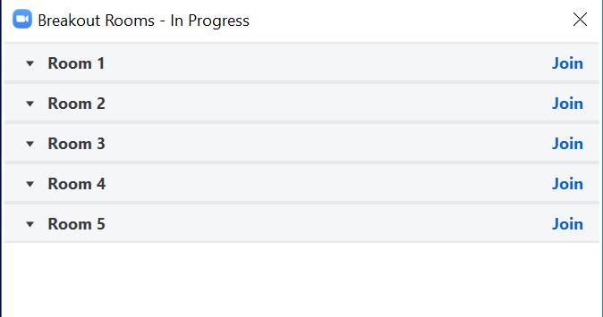
Breakout Sessions
We will automatically assign you to a breakout room
Breakout Rooms can be accessed on your control panel
Will bring up the following menu:
To leave the breakout room, click ‘Leave Room’ on control panel
Don’t forget to unmute!

