Slide 1
Stay Informed and Involved with WSC and AIChE
Recommended WSC AIChE Links presented by Conny (Marlene) Walker

Slide 2
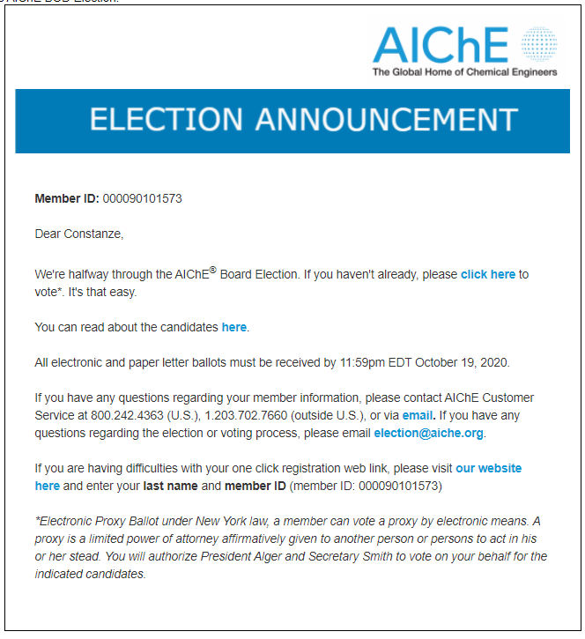
Vote for National AIChE Board Members by October 19, 2020
AIChE National Board Elections
See “details” https://www.aiche.org/about/governance/elections/2020-board-directors-election
See Candidates https://www.aiche.org/about/governance/elections/2020-board-directors-election
Get help if you have lost your email: election@aiche.org

Slide 3

AIChE Recent Topics
Out of my Inbox...
Education Division - Oct 2020
Waste Plastics Symposium - ongoing
Bioenergy Susainability Conference - ongoing
Center for Hydrogen Safety - Europe Conference - starts October 20, 2020
AIChE Exchange (must log in)

Slide 4
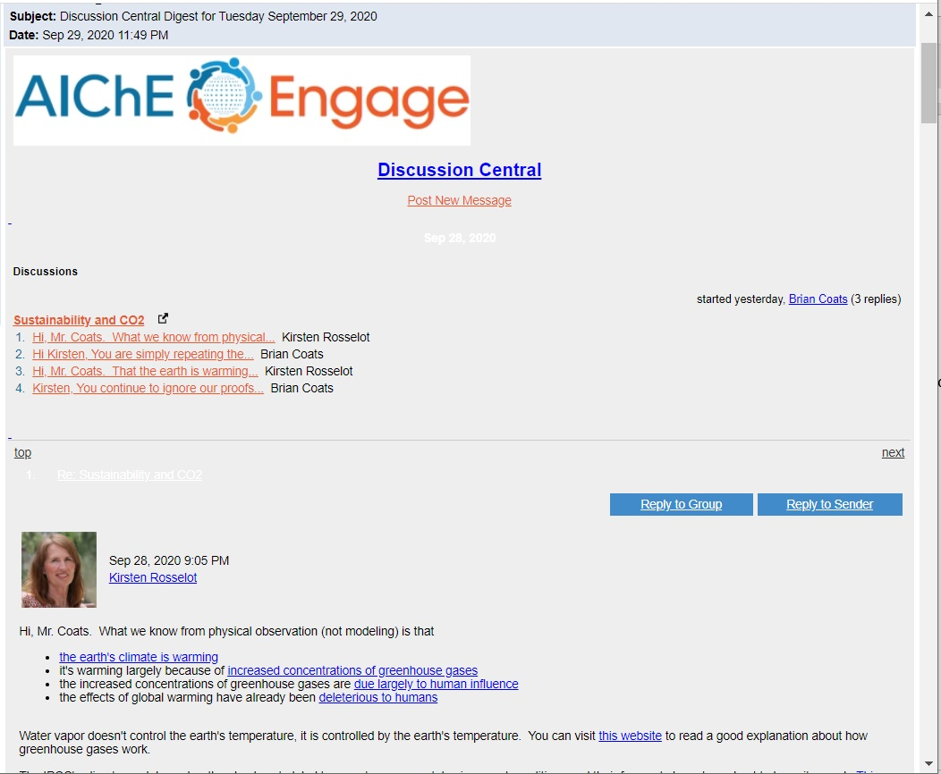
AIChE Discussion Central Digest
AIChE National Level Members only
Forum for engineers to ask questions and exchange ideas.
Engineers new to specific industries ask general questions
Engineers looking for specific design advice
Advice on manufacturing and industry best practices
Current issues (such as climate change, things in the media)

