Slide 1
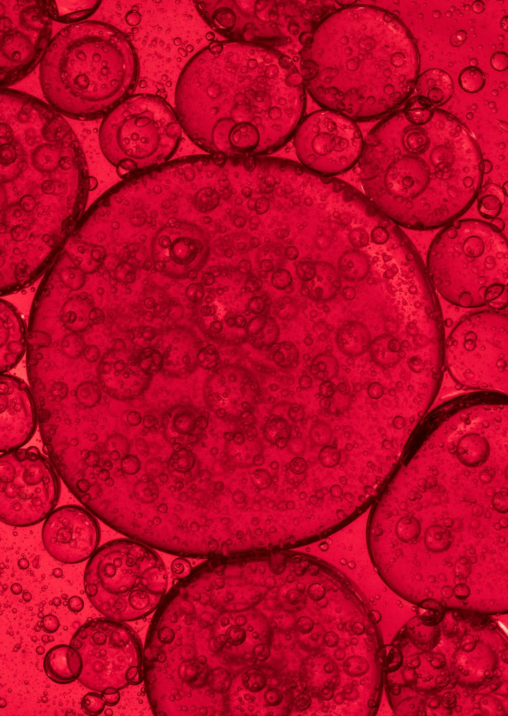
CROSSFLOW MEMBRANE FILTRATION
A COUPLE OF PRACTICAL APPLICATIONS

Slide 2
MEMBRANE MATERIALS OF CONSTRUCTION
POLYMERIC
CERAMIC
METAL
INSITU

Slide 3
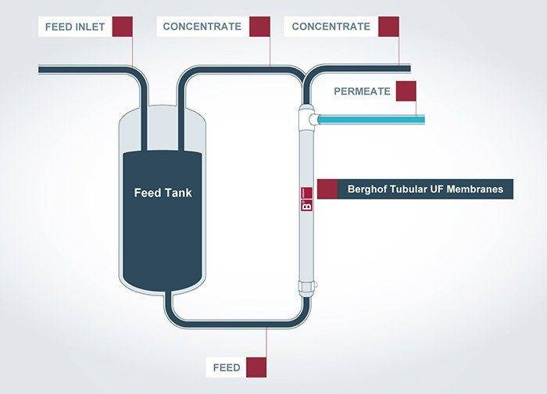
Crossflow membrane filtration- simplest process configuration berghof membranes

Slide 4
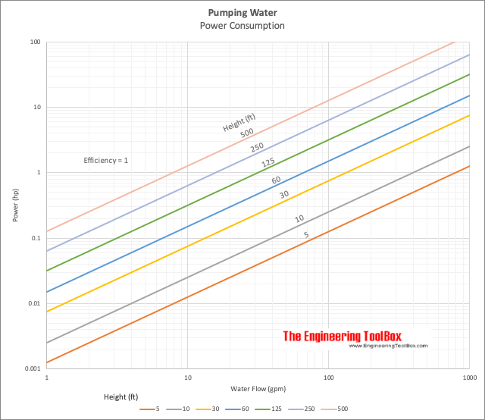
Crossflow membrane filtration energy input
PUMP POWER – 2,545 BTU/HR PER HP
10 HP PUMP = 25,450 BTU/HR or ~ 2 TONS COOLING
MORE CIRCULATION = MORE HEAT TO MANAGE

Slide 5
CROSSFLOW MEMBRANE FILTRATION some TYPICAL USES
WATER PURFICATION
WASTEWATER RECOVERY
DESALINIZATION
COLD PASTURIZATION
CONCENTRATION/WASHING OF DYES, COATINGS, ETC.

Slide 6
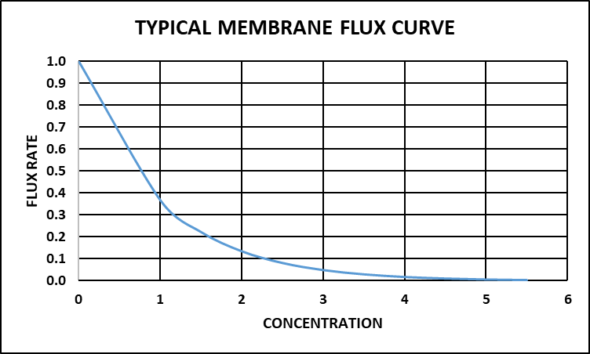
Crossflow membrane filtration flux rate
Flux Rate is typically a logarithmic decay curve, R= Ae^{(-BX+C)}
A, B, and C are affected:
  Particle morphology
  Viscosity
  Gel permeation layer characteristics
  Fluid velocity
  Chemical interactions
  Temperature

Slide 7
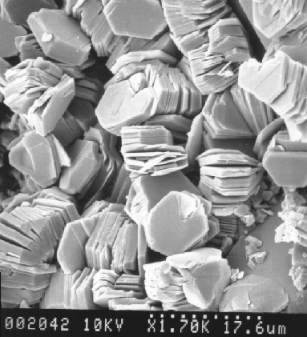
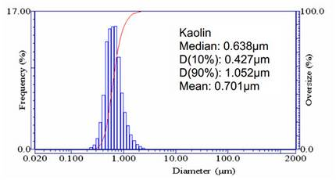
Crossflow membrane filtration - Kaolin clay
Kaolin, also called china clay, soft white clay that is an essential ingredient in the manufacture of china and porcelain and is widely used in the making of paper, rubber, paint, and many other products. Kaolin is named after the hill in China (Kao-ling) from which it was mined for centuries.
Typically, 80-100% finer than 2 μm
Largest application is coating paper
Separated by particle size at around 25% solids in centrifuges
Coagulated and filtered from 25% solids to 50-60% solids before final processing
The filtrate contains ~2% kaolin which is 100% less than 0.5 μm

Slide 8
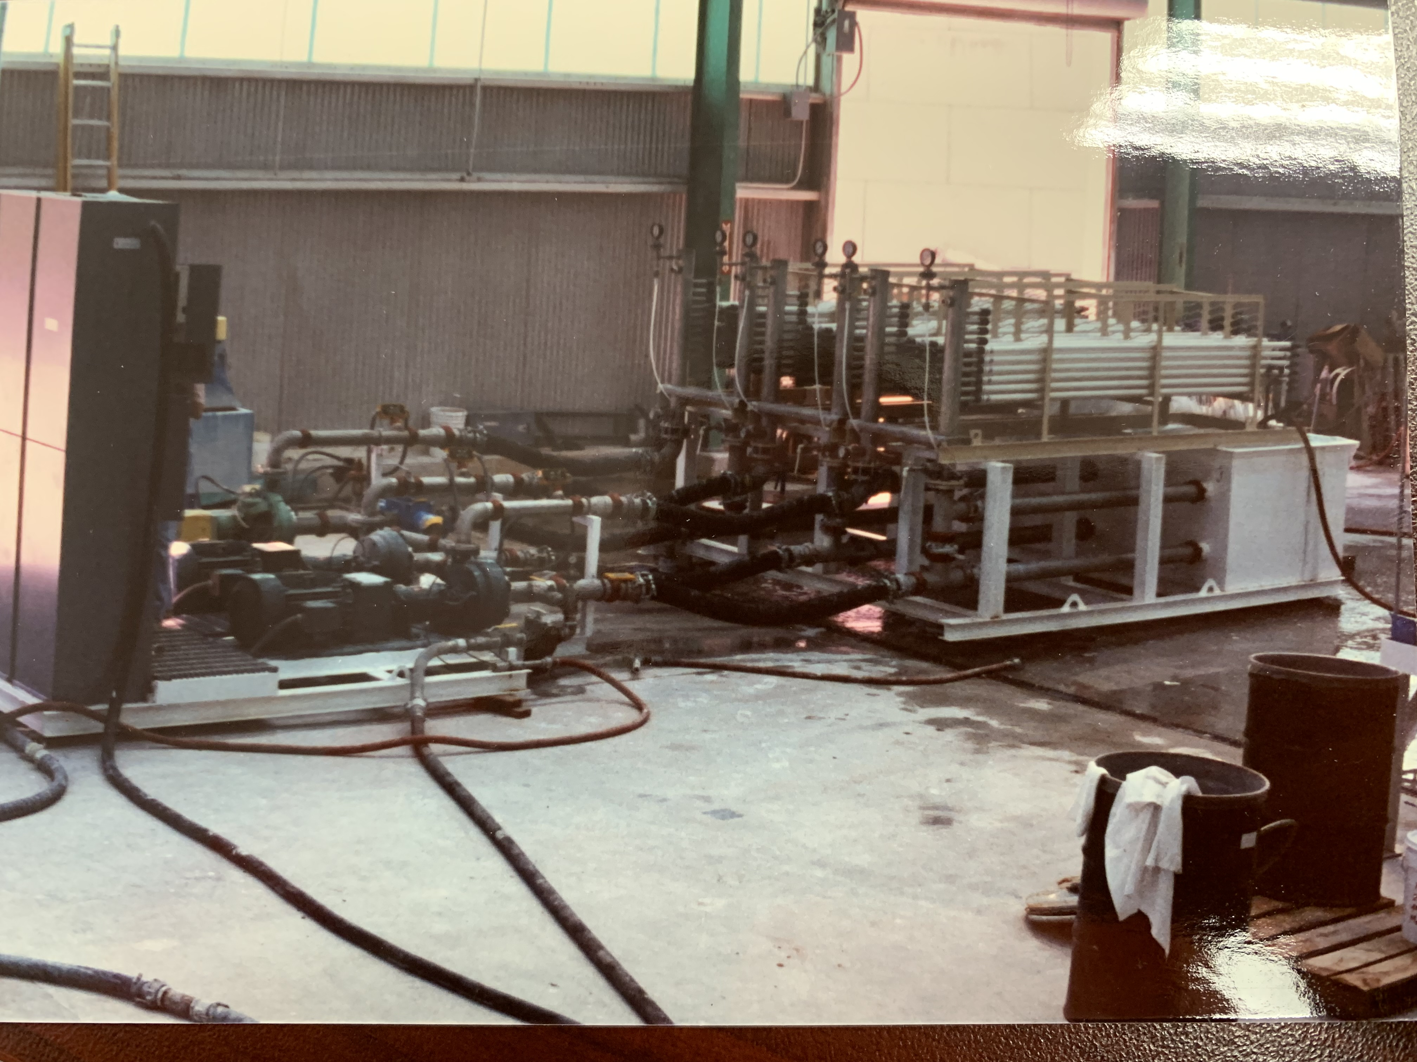
Crossflow membrane filtration - Kaolin clay initial project
Initial application was replacing rotary vacuum drum filters for fine coating clays.
Used a 3-stage approach
1st and 2nd multi tubes – concentrate from 25% to 40% solids
3rd stage single tubes– concentrate from 40% solids to 50-55% solids
Evaporate to 70% solids or spray dry to a powder
Used the 1st stage to cool the 3rd stage
Worked technically, but cost savings insufficient

Slide 9
Crossflow membrane filtration - Kaolin clay second project
Filtrate from drum filters contain 2% kaolin, recovered by flocculation and sedimentation and recycled to drum filters. Caused viscosity problems and filtration rate problems.
New product was introduced that produced a waste stream of dilute fine kaolin.
Replaced 1st and 2nd stages with spiral wound cartridges to provide enough area to handle dilute stream.
Used conventional tubular or plate and frame configuration for final concentration prior to evaporation or spray drying.
No flocculant in product to cause viscosity problems and no impact on drum filters.

Slide 10
CROSSFLOW MEMBRANE FILTRATION
ORTEC MEMBRANE FILTER PROCESS
PRODUCING A SPECIALTY MONOMER
VERY SENSITIVE TO INITIATION
VERY LOW LEVELS OF POLYMER INTERFER WITH PRODUCT USE
VERY EXPENSIVE TO PRODUCE
POLYMER MW LOW – 50,000 MW CUT-OFF NOT LIKELY TO WORK

Slide 11
Crossflow membrane filtration lab-scale set-up
Area = 0.011 m² per membrane
Pore size 10 nm and 5 nm
Circulating flow = 2.0-2.2 gpm
Tube ID = 7 mm
Linear velocity = 11.3 ft/s or 3.4 m/s
Pressure = 160-200 psig
Temperature = 25-30ºC
Flux Rate = 0.7 liters/m²-hr-bar

Slide 12
CROSSFLOW MEMBRANE FILTRATION
ORTEC MEMBRANE FILTER PROCESS
Product is a reactive monomer
MeHQ used as a polymerization inhibitor
Trace contaminants can initiate polymerization
High temperature can initiate polymerization
ANY polymer content makes the monomer unusable
Small peak @ 11.5 mins is polymer

Slide 13
CROSSFLOW MEMBRANE FILTRATION
ORTEC MEMBRANE FILTER PROCESS
Composite sample of permeate
Polymer peak @ 11.5 mins is gone

Slide 14
CROSSFLOW MEMBRANE FILTRATION COMMERCIAL UNIT
Time to scale-up
Basis:
  Batch size = 175 gallon
  Flux rate = 0.70 l/hr-m²-bar
  Temperature less than 35ºC

Slide 15
Crossflow membrane filtration – Commercial Batch #1
 | Pounds Solution | Pounds Monomer | Monomer Recovery
Membrane Feed | 4,732 | 1,410 | N/A
Membrane Product | 4,629 | 1,245 | 88.3%
Evaporator Feed | 3,967 | 1,067 | 75.7%
Evaporator Product | 980 | 980 | 69.5%

