Slide 1
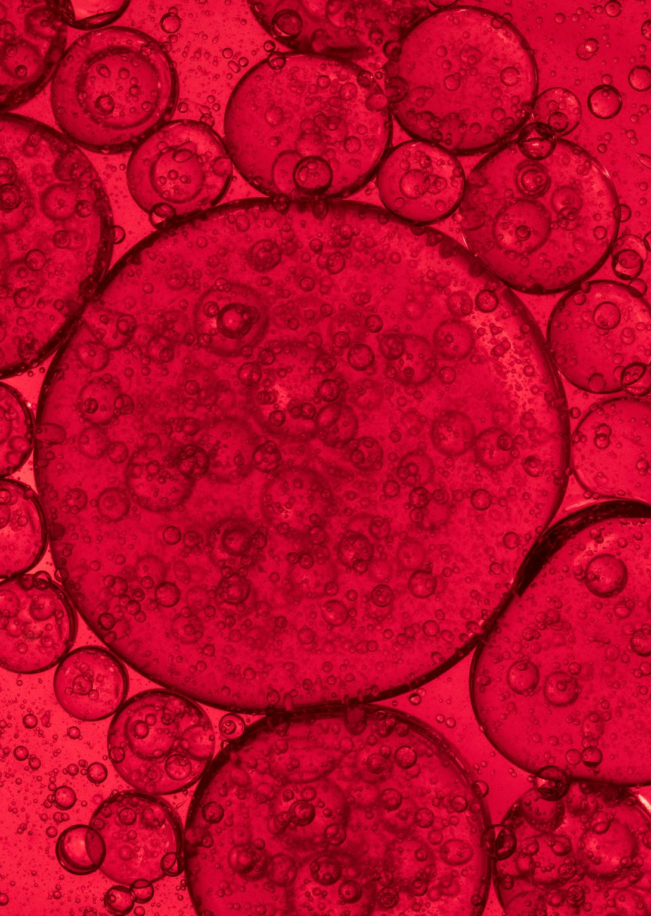
CROSSFLOW MEMBRANE FILTRATION
A COUPLE OF PRACTICAL APPLICATIONS

Slide 2
Crossflow membrane filtration agenda
INTRODUCTION
DESCRIPTION OF TECHNOLOGY
TYPICAL USES
KAOLIN CLAY SYSTEM
MONOMER PURIFICATION SYSTEM
QUESTIONS & ANSWERS (MAYBE)

Slide 3
Crossflow membrane filtration personal introduction
Bill Thompson – 1979 Clemson ChE graduate
Career:
DuPont – PET film for x-ray – 1979 to 1981
Texasgulf – phosphoric acid and phosphate fertilizers – 1981 to 1987
Georgia Kaolin Company – mineral processing – 1987 to 1993 (www.imerys.com/business/applications/paper-board)
FMC Lithium Division – lithium chemicals – 1993 to 2008 (www.livent.com)
Ortec, Inc. – specialty monomers and polymers – 2008 to date (www.ortecinc.com)
Worked in Plant Support, Maintenance, Process R&D, Process Scale-up, Technology Transfer, and Project Engineering
Built the first membrane filters in the kaolin industry to recover ultrafine kaolin
Demonstrated diafiltration for purifying lithium phosphate catalyst
Designed and built membrane filter for recovering contaminated monomer

Slide 4
Crossflow membrane filtration personal introduction

Slide 5
WHAT IS MEMBRANE FILTRATION?
Membrane filtration (MF) is a pressure-driven separation process that employs a membrane for both mechanical and chemical sieving of particles and macromolecules
(Benjamin and Lawler, 2013).

Slide 6
WHAT IS MEMBRANE FILTRATION?

Slide 7
WHAT IS CROSSFLOW?

Slide 8
Membrane filtration terms
PERMEATE – aka filtrate, what passes through the membrane
RETENTATE – what is held back by the membrane
PORE SIZE – size of the holes in the membrane surface
MOLECULAR WEIGHT CUT-OFF – another way to describe pore size, related to radius of gyration.
TRANSMEMBRANE PRESSURE – pressure between the inside of the membrane and discharge of the permeate side
FLUX RATE – flow rate per unit area per day per unit transmembrane pressure, usually gal/ft²/day/psi or liters/m²/hr/bar
GEL PERMEATION LAYER – high solids film that develops at the membrane surface
ASYMETRIC – in most cases the support structure pore size is larger than the membrane pore size

Slide 9
MEMBRANE CONFIGURATIONS
SPIRAL WOUND
TUBULAR
PLATE AND FRAME (FLAT SHEET)
VIBRATORY (FLAT SHEET)
HOLLOW FIBER

