Slide 1
Global Geopolitical and Economic Outlook 2021/2022
Pete Mento
Mento LLC
Monday September 21st, 2021
Pete.Mento@MentoLLC.com

Slide 3
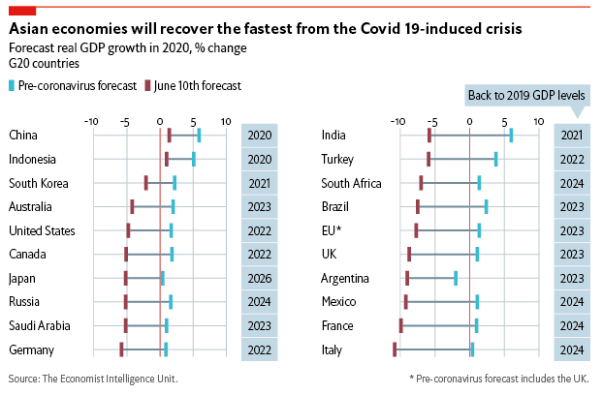

Slide 4
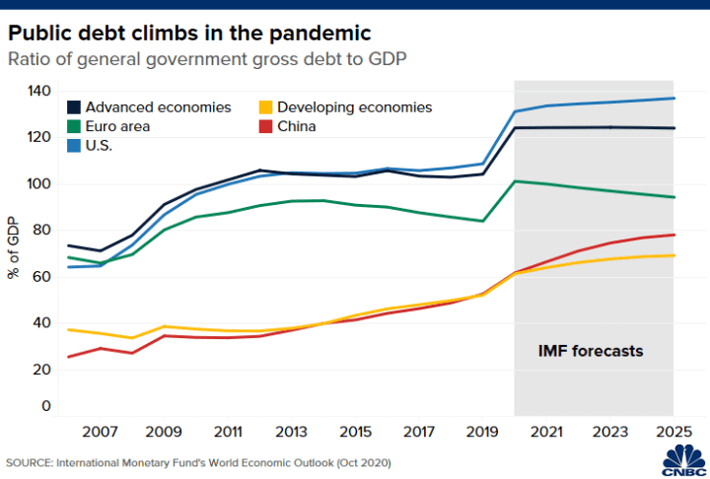

Slide 5
Evergrande – The New Conversation
China Evergrande Group is the world’s most indebted property developer, whose financial woes are rapidly becoming everyone’s problem.
Evergrande is the world’s most indebted property developer, whose financial woes are rapidly becoming everyone’s problem.
The group has debt due that it can’t pay, and its looming failure—whether that be a restructuring or total liquidation—threatens to cause a credit crunch, rock confidence in Chinese investments, and have global knock-on.

Slide 6
Evergrande
Evergrande currently has some $300 billion in liabilities and only around $15 billion in cash on hand. Swiss bank UBS estimates that liability figure to be closer to $313 billion—which amounts to 6.5% of the total liability of the debt-laden Chinese property sector—of which $19 billion is made up of outstanding offshore bonds.
The group also has a large network of loans. Monday was a deadline for domestic bank loan repayments; in a note, Deutsche Bank strategists said there was a 24-hour grace period from the Monday deadline. Chinese authorities warned banks last week that Evergrande wouldn’t meet these obligations.
A bigger pinch is likely to come Thursday when coupon payments for both domestic and offshore bonds are due. BlackRock (BLK), UBS (UBS) and HSBC (HSBC) are among the company’s bondholders.

Slide 7
"They've pioneered an expansive approach to stealing innovation through a wide range of actors, including not just Chinese intelligence services but state-owned enterprises, ostensibly private companies, certain kinds of graduate students and researchers, and a whole variety of other actors all working on their behalf.” – FBI Director Christopher Wray

Slide 8
Threats to Global Commerce
Cyber
Currency concerns
Russia, Natural Gas and Trade Blocks
Availability of Air Freight – Without Air Passengers
Companies looking at two separate supply chains – one for China, and one for the rest of the world.
China taking its place at the table of international discourse.
Entry type 321 and Retail

Slide 9
New Presidents and Dramatic Change
The US is currently engaged in numerous trade wars.
Many free trade agreements have been abandoned, put on hold or completely redirected during the last administration.
Pandemic impacts have forced both the trade and the government to reconsider the resilient supply chains – and both will be expected to take part in changing the script.
President Boden has been forced to act in a confrontational way with China thus far.
The US/UK/AUS alliance will create more friction.

Slide 10
And the Future?
Strategic national stockpile bills are likely forthcoming.
Economic opportunity beyond Covid ought to begin in earnest in November.
Air Travel and Air Cargo – US/UK announcement.
Automation – the big shoe to drop – Will Congress fund research?
Cybersecurity and the great unknown – How will Congress and the executive branch fund research and greater security?

Slide 11
And the Future?
Supply Chain resiliency has become the new popular term and likely will remain so for some time.
China has only vaccinated 40% of it’s population with a vaccine that is reported to be
Sinovac has an efficacy rate of 65.9% against Covid-19, is 87.5% effective at preventing hospitalization and 86.3% effective at preventing death.

Slide 12
Port Congestion
It’s not just bad off the coast of Los Angeles and Long Beach, California.
Ships waiting to offload are parked outside ports from Singapore to Savannah, Georgia, and big European gateways for trade like Hamburg, Liverpool and Rotterdam are dealing with bottlenecks and delays, too.
The current estimate is that 10% of total ocean capacity is involved in congestion.

Slide 13
Port Congestion
As of this AM – 70 Fully loaded container ships are floating off the port of LA Long Beach.
There are literally hundreds of thousands of containers piling up in South China, while the other ports are already at a breaking point.
We have an acute shortage of both vessel space and empty containers, so the South China port situation is rapidly becoming a massive systemic disruption.

Slide 14
Container Rates
Record-high container rates are only going higher.
A notice this month from Hapag-Lloyd AG informed shippers that starting July 18, it intended to execute a “peak-season surcharge” of $2,000 for each 40-foot container from East Asia to the U.S. and Canada — an extra fee that by itself is higher than the full rate for a container shipped on transpacific routes in 2019.

Slide 15
Freight Expenditures
Imports account for as much as one-fifth of trucking volumes.
When you see this number of imports hit the freight market out of nowhere, it creates an enormous amount of strain in terms of trucking capacity or trucking demand,.
There aren’t enough drivers in many countries, and shortages of equipment like chassis to haul containers are particularly acute around ports.
In all the discussions of driver shortages, not enough attention is paid to the geographic unavailability of this resource.

Slide 16
Freight Expenditures
Even with all the supply constraints, North America’s freight cycle is in high-growth mode.
U.S. capital-goods orders have recently broken through a generational ceiling.
There is a clear and unprecedented U.S. capex boom on the near horizon. So, even as federal-stimulus effects fade and consumer spending gradually reverts to services from goods, the extraordinarily strong U.S. freight recovery across the network in 2021 also has longer-term growth drivers.
Supply constraints will hold prices steady under strong, long-term demand.

Slide 17
Low Inventories
Some economists theorized that as countries reopen and travel restrictions are lifted, consumers will reduce online purchases of stuff and head off on vacation, easing the crunch in the global trade of physical goods.
Those Economist should clearly stick to teaching, because they are wrong.
Among the corporate casualties of COVID-19 is the just-in-time inventory model — a strategy justified if there’s cheap, reliable shipping on command.

Slide 18
Low Inventories
Barely stocked storerooms aren’t a problem if you know exactly when your next pile of containers arrives. That kind of certainty isn’t realistic these days.
That results in a “starvation mentality” to pad inventories and that might underpin demand even as people splurge again on holidays and entertainment.
And that is going to make the Holidays a complete mess.

Slide 19
Carrier Profits
An industry is doing well when the worst stock has risen 34% through the first half of the year (A.P. Moller-Maersk)
During the industry’s most profitable run yet, the stock of eight other publicly traded carriers are having even better years with Ming Marine Transport increasing 416% so far this year.
This is a relief from a decade of losses, bankruptcies and mergers that broke the playing field from two dozen major carriers to 10 that control 85% of the market.

Slide 20
New Vessels
With all this cash flooding in, carriers will be purchasing new tonnage.
None of which will be commercially available before 2024.
A year that most Economist believe we ought to see, if not a global economic cooling off, then a return to normal.
So, as usual, this industry returns to boom, bust operations. And nothing really gets solved,

Slide 21
Reality?
What is working poorly will likely do so for some time.
There is not a path for a meaningful solution to be driven out of Washington. Most solutions would need to originate from local efforts coupled with Government/Industry partnerships.
The only real way to gain traction here is massive cooperation on a global scale.
We can't even agree on how to fight a once in a generation pandemic that got 36M sick and killed 628K Americans.
So, I won't be holding my breathe.

Slide 22
Find me on Linkedin, Subscribe to the podcast and reach out if you need me!
Pete Mento
978-317-3250
Pete.Mento@MentoLLC.com

