Slide 1
Platelet-Mimetic Strategies for the Enhancement of Wound Healing Outcomes
Seema Nandi, Ph.D.
November 9, 2021

Slide 2
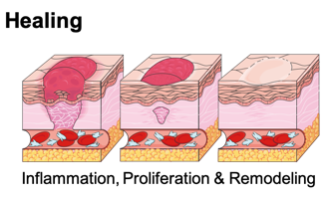
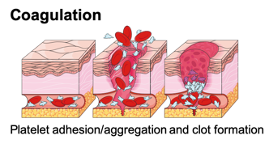
Wound healing
Hemostasis
Platelets and fibrinogen combine to form platelet “plug”
Secreted clotting factors stabilize fibrin network formation
Inflammatory Response
Cytokine activation
Leukocyte migration
Cell migration and proliferation
Fibroblasts synthesize new matrix
Keratinocytes differentiate to form new epithelial layer
Tissue remodeling
Complement system activation
Months to years
Type III collagen ⟶ Type I collagen

Slide 3
Complications of wound healing
Clinical Problems
Chronic Wounds
Coagulopathies
Days
7
14
21
28
Weeks
Normal
Inflammation
Remodeling
Hemostasis
Proliferation
Days
7
14
21
28
Weeks
Chronic
Hemostasis
Inflammation

Slide 4
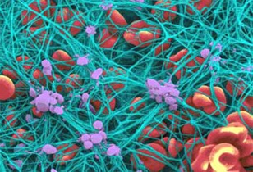
Platelets facilitate a variety of functions in wound repair
Fibrin binding
Promoting clotting following injury
Strategies: collagen and/or vWF binding motifs coupled to particles
Strategies: fibrinogen and/or fibrin-mimetic peptides coupled to particles
Veklich and Weisel, University of Pennsylvania School of Medicine
Nandi and Brown, Exp Biol Med. (2016)

Slide 5
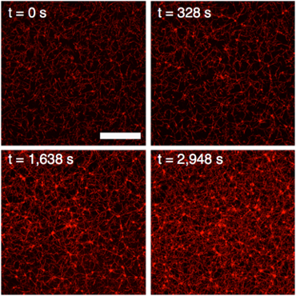
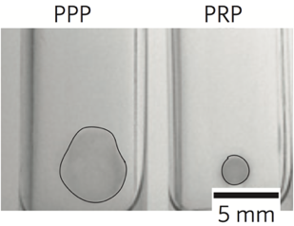
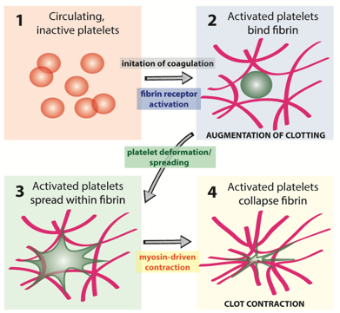
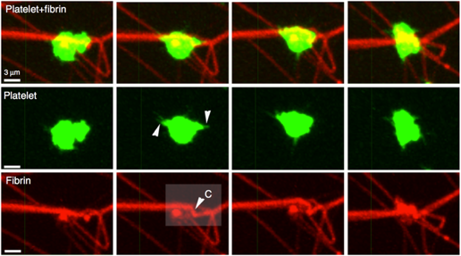
Platelets induce clot retraction
- Platelets
+ Platelets
Brown et al. Nature Materials (2014)
Facilitates healing by allowing perfusion to healing tissues
Stabilizes the clot and reduces its surface area
Kim et al. Nature Communications (2017)
Fibrin
Kim et al. Nature Communications (2017)
Brown et al. Nature Materials (2014)

Slide 6
Platelet depletion/dysfunction leads to impaired healing
Traumatic injury
Disease
Low platelet count
Insufficient coagulation factors
Insufficient coagulation factors
Monroe and Hoffman, Arterioscler Thromb Vasc Biol., 2006

Slide 7
Natural platelet replacements
Approach | Advantages | Limitations
Platelet transfusions | Biological functionality | Short shelf life (3-5 days) High storage costs Difficult to “bank” Immunogenicity risks
Lyophilized platelets | Longer shelf life | Limited biological functionality High clearance Immunogenicity risks
Nandi and Brown, Exp Biol Med. (2016)

Slide 8
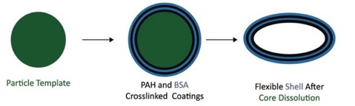
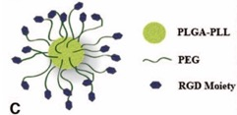
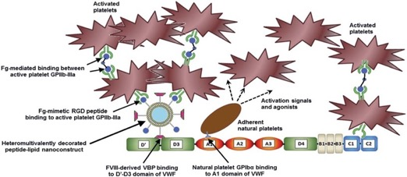
Artificial platelet technologies
Strategy: Mimicking platelet shape
Strategy: Promoting platelet aggregation
Anselmo et al. ACS Nano (2014)
Bertram et al. Sci Transl Med (2009)
Strategy: Mimicking platelet binding to wound and vasculature
Doshi et al. Adv. Mater. (2012)

Slide 9
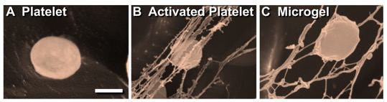
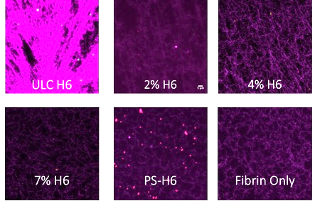
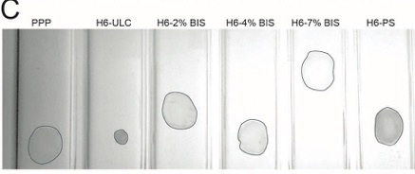
ULCs mimic native platelet body features
pNIPAM-co-AAc microgels
Highly deformable
Mimic spreading and contraction of platelet body
Sproul, Nandi et al. RETM (2019)
Increasing crosslinking
Brown et al. Nature Materials (2014)

Slide 10
Objective
The overall goal of this work is to apply hemostatic PLPs capable of responding to the body’s natural hemostatic cascade in order to augment clotting and mechanically enhance cell migration and wound healing outcomes.

Slide 11
B) Evaluate PLP impact on healing in a model of fibrin structural deficiency (hemophilia)
C) Investigate PLP impact on in vitro and in vivo healing in the presence of external stimulation (ultrasound)
A) Define impact of PLPs on in vitro and in vivo healing

Slide 12
Objective:
Hypothesis:
PLPs will enhance cell migration and wound healing responses in vitro and in vivo
PLPs will deform and stiffen clot matrices
Determine impact of PLPs on in vitro and in vivo healing
Assess the ability of PLPs to bring about clot retraction and investigate the effects of PLP-mediated clot retraction on wound healing responses

Slide 13
PLPs enhance fibrin clot stiffness
**p < 0.01
****p < 0.0001
Nandi et al. Biomaterials Science (2019)

Slide 14
Objective:
Hypothesis:
PLPs will deform and stiffen hemophilia-like clot matrices
Evaluate PLP impact on healing in a model of fibrin structural deficiency (hemophilia)
Assess the ability of PLPs to bring about clot retraction improved wound healing responses in a disease model of deficient fibrin network formation
PLPs will enhance cell migration and wound healing responses in in vitro models of hemophilia
⁺with Laura Sommerville, PhD (Duke), Mac Monroe, PhD (UNC), Maureane Hoffman, MD (Duke)

Slide 15
PLPs improve in vitro fibroblast migration within a model of hemophilic wound healing
*p < 0.05
****p < 0.0001
Nandi et al. Journal of Colloid and Interface Science (2020)

Slide 16
PLPs improve fibroblast migration in a hemophilia-like model of wound healing in the presence of platelets
*p < 0.05
**p < 0.01
***p < 0.001
Nandi et al. Journal of Colloid and Interface Science (2020)

Slide 17
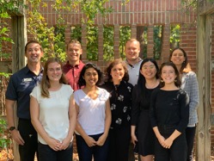

Acknowledgements
Advanced Wound Healing Laboratory
  PI: Ashley C. Brown, PhD
  Erin P. Sproul, PhD
  Emily Mihalko, PhD
  Kimberly Nellenbach, PhD
  Jennifer Sollinger
  Eunice Chee
  Halston Deal
  Grant Scull
  Mary Erb
  Mario Castaneda
  Shelby Funderburk
Doctoral Committee
  Marie Muller, PhD
  Dougald Monroe, PhD
  Maureane Hoffman, MD, PhD
  Danny Freytes, PhD
  Ke Cheng, PhD
Collaborators
  Michael Daniele, PhD
  Laura Sommerville, PhD
  Kaustav Mohanty, PhD
  Aditya Joshi, MS
  Lewis Gaffney
  Patrick Erb, PhD
  Elaine Zhou, PhD
NCSU Comparative Medicine Institute
Funding:
  NIH NIAMS R21AR071017
  American Heart Association Grant 16SDG29870005
  NIH NCATS UL1TR001117
  NIH NHLBI R01HL130918
  DoD CDMRP W81XWH-15-1-0485
  NCSU Chancellor‘s Innovation Fund
  NSF CAREER DMR 1847488

