Slide 1
Stay Informed and Involved with WSC and AIChE
Recommended WSC AIChE Links

Slide 2
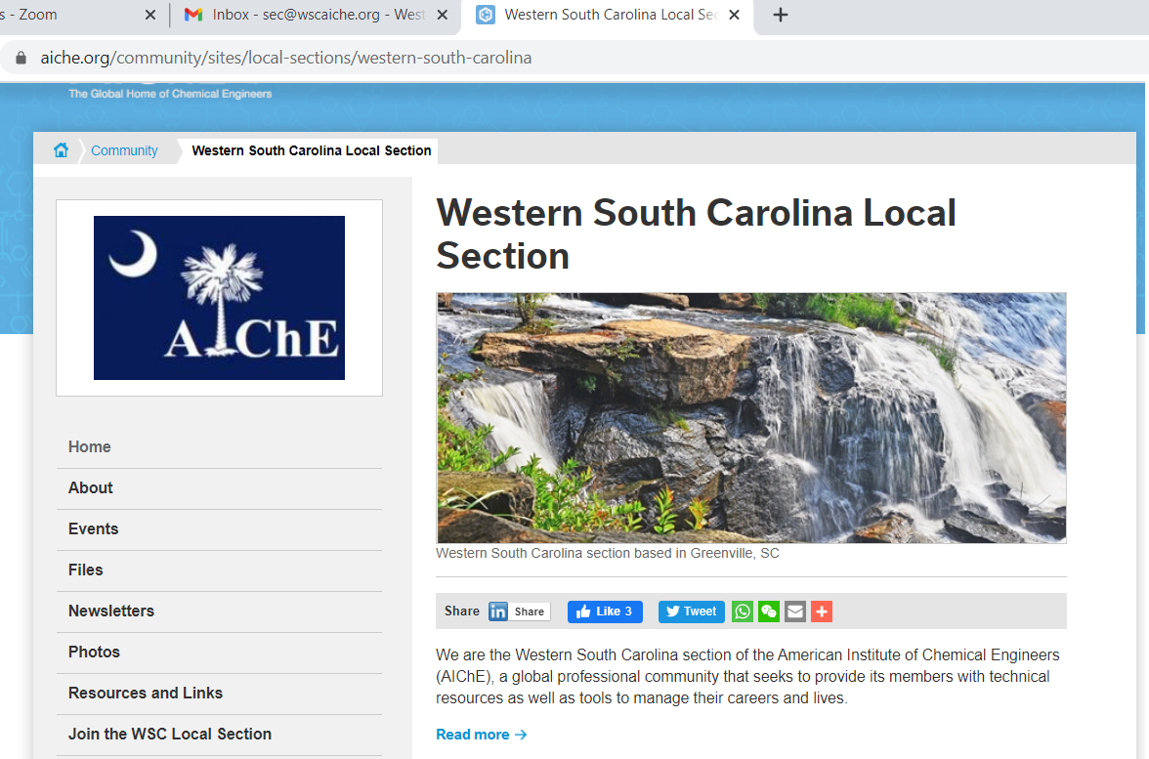
Visit our website and meet our officers
www.aiche.org
Go to local sections
We are the Western South Carolina section
You can conaxt us from the contact list
Or email sec@wscaiche.org
chair@wscaiche.org
vicechair@wscaiche.org

Slide 3
Today’s Meeting ZOOM 960 8512 9226 Passcode WSC2021
Meeting room opens at 6:30 for socialization
6:45 -7:00 Tell us about yourself
7:00 – Presentation starts
7:45 – Q & A
8:00 – Break out rooms on request

Slide 4
Next Meeting: Tuesday, May 11 or Thursday, May 13
Simultaneous in-person meeting with comic Barry McGuthrie Jr
and possibly a mead-making class at Wandering Bard Meadery
Check the national website for updates!!!

Slide 5
Setting up Election of Officers for 2021
Elected Officers | 2020-2021 | Duties/qualifications | Proposed 2021-2022
Chairman | Anil Wagle | Arranges speakers, leads meetings
Vice Chairman | Bonnie McCourtie | Arranges Speakers
Secretary | Conny Walker | Everything else
Treasurer | Rick Vogel | Writes checks
Ongoing At-Large Members | 2020-2021 | Duties/qualifications | Proposed 2021-2022
Former Chair | Marty Milne | Assists chair and vice-chair | Anil Wagle
WEBMASTER | Jacob Lindler | Keeps website current with upcoming events, pictures and meeting files.
NEWSLETTer Coordinator | none | Able to write and organize information and provide in PDF for website upload | Bonnie McCourtie
Membership Manager | Conny | proficient with internet, regularly attends meetings & knows the members
Meeting Host | Conny/Anil | proficient with ZOOM technology
Venue Coordinator | Conny/Anil | works with meeting location, organizes in-person events

Slide 6
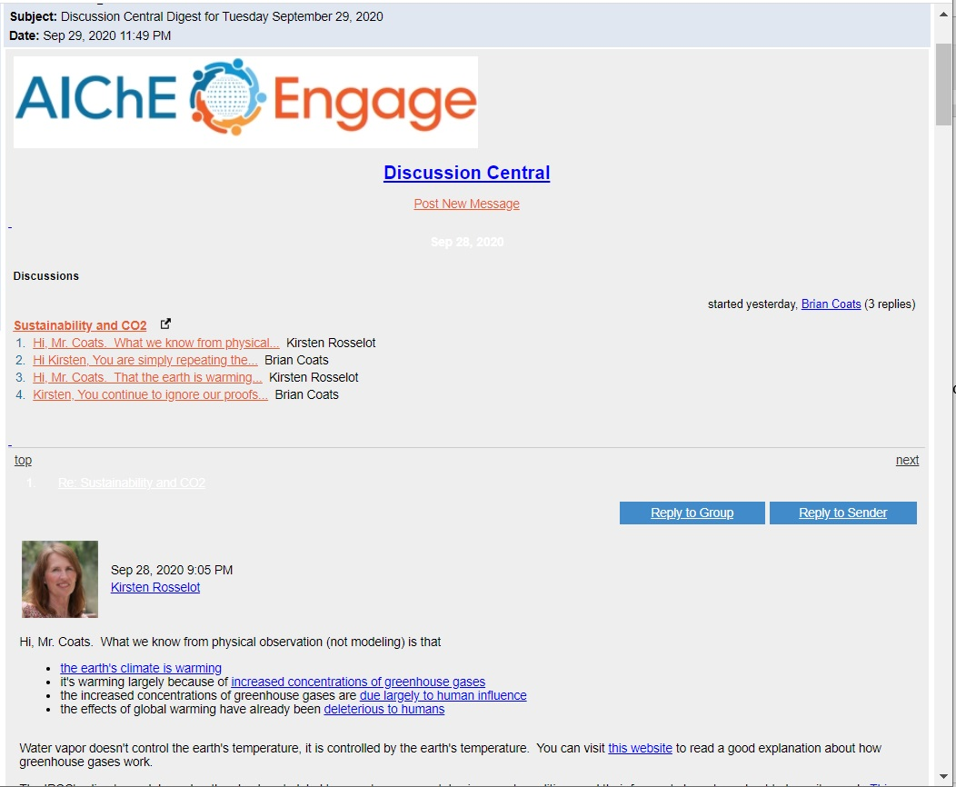
AIChE Discussion Central Digest
AIChE National Level Members only
Forum for engineers to ask questions and exchange ideas.
Engineers new to specific industries ask general questions
Engineers looking for specific design advice
Advice on manufacturing and industry best practices
Current issues (such as climate change, things in the media)

