Slide 1
2023 AIChE Spring National Meeting
Welcome!
to the
35th Annual
Ethylene Producers’
Conference
March 12 - 16, 2023
Houston, Texas

Slide 2
Session # - Title
Session Introduction
Chair Name
Company
Session Co-Chair Name
Company

Slide 3
Subcommittee Name Membership
Name Company
Name Company
Name Company
Name Company
Name Company
Name Company
Name Company
Name Company
Name Company
Name Company
Name Company
Name Company
Name Company
Name Company
If you are interested in participating on an EPC subcommittee, please provide your contact information to a member of the subcommittee.

Slide 4
Session Guidelines

Slide 5
Session Q&A and Surveys
sli.do is being used to submit questions and to gather survey input
Ways to access sli.do –
Click the slido link in the AICHE app located on the session app page
Go to www.slido.com or download/access via the slido app

Slide 6
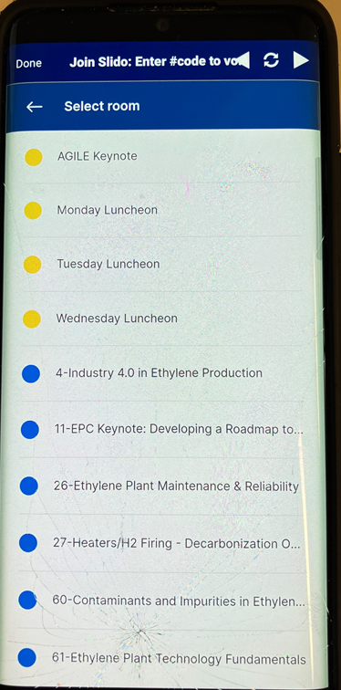
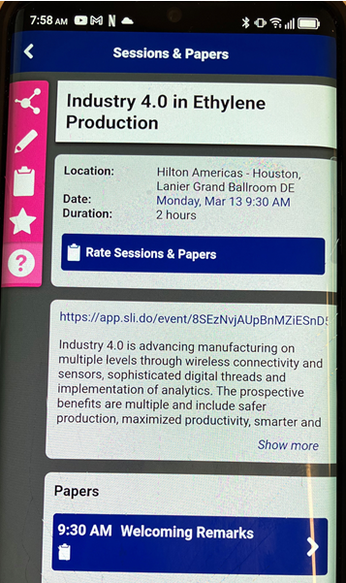
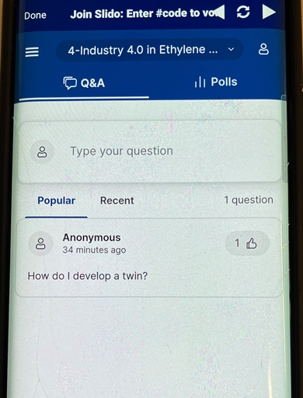
Sli.do Access – AIChE app
Ways to access sli.do -
Click the slido link in the AICHE app located on the session app page
3. You should arrive at a page similar to this, ready to go
1. Select sli.do link
2. Select your current session from the list

Slide 7
Sli.do Access – Sli.do
Ways to access sli.do –
Go to www.slido.com or download/access via the slido app
Code: #AIChE
Select: 2023 AIChE Spring Meeting and 19th GCPS
Room: Select session by # - Title of session you are in

Slide 8
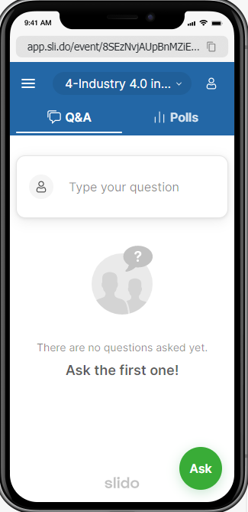
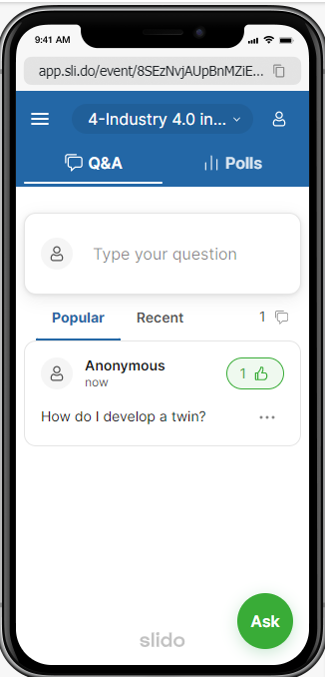
Session Q&A
To enter a question, go to “Q&A” tab
Session #/title
Enter question and name (optional)
Questions tab
Vote for already asked questions by clicking here

Slide 9
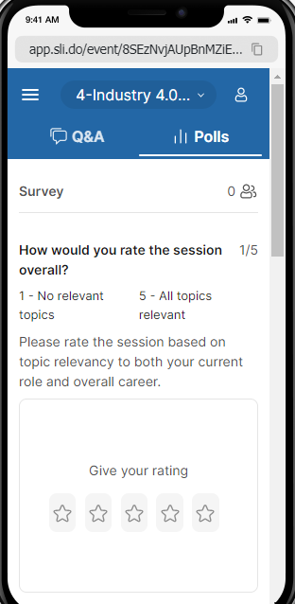
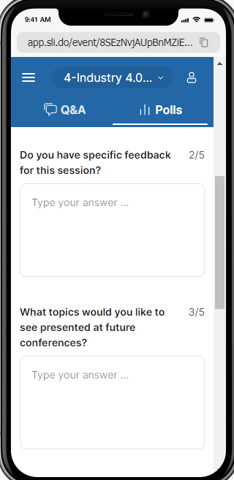
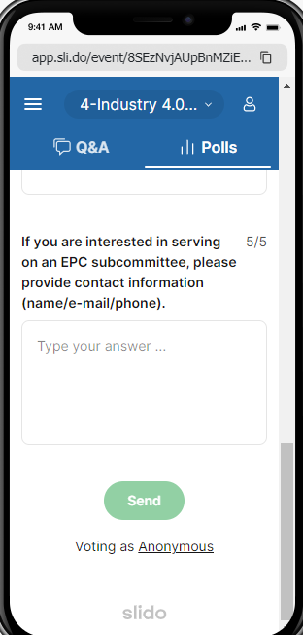
Session Survey
Near the end of the session, please complete a survey - go to “Polls” tab
Complete five questions and click “Send”
Note: Survey covers entire session, not individual papers
Opportunity to complete survey will be available entire day of session
Polls tab

Slide 10
Session # - Title
Welcome
Paper Title (Paper #)
Speaker, Company
Paper Title (Paper #)
Speaker, Company
Paper Title (Paper #)
Speaker, Company
Break
Note: You can convert these bullet titles into hyperlinks to the presenters' PowerPoints by highlighting the paper no. and doing an <insert/hyperlink>. (delete this text box from your final presentation)

Slide 11
Session # - Title
Paper Title (Paper #)
Speaker, Company
Paper Title (Paper #)
Speaker, Company
Paper Title (Paper #)
Speaker, Company
Closing Remarks
Note: You can convert these bullet titles into hyperlinks to the presenters' PowerPoints by highlighting the paper no. and doing an <insert/hyperlink>. (delete this text box from your final presentation)

Slide 12
Session # - Title
Please complete the session surveys (Polls) on sli.do
Reminders
slido.com or sli.do app
Code: AIChE
Select: 2023 Spring Meeting and 19th GCPS
Room: Select session by # - title of session you are in
Provide contact information for participating on EPC subcommittee if interested!

Slide 13
Proceedings Website
Current proceedings will be posted within six weeks of conference
Previous conference proceedings are available now
Many companies already subscribe and others are welcome to join
The above link is also available through the EPC Website
https://epc.omnibooksonline.com
https://www.aiche.org/epc

Slide 14
35th Ethylene Producers’ Conference
Thank you for a successful conference!
Special thanks to:
Attendees
Authors
Session Chairs / Co-Chairs
Subcommittee Chairs and Members
Members of the Ethylene Producers’ Committee

Slide 15
2022-23 Ethylene Producers’ Committee
Richard Beleutz LyondellBasell
Jake Berret Nova Chemicals
Daryl Bitting Eastman Chemical
Ryan Pitt Westlake Petrochemicals
Jose DeBarros Lummus
Bala Devakottai Chevron Phillips
Jeff Edwards Chevron Phillips
Jeff Elam Ineos
David Gent Nova Chemicals
Sanjeev Kapur Apex Petroconsultants
Aivars Krumins McDermott
John Pena Shintech
Ravi Lal Technip Energies
Jennifer Port ExxonMobil
Walter Postula Shell Global Solutions
Richard Rolke Dow Chemical
Mark Schmidt Dow Chemical
Micheal Smith ExxonMobil
Michael Tallman KBR
Jeremy Terro LOTTE Chemical
Sasha Vragolic Motiva
Yong Wang Technip
Mark Whitney Linde Engineering
Tim Zygula BASF TOTAL
Lucas Hartman OxyChem

Slide 16
Outgoing Officers
Jake Berret – Committee Chair
Mark Whitney – Committee Vice-Chair
Micheal Smith – Program Chair
Daryl Bitting – Program Co-Chair
Bala Devakottai – Treasurer

Slide 17
Incoming Officers
Mark Whitney – Committee Chair
Micheal Smith – Committee Vice-Chair
Daryl Bitting – Program Chair
Jeff Elam – Program Co-Chair
Bala Devakottai – Treasurer

Slide 18
2024 AIChE SPRING NATIONAL MEETING
36th Annual
Ethylene Producers’
Conference
March 24-28, 2024
New Orleans, Louisiana

Slide 19
European Ethylene Producers’ Conference
October 24-27, 2023
Vilamoura, Portugal

Slide 20
Help Shape Next Year’s Conference By:
Becoming a member of a sub-committee
Sub-committee membership is open to anyone who wants to contribute
Providing ideas to improve the conference
Suggesting topics / volunteering to present a paper

